Slide 1

COVID 19 Response in SUNY Libraries
May 1,2020
www.suny.edu

Slide 2

OLIS Update
Mark McBride, Library Sr. Strategist
www.suny.edu

Slide 3

Following Discussion on Listserv
  There is uncertainty on our campuses
  How to manage change; we can't do more with less
  Are there areas where the SLSS could offer more support to campuses?
  A shared library system provides us opportunities
  We can do more together than separate
www.suny.edu

Slide 4
Volunteers … PLEASE!
Seeking 4-6 volunteers from 4-6 different campuses
Not just library directors
Review the problem areas
Represent the problem areas to everyone next week
Seek another 4-6 volunteers, from 4-6 different campuses
This will be a 4 week assignment; members of OLIS will facilitate
Each week teams will report progress; seek feedback
May 29 solutions presented to implement; no one required to implement
www.suny.edu

Slide 5
Areas to Explore
Virtual Library Services
Shared Collection Management Strategies (CPC already working on)
Scholarly Communications Services
Coordinated Resource Sharing
Professional Development
External & Internal Partnerships
Course Reserves (Mike Daly leading)

Slide 6
Our Steps to Problem Solving (4 Weeks)
Be flexible, willing to change, & measure
Evaluate & Iterate
What is the solution
Implement
How can this be solved?
Generate Possible Solutions
What is it we are dealing with?
Gather Information
What are we going to solve?
Define the problem
www.suny.edu

Slide 7
https://bit.ly/4weekvolunteers
Notes:
To volunteer email Connie Perrin

Slide 8
SLSS Update
Shannon Pritting, Director of SUNY Library Shared Services
www.suny.edu

Slide 9
Need Help with Something?
If you're struggling with something related to COVID 19 response, please let us know, and we'll try to help.
  We've heard some campuses may need some help setting up configuration for laptop lending from emergency loans from state.
  Other adjustments related to services that you've needed to adjust for COVID 19 response.
www.suny.edu

Slide 10
SUNY OER Services Update
Michael V. Daly, Director of Operations, SUNY OER Services
www.suny.edu

Slide 11
SUNY Libraries, OER, and Inclusive Access Programs
SUNY campuses are exploring and, in some cases, implementing inclusive access (IA) / automatic billing programs
1
SUNY Libraries and librarians are uniquely positioned to be key participants and stakeholders in these campus conversations and decisions
2
Florida's Academic Library Services Cooperative is hosting an informational webinar next week:
3
"Responding to Publisher Course Material Proposals"
Thursday, May 7, 2020
10am
Email rsauls@flvc.org for the WebEx connection link
www.suny.edu

Slide 12
SUNY OER welcomes the SUNY Press
The SUNY Press will soon assume control over the production and printing of customized OER textbooks / PDF files as adapted by SUNY faculty
  Initial outreach to faculty currently using SUNY OER workflows has begun
  Final details will be shared with SUNY community in the coming weeks
www.suny.edu

Slide 13
SLC Update
Jennifer Smathers, SLC Consortial Engagement Coordinator
www.suny.edu

Slide 14


COVID-19 SLC Board Budget Response
No SLC Membership fee for 2020-2021
SLC Investing in SUNY Libraries Support Services
  $208,000 leveraged to support SLC libraries to extend SLSS Basic Support Services for a year
OLIS to manage remaining funds
  Salary for Jennifer Smathers to 2022
  Anticipated expenditures for the next in-person SLC meeting
www.suny.edu

Slide 15

SLC Spring 2020 Virtual Meeting
June 8-10
No Registration Fee
Open to All SLC
Breakout Rooms
Virtually Social Events
More details about the Zoom meeting, to include the agenda and need for registration, are under development
www.suny.edu
Notes:
Decorative image from https://www.pxfuel.com/en/free-photo-xnwek

Slide 16
VOTE for SLC Board
Each institution can vote once and should select three candidates
Voting ends at 5 p.m. Friday May 8th
Results will be shared the following week
https://forms.gle/8VVHPfrHB8tSKhxSA
Brian Sullivan
Dean of Libraries, Alfred-Ceramics
David Schuster
Interim Associate University Librarian, Binghamton
Alana Nuth
Head of Collection Management, Geneseo
Pauline Lynch Shostack
Emerging Technologies &Makerspace Librarian/Professor, Onondaga
Jill Locascio
Associate Librarian - Digital and Technical Services , Optometry
Jillian Kehoe
Library Director, Maritime
Christine Faraday
Library Chairperson, Nassau Community College
Joshua Beatty
Instruction and Reference Librarian (Associate Librarian), Plattsburgh
www.suny.edu
Notes:
Katie Ghidiu sent email on 4/22
From WebForm:
Vote for SLC Board Members, 2020
Each institution should submit this form to select three candidates from the slate of nominations. Responses are due by Friday May 8, 2020 at 5PM. Results will be shared to the Membership shortly after voting closes.
The two candidates with the highest vote totals will fill the three year positions. The third highest vote getter will fill the two year position.

Slide 17
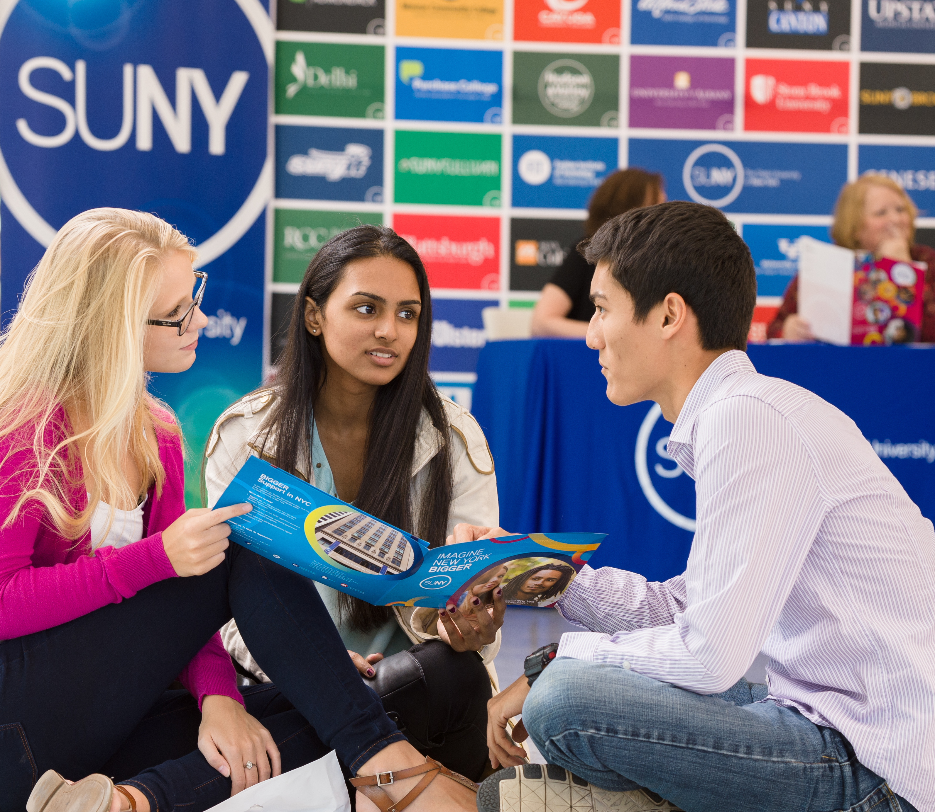

Questions?
How are Things Going at your Campus?
www.suny.edu

