Slide 1
AMERICORPS COMPETITIVE NOTICE OF FUNDING OPPORTUNITY
2022/23
TECHNICAL ASSISTANCE SESSIONS
General T/A Session,
Friday, October 1, 2021, 10:00 am
Theory of Change T/A Session on Tuesday, October 5, 2021, 10:00 am

Slide 2
NOFO T/A Session Agenda
What is AmeriCorps?
How to Apply
AmeriCorps Website Resources
Review of National Performance Measures
Navigating eGrants

Slide 3
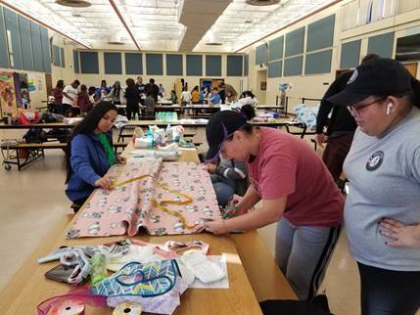
Part 1
What is AmeriCorps?

Slide 4
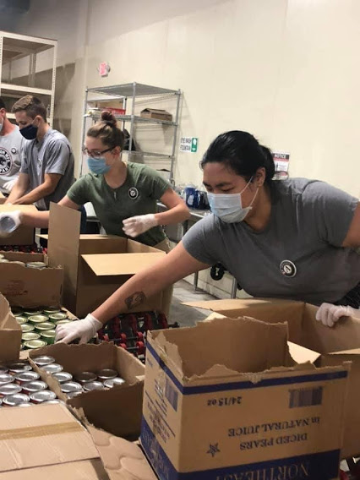
AmeriCorps, a federal agency, brings people together to tackle the country’s most pressing challenges, through national service and volunteering.
Individuals called AmeriCorps “Members” are recruited to serve with organizations dedicated to improving communities.
AmeriCorps helps make service to others a cornerstone of our national culture. Learn more at AmeriCorps.gov.

Slide 5
What is AmeriCorps?
Well, AmeriCorps is a lot of things, so we're going to break it down for you in this short video! Click picture to watch on YouTube

Slide 6
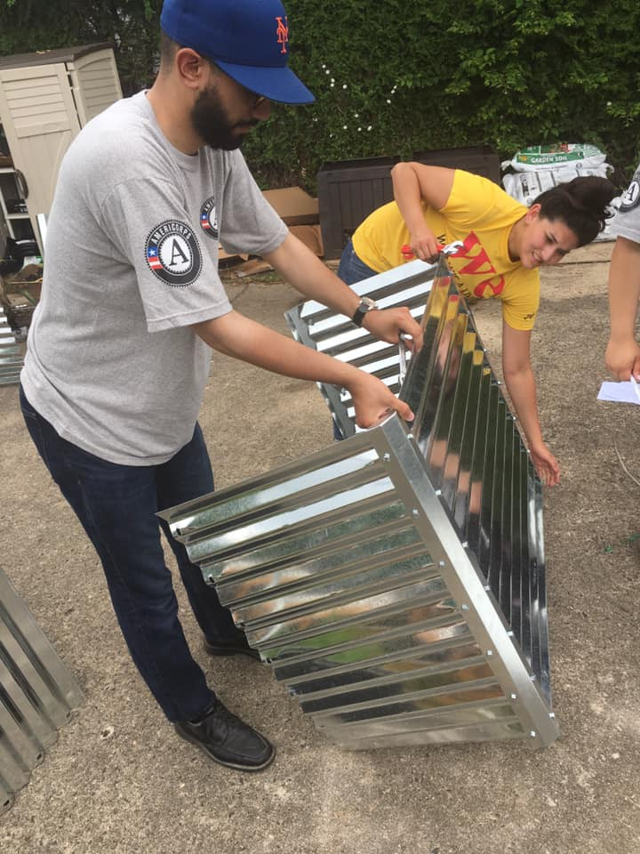
AmeriCorps IS
A TERM OF SERVICE
A COMMITMENT of #hours of Service
A win/ win for community and member
A program of service not longer than one year that has LOTS of regulations that MUST be followed by organizations and members

Slide 7
AmeriCorps Pledge
I will get things done for America - to make our people safer, smarter, and healthier. I will bring Americans together to strengthen our communities. Faced with apathy, I will take action. Faced with conflict, I will seek common ground. Faced with adversity, I will persevere. I will carry this commitment with me this year and beyond. I am an AmeriCorps member, and I will get things done.

Slide 8
National Service: The Funding Tree
Congress
AmeriCorps
AmeriCorps
AmeriCorps Seniors
AmeriCorps*NCCC National Civilian Community Corps
AmeriCorps*USA
AmeriCorps*VISTA
State Commissions Prime Grantee NJ Dept. of State
National Direct
Formula Funded Sub-prime sub- grantee
National Competitive Sup-prime sub- grantees

Slide 9
Focus Areas Include:
Disaster Services
Economic Opportunity
Education
Environmental Stewardship
Healthy Futures
Veterans and Military Families

Slide 10
What did NJ AmeriCorps Members accomplish last year? A glimpse…
Recruited 9,000+ volunteers
Volunteers donated 55,000+ hours
1,700+ individuals affected by disaster served
8,800+ children and youth served
900+ acres of public land improved

Slide 11
Service Requirements
Must be 17 years of age or older.
Must have a High School Diploma or Equivalency; or must be working towards the GED.
Must be a US Citizen or Permanent Resident of the USA.
Proof: Birth Certificate and/or Specific LIMITED Acceptable Documents
Must complete the Term of DIRECT Service – from 100 hours to 1,700 hours.
Committed to Making a Difference ….
Serve according to the application submitted to the NJ Commission and within the scope of the grant.
Serve according to their position description in their contract and consistent with the program’s performance measures

Slide 12
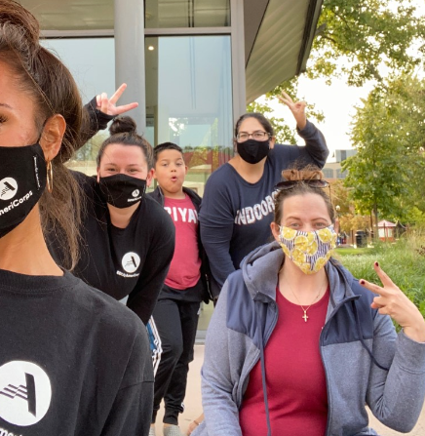
Benefits for All Members…
Receive Living Allowance
Gain Professional Experience
Improve Professional Network
Develop Soft and Hard Skills
Qualify for Education Award
Interest Accrual
Loan Forbearance

Slide 13
Terms of Service
TERM
HOURS
EDUCATION AWARD (est)
Full Time
Three Quarter
Half Time
Reduced Half
Quarter Time
Minimum Time
Abbreviated Time
1700 | $6,345.00
1200 | $4,441.50
900 | $3,172.50
675 | $2,417.14
450 | $1,678.57
300 | $1,342.86
100 | $ 357.08

Slide 14
Educational Award
TAXABLE
Up to seven years to use the award
Can be used at more than one institution and can help pay more than one loan.
MAY be used outside of the United States
In all cases, must be used at an institution or program that has been approved by the US Dept. of Ed, for participation in Title IV programs.

Slide 15
Education Award Transfer
If the AmeriCorps Member is age 55 or older
On or before their day of enrollment in an AmeriCorps state/National program, the award may be transferred once to a child, grandchild, foster child, or step child and is held at the NST for up to 10 years.
The transferee or designated individual must be:
A citizen, national or lawful permanent resident alien of the U.S.

Slide 16
Colleges & Universities Matching the Segal Education Award
Many colleges and universities around the country provide a match to the education award. The full list is on the AmeriCorps website: Schools of National Service search
NJ colleges that match include:
Camden County College
Monmouth University School of Social Work
New Jersey City University
Princeton University Woodrow Wilson School of Public and International Affairs
Stockton University
Thomas Edison College
William Paterson College
Rutgers University Bloustein School of Public Policy

Slide 17
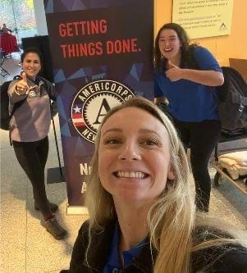
Term Limits
A member can now serve up to 4 terms of service… BUT Cannot earn or receive more than the equivalent of 2 FULL -TIME AWARDS

Slide 18
Background Checks
The following background checks must be cleared by the NJ Commission before AmeriCorps members can be enrolled to begin service:
NSOPW (DOJ: National Sex Offender Public Website)
State Background (TrueScreen)
FBI Fingerprint-based (FieldPrint)
All programs must use TrueScreen
Cost is about $33 per member unless there are additional out-of-state residences that must be checked
NOTE: Staff on the grant must also have background checks prior to the commencement of the grant. When staff changes, the new staff must be cleared as well.

Slide 19
Prohibited Activities
Prohibited Activities. While charging time to the AmeriCorps program, accumulating service or training hours, or otherwise performing activities supported by the AmeriCorps program or AmeriCorps, staff and members may not engage in the following activities (see 45 CFR § 2520.65):
Attempting to influence legislation;
Organizing or engaging in protests, petitions, boycotts, or strikes;
Assisting, promoting, or deterring union organizing;
Impairing existing contracts for services or collective bargaining agreements;
Participating in, or endorsing, events or activities that are likely to include advocacy for/or against political parties, political platforms, political candidates, proposed legislation, or elected officials;

Slide 20
Nonduplication and Nondisplacement
NONDUPLICATION
Funding can not be used to duplicate an activity that is already available in the area of a program. AmeriCorps Agency assistance will not be provided to a private nonprofit entity to conduct activities that are the same or substantially equivalent to activities provided by a State or local government agency in which such entity resides unless the entity complies with the “nondisplacement” requirements.
NONDISPLACEMENT
Members are not allowed to perform an employee’s duties or
otherwise displace employees. Please refer to the Mandatory
Supplemental Guidance for a full listing of nondisplacement
regulations

Slide 21
AmeriCorps members are NOT...
Cheap Labor
A Staff Builder
Interns
A Receptionist or Janitor
They ARE a cadre of individuals who are performing DIRECT SERVICE as the intervention to a specific community problem.

Slide 22
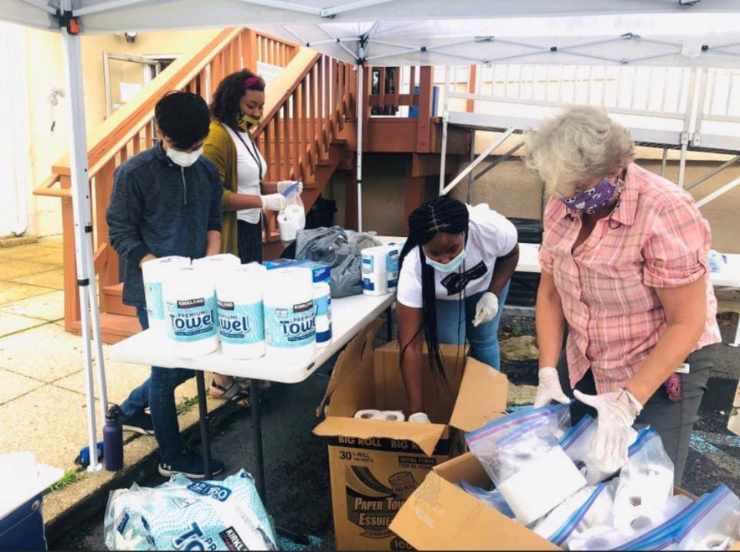
Supervision of AmeriCorps Members
Each program is required to have an onsite qualified supervisor to provide members with regular and adequate oversight on a daily basis, including certifying time sheets.
Members are prohibited from supervising another member.

Slide 23
Questions on What is AmeriCorps?
Thank you!
Vincent Funelis, Deputy Director
Vincent.Funelis@sos.nj.gov

Slide 24
Part 2
AmeriCorps Competitive NOFO Application process

Slide 25
Date | Activity
September 14 - 17 | Dissemination of NOFO flyer announcing the 2022/23 AmeriCorps Competitive competition. NOFO goes live on the NJ DOS website https://www.state.nj.us/state/volunteer-grant-opportunities.shtml
October 1 | NOFO Technical Assistance Session via ZOOM. Live at 10:00 am. Link to be sent upon registration. Session will be recorded and available at the NJ Department of State AmeriCorps grants website.
October 5 | Technical Assistance Session on Theory of Change, Evidence, Logic Models and Performance Measures via ZOOM. 10:00 am. Link to be sent upon registration.
November 3 | Notice of Intent to Apply due to Commission: click here for Notice of Intent to Apply form
November 16 | Competitive applications due to Commission on eGrants by 4:00 pm.
November 29 | Staff review of applications and budgets are begun
December 2 or 3 | Reader Arena Session via ZOOM. Arena scores and final rankings.
December 6 or 7 | Notification of applicants selected and Reader revisions requested for applications recommended for funding
December 16 & 17 | Final staff review on revisions
December 21 | Commission board vote on selected applicants
December 30 | NJ Commission target date for submission of Competitive package to AmeriCorps.

Slide 26
NOFO Sections
Section I: NJ Commission Grant Information and Timelines
Section II: Corporation on National and Community Service NOFO
Section III: Mandatory Supplemental Guidance
Section IV: Corporation Application Instructions

Slide 27
NOFO Sections
Section V: 2022 Performance Measures
Section VI: Evaluation Plan Template
Section VII: Diversity Questionnaire
Section VIII: Financial Management Survey
NOTE: Links to Sections II – VIII are available in the NOFO Section I.

Slide 28
NOFO Application Focus Areas for Performance Measures
Economic Opportunity
Education
Healthy Futures
Veterans and Military Families
Disaster Services
Environmental Stewardship

Slide 29
Economic Opportunity
Grants will provide support and/or facilitate access to services and resources that contribute to the improved economic well-being and security of economically disadvantaged people; help economically disadvantaged people, to have improved access to services that enhance financial literacy; transition into or remain in safe, healthy, affordable housing; and/or have improved employability leading to increased success in becoming employed.

Slide 30
Education
Grants will provide support and/or facilitate access to services and resources that contribute to improved educational outcomes for economically disadvantaged children; improved school readiness for economically disadvantaged young children; improved educational and behavioral outcomes of students in low-achieving elementary, middle, and high schools; and/or support economically disadvantaged students’ preparation for success in post-secondary educational institutions.

Slide 31
Healthy Futures
Grants will provide support for activities that will address the opioid crisis; increase seniors’ ability to remain in their own homes with the same or improved quality of life for as long as possible; and/or increase physical activity and improve nutrition with the purpose of reducing obesity

Slide 32
Veterans and Military Families
Grants will improve the quality of life of veterans and improve military family well-being; increase the number of veterans, wounded warriors, military service members, and their caregivers, families, and survivors served by AmeriCorps programs; and/or increase the number of veterans and military family members engaged in service through AmeriCorps programs.

Slide 33
Disaster Services
Grants will support increased and improved disaster services for individuals and communities to prepare and adapt to disasters, including but not limited to climate change events. Activities will provide support to increase preparedness for disasters, improve readiness to respond to disasters, support recovery efforts from disasters, and/or assist in the implementation of pre-disaster mitigation and adaptation measures. Grants will support communities and individuals in planning for disasters, in particular engaging disadvantaged communities in the planning process.

Slide 34
Environmental Stewardship
Grants will support responsible stewardship of the environment, while preparing communities for challenging climate and environmental circumstances and helping Americans respond to and recover from disruptive events: programs that conserve natural habitats; protect clean air and water; maintain public lands; support wildland fire mitigation and sustainable forest management; cultivate individual and community resilience; and provide reforestation services after floods or fires, such as nature based solutions.

Slide 35
Funding priorities (cont.)
Programs that prioritize civic engagement and social cohesion.
Evidence-based interventions on the AmeriCorps Evidence Exchange that are assessed as having Moderate or Strong evidence. Please note that many of these interventions have demonstrated effectiveness in improving outcomes for individuals living in underserved communities and that the agency has committed resources to supporting grantees seeking to replicate and evaluate these interventions in similar communities. AmeriCorps Evidence Exchange: https://americorps.gov/about/our-impact/evidence-exchange
Veterans and Military Families, Caregivers, and Survivors – a program model that improves the quality of life of veterans and improves the well-being of military families, caregivers, and survivors.

Slide 36
Funding priorities (cont.)
Rural intermediaries - organizations that demonstrate measurable impact and primarily serve rural communities with limited resources and organizational infrastructure.
Environmental stewardship and climate change including renewable energy and energy efficiency, building community resilience, sustainable food systems and agriculture, and conservation and habitat preservation.
Faith-based organizations.
Economic Mobility Corps (See Attachment A).

Slide 37
Funding priorities (cont.)
To receive priority consideration, applicants must show that the priority area is a significant part of the program focus and intended outcomes. Proposing programs that receive priority consideration does not guarantee funding.

Slide 38
Performance Measures
All applications must include at least one aligned performance measure (output and outcome) that corresponds to the proposed primary intervention. This may be a National Performance Measure or an applicant-determined measure. See the Performance Measure Instructions for details about performance measure requirements and selection rules.
Performance Measure Instructions: https://www.americorps.gov/funding-opportunity/fy-2021-americorps-state-national-grants#performance-measure

Slide 39
Determine Type of Program
REGULAR COST REIMBURSEMENT
Funds a portion of program costs and members’ living allowance.
PROFESSIONAL CORPS
Professional Corps programs place professionals in communities where there is a documented shortage of such professionals.
Stipends/salaries are paid by other organizations.
Can be either cost reimbursement or fixed-amount.
FULL COST FIXED-AMOUNT GRANTS (Only available for recompeting applications)
Applicants apply for a fixed amount per MSY* & use their own or other resources for the remaining cost of the program. No match requirements, but the program must still raise the additional funds needed to run the program. *Member Service Year

Slide 40
Organizational Eligibility to Apply
Eligibility is open to:
public or private non-profit organizations, including labor organizations;
community organizations including faith-based organizations;
American Indian Tribal communities;
Local Education Agencies (LEAs) including charter schools;
institutions of higher education;
government entities within the state (e.g., cities/municipalities, counties, state departments);
and partnerships or consortia consisting of the aforementioned.

Slide 41
Page Limitations
There are two sections with mandatory page limits: Narrative and Logic Model.
Applications must not exceed 10 pages for the Narrative or 12 pages for Rural Intermediaries.
In determining whether an application complies with page limits, the Corporation will count the following for the Narrative:
The application’s Executive Summary, SF 424 Facesheet, and The Narrative portions contained in the Program Design, Organizational Capacity, and Cost Effectiveness and Budget Adequacy sections of the application.
The Corporation strongly encourages applicants to print out the application from the “Review” tab prior to submission to check that the application does not exceed the page limit. The application page limit does not include the Budget, narrative portion of the Evaluation Plan, the Logic Model, performance measures, or the supplementary materials, if applicable.

Slide 42
Page Limitations
LOGIC MODEL The Logic Model may not exceed three pages when printed with the application from the “Review” tab in eGrants.
Please note the length of a document in word processing software may be different than what will print out in the AmeriCorps' web-based system. Reviewers will not consider any submitted material that exceeds the page limits in the printed report, also, note that the system will not prevent an applicant from entering text that will exceed page limitations. This applies to both the application page limit and the Logic Model page limit.

Slide 43
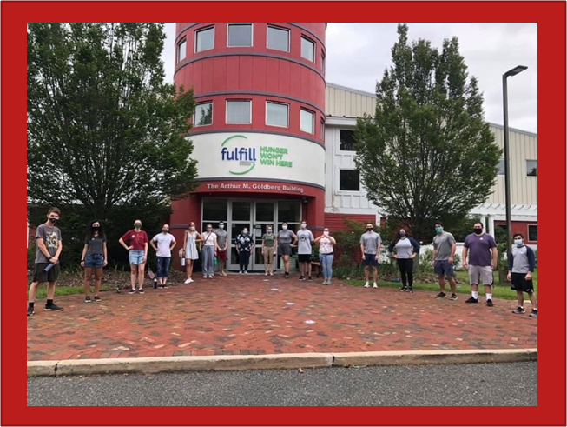
Funding Period
For New and Recompeting applicants, this is Year 1 of 3 of a multi-year grant period covering the following funding periods:
Year 1: Sept 1, 2022 to August 31, 2023
Year 2: Sept 1, 2023 to August 31, 2024
Year 3: Sept 1, 2024 to August 31, 2025

Slide 44
Notice of Intent To Apply
Applicants must fill out and submit the online Intent to Apply form by Wednesday, November 3, 2021, 4:00 p.m.
The following information is required:
Organization Name
Address
Contact Name
E-mail Address
Phone Number
Focus area/s application will address
Applying as New or Continuation and Regular Cost Reimbursement or Fixed Amount.
Click here to complete: NOTICE OF INTENT TO APPLY form
(The form can be also be found on our website)

Slide 45
Notice of Intent To Apply
Applicants must fill out and submit the online Intent to Apply form by Wednesday, November 3, 2021, 4:00 p.m.
The following information is required:
Organization Name
Address
Contact Name
E-mail Address
Phone Number
Focus area/s application will address
Applying as New or Continuation and Regular Cost Reimbursement or Fixed Amount.
Click here: Notice of Intent to Apply online form
(The form can be also be found on our website)

Slide 46
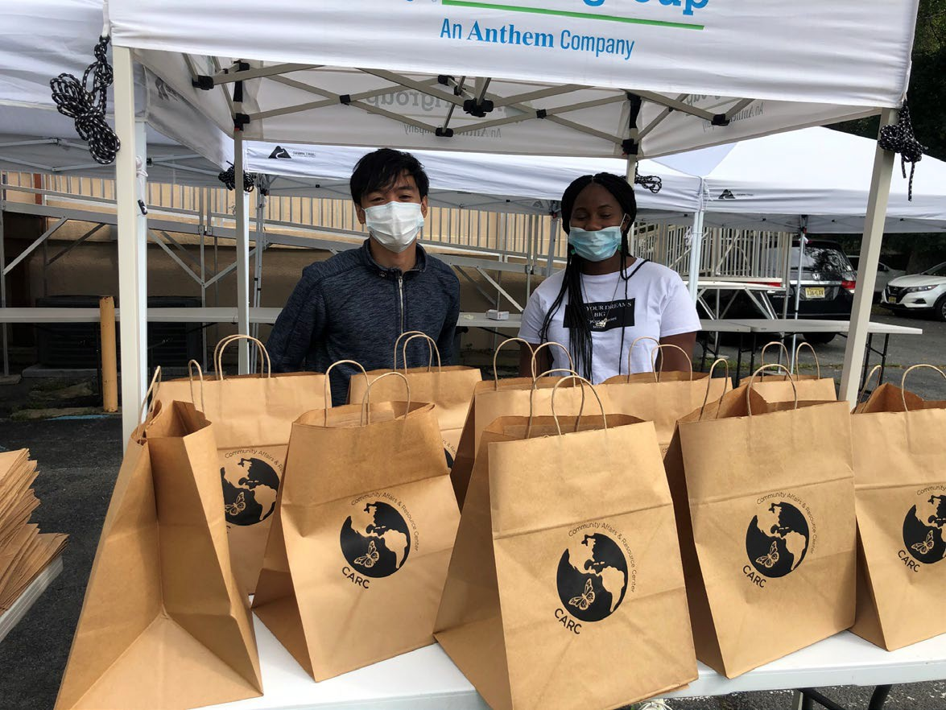
Applications must be submitted electronically on eGrants
NO LATER THAN
Tuesday, November 16, 2021, 4:00 p.m.

Slide 47
Additional Documents
All documents that are requested in Section II: AmeriCorps NOFO need to be sent to the NJ Commission and not to AmeriCorps. The NJ Commission will forward additional documents to AmeriCorps upon selection of the application at the NJ level. Please see the CNCS NOFO, Section I for further directions on submission of additional documents.
Applicants are required to submit the following additional documents by the application submission deadline:
Diversity Questionnaire, Financial Management Survey, Evaluation briefs, reports, studies. Please refer to the Evidence Base section for detailed instructions by evidence tier.

Slide 48
DUNS Number and SAM Registration
Applications must include a DUNS* number and an Employer Identification Number (EIN). The DUNS number does not replace an EIN. DUNS numbers may be obtained at no cost by calling the DUNS request line at (866) 705-5711 or by applying online: DUNS Request Service.
●AmeriCorps recommends registering at least 30 days before the application due date.
After obtaining a DUNS, all applicants must register with the SAM ** and maintain an active SAM registration until the application process is complete and, if a grant is awarded, throughout the life of the award. SAM registration must be renewed annually.
●AmeriCorps suggests finalizing a new registration or renewing an existing one at least two weeks before the application. Applicants must use their SAM-registered legal name and address on all grant applications to AmeriCorps.
*Dun & Bradstreet D‑U‑N‑S Number is a unique nine-digit identifier for businesses. **SAM - System for Award Management (SAM) is an official website of the U.S. government

Slide 49
PART 3 Selection Criteria
Category | Percentage
Executive Summary | 0
Program Design Theory of Change & Logic Model Evidence Tier Evidence Quality Notice Priority Member Experience | Total 50% 24 points 12 points 8 points 0 points 6 points
Organizational Capability Organizational Background & Staffing Compliance and Accountability Culture that Values Learning Member Supervision | Total 25% 9 points 8 points 4 points 4 points
Cost-Effectiveness and Budget Adequacy | Total 25%

Slide 50
Review Criteria (see Section II of NOFO)
A. Executive Summary (Required – 0%)
Please fill in the blanks of these sentences to complete the executive summary:
The [Name of the organization] proposes to have [Number of] AmeriCorps members who will [service activities the members will be doing] in [the locations the AmeriCorps members will serve]. At the end of the first program year, the AmeriCorps members will be responsible for [anticipated outcome of project]. In addition, the AmeriCorps members will leverage an additional [number of leveraged volunteers, if applicable] who will be engaged in [what the leveraged volunteers will be doing.]
This program will focus on the AmeriCorps focus area(s) of [Focus Area(s)].* The AmeriCorps investment of $[amount of request] will be matched with $[amount of projected match], $[amount of local, state, and federal funds] in public funding and $[amount of non-governmental funds] in private funding.*
* Fixed Amount grant application- you may omit the section after the asterisk.

Slide 51
Review Criteria (cont.)
B. Program Design (50%)
NOTE: The following information will be reviewed on the October 5 THEORY OF CHANGE SESSION
Theory of Change & Logic Model
Evidence Tier
Evidence Quality
24 pts. 12 pts.
8 pts.

Slide 52
Theory of Change and Logic Model (TOC) ( 24 points)
The TOC shall address:
The problem is prevalent and severe in communities where the program plans to serve – documented with relevant data.
The proposed intervention is responsive to the identified community problem.
The intervention is clearly articulated including the design, dosage, target population and roles of AmeriCorps members.
The intervention is likely to lead to the outcomes identified in the TOC.

Slide 53
Theory of Change and Logic Model (TOC) ( 24 points) cont’d.
Outcomes in the narrative and logic model represent meaningful progress in addressing the community probem.
The rationale for utilizing AmeriCorps members to deliver the intervention(s) is reasonable.
The service role of AmeriCorps members will produce significant contributions to existing efforts to address the stated problem.

Slide 54
Theory of Change and Logic Model (TOC) ( 24 points) cont’d
The Logic Model Shall Depict:
A summary of the community problem, including the role current or historical inequities faced by underserved communities may play in contributing to the problem.
The inputs or resources that are necessary to deliver the intervention, including:
Locations or sites in which members will provide services
Number of AmeriCorps members who will deliver the intervention.
The core activities (interventions) or program model that members will implement or deliver, including:
Duration of the intervention (# of weeks, sessions or months)
Dosage of the intervention (# of hours per session or sessions per week)
Target population for intervention (e.g., disconnected youth, 3rd graders at a certain reading level proficiency.

Slide 55
Theory of Change and Logic Model (TOC) ( 24 points) cont’d.
Logic Model (cont.)
The measurable outputs that result from delivering the intervention (i.e., number of beneficiaries served, types and numbers of activities conducted, etc.).
Outcomes that demonstrate changes in knowledge/skill, attitude, behavior, or condition that occur as a result of the intervention. If using National Performance Measures, indicate which.
NEW:
In the application narrative, applicants should discuss the community need as it relates to the CDC’s Social Vulnerability Index: https://www.atsdr.cdc.gov/placeandhealth/svi/index.html.
Also in the application narrative, applicants should discuss their rationale for setting output and outcome targets for their performance measures.

Slide 56
Evidence Tier (12 points)
Evidence Tier (12 pts.)
An evidence tier will be assessed for each applicant for the purpose of understanding the relative strength of each applicant’s evidence base and the likelihood that the proposed intervention will lead to outcomes identified in the logic model.
In order to qualify for consideration, the intervention evaluated in the submitted report(s) must match the intervention proposed by the applicant in the following areas
Characteristics of the beneficiary population, including evidence of current or historic inequities facing the population;
Characteristics of the population delivering the intervention;
Dosage (frequency and duration) and design of the intervention, including all key components and activities;
The context in which the intervention is delivered; and
Outcome of the intervention.

Slide 57
Evidence Tier (12 points) cont’d
In 2021, the evidence tiers of successful AmeriCorps State and National applicants that were competing were as follows:
^{Strong 38%,}
^{Moderate 19%,}
^{Preliminary 16%, and}
^{Pre-Preliminary 26%.}
As these figures indicate, AmeriCorps values and funds programs at all points along the evidence continuum and expects programs to progress along the evidence continuum over time. Thus, do not be deterred from applying for funding due to your current evidence level.

Slide 58
Evidence Quality ( 8 points)
Standards applied to assess quality of Preliminary, Moderate or Strong evidence:
Methodology
Relatively recent
Meaningful and Positive Effect on Beneficiaries
For Pre-Preliminary:
Same except should include past performance measure data or cited research studies.

Slide 59
Opportunities to develop as leaders. Gaining skills valued by future employers The program has a well-defined plan to recruit AmeriCorps members from the geographic or demographic communities in which the programs operate. Inclusive service culture where different backgrounds, talents, and capabilities are welcomed and leveraged for learning and effective service delivery. The applicant’s organization and/or program has a diversity, equity, and inclusion council that seeks to diversity its staff and board and create a supportive and safe environment as well ensure that its programming is culturally and community appropriate.
Member Experience (6 points)

Slide 60
Organizational Capability (25 points)
Organizational Background and Staffing (9 points)
The organization details the roles, responsibilities, and structure of the staff that will be implementing the AmeriCorps program as well as providing oversight and monitoring for the program.
The organization has facilitated, partnered, or participated in educational or workforce development programs (i.e., pre-apprenticeship/registered apprenticeship, work experience and job training programs, etc.).
The organization has a stated commitment and plan to advance diversity, equality, and inclusion (DEI) throughout its mission, for example by using a DEI council or strategic plan.

Slide 61
Organizational Capability (25 points)
Compliance and Accountability (8 points)
The organization has a monitoring and oversight plan to prevent and detect non-compliance and enforce compliance with AmeriCorps rules and regulations including those related to prohibited and unallowable activities and criminal history checks at the grantee, subgrantee (if applicable), and service site locations.
The organization has sufficient policies, procedures, and controls in place to prevent, detect, and mitigate the risk of fraud, waste, abuse, and mismanagement, such as appropriate segregation of duties, internal oversight activities, measures to prevent timekeeping fraud, etc.
The organization has an effective mechanism in place to report, without delay, any suspected criminal activity, waste, fraud, and/or abuse to both the AmeriCorps Office of Inspector General and AmeriCorps and a plan for training staff and participants on these reporting protocols.
If applicable, the AmeriCorps-required evaluation report meets AmeriCorps requirements.
If applicable, the AmeriCorps-required evaluation report is of satisfactory quality.

Slide 62
Organizational Capability (25 points)
3. Culture that Values Learning (4 points)
The applicant's board, management, and staff collects and uses information for learning and decision making.
The applicant’s board, management, and staff collect and use information to determine its programmatic effectiveness in serving in a community with members that are diverse.
4. Member Supervision (4 points)
AmeriCorps members will receive sufficient guidance and support from their supervisor to provide effective service.
AmeriCorps supervisors will be adequately trained/prepared to follow AmeriCorps and program regulations, priorities, and expectations.

Slide 63
E. Evaluation Summary or Plan (Required for recompeting grantees – 0 points)
If the applicant is recompeting for AmeriCorps funds for the first time (see definition of “recompeting” below) the program must submit its evaluation plan in the “Evaluation Summary or Plan” section of the Narratives field in AmeriCorps' web-based management system. If the applicant is recompeting for a subsequent time, the program must submit its evaluation report as attachments (see the Submission of Additional Documents section for more information) and must also submit an evaluation plan for the next three-year period in the “Evaluation Summary or Plan” field in the system. Evaluations plans submitted outside of the system will not be reviewed.
Please see the Commission’s NOFO for more detailed Evaluation Plan requirements.

Slide 64
Important to your Budget
What is a Cost Per MSY?
Grant Program | Maximum
Traditional Cost Reimbursement | $21,600
Professional Corps | Up to $1,000
Professional Corps Fixed Amount Grants | Up to $1,000
Full Cost Fixed Amount Grants | $21,600
The federal AmeriCorps grant is based on the number of MSY’s (or FTE’s) multiplied by $21,600
 EXAMPLE: An applicant requesting 10 full-time members may apply for a maximum of $216,000 and a program of 18 full- time members may apply for a maximum of $388,800.

Slide 65
Terms of Service and Living Allowance
Type of Member Position | Min. # of Hours | MSY | Min. Total Living Allowance | Max. Living Allowance
Full-time | 1700 | 1.000 | $16,502 | $33,004
Three Quarter-time | 1200 | 0.070 | $ 11,648 | $23,103
Half-time | 900 | 0.500 | $ 8,736 | $16.502
Reduced HT | 675 | 0.381 | $ 6,552 | $12,542
Quarter-time | 450 | 0.265 | $ 4,368 | $ 8,581
Minimum-time | 300 | 0.212 | $ 2,912 | $ 6,931
Abbreviated-time | 100 | 0.056 | $ 971 | $ 1,980

Slide 66
Important to your Budget Match Requirements Minimum Overall Share
Single overall minimum match of 24% for the first three-year cycle, match gradually increases every three years to 50% by year ten. Match may be cash or in-kind or a combination of both.
Yrs. 1, 2 & 3 | Yr. 4 | Yr. 5 | Yr. 6 | Yr. 7 | Yr. 8 | Yr. 9 | Yr.10
24% | 26% | 30% | 34% | 38% | 42% | 46% | 50%

Slide 67
Important to your Budget Budgeting Administration
Applicants may allocate administrative funds for their programs.
A portion or 1% - 2% of the administrative cap of 5% must be allocated for the NJ Commission according to the following:
Programs requesting 12 or less MSY’s do not have to allocate any portion of the administrative allowance to the Commission.
Programs requesting 13-17 MSY’s should allocate 1% of their administrative allowance to the Commission using this formula: Section I + Section II x 0.0526 x 0.20 = Commission Share
Programs requesting 18 or more MSY’s should allocate 2% of their administrative allowance to the Commission using this formula: Section I + Section II x 0.0526 x 0.40 = Commission Share

Slide 68
SUBMITTING YOUR APPLICATION IN EGRANTS
Please follow directions in the Application Instructions on page 4. Here is the link to the Application Instructions:
. https://americorps.gov/sites/default/files/document/ASN_FY2022_ApplicationInstructions_FINAL_.508.pdf

Slide 69
Program Manager Trainings and Meetings
Starting Strong – 3 days during end of July 2022
ASC Regional Training – 3 days
Other Training (e.g., Career Day, Site Supervisor Training) developed for members and project directors during the contract period.
Participate in all monthly conference calls or meetings.
In constructing the budget, figure in the cost for transportation, meals, and possible overnight accommodations related to all Corporation or Commission training sessions.

Slide 70
Statewide Corps Member Trainings and Events
All corps members and project directors are required to attend the following trainings/events:
AmeriCorps Launch – October 2022
End-of-the-Year Training – May or June 2023
Other statewide training i.e., Career Day

Slide 71
Additional Application Resources
Please consult the AmeriCorps.gov website for tutorials, evidence checklist, logic model Instructions, frequently asked questions, AmeriCorps Terms and Conditions and other resources.
FY 2022 AmeriCorps State and National Grants
The full Regulations are available online at www.ecfr.gov

Slide 72
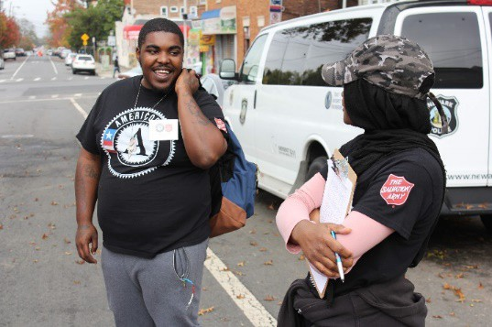
CONTACT INFORMATION
NJ Commission on National and Community Services NJ Department of State
33 west State Street, 4th Floor PO Box 456
Trenton, NJ 08625-0456
AmeriCorps.NJ@sos.nj.gov

