Slide 1
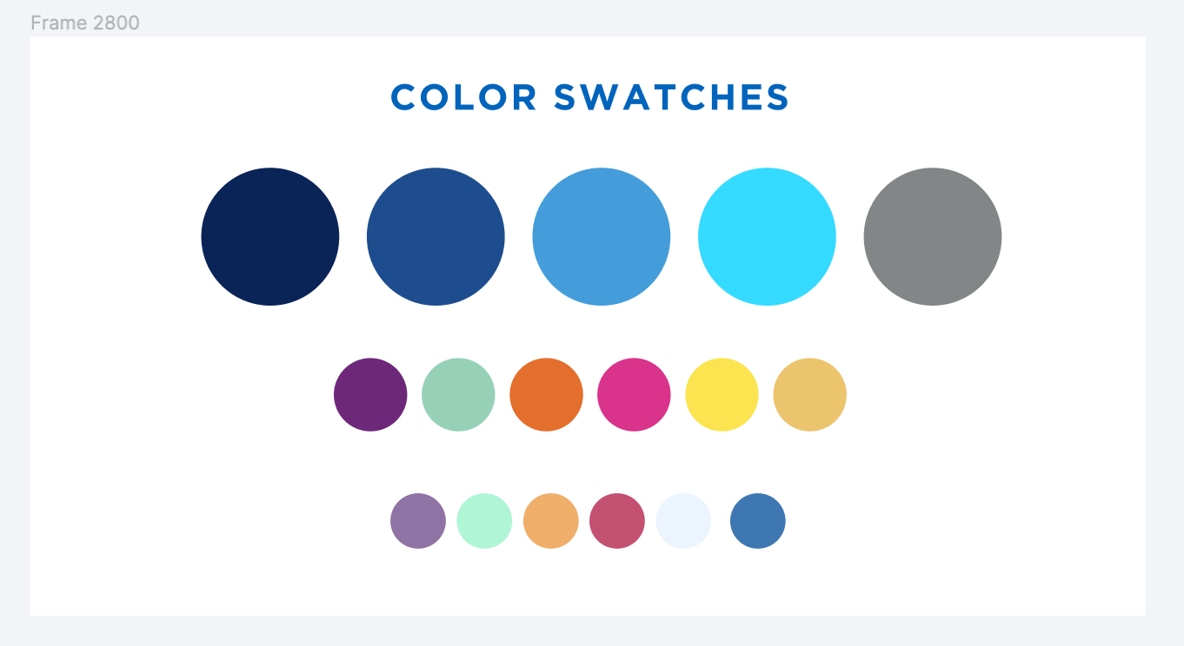
Advocating for Change in Alma/Primo: Idea Exchange
Improvements & Enhancements Working Group - May 4, 2022

Slide 2
Improvements & Enhancements WG
SUNY LSP Working Group
Formed November 2020 after Task Force Advisory Group on Improvements
Charge: ​
The Improvements and Enhancements Working Group will focus on gathering performance and functionality problems with the Alma and Primo systems across SUNY libraries, and work collaboratively with the SLS to pursue avenues for improvements

Slide 3
Improvements & Enhancements WG
https://slcny.libguides.com/improvements-working-group
Members:
Angela M. Rhodes, Morrisville, Chair
Ellen Bahr, Alfred University
Lana Bittman, Fashion Institute of Technology
Chaeyeon Kim, Upstate Medical
Gregg Headrick, SUNY Downstate
Jason Parker, University at Buffalo
Liz Simmons, Genesee Community College
Timothy Jackson, SLS
Will be recruiting new members for Fall 2022

Slide 4
Individual Support Cases & NERS
This presentation is not about support cases or NERS voting
Support Cases:
Should be used if problematic behavior is unexpected
Cases with response issues should be escalated
If the issue is the result of a bug, Ex Libris will add a fix to their roadmap
If Alma is behaving as currently designed, Ex Libris will recommend you submit an enhancement request
NERS:
ELUNA (Ex Libris Users of North America) and its sister organization IGeLU (International Group of Ex Libris Users) have a contractual agreement with Ex Libris for the enhancement of Ex Libris products
NERS (the New Enhancements Request System) is used to support voting by ELUNA members
Not enough votes in SUNY to make coordination worthwhile
Idea Exchange is SUNY’s best option for advocating for change

Slide 5
Idea Exchange
Idea Exchange is a platform where Alma/Primo users can suggest improvements
Only way to request new content to be added to the CDI
https://ideas.exlibrisgroup.com/
Log in with your SUNY email address
Anyone with a SUNY address can submit ideas and vote
Up to 25 votes allowed (3 votes allowed on a single idea)
Votes returned to you as ideas are added to Ex Libris roadmap
You can remove your votes from ideas if need be
Can leveraging the power of 60 campuses x hundreds of people x 3 votes each​
Ex Libris not obligated to implement ideas, but they do look at and implement upvoted ideas​

Slide 6
Idea Exchange: Recent Implementations
Ideas Implemented in March and April 2022:
Configuring different sender e-mail addresses (SMPT-envelope-from) for one letter-type
Implement auto holdings for Wiley
Search PO Line by PO Line Note in Alma
Alma should work on Mac Safari
Allow due date after patron expiry date
Add Access Model to PO Line reporting
Idea to be implemented in May 2022:
Push Requests to ILLiad should include comments in the resource sharing request

Slide 7
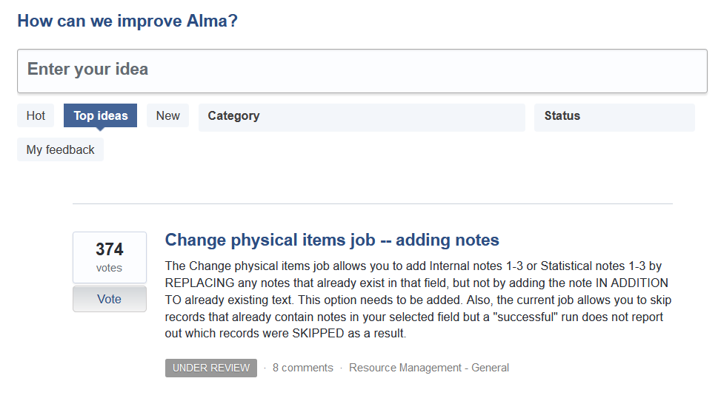
Voting & Creating New Ideas

Slide 8
Statuses of Ideas​
Under Review: When an idea has received a certain number of points, Ex Libris initiates a review of the idea, and its status changes to Under Review. You can still support and comment on the idea.
Accepted: If an idea has already been added to the product backlog or is added to the backlog based on the user community’s support, the idea’s status changes to Accepted. Accepted Ideas are ideas that Ex Libris acknowledges their importance and is planning to add them to the product roadmap, however there aren’t yet specific plans for adding them. ​​
Planned: If an idea has already been planned for the product road map or added to the road map based on the user community’s support, the idea’s status changes to Planned. When feasible, Ex Libris also adds release dates to ideas whose status is Planned.​
Completed: When an idea whose status is Planned is incorporated in a release, the idea’s status changes to Completed and all points associated with the idea are returned to the users who supported it.
Already Supported: From time to time, an idea is submitted for a feature that the product already supports.
Closed: In certain rare cases, an idea is not aligned with our product vision or is not technically feasible. In such cases, Ex Libris updates the status of the idea to Closed and provides an explanation.

Slide 9
Idea Exchange Voting Tips
If you’re creating an idea:
Make the title clear and concise
Limit submission to one idea
Phrase idea as a user story (“As a <role>, I would like <proposed feature> so that <feature’s benefit>.”)
Assign a category to your idea
Focus votes on ideas that have no status or are in the Under Review
Voting for ideas that have no status or are Under Review will encourage Ex Libris to consider those ideas for implementation
Voting for Accepted ideas could help accelerate implementation timeline
Not possible to vote for Planned ideas
Leave comments when voting (Ex Libris staff sometimes respond)

Slide 10
Improvements & Enhancements WG: Upvoting Ideas​
Consult our LibGuide on SLCNY for a full list of selected ideas requesting votes:
https://slcny.libguides.com/c.php?g=1092166&p=8305911
Add to the list of flagged ideas by submitting an idea through our SUNY Community Input Survey:
https://slcny.libwizard.com/f/IEC

Slide 11
Suggestions to Vote​
Embargoed Resources in Primo: https://ideas.exlibrisgroup.com/forums/308176-primo/suggestions/32631976-embargoed-resources-displaying-in-primo
Update Booking with End time: https://ideas.exlibrisgroup.com/forums/308173-alma/suggestions/30954355-automatically-populate-date-and-end-time-in-bookin
Adding Institution Address to Transit Slip Letter: https://ideas.exlibrisgroup.com/forums/308173-alma/suggestions/44086953-add-institution-address-information-to-xml-for-ful

Slide 12
Demo

