Slide 1

SMARTLY
R6 – Mainstreaming and Validation
14/11/2023
Fondazione Polo Universitario Grossetano

Slide 2
SUMMARY
Objectives and methodology
Overview on Induction Training on Green Jobs (R3) and Digital Jobs (R4) – Learning Outcomes
External evaluation (Employers)
References
Conclusions

Slide 3
Objectives
-To provide guidelines and tools to mainstream training structures ensuring coherence with the European Qualification Framework (EQF) at the beginning and during their development.
- To create a final reference report for project partners for accreditation/recognition purposes (Information on EQF, Training development process, Induction Green and Digital jobs training frameworks, evaluations, concrete example of accreditation, recommendations …).

Slide 4
METHODOLOGY
Based on EQF
European Qualification Framework
Mutual Recognition of Qualifications/trainings throughout EU
Training drafts: Internal and external feedback (content) + validation activities (coherence of structure with EQF - CASE)
Collection of official accreditation template for home-grown training from partners’ own
National or Regional accreditation authority and analysis
Identification and provision of final tool and guidelines to be used for mainstreamed development of R3 and R4 trainings on the basis of EQF
Final version, Accreditation in Malta,
Report/Manual

Slide 5

Green AND Digital TRAINING STRUCTURES
Induction trainings (Total amount 25 hrs): NEETs profiles are varied (R1); objective -> guidance for possible paths (ALMP)
Trainings:
  Content: composed by different Areas -> LEARNING OUTCOMES that the learner is expected to acquire at the end of the training activity, in terms of KNOWLEDGE and SKILLS
  Each training proposes reference Learning methods, Reading material and Assessment methods.
  Trainers education level and specifications and Entry requirements learners are provided.

Slide 6

Induction training on Green Jobs
AWARD IN GREEN SKILLS – THE FOUR CHALLENGES EXPERIENCE
5 Thematic Areas:
Area A. Introduction to green jobs addressing sustainable challenges
Area B. Climate Action
Area C. Sustainable Consumption
Area D. Water Management
Area E. Biodiversity

Slide 7
Example: AREA C - Sustainable Consumption
Overall Description of Area C
The objective of this Area is to explain how the worldwide consumption and production — a driving force of the global economy — rests on the use of the natural environment and resources in a way that continues to have destructive impacts on the planet.
Economic and social progress over the last century has been accompanied by environmental degradation that is endangering the systems on which our future development — indeed, our very survival — depends.
The module will concentrate on three negative aspects specifically:
● Food waste
● Energy waste
● Ecological footprint
Next, the participants will be encouraged to focus on the following countermeasures:
● Circular economy and sustainability
● Recycling
● Green Jobs referring to sustainable use of resources (e.g. Recycling collector, Site recycling Manager, Recycling Operator)
The implementation of this module is based on :
- The introduction of the basic concepts set out in the "4 challenges of the SD" support by the trainer
- The implementation of individual or group activities by choosing from the catalogue of activities proposed in the support "Green job Activities" in section 2 on sustainable consumption. The activities are chosen to allow for rotation among the learners, depending on their number.
6 hours

Slide 8
Example: LOs AREA C - Sustainable Consumption
LEARNING OUTCOMES FOR KNOWLEDGE
The learner will be able to:
On the subject of Food waste:
● Indicate best sustainable practices in use in the food system
● Describe the food production system, the stakeholder involved and their different roles
LEARNING OUTCOMES FOR SKILLS
The learner will be able to:
On the subject of Food waste:
● Provide examples and arguments in favor of sustainable processes
● Discuss patterns possible for implementing within consumption processes
● Define and apply at least two eco-gestures likely to respond to this environmental challenge. Explain them to an audience.
● Plan and suggest participant’s own alternative behavior patterns enhancing sustainability
…
…

Slide 9


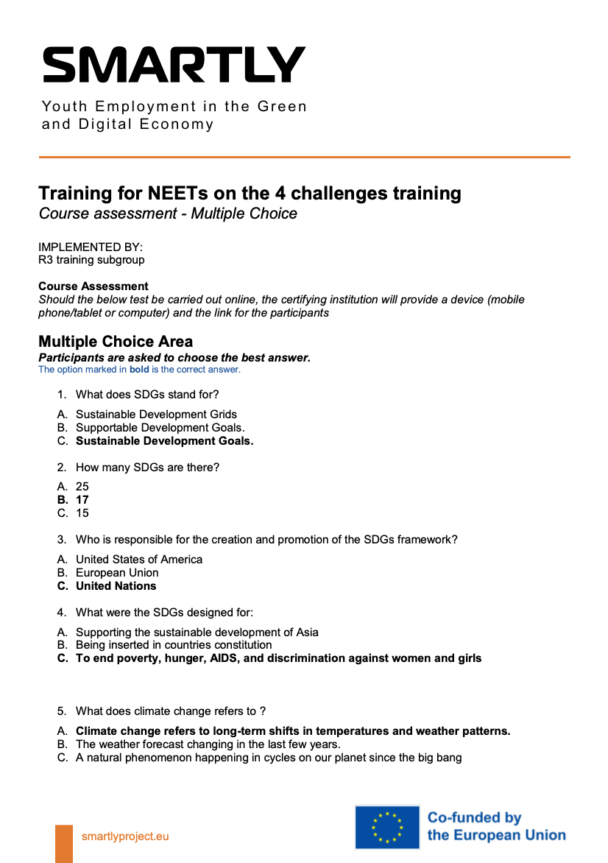
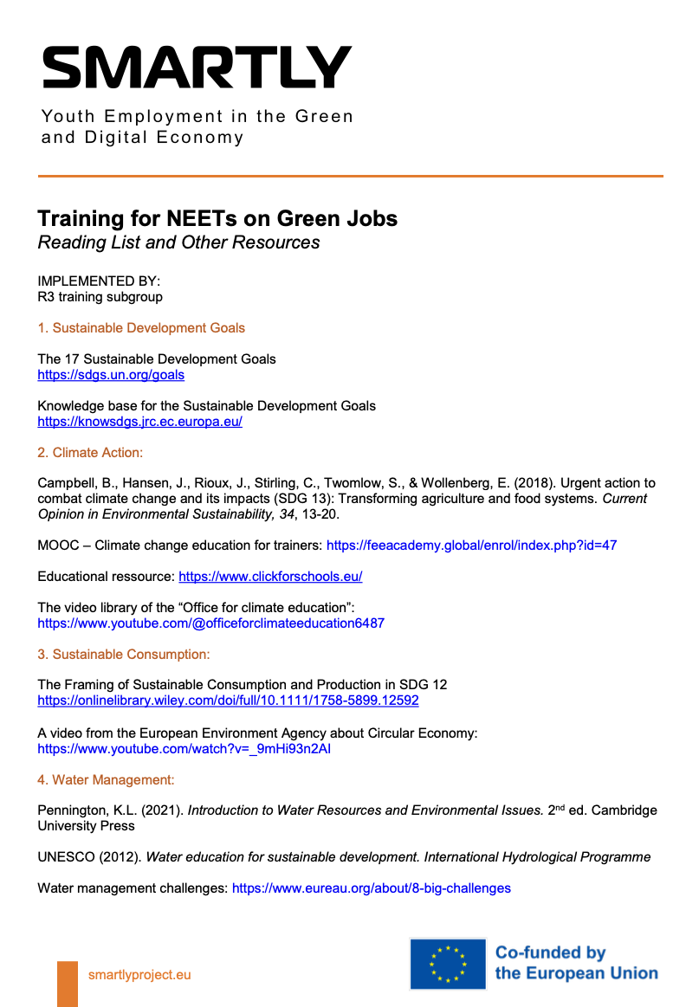
Further information:
Please find more information on the Induction Training on Green Jobs on:
https://www.smartlyproject.eu/news

Slide 10


Slide 11

Induction training on Digital Jobs
AWARD IN DIGITAL SKILLS
5 Thematic Areas:
Area A: Introduction to digital jobs
Area B: Digital communication
Area C: Digital training and digital information
Area D: Digital Opportunities
Area E: Green digital jobs

Slide 12
Example: AREA B - Digital communication
This Area will cover the topic of Digital Communication, which is a key sector of the digital economy.
Moreover, this sector has a general great relevance in every person’s lives nowadays.
Modules:
1. A shared definition of personal, formal/informal, professional “Digital communication”.
2. Netiquette: definition and rules.
3. Instant messaging: services and tools, most appropriate ways to use them.
4. Social networks: main platforms and their use.
5. Digital reputation: what it is and why it is important.
6. Practical session to test what they learnt.
Learners during the module will attend theoretical and practical lessons on the topic. This will help them to become more conscious digital users, as well as in better understanding how to work in this job sector.
This Area will start with a brainstorming session in which the learners will come up with a shared definition of personal, formal/informal, professional “Digital communication”.
After the brainstorming session, the module will cover the following topic of modules 2, 3, 4 and 5. These topics will be covered by encouraging learners to share their knowledge and ideas.
At the end of the module the learners will take part in practical session to test what they learnt.
6 hours

Slide 13
Example: AREA B - Digital communication
LEARNING OUTCOMES FOR KNOWLEDGE
The learner will be able to:
2. Netiquette: definition and rules.
● Provide a definition of netiquette, what it is and why it is important.
● Understand the basic rules of netiquette in order to be able to communicate in a proper way with digital tools (e.g. user identification must be clear in all communications; etc.).
LEARNING OUTCOMES FOR SKILLS
The learner will be able to:
2. Netiquette: definition and rules.
● Use and recognize the basic rules of netiquette.
● Communicate in a proper way with digital tools.
…
…

Slide 14



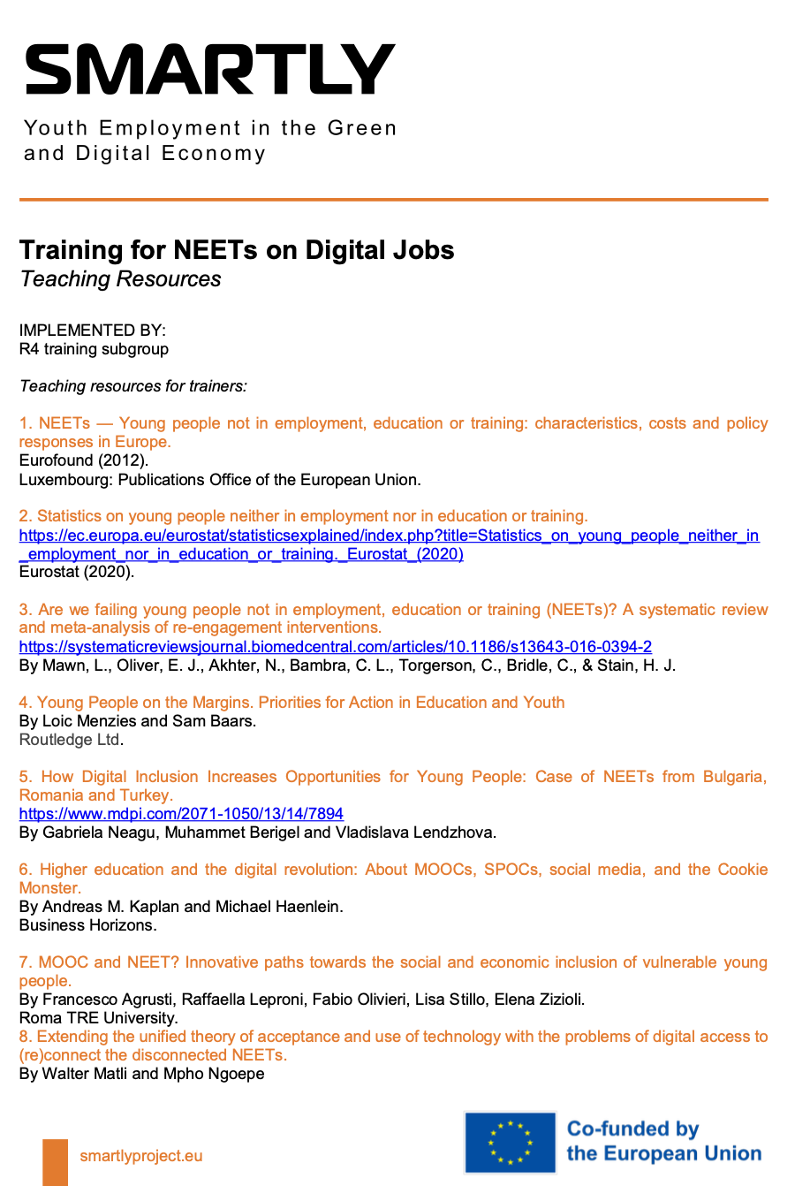
Further information:
Please find more information on the Induction Training on Digital Jobs on:
https://www.smartlyproject.eu/news

Slide 15
EXTERNAL EVALUATION OF TRAININGS
EMPLOYERS
A. Responsiveness of training Module (x) to the job market needs;
Green Jobs 4.15-4.38/5
Digital Jobs 4.15-4.5/5
B. Responsiveness of the overall training to the job market needs?
Green Jobs 4.15/5
Digital Jobs 4.3/5
C. Will it be an asset if a candidate at your workplace shows a certificate of attending such training?
100% Yes
85% Yes

Slide 16
EXTERNAL EVALUATION OF TRAININGS
EMPLOYERS
D. What topics on green skills would fit to be included in the future training program development?
● Ecological design, Certification of environmental standards, Knowledge of environmentally friendly materials, Calculation of the energy efficiency of buildings, Providing expert environmental advice (from a real estate representative)
● Bioeconomy (from a Research and Education representative)
● How to implement the knowledge and to translate it to actual behavior change (from an Electricity and Automobile Mechanics sector representative)
● Link between digital architecture and Sustainability (from a Research and Education representative)
.

Slide 17

REFERENCES
EQF
Overall process
SMARTLY training frameworks
Employers evaluation
Accreditation
…
Green Jobs
Digital Jobs
https://www.smartlyproject.eu/news

Slide 18
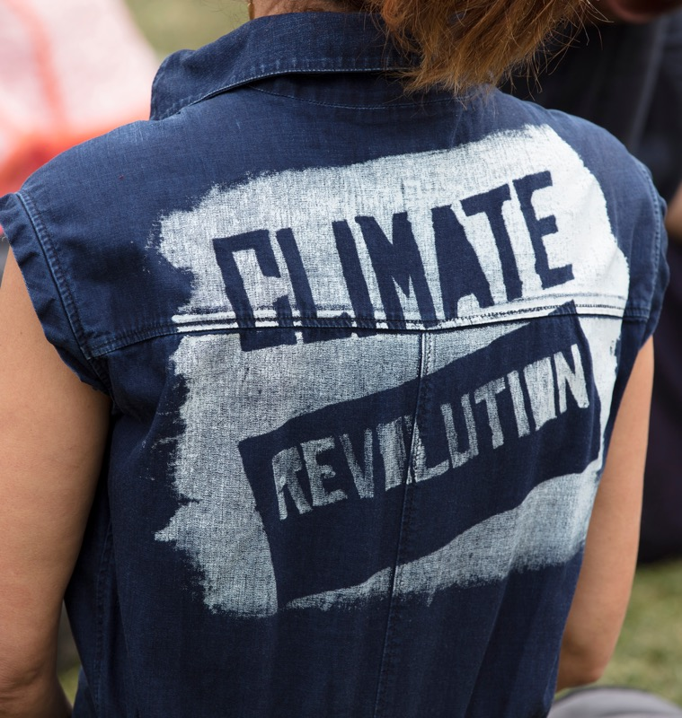
CONCLUSIONS
European Qualification Framework approach and opportunities opportunity to share effective ALMP measures.
Need for a mix of practical knowledge and soft/learning skill (coherence with R1 analysis)
Important to include practitioners' (employers) feedback in a framework’s final version
Induction trainings were generally found to provide added value for candidates, altough effectiveness may vary according to the NEET and the company’s profile.
Regarding the accreditation process, need to foresee further work to adjust the training.
Both trainings were successfully accredited in Malta.

Slide 19

SMARTLY
Thank
You.
projects@pologr.it Fondazione Polo Universitario Grossetano

