Slide 1
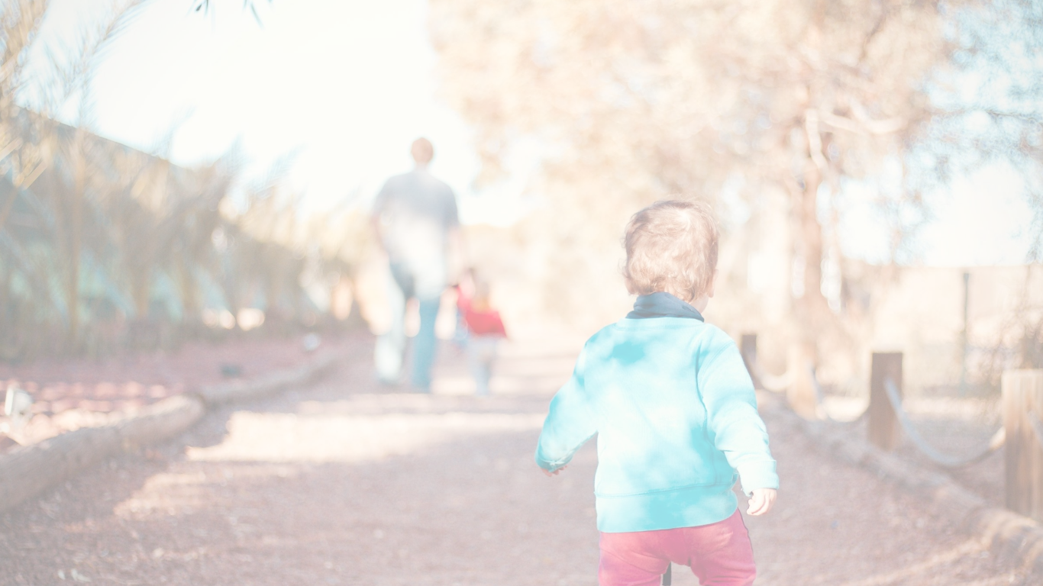
Better Together Family Café:
Active Families, Active Children:
How Everyone Benefits
from Movement
Notes:
Trainer Note: Introduce yourself and welcome participants to the cafe.

Slide 2




Let's get ready!
Rename yourself if your screen does NOT say your name.
Move the mouse over your picture until you see 3 little dots in the top right corner.
Click on the dots and then click on “Rename” and type your first and last name.
Please be actively engaged during our time together
Participating in the chat box, discussing topics, contributing to the conversation
1
4
2
Type the following information in the chat box:
First and last name
Tell us the name of the ECE Program your child attends
5
Please stay muted unless you have a question or comment.
Please turn on your video at this time.
If two of you are watching together, we must be able to see both of you throughout the training.
If you get kicked off during the training due to a technology issue, please log back in using the same link in your confirmation email.
3
6
Notes:
Trainer Note: Omit this slide if you are hosting the cafe in person.

Slide 3
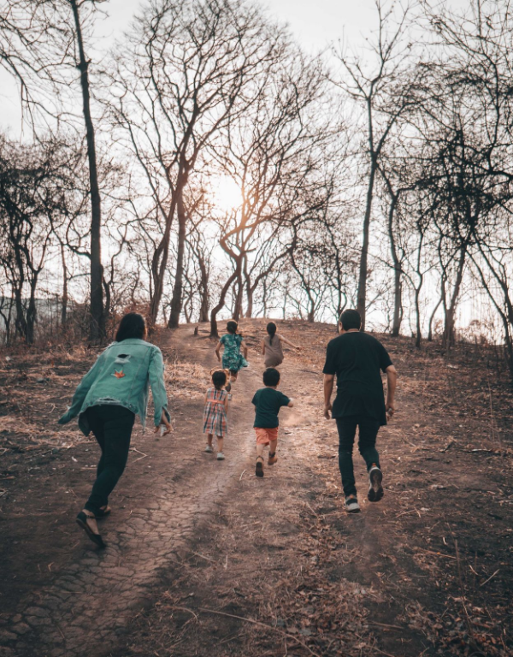
Welcome!
If you were given an extra hour each day, how would you use it?
Notes:
If you were given an extra hour each day, how would you use it?
Trainer Note: Share your own response to start the conversation.
Encourage participants to respond to this question and engage in conversation.
Thank you all for sharing! Now let’s find out more about what we’re going to be discussing.

Slide 4
Objectives
To understand how the Four Building Blocks of HOPE (Healthy Outcomes from Positive Experiences) support the physical development of the child and family
To discuss the health and well-being benefits for children of being physically active as a family
Notes:
To understand how the Four Building Blocks of HOPE (Healthy Outcomes from Positive Experiences) support the physical development of the child and family
To discuss the health and well-being benefits for children of being physically active as a family
We will start by discussing the Building Blocks of HOPE.

Slide 5

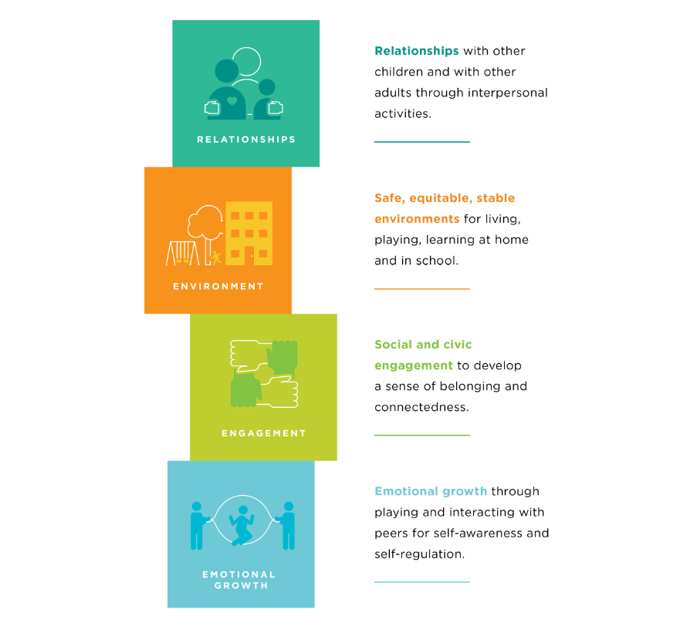


The Four Building Blocks of HOPE
Sege and Browne. Responding to ACEs with HOPE: Health Outcomes from Positive Experiences. Academic Pediatrics 2017; 17:S79-S85
Notes:
Just as ACEs (Adverse Childhood Experiences) are organized into categories or domains, we see that PCEs (positive childhood experiences) can be organized into the Four Building Blocks. HOPE (Healthy Outcomes from Positive Experiences) centers around key Positive Childhood Experiences (PCEs) that buffer against the negative lifelong health effects caused by Adverse Childhood Experiences. These Building Blocks are essential for healthy development - even in the absence of ACES.
Research shows that positive experiences promote children’s long-term health and well-being. They allow children to form strong relationships and meaningful connections, cultivate positive self-image and self-worth, provide a sense of belonging, and build skills to cope with stress in healthy ways.
Now we will look deeper into each of the Four Building Blocks: Relationships, Environment, Engagement, and Emotional Growth
Background Information:
Information about HOPE & the Mission- Spreading-HOPE_FINAL_2.2.2021.pdf (positiveexperience.org)

Slide 6
The Four Building Blocks of HOPE: Relationships
Sege and Browne. Responding to ACEs with HOPE: Health Outcomes from Positive Experiences. Academic Pediatrics 2017; 17:S79-S85
Notes:
Being in nurturing, supportive relationships are critical for children to develop into healthy, resilient adults.
Having key foundational relationships: parents/caregivers who respond to a child’s needs and have warm, responsive interactions.
Having adults outside of the family that take a genuine interest in a child and support their growth and development.
Having healthy, close, and positive relationships with peers.
Trainer Note:
Below is more information regarding this HOPE Building Block. It provides more relatable context. However, if you have already covered the HOPE Building Blocks with the group you are working with in a previous session, please use your discretion in reviewing the information.
For child care providers: Individuals that recall having these types of relationships during childhood experience significantly lower rates of depression and poor mental and physical health during adulthood. When working with families, especially vulnerable families affected by trauma, it is important to ask about the types of positive relationships a parent may recall from their childhood. This information can then be celebrated and used to help create opportunities for their children to experience the types of relationships encompassed by this Building Block of HOPE.
For parents/families: Individuals that recall having these types of relationships during childhood experience significantly lower rates of depression and poor mental and physical health during adulthood. We encourage you to think about these types of positive relationships from your own childhood. Reflecting on this yourself can then be used to help create opportunities for your own children to experience these types of relationships encompassed by this Building Block of HOPE.
Trainer Note: Ask for response-As you think about the positive relationships in your life - what characteristics have they had?
Maybe the relationships have been trusting, nurturing, supporting, etc.
The next Building Block we will discuss is Environment.

Slide 7
The Four Building Blocks of HOPE: Environment
Sege and Browne. Responding to ACEs with HOPE: Health Outcomes from Positive Experiences. Academic Pediatrics 2017; 17:S79-S85
Notes:
Children who live, learn, and play in safe and stable environments are less likely to experience poor mental and physical health as adults. So what do we mean by safe and stable environments?
A safe, stable environment, secure in meeting a child’s basic needs, including adequate food, shelter, and healthcare
A school or home where children feel emotionally safe
A stable school environment where children feel valued and receive high-quality education
A community environment to play and interact with other children safely
Trainer Note:
Below is more information regarding this HOPE Building Block. It provides more relatable context. However, if you have already covered the HOPE Building Blocks with the group you are working in a previous session, please use your discretion in reviewing the information.
For providers: It is crucial to ask caregivers about the types of environments their children are experiencing. Celebrate the positive and work with families to help ensure their child has the opportunity to live, learn and play in safe and nurturing environments.
For parents/families: It’s important to think about the types of environments your children are experiencing. Celebrate the positive and work to ensure your child has the opportunity to live, learn, and play in safe and nurturing environments.
Think about your child's environment - what positive things does your child experience in their environments?
Do they have friends in their neighborhood they like to play with? Do you have a garden where they can enjoy learning outside?
We will now move on to discuss the Engagement Building Block.

Slide 8
The Four Building Blocks of HOPE: Engagement
Sege and Browne. Responding to ACEs with HOPE: Health Outcomes from Positive Experiences. Academic Pediatrics 2017; 17:S79-S85
Notes:
Children need opportunities for social engagement and to develop a sense of connectedness. Developing a connection to and sense of belonging in a community, as well as a sense that you matter to your community, describes the essence of the third of the Four Building Blocks of HOPE. What are some examples of social and community engagement?
Being involved in projects, peer-mentoring, or community service through one’s school or religious organization
Partaking in family cultural traditions
Participating in organized music, art, or sports
Trainer Note:
Below is more information regarding this HOPE Building Block. It provides more relatable context. However, if you have already covered the HOPE Building Blocks with the group you are working with before, please use your discretion in reviewing the information.
Children need to feel connected to their communities, loved, and appreciated. Having this type of engagement (involvement in social institutions and environments, awareness of cultural customs and traditions, and a cultivated “sense of mattering” and belonging) helps children develop into secure and resilient adults.
Have you experienced positive benefits or had good experiences being part of a community group or friend group that you would be comfortable sharing?
Trainer Note: Add a personal story or experience here if participants don’t feel comfortable sharing.
Now let’s move on to discuss the last Building Block- Emotional Growth.

Slide 9
The Four Building Blocks of HOPE: Emotional Growth
Sege and Browne. Responding to ACEs with HOPE: Health Outcomes from Positive Experiences. Academic Pediatrics 2017; 17:S79-S85
Notes:
The final Building Block of HOPE Emotional Growth: through playing and interacting with peers for self-awareness and self-regulation.
Children need opportunities for social and emotional development. What do we mean by social and emotional development?
Developing a sense of emotional and behavioral self-regulation
Having the ability to respond to challenges in a productive manner
Developing key socially and culturally appropriate communication and interpersonal skills
Children need to have ample opportunity to develop their sense of social and self-awareness, learn how to self-regulate emotions and behaviors, and acquire skills needed to respond functionally and productively to challenges.
Trainer Note: (emphasize this point)- Opportunities to develop these skills arise during child-centered play. Children need the support of adults to name and understand make meaning of their emotions. Whether a child needs help developing these skills or they naturally pick up on them, these skills are critical for children to be able to become resilient, emotionally healthy adults.
Trainer note:
Examples of play and social emotional development:
Play pretend with baby dolls with your child. This helps develop empathy as young as eighteen months. Say aloud what you’re doing by responding to the baby “crying” and naming their feelings. “Oh the baby must be sad”. Then give the doll to your child and encourage them to do the same.
Play dress up and imitate housework activities to help them develop a sense of independence.
Practice taking turns. Use a toy (i.e., race car, blocks, etc.) to model this skill. Use cues such as “my turn, your turn”, “I love the way you’re being patient as you are waiting for your turn”. You can practice this skill with an infant by playing games such as peek a boo and cooing back and forth.

Slide 10
Why HOPE?
Positive experiences can alleviate toxic stress and help children grow into more resilient, healthier adults.
HOPE aims to evolve our understanding and support
of these key experiences.
Notes:
By promoting the HOPE Building Blocks, we aim to support resiliency for our families. We want to encourage positive experiences and the Building Blocks to help children grow into resilient, healthy adults, and to help lessen the effects of adversity.

Slide 11



Partner Activity
What is your favorite physical activity memory as a child?
Notes:
Ten minute activity: Four minutes in groups or breakout rooms, six minutes to debrief upon return
Trainer Note:
Pose question to participants: What is your favorite physical activity memory as a child?
Send participants to groups or breakout rooms in groups of two-three. Allow four minutes total, approximately two minutes for each partner to share.
Debrief: We invite anyone to share your own thoughts or share something from your partner, whatever you are most comfortable with.
Trainer note:
If no one speaks up during debrief, trainer can share experience first.
Relate back to the Building Blocks of HOPE how we are supporting these Building Blocks by being physically active with our families.
Relationship Building Block: ex: Taking walks together gives opportunities to move and connect. When we spend time playing and having fun it connects us to others and builds our relationships.
Environment Building Block - ex: Exploring local parks or playing outside in your own yard/neighborhood
Children who live, learn, and play in safe and stable environments are less likely to experience poor mental and physical health as adults.
Engagement Building Block - ex: Creating friend groups through school, church or other community opportunities is important.
Children need opportunities for social engagement and to develop a sense of connectedness. Developing a connection to and sense of belonging in a community, as well as a sense that you matter to your community is the essence of this building block.
Emotional Growth Building Block: ex: When you play with your child you can take the opportunity to model regulating emotions (learning how respond and express feelings when a game or activity doesn’t go their way).
Children need to have ample opportunity to develop their sense of self-awareness and social cognition, learn how to self-regulate emotions and behaviors, and acquire skills needed to respond functionally and productively to challenges.
Thank you all for participating in our partner activity! We appreciate you sharing your own memories of being physically active. We wanted you to reflect on this because those memories of playing and having fun are impactful and we want to ensure your children have the same types of memories to carry with them.

Slide 12
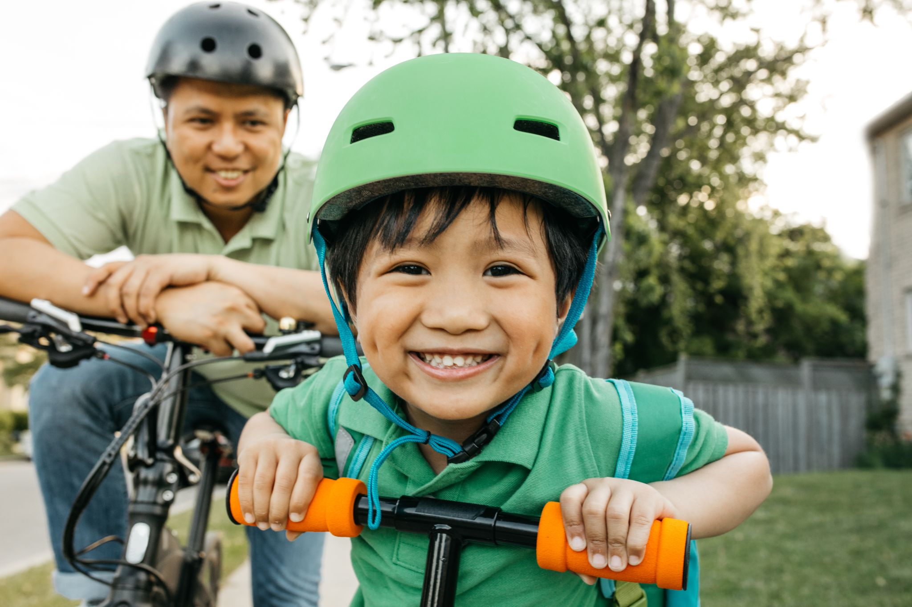
Physical Activity
When you are physically active, how do you feel in your body?
Notes:
Physical activity plays a key role in personal wellness. How do you feel after you are physically active? Do you notice a difference in your mood or in your body?
Trainer Note: Pause to give participants a chance to respond. Prepare to share a personal example.
Let’s look at the many benefits of being physically active.

Slide 13
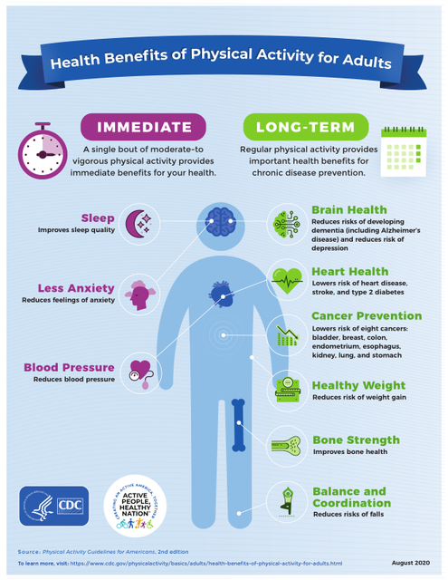
Notes:
There are many immediate and long-term health benefits of physical activity for adults.
Moderate-to-vigorous physical activity (moderate: raises heart rate but still able to talk. Examples: brisk walk, heavy cleaning, or a leisurely bike ride. Vigorous: causes you to breathe much deeper and faster than normal and leaves you somewhat breathless. Examples: a jog or run, playing basketball, a fast bike ride). These type of physical activities can help improve sleep patterns, lower blood pressure and reduce anxiety. On a day-to-day basis, being physically active reduces feelings of being overwhelmed and stressed. Exercise reduces levels of the body's stress hormones, such as adrenaline and cortisol. It also stimulates the production of endorphins, chemicals in the brain that are the body's natural painkillers and mood elevators.
Regular physical activity is important to prevent long-term chronic diseases.
Physical activity:
reduces risk of depression and dementia (including Alzheimer’s disease).
improves your heart health.
lowers the risk of developing Type II Diabetes and several types of cancer.
reduces weight gain, strengthens bones and impacts balance and coordination which are all important as one ages.
For our health today and in the future, it is important for adults to stay physically active.
Trainer note: Connect the importance of modeling regular physical activity to the impact it may have on young children.
Let’s take a look at the best practices for children as it relates to physical activity.

Slide 14
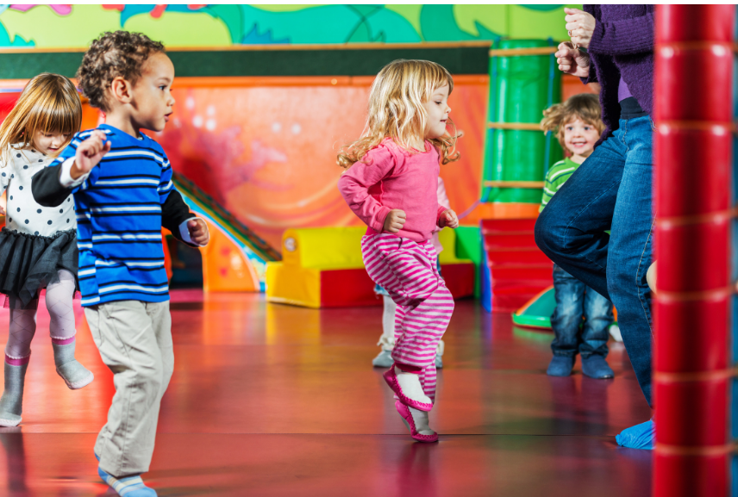
Physical Activity Together
Best practices recommend:
Toddlers are provided 90 minutes or more for indoor and outdoor physical activity each day
Preschool age children are provided 120 minutes or more for indoor and outdoor physical activity each day
Notes:
Children are getting a lot of physical activity throughout the day with their childcare provider and at home, but did you know that toddlers need 90 minutes and preschool age children need 120 minutes of physical activity each day? That is why it is so important to get your kids up and moving at home!
It is also important to note that physical activity occurs even during leisure time (walking around, folding laundry, cleaning the house, making the bed, etc). All of those things add up over the course of a day.
The healthy practices you develop at home will become positive habits for your children as they grow, which will have a lasting impact on their health and wellbeing.
Let’s now set the stage for our cafe conversations.

Slide 15
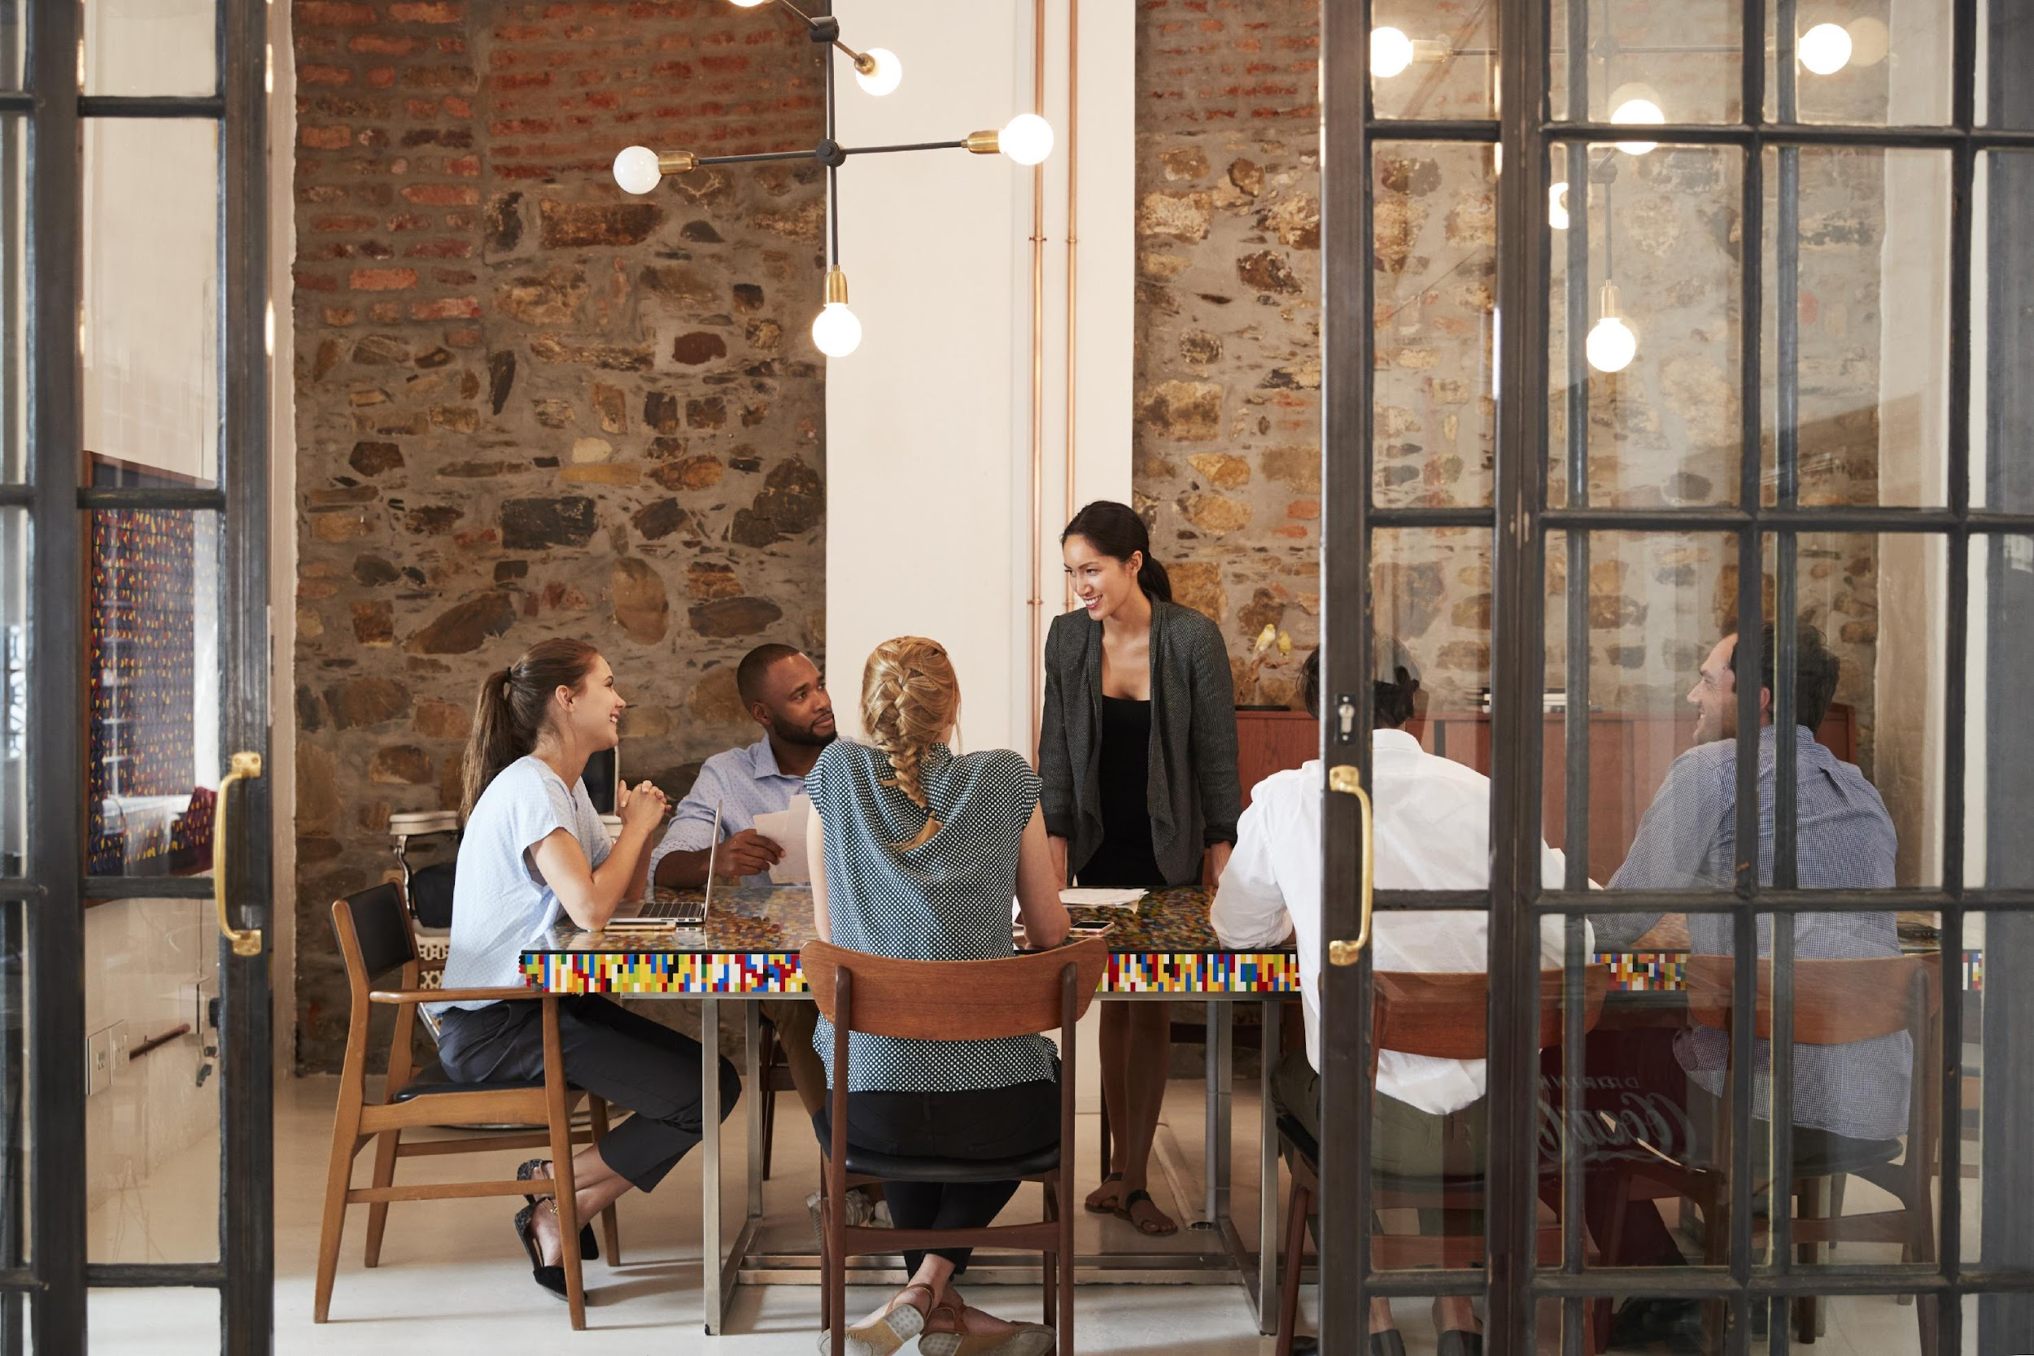
Creating an Emotionally Safe Environment
Active listening
Judgement free zone/safe place
Confidentiality
All responses welcome!
Notes:
Before we move into the discussion, we want to make sure we are setting a space for a positive environment and experience for all who are participating today. This will help set the stage for our conversations.
Active listening- truly listening to everyone sharing and being present
Judgement free zone/safe place- This is a judgement free zone in order to help create a safe place.
Confidentiality-What happens in the café, stays in the café!
All responses welcome! We encourage everyone to be open in sharing their thoughts and experiences. That's what makes a cafe so special!
Any questions? Alright, let’s dive into the Cafe questions.

Slide 16
Cafe Questions
Active Families, Active Children:
How Everyone Benefits from Movement
Notes:
Trainer Note: Based on the number of participants, divide into groups of up to five people. Breakout rooms will be used for each of the cafe questions. Small group discussions should last for eight-ten minutes.
If the Cafe is in person, refer to the Better Together Family Cafe Toolkit for facilitation instructions.
At this time, give a brief explanation of how the cafe portion works to the participants.
Sample Script (This will vary based on several factors: in person/virtual, large group/small group, etc):
We are about to move into the cafe questions. During this time, you will have about eight minutes with your group to discuss the each question. This is an opportunity to connect and collaborate with each other. After each cafe question, we will come back together to debrief our discussion with the whole group.

Slide 17

#1
When is a time you felt really good? What was going on?
Notes:
When is a time you felt really good? What was going on?
Trainer Note:
Prior to separating into small groups, consider these prompts to initiate thinking.
Was it a time when you were eating well, or being physically active? A time when the relationships with family were strong? A time when your job was going well, or you were feeling strong financially?
What was happening in your life that would support that?

Slide 18

Think about an activity you are currently doing or would like to do as a family. What are ways that activity supports child development (cognitive, language, physical, sensory, social-emotional)?
#2
Notes:
Think about an activity you are currently doing or would like to do as a family. What are ways that activity is supports child development? (cognitive, language, physical, sensory, social emotional)
Cognitive- Supports brain development
Language- Supports communication skills
Physical- Supports a healthy body
Sensory- Learning about the world through senses
Social-emotional- Supports positive, healthy relationships
Trainer Note:
Prior to separating into small groups, consider these prompts to initiate thinking. Do you have a garden where your child can work with their hands or work with their senses to explore sensory development? Do you take walks together? Do you engage your children in your house chores?

Slide 19

#3
What are some of your favorite activities to do as a family?
Notes:
Share ideas about things your family loves. What are some of the things you have done as a family that are fun and your kids enjoy? These could be indoor or outdoor activities.

Slide 20
Reflection
How do you feel after listening to the responses from the other participants?
How did you feel sharing your own thoughts and experiences?
What is one thing you will take away from today?
Notes:
Trainer Note: It is important to ask each reflection question individually and allow wait time for responses.

Slide 21
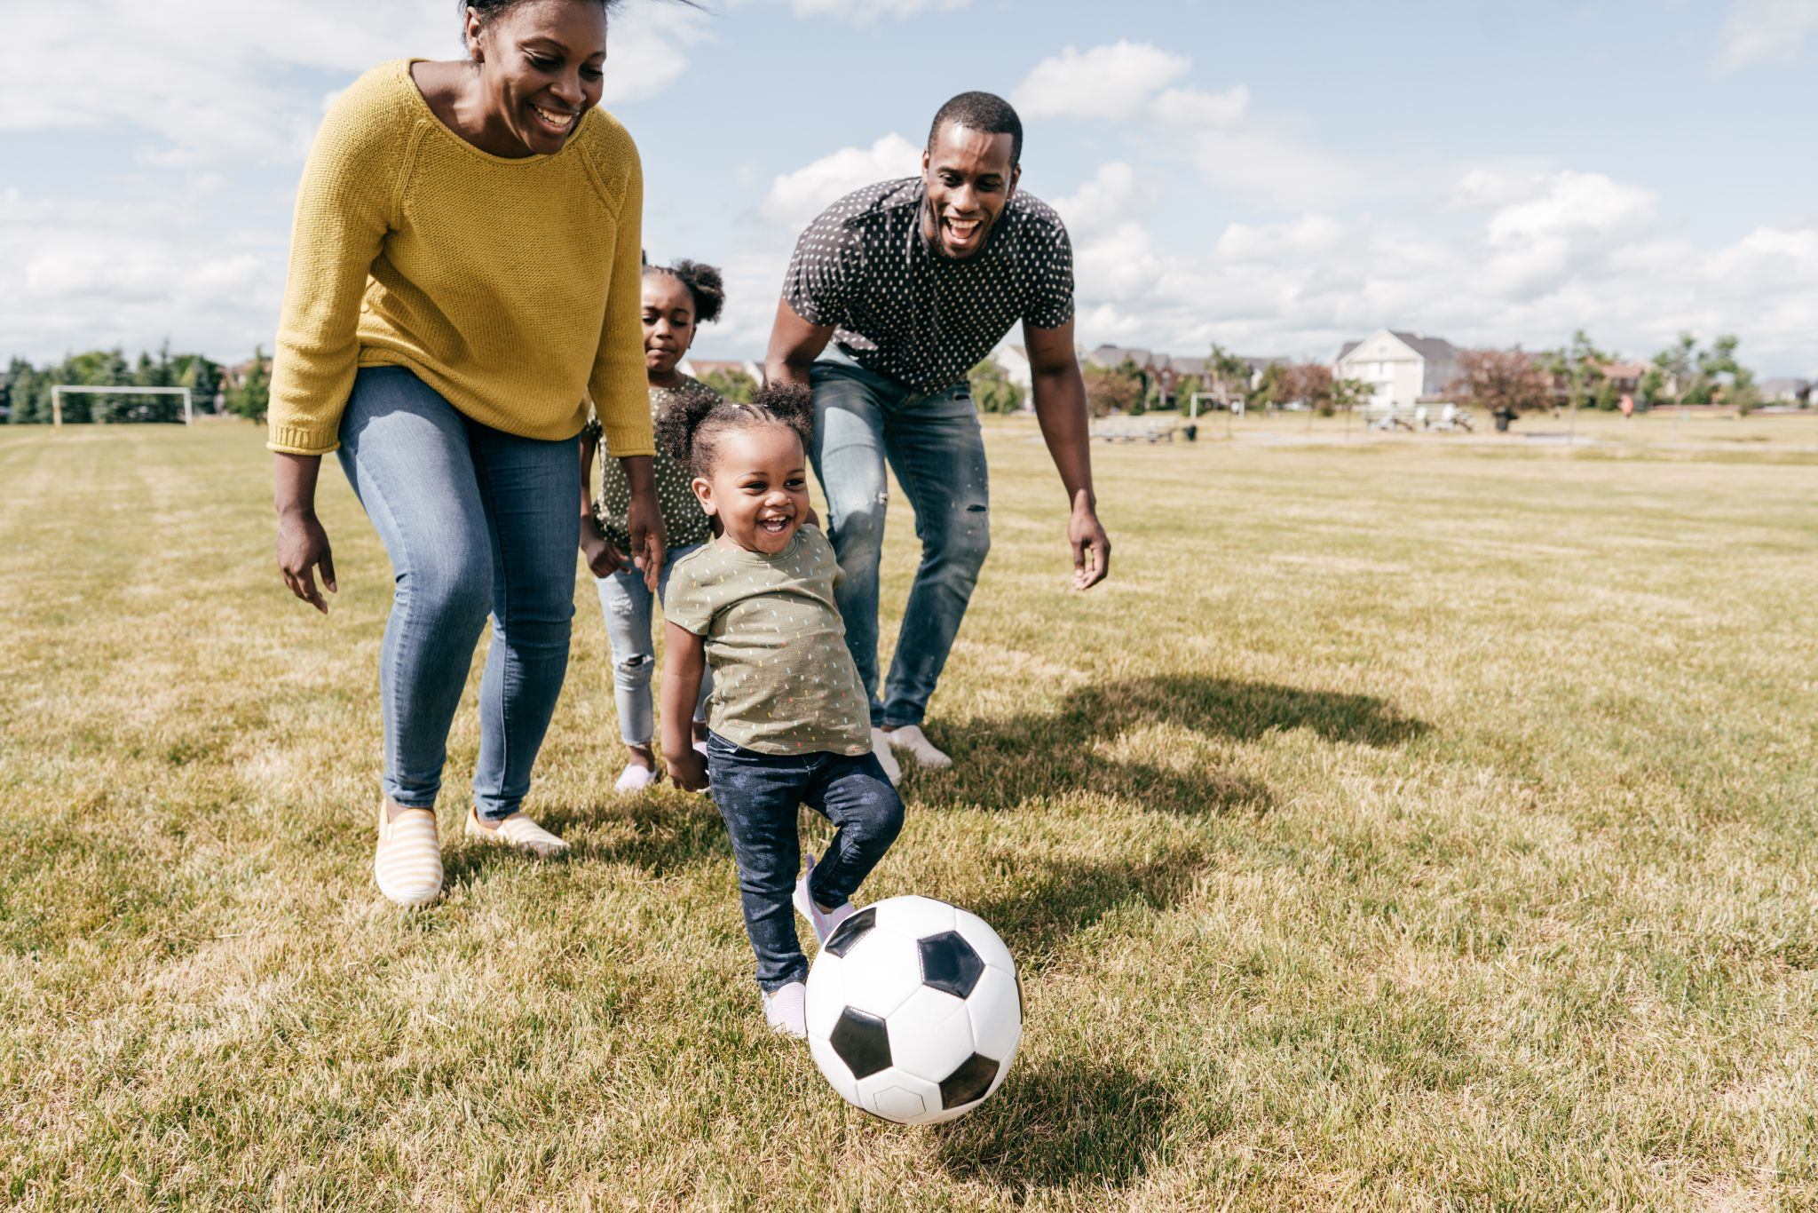
Note to Self
What is one thing you could do to increase/add physical activity into your daily life with your family?
Notes:
What is one thing you could do to increase/add physical activity into your daily life with your family?
Reminder: It doesn’t have to be going to the gym or anything formal - it can be housework or working in the yard.

Slide 22
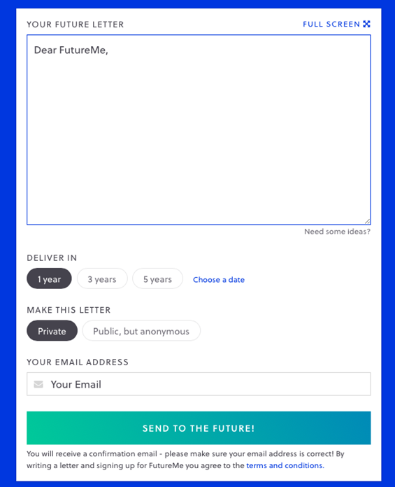
Futureme.org
Type response after reflecting on the
“Note to Self”
Click ‘Choose a Date”
  Enter the date two weeks from today
Make this letter private
Type in your email address
Click “Send to the Future!”
Notes:
Trainer Note: Only use this slide if you are hosting the cafe virtually. If you are hosting in person, please refer to the Better Together Family Cafe Toolkit for more details.
Futureme.org is a website we suggest using for the Note to Self. Type in your response, click “Choose a Date” and enter the date two weeks from today. Keep the letter private. Type in your email address. Click “Send to the Future!” On your selected date, your note to self will arrive in your email to serve as a reminder of the positive experience you wanted to create for your family.
Background Information:
https://www.futureme.org is a website participants can use, especially virtually, to send the note to self. The link and information should be included in the follow up email if the cafe is done virtually.

Slide 23
Questions?
Notes:
Trainer Note: This slide can be used to discuss any questions, evaluations, next steps, etc.

Slide 24

THANK YOU!
Notes:
Type your notes

