Slide 1
Got Strategy? Collaborative and Inclusive Departmental Strategic Planning
Kabel Stanwicks (he/him/his), head of access services
University Libraries, university at Albany, SUNY

Slide 2
Overview & Objectives
Overview
Institutional background
Why my department developed a strategic plan
How we approached the planning process
A look at our plan
Helpful ideas
Next steps for us
Objectives
Understand why planning at this level is important
Utilize an easy process for basic planning

Slide 3
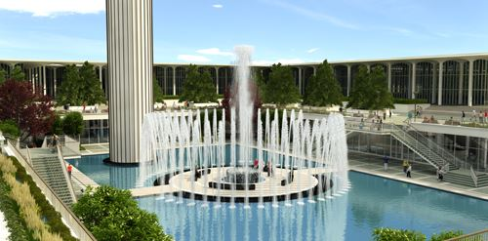
The University at Albany
Over 17,000 students and 1,100 faculty
Originally founded in 1844 as a State Normal School → College for Teachers → University
Three campuses: Uptown, Downtown, Health Sciences

Slide 4
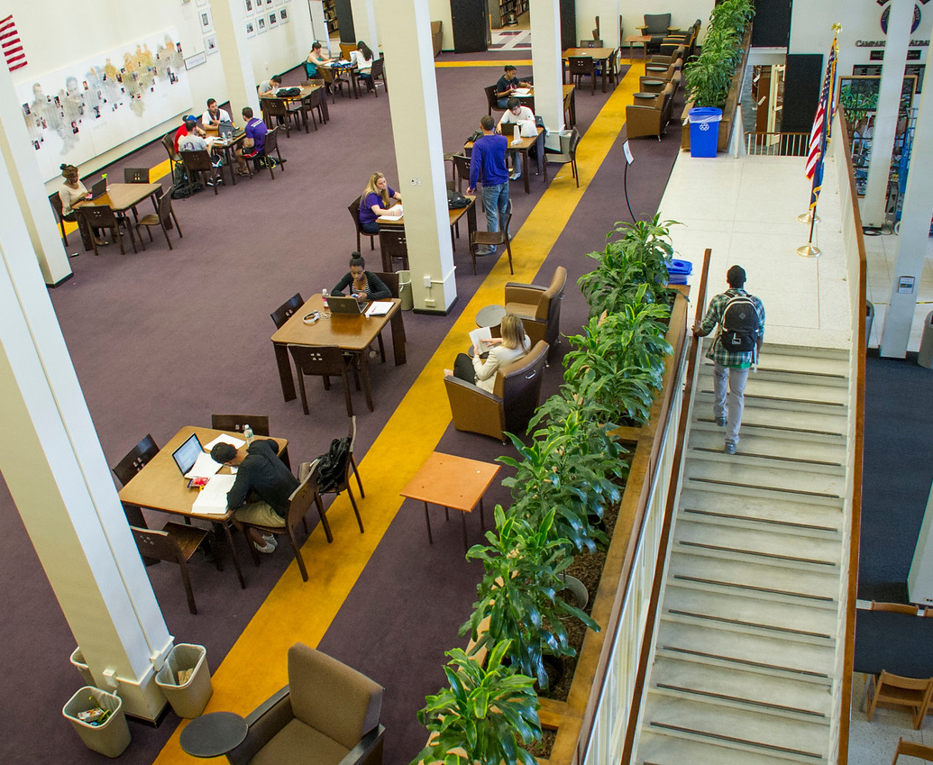
The University Libraries
Three Libraries: University Library, Dewey Graduate Library, Science Library
Over 2.3 million print volumes
Approximately 400K visitors annually
73 faculty/staff members

Slide 5
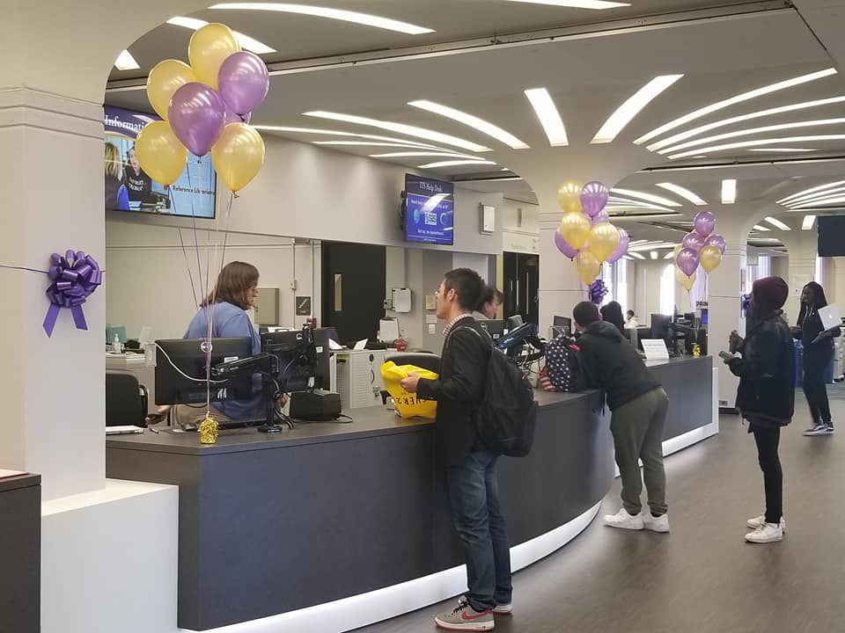
Access Services Department
Circulation Services
Interlibrary Loan/Document Delivery
Course Reserves (physical & electronic)
Stacks Maintenance
Periodicals & Microforms
Circulation Billing
Student Employment

Slide 6
Access Services Department
Access Services
Dewey Library Access Services
Resource Sharing & Reserves
Access Services Technology & Operations
Frontline Services
Staffing
1 librarian
6.5 professional staff
10 clerical staff
40 student employees
Department reorganizations
Retirement wave
Civil Service & promotions
Moving out, moving up
Financial/Budget impacts
Collapsed work units
Cross-training

Slide 7
If you fail to plan, you are planning to fail!
Benjamin Franklin
Why we embarked on the strategic planning process at the departmental level…

Slide 8
UAlbany Strategic Plan
University went through strategic planning process in 2016 – 2017
Strategic Plan focuses on:
Student Success
Research Excellence
Diversity & Inclusion
Internationalization
Community Engagement
Staff members knew their work was important but connection not really apparent

Slide 9
University Libraries Strategic Plan
Strategic Goals:
Provide excellent services and collections to support research, teaching and learning to a diverse campus community.
Foster collaboration within the Libraries, with other University departments/units, with SUNY campuses, and internationally.
Invest in physical and virtual library spaces that are inclusive and welcoming.
Promote an organizational culture that helps library faculty and staff succeed in a changing environment, embracing broader engagement with the University at Albany community and academia.
Provide services to support the full cycle of research and scholarly communication. Lead the effort to capture, steward and share the scholarly record and research output of the University at Albany.
The Libraries underwent a strategic planning process in 2018.
Divisions took different approaches to contribute to the plan.
Developed five broad strategic goals—each with objectives and initiatives.

Slide 10
Where does the Access Services Department fit?
Staff members felt left out of processes & final written documents.
Morale issues result from disconnect.
Needed explicit connection to University’s strategic plan & Libraries’ strategic plan.

Slide 11
How do we prioritize all the work?
Access Services staff members are always here
There are lots of things we should be doing
There are lots of things we want to do
There are certain things we must do

Slide 12
Two Realizations & One Epiphany
We can’t do it all
We don’t agree on what to do
Service demands are increasing
Budgets are decreasing
Staffing has so much capacity
Large department: ~25% of University Libraries personnel
Divergent views on what’s important
We need a shared understanding of what’s important and how we’re going to invest our time and energy… or we will fail.

Slide 13
A Communication Tool
A documented, shared understanding of our priorities and initiatives is helpful to internal communication and conversations.
Our strategic plan shows others in our organization what we are doing and what our priorities are.
Manage workload/job creep.
Communicating what we do to job applicants.

Slide 14
People in any organization are always attached to the obsolete—the things that should have worked but did not, the things that once were productive and no longer are.
Peter Drucker
How we embarked on the strategic planning process…

Slide 15
SWOT
Internal
External
Strengths: things we are really good at doing
Weaknesses: things we need to do better
Opportunities: things we can take advantage of
Threats: things that can negatively affect us

Slide 16
The Process
Meeting to introduce SWOT, process, timeline, and examples
1
Staff members work independently or in groups to develop ideas for SWOT matrix
2
Meeting to discuss & brainstorm Strengths and Weaknesses
3
Meeting to discuss & brainstorm Opportunities and Threats
4
Meeting to review inventory; final additions; generate strategic ideas
5
Department managers meet to group strategic ideas into themes; which ideas are/aren’t strategic?
6
Draft plan based on outcomes from department managers meeting; share for feedback
7
Input from department; finalize plan
8
Share plan broadly
9
Review, Digest, Add Content, Provide Feedback between each step

Slide 17
What are our Strengths?
Collection Quality
Purchase recommendation in ILLiad
Resources
3 libraries & 3 circulation points (convenience, spaces, services)
Dedicated Staff: adaptable, flexible
Student employees (and funding)
Hours
Combined Service Desk
PhD Study Carrels
Centrally located on campus: study, space, collaborate
Training materials/handouts
Reserves: textbooks
Request services (delivery & ILL)
High usage
Budget (healthy for services)
Zoned spaces
Group Study Rooms with technology
ILL/DD services (paging, distance, office delivery)
Equipment: scan, copy, print, laptops, phone chargers, calculators, etc.
Services and libraries appreciated & highly regarded by campus community
Staff's general university knowledge
Final exams: extended hours, programs
Transforming Space
What are our strongest contributions to the university community?
What do we do that no one else does?
What do users like best about our services?

Slide 18
What are our Weaknesses?
Recalls and communicating policies
no quality feedback from community
multiple, disconnected systems used to provide service
need more study rooms and equipment
projects interdependent with other departments
siloed from other library departments
public space set up: needs cohesive thought/approach, not maximizing space, not modern/friendly
old security technology
multiple buildings to staff/manage
Lack IT support for implementing new stuff
service to Health Sciences Campus
convoluted billing: outdated, appeals, staff time (and cost)
Our department data not used for collection development
communication across shifts, departments, desks
SUNY Card (guest cards, machines, service): bad machines and directions, printing/SUNY Card problems reflect poorly on us
Inconsistent equipment between libraries
Tied to email/USPS communication
E-Reserves: Ares/Blackboard
Permanent Reserves
non-circulating materials in regular collection and storage
IT on Saturdays
How/where are we lacking resources?
What do we need to improve?
What do users want us to do better?

Slide 19
What are our Opportunities?
Decreased collection use: reallocate space
better signage and naming conventions for zones
Science Library open space on second floor; Index/Abstract area; current periodicals; CCBW for library book storage; B&N patio
ALMA migration
RFID
Online fine payment, do away with cash transactions
Online forms (appeals, claims returned, etc.)
Different approach for printing/SUNY Card funds; remove SUNY Card guest cards (sell at desk if needed) to improve customer service
Weeding
Purge records to speed up transactions
School of Public Health services for students
Collection sharing between SUNYs
Collaborate with other student service units on campus; build relationships
Inconsistent equipment between libraries
Comprehensive space planning with more appropriate furniture
Community Outreach
Involvement with advancement
Contact with patrons: marketing, outreach, promotion
Programming
Collaboration in workplace
Engage Public libraries
What could we do better if we had resources to do it?
What are things happening outside our organization that we would like to take advantage of?
What are things that we can build from our strengths?

Slide 20
What are our Threats?
ALMA Migration
Tipasa Migration
Office of Campus Planning
Copyright costs
decreased staffing in science library and increased building activity
Budget cuts: TS, S&E, collections
Campus Center
Decreased collection use
Security/UPD presence; public safety threats; community users
Accounting/Audit decisions/policies without consultation
Not enforcing zones (alienating users)
External problems internal to libraries (vending machines, SUNY card)
ITS computers slow boot time
What are things happening outside our organization that could impact us negatively?
Does someone else provide similar services with greater ease for our users?
What weaknesses leave us vulnerable?

Slide 21
Actionable items
Action Item List Examples:
Promote our services/collections to public libraries; promote public libraries to our users (CDLC)
Update/Upgrade PA system (including automated announcements)
Move appeals process online
IDS reports: automate request data reporting for collections (partner with collections on system development)
Assess noise zones; consider level-by-level zones
Remove SUNY card guest cards from machines: sell at desk, give away at desk, sell with money already loaded?
Collaborate with bookstore to place materials on reserve (proactive)
Work with collections to purchase frequently requested items for reserves
Purge records to speed up transactions (patrons, equipment, items)
Streamline transactions (e.g., laptops) with electronic forms/workflows
Loan period consistencies: laptops, rooms, markers, etc.
Documentation: better/consistent approach to training & customer service.
What are some things that we just need to do?
How can we leverage our strengths to address our weaknesses or threats?
What opportunities can we take advantage of to mitigate threats or offset weaknesses?
SWOT concepts that need to be addressed on their own?

Slide 22
Grouping Ideas
Develop quality documentation and training to improve service quality, better empower staff, and decrease on-boarding time for new staff members and student employees.
Revise existing documentation and create new documentation for services, tasks, workflows, policies, and procedures.
Design interface for online policy/procedure manual to store documentation; populate with documentation
Review and revise staff training plan; develop student employee training plan
Design and deploy training modules aligned with training plan: use documentation; develop exercises, tracking, assessment
Student Employment & Supervision
Develop training guides for consistent training delivery
Enhance patron services
Move forms online
Enterprise Systems Migrations and Futures:
Data cleanup: IPS cleanup, delete patron records,
Training
Ares
Tipasa
Alma
Billing
Appeals process
Old bills: write off delinquent, uncollectable debt
Migrate billing to PS
Revise fine/fee structures

Slide 23
Groupings → Themes
Enhance patron services to better meet users' needs.
Develop quality documentation and training to improve service quality, better empower staff, and decrease on-boarding time for new staff members and student employees.
Re-evaluate department student employment & supervision policies and practices and implement new approaches.
Address issues related to enterprise system migrations and futures in Access Services.
Streamline circulation billing practices to facilitate patron payments, billing management, and system migration.

Slide 24
Patron Services
Enhance patron services to better meet users' needs.
Develop a culture committed to providing high-quality customer service to users in-person and remotely.
Migrate and centralize patron forms online.
Improve ILLiad patron interface and ILLiad communication with patrons using email notifications and IDS Logic; identify repeat requests for re-delivery (articles) or purchase on demand (monographs).
Promote paging and delivery services.
Promote reserves textbook services (i.e., instructor personal copies on reserve) to instructors to facilitate student access to textbooks.
Enhance library materials access for School of Public Health graduate students.
Examine current practices for SUNY Card machines, recommend improvements, and implement changes as needed.
Complete collection shifts and collection space assessments to improve collection usability and inform space planning decisions.
Focus on collection inventory to improve the accuracy of our libraries' holdings in discovery interfaces.

Slide 25
Documentation and Training
Develop quality documentation and training to improve service quality, better empower staff, and decrease on-boarding time for new staff members and student employees.
Revise existing documentation and create new documentation for services, tasks, workflows, policies, and procedures.
Design interface for online policy/procedure manual to store documentation; populate with documentation.
Review and revise staff training plan; develop student employee training plan.
Design and deploy training modules aligned with training plan: use documentation; develop exercises, tracking, and assessment.
Create documents for staff to use for consistent student training process.

Slide 26
Student Employment
Re-evaluate department student employment & supervision policies and practices and implement new approaches.
Review and modify/supplement existing employment policies.
Document the hiring process and work with Library Budget Officer to re-evaluate portions of process.
Improve student employee attendance through consistent follow up, tracking, and attendance policy enforcement.
Empower staff to succeed in student supervision duties.

Slide 27
Enterprise Systems
Address issues related to enterprise system migrations and futures in Access Services.
ALMA Migration:
Clean up data to facilitate the move to Alma (IPS, Sublibrary, Collection Code, expired patron records, old billing data).
Redesign department workflows for Alma.
Investigate using Primo with Alma as the primary user interface for resource sharing.
Migrate ILLiad circulation into Alma Fulfillment.
Enhance collection sharing between SUNY schools and other resource sharing partners.
Prioritize staff training: schedule time for staff to learn and practice using the new system; develop training strategies to facilitate continued service delivery at go-live.
Ares Electronic Reserves
Upgrade the Ares system to maintain vendor support.
Assess options, and continued need, for providing electronic reserves services to the campus community; develop services to meet users' needs.
ILLiad to Tipasa
Work with regional and national resource sharing partners to advocate for needed functionality in the Tipasa system, and to develop workarounds to address system shortcomings as needed.
Provide staff training in new system.

Slide 28
Update Circulation Billing
Streamline circulation billing practices to facilitate patron payments, billing management, and system migration.
Revise fine/fee structures and write off old Aleph debt in preparation for Alma migration and to design user-focused fine/fee structures.
Streamline the appeals process to make the process more efficient for users and staff.
Clean up legacy financial files to facilitate billing management; write off old, delinquent, uncollectable debt; purge old paper files.
Migrate billing from Integrated Library System/Library Service Platform to PeopleSoft E-Pay to facilitate payment and increase collection rates; automate data transfers between systems.

Slide 29
Tips for Success
Determine staff members’ prior experiences (especially the bad ones) with strategic planning—plan around these experiences
Ground rules for meetings
Handling the ideas that don’t apply to your department
What about the ideas that didn’t make it onto the plan?
SMART goals
Tie it into the parent organization’s strategy
Keep the plan front and center

Slide 30
Our Successes & Happy Accidents
Shared understanding
Explicit connections
Morale boost
Advocating for positions (new and rehires)
Incorporating the plan in the employment interview process
Communicating up

Slide 31
Next Steps
Current Plan
Wrapping/scrapping remaining action items.
Assessment
Planning for the next plan
Use SWOT internally again
Include student employees in next SWOT
Survey others in the library to contribute to our SWOT
Student Advisory Board input

Slide 32
Questions, Comments, Ideas Please reach out! Kabel Stanwicks
Email: kstanwicks@albany.edu
Twitter: @kstanwicks
Phone: 518-442-3578

