Slide 1
Neighborhood Navigator LuCynthia Jones
Department of Housing and Community Development
April 15, 2024

Slide 2
Upcoming Projects from the Department of Housing and Community Development
AmeriCorps Volunteers Needed (next slide)
Tenant Tuesday: April 30th from 12-3pm at the Toledo Lucas County Library (last day to register is April 15th). Register at https://www.Toledo.oh.gov/tenant-Tuesday
Homeownership Fair: Saturday, June 22, 2024 at Scott High School from 10-3pm (volunteers needed)
Neighborhood Revitalization Strategy Area Tour (TBD in July 2024 for TNCBI Cohort II participants)
Toledo Neighborhoods Capacity Building Institute (TNCBI): August 1 2024 through June 5, 2025

Slide 3
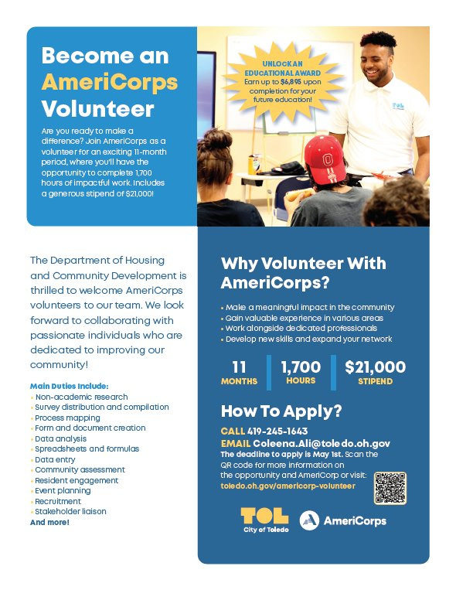

Slide 4
What are the responsibilities of a Neighborhood Navigator?
Assists neighborhood based community organizations in increasing their capacity and sustainability by providing assessment and technical assistance to increase organizational stability and project management capacity: Toledo Neighborhoods Capacity Building Institute (TNCBI)
Serve as a liaison between City, neighborhood and community organizations, neighborhood residents and civic/public service groups desiring to communicate issues and effect positive change
Assist community and neighborhood groups with solving community problems
Resource for referral of citizen problems and information needs/ link citizens to the appropriate government and/or community agency
Conduct physical, economic, housing and population research of neighborhoods (Comprehensive Enhanced Neighborhood Assessment-CENA).
Notes:
Encourage all neighborhood associations, organizations, or Coalitions to register their community organization on the City of Toledo Neighborhood Association website: City of Toledo | Neighborhood Associations (oh.gov) .

Slide 5
City of Toledo Neighborhoods
Notes:
Encourage all neighborhood associations, organizations, or Coalitions to register their community organization on the City of Toledo Neighborhood Association website: City of Toledo | Neighborhood Associations (oh.gov) .

Slide 6
Toledo Neighborhood Capacity Building Institute
In partnership with Reinvest Toledo, the Toledo Neighborhood Capacity Building Institute (TNCBI) Cohort II will commence on August 1, 2024 through June 5, 2025. The TNCBI will engage fifteen (15) select grassroots community-based nonprofit organizations to build capacity in strategic areas necessary for effective neighborhood revitalization and sustainability. Cohort II will offer a streamlined focus on the following topics:
Board Development,
Strategic Planning,
Succession Planning,
Collaborations and Partnerships,
Grant Writing
Fund Development vs. Fundraising,
Financial Policies, Grant Writing,
Providing Solutions-based programming and services,
Planning and Zoning in Neighborhoods, and
Social Media Marketing.
TNCBI will also include four to six (4-6) Micro-Learning sessions focused on specific organizational and neighborhood issues identified by participants of the institute. These sessions will be led by subject matter experts and offer real-time solutions to current issues. Finally, participants will be led through a capstone project to demonstrate the knowledge and skills learned throughout the institute.
Notes:
We have identified several grassroots community based organizations to participate in Cohort II. We are in need of several more organizations that would like to strengthen their capacity. If you know of any CBOs that would be interested in participating in this intensive, year-long program, please send the organizations name and contact information to LuCynthia.Jones@toledo.oh.gov or 419-936-2602. Thank you!

Slide 7
MODULES AND CURRICULUM OBJECTIVES
City of Toledo Housing and Community Development Department (PRE-RECORDED): What is a NRSA (update) and how does this designation impact my neighborhood? Overview of the HCD department and how to gain access to valuable programs.
Board Development: Board Recruitment Strategies. What is a working board vs. governance board? Should all board members fundraise? Why you should look outside your sphere for board members? How an inactive Board can negatively impact your Mission and Vision? What committees should your board have? What are bylaws (code of regulations) and why are they important?
Strategic Planning: What is a strategic plan and why is it important? How do you ensure execution of the strategic plan? The CAPE Method (Champion, Assess, Plan, and Execute).
Financial Policies/Budgeting: What is legally required for a nonprofit? How to develop an operational budget? How to create a budget with limited resources? How to create buy-in for organizational changes effected by a lean budget? The components of a financial reporting system. The importance of a well executed budget.
Grant Writing: Components of a well-written grant (including: how to write a grant, how to articulate/measure your community impact successfully, what is leveraging, and how to articulate your organization’s capacity). Community Development Block Grant overview. Applying for foundation grants.
Providing Solutions-based Programming and Services: How to measure program impact? How to involve community partners? Identifying collaborative partners? When do you need an MOU? How to develop a social enterprise? Asset/resource mapping?
Notes:
If you know of anyone who has expertise in one or more of the modules listed above, please ask them submit a letter of interest with their biography and resume to ameliareinvest@gmail.com.

Slide 8
MODULES AND CURRICULUM OBJECTIVES
Succession Planning: How to determine which vacancies your nonprofit will address? Aligning an internal vision for your nonprofit. How to cultivate internal talent for future transitions. How to attract external talent? Best Practices in succession planning. How to communicate your vision? What information should be gathered? Creating a realistic timeline. Creating a plan for workload coverage. How to create an atmosphere for success for the new leader.
Fund Development vs. Fundraising: How to create a fund development strategy? How to engage your Board? Creating successful, low cost fundraising events?
Building Collaborative Partnerships and Networks: How to cultivate trust? How to convene the right people? How to stay on mission in the collaboration process? How to coordinate activities in an effort to decrease duplication?
Planning & Zoning: Understanding neighborhood planning and zoning process. Understanding the land use and permitting process.
Overview of the Community Reinvestment Act (PRE-RECORDED): What is CRA and how to access funding to further your mission?
Social Media Marketing Strategies (PRE-RECORDED): How to use social media to empower and raise awareness? How to Convey your mission/vision? How to create an interactive platform? Using SM as a fundraising and marketing tool.
Conducting Effective Staff and Board Meetings (PRE-RECORDED): How to create a concise agenda? Ground rules for conducting an effective meeting. Robert’s Rules of Order simplified and when should this process be used?
Micro-Learning Sessions (Lunch and Learn): Neighborhood Specific Problem Solving: One-hour lunch and learn meetings offered during the second semester of the institute to discuss specific issues within your organization and/or neighborhood. Subject Matter Expert will be brought in to “problem solve”. Mid-Review surveys will be completed in October and November 2024 to develop these meetings.
Notes:
If you know of anyone who has expertise in one or more of the modules listed above, please ask them submit a letter of interest with their biography and resume to ameliareinvest@gmail.com.

Slide 9
TNCBI: Program Completion Incentives
10 hours of Strategic Planning,
10 hours of Grant Writing Support,
10 hours of CPA review/Financial Management, or
10 hours of organizational infrastructure consultation/review. Organizations will be able to pick two incentives after program completion.
Post-Program Group Mentoring/Coaching: Four (4) group mentoring sessions will be offered after graduation in June and July 2025. These sessions will be led by the Institute facilitators and is an optional resource to institute graduates.
Notes:
We have identified several grassroots community based organizations to participate in Cohort II. We are in need of several more organizations that would like to strengthen their capacity. If you know of any CBOs that would be interested in participating in this intensive, year-long program, please send the organizations name and contact information to LuCynthia.Jones@toledo.oh.gov or 419-936-2602. Thank you!

Slide 10
TNCBI Important Upcoming Dates
April 29-May 31, 2024: Admissions Form Available on City of Toledo | Neighborhood Capacity Building Institute (oh.gov) and due by May 31, 2024
June 3-7, 2024: Review submitted admissions forms (online)
June 14, 2024: Formally notify all organizations of their selection in the next cohort
July 8-26, 2024 TBD: *NRSA Tour and Community Conversation (1/2 day event with cohort II participants)
August 1, 2024: TNCBI Kick-Off Event in City Council Chambers (reception in One Government Center Lobby)
*Neighborhood Revitalization Strategy Area (NRSA): Englewood, Old South End, Junction (Choice Neighborhood) Increase economic development (housing, employment, etc.) and remove the 15% public service cap on CDBG funds for Community Based Development Organizations.
Notes:
We have identified several grassroots community based organizations to participate in Cohort II. We are in need of several more organizations that would like to strengthen their capacity. If you know of any CBOs that would be interested in participating in this intensive, year-long program, please send the organizations name and contact information to LuCynthia.Jones@toledo.oh.gov or 419-936-2602. Thank you!

Slide 11
Engaged Community
Encourage all neighborhood associations, organizations, or coalitions to register their community group on the City of Toledo Neighborhood Association website: City of Toledo | Neighborhood Associations (oh.gov).
We have identified several grassroots community based organizations to participate in TNCBI Cohort II. We are in need of several more organizations that would like to strengthen their capacity. If you know of any CBOs that would be interested in participating in this intensive, year-long program, please send the organizations name and contact information to LuCynthia.Jones@toledo.oh.gov or 419-936-2602.
If you know of anyone who has expertise in one or more of the TNCBI modules listed on the previous slides, please ask them submit a letter of interest with their biography and resume to ameliareinvest@gmail.com by April 30, 2024.

Slide 12
Thank you.
toledo.oh.gov

