Slide 1

George Mason District
Roundtable
August 10, 2023

Slide 2
Agenda
Pledge and Welcome
Questions about Read-ahead
General Announcements
George Mason Calendar
Fall Camporee Update
Joint Session: Join Scouting Discussion
Joint Session: Summer Activities/Camps Discussion
Cracker Barrel/Networking (Optional; NLT 9pm)
Next Meeting: Sept.14, 2023 (7:30pm) – Thoreau MS

Slide 3

Pledge

Slide 4
Welcome
New to Roundtable?
Please introduce yourself!

Slide 5
Questions/Clarification about Read-ahead?

Slide 6
General Announcements

Slide 7

Current 2023 George Mason Calendar
August 10, 2023 – Join Scouting Night/Roundtable
August 16-18, 2023 – Summer Ordeal, Camp Snyder
September 23, 2023 – Scouts Night – Nationals vs Atlanta Braves
September 23, 2023 – Life to Eagle Seminar (in-person)
October 6-9, Climb-o-ree
October 20-22, 2023 – Fall Camporee
October 28, 2023 – Scouting for Food (Tags)
November 4, 2023 – Scouting for Food (Collection)
November 11, 2023 – Flags In (Veterans Day)
November 25, 2023 – 5K Trot & Ride, Camp Snyder, Haymarket, VA

Slide 8

Fall Camporee
Oct 20-22, 2023
Rock Enon Scout Camp
292 Rock Enon Springs Rd
Gore, VA 22637

Slide 9
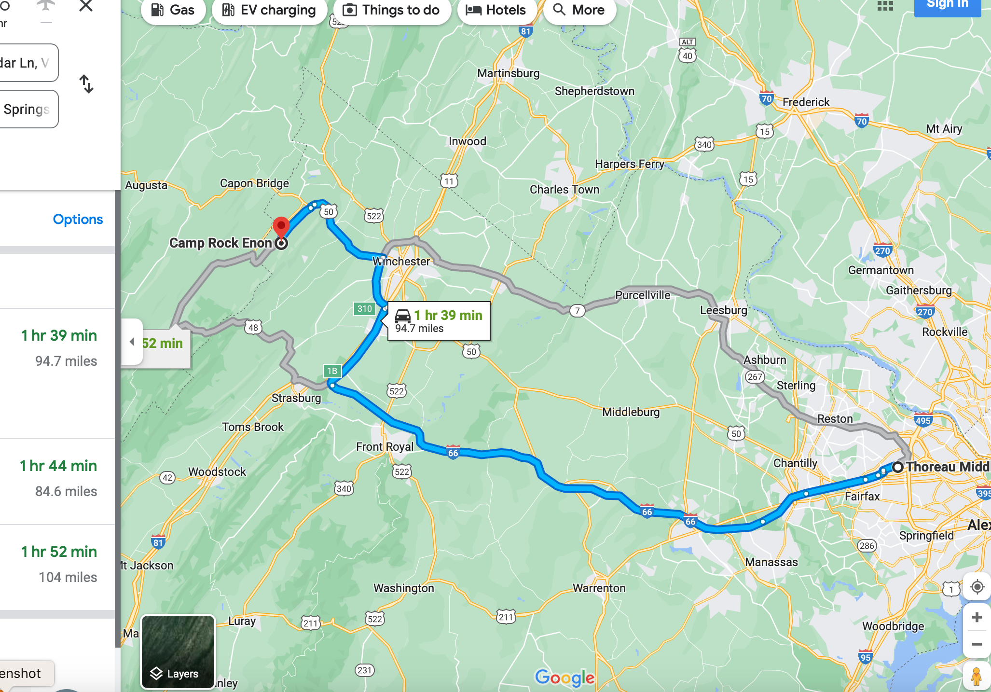
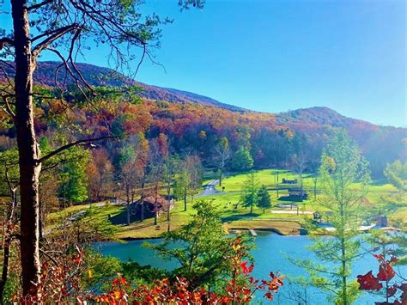
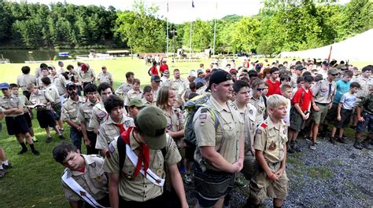
Location & Venue
Just West of Winchester
90 minutes from Vienna
Shenandoah Council Camp
Full Scout Camp facilities

Slide 10
Theme: Merit badge Carnival
Partial and full merit badge classes
Scouts sign up for Merit Badges when they register and pay
Cut off for MB Sign Up is Oct 2
Cost is $30 for scouts, adults and staff
Open to districts outside GMD

Slide 11






Merit Badges
Astronomy
Backpacking
Canoeing/Kayaking
CITC, CITN, CIS, CITW
Communications
Cooking
Ecology
Environmental Science
First Aid
Orienteering
Pioneering
Shooting Sports: Rifle, Shotgun, Archery

Slide 12

Merit badge counselors:
Additional merit badges
Email: trlapham@gmail.com
No restrictions on MBs for counselors
Counselors must bring their own supplies
Include availability and partial vs. complete

Slide 13


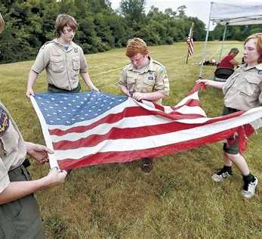

MB Schedule
2 90-minute AM MB slots
2 90-minute PM MB slots
1 60-minute slot prior to dinner break

Slide 14

Check IN:
5-9 PM Fri
7-8 AM Sat
QUESTIONS?
TRLAPHAM@GMAIL.COM
703 969 9900

Slide 15
Join Scouting - Discussion

Slide 16
Summer Activities/Camps - Discussion

Slide 17
Time for Cracker Barrell
Minutes and slides available on the GMD web site (District Resources, Roundtable). Password is “GMDRT”
Next meeting – September 14, 2023, at Thoreau MS 7:30pm

Slide 18
Backup Slides

Slide 19
Join Scouting

Slide 20
Join Scouting Night/Event Prep
Goal: Provide information and resources that can assist your Unit for upcoming recruitment events. This includes:
Online Tools
Resources Available from Council
Planning Timelines
Best Practices – Please share your successes!

Slide 21
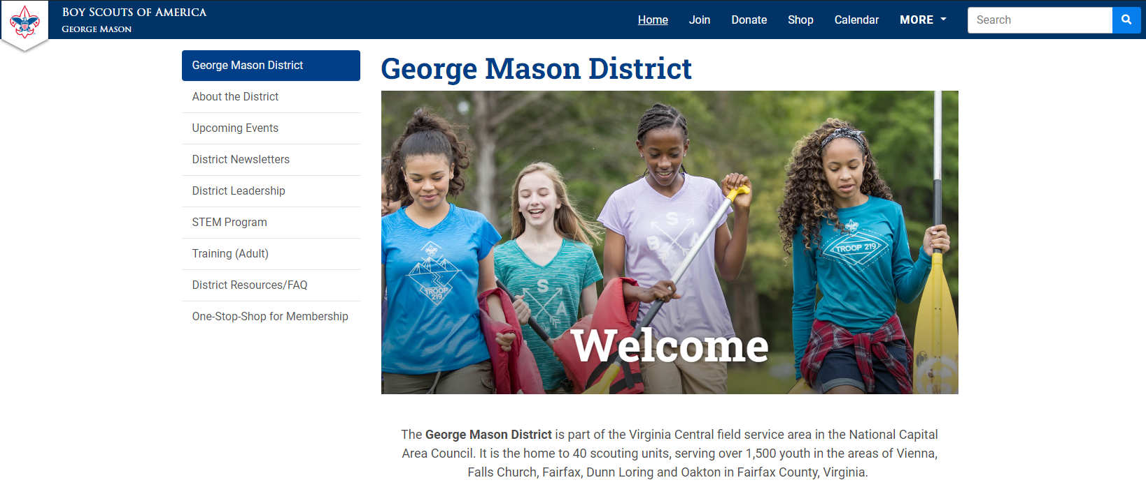
On-Stop Shop for Membership https://ncacbsa.org/george-mason/

Slide 22
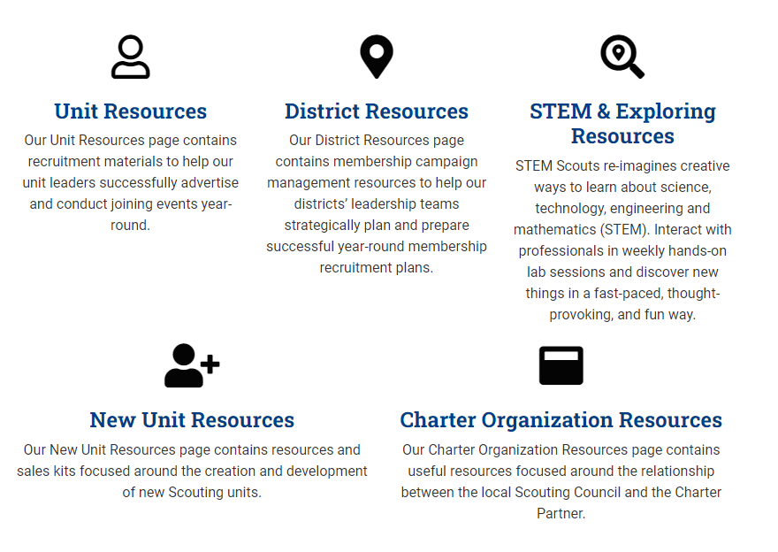
On-Stop Shop for Membership https://ncacbsa.org/membership-resources/

Slide 23
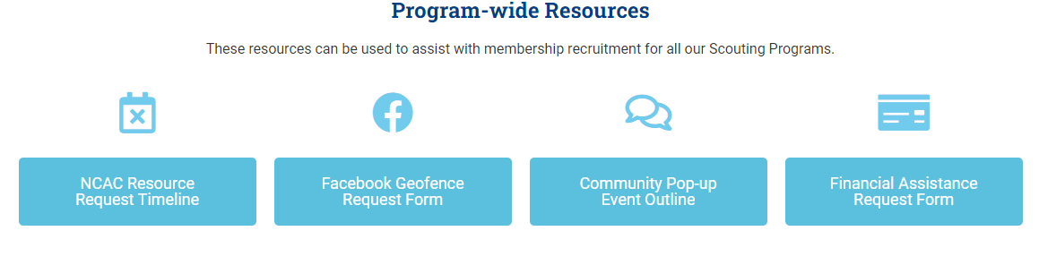
On-Stop Shop for Membership https://ncacbsa.org/unit-resources/

Slide 24
Geofence Request Form
Information Needed:
Email
District
Unit Number
Unit Type (Pack, Troop)
Name of Chartering Organization
Is the event In-Person or On-line
  Address of In-Person Event
  URL (if virtual event) w/ login instructions
Event Date/Time and description of activity
Unit Facebook Page info (if applicable)
Flyer (if available)

Slide 25
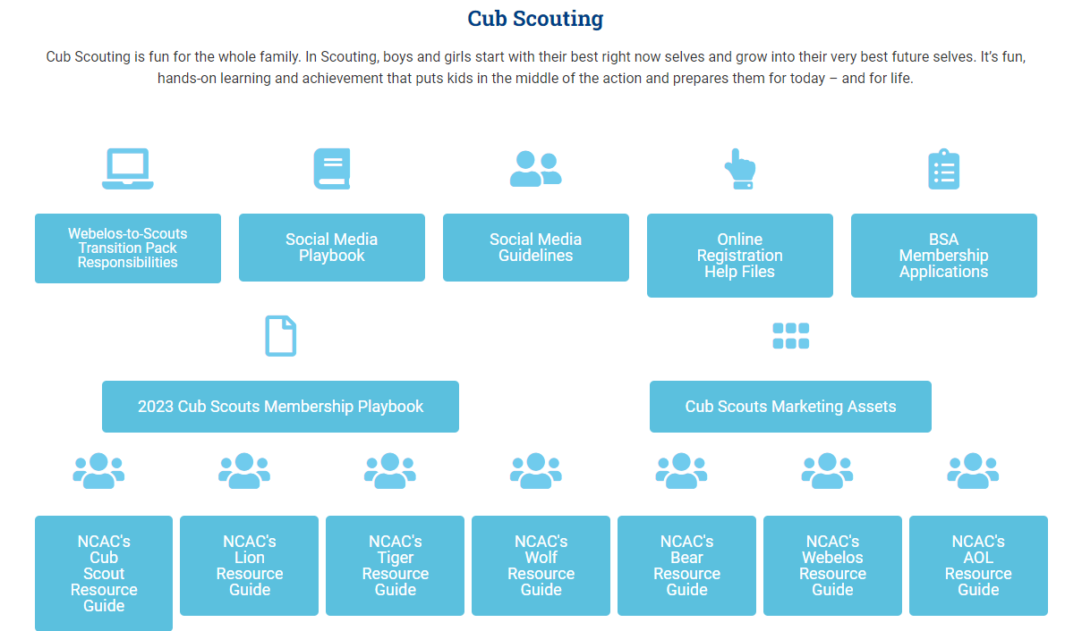
On-Stop Shop for Membership https://ncacbsa.org/unit-resources/

Slide 26
JSN Resources
Scout Talks – Videos
JSN Logistics – Resources for various stations – Activities, Advancement, Ideals of Scouting, Calendar, Application, etc.
New Leader Welcome Packet
Program Information
Unit Guides

Slide 27

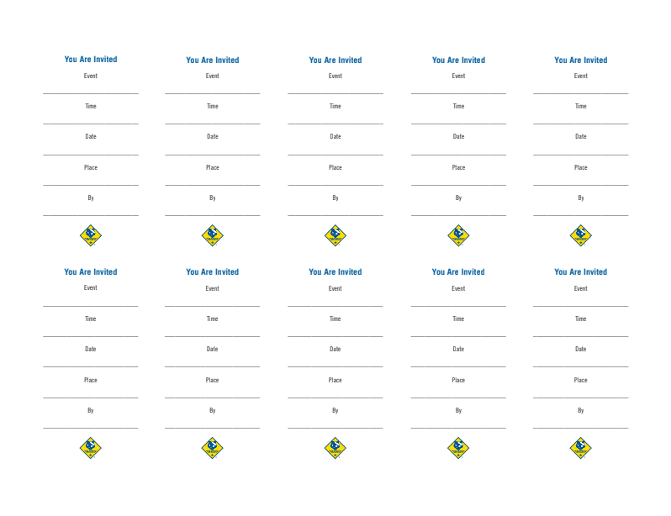
Peer-to-Peer Cards

Slide 28
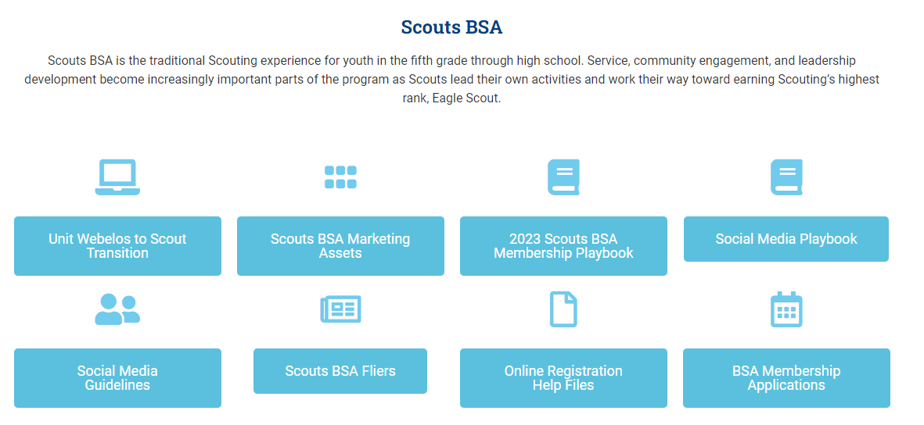
On-Stop Shop for Membership https://ncacbsa.org/unit-resources/

Slide 29

NCAC Resources Available
Items to request/keep on-hand:
Flyers – Please give Liz 2-3 week’s notice
Yard Signs
BeAScout.org Pencils
Stickers
Parent’s Guides
Paper Applications
Items to borrow and return:
Roll-out recruitment banners
Pup-up Tents

Slide 30
Planning Timelines (Suggested)
Three Weeks Prior:
Requested Facebook Geofenced Advertising (date, location, time, & contact info)
Requested PeachJar Advertisements (Flyer, Schools, additional info)
Two Weeks Prior:
Submitted Physical Flyer Requests (Color: 10 cents per page)
Submitted Peer-to-Peer Cards Requests
Requested Council Recruitment Banners (While resources are available)
Requested Council Projectors (While resources are available)
Requested Council Pop-Up Tents (While resources are available)
One Week Prior:
Requested Yard Signs
Requested Parents’ Guides
Requested Paper Applications
Requested Printed “How-To” Social Media templates
Requested Pens/Pencils

Slide 31
Best Practices Some Units Use
(Please share your successes/ideas!)
Have information they need – ideally one page
  Meeting location, day of week/month and time
  Background about the unit (size, history, typical events)
  Contact information
  Costs – BSA, NCAC insurance, Unit fees, how you raise funds
  Other needed items – uniform, equipment, books, etc.
Have a way to sign up immediately
  Tablet / Computer for adults to register their youth
  Paper forms and pens
  A way to collect fees (Square, check, etc.)
Have a way for Parents to volunteer/be informed of unit needs
  Emphasize that your unit is a volunteer organization
  Have a list of possible jobs they can volunteer to do
  Emphasize the need for YPT when recruiting Adults

Slide 32

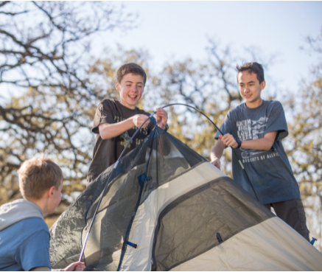

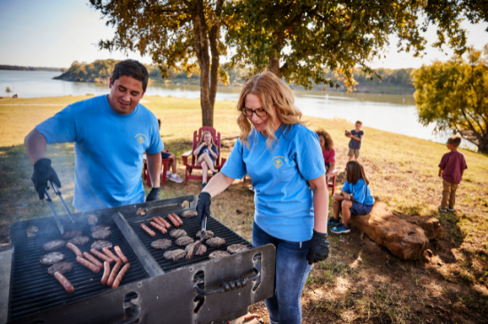
Make it fun!

Slide 33
STEM
08/12 – Townes Supernova Project – Individuals and Small Groups, Camp Snyder, Haymarket, VA
Anytime – DC STEM Trek- Showcases 24 government agencies, private organizations and monuments related to the tenets upon which STEM is based. Two hikes - 10.57 miles, or 4.75 miles

Slide 34

District Life to Eagle Seminar – September 23
Saturday, 23 September 2023
1:00 to 4:00 p.m.
In Person at St. James Catholic Church in Falls Church
Register at: https://scoutingevent.com/082-70702
Who should attend:
Life Scouts or advanced Star Scouts who want to pursue the Eagle Rank
Eagle advisors, coaches or unit leaders that haven’t attended a seminar in two years
Parents of Scouts working on Eagle or other adults interested in Scouting
Registration is live now and must be registered by 21 September 2023.
Any questions contact Matt Burns at 703-938-9550 or at gm.advancement@gmail.com

Slide 35


Merit Badges
The online Merit Badge Counselor registration works for all Scouters who do not already hold another District position.
New Merit Badge Counselors must complete online merit badge counselor training, in addition to YPT. Be sure the counselor uses his/her legal name – no nicknames.
Merit Badge Counselors, or the unit Dean/Leader, also need to scan and send Margee the Merit Badge application form listing the badges the counselor is applying to teach and providing a justification of his/her qualifications.
Youth Protection Training is the essential first step. Don’t hit “send” on the application without it!
Contact Margee if you have questions at GM.MB.Dean@hotmail.com.
Did you know:
The National Council does not limit the number of merit badges a youth may earn from one counselor, though a unit leader is permitted to do so, as long as the same limit applies to all Scouts in the unit. Ideally, Scouts should work with a variety of adults. (GTA 7.0.0.3)
Partial Merit Badges have no expiration except the Scout’s 18th birthday. (GTA 7.0.3.3)
Due to the BSA policies related to Youth Protection and two-deep leadership, a merit badge counselor must have another adult present during all merit badge counseling sessions. However, the parent or legal guardian of the Scout may serve as the second adult. This parent or legal guardian does not have to be a registered leader.
If the requirements for a merit badge differ between the merit badge pamphlet and the current edition of Scouts BSA Requirements, the requirements in the Scouts BSA Requirements book supersede all others.

Slide 36

Training (https://www.ncacbsa.org/george-mason/training/)
Basic Adult Leader Outdoor Orientation (BALOO;C32) – 10/13/23 – 10/14/23, Huntingtown, MD
Introduction to Outdoor Leadership Skills (IOLS; S11)
  09/15/23 – 09/16/23, Camp Snyder, Haymarket, VA
  10/13/23 – 10/14/23, Huntingtown, MD
Back Country Outdoor Leadership Skills (BCOLS)
  09/23/23 (Alexandria, VA) & 10/21/23-10/22/23 (Markham, VA)
Back Country Outdoor Leader Skills (BCOLS) - 09/23/23 (Alexandria, VA) & 10/21/23 -10/22/23 (Camp Big Mac, Markham, VA)
NYLT
  24-1: 01/12/24 -01/15/24 & 01/27/24-01/28/24
  24.2: 06/16/24-06/21/24
  24.3: 06/23/24-06/28/24
  24.4: 07/28/24-08/02/24
  24.5: 07/28/24-08/02/24
  Registration will open in the Fall and will be announced via email and on Facebook
Powder Horn – 08/17/23 – 08/20/23 – Camp St. Charles, Newberg, MD
Wilderness First Aid (N02) - 09/08/23 – 09/10/23 & 10/07/23 - 10/08/23
Wood Badge (A90) https://www.ncacbsa.org/wood-badge/ - 09/08/23 - 09/10/23 & 10/07/23 – 10/08/23
Leave No Trace/Outdoor Ethics - 10/16/23 (Zoom) & 10/21/23 (Camp Snyder)
BSA Leave No Trace Trainer Course - Outdoor Ethics - 10/16/23 (Zoom) & 10/21/23 – Haymarket, VA
Outdoor Ethics Orientation Courses (Scouts and Cubs)
  09/09/23 – Brandywine, MD
  12/03/23 – Brandywine, MD
Outdoor Ethics Newsletter - Sign up here.

Slide 37

GM High
Adventure
NCAC High Adventure Trips - 2024
  Philmont – Jul 13-27, 2024 - Crew of 8-12, 4Y/2A booked - $2,795
  Includes White Water Rafting & Pike’s Peak!
  Northern Tier – Jul 23-Aug 3, 2024, Crew of 6-8 - $2,095
  Sea Base – Jul 29-Aug 3, 2024 - Crew of 6-8, 3Y/2A pre-booked, $2,100
  Lenhok’sin – James River Canoeing Trek - Crew of 6-12, July 7-13, 2024
  FOR INFO: highadventure@ncacbsa.org
Training
  BCOLS: Sep 23/Oct 21-22, Heritage Pres & Camp Big Mac
  Philmont 2024 Sessions: I – 11/19/23; II – 01/07/24; IIIa – 03/24/24; IIIb – 04/06/24
  Philmont Advisor Hikes: 08:00, Sat 3/09 & Sun 3/17/24, 0800 Catoctin Mt Park, Thurmont, MD
  Northern Tier 2024 Sessions: Sat, 04/06/24 (in-person); Sat, 04/20/24 (virtual)
National High Adventure Base Quick Links
  Philmont: https://www.philmontscoutranch.org/register/
  Northern Tier: https://www.ntier.org/provisional-scout-connections/
  Sea Base: https://www.bsaseabase.org/scouts/scout-connections/
  Summit: https://www.summitbsa.org/registration/scoutconnections/
Other High Adventure Bases
  Adirondack High Adventure Area: https://public.3.basecamp.com/p/hLgsVbk7Suju6cuDzQQJaEn4
  Maine High Adventure Area: https://www.mainehighadventure.org/
  Montana Outdoor High Adventure Base: https://montanabsa.org/camps/high-adventure/
August 2023
Notes:
Sea Base Trip on Jul 29-Aug 3, 2024 - FULL

Slide 38
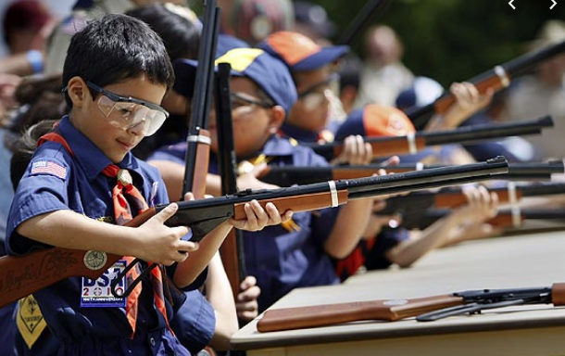
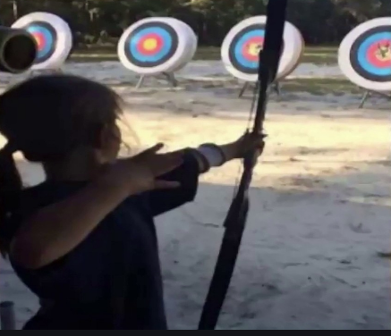
Shooting Sports
Requests for Shooting Events – Lead Time!
  50+ scouts - 6mos
  Less than 50 scouts - 3mos
Shooting on private land:
  Requirements
  Permissions/protocols
Shooting Sports web page
Shooting Sports Instructor Classes:
  Rifle/Shotgun
  Archery

Slide 39
Order of the Arrow
  2023 Dues can be paid online: https://wipit470.org/dues.html
  08/16/23 – 08/18/23 – Summer Ordeal, Camp Snyder
  09/08/23 – 09/10/23 – Fall Fellowship, Goshen
  11/01/23 – Election Season Opens
  * Registrations open online https://wipit470.org/index.html under “Events”

