Slide 1
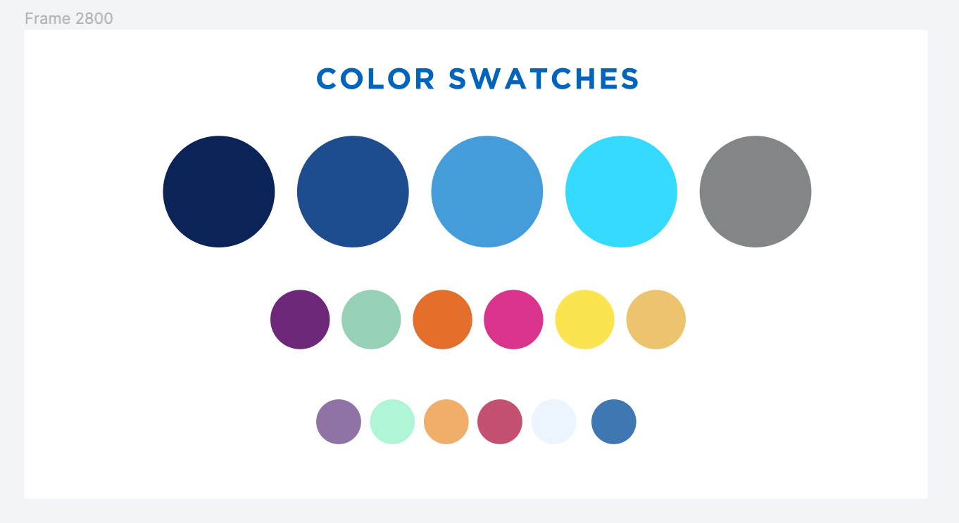
February-March 2022 SLS Update
March 30, 2022

Slide 2
GENERAL UPDATES
Shannon Pritting

Slide 3
Staffing Changes
Maggie's last day as NZ Coordinator is this Thursday 3/31
Thanks to Maggie for all she's done for SUNY over the last 3 years.
Best wishes!
Rebecca Nous's first day is this Thursday 3/31
Rebecca will be joining SLS from her most recent role at U Albany.
Rebecca will be in a Support Specialist role.
Associate Director position has been filled
Start date of Associate Director will be end of April 2022, and we'll share her name soon.

Slide 4
Upcoming CPD Leadership and Management Certificate
OLIS has been working with CPD and librarian experts within and beyond SUNY to create courses connected together through a certificate.
Feedback from many individuals in SUNY libraries who went through other leadership programs was used in developing certificate.
Certificate will launch in Fall 2022, and first iteration will be roughly a year.
Focus will be on learning and applying methodologies and tools to issues that librarians and staff face regularly.

Slide 5
Upcoming CPD Leadership and Management Certificate
Courses will be in two groups.
Courses in Leadership and Management
Change Mgmt
High Performance Teams
Assessing your leadership style
Inclusive Leadership
Project Management
Courses using methods in different functional areas
Universal Design for Libraries
Access and Collection Strategies
Developing Library Partnerships
Library Strategic Planning
Library Assessment

Slide 6
Upcoming Book Study and Discussion: Academic Ableism
SUNY Accessibility Cohort, supported by SLS, will be facilitating a book study and discussion on the OA book: Academic Ableism: Disability and Higher Education:
https://www.fulcrum.org/concern/monographs/1c18dg49d
Group will be open to all and will feature guided discussion of the reading by cohort members.
Target start date is late Spring to wrap up by early Summer.

Slide 7
SUNY Alma-Primo VE Renewal
We've been working with ExLibris on reviewing our access and use restrictions.
Thanks to all for helping with named user cleanup.
Bibs, Unique Journals, Primo documents, and FTE served are all within limits, or SUNY and ExLibris have agreed to move forward.
5-year renewal beyond initial term.

Slide 8
Artstor
Working on a 10-year agreement to replace current agreement.
Exemption request still in review by OSC.
Limited escalation and central agreement with invoices paid by campuses.
Hope to begin developing contract soon, but still time as current agreement doesn't expire until December 2022.

Slide 9
Springer-Nature Agreement
Still under review by OSC, but close to finalization.
For Nature and Nature branded journals.
In development for 17 months
Will reach out to interested campuses before renewal time.

Slide 10
Empire Library Delivery
ESLN-Vendor and ESLN-SUNY contract expires in roughly 1 year.
SLS will work closely with campuses and stakeholders to determine how to move forward beyond June 2023.
Not likely that we can continue to have ELD as central agreement and direct charge.
Will give the longest lead time possible for adjustments, with expectation that status quo will persist until June 2023.
Tim talking about planning later in presentation.

Slide 11
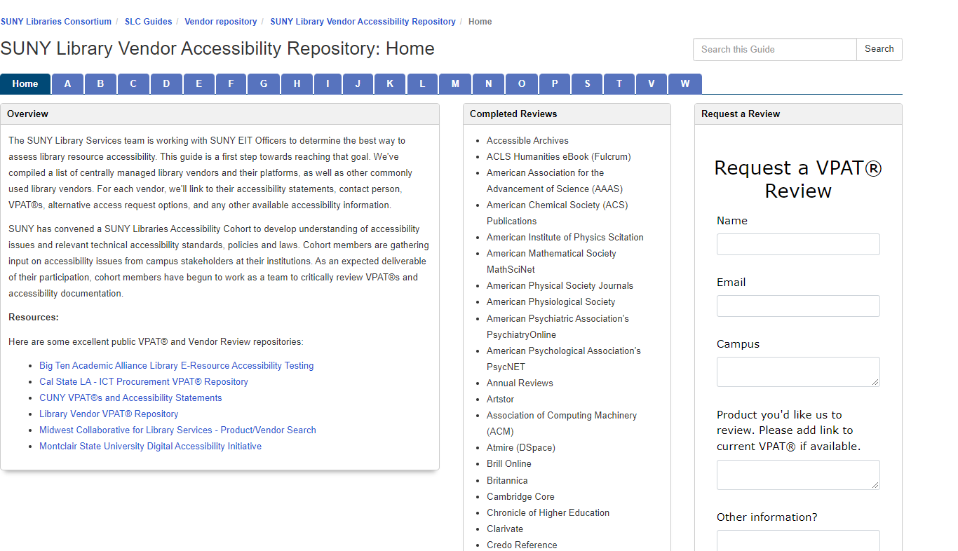
Reminder on Accessibility Reviews
SLS continues to work through accessibility reviews of products.
Requests for VPAT reviews can be generated via the repository page: https://slcny.libguides.com/vendor_accessibility

Slide 12
Spotlight on SUNY Libraries
Series developed by Cori Wilhelm to focus on the great things that SUNY libraries are doing!
First spotlight session is April 6 from 12-1 and will features ECC's Embedded Librarianship Program
https://slcny.libcal.com/event/9036419

Slide 13
Reminder: Ask if You Need Help!
If you're struggling with something related to the LSP or library technology, please don’t hesitate to reach out to us.
Best way to contact us is via LibAnswers: info@slcny.libanswers.com as someone on the team is reviewing these M-F.
Please don’t hesitate to ask for help, even if you're not an extended support campus.
We're happy to help to address issues or provide assistance.

Slide 14
OGS Library Contract
OGS released its invitation for bids for the next OGS contract:
https://ogs.ny.gov/procurement/biddocument/23260bid
https://ogs.ny.gov/system/files/documents/2022/03/2007023260i_solicitation.pdf
Bids are due by May 10th
OLIS and SUNY Procurement partnered with several SUNY campuses who heavily used the OGS contract to provide input.
Overall, OGS appears to have taken much of our input into account when crafting its next contract.
Major change: 4 lots rather than 2:
Printed Publications and Non-Print Library Materials
Electronic Publications
Databases
Library Resource Management and Research Support Products
Help us to spread word to vendors.

Slide 15
Alma Based Resource Sharing with CUNY
We've made it a SUNY priority to try to get Alma-based resource sharing for returnables with CUNY going through Alma.
Targeting Summer 2022 for making this happen.
Will strengthen NYS resource sharing and improve services for downstate libraries, and keep a higher percentage of resource sharing in Alma.
Will update everyone on progress and timelines once we get a firm commitment from CUNY.
SLS would work to make this as seamless as possible for campus libraries.

Slide 16
Discovery & E-Resources
Michelle Eichelberger

Slide 17
Improvements Coming
Applies to Alma adds/deletes
Goal is 24-48 hours
Currently testing
Expect rollout April/May
1
CDI Publishing
2
3
4

Slide 18
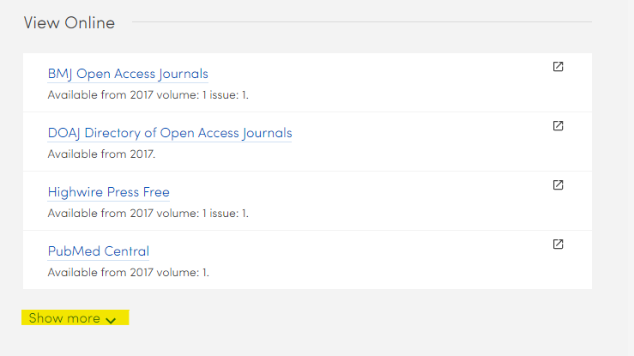
April Discovery Updates
Return of option to see all possible links on Full Record:
CDI migration made it impossible to show both Link in Record and Link Resolver links on same record, leading to suppression of links to subscription content
New option to "Display all links in View Online section" in View Configuration, General tab, General Attributes
Have to opt-in
Can change label names in label tables
Some variety in what types of links take precedence
Updates to March rollout of compressed Advanced search fields
Fields expanded when user switches from basic to advanced
Fields still compressed if you link to subject heading or want to revise advanced search
Group Locations by Library in Get It: for multi-library campuses
Custom RIS Mapping: for export to RIS, BibTeX and EndNote
Primo VE 2022 Release Notes

Slide 19
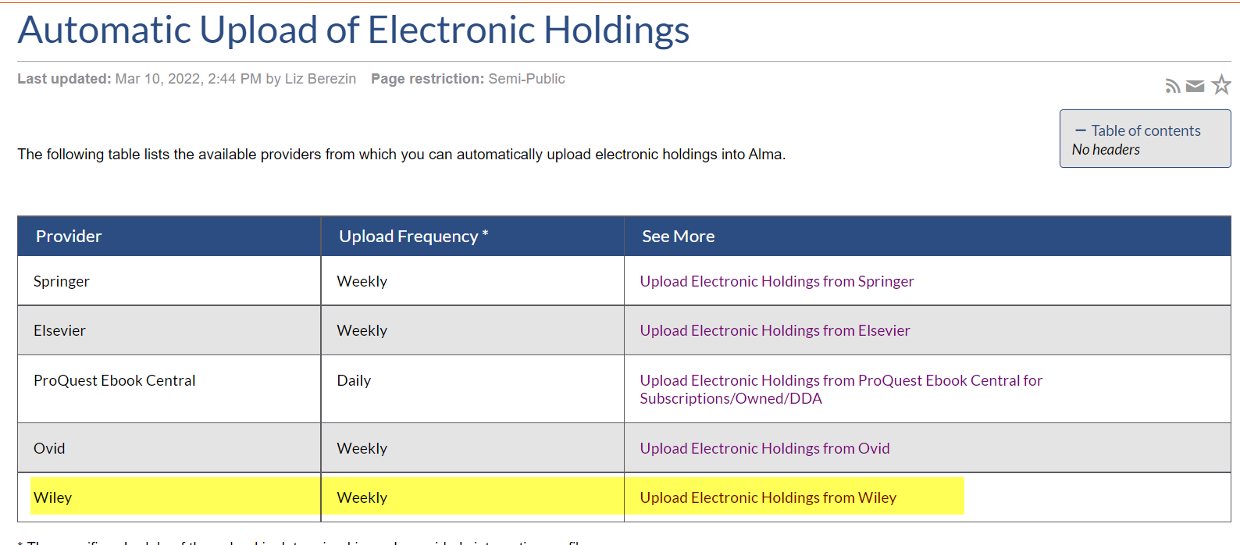
April E-Resource Updates
Auto-Upload for Wiley:
Was supposed to be included in March release but was delayed
Will be able to automatically pull in Wiley holdings. See Upload Electronic Holdings from Wiley
Alma 2022 Release Notes

Slide 20
Shared Collections
Esta Tovstiadi

Slide 21
Renewal Updates
Chronicle of Higher Education
SUNY contract, direct charge for billing, pricing listed in Collections Portal
Campuses up for renewal have been contacted; please respond by April 7
New subscribers confirm by April 7
ProQuest Resources
Waiting on contract finalization and vendor to send invoices
STAT!Ref Nursing eBooks
Renewal information forthcoming
Elsevier PIAs
Over half received, we will be in touch if we have not yet received yours

Slide 22
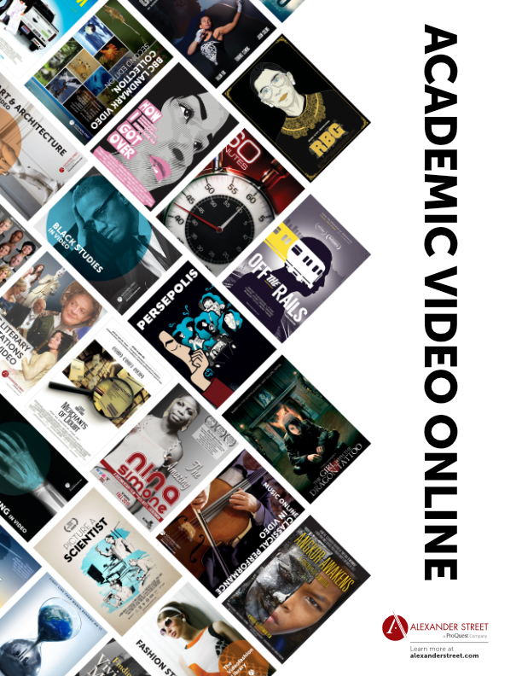
SUNYConnect Updates
Academic Video Online
Vendor demo Monday April 4 at 1 pm: https://slcny.libcal.com/event/9001402
Access start date estimated for Aug. 1
Current subscribers who have renewal cycles outside of Aug – Jul, we will work with ProQuest and the campus to prorate.
EBSCO
Access for new DEI ebook collection begins July 1
8 databases will be removed from SUNYConnect starting July 1, for more information: https://slcny.libguides.com/c.php?g=1030210&p=7466759

Slide 23
Resource Management
Maggie McGee

Slide 24
Brief Level Rules
March 2022, Brief Level Rules were updated in the Network and all SUNY Institutions
Brief Level Rules were updated to align with OCLC encoding level changes
March 18, 2022, an error in the way the rule was being applied was reported and identified
Brief level rules were updated in the Network and all Alma instances to fix the issue
Link to MSP 42: Brief Level Rules in Alma: https://slcny.libguides.com/ld.php?content_id=50351537

Slide 25
Change the Subject Project
November 12, 2021, the Library of Congress (LOC) approved changing the following subject headings:
"Aliens" to "noncitizens"
"Illegal aliens" to "illegal immigration"
February 2, 2020, the SUNY Metadata Standards & Policy (SMSP) Working Group voted to:
Adopt "noncitizens" to replace "aliens" for LOC subject headings
Reject "illegal immigration" and continue to use "undocumented immigrants"
March 14, 2022, the SUNY Library Consortium LSP Advisory Board accepted the SUNY Metadata Standards and Policies Working Group’s recommendations
March 21, 2022 – March 28,2022, the SLS implemented the changes in the Network and for all institutions
Link to the Change the Subject Project LibGuide: https://slcny.libguides.com/c.php?g=986218&p=7623203

Slide 26
Change the Subject Project
Changes applied to the Change the Subject Project:
Display norm rules updated
Normalization rules updated
Two local subject headings created for:
Undocumented immigrants
Undocumented immigrants in literature
Existing records were updated to reflect the current changes
Case #06316722
Defect in Alma/Primo VE that is breaking searching the local authority record to search non-preferred terms (450s)
Worked with Yoel to replicate the issue
SLS has been instructed on next steps once the case is resolves:
Re-indexing all impacted records in the Network and in all institutions
Test the defect has been resolved

Slide 28
Resource Sharing
Timothy Jackson

Slide 29
April Alma Release
Alma/WorldShare ILL Integration
Allows non-ILLiad libraries to automatically export unfilled Alma borrowing requests directly to WorldShare ILL
Corning and Niagara have been testing this feature since March Alma release (thank you!)
Feature will be available to all libraries in April release
Configuration and Workflow FAQ: https://slcny.libanswers.com/faq/364579
Please reach out to me if you want help configuring this integration
Will need you to first obtain API key from OCLC
Lending Locate Improvements
Currently, a lending request will end up in the Locate failed status if the lending library owns the requested title in both print and electronic
Lending locate process will start automatically select the print record once April release is available
Should significantly decrease likelihood of a lending locate failure

Slide 30
April Alma Release
Borrowing requests automatically updated to returned
Alma will automatically update a borrowing request to Returned Item to Partner if it is received after the request's needed by date, but it won’t tell you why this happened
April release includes an alert message when a borrowing request is automatically updated to Returned Item to Partner because it was received after the request's needed by date
Recommend removing needed by date from your resource sharing request form
Turning Alma resource sharing on and off
Currently, only General System Administrators can do that
Fulfillment Administrators will be able to do this once April release is available
Regular Expression for Creating Users in ILLiad
You will be able to configure your ILLiad resource sharing partner to use regular expressions to modify the username being sent to ILLiad (ex. send email address minus domain info to ILLiad)
May be helpful for campuses who can’t export unfilled requests to ILLiad because their ILLiad usernames don’t match an Alma identifier

Slide 31
Empire Library Delivery
Several SUNY libraries recently changed hubs
Libraries moved to NYC hub: Purchase, Rockland, Westchester
Libraries moved to BNG hub: Cortland, Tompkins-Cortland
Alma resource sharing partner addresses already updated
Please be sure to update ILLiad lender address records
ELD Contract Renewal
Current ELD Contract expires next summer
ELD Advisory Board will be meeting tomorrow to start discussions about renewal process
SLS and a handful of SUNY campuses are represented on the advisory board
Will keep everyone posted on how the renewal process is going
SLS will be forming a task force to help manage this renewal on our end
Will be putting out a formal call for volunteers in early April
Email info@slcny.libanswers.com if you’re interested in participating

Slide 32
ProQuest Ebook ILL Pilot Project
Pilot Project Parameters:
Pilot project started in mid-January 2022 and will last one year
35 SUNY campuses are participating
Approximately 3,300 Ebook Central titles are currently requestable
Collection of requestable titles and all requests are being centrally managed by SLS staff
Request volumes:
162 requests filled to date
Feedback has been largely positive
Top 5 Borrowers:
Albany (31), FIT (21), ESC (12), Old Westbury (12), Purchase and Old Westbury (10)
Top 5 Lenders:
Buffalo (95), Binghamton (26), New Paltz (9), ESC (8), Hudson Valley (6)

