Slide 1
The State Health Care System Planning (HCSP) Cabinet Primary Care Workgroup & Sustainable Payments for Advanced Primary Care
Clinical Strategy Committee | November 15, 2024

Slide 2
Agenda
Presenter/Topic | Time
Welcome & Announcements Moderator: Pano Yeracaris, MD, MPH, Chief Clinical Strategist, CTC-RI | 10 minutes
The State Health Care System Planning (HCSP) Cabinet Primary Care Workgroup Recommendations & Updates Jerome Larkin, MD, Director of Health, Rhode Island Department of Health, Co-Chair Elena Nicolella, MPH, President & CEO of the Rhode Island Health Center Association, Co-Chair Debra Hurwitz, MBA, BSN, RN, Executive Director, CTC-RI | 15 minutes
Sustainable Payments for Advanced Primary Care Patricia Flanagan, MD, Medical Director, CTC-RI Michael Bailit, MBA, Bailit Health Facilitator: Pano Yeracaris, MD, MPH, Chief Clinical Strategist, CTC-RI | 25 minutes

Slide 3
Announcements
Nov 18: Think Tank Series: The Role of Certified Community Behavioral Health Clinics (CCBHCs) in Addressing Alcohol Use Disorder Among Patients in Primary Care Register Here
Nov 19: Signs and Symptoms of Cognitive Impairment in Older Adults Register Here
Best Practices in Addressing Sexually Transmitted Infections (STI) in Primary Care QI – Deadline Nov 15 – Apply Here
For questions or support: Contact Nijah Mangual, Program Coordinator at nmangual@ctc-ri.org

Slide 4
Objectives
Learn about and discuss the draft recommendations from the primary care subcommittee of The State Health Care System Planning (HCSP) Cabinet Primary Care Workgroup
Review team-based care core competencies previously identified fro or success in pediatric and adult primary care capitation.
Discuss sustainable payment options for team-based care.

Slide 5
CTC-RI Conflict of Interest Statement
If CME credits are offered, all relevant financial relationships of those on the session planning committee have been disclosed and, if necessary, mitigated.
Claim CME credits here: https://www.surveymonkey.com/r/ZDZS5HG
The AAFP has reviewed ‘Advancing Comprehensive Primary Care Through Improving Care Delivery Design and Community Health,’ and deemed it acceptable for AAFP credit. Term of approval is from 03/18/2022 to 03/18/2023. Physicians should claim only the credit commensurate with the extent of their participation in the activity. NPs and RNs can also receive credit through AAFP’s partnership with the American Nurses Credentialing Center (ANCC) and the American Academy of Nurse Practitioners Certification Board (AANPCB).

Slide 6
RI Health Care System Planning Primary Care Workgroup Recommendations
Workforce Retention
Reduce administrative burdens on primary care providers
Reduce the health education debt of primary care providers
Payment
3. Ensure primary care practices provide and are appropriately paid for coordinated, comprehensive team-based primary care.
Recruitment
4. Develop a Statewide Primary Care Recruitment and Retention Program
5. Increase the capacity and quality of primary care training sites
Monitoring and Accountability
6. Collect, analyze, monitor, and report on data points describing the state of Rhode Island’s primary care system and evaluate the impact and effectiveness of current and future programs and initiatives
Integration
7. Invest in the advancement and implementation of high-fidelity, integrated, team-based primary care.

Slide 7
Sustainable Payments for Advanced Primary Care

Slide 8
Read the report here: https://ctc-ri.org/sites/default/files/White%20Paper_Comprehensive%20PCC.pdf

Slide 9
PEDIATRICS Provisional Principles for Pediatric CPPC
Family-centered care is provided by developing a trusting partnership with families, respecting their diversity, and recognizing that they are the constant in a child’s life.
Care team members share clear and unbiased information with the family about the child’s medical care and management and about specialty and community services they can access.
Primary care, includes but is not restricted to acute and chronic care and preventive services, including breastfeeding promotion and management, immunizations, growth and developmental assessments, appropriate screenings, health care supervision, and patient and parent counseling about health, nutrition, safety, parenting, and psychosocial issues.
Ambulatory care for acute illnesses will be continuously available (24 hours a day, 7 days a week, 52 weeks a year).
Care will be provided over an extended period to ensure continuity. Transitions, including those to other pediatric providers or into the adult health care system, should be planned and organized with the child and family.

Slide 10
PEDIATRICS Provisional Principles for Pediatric CPPC
Primary care providers identify the need for consultation and appropriate referral to pediatric medical subspecialists and surgical specialists. (In instances in which the child enters the medical system through a specialty clinic, identification of the need for primary pediatric consultation and referral is appropriate.)
Primary, pediatric medical subspecialty, and surgical specialty care providers should collaborate to establish shared management plans in partnership with the child and family and to formulate a clear articulation of each other’s role.
Care teams should interact with early intervention programs, schools, early childhood education and childcare programs, and other public and private community agencies to be certain that the health-related social needs of the child and family are addressed.
Care coordination services should be organized so the family, the physician, and other service providers work to implement a specific care plan as an organized team.
Care teams should maintain an accessible, comprehensive, central record that contains all pertinent information
about the child, preserving confidentiality.

Slide 11
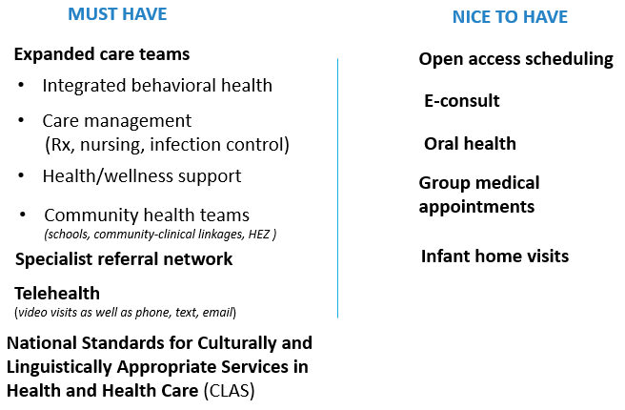
Pediatric Components of Care Delivery Model for CPCC/TCOC
Adult and Pediatric Decks complete (for now) and posted online:
CTC-RI Adult Care Delivery Components 12.01.20
CTC-RI Pediatric Care Delivery Components 12.01.20

Slide 12
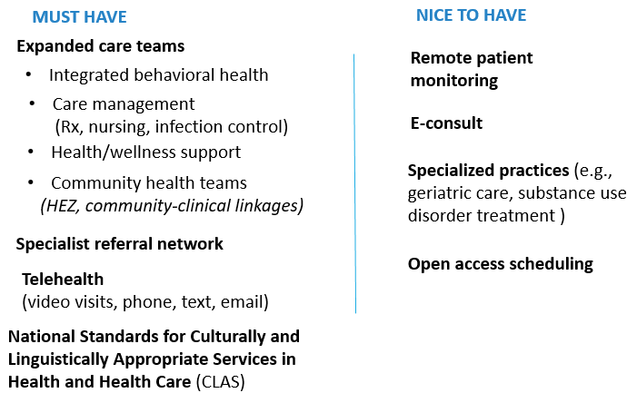
Adult Components of Care Delivery Model for CPCC/TCOC
Adult and Pediatric Decks complete (for now) and posted online:
CTC-RI Adult Care Delivery Components 12.01.20
CTC-RI Pediatric Care Delivery Components 12.01.20

Slide 13
EXPANDED CARE TEAMS Core Care Team Functions
DOMAIN | TASKS | APPROPRIATE STAFF
Population Health Promotion & Management | Identify populations with modifiable risks Assign each patient to a specific provider and/or team who is responsible for their care Develop actionable steps using evidence based or clinical guidelines Conduct Pharmacy-focused population health analytics | Physician, APRN, PA and Pharmacist work with Population Health Specialist to identify populations and action steps
Comprehensive Care Management | Identify individuals with complex health care needs Conduct Person Centered Assessment (PCA) Develop, execute and monitor Individualized Care Plan (ICP) Establish annual training to successfully integrate and sustain comprehensive care teams. Assess individual readiness to transition to self-directed care maintenance Monitor individual need to reconnect with Comprehensive Care Team Evaluate and improve the intervention | RN
Care Coordination | Conduct Pre-visit Planning Develop Care Plans and address Gaps in Care Coordinate care with specialists and other providers Coordinate transitions of care Populate and update patient’s care plan Link to community supports and resources Support patients and family members with managing care plans and appointments | Care coordination activities should be directed by the PCP or an RN/Social Worker or equivalent serving in the role of Care Coordinator. Community Health Teams and MAs may provide care coordination support, under the direction of the PCP or Care Coordinator. Although patients’ family members may choose to take on care coordination roles, they should have access to a qualified Care Coordinator
Patient Navigation | Identify individual barriers to accessing care, including high cost of prescribed medications, understanding how to use benefits and how benefits can impact decisions regarding choice of provider Address social determinants of health, emotional, financial, practical, cultural/linguistic and/or family needs Assist patients with pre-visit planning, getting to appointments, and follow up Ensure timely follow up and reduce delays in care throughout the continuum of care for a medical episode Facilitate communication between providers and patients | Social Worker, Community Health Team, Patient Navigator (privately credentialed, specific training)

Slide 14
EXPANDED CARE TEAMS Core Care Team Functions
DOMAIN | TASKS | APPROPRIATE STAFF
Health Promotion and Chronic Illness Self-Management | Identify the population who will benefit from self-management Health or lifestyle coaching and patient education Promote chronic illness self-management Develop programs that are culturally diverse and address SDOH and other barriers to self-management Nutritional education and counseling Basic screenings and assessments Work closely with patients and families (if available) | RN, Dietician, Diabetic/Asthma Educator, Nutritionist, Pharmacist, Community Health Worker, Social Worker
Medication Prescribing and Management Functions | Medication reconciliation/ best possible medication list Medication monitoring/follow-up care coordination across multiple prescribers and pharmacies Initiating, modifying, or discontinuing medication therapy Comprehensive medication management | PCP, Pharmacist, RN, MA – scope of delegation determined by the practice/PCP; in the case of pharmacists, scope should be established in a collaborative practice agreement (CPA)
Behavioral Health Integration | Behavioral health screenings and initial assessments Brief interventions, consultations, medication, and episodic care Referrals to extended therapy/counseling, medication and higher levels of care (day treatment, partial hospitalization Dedicated behavioral health care coordination to help patients make connections to treatment and community-based services, follow up and track process, and facilitate care team communication with behavioral health clinicians Linkages to behavioral health community-based services, such as free-standing behavioral health providers: outpatient services, Assertive Community Treatment Teams, crisis intervention, Community Support Teams, evidenced based in-home teams for children, families and adults, and case management services | Psychologist, APRN, LCSW Care coordination supported by care team member with behavioral health expertise Community health teams trained in specialized roles such as a Recovery Coach may support behavioral health integration

Slide 15
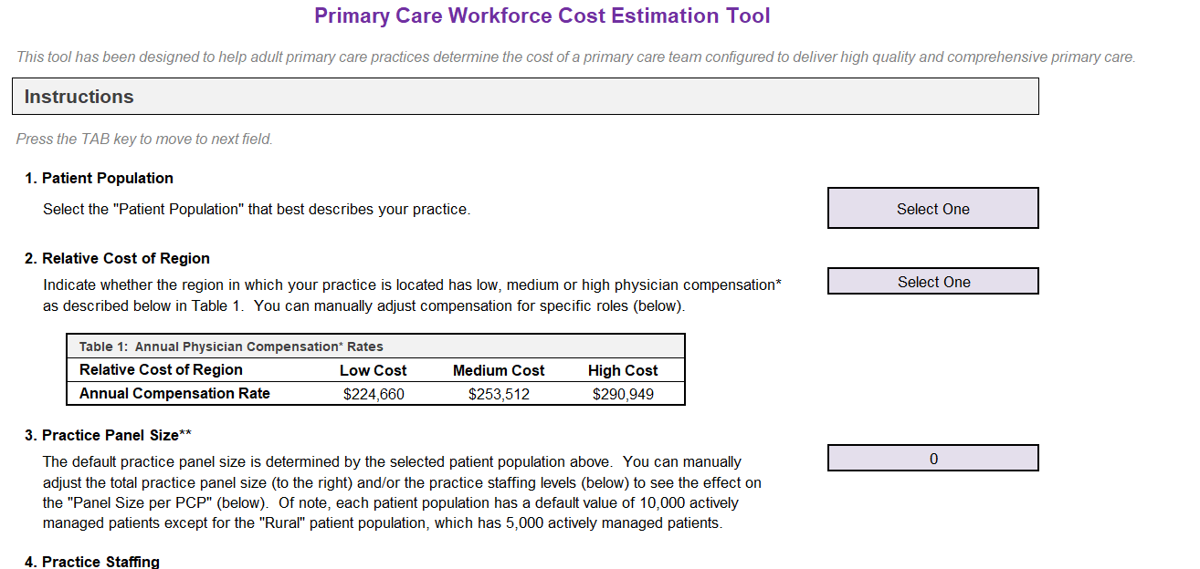
Cost Calculator
https://public.3.basecamp.com/p/VXXFJQEprRDCP2UnyyUYr4ak

Slide 16
Primary Care Workforce Models: Understanding Teams in Primary Care
November 15, 2024

Slide 17
Introduction
In 2017 Bailit Health partnered with Abt Associates and Ed Wagner and his colleagues at the MacColl Center for Health Care Innovation to develop workforce models capable of delivering high-quality, comprehensive primary care for AHRQ.
The work produced multiple publications.

Slide 18
Study Activities
The work entailed the following:
Defined high quality, comprehensive primary care and created a conceptual framework accordingly.
Used the definitions and framework to explicate the specific capacities and functions needed on a primary care team.
Translated the capacities and functions into the number and type of staff needed to deliver high quality, comprehensive primary care to 10,000 actively managed adults with characteristics mirroring Census statistics
Modified the “index” model to create workforce configurations for patient cohorts with; a high concentration of geriatric, chronic care needs; with high social needs; or located in sparsely populated and resource-poor rural areas.
Estimated PPPM cost for each configuration.

Slide 19
Method and Findings
Data from a sample of exemplary practices, site visits, literature and input from an expert panel were used to develop, corroborate and validate the models.
We estimated the following workforce configuration
Index Model: 37 staff, including 8 primary care providers (PCPs), at a cost of $45 PPPM to provide high-quality, comprehensive primary care to a panel of 10,000 actively managed adults
Geriatric Model: 52 staff (12 PCPs) at $64 PPPM to serve a 10,000- patient panel with high proportion of geriatric patients
High Social Needs Model: 50 staff (10 PCPs) at $56 PPPM to serve a 10,000-patient panel with high social needs
Rural Model: 22 staff (4 PCPs) at $46 PPPM to serve a 5,000-patient panel in rural areas

Slide 20
Index Model Care Team Functions, Members and FTEs
Planned, Evidence-based Primary Care (PCP) | 8.0 (6.0 MD/DO & 2.0 NP/PA)
Planned, Evidence-based Primary Care (RN/LPN or LVN) | 1.5 (1.0 RN & 0.5 LPN or LVN)
Planned, Evidence-based Primary Care (MA/LPN or LVN) | 9.0 MA
Complex Care Management/ Transition Management | 2.5 RN
Behavioral Health Integration | 2.5 (1.5 LCSW & 1.0 Master's-level Therapist)
Medication Management | 1.0 Pharmacist
Care Coordination/Referral Management | 2.0 (1.0 MA/ 1.0 Layperson)
Self-Management Support | 1.5 (1.0 MA & 0.5 RN)
Community Linkages | This function is performed by other staff in the model
Front Desk Administration—Reception, Intake | 8.0 Clerks
Quality Improvement/ Optimizing Health Information Technology (Leadership) | 0.3 MD/DO
Population Management (Leadership) | 0.5 RN
Total FTEs Per Year | 36.8 FTE
Individual PCP Actively Managed Adult Patients | MD/DO: 1,333; NP/PA: 1,000

Slide 21
CME Credits & Eval
Reminder to please complete the evaluation in order to claim CME credits!
Claim CME credits here: https://www.surveymonkey.com/r/ZDZS5HG
The AAFP has reviewed ‘Advancing Comprehensive Primary Care Through Improving Care Delivery Design and Community Health,’ and deemed it acceptable for AAFP credit. Term of approval is from 03/18/2022 to 03/18/2023. Physicians should claim only the credit commensurate with the extent of their participation in the activity. NPs and RNs can also receive credit through AAFP’s partnership with the American Nurses Credentialing Center (ANCC) and the American Academy of Nurse Practitioners Certification Board (AANPCB).

Slide 22
THANK YOU
Debra Hurwitz, MBA, BSN, RN
dhurwitz@ctc-ri.org
www.ctc-ri.org
ctc-ri

