Slide 1
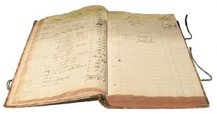
Ledgers, Summary Funds, and Funds

Slide 2
Reviewing (and Revising) Fund Structures
Before starting to add ledgers and funds to your Alma instance, consider the following questions:
How is your library’s current fund structure set up?
What works well? What does not?
What type of analytics do you need or anticipate needing for reporting purposes, budget forecasting, and/or analysis?
How does your institution organize funds and would you like Alma to reflect your institution’s fund structure?

Slide 3
Reviewing (and Revising) Fund Structures
Review the fund structure currently being used
How many Ledgers are necessary for your institution?
What type of funds does the institution have?
State funds, endowments, grants, etc.
How do these funds need to be tracked at your institution?
Is your institution using the equivalent to Summary Funds now?
If so, will the structure be able to be replicated in Alma?
If not, how can this structure be changed?
How many funds does the institution have?
How many funds does your institution need?
How will you organize your funds?

Slide 4
SUNY Oneonta’s Current & Alma Fund Structure

Slide 5
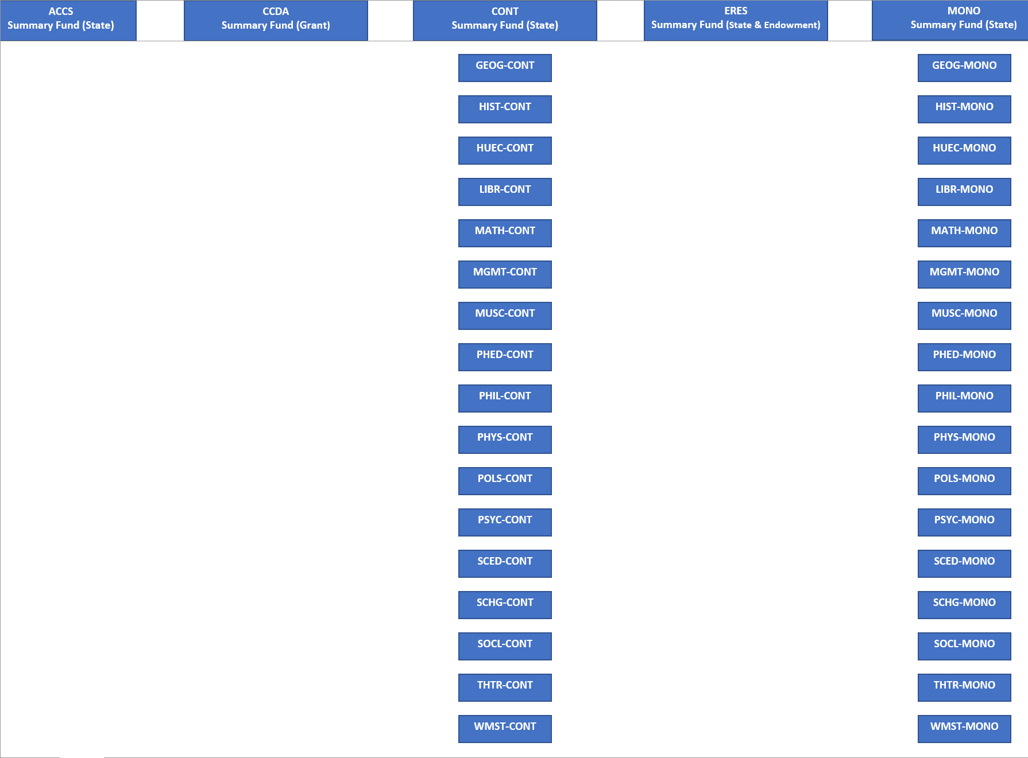
SUNY Oneonta’s Current & Alma Fund Structure Continued

Slide 6
Geneseo’s Milne Library Alma Fund Structure

Slide 7
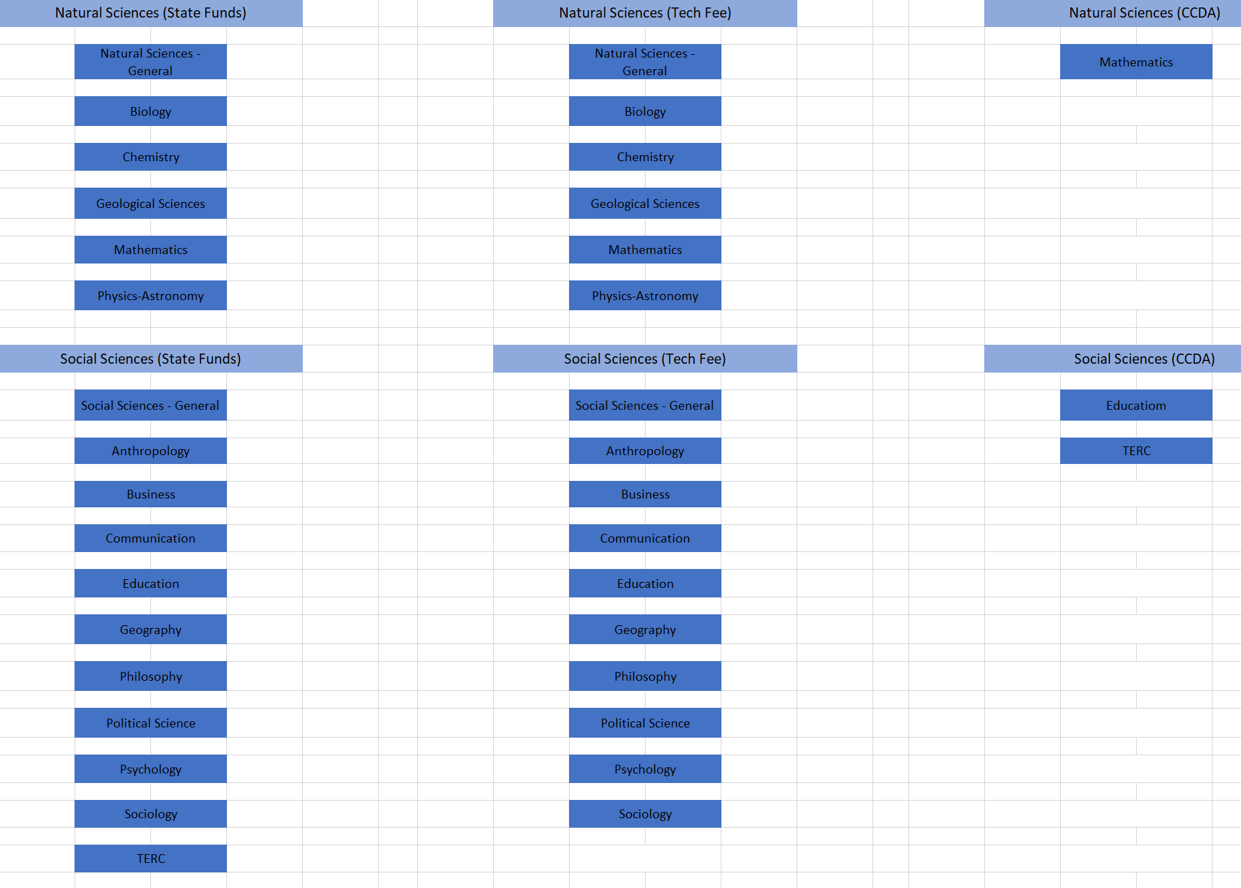
Geneseo’s Milne Library Alma Fund Structure Continued

Slide 8
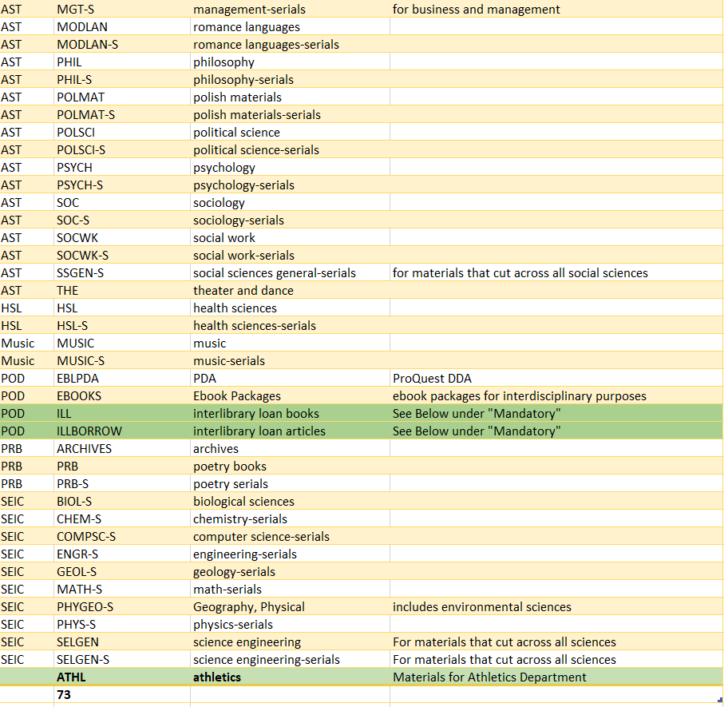
University of Buffalo’s Library Current Fund Structure

Slide 9
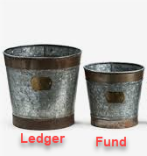
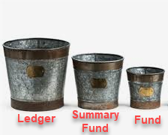
Understanding Ledgers & Funds In Alma
Ledger - is a collection of funds and they are defined by a specific date range
Only a single ledger is needed
Separate ledgers are recommended for funds with different fiscal years
Multiple ledgers require advanced analytics skills
Summary Funds – allow for the aggregate reporting of funds
Are not required
Can have multiple Summary Funds
They are useful to review and track a subset of allocated funds
Funds – represents money in an account
A minimum of one fund is required
Money and transactions are at the Fund level
Fund structures should reflect how your institution organizes funds, especially if your institution pays invoices electronically

Slide 10
AWG Policies for Ledgers & Funds
AWG-2 Policy: Fund Structure
https://slcny.libguides.com/ld.php?content_id=45357471
Requires a minimum of one Ledger and one Allocated Fund to use Acquisitions
Must create a separate Ledger for a funding source that has its own fiscal year start and end date
An institution can have as many Allocated Funds in a ledger as is necessary
Creating Ledger and Funds Naming Conventions
Code - is fixed and cannot be changed
Should not include a year
Name - is not fixed and can be changed
This can include the year
At roll-over the name can be changed to update the year
Summary Funds
Can be used to cluster funds by purchase type
Can be used to mirror categories used by campus reporting agencies

Slide 11
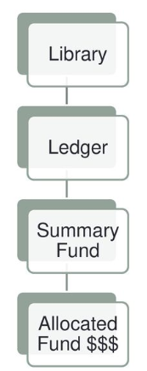
Create the Ledger & Funds Structure from the Top Down
If you do not have a Ledger or Funds set-up in Alma:
Add a Ledger
Add Summary fund(s)
Add Fund(s)
It is easier to start with a simple Ledger & Fund structure and get more complex over time
If you migrated your budget structure from Alma:
Did the structure come over as expected?
If not, add to the Ledger & Funds structure in Alma to match Aleph
Example, the equivalent of our Summary Funds in Aleph did not come over. Resolution, added Summary Funds and moved Funds to the appropriate Summary Fund

Slide 12
Multiple Ledgers
Multiple Ledgers are necessary for:
Multiple libraries with different budgets
Funds that have a different fiscal year
Rules are used in the Ledger to allow multiple fiscal years to run concurrently. Set the following rules to reflect the different fiscal year:
Encumbrances prior to the fiscal period (days)
Expenditures prior to the fiscal period (days)
Transfers prior to the fiscal period (days)

Slide 13
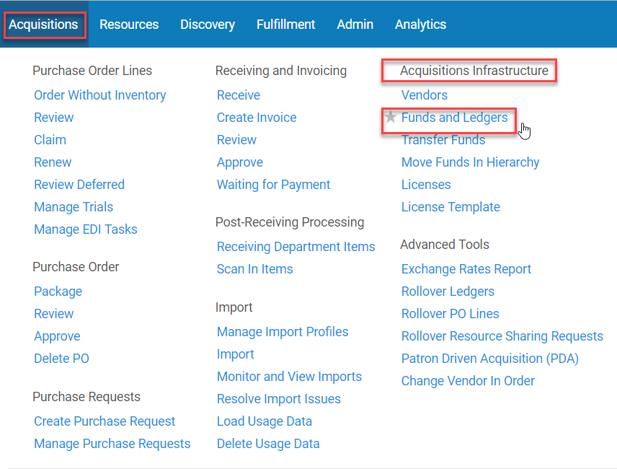
Roles Required to Add Ledgers and Funds in Alma
Roles required to manage ledgers:
Ledger Manager
Fund-Ledger Viewer (view only)
Roles requires to manage funds
Fund Manager
Fund-Ledger Viewer (view only)
Ledgers and funds can be managed here:
Acquisitions>Acquisitions Infrastructure>Funds and Ledgers

Slide 14
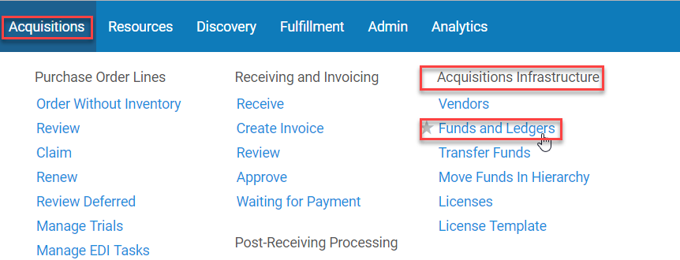
Adding a Ledger
Acquisitions>Acquisitions Infrastructure>Funds and Ledgers
Click Add Ledger
Summary Tab
General:
Name: [can include the year, not fixed]
Code: [do not include the year, fixed]
Owned by: [owning institution or library]
Available for: [choose applicable library/institution]
Status: [defaults to Draft]
Currency: [default unit of currency used]
Fiscal Period: [defaults to the active fiscal year]

Slide 15
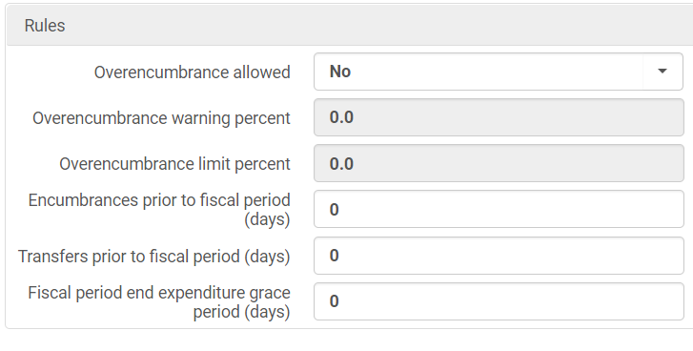
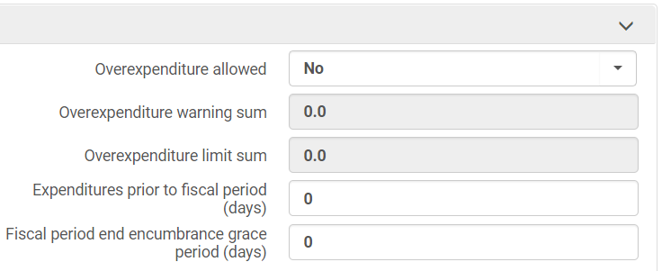
Adding a Ledger
Summary Tab
Rules:
Overencumbrance allowed: NO
Overexpenditure allowed: NO
Overencumbrance warning percent: 0.0
Overexpenditure warning sum: 0.0
Overencumbrance limit percent: 0.0
Overexpenditure limit sum: 0.0
Encumbrances prior to fiscal period (days): 0
Expenditures prior to fiscal period (days): 0
Transfers prior to fiscal period (days): 0
Fiscal period end encumbrance grace period (days): 0
Fiscal period end expenditure grace period (days): 0
Click Activate – Saves and Activates the Ledger

Slide 16
Oneonta’s Ledger Rules Migrated from Aleph into Alma

Slide 17
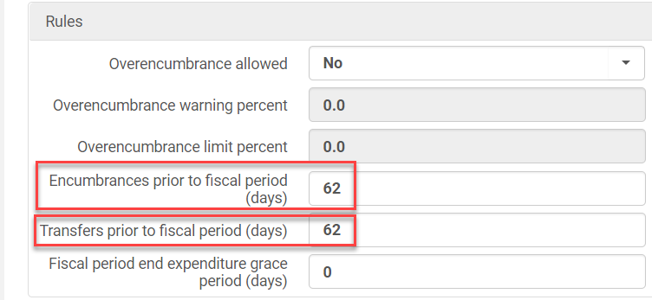
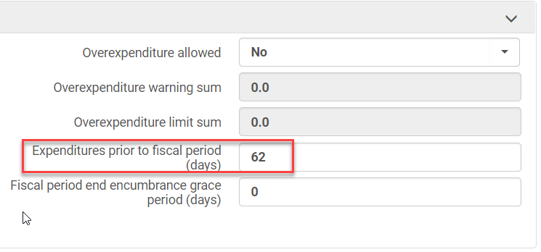
Ledger Rules for Ledgers with Different Fiscal Years
Rules:
Rules apply from the top down
Ledger>Summary Fund>Funds
Only one fiscal year is permitted and rules are required if:
One or more of the ledgers has a different fiscal year cycle than the main ledger
Example, our fiscal year is 7/1-6/31. The new Test Ledger’s fiscal year is 5/1-4/31. 62 days adjusts the end of the fiscal period so that no more encumbrances, expenditures, or transfers can happen after 4/31.
Rules allow the Ledgers with a different fiscal periods to run concurrently
ExLibris’ Ledger Rules definitions:
https://knowledge.exlibrisgroup.com/Alma/Product_Documentation/010Alma_Online_Help_(English)/020Acquisitions/090Acquisitions_Infrastructure/020Managing_Funds_and_Ledgers#Editing_a_Fund

Slide 18
Adding a Summary Fund
Summary Fund
Return to the Ledger Menu
Click Edit next to the Ledger
Click the Funds tab
Click Add Fund
Choose Summary Fund
Populate the required fields:
Name
Code
Fund Type can be selected if the all the funds in the Summary Fund have the same fund type
Review pre-populated fields that have been adopted from the Ledger, such as rules
Click Activate – it saves the Summary Fund
If you click Save instead of Activate you will still need to activate the Summary Fund

Slide 19
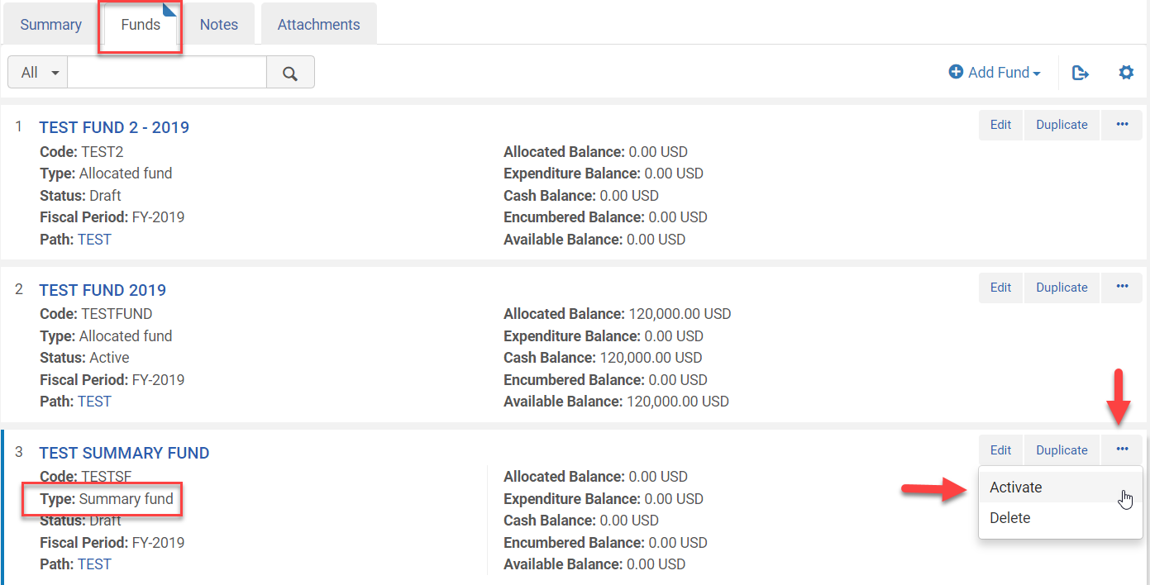
Alternate Way to Activate a Summary Fund
Alternate way Activate Summary Fund
Use if you clicked Save and not Activate
Click Edit next to the Ledger
Click the Funds tab
Locate the Summary Fund
Click on the ellipses
Choose Activate

Slide 20
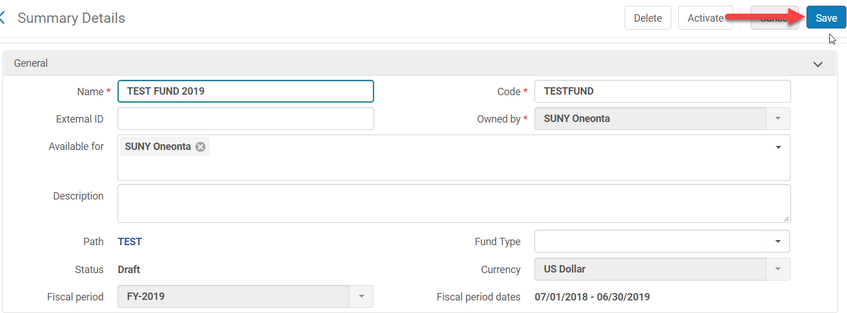
Adding a Fund
Funds
Click Edit next to the Ledger
Click the Funds tab
Click Add Fund
Choose Allocated Fund
Populate the required fields:
Name
Code
Fund type can be added here if not all fund types are the same for all Funds under the Summary Fund
Review pre-populated fields that have been adopted from the Ledger
Click Activate – this saves the Fund
If you click Save instead of Activate you will still need to activate the Fund

Slide 21
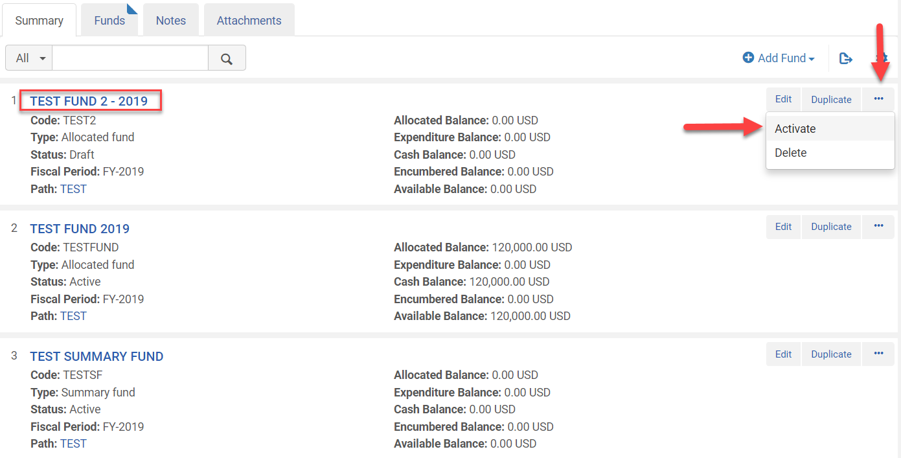
Alternate Way to Activate Funds
Alternate was to activate Funds
Use if you clicked Save and not Activate
Click Edit next to the Ledger
Click the Funds tab
Locate the Fund
Click on the ellipses
Choose Activate

Slide 22
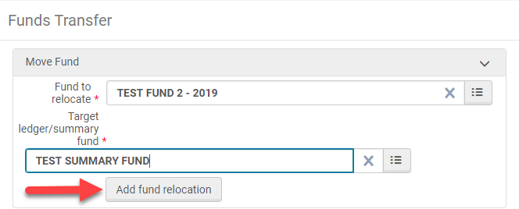
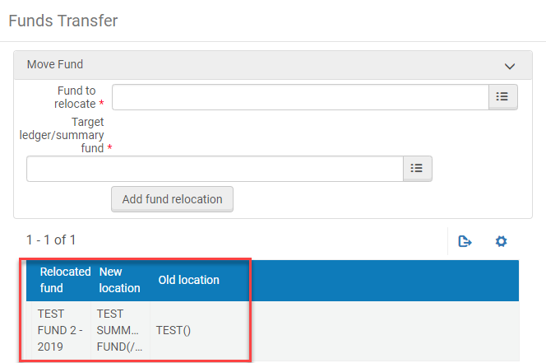
Moving Funds to a Ledger or Summary Fund Option 1
Acquisitions>Acquisitions Infrastructure>Move Funds in Hierarchy
Fund to relocate: [select the fund to relocate]
Target ledger/summary fund: [select ledger or summary fund to move above fund to]
Click Add fund relocation
Click Confirm on the Confirmation message pop-up
The transfer will show at the bottom of the Fund Transfer screen
Old Location shows the old hierarchy of the fund

Slide 23
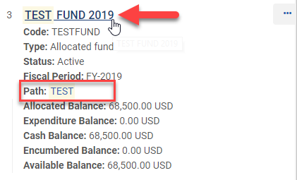
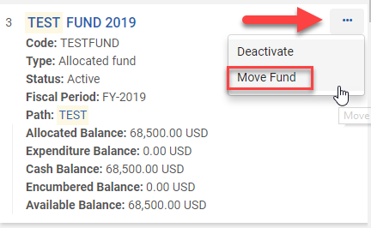
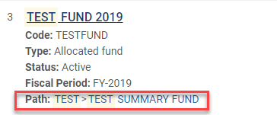
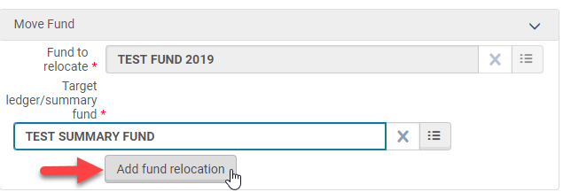
Moving Funds to a Ledger or Summary Fund Option 2
Acquisitions>Acquisitions Infrastructure>Funds and Ledgers
Select the fund you want to move to a Ledger or Summary Fund
Click on the ellipses and choose Move Fund
Fund to relocate: [automatically populated]
Target ledger/summary fund: [select ledger/summary fund to move it to]
Click Add fund relocation
Click Confirm on the Confirmation message pop-up
New hierarchy path will show in the Fund summary

Slide 24
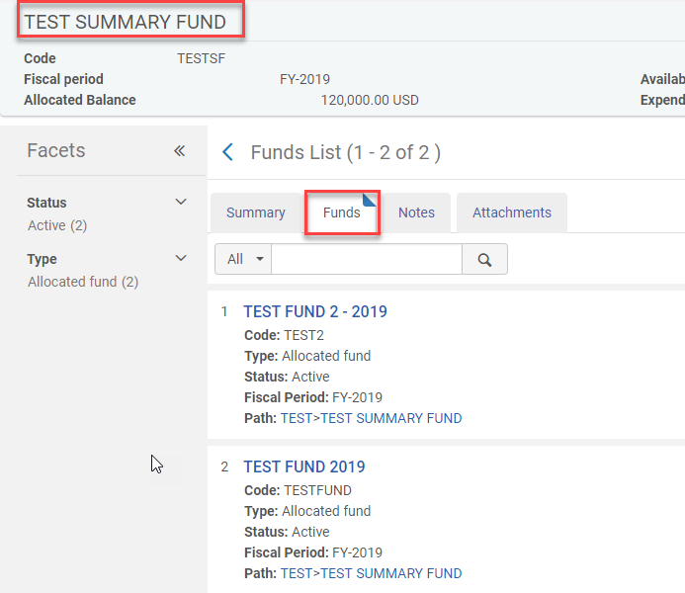
Reviewing the Fund Hierarchy Once Moved to a Summary Fund

Slide 25
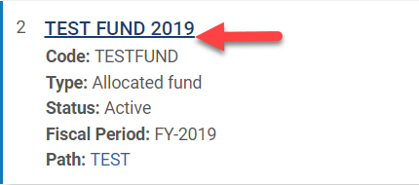
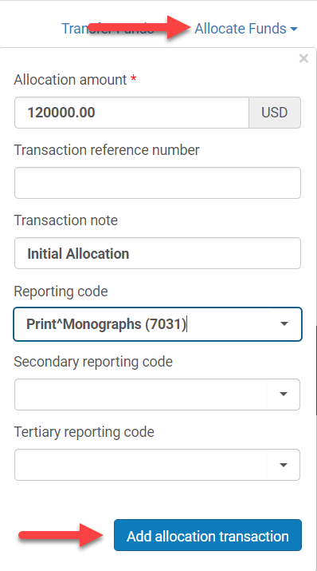
Adding an Allocation to a Fund
Adding an Allocation
Click Edit or on Fund Link
Click the Transactions tab
Click Allocate Funds
Choose Allocated Fund
Allocated amount: [mandatory]
Transaction Reference Number: [optional]
Transaction note: [optional]
Reporting code: [need to configure if they do not exist
Secondary reporting code: [optional]
Tertiary reporting code: [optional]
Click Add allocation transaction
Click Confirm when the Add allocation confirmation pop-up appears
Click Save

Slide 26
Allocated Fund Example

Slide 27
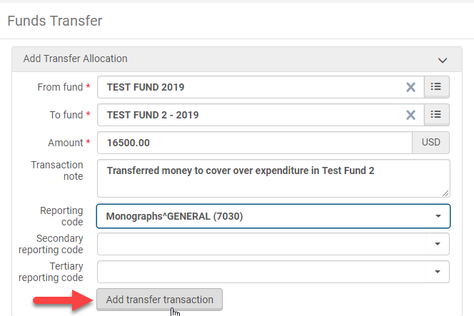
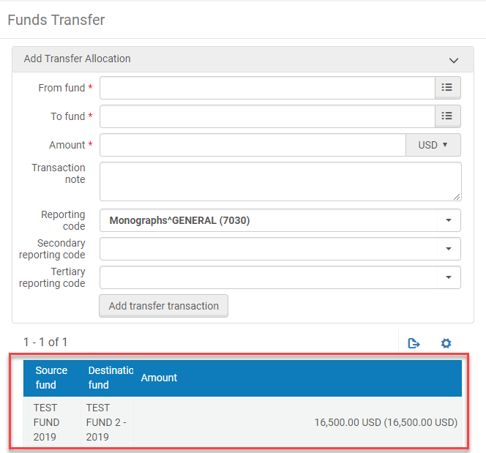
Transferring Funds Option 1
Acquisitions>Acquisitions Infrastructure>Transfer
Required Fields:
From fund: [Fund money is being transferred from]
To fund: [Fund where money is being transferred to]
Amount: [amount being transferred]
Recommended Fields:
Transaction note: [important to explain why funds were transferred]
Reporting code: [need to configure in Alma]
Click Add transfer transaction
Click Confirm when the Confirmation Message pop-up appears
The transfer will show at the bottom of the Fund Transfer screen

Slide 28
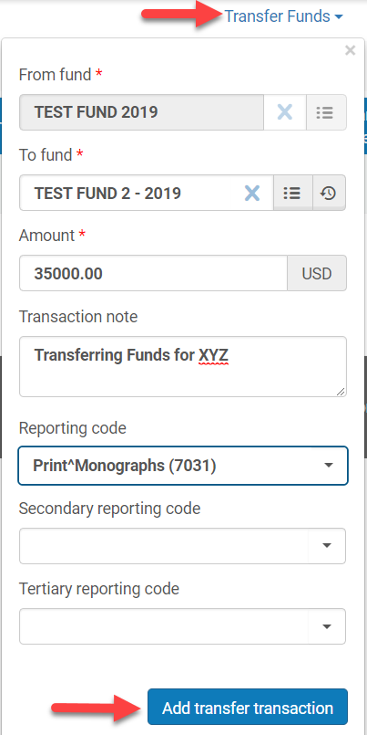
Transferring Funds Option 2
Acquisitions>Acquisitions Infrastructure>Funds and Ledgers
Click Edit or on Fund Link that money is being transferred out of
Click the Transactions tab
Click Transfer Funds
From Fund: [pre-populated]
To Fund: [select the fund to transfer to]
Amount: [type in amount to transfer]
Transaction note: [not required, but important]
Reporting Code: [add if configured]
Click Add transfer transaction
Click Confirm when the confirmation message pop-up appears
Click Save
Transferring Funds – requires more than one Fund

Slide 29
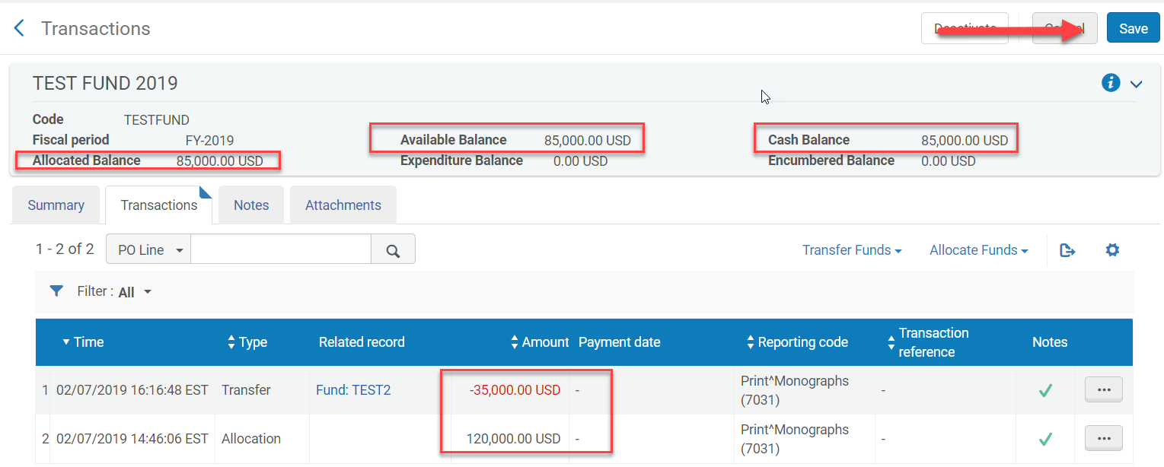
Transfer Fund Option 2 Example

Slide 30
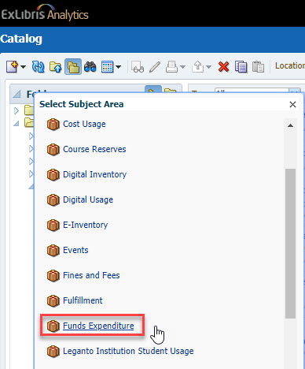
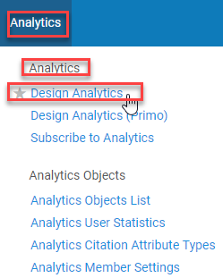
Basic Analytics Report to View the Fund Structure
Role required to create an analytics report:
Analytics Administrator
Analytics>Analytics>Design Analytics
Click Catalog
Click the New icon
Click Analysis
Select Funds Expenditure
Click on Fund Ledger
Click and drag Fund Ledger Status into Selected Columns
Click and drag Parent Fund Ledger Name into Selected Columns
Click and drag Fund Ledger Name into Selected Columns
Click on Fund Transactions
Click and drag Transaction Allocation Amount into Selected Columns

Slide 31
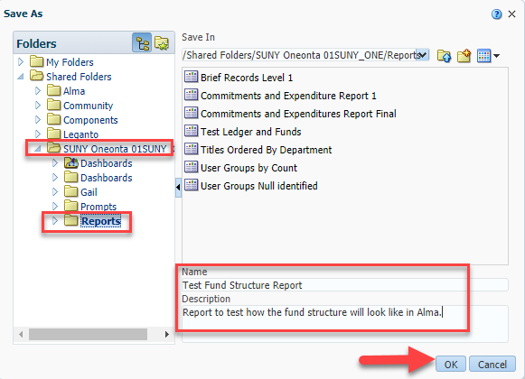
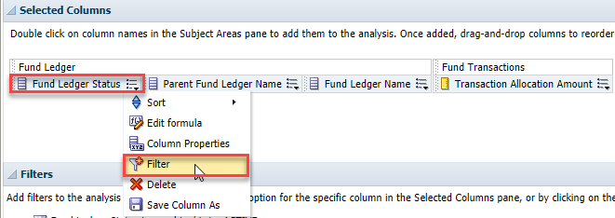
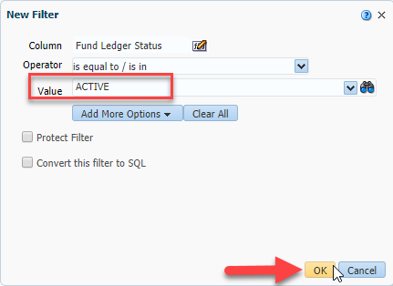
Basic Analytics Report to View the Fund Structure Cont.
Click the Save icon
Click on your Institutions Folder
Click on the Reports folder
Name the Report – do not use symbols
Add a description
Click OK
Add Filters
Click menu for Fund Ledger Status
Click Filter
Column: [keep default]
Operator: [keep default]
Value: ACTIVE
Click the menu for Fund Ledger Name
Click Filter
Column: [keep default]
Operator: [keep default]
Value: [choose name of summary fund]

Slide 32
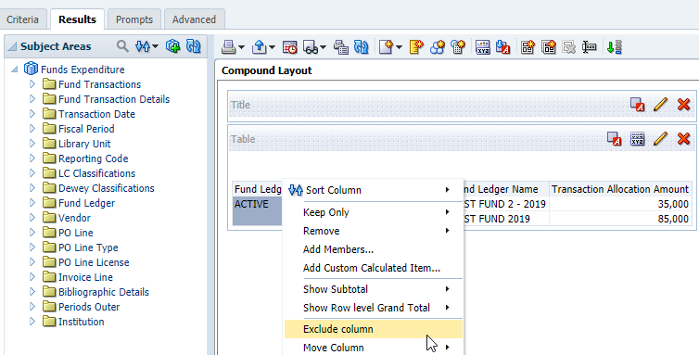
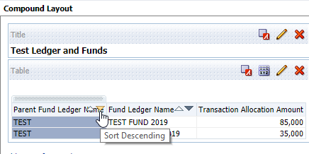
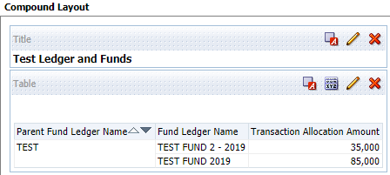
Basic Analytics Report to View the Fund Structure Cont.
Hide Columns
Click on the Results tab
Right click on Fund Ledger Status
Click Exclude Column
Sort Columns
Click the down arrow on Parent Fund Ledger Name to remove repetition of the name
Click the Save icon

Slide 33
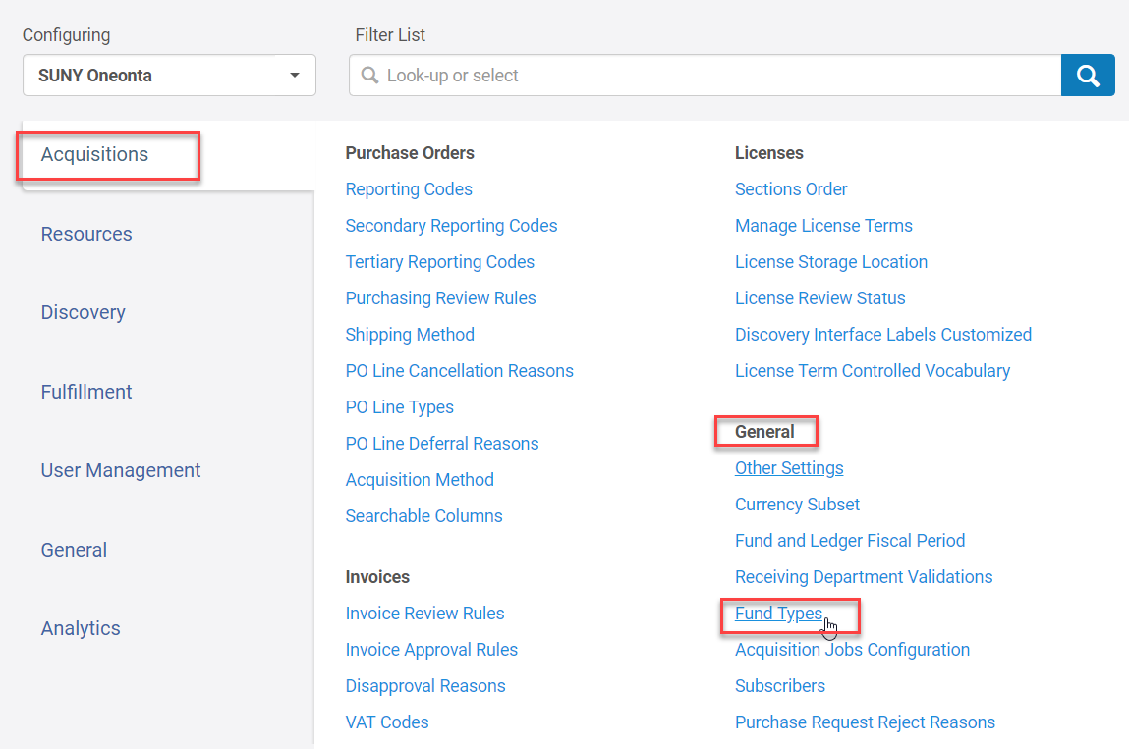
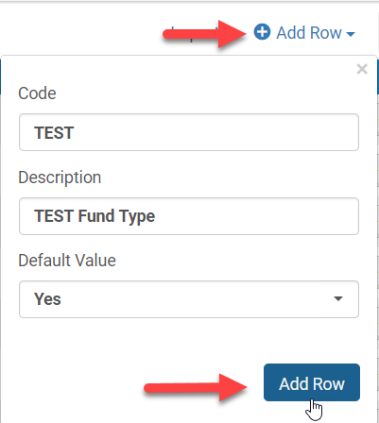
Fund Types
Fund Types are for informational purposes only
To add Fund types you need the following permissions
Acquisitions Administrator
General System Administrator
Configuration>Acquisitions>General>Fund Types
Click Add Row
Code: mandatory
Description: optional
Default Value: No
Click Add Row

Slide 34
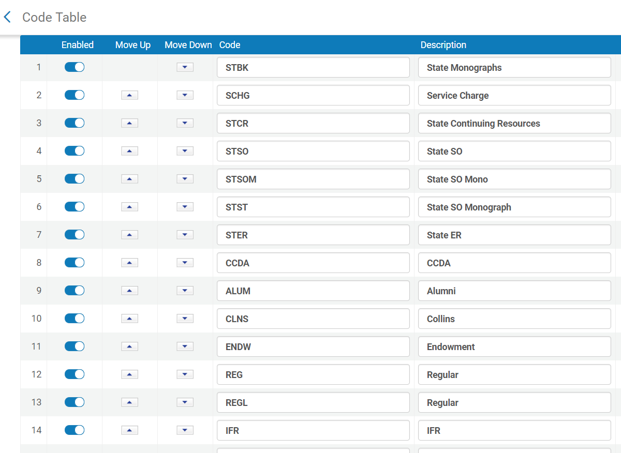
Oneonta’s Fund Types Migrated from Aleph

Slide 35
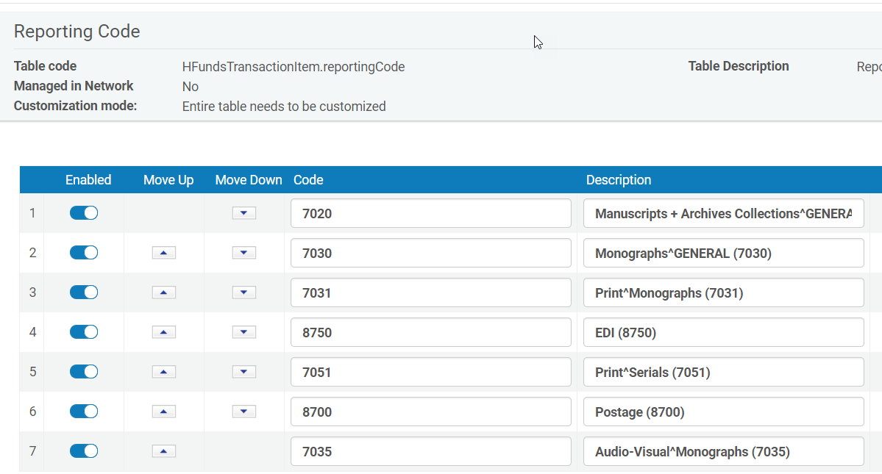
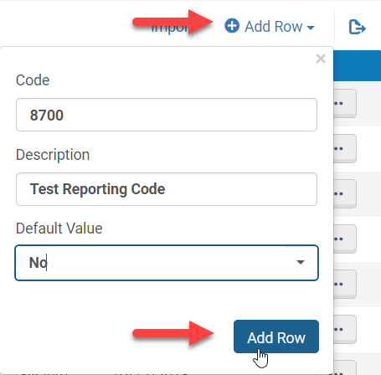
Configuring Reporting Codes
Roles required to add Reporting Codes:
Acquisitions Administrator
General System Administrator
Adding Reporting Codes
Configuration Menu > Acquisitions > Purchase Orders > Reporting Codes
Click Add Row
Code: [assign a code]
Description: [optional, but useful]
Default Value: No
Click Add Row
Reporting Codes are useful for acquisitions analysis
They are not required
They appear in the PO Line Summary Tab as well under the Transaction tab for a Fund
Review what reporting codes your institution uses

Slide 36
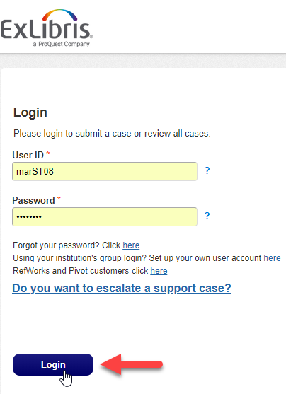
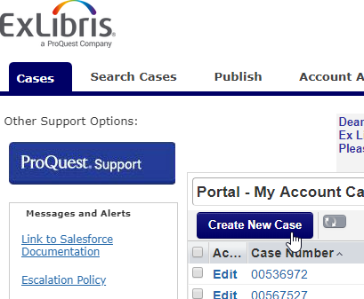
Retaining the Ledger & Funds Structure for Cut-over
Ledgers and Funds can be retained at cut-over for:
Institutions that do not have any budget data in Aleph
To retain the Ledger and Funds your institution must:
Let the Project Lead know that your institution wants to retain your Ledger & Funds structure at cut-over
Open a SalesForce case with ExLibris
How to open a SalesForce case:
Go to: https://exlidp.exlibrisgroup.com/adfs/ls/
Type in your User ID and Password
Click Login
Click Create New Case
Fill out the form
Click Submit

