Slide 1
Clinical Strategy Meeting:
Global Capitation & Patient Support Model
Aug 18, 2023
5/12/2022
Care Transformation Collaborative of Rhode Island
‹#›
Prepared by Care Transformation Collaborative of RI

Slide 2
Agenda
Item | Time
Welcome & Announcements Paul Larson, MD, MBA, Chief of Primary Care, Lifespan Physician Group Barry Fabius, MD, CMD, FACP, Chief Medical Officer, UnitedHealthcare | 5 min
Moderator: Pano Yeracaris, MD, MPH, Chief Clinical Strategist, CTC-RI
CPGRI: Global Capitation: Enabling Better Patient Care 2023 Monica Walston Kucks, RN, BS, CCM, Vice President of Care Integration and Transformation/CharterCARE Provider Group RI LLC | 25 min
Patient Support Model (PSM) for Physician Transitions Edward McGookin, MD, F.A.A.P., President of Coastal Medical | 25 min
Reactants Cory King, MPP, Acting Health Insurance Commissioner at Rhode Island Office of the Health Insurance Commissioner Nick Lefeber, SVP Value Based Care, Blue Cross Blue Shield Noah Benedict, MHL, Chief Executive Officer at Rhode Island Primary Care Physicians Corporation | 15 min
Discussion & Questions | 20 min
5/12/2022
Prepared by Care Transformation Collaborative of RI
‹#›

Slide 3
Announcements
CTC-RI Annual Conference Registration *NOW OPEN*
https://www.eventbrite.com/e/579436378807
NCQA Health Equity Accreditation Training Option for up to *50* Participants
DULCE: Developmental Understanding and Legal Collaboration for Everyone due Sept 1^{st:}
https://public.3.basecamp.com/p/fYWNbwxdrCEfb2SWUrNw7NeX
Increasing Access to Care for Children with Restrictive Eating Disorders by Optimizing Integrated Behavioral Health Care: Application deadline: August 21, 2023 - https://www.ctc-ri.org/sites/default/files/Restrictive%20Eating%20call%20for%20applications%207.25.23.pdf
5/12/2022
Prepared by Care Transformation Collaborative of RI
‹#›

Slide 4
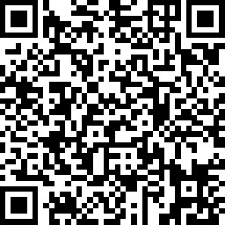
CTC-RI Conflict of Interest Statement & CME Credits
If CME credits are offered, all relevant financial relationships of those on the session planning committee have been disclosed and, if necessary, mitigated.
Claim CME Credits here:
https://www.surveymonkey.com/r/ZDZS5HG
5/12/2022
Prepared by Care Transformation Collaborative of RI
‹#›

Slide 5
Objectives
Learn about strategic and programmatic approaches taken by CharterCARE to be successful in global capitation
Learn about practice-based strategies and Coastal Medical/Lifespan to implement primary care capitation under global medical risk contracting
Hear reactions from health care leaders in RI and engage in discussions regarding lessons learned and implications for other systems of care in RI.
5/12/2022
Prepared by Care Transformation Collaborative of RI
‹#›

Slide 6
CPGRI
Global Capitation: Enabling Better Patient Care 2023
Independent Physician Association
Personal & Confidential | Not for Distribution | Property of CPGRI, LLC

Slide 7
Measuring Success with Global Capitation
In 2022, CharterCARE entered into a global capitation agreement with BCBSRI for their BCBSRI MA population; while continuing with delegation for CM & UM (only SOC in RI to have delegated and global capitated arrangement with BCBSRI for MA members)
What does this mean? CharterCARE receives a fixed payment per member per month and must meet all the needs of a broad patient population
Care Management can impact total admissions and reduce unnecessary readmissions;
1 admission at a time
Comparing # of actual BCBS MA readmits for CY 2019 to CY 2022, CharterCARE readmissions have been reduced by 6 readmissions per month for a total of:
$ 1 million + in savings
o Savings that allow our PCPs to coordinate better care, reduce duplicative testing and increase patient satisfaction → Value Based Care

Slide 8
Clinical Program Outcomes BCBSRI MA
CY | 2018 | 2019 | 2020 | 2021 | 2022
Readmit Rate | 14.48% | 15.44% | 13.31% | 15.96% | 11.83%
24% READMIT REDUCTION!
(2019 vs 2022)
3

Slide 9
Does global capitation enable better patient care?
Why global capitation?
CharterCARE system of care had high utilization, fragmented care coordination, poor documentation of diseases and low patient & physician satisfaction
By taking full risk and enabling our provider led system of care to be the driver of care coordination- our outcomes have drastically improved
Demonstrate to our Physician network that you can be compensated for outcomes and not how many visits/procedures you do
Global capitation enables CPGRI IPA to assess, design and implement clinical and administrative programs based on the needs of our patients AND the needs of our providers
Our mission has been to keep our core clinical programs in house as much as possible in order to reduce silos, remove any break in care and cut down on duplicative efforts
Inpatient utilization down 35%
HCC recapture rate went from 60% to >90%
< 3 STAR to 4 STAR SOC

Slide 10
CharterCARE Clinical Programs
Our Care Management team strives to achieve the quintuple aim by providing several care management programs to patients based on need to:
Care Management
Remote Patient Monitoring
(home)
(telephonic &
PCP office)
Care@Home
(home)
Patient
Advanced Illness Care Coordination (home)
Social Worker (telephonic & home)
Improve patient
experience
Better outcomes
Lower costs
Improve the provider
experience
Health equity
COPD
Disease Mgmt (telephonic)
Transitions Coaching
(home)
Pharmacy MTM
(telephonic
& PCP office)
5

Slide 11
Community Relationships
IMPROVING QUALITY of PATIENT CARE
Vendor Partners | Solving for:
Preferred Urgent Care Network | PCP access issues & ED/SNF avoidance
Professional Ambulance | Retention
Kent Hospital at Home | ED/SNF avoidance
Conversio | COPD admission avoidance
Healthcentric Advisors | RPM platform for ED/inpatient avoidance
Doctustech | HCC coding education (CMEs)
Centers to Advance Palliative Care (CAPC) | End of life education (CMEs)
UniteUs | SDOH needs
FHR | Behavioral Health needs
Highbar Physical Therapy | VNA access issues & ED/SNF avoidance

Slide 12
Care@Home Team at Work
Outreach specialist receives referrals and outreaches to patient within 24 hours
CAH RN completes initial visit to enroll patient within 7 days of referral
CAH provider completes visit within 30 days of enrollment
Patient goals of care are addressed and communicated back to PCP via calls/notes
Patient reviewed during morning huddles and weekly IDT with CAH Medical Director
CAH patients are given CAH VIP card; enables them to receive coordinated care from GSV team at RW resulting in better care with providers who are familiar with patient
Patients receive routine visits, urgent visits and 24/7 on call coverage by CAH team ₇

Slide 13
Care@Home VIP Card
(CAH & RW GSV Team Coordination)

Slide 14
Care@Home Outcomes 2022
CAH program is at or exceeding goal for all outcome measures for 2022
2,859 home visits completed
395 patients enrolled
176 patients discharged from CAH
72% of patients seen within 3 days of hospital discharge
24% of patients seen within 7 days of hospital discharge
33 patients deceased
32 patients transitioned to hospice
66% with Advance Directives completed
90 NPS Score
CAH PROGRAM Utilization Metrics 2022 | Jan | Feb | Mar | Apr | May | Jun | Jul | Aug | Sept | Oct | Nov | Dec | CC CAH Avg | BCBSRI MA Bench mark Goal
Inpatient Admits per/1000 | 48 | 59 | 60 | 63 | 101 | 102 | 32 | 48 | 32 | 48 | 38 | 44 | 56 | 152.7
ED visits per thousand | 56 | 80 | 47 | 76 | 66 | 49 | 41 | 78 | 77 | 48 | 25 | 44 | 57 | 295.7
UC per thousand | 16 | 13 | 9 | 18 | 0 | 18 | 14 | 22 | 27 | 31 | 17 | 9 | 16 | 141.2
SNF admits per thousand | 24 | 25 | 30 | 31 | 40 | 40 | 41 | 22 | 14 | 26 | 30 | 31 | 29 | 34.6
SNF LOS | 15 | 12 | 17 | 13 | 14 | 11 | 22 | 14 | 7 | 19 | 12 | 17 | 14 | 14
9

Slide 15
Patient Story Care@Home
84 yo female patient, BCBS NCM called PCP office to request additional help for patient related to progressing dementia and recent TIA
NCM referred patient to CAH; patient enrolled in CAH Oct 2022
PMH: depression, CKD3, dementia, anemia, chronic gastritis, hypertension
Patient lives at home with daughter. Last hospitalization Nov 2022 for dizziness and BP issues CAH team reviewed/completed MOLST form with patient & daughter
Mid March 2023, daughter called CAH team to report patient woke up agitated and stopped
breathing during the night; regained consciousness but refused to go to hospital
CAH RN made immediate visit, patient extremely adamant and stated: “I absolutely do not want to prolong this and suffer” (in line with her wishes on MOLST form)
CAH RN sent in request for hospice eval; PCP initially declined to order hospice for patient as
she believed patient had more than “6 months to live”
Though the trusting relationship with CAH team RN, patient’s daughter felt empowered to call hospice company directly to request hospice care for mom; CAH team worked with PCP to facilitate smooth transition over to hospice
Patient passed away 3 weeks later
ED/admission avoided; patient able to pass peacefully at home in accordance with her wishes
Patient centered care at its best!
“When you have the best, you do the best!”
Care@Home Patient Testimonial

Slide 16
RPM Team at Work
Alerts are monitored and responded to by Patient Onboarding Specialist
Patient Onboarding Specialist escalates critical alerts to NCM and PCP
Trending data is routinely reviewed by Patient Onboarding Specialist; sent to NCM and PCP for review/med adjustments to prevent exacerbations
Patient and care team can respond via 2way texting platform if there are
any additional needs
11

Slide 17
RPM Outcomes 2022
Industry standards for RPM indicate that a well managed RPM population should trigger roughly 2-3% patient alerts
In 2022, 22,131 readings were submitted through PRISM alert portal for BP, CHF, COPD, DM
Of those 22,131 readings; 5% triggered an alert (n=1231)
Of those 5%, multiple alerts were due to user error (device, data, cold hands etc)
Pros of RPM solution:
Alerts managed in real time by Patient Onboarding Specialist (POS)
Encourages real time referrals from NCM over to POS
POS able to do repeat home visits for BP checks or troubleshooting RPM devices
Cons of RPM solution:
Not all devices are Bluetooth enabled resulting in false readings
Not currently billing for RPM
Not integrated into our EMR
Requires pt to have email or smartphone access to use RPM application
78 enrolled
1,231 critical alerts escalated
13 graduated YTD
87 NPS Score
12

Slide 18
Patient Story RPM
86-year-old female with PMH of CHF, HTN, DMII, Thyroid CA, depression, and neuropathy
Patient submitted BP readings via RPM with elevated reading of 190/94
POS responded to alert in timely manner, escalating up to NCM
NCM outreached to patient, symptoms were addressed, and reading was sent to the PCP.
BP medication dose was changed, NCM provided education on dose adjustment to patient
Patient’s BP returned to normal limits
ED visit avoided
Patient
Patient Onboarding Specialist
57-year-old female with PMH of HTN, DMII
Patient Onboarding Specialist had done trouble shooting earlier that week and changed out equipment to ensure this was not reason for her multiple high readings
Patient’s BP levels continued to rise, going as high as 175/118
POS escalated the alert to NCM
Upon outreach by NCM, pt was ready to go to ED
NCM quickly reviewed the rising BP values with the PCP
PCP added additional medication to patient's regimen
Patient initiated new medication and BP stabilized
ED visit avoided
NCM
PCP
13

Slide 19
Global Cap Opportunities
Delegated UM and CM enables us to admit to observation vs inpatient
Reduce duplicative testing
Empower PCP to take active role in patient care and hospice transitions
Increase awareness of clinical program offerings
Data share KPIs with providers and clinical team FREQUENTLY
Review inpatient data daily/weekly to identify inpatient or ED trends in real time
Cascade information down to front line team who performs hands on patient care via:
Monthly board meetings
Monthly PCP POD meetings (educational topics by disease state and led by our Sr. Medical Director with 40 years of PCP practice real world experience!)
Monthly Office Manager meeting
Weekly Nurse Care Manager meeting
Daily clinical team huddles
Daily patient encounters
Broader system communication with:
Hospital ED, urgent care sites and preferred SNFs
Kent and Lifespan Dir of CM meetings
Preferred palliative and hospice vendors
Patient level identification: CharterCARE sticker on insurance card!
Treat every event; admission or readmission as a way to do better

Slide 20
CPGRI
THANK YOU!
15

Slide 21
Patient Support Model (PSM)
for Physician Transitions
August 18, 2023
Notes:
H:
Good morning and thank you for the invitation to talk about our Patient Support Model
O:
P:
Let me start by describing the way I practiced in my first year as a general pediatrician in 1998.
I fondly recall working…
The problem is, so much has changed in the last 25 years that in 2023, we need a vastly different care model than what we had in 1998.
T:
Let me start by framing the problem we needed to solve

Slide 22
A perfect storm
Four physicians retired in Q4 2022, and Coastal needed to “bridge” 6,000 patients within existing practices until new physicians arrived in the summer of 2023
Discharging patients violated our commitment to the Patient Centered Medical Home
The 6000 displaced patients represented $5.8 million in potential lost revenue
FFS + Capitation Payments + Quality + Infrastructure Support
Notes:
H:
We faced something of a perfect storm
O:
P:
Coastal had been acquired by Lifespan in April 2021.
Many physicians chose to delay retirement and stay through the transaction.
At the end of 2021, we had 4 physicians retire and it consumed all of our available clinician capacity to keep those patients at the beginning of 2022. At the end of 2022, we had 4 more physicians scheduled to retire and the prospect of reassigning 6000 more patients was overwhelming.
To make matters worse, we had a horrible recruiting year for new physicians in 2021. So, we did not have enough new clinicians joining us in 2022 to assume the care of the patients whose PCPs were retiring.
At the beginning of the year, we transferred patients to our new LPG primary care partners and had to discharge patients. We swore we would never do that again as it violated every aspect of our commitment to the Medical Home concept.
We also knew that discharging patients was a financial disaster, particularly in value-based care payment models in which revenues are derived from quality performance, capitated payments and infrastructure support based on the number of covered lives we manage.
T: As the saying goes, “necessity is the mother of invention.”

Slide 23
We needed a new model of care
Medical Assistants
Dedicated support to each clinician in the practice
Practice Manager
Monitor access and capacity
Tools for active schedule management
Clinical Practice Nurse
Triage calls/portal messages/TE’s to clinicians
Review and address Lab/DI/documents
Prioritized access to MA Float Pool
Physician
Provide care to an expanded panel with greater administrative resources
Clinical Practice Navigator
Monitor and review RPM for PSM patients
Support for Practice Nurse and MAs for patient outreach/follow up
Advanced Practitioner
Expands access to provide sick visit care or follow up care
Additional capacity with Float AP’s – for surges or coverage
Notes:
H: We needed a new model of care that would allow us to increase the number of patients for which a clinician or team of clinicians could care.
O: Here are the team members that are a part of the new model of care
P:
Our goal was to have a very capable team monitor the clinical care and needs of a large patient panel. To do that we needed to provide face-to-face visits for the patients who needed to be seen, cover the influx of clinical information coming into the digital inboxes of clinicians, complete notes on time and allow clinicians to go home at night or on weekends with as few interruptions as possible.
We needed a Practice Nurse who had the clinical skills to triage patient calls, respond to Patient Portal messages, review telephone encounters, and review documents, labs and imaging results leaving only those essential for a physician to see and respond to.
We needed 1 MA for every clinician, everyday.
We needed a Clinical Navigator to help the practice nurse coordinate care for patients. So, we established a 1.3:1 ratio of MA’s to clinicians and had the 4th MA function as that navigator. If the team was fully staffed with MA’s the navigator assisted the Practice Nurse. If an MA was out, the Navigator stepped into the MA role for the day to maintain a 1:1 MA to Clinician ratio.
We utilized various combinations of Advanced Practitioners and Physicians
Our practice managers were essential to monitoring and actively managing schedules.
In addition to these traditional office staff, we provided each participating clinician with a scribe and engaged a Nurse Triage service for weeknight and weekend call coverage.
T: To do something new, you need to stop doing something old.

Slide 24
Identifying our most vulnerable patients
Priority Level | Criteria
Priority 1 (20% of patients) | High-Risk problem list codes (Active) Any patient with warfarin use monitored by Coastal, Utilization: >3 TOC Encounters for utilization in the past 6 months HIV/AIDS diagnosis, Substance use disorder Age >80
Priority 2 (50% of patients) | High Risk codes (Surveillance) Intellectual disability Greater than 3 chronic conditions Benzodiazepine use (updated in last 6 months) Immunosuppressive therapy Opioid use (updated in last 6 months)
Priority 3 (30% of patients) | All other patients that do not meet any of the above criteria RPM patients
PSM 1
PSM 2
PSM 3
Notes:
H: We needed to think about a model that didn’t treat every patient like a 74-year-old with multiple chronic conditions.
O: We once again applied a risk stratification model to the patients we were managing
P:
Risk stratification allows us to better anticipate the needs of our patients and provide for differentiated levels of care that are best suited to patient’s needs.
-Priority 1 patients are complex and need frequent visits or close follow up.
-Priority 2 patients are moderate risk who may need support as needs arise.
-Almost 1/3 of the patients included are Priority 3 who likely need care that is convenient for them and who may prefer telemedicine visits, care at Coastal365, or communicate through the Patient Portal.
T:
This was a disruptive idea and clinicians don’t generally like disruptions.

Slide 25
Clinicians liked the PSM
Notes:
H: But the clinicians who accepted the challenge of this pilot liked it.
O:
This graph illustrates the responses to the AMA Mini-Z Physician Burnout Assessment.
The top bar represents Coastal’s 2022 survey results
The bottom bar represents the responses of the PSM participating clinicians.
Let me be clear, this is not a statistically significant comparison. The sample sizes were vastly different, and we were not comparing the results of the PSM clinicians to their previous responses.
P:
The point here is only to illustrate that informally, the PSM clinicians generally found the new model satisfying and we may see a notably different degree of job satisfaction if we were able to scale the PSM model.
T:
We wanted to find a way to serve more patients safely with few clinicians. But we also wanted to reduce burnout. That was a very tall order.

Slide 26
Could the PSM reduce burnout?
Notes:
H: Again, not statistically significant but using the same AMA Mini-Z questions, we saw that the PSM clinicians were feeling differently than their peers. O: P: T:
The subjective feedback was very positive, and we recognized the opportunity to expand the model.

Slide 27
Expansion Assumptions
Add at least one PSM team to each primary care office
28 clinical hours per MD
Panel size of 2,200 patients
Maintain the same average visits per day for clinicians
Increase the care between PCP visits
Remote Patient Monitoring
Disease management programs
Notes:
H: Expansion of the model required a more detailed understanding of the requirements
O: P: We wanted to bring the PSM model to every practice
At Coastal, the average number of face-to-face clinical time is 28 clinical hours per physician per week
We assumed a panel size of 2200 patients based on data from MGMA and Sullivan Cotter
We did not want to require clinicians to see more patients per day. Incidentally however, many indicated that in this model it was quite easy to see 2-3 more patients per day, but that wasn’t a premise.
We did need to capitalize on the value of care provided to patients between visits through our disease management and remote patient management programs.
T:
We made the initial investments based on the idea that if we did nothing and lost the patients, we would lose almost $6 million in revenues. Now we had to be much more deliberate in calculating the direct and indirect costs of the model.

Slide 28
We can’t afford NOT to do this
Coastal
Total Revenue = $3,976,894
Total Expense = $3,952,413
Net Profit = $24,481
LPG
Total Revenue = $1,127,563
Total Expense = $1,280,622
Net Loss = ($153,058)
16 Additional Teams
20 Teams in Total
5 Teams
Notes:
H: Based on the feedback from the participants in the model, we realized that it was good for patients, employees, and clinicians. So good, we couldn’t afford not to do it. O: P: Assuming a patient panel size of 2200 patients per clinician
Coastal primary care offices could add 16 additional teams at close to a break-even cost
And our LPG practices could add a team to each office at a modest net loss.
The loss at the LPG practices is largely due to them not being on a primary care capitation contract.
T:
While this was risky, it wasn’t an entirely hairbrained idea.

Slide 29
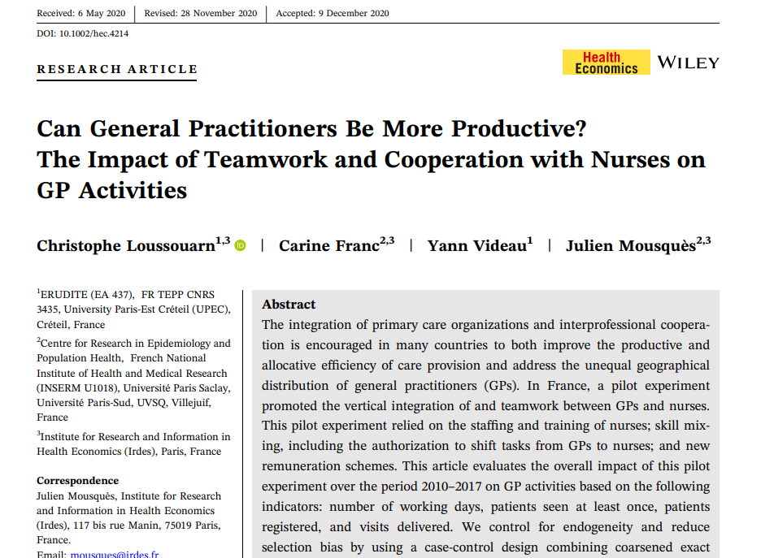
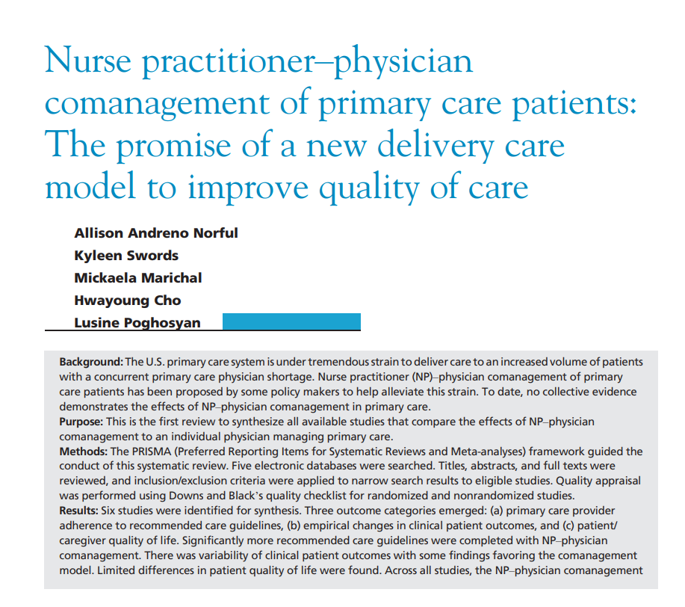
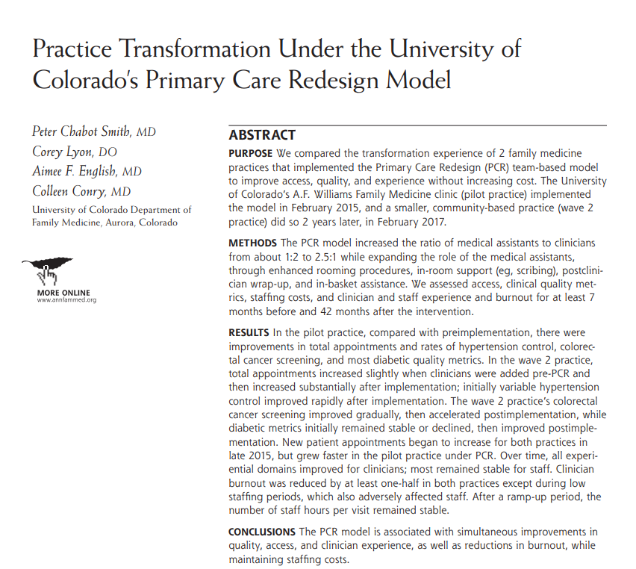
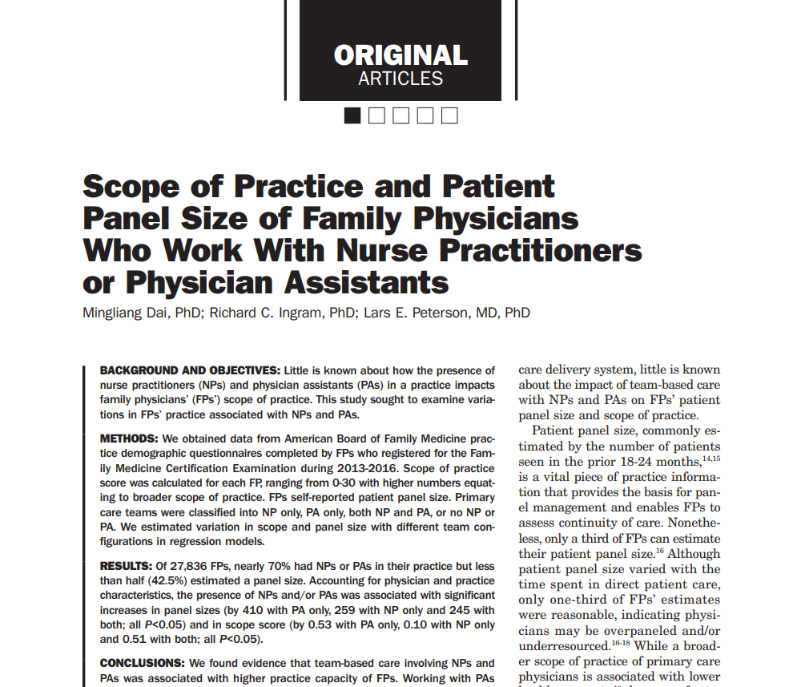
Research supports the idea
Notes:
H: Multiple studies supported the concepts we used. O: H:
While the model we used was not specifically studied, there were many studies that looked at increasing the productivity of clinical teams.
O:
P: While some of the available studies were done in Canada, and in France, the idea of improving clinical productivity by resourcing teams appropriately is not a novel idea.
T:
While I can tell you that our PSM was sufficiently successful to warrant expansion to every Coastal practice, I’d like one of our PSM physicians tell you in her own words what she thinks of the model.

Slide 30
In her own words
Hi Ed,
Just wanted to let you know that the PSM model has been a life saver. Every aspect of it, including having a clinical practice nurse and navigator to help with telephone messages/labs/documents, the nurse triage service helping with weekend calls and having a scribe to help with my notes, have made a tremendous difference to the way I practice medicine.
My work now is more enjoyable and less stressful. I’m able to finish my notes on time, my labs and documents are reviewed on time, patients get a call back without having to wait till the end of the day and I’m even able to do go through my schedule for the following week to do some pre-visit planning and charting.
I would not have been able to continue working here if it had not been for the support, I get from PSM. I feel like I got my life back!
Notes:
Thank you.

Slide 31
Evaluation & CME Credits
Please complete the evaluation in order to claim CME credits!
Claim CME Credits here:
https://www.surveymonkey.com/r/ZDZS5HG
5/12/2022
Prepared by Care Transformation Collaborative of RI
‹#›

Slide 32
THANK YOU
www.ctc-ri.org
CTC-RI
5/12/2022
Prepared by Care Transformation Collaborative of RI
‹#›

