Slide 1
Submitting a good support ticket
Shared Library Services Platform Project
Jennifer Koerber
Notes:
As SUNY continues to move from implementation to support, more of you will be submitting support tickets.

Slide 2
Agenda
Before You Submit a Ticket
Basic Documentation
Elements of an Effective Support Ticket
Submitting a Project Question or Improvement Suggestion
Where to Find the Details
Additional Resources
Screencast or screenshot options
Articles to read
Notes:
Not just when something’s gone wrong, but to ask questions and get advice from Ex Libris.

Slide 3
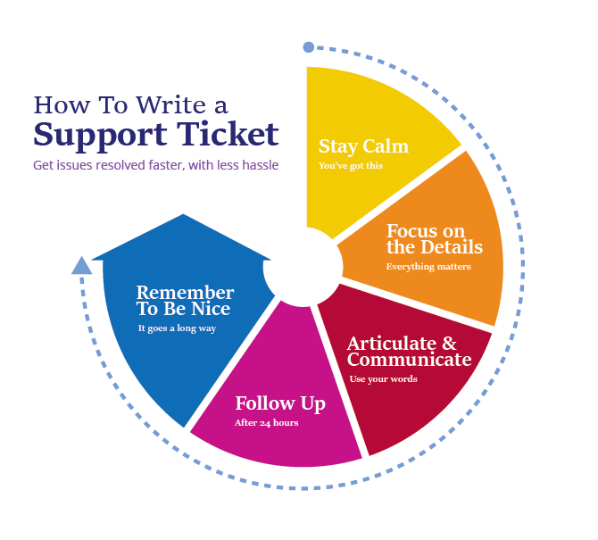
http://blog.cimcloud.com/blog/how-to-write-a-great-support-ticket
Notes:
Be articulate, kind, and thorough and you will develop a great relationship with your Support team, leading to more effective resolution of your issues.

Slide 4
Before Submitting a Ticket
Log out of Alma or Primo, clear your browser cache, then log back in
Reboot your computer
Ask at your institution – are others having the same issue? – local or in SUNY Basecamp
Look through Ex Libris and SUNY documentation and FAQs
Make sure you can replicate the issue - more than once, using different browsers, machines, and user accounts/user roles
Accumulate examples
Document everything you’ve tried and what happened, including screenshots & screencasts
Notes:
Ask if other campuses are having the same issue because then you’ll know whether it’s just you or not. If it’s more than one, you can each provide different examples of what’s wrong, and submitting multiple tickets about the same topic boosts the importance of those tickets in the queue.
Replication is key to provide examples and to help Ex Libris work to figure out the issue. If they can’t replicate it, they can’t fix it.

Slide 5
Basic Documentation
Each time you replicate the issue, document:
User name and Alma ID, relevant user roles/permissions if known
Operating system and browser with version number
Step by step details of what you clicked on or typed in
Exact wording of any error messages you get (or screenshot them)
One or more screenshots of configuration screens, search results or facets (or where they should be), or other still images
If the ticket is about page load times, screencast the full load time, including how you get to the page
If the ticket is about a sequence of actions, screencast the full sequence, from the first thing you click
Notes:
Don’t wait for support to ask questions – you don’t have to guess at what they want.
If you do this, you’ve written most of your ticket already and given support nearly everything they need to answer your question quickly and without a lot of follow up questions.
As you slow down and document, you might figure it out for yourself and not have to submit a ticket.
Screencasts from first click to last click, for page loads or sequences of tasks.

Slide 6
What details?

Slide 7
What Does Ex Libris Support Want?
Your case Subject should include a brief but informative description of the problem
Description of problem behavior (include expected behavior vs actual behavior) or question
Scope (who is affected), impact (severity) and urgency (timeline for resolution/ deadlines) related to the problem
Conditions and steps for replication
Other details or important items for Support to be aware of, such as recent changes that may be related, troubleshooting steps already taken, etc.
From https://knowledge.exlibrisgroup.com/Cross_Product/Knowledge_Articles/What_information_should_be_provided_when_opening_a_Case

Slide 8
Subject Line
As few words as possible but as descriptive as possible
"Get It" section taking 6-8 seconds to load
Seeing "Internal server error occurred" error message when submitting duplicate resource sharing requests
JSTOR Complete - Primo is not searching for this collection at the article level
If needed, indicate the priority in the subject line - if a major functionality seems to be offline, for instance
Notes:
Stay calm when writing – make the subject line work for you. “It’s BROKEN!” is worse than useless – Support will skip this and move on to questions they can answer quickly before they come back to yours. They’re not psychic and there isn’t a human being monitoring every system every hour of the day (just monitoring systems).
In contrast, a good subject can get your question answered quickly, especially if it turns out the answer is straightforward. They get tickets from hundreds of institutions - a clear subject gets your question moved on – or triaged – to the most relevant person, and saves having to forward it to other teams later. Finally, a good subject helps with searching through your tickets later.
Actual subjects from current cases

Slide 9
Descripton – Scope and Impact
Notes:
From Bruce’s presentation

Slide 10
Description – Details and Replicability
Does the problem happen all the time? Note time/date of first observed occurrence.
Is it random, or does it appear under a consistent set of conditions?
Does it happen for all records or specific ones? Include relevant record IDs (MMS ID, Object Portfolio ID etc.).
Does it impact all operators or patrons? Specific operators or patrons? Include relevant User IDs or names.
What are the steps the analyst should follow to replicate?
Are there login credentials the analyst will need to replicate the issue? (e.g., to a database or other non-Ex Libris system?)
Specific messages or errors that display (screenshots or exact text of message)
From https://knowledge.exlibrisgroup.com/Cross_Product/Knowledge_Articles/What_information_should_be_provided_when_opening_a_Case
Notes:
Noting the date and time helps Support review the monitoring logs much more quickly, leading to a faster answer for you.
A good, thorough description with screenshots can save the back and forth questions that are the truly frustrating part of this process. You’ll also save lots of time.
The date and time will help Ex Libris go through the monitoring logs for the system and find the details that may answer what’s going on.
Third party credentials are important for things like link testing because it’s harder to fully test if they can’t get into the database on the other side.

Slide 11
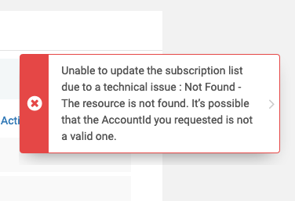
Description – Details and Replicability
If your ticket text is long, put highlights at the top
Share your goal – what are you trying to do?
Use a list or bulleted points, not paragraphs
Describe what you expect to be happening and then what you’re actually seeing
If you think you know what’s not working properly, describe that
Provide at least a few examples of records, affected users, or bad search results for each case
Notes:
Stating what you expected to happen and then what actually happened gives Support insight into what your goal was and how you were trying to achieve it.
Screenshots can also help with this because Support may take one look at a screenshot, read what you expected to happen, and then come back to you to explain what’s actually going on or that something really isn’t right at all. They might see something it would never have occurred to you to mention or them to ask for. You’ll get additional context about how the system works and that’s cool.

Slide 12
Referring to Ex Libris Systems
Ex Libris uses specific terminology:
Products are generic
Assets are institution-specific
Assets are generally named with the convention Institution Name - Product
For example, Ex Libris University may use the products SFX, Primo and Alma. The names of their associated Assets, then, would be Ex Libris University - SFX, Ex Libris University - Primo, and Ex Libris University - Alma.
This naming convention will help you choose the correct asset for your institution
Also specify whether you’re working with Institution Zone, Network Zone, or Community Zone records or processes.

Slide 13
Submitting a Workflow/Project Question or Feature Enhancement
Also use Salesforce to:
Ask for guidance on improvements in workflows or upcoming large projects – they might be able to recommend solutions
Ask for advice on implementing something in the Release Notes for the next release.
When submitting these cases:
Set priority to Low or Normal
Describe what you want to do and the result you want to achieve
Include screenshots of existing features if relevant

Slide 14
Finding details

Slide 15
Operating System Details
Windows Operating Systems:
Select the Start button > Settings > System > About .
Under Device specifications > System type, see if you're running a 32-bit or 64-bit version of Windows.
Under Windows specifications, check which edition and version of Windows your device is running.
https://support.microsoft.com/en-us/help/13443/windows-which-version-am-i-running
Mac Operating Systems:

Slide 16
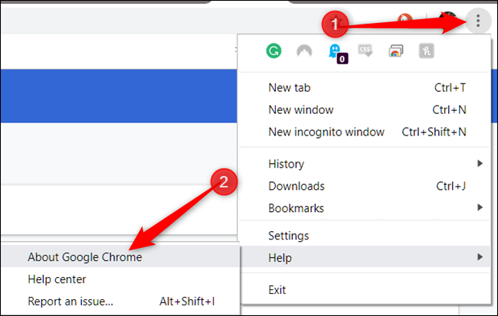
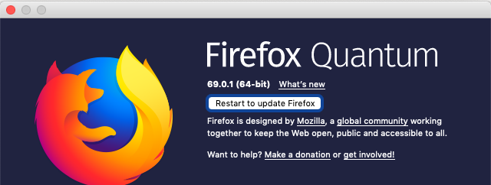
Browser Details
On Windows:
On a Mac:

Slide 17
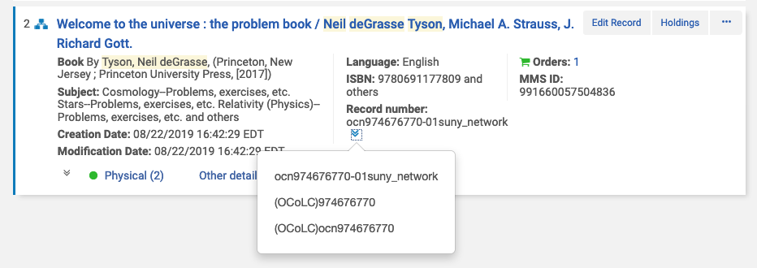
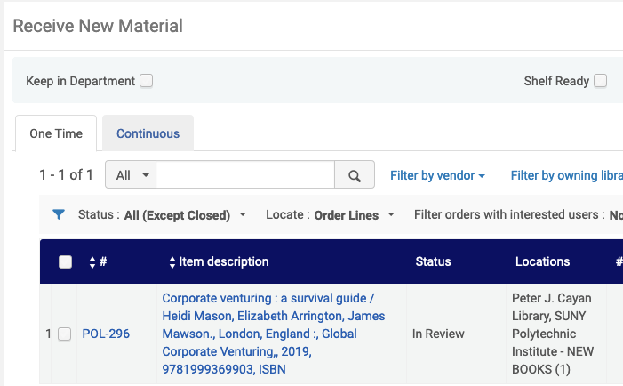
Record and Process IDs
Notes:
MMDID and Record numbers, POL/Order number, Request Type and ID number

Slide 18
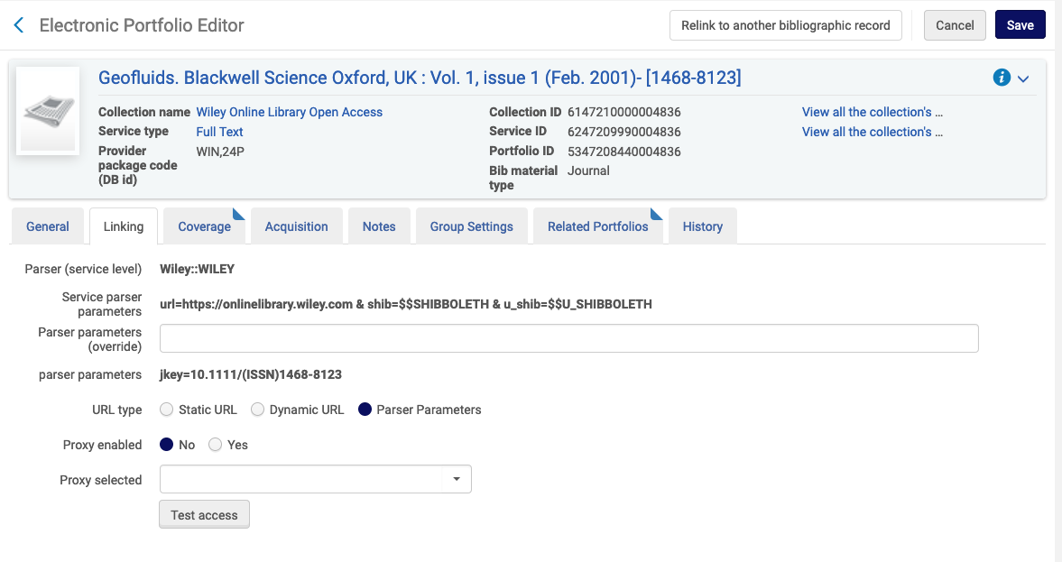
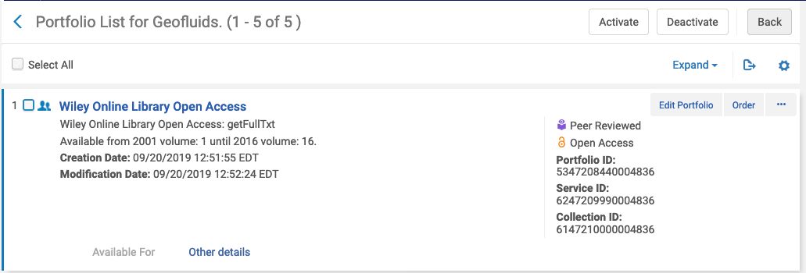
eResources IDs & Details

Slide 19
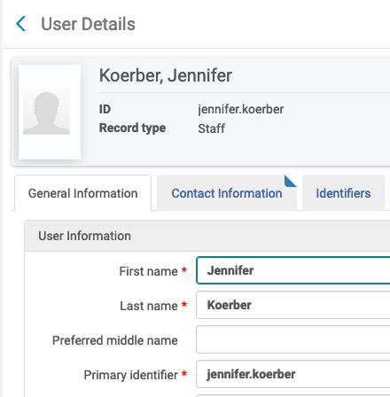
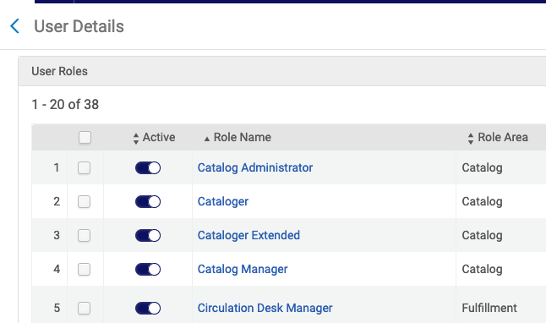
User IDs and Roles/Permissions

Slide 20
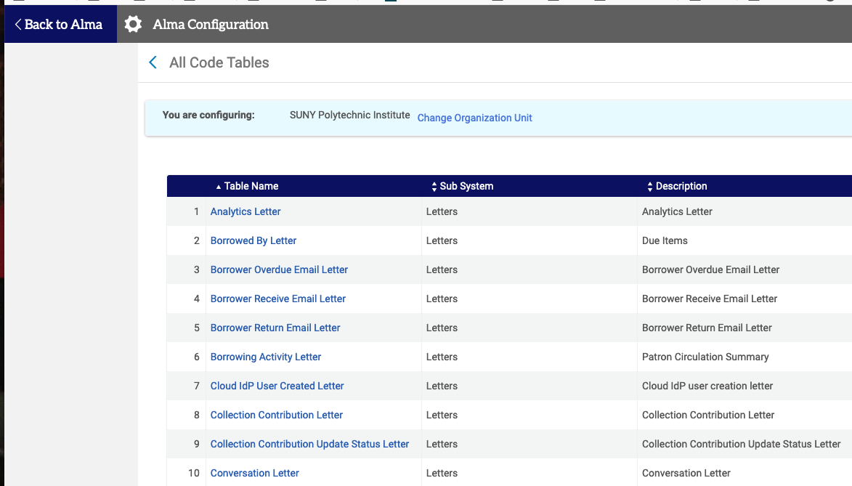
Configuration Screens
Notes:
One thing to remember is that the more you customize any part of Alma or Primo, the more of a challenge it will be for Support to help you with it. They know what the systems do with the default settings, but they can’t possibly know your customizations inside and out – you have to know that part.

Slide 21
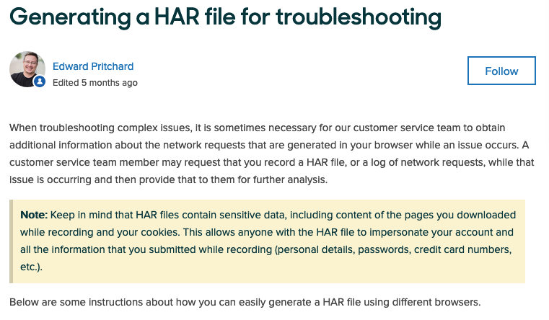
Page Load Time Tracking
Use .HAR files to track the amount of time it takes Alma pages to load:
https://support.zendesk.com/hc/en-us/articles/204410413-Generating-a-HAR-file-for-troubleshooting
Use screencast videos for Primo or for staff who aren’t able to create .HAR files

Slide 22
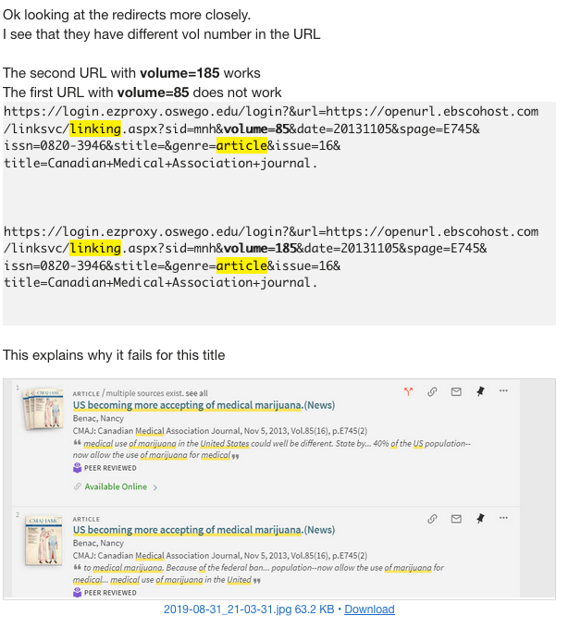
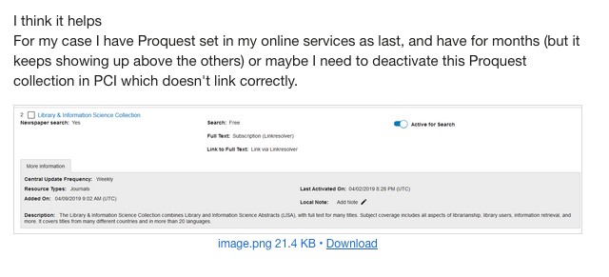
Article Linking

Slide 23
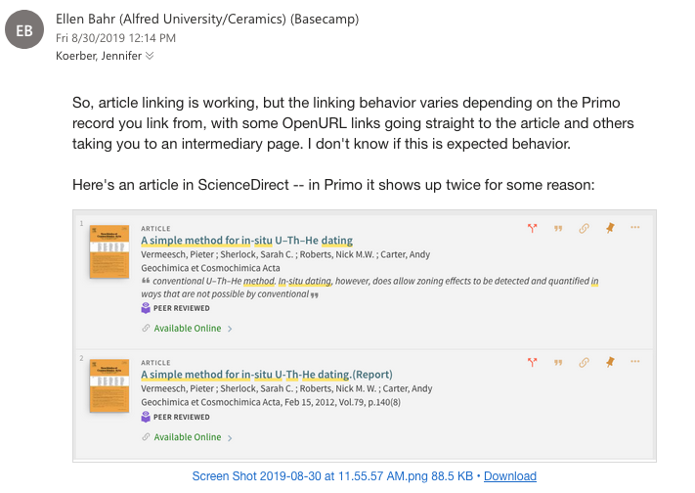

Slide 24
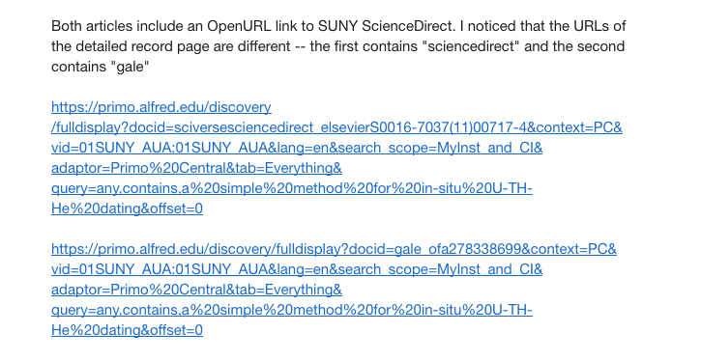

Slide 25
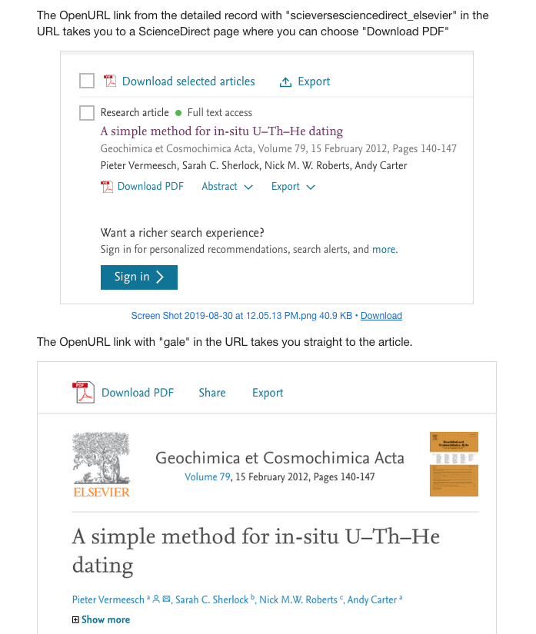

Slide 26
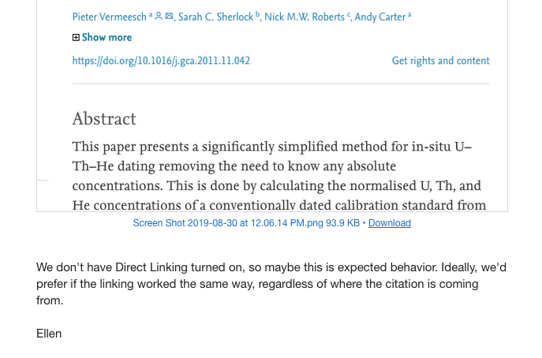

Slide 27
Follow-up

Slide 28
Response Times (aka, be patient)
Notes:
Follow-up is on both parties – you and Support. If you don’t have a response from them in these timeframes, it’s on you to follow up and find out why. The ticket might have gotten mis-assigned, lost in the queue, or they might be receiving much higher-than-normal volume. If that last is true, it’s a good bet that your URGENT issue is everyone’s urgent issue, so they’re working on it.
If you don’t hear from

Slide 29
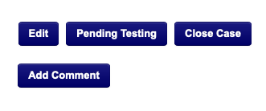
How to Follow Up
Find the case you want to follow up on and click the Subject or Case Number to view it. (Don’t click Edit - you’re not changing the original ticket, just following up.)
Choose what you want to follow up with:
Click Add Comment to add information, questions or other notes for the Support Analyst.
Use Pending Testing to keep a case open for additional time to evaluate the change to confirm that it has addressed the problem you experienced. Case Status will change to Pending Customer Testing for 11 months before changing to Resolved status.
Click the Feedback button to use the In-Case Feedback option to share your feedback on how Support is handling your Case. Your Feedback will be seen by the Ex Libris Support Case Owner, and Support Management, who will acknowledge your In-Case Feedback by checking a box to acknowledge your message, or by adding a comment to respond to your feedback.
Notes:
....and that’s it. Everything else comes from your documentation.

Slide 30
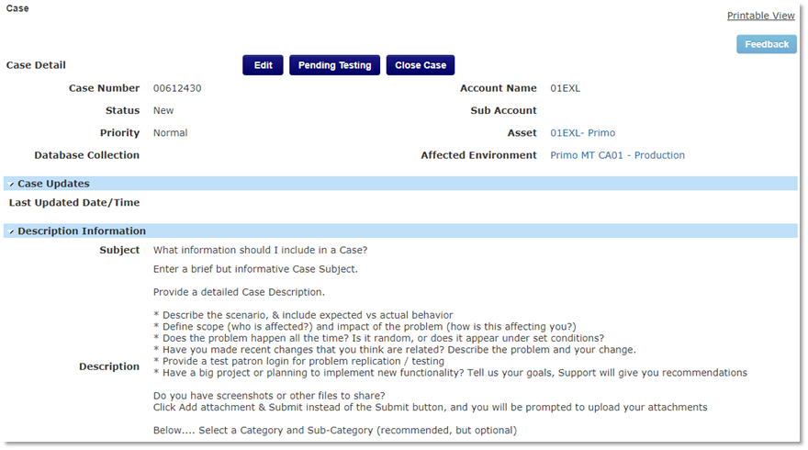
Inside Salesforce

Slide 31
Inside Salesforce

Slide 32
Inside Salesforce
Portal – My Account Cases allows you to see all cases for your institution, including cases opened by one of your colleagues.
Portal – My Account Open Cases allows you to see all cases for your institution that are not in a status of Closed.
Portal – My Cases allows you to see all cases opened by you.
Portal – My Open Cases allows you to see all cases opened by you that are not in a status of Closed.
Recently Viewed Cases allows you to see cases which you have viewed recently.

Slide 33
resources

Slide 34
Resources – Screencasts & Screenshots
Screencast-o-matic (screencast-o-matic.com/plans, free & $)
SnagIt (www.techsmith.com/screen-capture.html, trial & $)
Captivate (Adobe) & Camtasia (TechSmith) are higher-cost, more-feature options
Zoom, GoToMeeting, any other online meeting platform that can record
Windows OS: Print Screen button and use Photos to edit the shot
Mac OS: Shift + Command (⌘) + 5 to get to the screenshot/screen recorder in QuickTime
Note: Jing is being replaced by Screencast and SnagIt, all from TechSmith

Slide 35
Resources – Ex Libris
Support Portal User Guide https://knowledge.exlibrisgroup.com/Cross_Product/Support/030_Salesforce/Support_Portal_User_Guide
Transition to Support Webinar (9/26/2019) https://public.3.basecamp.com/p/W1znT4MUjiMVxzmQgeiqzG8K
Troubleshooting Tips to Help Get an Alma Case Solved Quicker, by Tari Keller https://knowledge.exlibrisgroup.com/Alma/Community_Knowledge/Troubleshooting_Tips_to_help_get_Alma_Case_Solved_Quicker
Support Case Status List and Descriptions https://knowledge.exlibrisgroup.com/Cross_Product/Knowledge_Articles/What_is_Case_Status_and_What_Does_It_Mean
Ex Libris Knowledge Center https://knowledge.exlibrisgroup.com/Alma https://knowledge.exlibrisgroup.com/Primo

Slide 36
Resources – Additional Reading
“5 Steps to Writing a Good Support Ticket” by for TableXI https://www.tablexi.com/5-steps-to-writing-a-good-support-ticket
“Writing a Good Help Desk Ticket” from Rio Hondo College IT https://www.riohondo.edu/its/helpdesk/writing-a-good-helpdesk-ticket/
“Request Helpdesk Support the Right Way: The Elements of a Great IT Ticket” by Tim Burke for BetterCloud https://www.bettercloud.com/monitor/how-to-request-helpdesk-support-it-ticketing/
“How to Submit a Great Support Ticket” by Reed Gilbride for HubSpot https://blog.hubspot.com/customers/how-to-submit-a-great-support-ticket
“How to Write a Support Ticket that Gets Results” from Apex Investing Institute A little tongue-in-cheek, and absolutely right https://www.youtube.com/watch?v=OTDSgaM3ZtM

Slide 37
Questions?

