Slide 1
Creating E-Resources Usage Analyses in the Usage Data (COUNTER) Subject Area of Alma Analytics
Elizabeth York
Electronic Resources Librarian
Rutgers University Libraries
Ex Libris Northeast Users Group 2024 Meeting
October 17, 2024

Slide 2
This presentation assumes we have:
Familiarized ourselves with the COUNTER 5.0 standard
Determined which COUNTER 5.0 reports we want to collect
I chose PR_P1, DR_D1, TR_J1, TR_J3, TR_B1, and IR_M1 because they include metrics required by ACRL and ARL. If you collect different reports, you’ll still be able to use the report-building techniques from this presentation; just make sure to use the Analytics measures from the report types you collect!
Loaded our COUNTER 5.0 reports into Alma, whether via spreadsheets or SUSHI
When we loaded our COUNTER 5.0 reports into Alma, we associated each provider’s data with an appropriate vendor record
Familiarized ourselves with Alma Analytics

Slide 3
What if I haven’t completed those steps yet?
Don’t worry, you are still welcome at this presentation! This presentation will help you understand what you can do with your COUNTER data in Analytics after you load it into Alma. To learn to load your COUNTER reports into Alma, you may want to check out:
Ex Libris Knowledge Center documentation: Managing COUNTER-Compliant Usage Data
My presentation slides from ENUG 2023 (available in the ENUG 2023 site): Managing Usage Statistics in Alma: COUNTER, SUSHI, and Ongoing Maintenance

Slide 4
Overview of today’s presentation
1. Overview of the Usage Data (COUNTER) Subject Area in Alma Analytics
2. Basic ARL/ACRL Sum Totals Report
3. Detailed walkthrough of steps to construct a prompted analysis of PR_P1 data
4. Tweaking those steps to build analyses for DR_D1, TR_J1, TR_B1, and IR_M1
To minimize risk of interruption due to network slowness, I will not be demonstrating live in Analytics. I will be using screenshots of Analytics instead. I have also shared my analyses in Analytics:
Shared Folders→ Community → Reports → Institutions → Rutgers → ENUG 2024 Usage Reports
Because we will be constructing PR_P1 step by step, this folder contains a sequence of PR_P1 reports. For the other analyses, the folder contains only the final analysis.

Slide 5
This presentation focuses on Counter 5 (5.0). I need to address an elephant in the room…

Slide 6
COUNTER 5.1 is coming
COUNTER 5.1 becomes the “official” standard in January 2025. Some providers have announced they will begin offering COUNTER 5.1 reports as of January 2025 and, in the months after, will be discontinuing COUNTER 5.0
When COUNTER 5 replaced COUNTER 4, some vendors were quick to offer COUNTER 5, while others were slow. We might see a similar staggered response this time.
The Ex Libris Alma Roadmap for H2 2024 includes: “Following the recent 5.1 COUNTER publication, COUNTER data will be adjusted to meet the latest updates in the Usage (COUNTER) and E-Inventory subject areas.”
On a practical level, changes from 5.0 to 5.1 are relatively minor—the report types are the same, and our most important metrics are not changing either.
Going forward, pay attention to announcements from vendors and communications from Ex Libris. We may need to:
Set up COUNTER 5.1 SUSHI connections
Adjust Analytics reports to include COUNTER 5.1 measures instead of (or alongside) COUNTER 5.0
Next year, carefully check the instructions provided by reporting organizations (such as ACRL & ARL).

Slide 7
With that in mind, let’s talk about building COUNTER 5 (5.0) reports. Our COUNTER 5.0 understanding and design skills should transfer to COUNTER 5.1.

Slide 8
We’re going to focus on the Usage Data (COUNTER) area of Alma Analytics
This is the subject area of Alma Analytics that contains all the COUNTER 4 & 5 usage data we have loaded into Alma.

Slide 9
Let’s look at the folders and fields in Usage Data (COUNTER) that we will use to build our analyses

Slide 10
Usage Data Details—Release 5 Folder
Folder is organized by COUNTER Report type and contains the different metrics in COUNTER 5 reports.
The list is so long that we only see DR, DR_D1, and a little of DR_D2 in my screenshot, but all the other report metrics are there if you scroll down
We’ll select from these metrics when we build our analyses.

Slide 11
Usage Date folder
COUNTER data is issued monthly
The fields in this folder will help us view yearly and monthly data

Slide 12
Title Identifier folder
COUNTER title and item reports include the title of each resource (book title, journal title, media title, etc.).
COUNTER database reports include the title of each database.
We’ll add the Normalized Title field to our reports on databases, books, journals, and media to see the title associated with each row of usage.

Slide 13
Platform folder
Each row of COUNTER usage has a Platform column. Per the COUNTER Standard, the Platform “Identifies the platform/content host where the activity took place.”
This field is especially important when working with platform (PR and PR_P1) reports, but it also can be helpful for other reports
You may have access to the same book or journal title on multiple platforms, so platform can be a helpful differentiator
The same vendor may have multiple platforms (for example, Alexander Street has both search.alexanderstreet.com and video.alexanderstreet.com)
If a vendor moves platforms, you might see one row for earlier data (old platform) and another row for later data (new platform)

Slide 14
Load File folder
Load File COUNTER Report Type field allows you to limit by report type (PR_P1, DR_D1, TR_B1, TR_J1, IR_M1 etc.), making it easy to create an analysis limited to all your reports of the same type
Other fields may be useful for troubleshooting if what you see in Analytics does not match what you think you loaded in Alma

Slide 15
Uploading Vendor folder
When uploading a COUNTER usage data file into Alma, whether via spreadsheet or SUSHI, you must attach it to an Alma vendor.
Best practice is to carefully choose a vendor for each provider, and consistently load usage from that provider to that vendor record.
The vendor to which you upload a usage file is the “Uploading Vendor” in Alma analytics. So, if you uploaded usage to your vendor records consistently, you can use Vendor Name as a filter.

Slide 16
Simple ARL/ACRL COUNTER 5.0 reporting
We build the analysis in the Criteria tab
From Usage Date folder, add a column for Usage Date Fiscal Year (use Usage Date Calendar Year if you report on calendar year). Add a filter for “is equal to/is in,” and add the year values you want to see.
From Usage Data Details – Release 5 folder, add columns for the COUNTER report measures requested by ACRL & ARL. I’ve added PR_P1 Searches Platform, DR_D1 Searches Regular, DR_D1 Searches Federated, TR_J1 Unique Item Requests, TR_J3 Unique Item Requests, TR_B1 Unique Title Requests, and IR_M1 Total Item Requests.

Slide 17
Viewing the ARL/ACRL Results
We see the Usage Date Fiscal Year column with all the year values we selected. We see all the metrics we selected and the numbers for each year. This Screenshot was taken in early October 2024, and our Fiscal Years are July – June, so FY2025 only contains a couple months of data.

Slide 18
That’s a neat summary that adds up all our metrics for us. What if we want to see a breakdown of each platform’s data? We need that information to make collection development decisions. So, we’re going to build an analysis showing all our PR_P1 data.

Slide 19
Simple Report showing PR_P1 data for all our platforms
From Load File folder, add Load File COUNTER Report Type, and filter by “is equal to/is in pr_p1”
From Uploading Vendor folder, add Vendor Name
From Platform, add Normalized Platform
From Usage date, add Usage Date Year
From Usage Data Details – Release 5 folder, add columns for the PR_P1 report measures we want to see: PR_P1 – Searches Platform, PR_P1 – Total Item Requests, and PR_P1 Unique Item Requests

Slide 20
We go to the Results tab
We see all the vendors and platforms for which we uploaded PR_P1
If a vendor has multiple platforms (such as American Meteorological Society, which changed platforms) there are different rows for the different platforms
There is a separate row for each year of usage
There is a separate column for each metric

Slide 21
What if we want to see monthly usage?
We go back to the Criteria tab and, from the Usage Date folder, we add Usage Date Month and Usage Date Month Key. Usage Date Month is the name of the month (January, February, March…) Usage Date Month Key is the chronological number of the month (1,2,3…)

Slide 22
In our Results, the months are in alphabetical, not chronological order
Columns are sorted from left to right, so we drag and drop “Usage Date Month Key” so it is to the left of Usage Date Month

Slide 23
After dragging and dropping “Usage Date Month Key,” our months are chronologically ordered!
This is a workable report of monthly platform usage.
It is very long because each month is a separate row.

Slide 24
How do we set up our report with months oriented horizontally (as columns) instead of vertically (as rows)? We make a pivot table!

Slide 25
Adding a Pivot Table
1. In the Results tab, in the Views box in the lower left corner, select the down arrow next to the blue bar chart
2. In the menu that opens, select Pivot Table

Slide 26
A table preview and a Layout panel open. We use the Layout panel to arrange our pivot table.

Slide 27
Drag and drop “Usage Date Month Key” and “Usage Date Month” into the Columns section

Slide 28
Put “Usage Date Month Key” on top of “Usage Date Month” so the months are ordered from 1-12.
Pivot table columns are ordered from top to bottom, so putting “Usage Date Month Key” on top puts our months in chronological order.
We check the table preview on top to confirm it looks as we expect.
There is a visual improvement we can make: Viewers don’t need to see the usage date month key numbers. We just need them to be used “behind the scenes” for sorting.

Slide 29
We hide the “Usage Date Month Key” field
We select the gear next to “Usage Date Month Key”
In the menu that opens, we select “Hidden”
The field will be hidden from view, but because it’s still in the table, it will still be used to sort the months

Slide 30
Now we see only month names, not numbers. Click Done to confirm our pivot table layout (make sure to Save too!).

Slide 31
In the Results Screen, we see our original table. We need to add our pivot table to the layout and remove the original table.

Slide 32
We Add our Pivot Table
In the Results tab, in the Views section in the lower left corner, select Pivot Table. This is the Pivot Table we just created.
Select the right-pointing arrow to add the Pivot Table to the Layout.

Slide 33
Our Pivot Table is added to the Layout. We now need to remove the original Table.
In the Views section, select the plain Table
Select the tiny >> option on the right side of the Views header

Slide 34
In the menu that appears, select “Remove View from Analysis”

Slide 35
Now we only see our pivot table

Slide 36
Let’s scroll across our analysis and check our 3 different metrics on our pivot table
We’re not using Alma Analytics live, so we’ll simulate this with a series of slides.

Slide 37
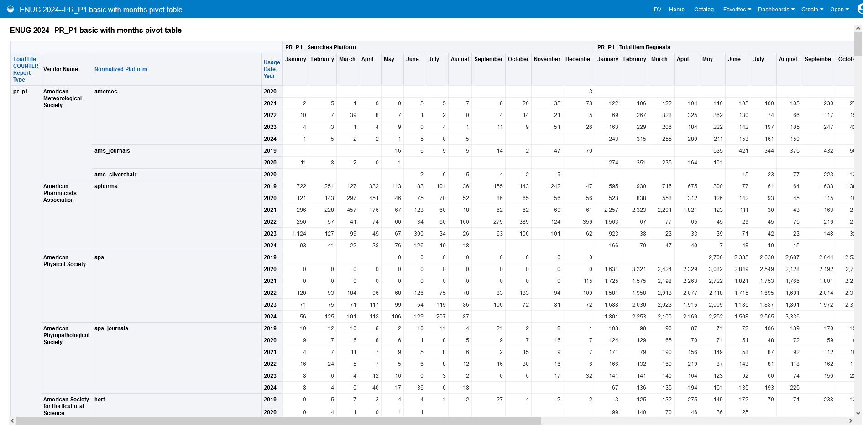
We see all the PR_P1 data associated with all our vendors, the platforms associated with each vendor, and the usage date years. As we scroll across, we see our 3 metrics, each with usage arranged from January – December. First we see PR_P1 Searches Platform, then we see PR_P1 Total Item Requests, and finally we see PR_P1, Unique Item Requests.

Slide 38
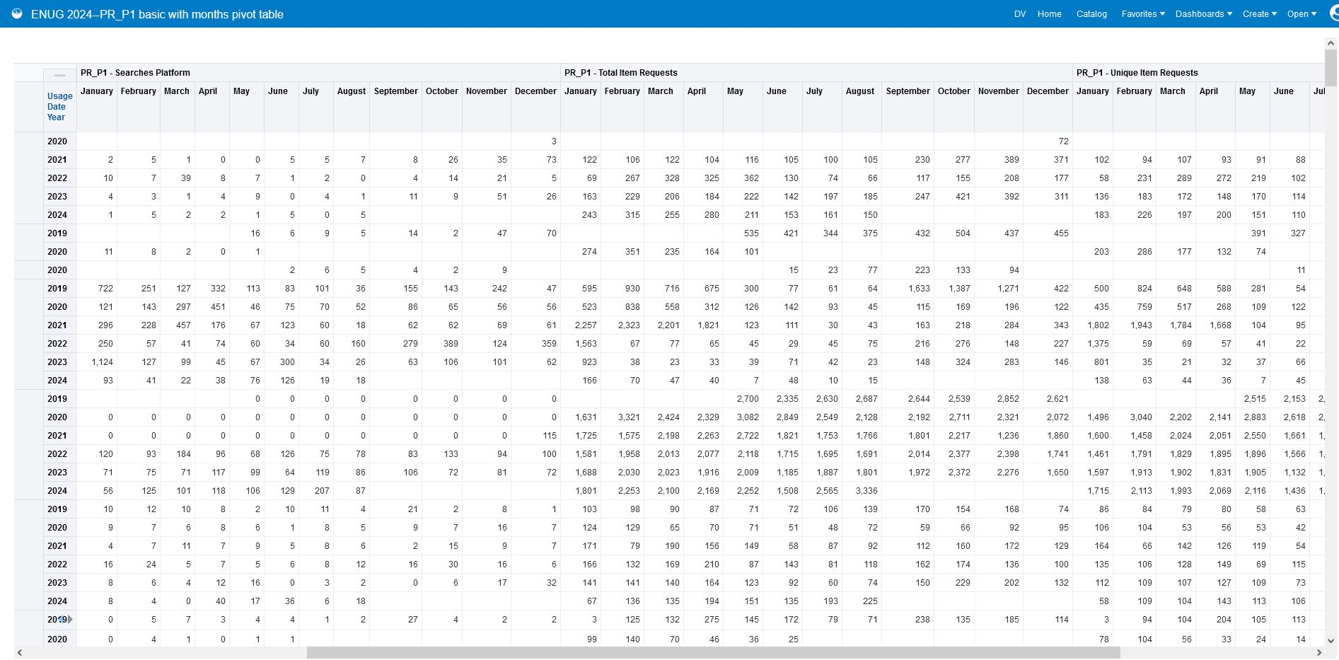

Slide 39
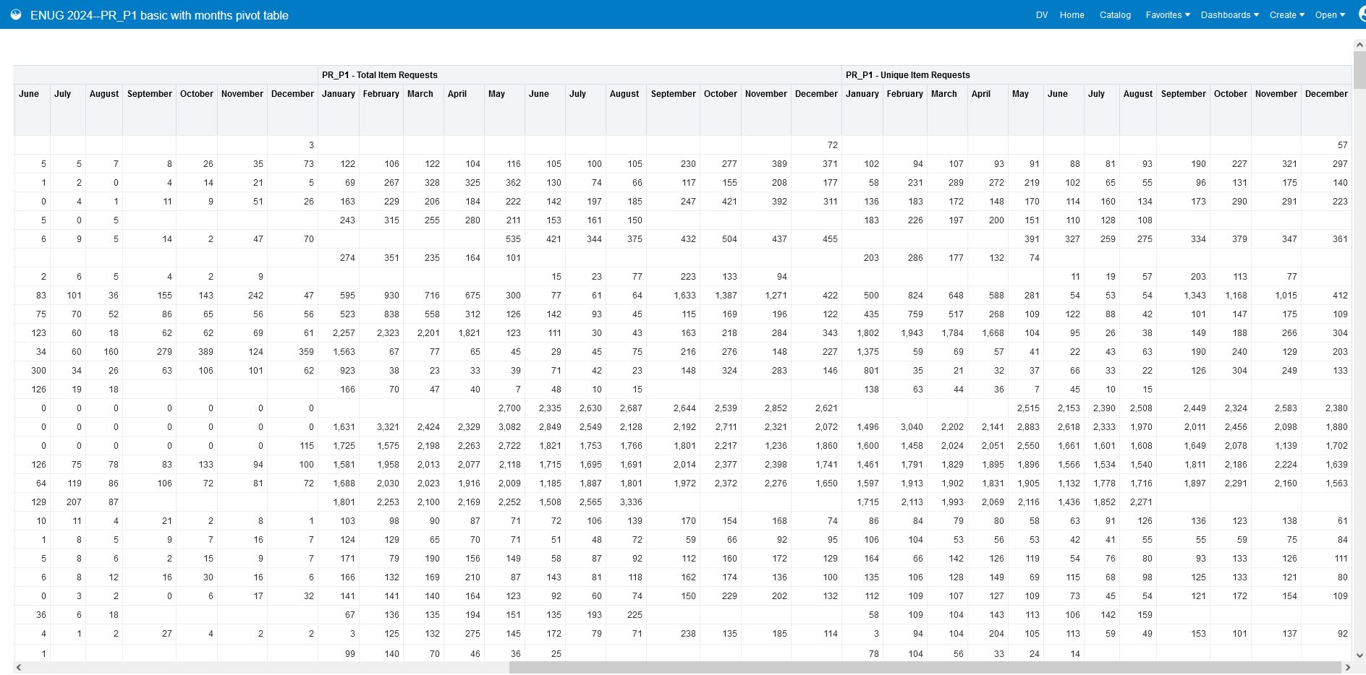

Slide 40
To make it easier for viewers to see that there are 3 different metrics as we scroll across our report, we apply different colored backgrounds to our 3 metrics

Slide 41
We edit Column Properties to apply background colors to our 3 metrics
In the Criteria tab, next to the column to which you want to apply color, select the gear icon. In the menu that appears, select Column Properties.

Slide 42
In the Style tab, in the Cell section, select the dropdown next to Background Color

Slide 43
Pick a color in the Color Selector
You can select from pre-defined colors or enter your own hex value
I prefer to choose lighter colors so the default black font is still visible
If you choose a darker color, you might need to change the font color so there is contrast between the background color and text
Remember that color can be an aid, but it should not be the only means of conveying information
You can also make font, border, and other customizations from this screen

Slide 44
After applying different colors to all 3 of our metrics columns, we check the results.

Slide 45
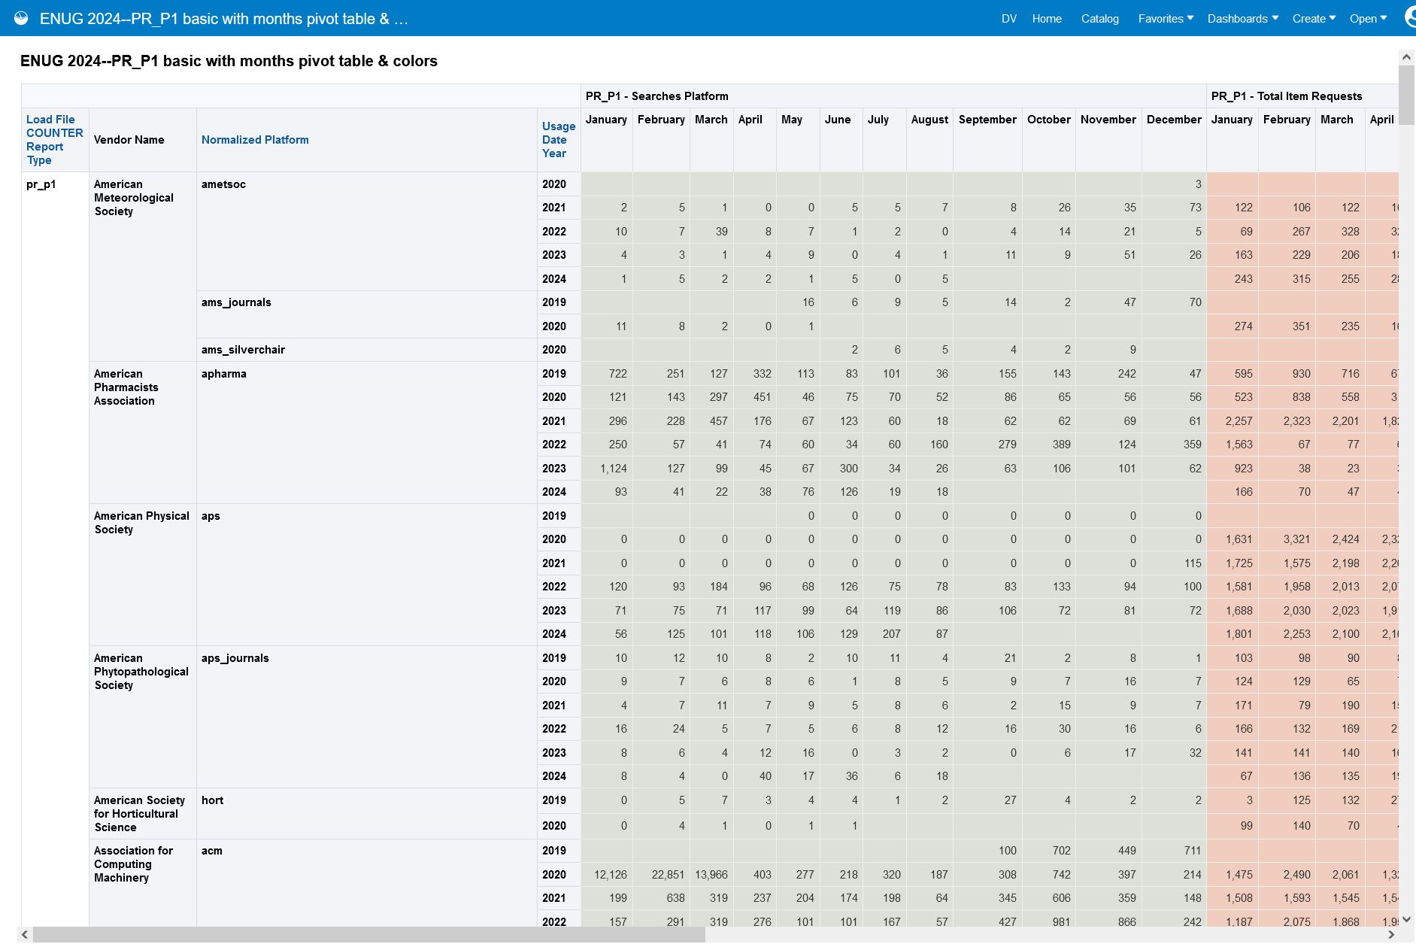
Now our metrics each have a different background color: first we see PR_P1 Searches Platform in green, then we see PR_P1 Total Item Requests in red, and finally we see PR_P1, Unique Item Requests in blue.

Slide 46
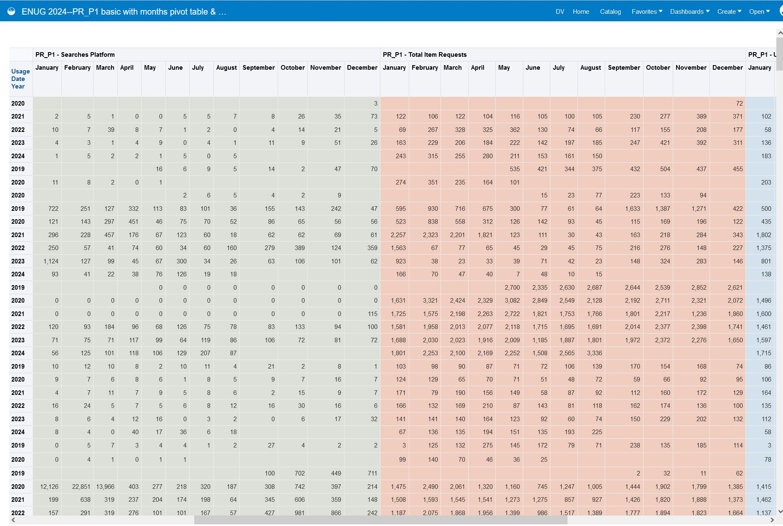

Slide 47
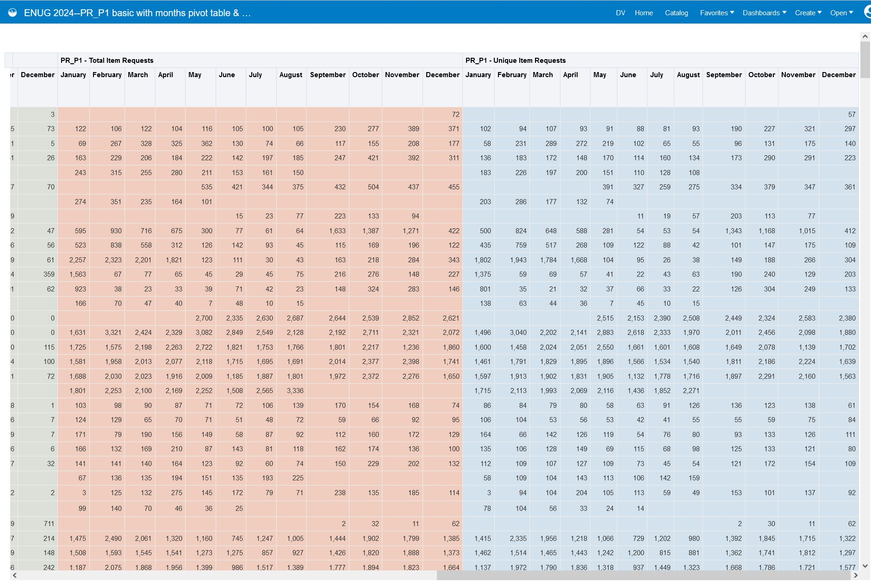

Slide 48
For many of our viewers, the colored backgrounds will help to distinguish the 3 different metrics. That’s a nice analysis showing all our usage from all our PR_P1 reports.
What if we need a more targeted analysis showing just some of our usage? What if a subject selector asks for a report of usage from a single platform?

Slide 49
We can set up prompts to drill down to the data we need
A prompt is like a filter, but instead of editing it in the Criteria tab, you interact with it via a point-and-click interface. It allows you to limit the data you see without editing the underlying analysis. You can make prompted reports to make your own job easier, and you may also share them with colleagues.
We can create a single prompt, or we can create multiple prompts that can be used together.
Consider which prompts will be useful for your scenario. Here are the columns I decided to turn into prompts for our platform report:
Vendor Name—We might be interested in all the usage associated with a specific vendor.
Normalized Platform—We might want to drill down to usage by platform.
Usage Date Year—Our selectors may want to see usage from specific years.

Slide 50
To get started adding prompts, we edit our report. Instead of staying in the Criteria tab, we go to the Prompts tab

Slide 51
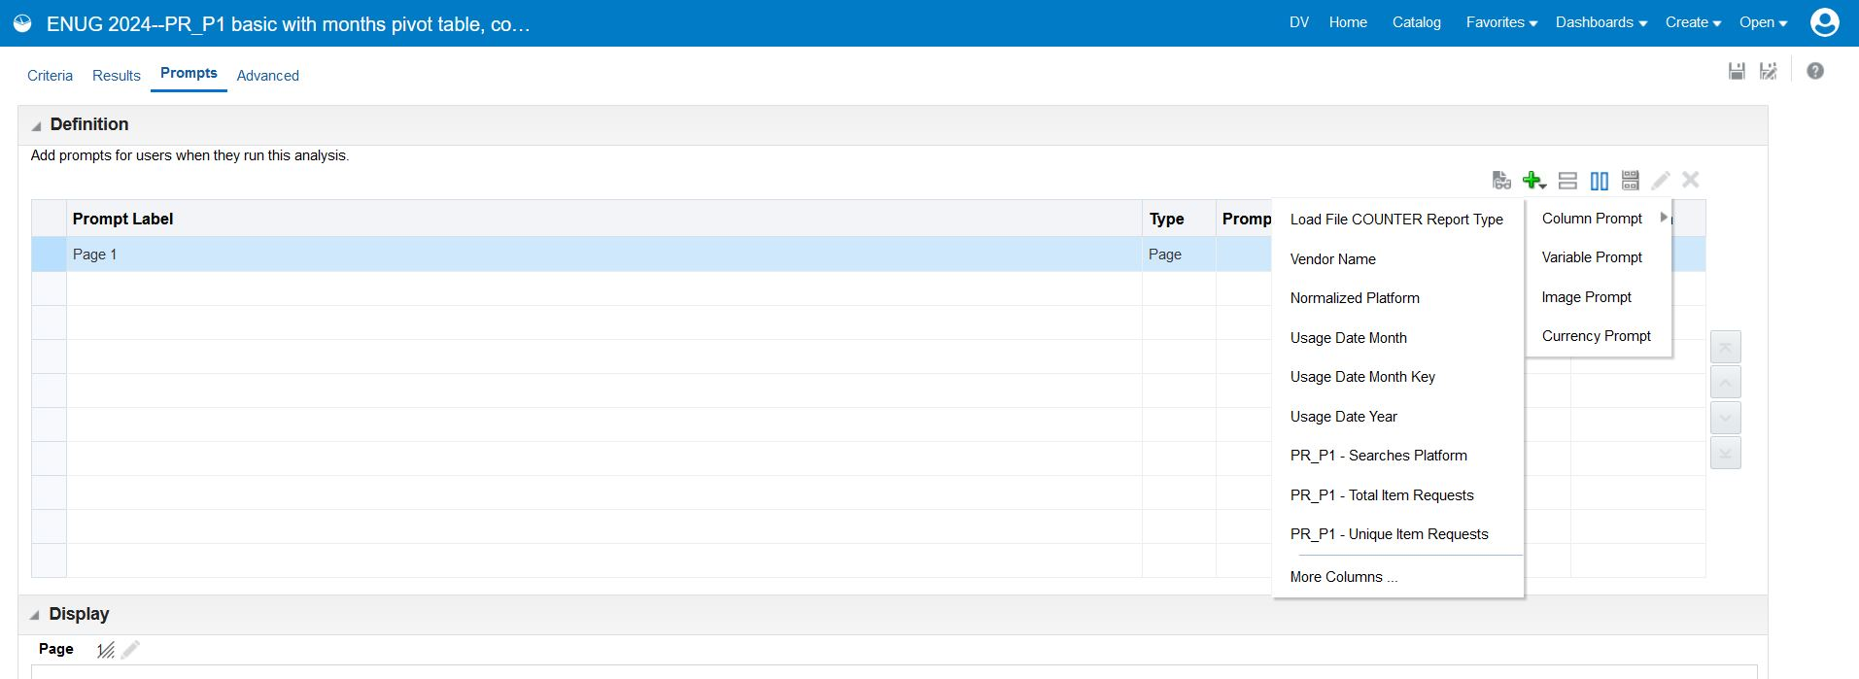
Select the green + icon and then hover over Column Prompt to see all the columns. Click a column name to create a prompt for that column.

Slide 52
Creating Vendor Name, Provider, & Year Prompts
For all 3, I choose the same options (most of these are defaults):
User Input is Choice List: This makes it so users can’t just enter any value. They choose between the values that are in this column.
Checked enable user to select multiple values: This makes it so we can select multiple vendors, platforms, or years for our analyses.
Checked enable user to type values: This allows a user to start typing, and the choice list will narrow to show only the matching values
Did not check require User Input: We want to be able to choose to enter values for some prompts but not others, so we do not check this.
Checked limit values by All Prompts: This makes it so you if select a value for one prompt, the other prompts’ choice list values will narrow so they only include values that occur in combination with the value you selected. For example, if I select a vendor, the platform choice list will narrow to only show platforms whose reports I uploaded to that vendor.

Slide 53
We add all 3 prompts, check them in the Display section, and Save

Slide 54
To interact with our prompts, we go back to the Catalog, find our analysis, and select Open

Slide 55
When we open the analysis, we see our prompts

Slide 56
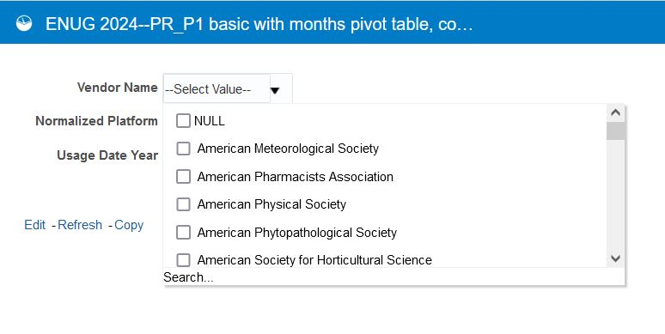
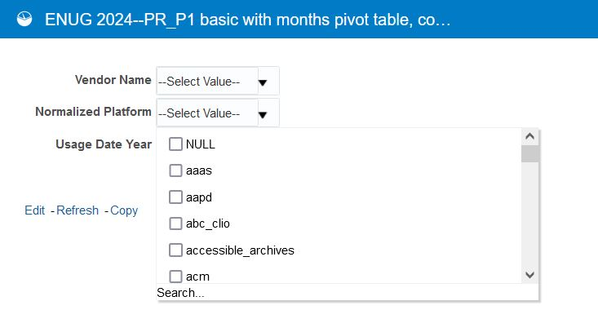
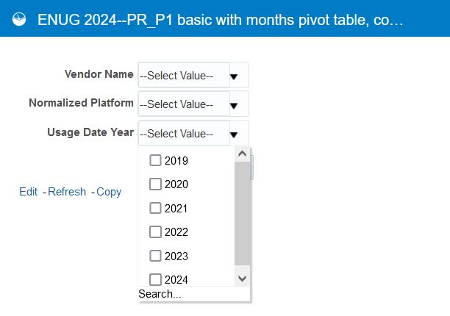
Clicking the dropdown arrow next to each prompt shows the choice lists. We can use the checkboxes to select vendor(s), platform(s), and year(s).
Vendor Name
Normalized Platform
Usage Date Year

Slide 57
Let’s see our prompt configuration choices in action!

Slide 58
Because we selected “Enable User to Type Values,” we can start typing, and matches will appear
When we start typing “pro…” in the vendor box, the choice list is limited to vendors beginning with “pro…”
We can then select the vendor we want.

Slide 59
Because we selected “Limit Values by All Prompts,” after we select one value, the other prompts’ values narrow
Because we selected “ProQuest” as the vendor, our platform select list is limited so it only includes platforms whose data we uploaded to the Vendor ProQuest

Slide 60
Because we chose “Enable User to Select Multiple Values,” we can select multiple values
Perhaps we want to check usage on both the search.alexanderstreet.com and video.alexanderstreet.com platforms. We chose multiple platform values:
search_alexanderstreet_com
video_alexandeerstreet_com

Slide 61
Because we did not select “Require User Input,” we don’t have to enter a value into all prompts
We don’t have to enter any values into Usage Date Year. That will make it so all years with data appear in our results.
We select “OK” when we have filled in all our prompts, and then we see our results!

Slide 62
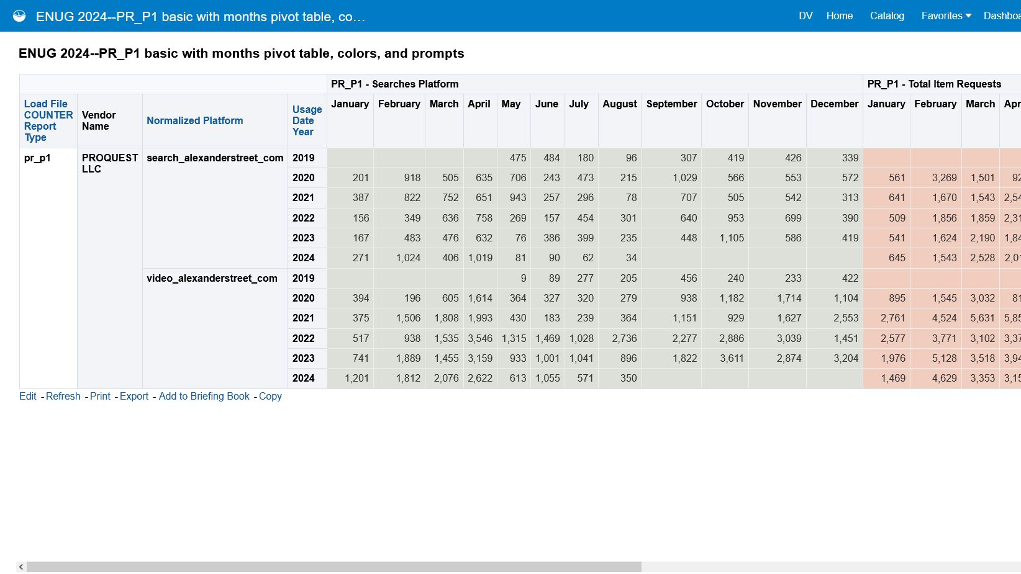
We see the PR_P1 data associated with the vendor we selected (PROQUEST LLC) and the platforms we selected (search_alexanderstreet_com & video_alexanderstreet_com). Because we didn’t enter any values into the Usage Date Year prompt, we see data from all the years and months we loaded into Alma.

Slide 63
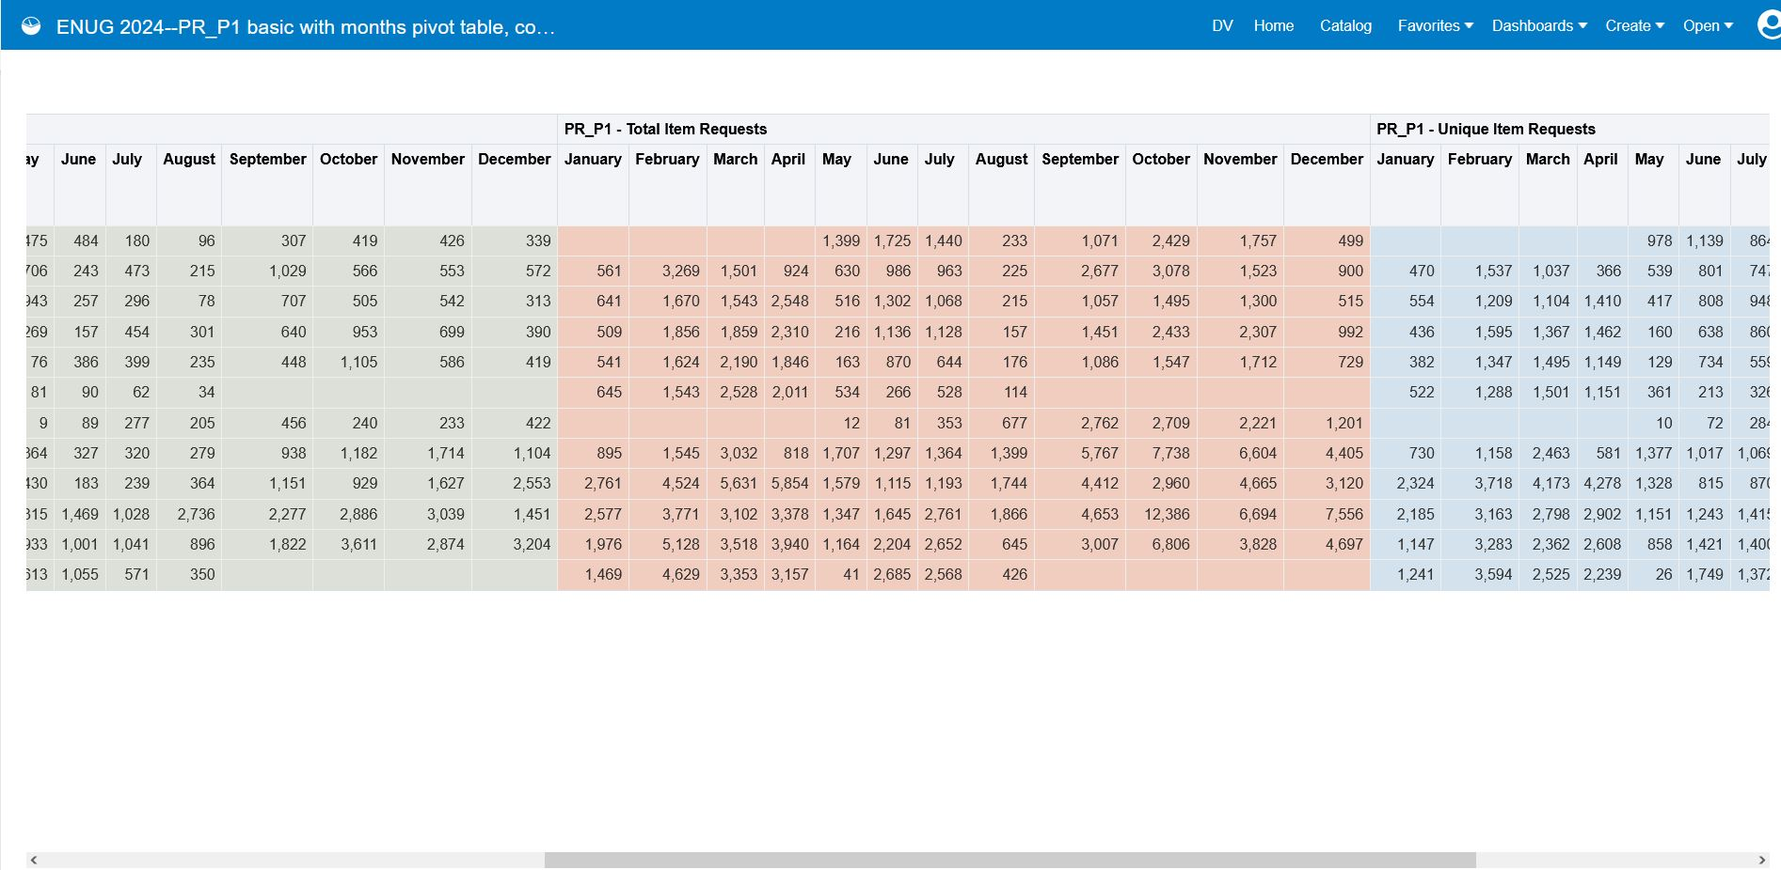

Slide 64
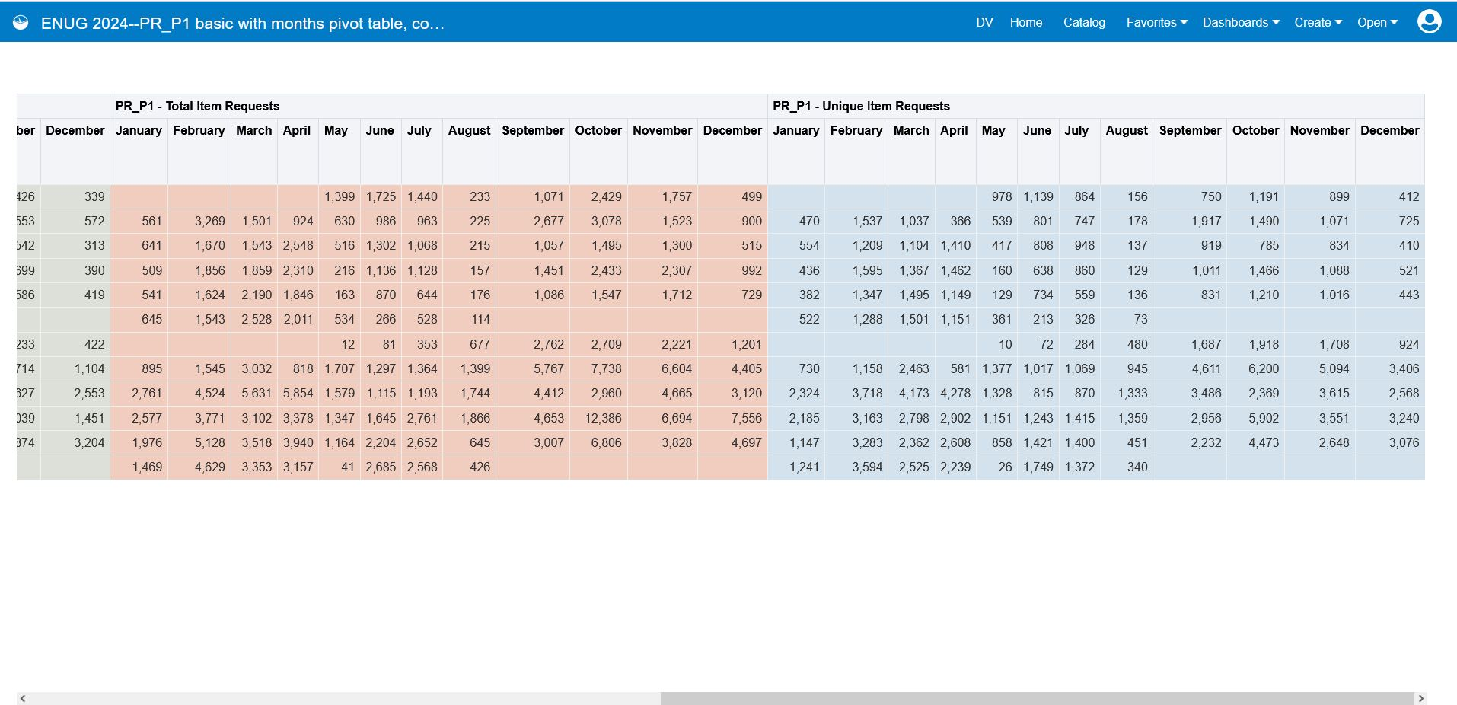

Slide 65
That was a good way to see usage across a whole platform! We often have multiple databases on the same platform. What about making a DR_D1 report for databases?

Slide 66
We can follow the same process to build a report showing all our DR_D1 data, with just minor differences:
In our Criteria:
We filter Load File COUNTER Report Type by “is equal to/is in dr_d1.”
Because DR_D1 reports include the title of each database, we add the column Normalized Title. This will contain the title of each database.
Instead of including PR_P1 metrics, we include DR_D1 metrics: DR_D1 Searches Regular, DR_D1 Total Item Investigations, and DR_D1 Total Item Requests.
When we make our prompts:
In addition to Vendor, Platform, and Year prompts, we make a prompt for Normalized Title (we make it a choice list like the other prompts, and we use the same settings).

Slide 67
Let’s try out our DR_D1 analysis with prompts

Slide 68
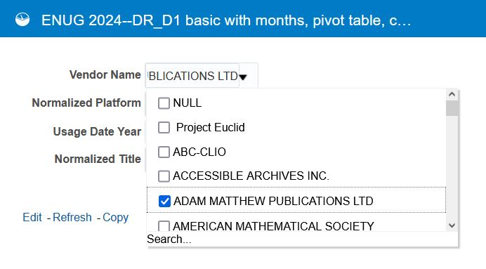
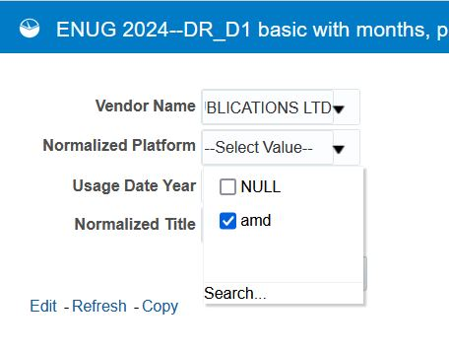
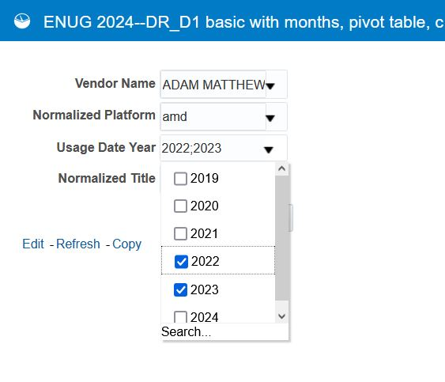
Let’s start by looking at usage of all databases on a platform. We select Vendor Name, Platform, and Years to see all the usage associated with the vendor and the platform for specific years. We don’t make any selections for Normalized Title because we want to see usage of all databases.
Select Vendor Name
Select Platform
Select Years

Slide 69
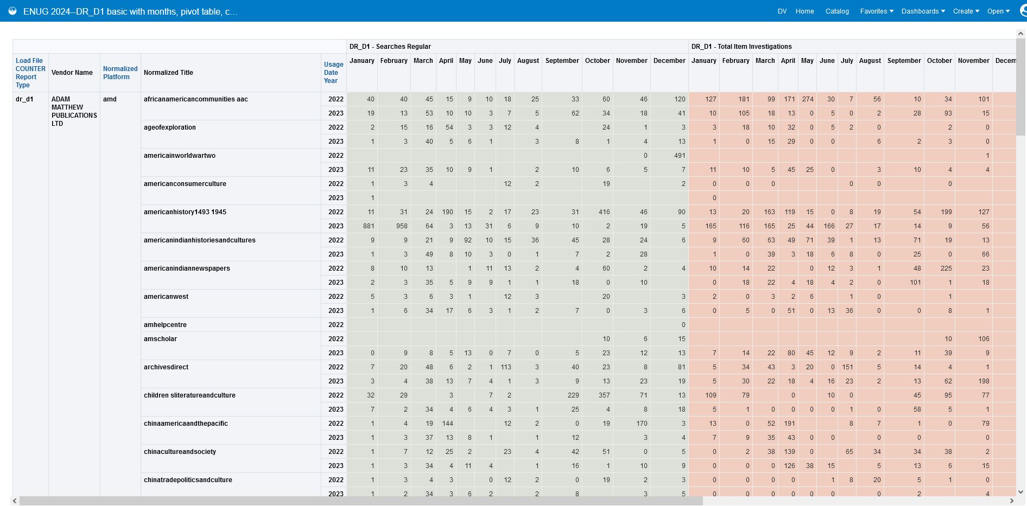
We see just the DR_D1 data associated with the vendor we selected (ADAM MATTHEW PUBLICATIONS LTD), platform we selected (amd), and years we selected (2022 & 2023). Because we didn’t select any normalized titles (databases), we see usage for all databases on the platform.

Slide 70
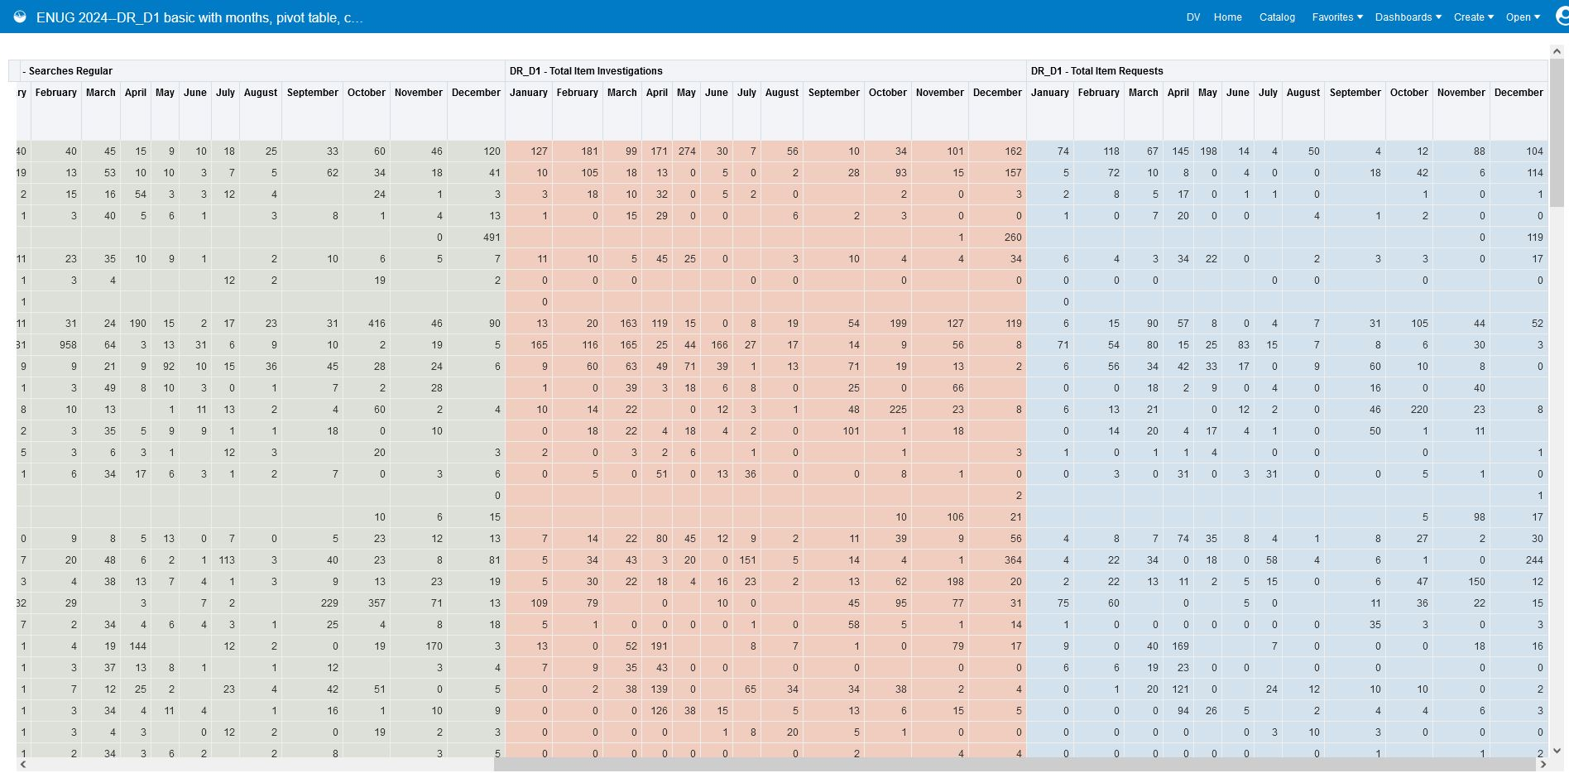

Slide 71
To see usage of a single database, we use the Normalized Title prompt
In this case, we’re looking up usage of the Victorian Popular Culture database

Slide 72
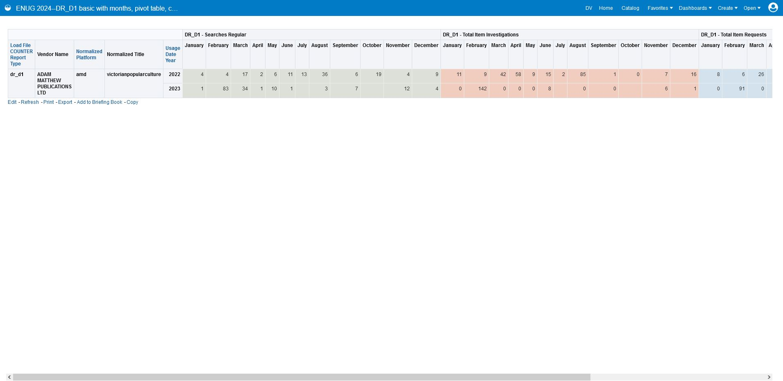
Now we see the DR_D1 data associated with the vendor we selected (ADAM MATTHEW PUBLICATIONS LTD), platform we selected (amd), years we selected (2022 & 2023), and normalized title (for DR_D1, this is the database title) we selected (victorianpopularculture).

Slide 73
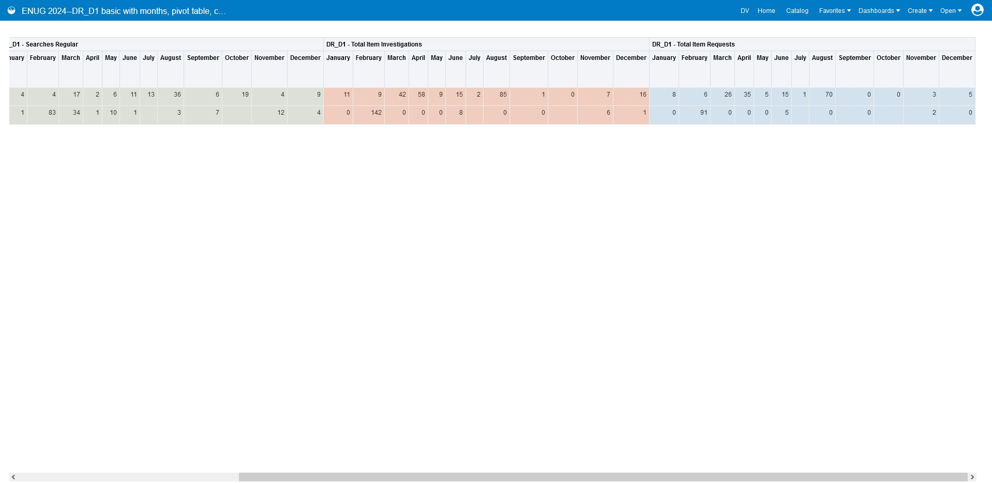

Slide 74
What if we want to make a report showing journal usage (TR_J1)?

Slide 75
We can follow the same process to build a report showing all our TR_J1 data, with just minor differences:
In our Criteria:
We filter Load File COUNTER Report Type by “is equal to/is in tr_j1”
Like we did for DR_D1, we add the column Normalized Title. This time, this will contain the title of each journal (because we limited by report type TR_J1).
PR_P1 and DR_D1 show searches as well as item-level investigations or uses. TR shows only full-text use. So, instead of adding 3 different metrics to our report, we add just a full-text use metric for journal articles—TR_J1 unique item requests.
When we make our prompts:
In addition to our Vendor, Platform, and Year prompts, we make a prompt for Normalized Title.
Because there are so many journal titles throughout all our reports that a choice list might be unwieldy, we make Normalized title a Text Field prompt instead of a Choice List prompt. We use “contains any” as our operator because we want to be able to enter just a few words of a lengthy title and find a match.
In our Pivot table:
Because we no longer need to convey 3 different metrics horizontally, we can use our horizontal space differently. “Year” can be one of our pivot table columns so we see usage displayed chronologically from left to right. This will result in a report that looks a lot like a COUNTER spreadsheet.

Slide 76
Setting up the pivot table for TR_J1
This time, we move Usage date year, Usage Date Month Key, and Usage Date Month into the Columns section.
Our columns are ordered from top to bottom. So, make sure Usage Date Year is on top (so usage is first ordered from left to right by year) Usage Date Month Key is next (so it is used to order the months), and Usage Date Month is on bottom
Like we did before, we hide Usage Date Month Key from view

Slide 77
Setting up our Normalized Title Text Field prompt
We choose User Input “Text Field”
We chose Operator “contains any” because if we type just a few words instead of a full title, we want to match to titles that contain those words
We don’t require user input because we want to be able to filter by vendor or platform and then leave the Normalized Title prompt blank to see all the TR_J1 usage from all journal titles associated with that vendor or platform.

Slide 78
Let’s try out the TR_J1 Prompts

Slide 79
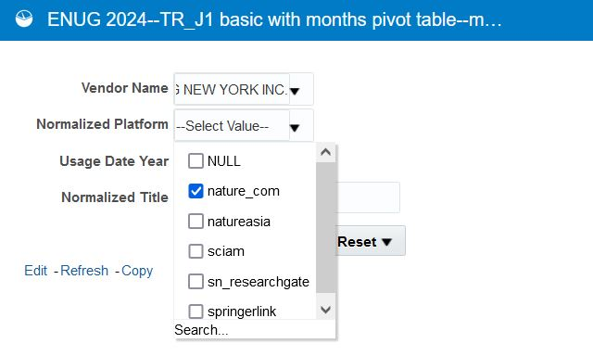
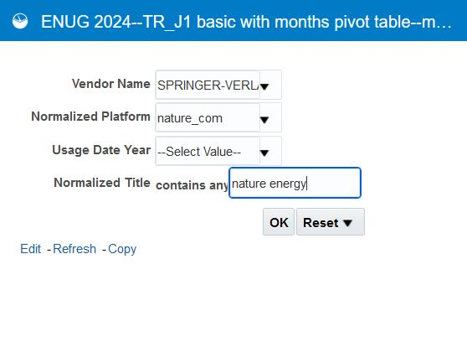
We can use the normalized title prompt to look up usage of a specific journal title
Find our Vendor Name
Select our Platform
Enter a journal title (use lowercase because it’s normalized)

Slide 80
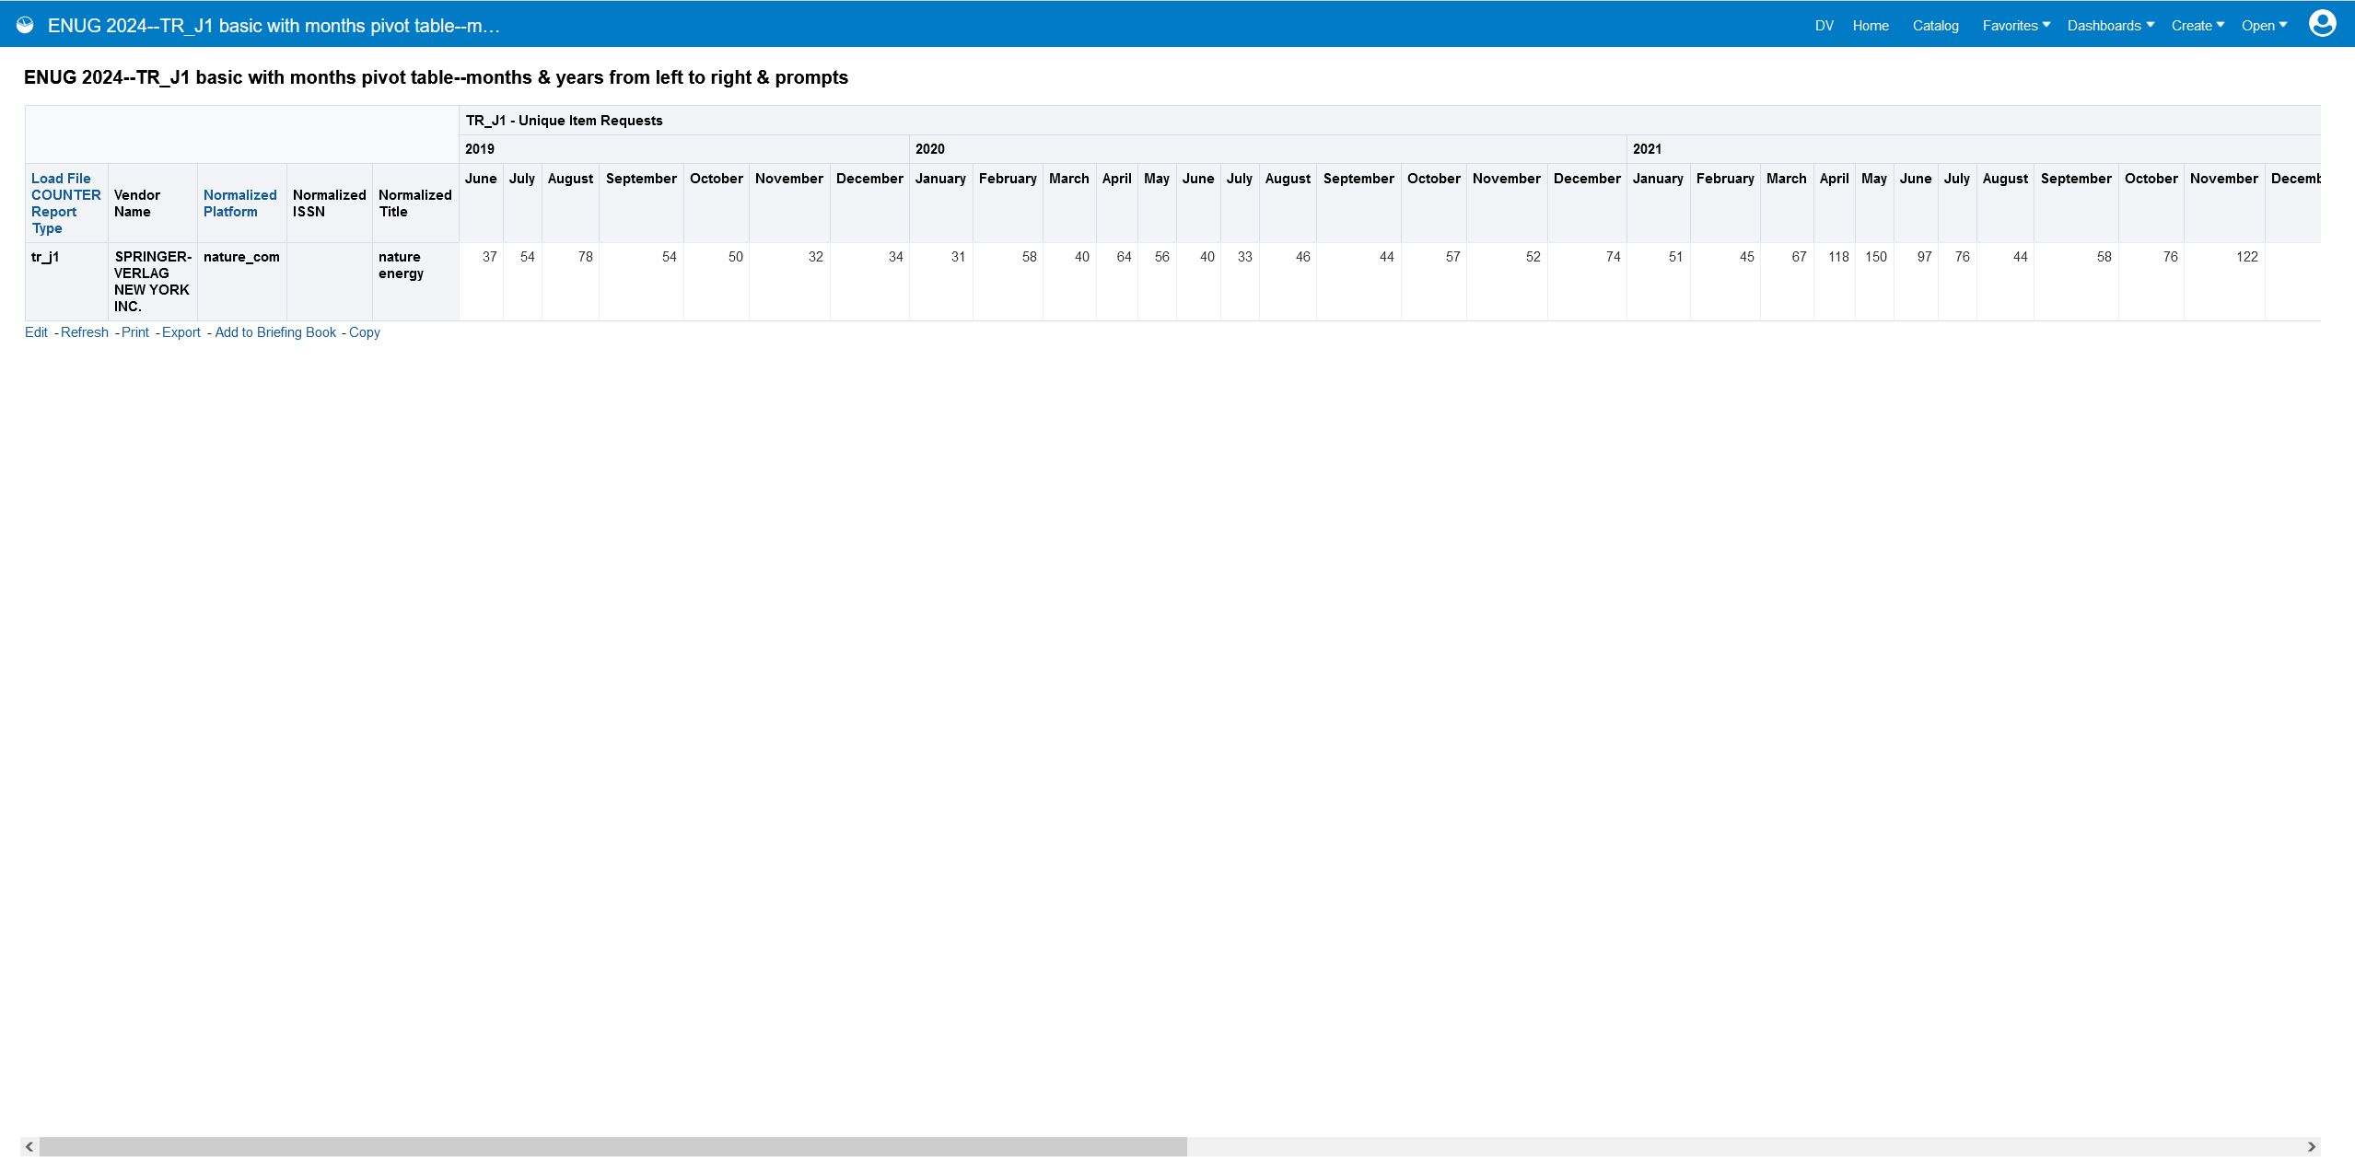
We see the TR_J1 data associated with the vendor we selected (SPRINGER-VERLAG NEW YORK INC.), platform we selected (nature_com), and normalized title (for TR_J1, this is the journal title) we entered (nature energy). Because we turned usage date year into a pivot table column, usage data is arranged chronologically from left to right, just as in a traditional COUNTER spreadsheet.

Slide 81
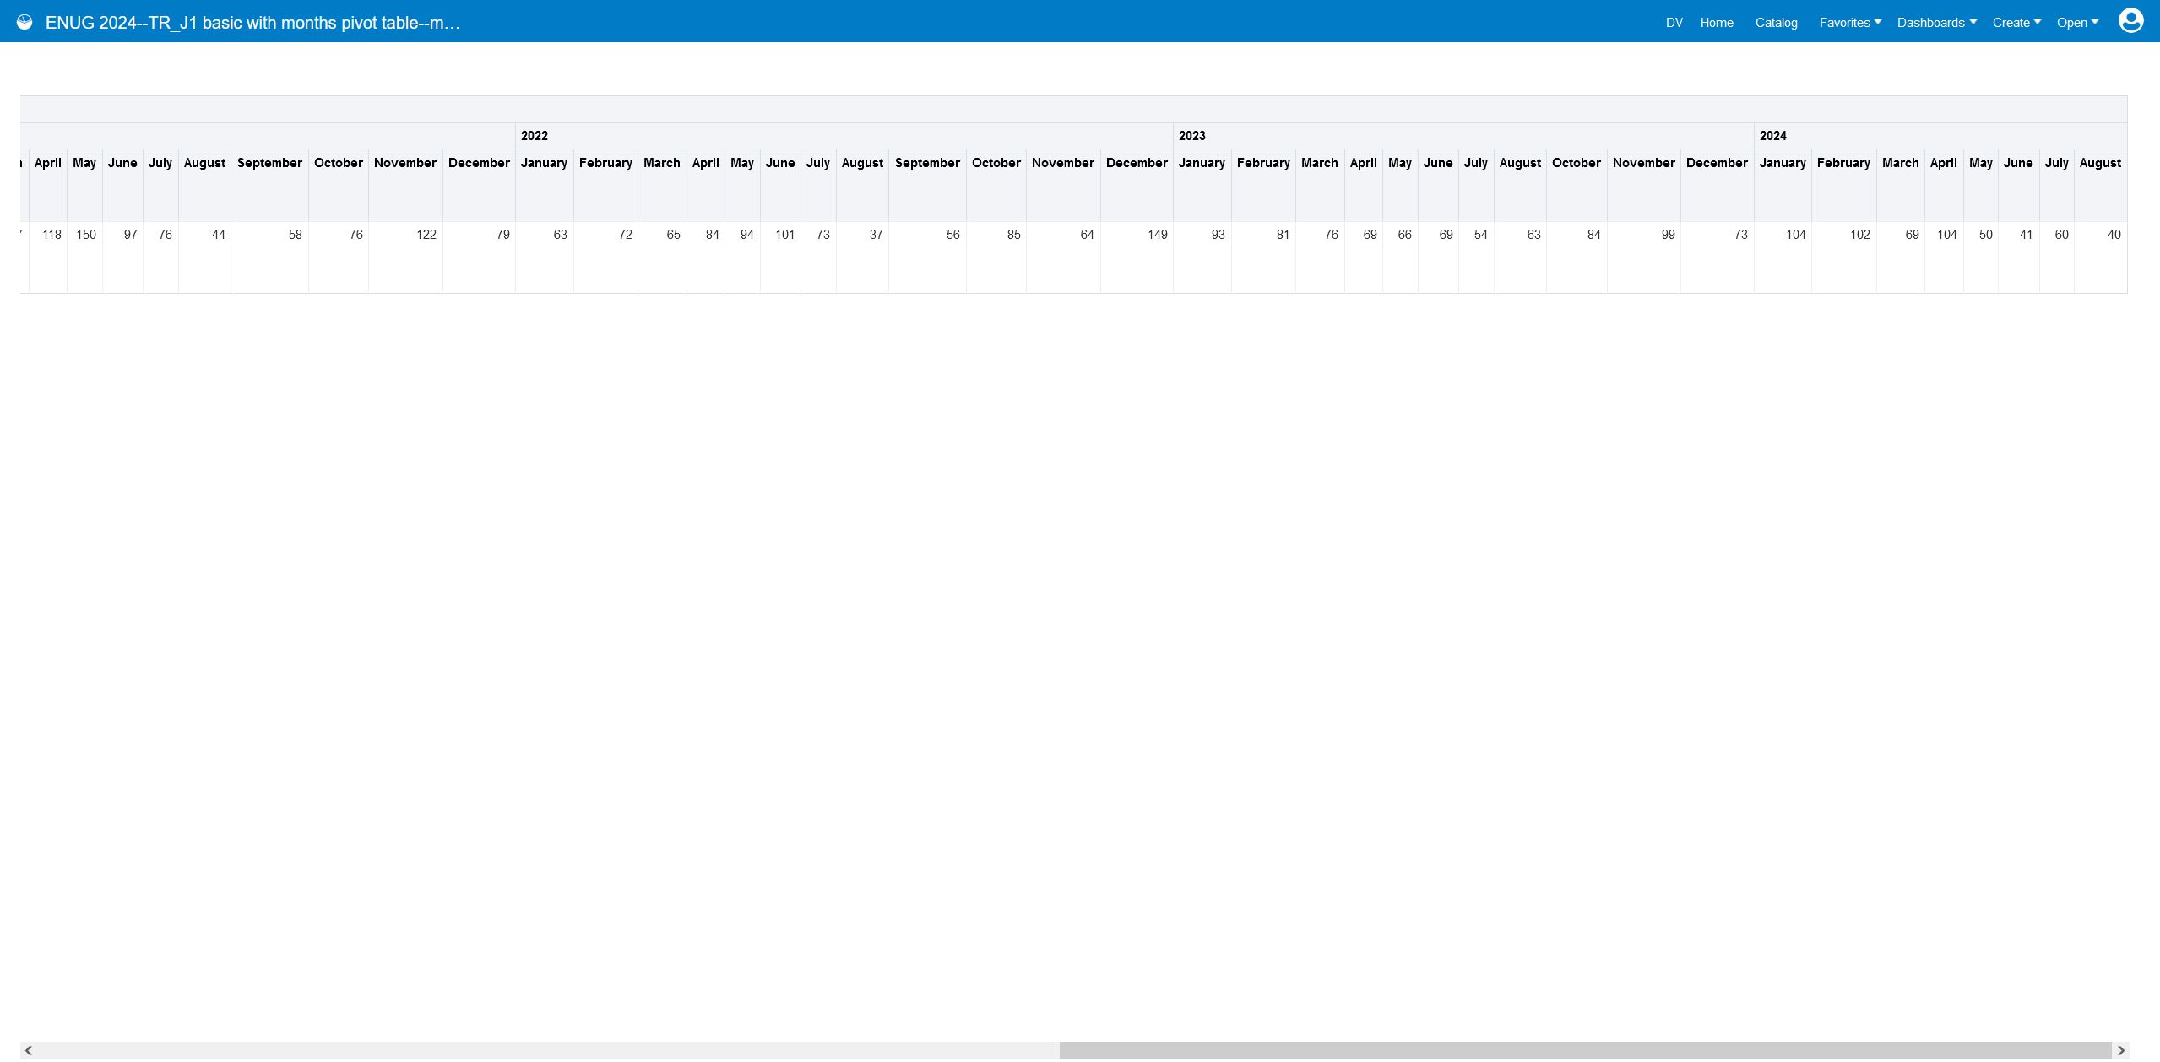

Slide 82
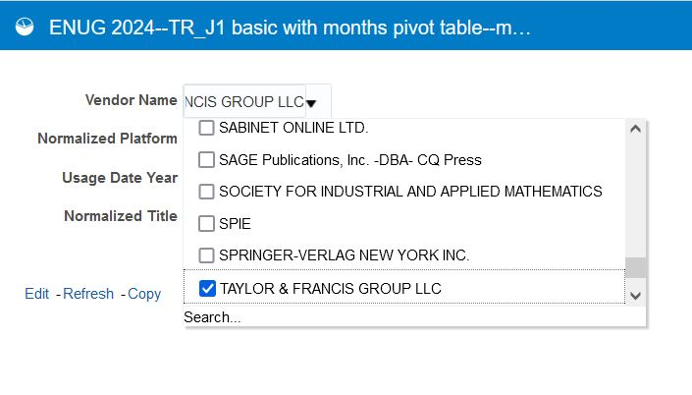
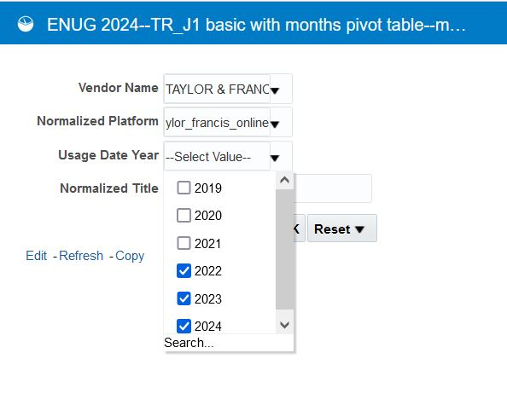
We can look up usage of all journals on a platform during the years of our choice
Select Vendor Name
Select Platform
Select Years

Slide 83
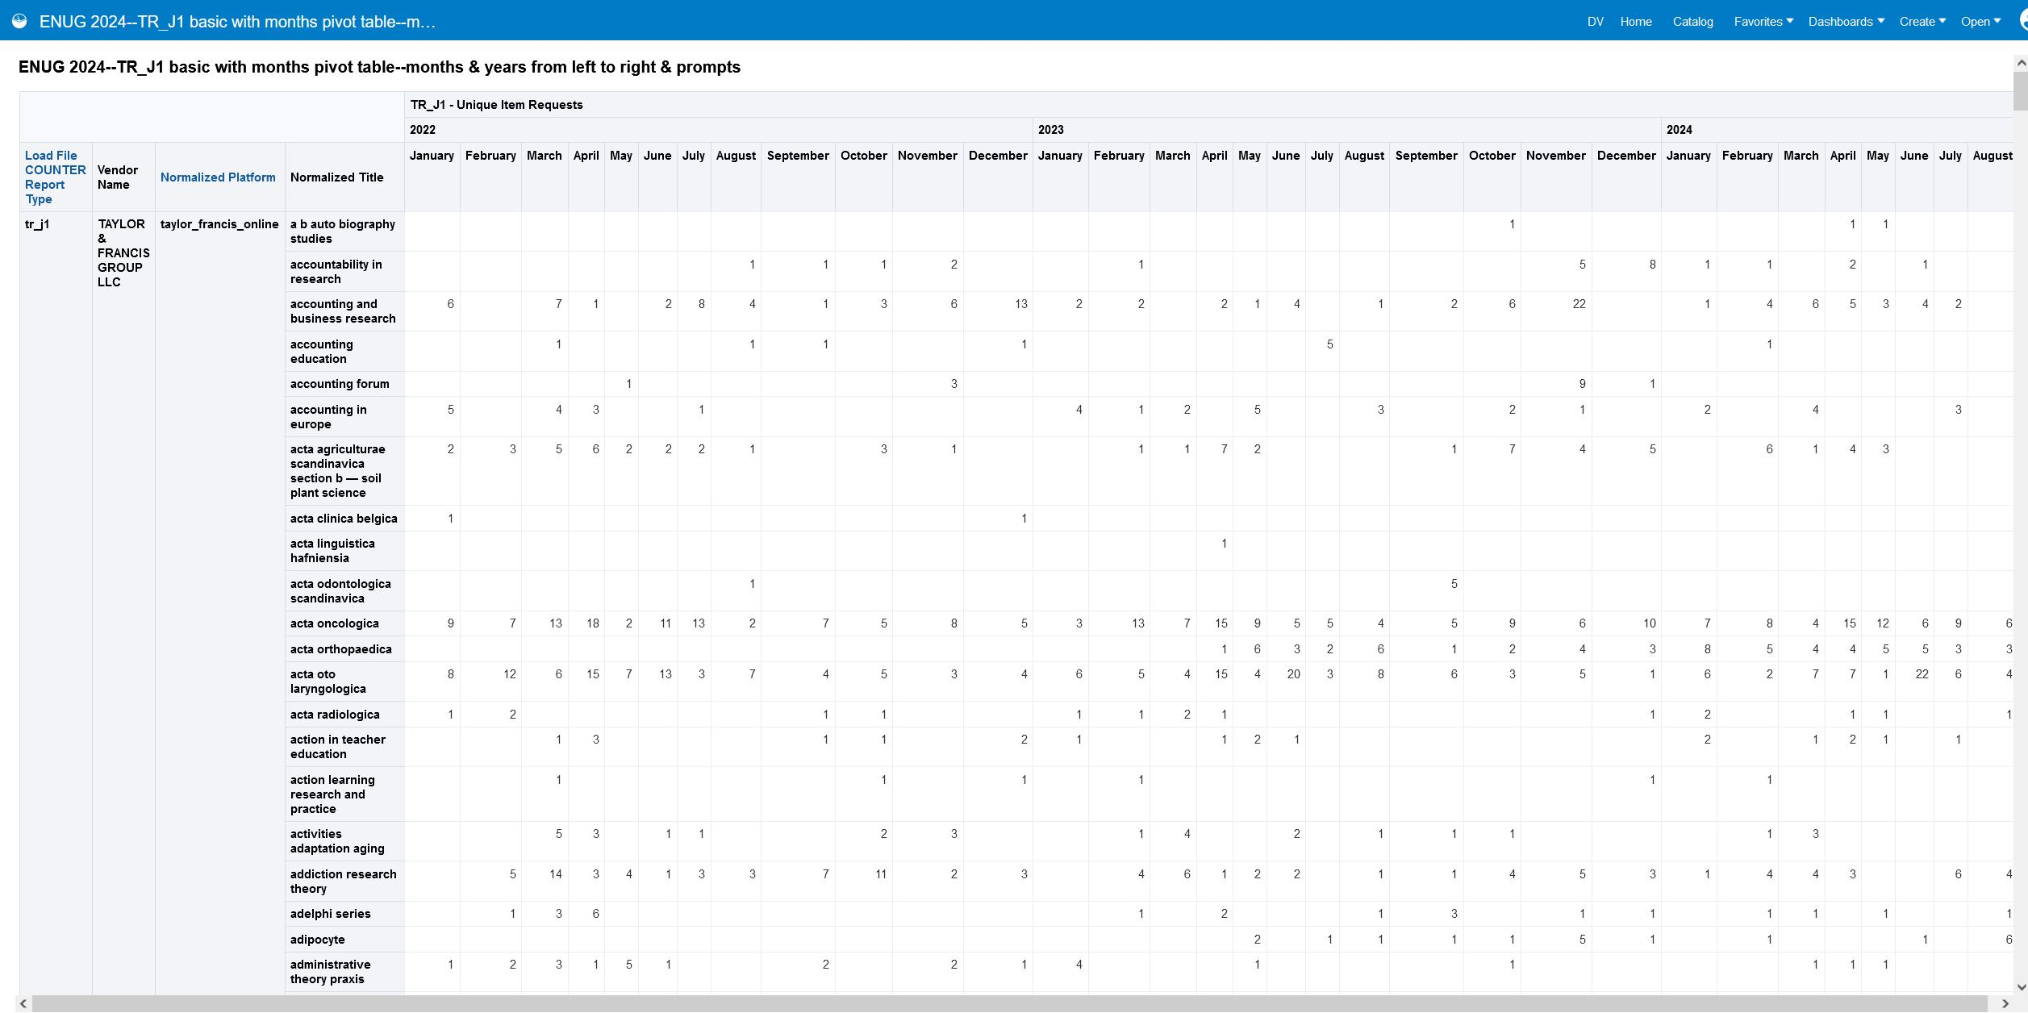
We see the TR_J1 data associated with the vendor we selected (TAYLOR & FRANCIS GROUP LLC) platform we selected (taylor_francis_online), and years we selected (2022, 2023, & 2024). Because we didn’t enter anything into the normalized title prompt, we see data for all journals on this platform.

Slide 84
What if we had a “sum total” column that added up total usage for each journal during the time span shown on the report?

Slide 85
Go back to the Criteria and add a 2nd TR_J1, Unique Item Requests column

Slide 86
We confirm it goes into the right place in the pivot table Layout
The original is in the Measures section and provides the monthly data
The new one is in the rows section and provides the sum total

Slide 87
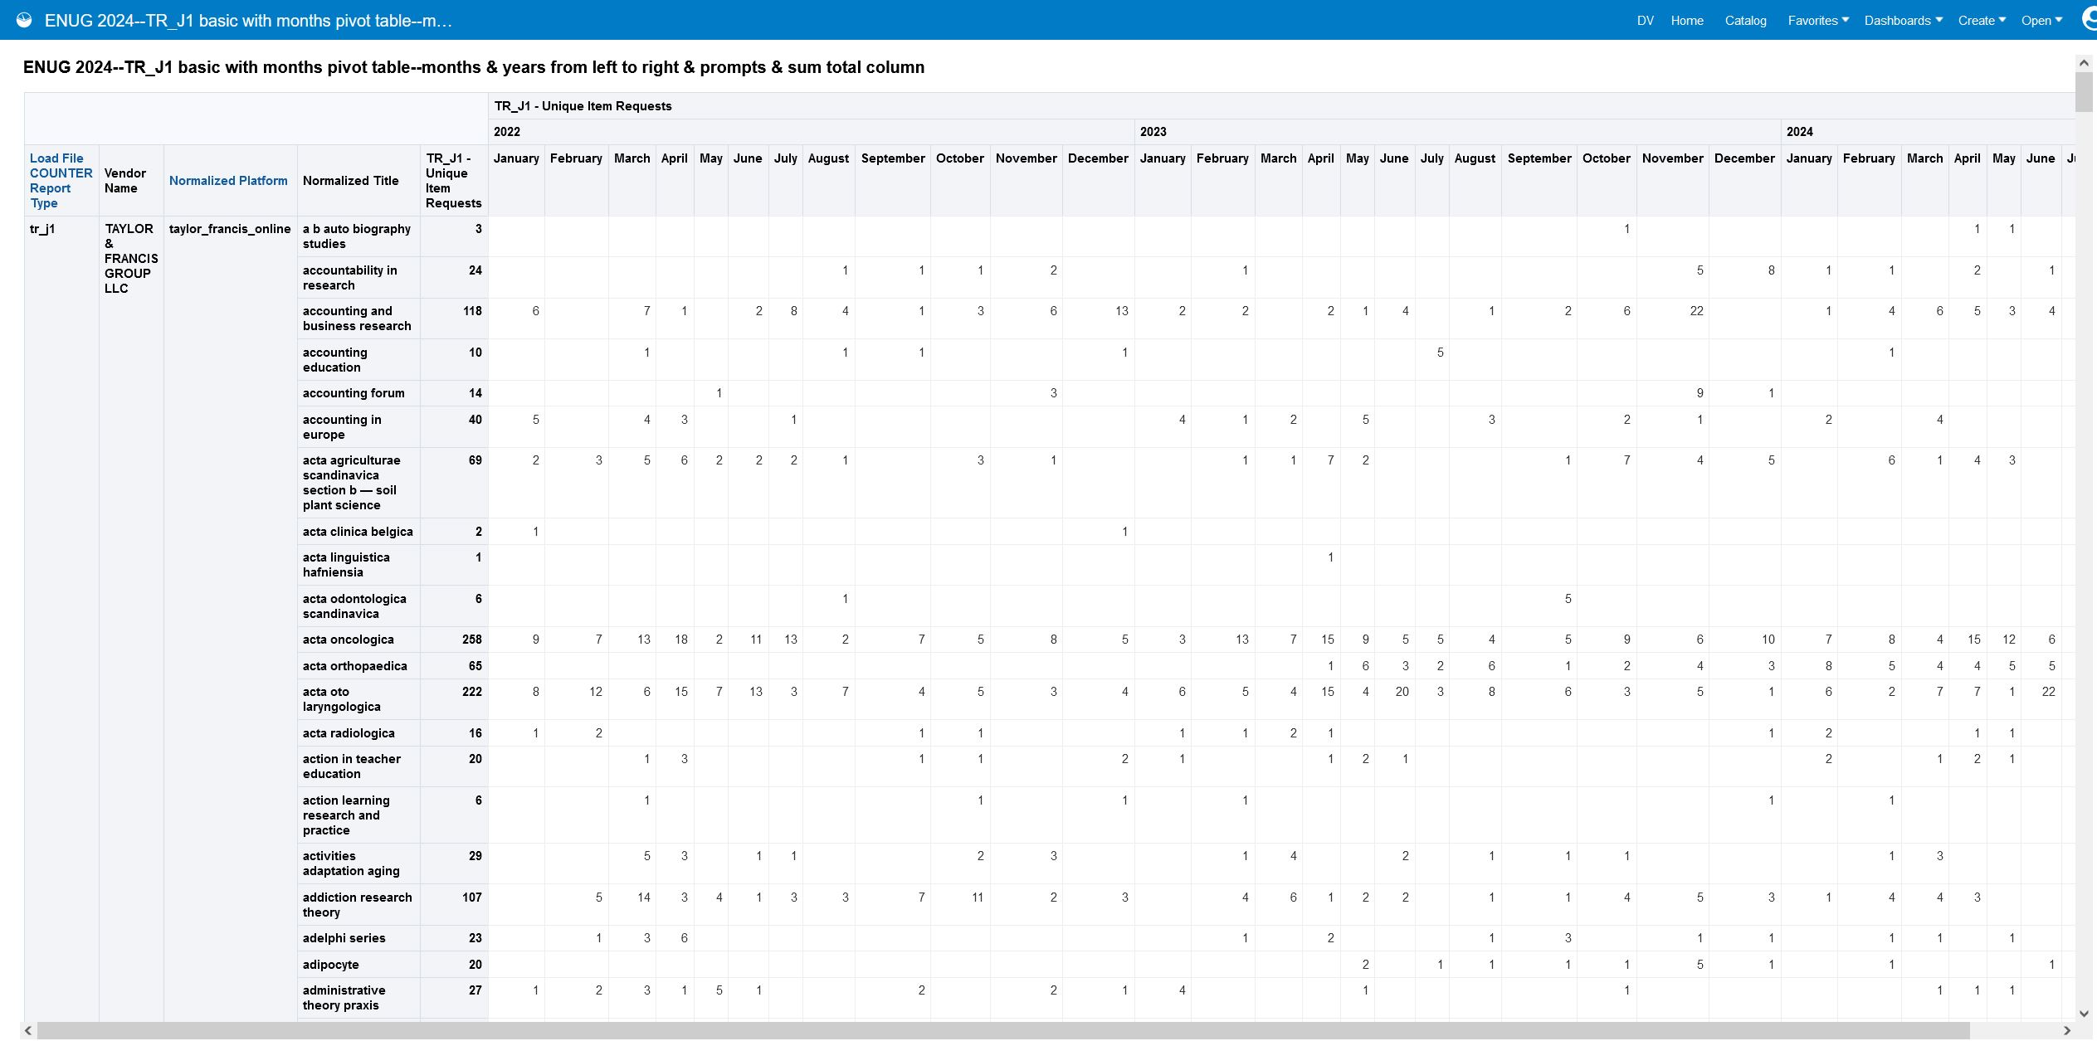
Now when we run our prompted analysis, we see our new column that adds up the usage for each journal for the time span shown in our analysis.

Slide 88
That was neat for journals! Can I do the same type of reporting for books?

Slide 89
We can copy our TR_J1 report, and, with just a couple changes, make it into a TR_B1 report
Criteria
Filter by Load File COUNTER Report Type is equal to/is in TR_B1
Use measure TR_B1 Unique Title Requests. Be sure to include it twice so one column is used for the monthly usage breakdown and one column is used for the sum total!
Continue to use Normalized Title field. This time, it will contain book titles (because we limited to report type TR_B1).

Slide 90
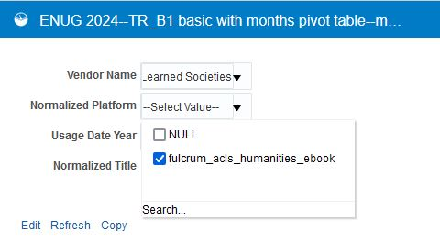
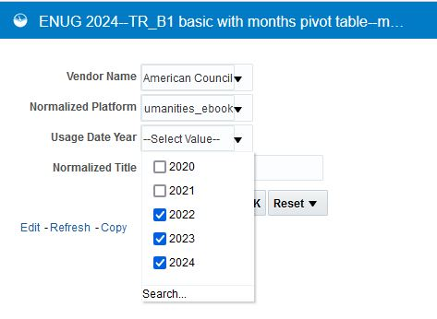
We can look up usage of all books on a platform during the years of our choice
Select Vendor Name
Select Platform
Select Years

Slide 91
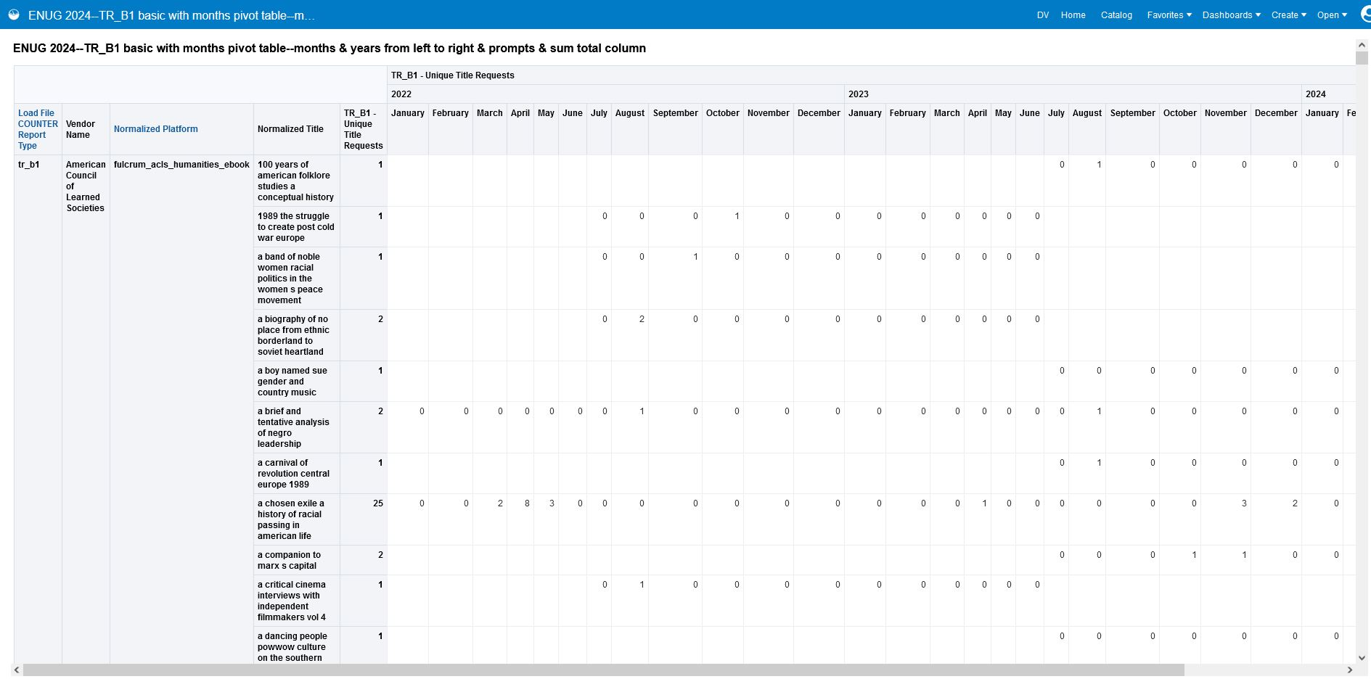
We see the TR_B1 data associated with the vendor we selected (American Council of Learned Societies), platform we selected (fulcrum_acls_humanities ebook), and years we selected (2022, 2023, & 2024). Because we didn’t enter anything into the normalized title prompt, we see data for all books on the platform.

Slide 92
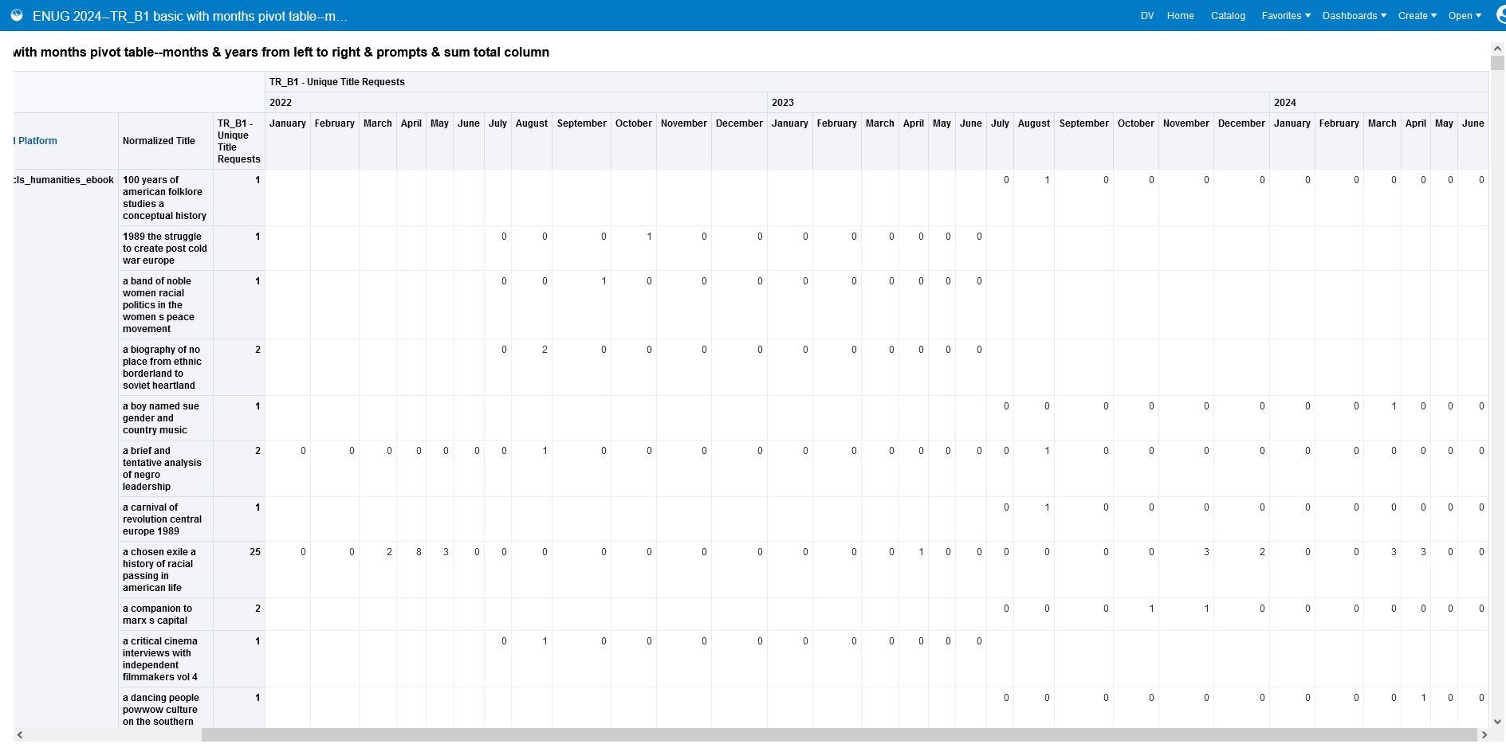

Slide 93
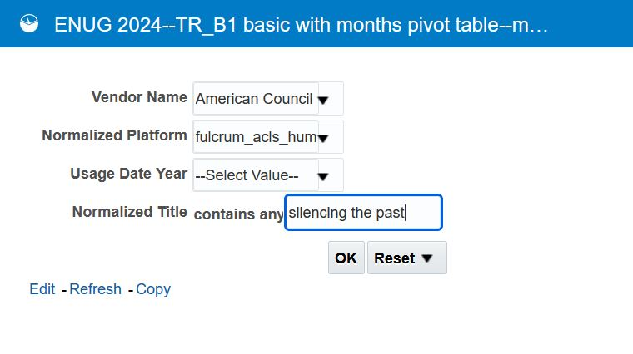
We can look up usage of a specific book by title using the Normalized Title prompt
Select Vendor Name
Select Platform
Enter normalized title (make sure to use all lowercase)

Slide 94
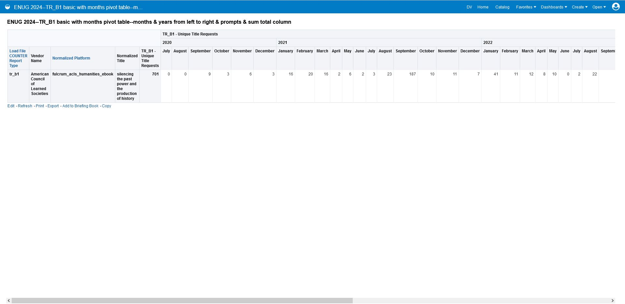
We see the TR_B1 data associated with the vendor we selected (American Council of Learned Societies), platform we selected (fulcrum_acls_humanities ebook), and book title that matches what we entered into the prompt (silencing the past). Because we used “contains any” as our prompt operator, we were able to enter just a few words of the title and find a match.

Slide 95
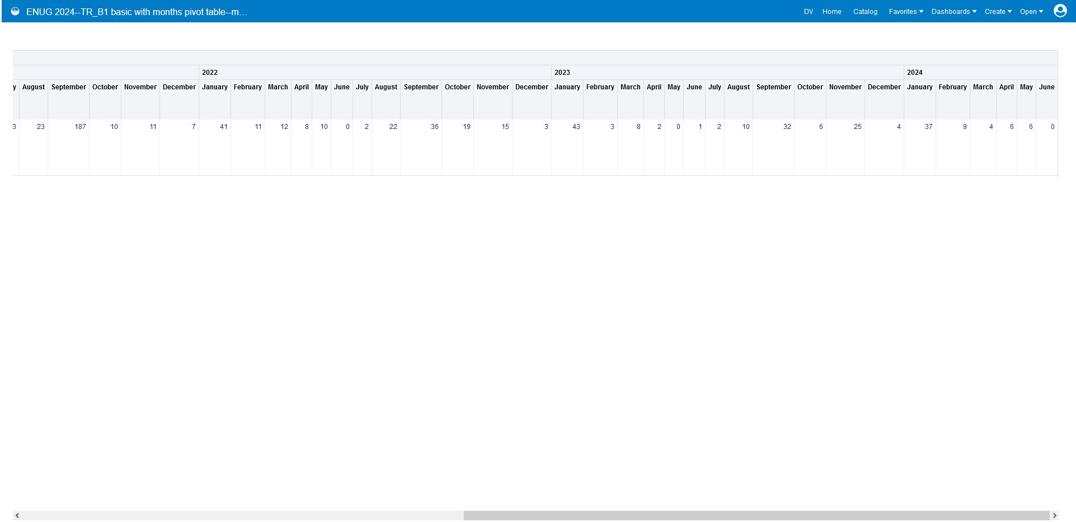

Slide 96
What about reporting on media usage? We can build an analysis of IR_M1, which includes usage of video, audio, and images.

Slide 97
We can copy our TR_J1 or TR_B1 report, and, with just a couple changes, make it into an IR_M1 report
Criteria
Filter by Load File COUNTER Report Type is equal to/is in IR_M1
Use measure IR_M1, Total Item Requests. Be sure to include it twice so one column is used for the monthly usage breakdown and one column is used for the sum total!
Continue to use Normalized Title field. This time, it will contain media titles (because we limited the report type to IR_M1).

Slide 98
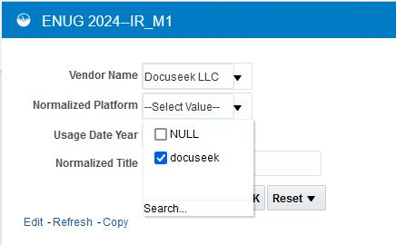
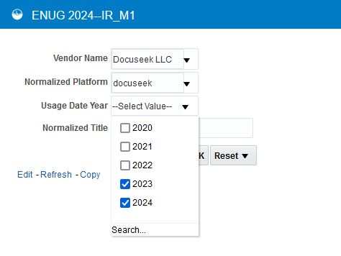
We can look up usage of all media associated with a vendor and platform during the years of our choice
Select Vendor Name
Select Platform
Select Years

Slide 99
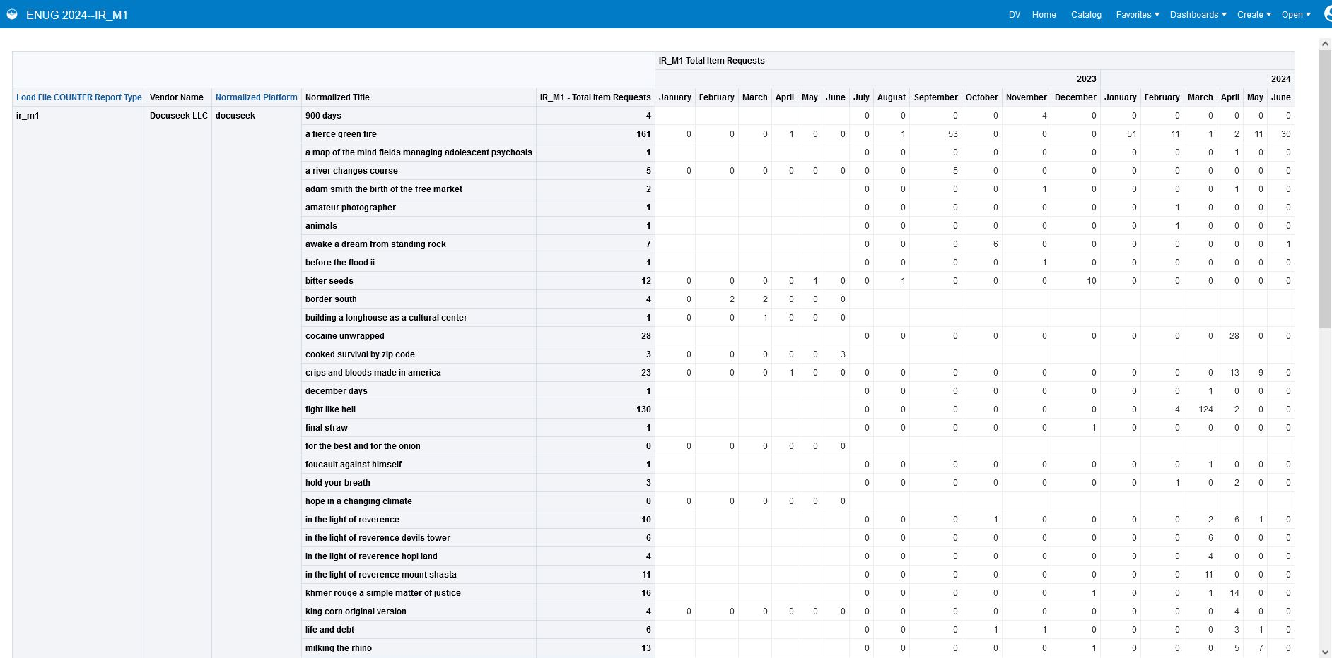
We see the IR_M1 data associated with the vendor we selected (Dcuseek LLC) platform we selected (docuseek), and years we selected (2023 & 2024). Because we didn’t enter anything into the normalized title prompt, we see data for all media items on this platform.

Slide 100
If we have access to a title on multiple platforms, we can search for a normalized title without filling in the other prompts to see usage across all the platforms (you can do this with TR_B1 and TR_J1 too)

Slide 101
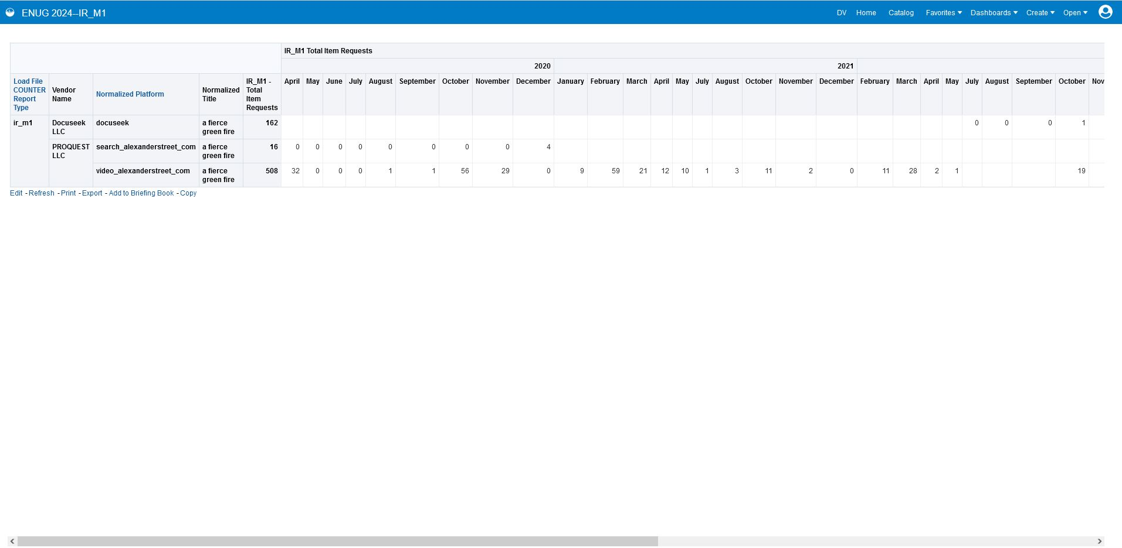
We see the IR_M1 data associated with the title we entered (a fierce green fire). Because we didn’t enter anything into the vendor, platform, or year prompts, we see all usage across all vendors, platforms, and years. This type of query can be helpful when you have access to the same resource on multiple platforms. You can do the same sort of query with your TR_J1 and TR_B1 analyses!

Slide 102
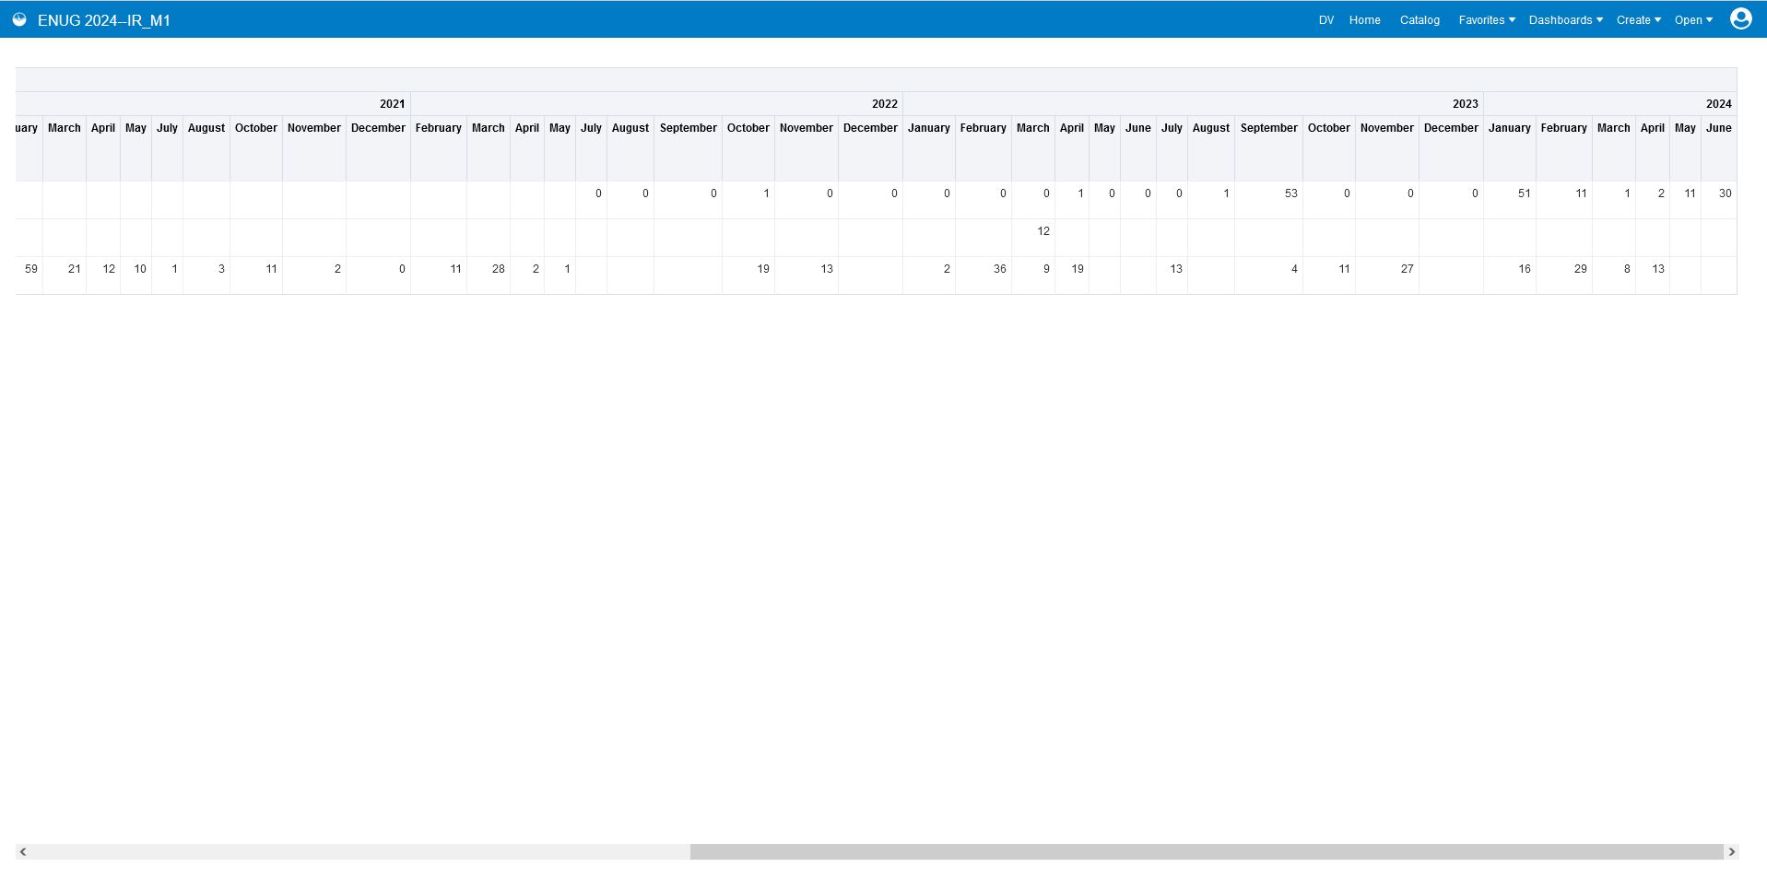

Slide 103
Further Report-Building Ideas
Add a button in your results that will take you back to the prompts and allow you to rerun the report—see Ex Libris presentation How to create a link to rerun a prompted Alma Analytics report
Customize column, row, and prompt label text to make your report easier to understand by non-experts
Improve your prompt and analysis visual design by customizing font sizes, fonts, tooltips, and more
For help with ambiguous titles, add ISBN to TR_B1 and ISSN to TR_J1 (note that not all COUNTER reports will include these, and it’s not a perfect match point, as different sources may include different ISBNs and ISSNs)
Remove normalized title from TR_B1, TR_J1, and IR_M1 to show total usage per platform instead of title-by-title usage

Slide 104
Thank you!
You can find the reports from this presentation in:
Shared Folders→ Community → Reports → Institutions → Rutgers → ENUG 2024 Usage Reports
Please feel free to contact me at:
ey137@libraries.rutgers.edu

