Slide 1
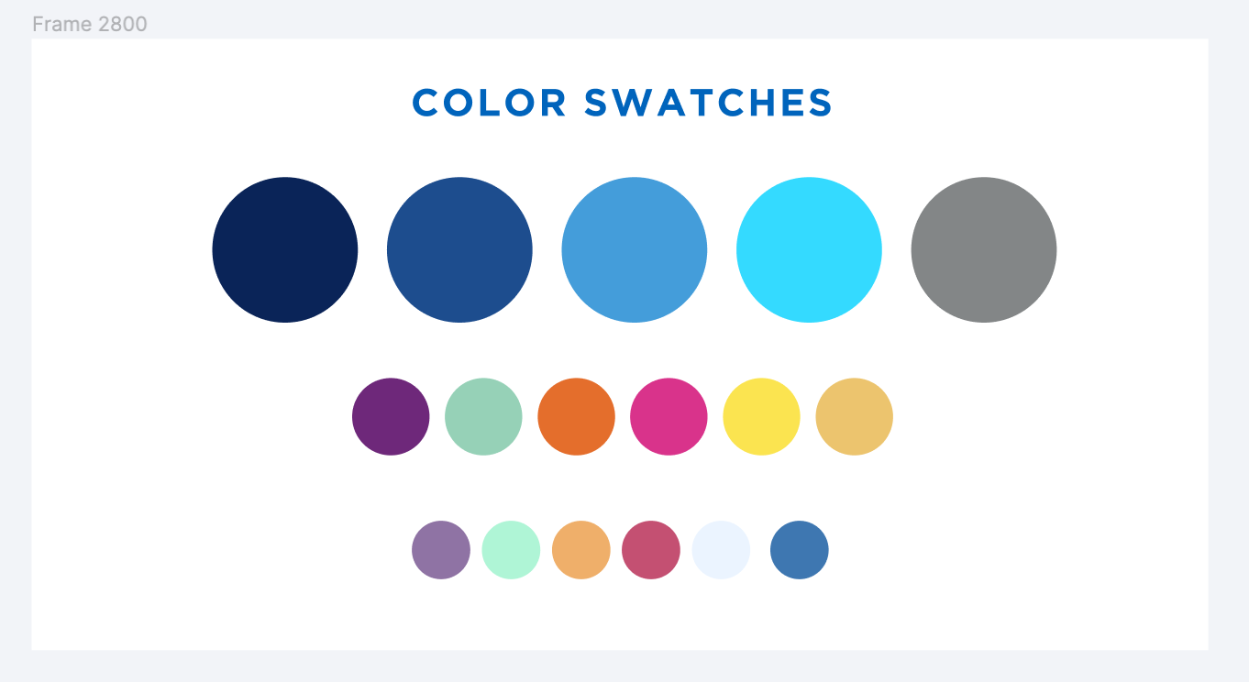

Alma Analytics: eResources
Michelle Eichelberger
SUNY OLIS
October 29, 2024

Slide 2
SUNY Alma Analytics series:
1. Intro to Alma Analytics
2. Resource sharing
3. Physical collections
4. Acquisitions: October 8
5. Fulfillment: October 15
6. Sharing reports: October 24
7. eResources: October 29 (TODAY!)

Slide 3
Agenda
Electronic Resources Management
Usage
Notes:
Michelle

Slide 4
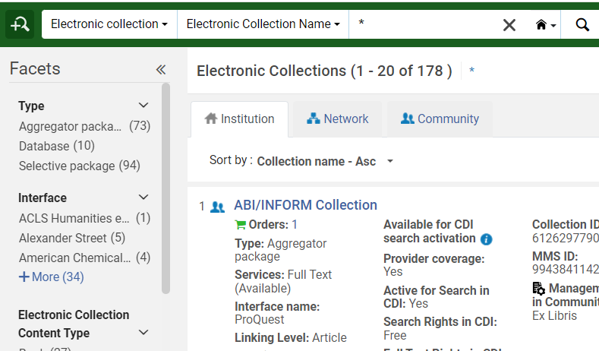
Routine Maintenance
Sometimes Analytics isn't the best way to find content that needs to be tidied.
Electronic Collection Search: search for * to see everything that’s activated and review settings
DARA: Can look at DARA recommendations, but you don't have to do everything it recommends

Slide 5

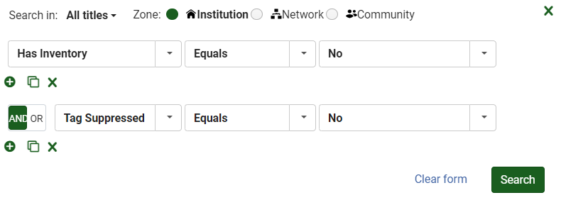
Routine Maintenance: Advanced Search
All Titles Advanced Search:
    Electronic titles with no portfolios, may be suppressed or unsuppressed
    Need to clean up or suppress unsuppressed bibs with no holdings or they’ll show in Primo
    Can add MMS Creation Date (Title) before date to avoid things that are one order
    Can save as a set and delete with Delete Bibliographic Records job

Slide 6
Routine Maintenance: Advanced Search
Electronic Portfolios Advanced Search:
      Portfolios that are stand-alone and could be moved into a collection:
      Electronic Portfolio: Is Standalone = yes
      Local portfolios that could be linked to the CZ:
      Electronic Portfolio: Is Local (Electronic Portfolio) = Yes
      Inactive portfolios:
      Electronic Portfolio: Availability (Electronic Portfolio) = Not Available

Slide 7
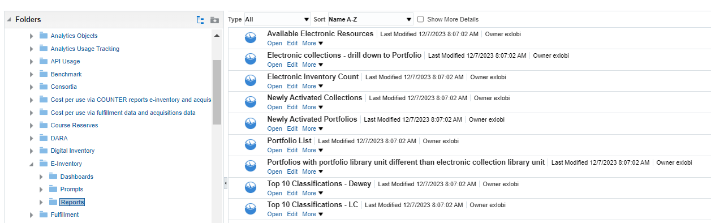
Routine Maintenance: Alma Reports

Slide 8
Routine Maintenance: Build Your Own Report
Advanced Search, Dara, and * collection search are usually enough to maintain eResources in Alma. Occasionally you'll need to use Analytics for historical research, e.g. what happened to a specific title?
Steps:
Go to e-Inventory Subject Area
Choose fields like Portfolio Activation Date, Portfolio Modification Date
Scroll down to Bibliographic Details and choose title, identifier, lifecycle, whatever you'd like to know
Might also want to add Modified by to see if it was a system change (e.g. CZ Updates job) or a staff change

Slide 9
SUSHI

Slide 10
SUSHI
Alma Analytics can only show you data that it knows about. To be able to run eResources usage and cost per use reports, you need to get the vendor usage data into Alma.
Could spend the whole session on SUSHI, but in a nutshell:
SUSHI is a way to automatically harvest COUNTER usage reports from vendors
Not all vendors offer this option
Can manually load COUNTER reports for those who don't offer it, but not all vendors provide COUNTER
Use default Alma vendor SUSHI settings whenever possible
Reach out to SLS if you need help – we can see if someone else has it set up and guide you on necessary fields

Slide 11
SUSHI Set-up
Set up "subscriber" under Config>Acquisitions>General>Subscribers (should already be done for you since SLS set up SUNYConnect SUSHI harvesting)
Set harvest job to run: Config>Acquisitions>General>Acquisitions Jobs Configuration. Once a month is probably fine, choose after 15th of the month. Don't be alarmed if you see job errors.
Set up vendor for resource you want to harvest. Acquisitions>Acquisitions Infrastructure>Vendors. Must add at least "Access Provider" to get vendor set up.
Add SUSHI credentials to Vendor in Usage Data tab.

Slide 12
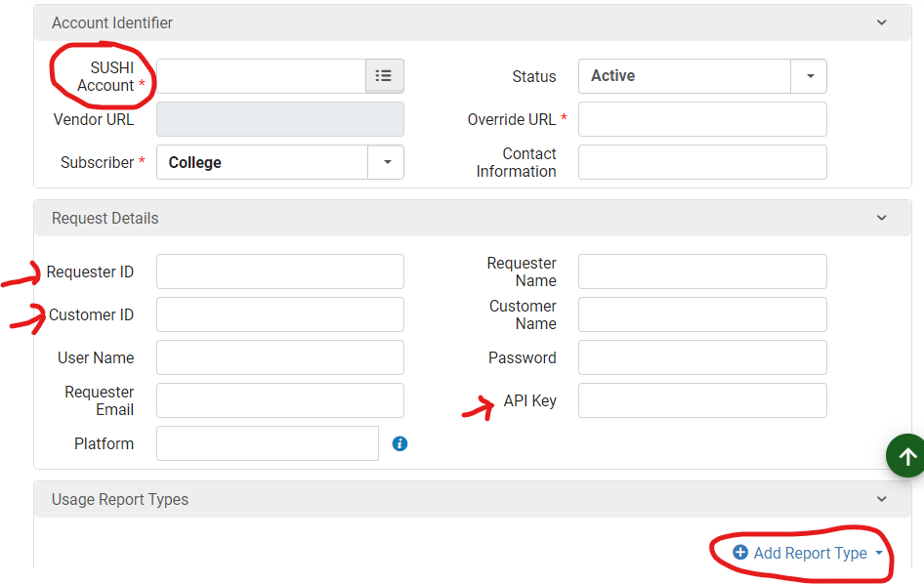
SUSHI Vendor Credentials
Each vendor requires different credentials. Search for information on the vendor's admin or stats site. SUNY SUSHI Tips and Tricks FAQ
Choose Add SUSHI Account. Use Release 5 – that's the current standard
Type vendor name in SUSHI Account and use default URL
Add required credentials
Add reports you want to ingest

Slide 13
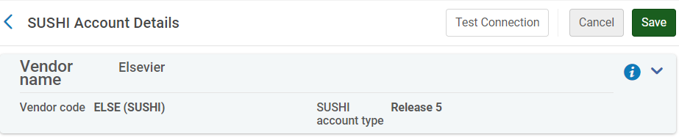
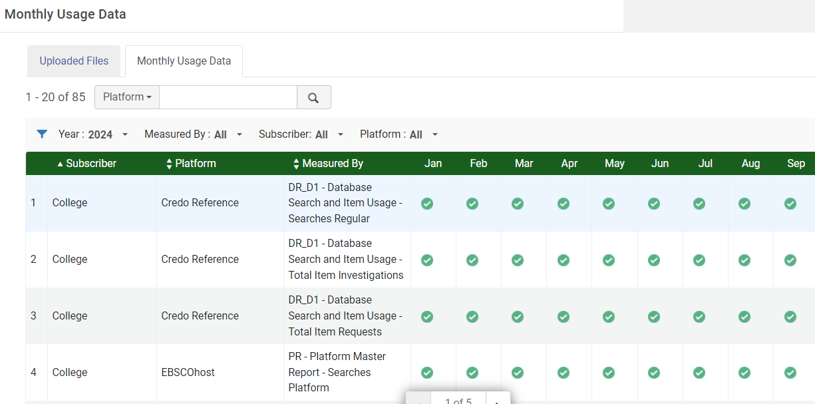
SUSHI Test Access
Use the Test Connection button to test access – will get a json file you can open with Notepad
Can also try to Harvest Now
Keep an eye on the Acqusitions>Import>Load Usage Data, Monthly Usage Data tab to watch for problems

Slide 14
COUNTER Reports

Slide 15
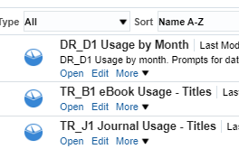
COUNTER Reports
You won't be able to see the actual data in the Usage Reports tab in your vendor, only that the harvest worked or didn't work
Use COUNTER Analytics Reports to see the data
We recently copied three COUNTER reports to an SLS folder in your shared folders – feel free to set up analytics objects for these reports
Search Catalog for other COUNTER report options

Slide 16
ENUG COUNTER Report Presentation
Elizabeth York from Rutgers gave a thorough overview of creating COUNTER reports in Analytics at ENUG 2024 two weeks ago. We’ll post her slides in the recording area for this session.

Slide 17
Demo

Slide 18
Live Demo
* Collection search
Advanced Search
DARA
SUSHI set up
Alma Canned Reports related to eResources
SUNY Reports
Handy Subject Areas
Notes:
Michelle

Slide 19


