Slide 1
DULCE Learning Collaborative
December 12 , 2024
5/12/2022
Care Transformation Collaborative of Rhode Island
‹#›
Prepared by Care Transformation Collaborative of RI

Slide 2
Agenda
Presenter/Topic | Time
Welcome & Announcements Susanne Campbell, RN, MS, PCMH CCE, Senior Project Administrator | 5 minutes
Practice Updates: Hasbro Tri-County Community Health Center Blackstone Valley Community Health Center CNEMG Family Care Center | 25 minutes
CHW Billing & Success Stories – all practices Yolanda Bowes, BS, Senior Project Manager | 20 minutes
Sustainability Updates: ECHO & Practice Amendments Susanne Campbell, RN, MS, PCMH CCE, Senior Project Administrator | 10 minutes
Well Child Visit Data Michelle Mooney, MPA, Program Coordinator II | 5 minutes
Q&A / Discussion | 15 minutes
Prepared by Care Transformation Collaborative of RI

Slide 3
Announcements!
December 13, 2024 at 7:30am - Breakfast of Champions: Technology to Support Primary Care Register Here
Screened for Developmental Delay, Now What? ECHO® – Register by Dec 13, 2024
December 16: Addressing Alcohol Use Disorder in Primary Care Think Tank Series Register Here
December 17, 2024 at 8:00-9:00am Best Practices in Team-Based Care: Navigating Eating Disorders in a Pediatric Primary Care Setting Register Here
December 17, 2024 at 6:00-7:00pm: ﻿"Uncoding" new 2025 codes for Telehealth and Advanced Primary Care Management with Dr. Peter Hollman Register Here
December 20, 2024 at 7:30am:
New Primary Care Management Codes, an examination of the impact of primary care on total medical expenses in Massachusetts, and an update on the AHEAD Model
Email Michelle Mooney to join: mmooney@ctc-ri.org
CHW Asthma Basics Training – Call for Applications Launching this week!
Prepared by Care Transformation Collaborative of RI
Prepared by Care Transformation Collaborative of RI

Slide 4
Hasbro Children’s Hospital
Providence, RI
Team Members
Enrollment Data*:
Yokasta Suero - Family Specialist
Jennifer Jencks, LICSW, PhD, Manager of Peds SW
Carol Lewis, MD, Director, Refugee Health Program & Clinician Educator
Joel Guzman, CCHW, CHW Supervisor
Laudine Koster, BSW, Program Coordinator
37 enrolled in DULCE
34 families (92%) received WCVs on time
70 (75%) of WCV CHW/FS attends
32 (94%) screened for SDOH
Family surveys not rec’d yet
*Through 9/17/24
PDSA:
Original Aim: 90% of WCVs are attended by FS;
Overall result: we are happy with our rate of 75-77% given the challenges of the clinic
PLAN: Continuous education to residents/providers is needed to keep the model front of mind. Prioritize 2nd WCV so families are less overwhelmed at newborn visit. Designate certain days of the week to only DULCE patients. Train additional CHWs in the model so they can provide coverage when needed. LCSW has been hired and will be able to support the DULCE CHW. CHWs have been given a highly visible workspace which makes them more accessible for clinic staff. CHWs will be able to drop charges soon which will help with sustainability.
Prepared by Care Transformation Collaborative of RI

Slide 5
Tri-County Community Action Agency
Team Members
Enrollment Data*:
Belinda Soares, Family Specialist
Brenda Dowlatshahi, COO & Health Center Director
Rebecca Friedman, MD, Pediatrician
Bettina Cullinane, RN, NCM, Nurse Care Manager
Jennifer Caffrey, LICSW, Director of Behavioral Health
Pre-Natal Partner: Suzanne Lowe, CNM, Director of Women’s Health
Anne Marie Barone, Director of Health Information Management
59 babies enrolled in DULCE, 28 graduated
15 prenatal patients enrolled overall
36 (100%) WCV that CHW/FS attends
42 screenings
39 linkages (93%)
36(85.7%) received WCV on time
PDSA:
75% of WCV are attended by CHW/Family Specialist - TriCounty = 100%
*As of Dec 2024
Prepared by Care Transformation Collaborative of RI

Slide 6
CHW billing – TriCounty
Data Collection: Define data that can be collected and monitored to measure success and evaluate sustainability.
Minimum Required: # of billed FS/CHW Services from grant proposal
Reporting Period | # of Billed FS/CHW Services since 2/2/24 | # of Held Claims for No MID# | # of unique patients (Medicaid)
Baseline 2/2/24 – 7/15/24 | 96 (included CHW overall) | 47
2/2/24 – 8/31/24 | 86 (FS/CHW) | 27 (reduced from 60) | 46+ encounters
Prepared by Care Transformation Collaborative of RI

Slide 7
Blackstone Valley Community Health Center
Team Members
Enrollment Data*:
Manuela Andres , CHW/Family Specialist
Scott Hewitt, Assoc. Dir. Of Integrated Care
Morgan Motia, MD, AE Medical Director
Kathleen Ricci, Nurse Care Manager
Pre-Natal Partner: Carolyn Pearce, MD, Family Medicine & OB/GYN Medical Director
66 (55 Children, 11 Prenatal) enrolled in DULCE, 24 graduated
11- prenatal patients enrolled
81 (37%) of WCV that CHW/FS attends
42 (67%) of screenings
11 (100%) of linkages
40 (63%) received WCV on time
Family surveys on-going
PDSA:
90% of families with concrete needs identified through HRSN receive support – BVCHC = 100%
*As of 10/31/24
Prepared by Care Transformation Collaborative of RI

Slide 8
Care New England Family Care Center
Pawtucket, RI
Enrollment Data*:
Team Members
71 enrolled in DULCE, 12 graduated **
17 prenatal patients enrolled overall**
123 (91%) of WCV that CHW/FS attends*
39 of screenings *
39 of linkages*
27/35 (77%) received WCV on time*
Family surveys on-going
Jalyn Alzate, Family Specialist
Marybeth Sutter, MD
Nicole Quindazzi, MS, Practice Manager
Margaret Lebeau, Nurse Care Manager
Debra Moorhead, Academic Social Worker
PDSA: performance compared with national data
95% of families are screened for Health-Related Social Needs (HRSN) – CNE = 100%
90% of families with concrete needs identified through HRSN receive support – CNE = 100%
*As of Nov 2024
Prepared by Care Transformation Collaborative of RI

Slide 9
CHW Billing/Sustainability Update
1 Practice has implemented billing – Tri County
High rate of claims held due to no Medicaid ID number
Implemented workflow to follow up on missing #s
Working to identify non-face to face billable encounters
3 Practices In Implementation Process CHW billing
Hasbro – On the Fast Track to Implement Billing Agency Wide
Blackstone Valley – Set Up in progress – building backend system- Testing Workflows
Care New England – Set Up Complete – Beginning to Submit Claims
Sustainability Plan by March 2025
New sustainability funding added to planning tool ($12,500 per practice)
12-month ECHO Series (MLPB & RIAIMH)
MLPB Support through CHW Grant
Prepared by Care Transformation Collaborative of RI

Slide 10
Inspiration for Sustainability
Where are you in your journey/plan?
What are some lessons learned?
What is your inspiration for wanting to sustain this work?
What are some success stories you have to share?
Prepared by Care Transformation Collaborative of RI

Slide 11
Funding Timeline
Year 1 (2022 – 2023)
Year 2 (2023 – 2024)
Year 3 (2024 – 2025)
Year 4 (2025 – 2026)
RIDOH: ECCS and UnitedHealthcare Funding
RIDOH: ECCS Funding
Congressional Direct Spend (Sept 2023 - Nov 2024)
United Healthcare
Tufts Health Plan
RIDOH: HCBS (Dec 2024 through March 2025)
RIDOH: ECCS Funding
Sustainability Funds (April 2025-June 2026
Congressional Direct Spend (extension ends Nove 2024)
RIDOH: HCBS (added Dec 204- March 2025)
RIDOH: ECCS Funding
RIDOH: HCBS (March 2025-June 2026
Prepared by Care Transformation Collaborative of RI

Slide 12
Sustainability Extension: Practice Agreement
$12,500 available for practice to use for customized sustainability efforts (e.g., DULCE model: CHW, Medical Legal Partnership, Training).
Funding available starting 4/1, with team participation in 12-month ECHO session beginning June 2025-April 2026.
Practices to complete a Sustainability Planning Tool and provide progress updates.
Participation in ECHO and a case study required for funded practices (open to all without funding).
Practices may access to additional legal resources through MLPB (through August 2025) and Reflective Supervision training (details in Participative Agreement).
Agreements due: January 31, 2024
Payment Schedule
March 2025 - $3,625 | Submission of updated Practice Sustainability Plan
July 2025 - $3,625 | Enrollment in ECHO®
Oct 2025 - $3,625 | Practice Sustainability Plan Updates & continued participation in ECHO®
May 2026 - $3,625 | Final Practice Sustainability Plan Updates & Completion in ECHO®
View agreement here
Prepared by Care Transformation Collaborative of RI

Slide 13
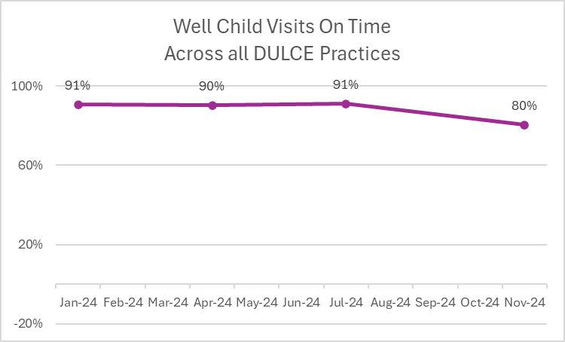
Well-Child Visit Rates
National Goal: 75%
*Hasbro, BVCHC and TriCounty had just begun enrolling in Jan and would not have WCV for this period.
**Data includes Coastal Toll Gate from Jan 2024 – July 2024.
Prepared by Care Transformation Collaborative of RI

Slide 14
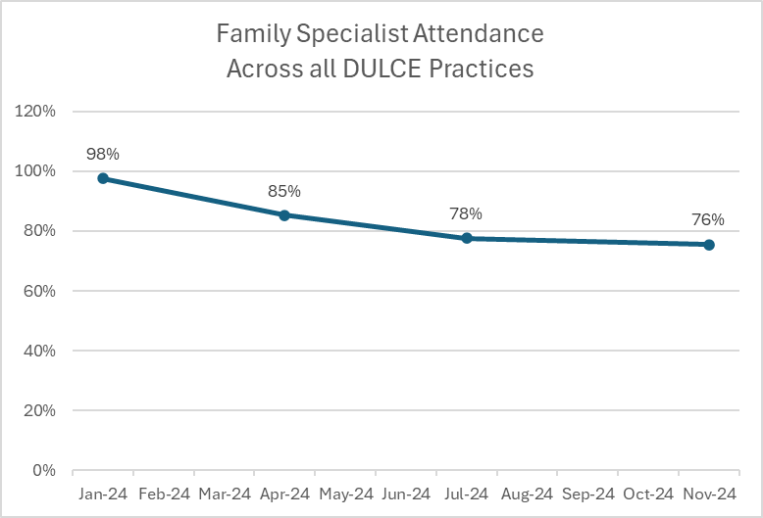
Family Specialist Attendance
National Goal: 90%
*Hasbro, BVCHC and TriCounty had just begun enrolling in Jan and would not have WCV for this period.
**Data includes Coastal Toll Gate from Jan 2024 – July 2024.
Prepared by Care Transformation Collaborative of RI

Slide 15
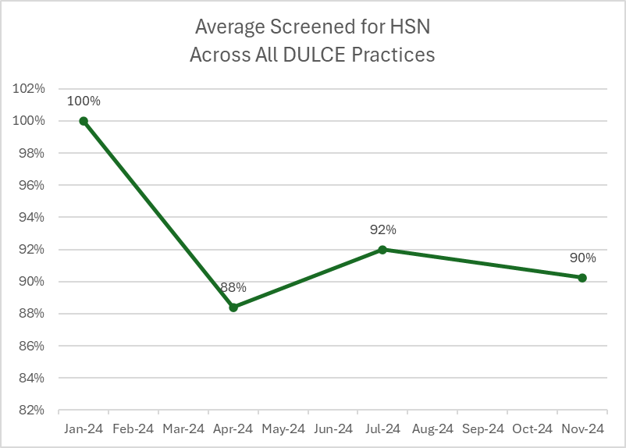
HRSN Screening Data
National Goal: 95%
*Hasbro, BVCHC and TriCounty had just begun enrolling in Jan and would not have WCV for this period.
**Data includes Coastal Toll Gate from Jan 2024 – July 2024.
Prepared by Care Transformation Collaborative of RI

Slide 16
Next Steps
Year End Data Reporting for CSSP – Michelle may be reaching out for additional information
Please submit data by January 06, 2024 (in lieu of January 15, 2024)
Continue to meet with Practice Facilitators
Practice Agreements for sustainability funds will be shared out after this meeting
Next Learning Collaborative: March 13, 2025 @ 7:30am
Prepared by Care Transformation Collaborative of RI

Slide 17
THANK YOU
www.ctc-ri.org
CTC-RI
5/12/2022
Prepared by Care Transformation Collaborative of RI
‹#›

