Slide 1

COVID 19 Response in SUNY Libraries
March 24,2020
www.suny.edu

Slide 2

System Update
Carey Hatch, Sr. Associate Provost for Academic Services
www.suny.edu

Slide 3
OLIS Update
Mark McBride, Library Sr. Strategist
www.suny.edu

Slide 4
Collections Update
Esta Tovstiadi, SUNY Shared Collections Strategist
www.suny.edu

Slide 5
Extended EBSCO Access through June 15, 2020
Academic Search Ultimate, Business Source Ultimate, and EBSCO’s eBook Academic Collection​
Databases should appear in your list of available databases on the EBSCO interface​
All of the eBooks in the eBook Academic Collection are also available via the “eBook Collection (EBSCOhost)” database – this is the one that houses ALL EBSCO eBooks that a library has access to.​
For more info, see:​
https://www.ebsco.com/products/ebooks/academic-collection​
https://www.ebsco.com/products/research-databases/business-source-ultimate​
https://www.ebsco.com/products/research-databases/academic-search-ultimate
www.suny.edu

Slide 6
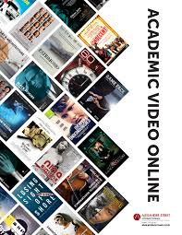
Academic Videos Online (AVON) trial (ProQuest)
Until June 26, 2020​
66,000+ videos in a variety of subject areas. ​
Over 800 distributors​
For more info, see: https://alexanderstreet.com/products/academic-video-online ​
All films available in Academic Video Online include limited public performance rights, which includes permission for classroom showings, as well as public screenings, as long as no admission is being charged.​
www.suny.edu

Slide 7
Summary of Additional Available Content During Pandemic
MIT Press ebook access free until May 31, 2020, setup required
Annual Reviews removing paywalls until April 30th
Simultaneous use caps for STAT!Ref lifted through April 19, 2020
JSTOR access to all Archive journals and Primary Source content through June 30, 2020
Purchased ebooks on EBSCO upgraded to unlimited access licenses
Purchased ebooks on ProQuest upgraded to unlimited access licenses
www.suny.edu

Slide 8
SLC Update
Jennifer Smathers, SLC Consortial Engagement Coordinator
www.suny.edu

Slide 9

SLC
Board
Actions
Approving SLSS & OLIS Actions
Resource Sharing Policies to ease Displaced Students
Settings changes across the SUNY system to turn off physical borrowing in Alma
Negotiate a SUNY license for Springhare products, while getting access for those few libraries without chat
2 special meetings to discuss COVID-19 implications for SLC members
Increased Communication of rapid changes to membership
Thanks to the SLC Board Members for their attentive service to the consortium during this hectic time!
www.suny.edu
Notes:
Special Meetings
Approved Temporary Resource Sharing Policy changes to help
Chair, At Large Representative
Ken Fujiuchi, Head of Information Commons & Emerging Technology Librarian, Buffalo State College
Vice Chair and Chair Elect, At Large Representative (double duty as treasurer)
Carrie Fishner, Library Director, SUNY Delhi
Secretary, At Large Representative
Katie Ghidiu, Library Director, Monroe Community College
University Center Representative
Curtis Kendrick, Dean of Libraries, SUNY Binghamton
Rebecca Mugridge, Dean of University Libraries, University at Albany
Office of Library and Information Services Representative
Mark McBride, Sr. Library Strategist, SUNY System Administration
At Large Representative
Susan Lieberthal, Campus Head Librarian, Ammerman Campus, Suffolk County Community College

Slide 10
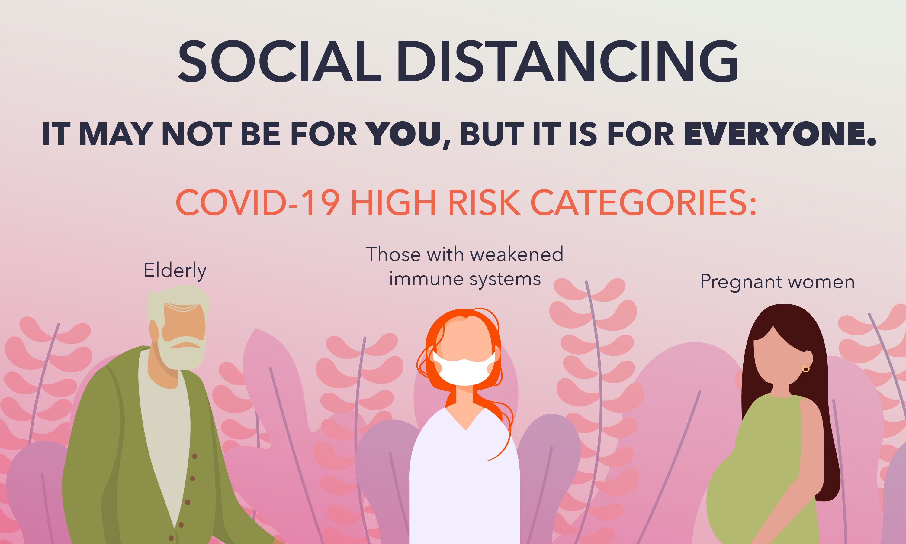
Communication Channels
www.suny.edu
Notes:
Clear
Coordinated
Up To Date -surveys, Basecamp, e-mail
Lessen the Email Flood
Otherwise Helpful
-do appreciate any feedback for how this worked for you

Slide 11
Helpful links:
SUNY Libraries COVID-19 Planning and Information
SUNY’s COVID-19 Response
SUNY Libraries COVID-19 Survey
Basecamp for COVID 19 Library Response and Planning -join link
Ithaka S+R Survey: https://tinyurl.com/covidlibrary
www.suny.edu
Notes:
Nope, not reading this slide ;) PLEASE these Links into chat:
Helpful Links:
SUNY Libraries COVID-19 Planning and Information
SUNY’s COVID-19 Response
SUNY Libraries COVID-19 Survey (take as often as library circumstances change)
Basecamp for COVID 19 Library Response and Planning -join link
Ithaka S+R Survey: https://tinyurl.com/covidlibrary

Slide 12
SLSS Update
Shannon Pritting, Director of SUNY Library Shared Services
www.suny.edu

Slide 13
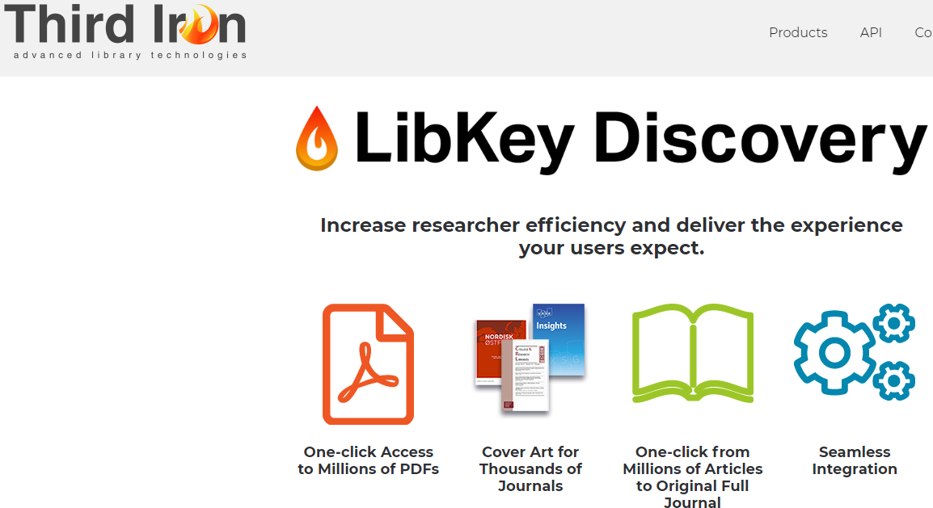
Libkey
We’re caught up with implementing Libkey at libraries who expressed interest.
If you’re interested, but we haven’t set you up or you haven’t contacted us, please reach out as soon as possible.
www.suny.edu

Slide 14
Resource Sharing Development
Plan is to connect with libraries outside of SUNY for Alma-based resource sharing by end of Spring semester, or as soon as threat from pandemic is reduced.
Tim successfully tested with Union College.
Working with IDS to agree on common loan period between NYS IDS members and SUNY.
SLSS will handle configuration, set up, and project coordination as we add libraries.
www.suny.edu

Slide 15
Science Direct PTA/Elsevier New Deal
Esta and Michelle developed process for PTA files to be moved into Alma compliant portfolio loader file type.
SLSS staff will begin adding these local collections to your IZs later this week.
Will host common PTA and 248 frontfile in the NZ.
www.suny.edu

Slide 16
CUNY and reciprocal returns
Shannon in discussions with CUNY Interim Dean.
With NYC situation, reciprocal returns isn't a good idea now.
As soon as situation improves and public access is possible again, will pick up this with CUNY to serve displaced student needs.
www.suny.edu

Slide 17
Upcoming Webinars for Online Library Services
SLSS asked by SUNY CPD to provide webinars for faculty on library services across SUNY available to faculty who are now teaching online.
SLSS reached out to and working with SUNYLA and WGIL to coordinate as reference and instruction services will be involved.
Webinars SUNY Libraries and Remote Learning: We're Here to Help :
  April 2nd at 1:00 and 5:00
To register: https://sunycpd.eventsair.com/QuickEventWebsitePortal/suny-remote-teaching-clinic/site/ExtraContent/ContentSubPage?page=2&subPage=1
www.suny.edu

Slide 18
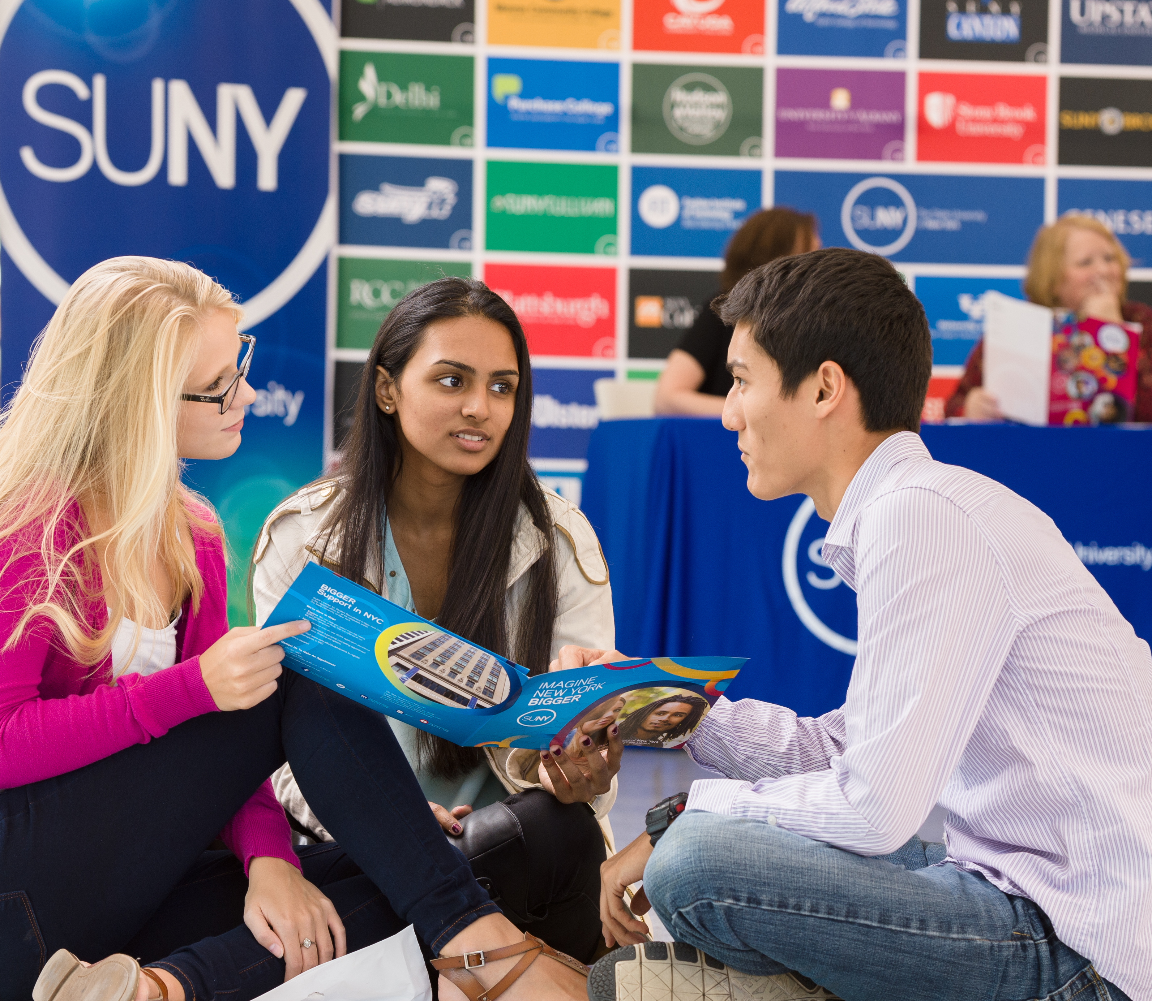

Questions or Discussion?
www.suny.edu

