Slide 1
Publishing Profiles: Creating Sets and Running a Job to Change the Flag to “Don’t Publish”
Shared Library Services Platform Project
Maggie McGee

Slide 2
Bib Records Flagged to “Publish Bib” in Alma
All bib records are flagged “Publish Bib” during migration
All new bib records added to your holdings are flagged “Publish Bib”
If you do not want new records published to OCLC they will need to have their flag changed to “Don’t Publish”
Change the bib record flag “Publish Bib” to “Don’t Publish” to keep it from being published to OCLC. This can be done:
Individually in the MD Editor
From a set and by running a job on the set
LDR 05 is set to “d” when bib records set to “Don’t’ Publish”
This means the record is considered “deleted” by OCLC and the holdings will not be published, or they will be removed from OCLC if they were previously published
The “d” gets added to the LDR in the exported marc record that is sent to OCLC and does not change in Alma

Slide 3
Quick Way to Tell is a Bib Record is Flagged “Publish Bib”
Click on the bib record title link
Export to Worldcat: Publish Bibliographic record…. or Don’t Publish
CZ records are flagged to “Publish Bib” but they will not be published since we have not set up an electronic datasync publishing profile in Alma

Slide 4
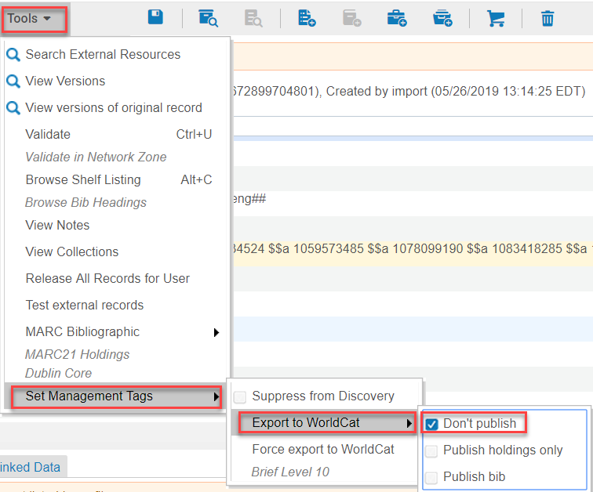
Unflagging an Individual Bib Record Manually
Open a bib record in the MD Editor
Go to Tools>Set Management Tags>Export to Worldcat
Click on the check box next to “Don’t Publish”
Save and Release Record (Ctrl+Alt+R)

Slide 5
Sets
There are two types of set that can be created in Alma:
Logical
Itemized
Logical sets are created from a repository search in Alma
Logical sets are dynamic
Itemized sets are created from a file or from analytics
Itemized sets are static
You need to create a set on the title level in order to run the job to change the flag from “Publish Bib” to “Don’t Publish”

Slide 6
Identify the Bib Records That Will Not Be Published to OCLC
Identify the types of bib records you do not want to be published in OCLC:
Resource type
e-books
e-journals
Brief bib records
They will not have an OCLC # (ocn) upon creation
Assigned a brief level of 01 in the NZ
If you apply the NZ brief level rules, they will have a brief level of 01 in Alma
Be aware that brief level 01 is also assigned to vendor records and records that have not been fully cataloged
Proprietary vendor records
They will not have an OCLC number in the 035, but a vendor assigned number

Slide 7
Creating Sets
Shared Library Services Platform Project
Maggie McGee

Slide 8
Creating a Set from an “Physical Titles” Repository Search
Quickest way to view all your holdings by resource type that are not linked to the CZ is by performing the following repository search:
Physical Titles>Title>*
Or “Electronic Title>Titles>*
Or All Titles>Titles>*
Expand the Resources Type facet in the left-hand pane of the MD Editor

Slide 9
Creating a Set from an “Physical Titles” Repository Search
Click on the Resource Type you want to create a set from
The results will display
Click Save Query

Slide 10
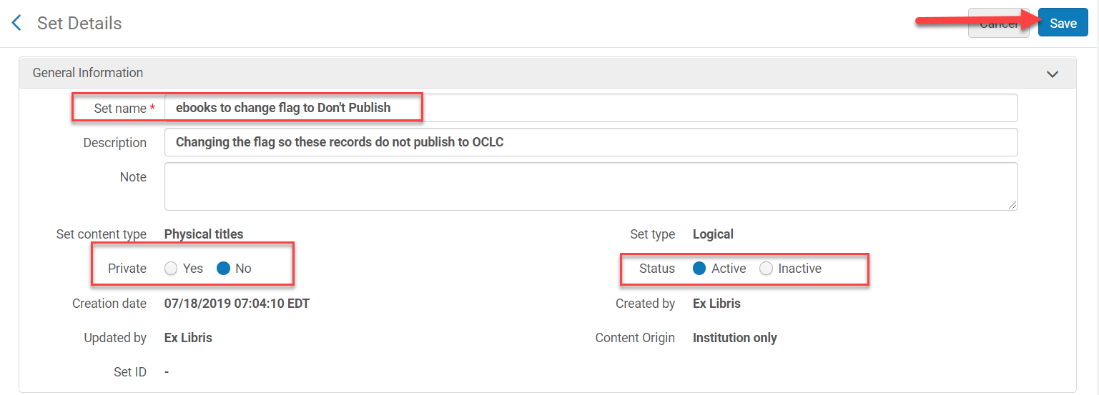
Creating a Set from a “Physical Titles” Repository Search
Name: [name the set] – it’s the only mandatory field
Description: [always a good idea to populate this]
Private: NO
Status: Active
Click Save

Slide 11
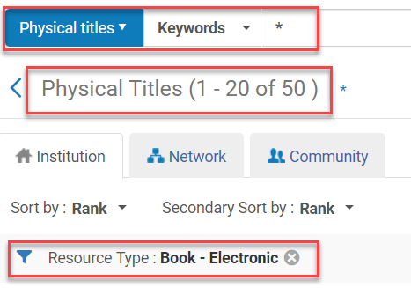
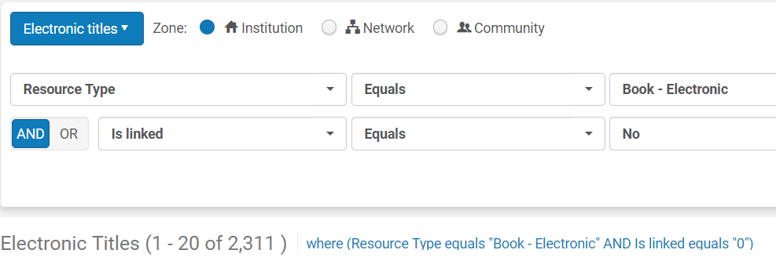
Creating a Set from an “All Titles” Repository Search
You may need to get creative if you see the results from a “Physical Title” or “Electronic Title” search do not reflect what is your collection
Perform an “All Titles” advanced search:
Resource>Equals>[Book-Electronic]
Is linked>Equals>No

Slide 12
Creating a Set for Suppressed Records Not Linked to the NZ
Perform the following advanced repository search for “Physical Titles”:
Tag Suppressed (Title)>Equals>Yes
Is Linked>Equals>No
Process type>Is empty
This prevents Resource Sharing items from appearing in the search results
Review the results to make sure they are what you want
Click Save Query

Slide 13
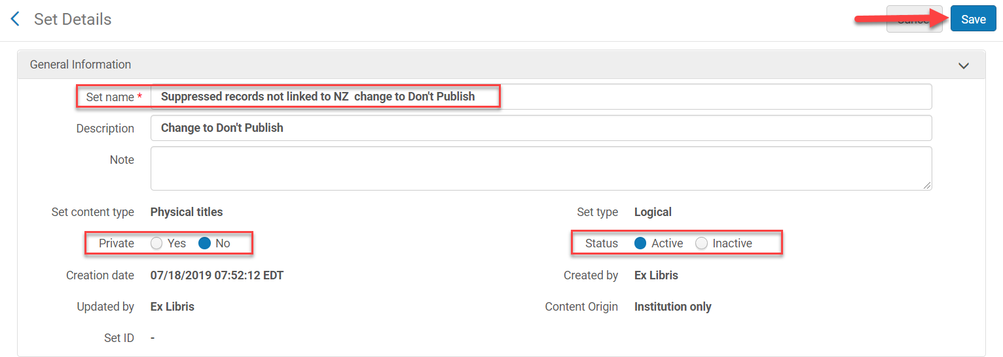
Creating a Set for Suppressed Records Not Linked to the NZ
Name: [name the set - mandatory field]
Description: [good practice to add a description]
Private: NO
Status: Active
Click Save

Slide 14
Creating a Set for Physical Titles Without OCLC#
Perform the following advanced repository search using Physical Titles:
Other System Number>Not Contains Phrase>(OCoLC)
Is Linked>Equals>No
Click Save Query

Slide 15
Creating a Set for Physical Titles Without OCLC#
Same query but Is Linked>Equals>Yes
There are no results, which are the expected because a record cannot be linked to the NZ without an OCLC number

Slide 16
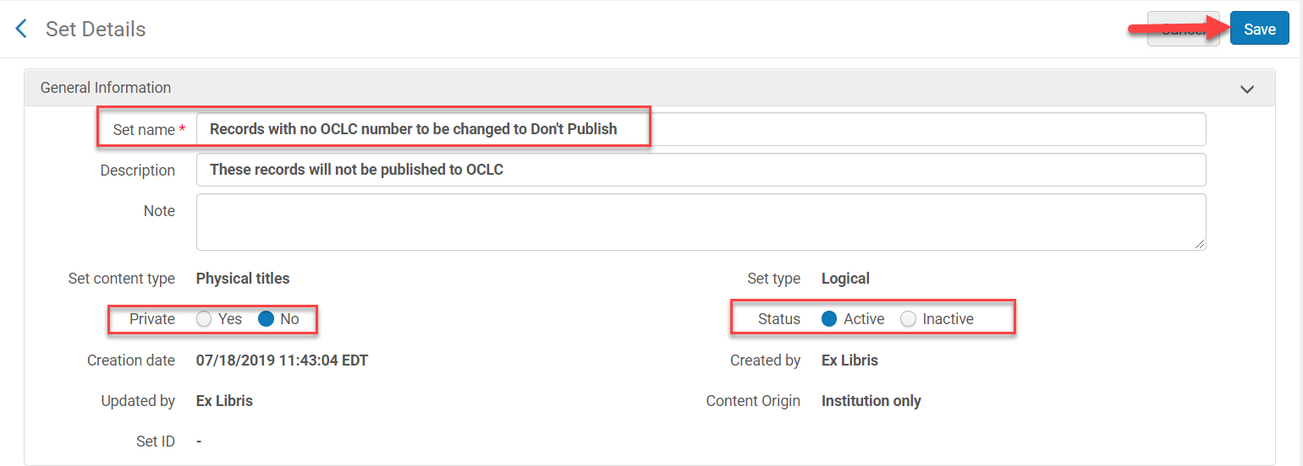
Creating a Set for Physical Titles Without OCLC#
Name: [name the set - mandatory field]
Description: [good practice to add a description]
Private: NO
Status: Active
Click Save

Slide 17
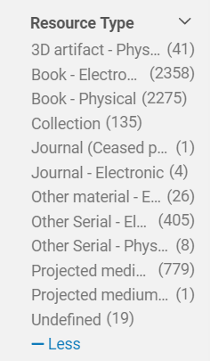
Creating a Set for Records Without OCLC & CKB Numbers
Perform the following advanced repository search for “All titles”:
Other System Number>Not Contains Keywords>(OCoLC)
Other System Number>Not Contains Keywords>CKB
Click Save Query
The facets in the left-hand pane can narrow results down by the Resource Type

Slide 18
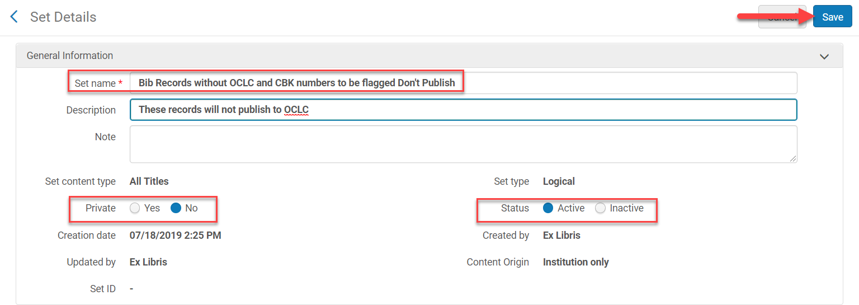
Creating a Set for Records Without OCLC & CKB Numbers
Name: [name the set - mandatory field]
Description: [good practice to add a description]
Private: NO
Status: Active
Click Save

Slide 19
Creating a Set on Brief Levels
Perform the following advanced repository search for “All Titles” or “Physical Titles”:
Brief Level> <= > 10
Other System Number>Not Contains Keyword>(OCoLC)
Is Linked>Equals>No
Click Save Query

Slide 20
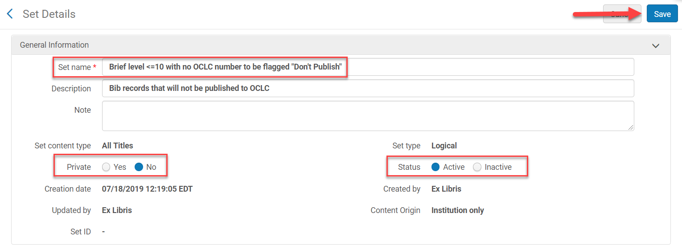
Creating a Set on Brief Levels
Name: [name the set - mandatory field]
Description: [good practice to add a description]
Private: NO
Status: Active
Click Save

Slide 21
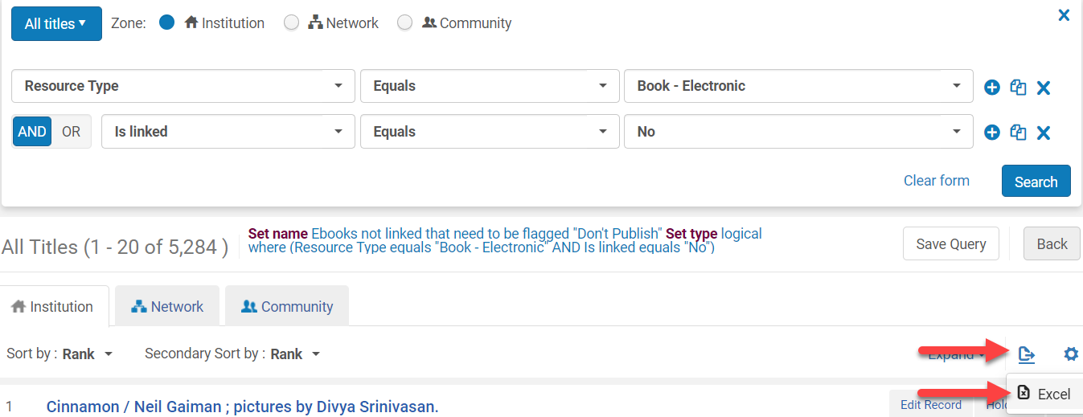
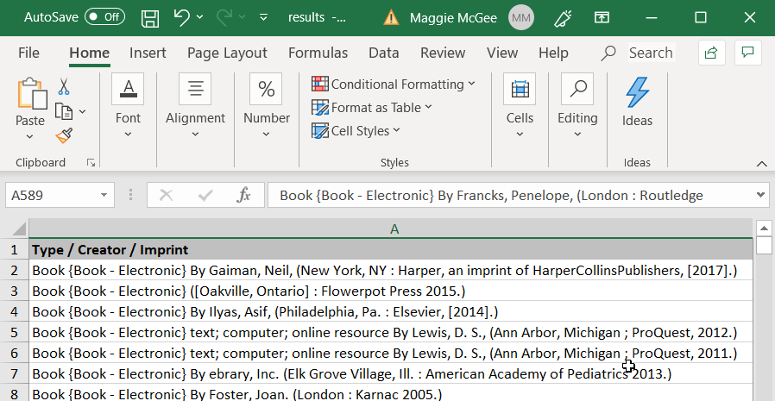
Exporting Repository Search Results to Excel
Any repository search can be exported to Excel
The benefits of exporting repository search results to a excel:
Easy to review the results as a whole
Easy was to edit the search results directly in the file
To export any repository search results
Click on the Export List icon
Click on Excel

Slide 22
Using an Excel File to Create an Itemized Set
After reviewing and/or editing the repository search results in the Excel file it can be saved and uploaded into Alma to create an itemized set:
Go to Admin>Manage Jobs and Sets>Manage Sets
Click Add Set
Click Itemized

Slide 23
Using an Excel File to Create an Itemized Set
Name: [name the set – this is mandatory]
Description: [good practice to add a description]
Private: No
Status: Active
Add Contents from File to Set: From File
Click on the folder icon to upload the excel file

Slide 24
Using an Excel File to Create an Itemized Set

Slide 25
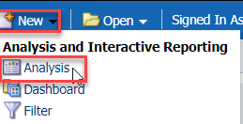
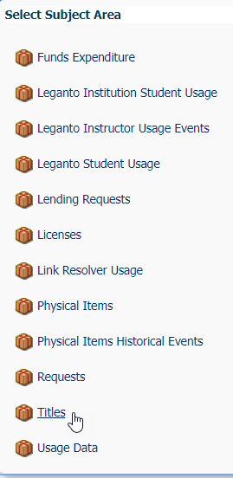
Using Analytics to Create an Itemized Set
You can create a set from an analytics report
The analytics report must have at least one unique identifier that the bib records can be matched on, such as:
MMS ID
ISBN/ISSN
The itemized set needs to be created with a set content type of All Titles or Physical Titles
To create an analytics report, go to Analytics>Analytics>Design Analytics
Click New
Select Analysis
Choose a Subject that contains bibliographic information that allows for selecting a unique identifier

Slide 26
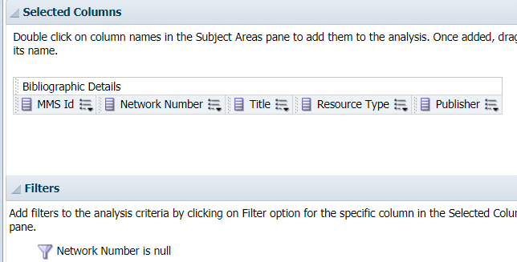
Using Analytics to Create an Itemized Set
“Network Number” under Bibliographic Title subject folder will retrieve the OCLC number
The Network Number contains the 035 or 019
https://knowledge.exlibrisgroup.com/Alma/Product_Documentation/010Alma_Online_Help_(English)/080Analytics/080Shared_Dimensions/010Bibliographic_Details
Filter Network Number is Null if you want to retrieve bib records without an OCLC number
This simple report will pull all records without an OCLC number
Remember that it will pull records you no longer own because analytics retains all information

Slide 27
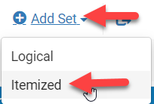
Creating a Set from an Analytics Report
Go to Admin>Manages Jobs and Sets>Manage Sets
Click Add Set
Click Itemized
Name: [name the set – this is mandatory]
Description: [good practice to add a description]
Private: No
Status: Active
Add Contents from File to Set: From Analytics
Analytics Folder: [select the correct folder]
Name: [select the report name]
Click Save

Slide 28
Creating a Set from an Analytics Report

Slide 29
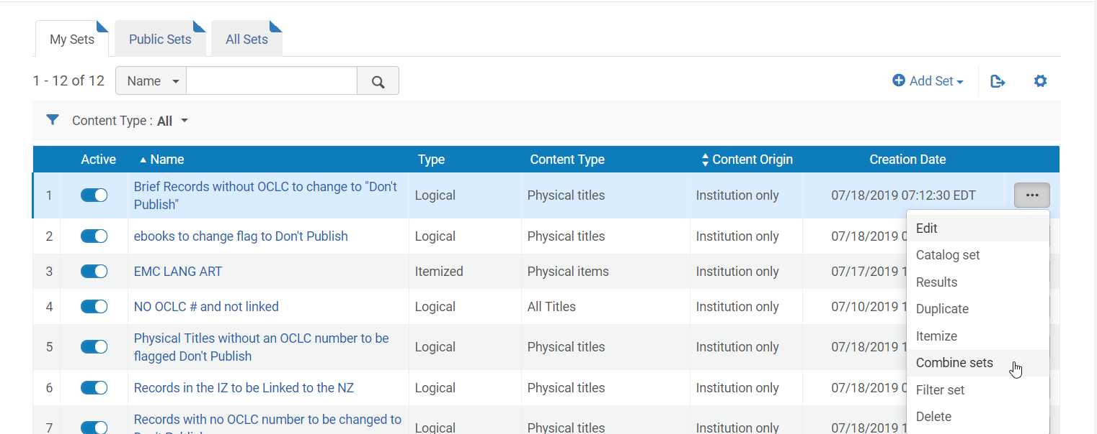
Combining Sets
It is possible to combine sets if you want to consolidate sets and run the job to change the flag
You can combine logical and itemized sets if they have the same content type
Go to Admin>Manage Sets and Jobs>Manage Sets
Click Combine from the ellipses you would like to combine a set with

Slide 30
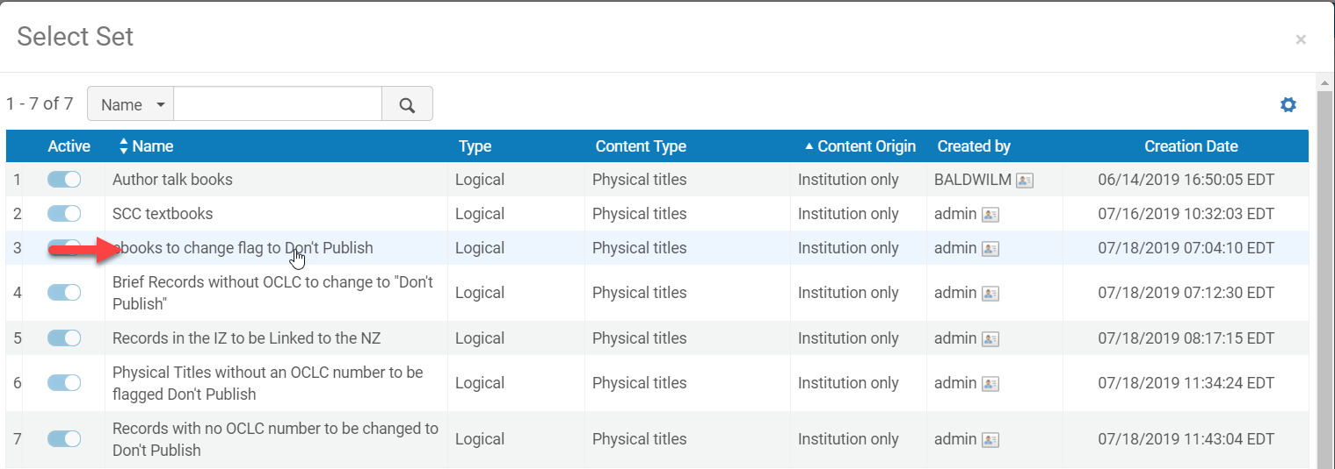
Combining Sets
Click on the Select from list icon
Click on the set you want to combined/added

Slide 31
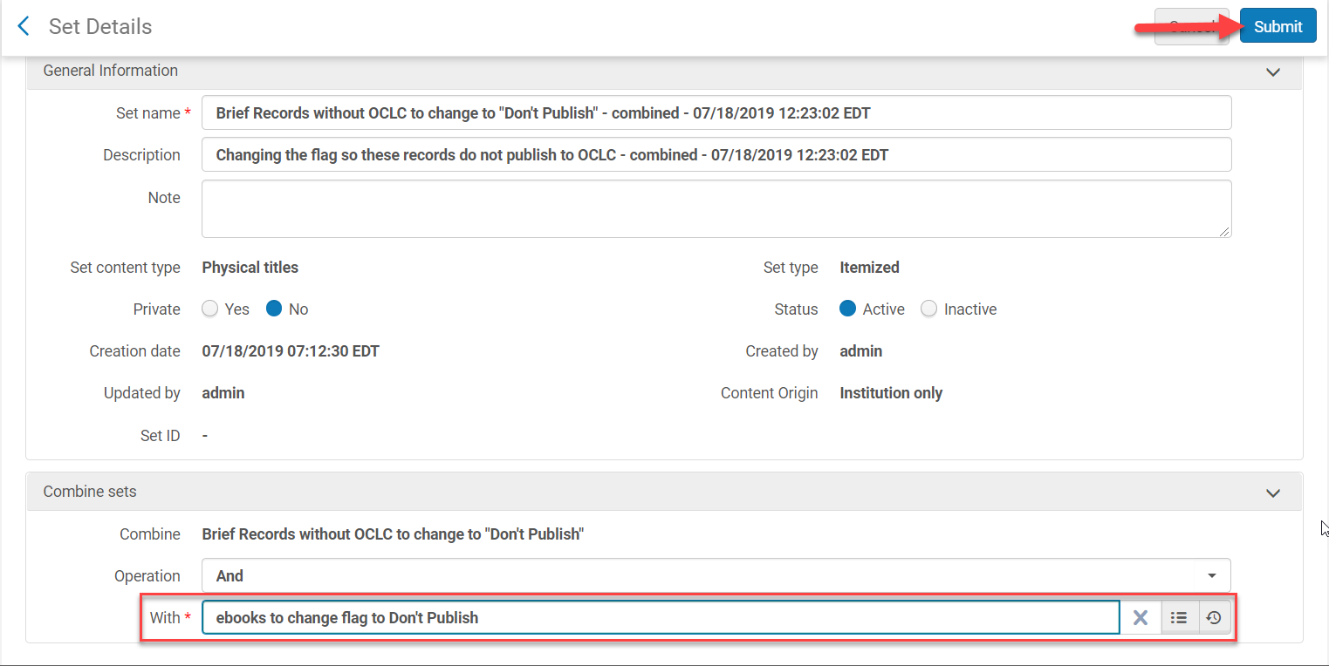
Combining Sets
Click Submit

Slide 32
Combining Sets
Click Confirm when the pop-up Confirmation Screen appears
A job will run to combine the set

Slide 33
Job to Change the Bib Record Flag
Shared Library Services Platform Project
Maggie McGee

Slide 34
Running the “Synchronize Bib records with external catalog” Job
Create and save a set of records that you do not want to be published to OCLC
Go to Admin>Manage Jobs and Sets>Run a Job
Search job name: Synchronize Bib records with external catalog
Click on the radio button for the “Synchronize Bib records with external catalog” job
Click Next

Slide 35
Running the “Synchronize Bib records with external catalog” Job
Click on the radio button next to the set you want to run the job on
Click Next

Slide 36
Running the “Synchronize Bib records with external catalog” Job
Click on the “Don’t Publish” radio button
Click Next
Review the job and click Submit

Slide 37
Running the “Synchronize Bib records with external catalog” Job
Click Confirm
The job will run, and the flag will change from “Publish Bib” to “Don’t Publish”

Slide 38
Reviewing OCLC Datasync Files in worldshare
Shared Library Services Platform Project
Maggie McGee

Slide 39
Reviewing OCLC Datasync Files in WorldShare
Once processing is completed, standard 2-column Cross Reference (XREF) reports will be created:
A report for resolved (matched) records
A report for the staged (unresolved) records
Additionally, a bibliographic detail exception report will be created for the staged records that are sparse (brief), or that have MARC validation errors so that you can identify what may need to be corrected
After processing, these reports will be available via the OCLC Usage Statistics Portal (under Cataloging > WorldShare Collection Manager).
The Cross Reference and Bib Exception Detail files will be found under My Files (under the WorldShare Metadata tab) and via FTP (metacoll/reports OR xfer/metacoll/reports for sFTP). These files will only be available for 90 days.
OCLC recommends waiting 24 to 48 hours to retrieve your reports and stats
For more details on report locations, please visit the Online Help

