Slide 1
ASHRAE
Cinthya Carrillo
ASHRAE Orange Empire, Student Activities Chair

Slide 2
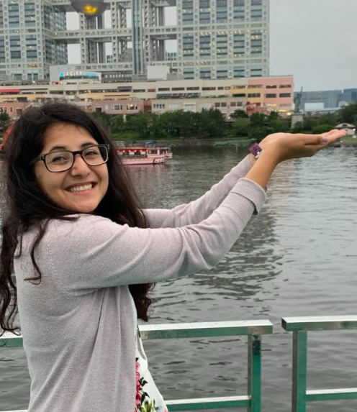
About Me
Cinthya Carrillo, PE
Graduated from Cal Poly, SLO with a mechanical engineering degree w/ concentration HVAC+R
Mechanical Design Engineer for Haskell
Orange Empire ASHRAE: Student Activity Chair
Contact Info: cinthya.carrillo@haskell.com

Slide 3
ashrae
American Society of Heating Refrigeration and Air-Conditioning Engineers
Mission: To serve humanity by advancing the arts and sciences of heating, ventilation, air conditioning, refrigeration and their allied fields.
50,000 members from over 132 nations with over 100’s of local chapters
Website: https://www.ashrae.org/

Slide 4
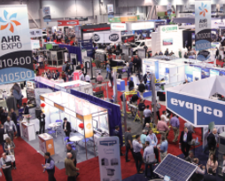
Ways ASHRAE is involved
Technical Committees (write standards + Guidelines)
Conferences: Expo
Student Programs
YEA (Young Engineers in ASHRAE)
Training
Website: https://www.ashrae.org/

Slide 5
Society Student Benefits
Scholarships
(due December)
Networking
Student competitions
Previous student members receive discount membership once becoming a professional
Smart Start Program (~ normal 1 year cost covers membership for 3 years)

Slide 6
Local Orange Empire Student Benefits
Local Scholarships
Local Travel Grants to Winter Conferences
(Due December 14)
Free Attendance to the Orange Empire Chapter Meetings (Must Register Beforehand)
Reimbursable Student membership cost
Marketing Competition
(Due November 18)
Reimbursable passed FE exam

Slide 7
Marketing Completion
Orange Empire ASHRAE is hosting a video promotion competition.
Students may work as individuals or teams to make a 30 second – two minute video promoting ASHRAE.
Up to $1000 will be given away in scholarships to the winners.
Due November 18.

Slide 8
Travel Grant to Winter Conference
ASHRAE Winter Conference in Atlanta GA
Conference: February 4-February 8, 2022
(2) $1500 travel grants will be given to cover admission fees, transportation, food and lodging.
Due December 14.

Slide 9
Orange Empire ASHRAE
Next Meeting: November 17, 2022 @ The Villa
Meeting Agenda
5:30 p.m. - 6:30 p.m. - Tech Session 6:30 p.m. - 7:30 p.m. - Registration / Main Meeting Start 7:30 p.m. - 8:30 p.m. - Dinner Presentation
Location: 510 E Katella Ave Orange, CA 92867
Tech Session: MARKET TRENDS AND THE FUTURE OF BIoT
Dinner Presentation: ​The ASHRAE presentation covers the basics of hydronic balancing, differences between manual & automatic balancing and both the short-term and long-term advantages & disadvantages of each. It also covers the different technologies in automatic balancing used today.
Website: http://events.r20.constantcontact.com/register/event?llr=ymsp8ocab&oeidk=a07ejgr4t3db07ff607

Slide 10
Questions?

