Slide 1
Alma Analytics Basics

Slide 2
Topics in this presentation
Accessing and navigating analytics
Setting your user preferences
Running out-of-the-box reports
Copying and editing shared reports
Exporting results
Analytics terminology

Slide 3
Accessing and navigating analytics
Analytics User Roles -
Designs Analytics
Analytics Administrator

Slide 4
Alma > Analytics

Slide 5
Analytics landing page (all new users) – this is a blank page, can be customized.

Slide 6
Search box – to search available analytics reports, dashboards, prompts etc.

Slide 7
Advanced – open an advanced search box

Slide 8
Home – the most recent and popular items/activities, navigation pane on the left

Slide 9
Catalog – to access My Folders and Shared Folders (out-of-box reports)
Note– Helpful tip
Use the Catalog to get back to the folder and list of report view quickly, like a “Back” button to navigate back to the Folder/report menu

Slide 10
Favorites and Dashboards

Slide 11
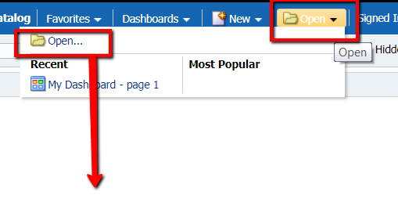
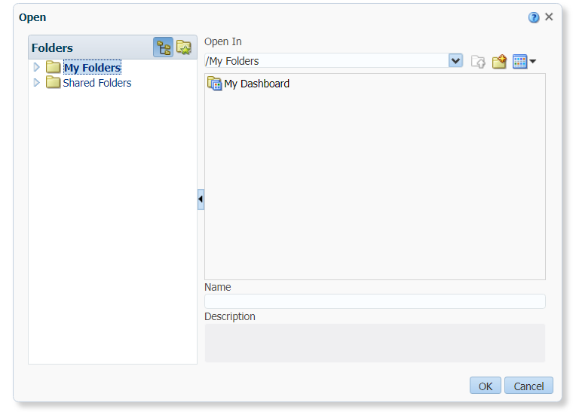
New and Open

Slide 12
User Account – My Account
This is where to set user preferences
Setting your user preferences

Slide 13
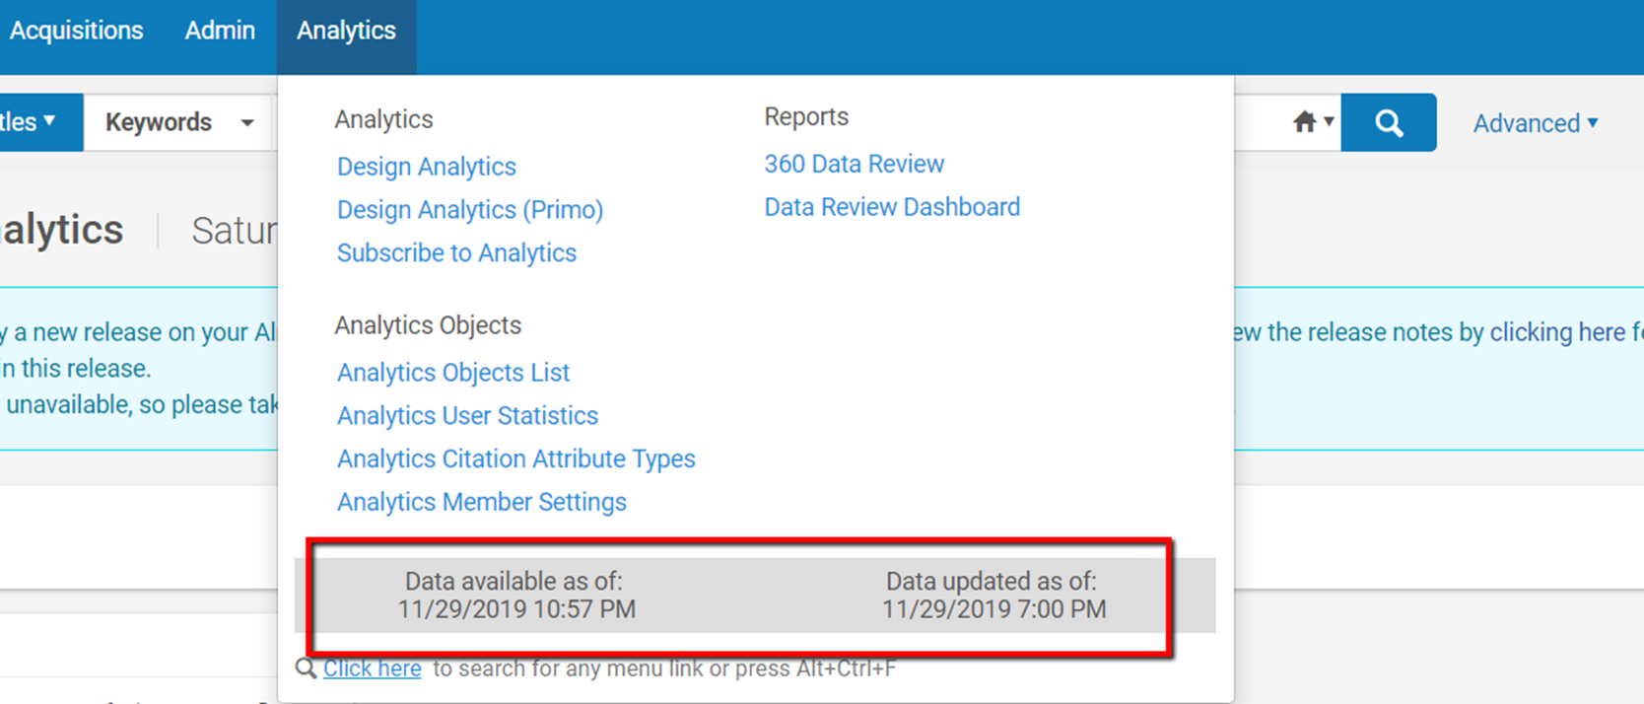
My Account – Preferences set starting page, location & time zone
Note - make sure the time zone is set correctly, as this is the time zone to present the data updated in available timestamp in the Analytics menu

Slide 14
My Account – Preferences cont. set analysis editor
Note – a helpful tip
Set the Analysis Editor to Start on Criteria tab when editing Analysis

Slide 15
Catalog – Folder organization My Folders and Campus Shared Folder
My Folders – my own work area (not shared)
My Campus shared folder – to share and for others to subscribe to reports and analytics objects

Slide 16
Catalog – Folder organization Community Shared Reports
SUNY Consortium shared folder – created by SUNY Analytics WG and SLSS staff.
[Shared Folders > Community > Reports > Consortia > SUNY]
Feel free to copy any reports from this shared folder.
If you make any changes (add/delete) to this folder, please notify the SLSS staff immediately.
Ex Libris maintains the admin and organization of the entire Shared Folders, the order of the folders might change.

Slide 17
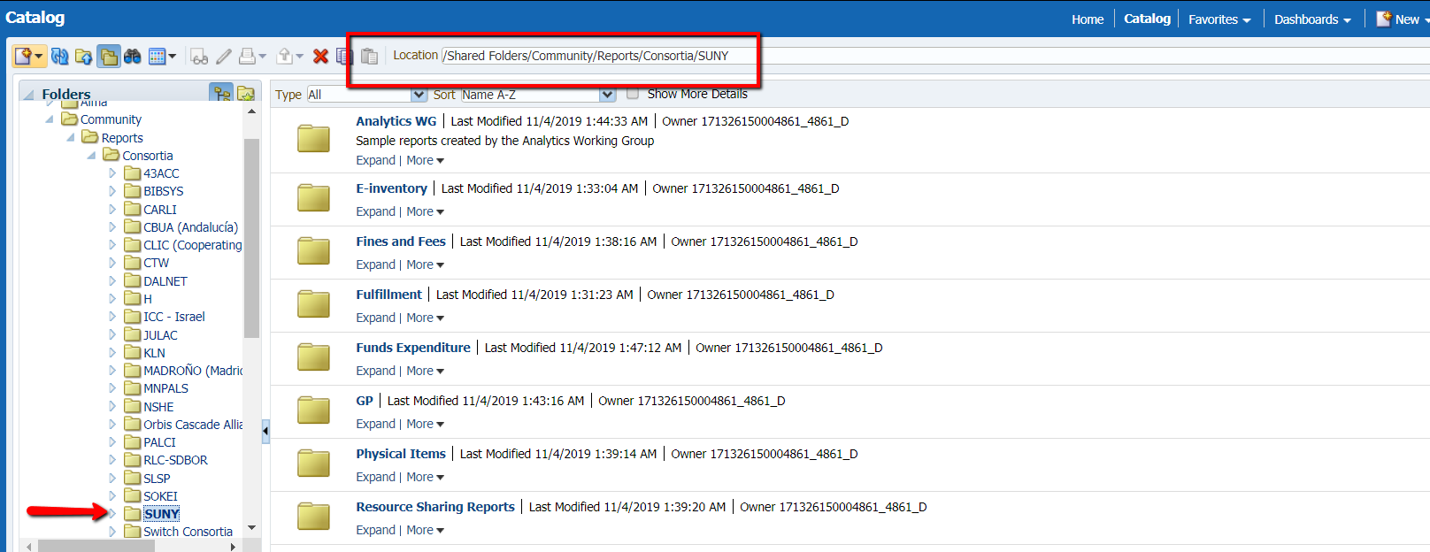
Running out-of-the-box reports
Demo – SUNY shared reports (how to navigate here)
Click on Catalog
Shared Folders > Community > Reports > Consortia > SUNY

Slide 18
Shared Folders > Community > Reports > Consortia > SUNY > GP (will use this folder as the demo)

Slide 19
Example report – Newly cataloged titles
Click Open to see the report result

Slide 20
Report shows your own campus data

Slide 21
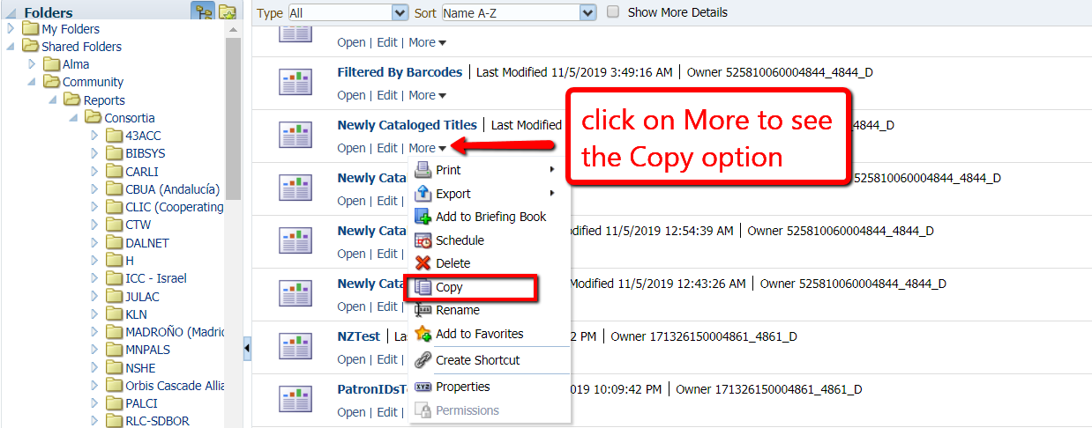
Copying and editing shared reports
Return to Folders view, click on Catalog
Under the report, click on More to copy the report

Slide 22
Copying and editing shared reports – cont.
Navigate to My Folders
Click on the New icon (right above My Folders), create a new folder

Slide 23
Copying and editing shared reports – cont.
Paste that copied report to the new folder

Slide 24
Edit the report in “My Folder”

Slide 25
Edit report – edit/delete/add new filter
This “Newly cataloged titles” report is showing results of the newly cataloged items that were cataloged (created) from the past 7 days prior to the current date.
What if I want to see the report of items cataloged (created) within a date range? For example, from Oct 1, 2019 to Nov 1, 2019.

Slide 26
Adding a new filter [this slide has a short video embedded] click on the ”new filter” icon, select Item creation date, choose the in-between from Operator dropdown, enter the dates

Slide 27
Run the report result with new filter [this slide has a short video embedded]

Slide 28
Save the report with new filter [this slide has a short video embedded]

Slide 29
Format result data column properties before Exporting to Excel [this slide has a short video embedded] (Item Creation Date only displayed on the 1st item, other item lines are blank) Go to Criteria – Item creation date column properties – Column format - Repeat

Slide 30
Exporting Results/Reports
Click on the “Export this analysis” icon
Choose the export file format, such as pdf, Excel, etc.
Export data size limits:
65,000 rows limit to Excel
500,000 rows limit for export in csv format

Slide 31
Analytics Terminology useful to know when creating a new report and editing existing
Subject Area
Dimensions
Shared dimensions
Fields/Columns (3 types)
Measures/Measurements
Descriptions/Attributes
Hierarchical

Slide 32
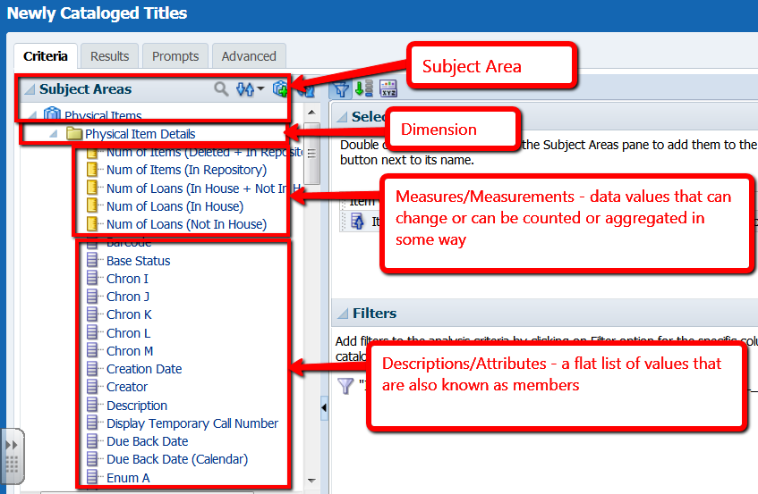
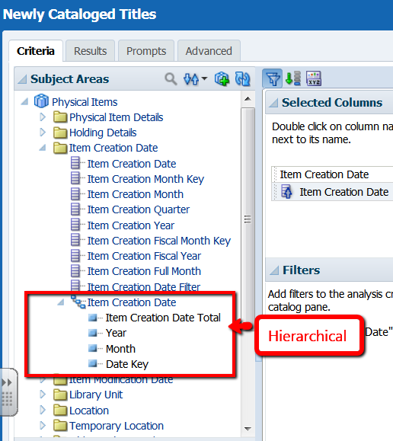
Analytics Terminology – using the demo report

Slide 33
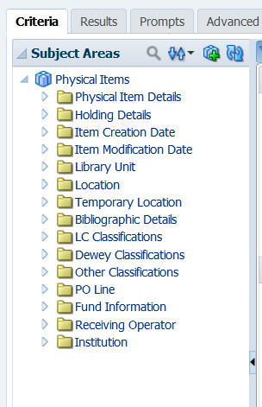
Analytics Terminology – cont.
Shared Dimensions
For more info on Shared Dimensions see ExL Product Documentation

Slide 34
Analytics training and info
Ex Libris Analytics Training Main page
https://knowledge.exlibrisgroup.com/Alma/Training/Analytics
Analytics General Terminology
https://knowledge.exlibrisgroup.com/Alma/Product_Documentation/010Alma_Online_Help_(English)/080Analytics/010Introduction/General_Terminology
Analytics Subject Area Terminology
https://knowledge.exlibrisgroup.com/Alma/Product_Documentation/010Alma_Online_Help_(English)/080Analytics/010Introduction/Subject_Area_Terminology

