Slide 1

George Mason District
DCOH/Roundtable
April 11, 2024

Slide 2

Pledge

Slide 3
Agenda
Welcome and Pledge
District Court of Honor
Questions about Read-ahead
Award(s)
General Announcements
Council Announcements
Program Announcements
Alignment Update
Cracker Barrel/Networking (Optional; NLT 9pm)
Next Meeting: May 9, 2024

Slide 4
District Court of Honor

Slide 5
District and other Award(s)

Slide 6
Welcome
New to Roundtable?
Please introduce yourself!

Slide 7
Questions/Clarification about Read-ahead?

Slide 8
General Announcements

Slide 9

Current 2024 George Mason Calendar
April 13, 2024 – GMD Pinewood Derby, St James, Falls Church, VA
May 3-5, 2024 – Spring Camporee, 4H
May 27, 2024 – Memorial Day Flags In, Falls Church, VA
May 29, 2024 – Elks Youth Recognition Dinner for 2023 Eagle Scouts

Slide 10
STEM
05/04/24 – 19th Annual NCAC Orienteering Meet, Prince William Forrest
07/08/24 – 07/12/24 – STEM Summer Workshop, Alexandria, VA
08/05/24 – 08/09/24 – STEM Summer Workshop, Alexandria, VA
Ancient Earth: Birth of the Sky (on PBS) - link
Anytime – DC STEM Trek- Showcases 24 government agencies, private organizations and monuments related to the tenets upon which STEM is based. Two hikes - 10.57 miles, or 4.75 miles
Ancient Earth: Birth of the Sky (on PBS) - link
Anytime – DC STEM Trek- Showcases 24 government agencies, private organizations and monuments related to the tenets upon which STEM is based. Two hikes - 10.57 miles, or 4.75 miles

Slide 11
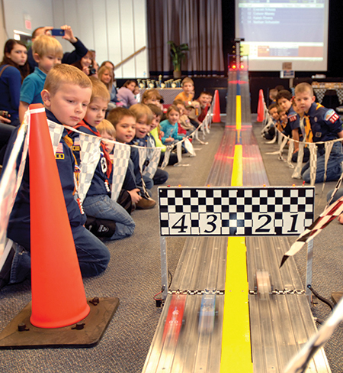
2024 George Mason Pinewood Derby
Race Day is April 13, 2024
Race will be held at St James Catholic Church, Falls Church, VA.
Need volunteers to help with setup on Apr. 12th and race day on Apr. 13th, to include from older Scouts looking for service/Den Chief hours: https://m.signupgenius.com/#!/showSignUp/5080E4BA9AE2DA1FA7-48723540-gmdistrict
For questions, contact Pat Berney.

Slide 12

Elks Youth
Recognition Dinner
For youth that earned Eagle in 2023 (i.e. their Eagle Board of Review was held in the 2023 calendar year) and their Scoutmasters.
Thursday, May 29, 2024
Elks Lodge - 2188, 8421 Arlington Blvd., Fairfax, VA.
Will need unit leader help in contacting Scouts and obtaining an RSVP.
Scoutmaster are invited at no cost to them.

Slide 13

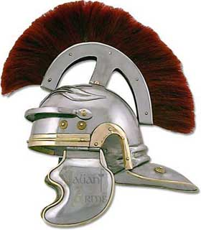
George Mason District Roundtable
GREEKS VERSUS ROMANS
SPRING CAMPOREE

Slide 14
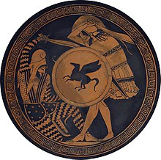
The Details
When: May 3-5, 2024
Where: 4-H Camp, 600 4H Center Drive, Front Royal, VA 22630
Cost:
  Scouts: $ 25
  Adults: $ 25
  Cubs: $25

Slide 15
Need Some Volunteers
As far as Program goes, here's what we're looking for:
Roman Shield Drills: Teach and call commands for Roman formations. This is one of the most fun things you will ever do! Don't worry, we have a guide, and it gives you an excuse to watch Gladiator again.
Greek Shield Drills: Teach and call commands for Greek phalanx formations. Don't worry, there are instructions!
Crossing the Rhine (monkey bridge): Brian Fleck is leading this, but he could use a second.
Hoplite Down (first aid): General supervision of volunteer victim Scouts in Greek armor being treated. Not required, but if you are familiar with moulage or have always wanted to try it, that would be extra cool. Also cool if it's someone who can sign off on first aid requirements.
Chariot Race: We could use some adults to help at the start and finish lines.

Slide 16
Alignment Update

Slide 17
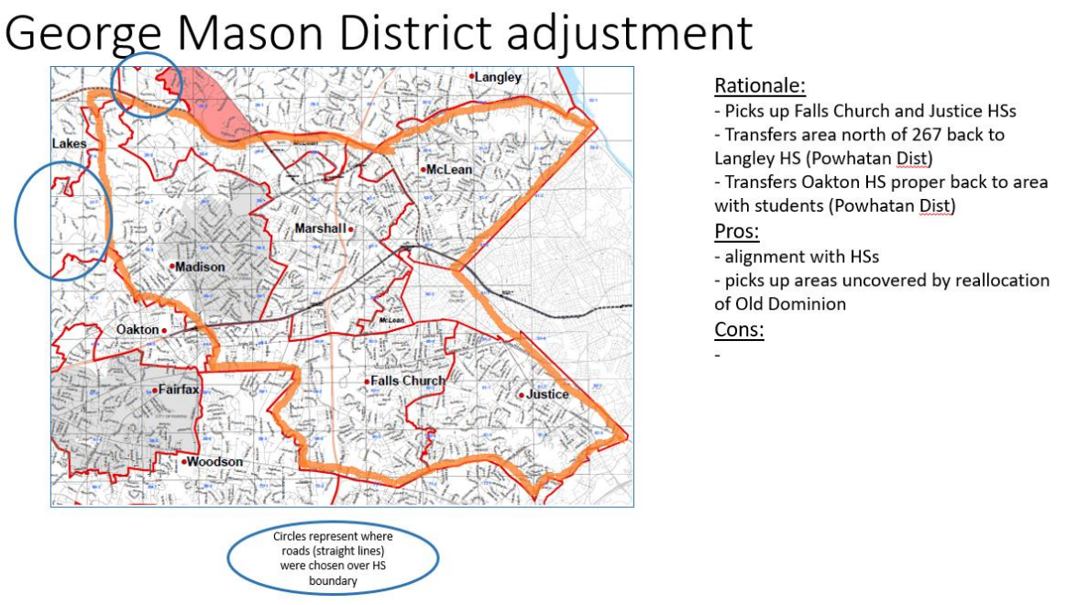

Slide 18
Units Impacted
GMD:
  Packs – 0187, 1513 (to Powhatan)
  Troops – 0187, 0918, 1113, 1887, 1888 (to Powhatan)
Old Dominion District
  Packs – 0855, 1845, 1962 (to GMD)
  Troops – 0875, 1845 (to GMD)
Chain Bridge District
  Still under review

Slide 19
Time for Cracker Barrel
Minutes and slides available on the GMD web site (District Resources, Roundtable). Password is “GMDRT”
Next meeting – May 9, 2024, at Thoreau MS

Slide 20
Backup Slides

Slide 21


Merit Badges
The online Merit Badge Counselor registration.
New Merit Badge Counselors must complete online merit badge counselor training, in addition to YPT. Be sure the counselor uses his/her legal name – no nicknames.
Merit Badge Counselors, or the unit Dean/Leader, also need to scan and send Margee the Merit Badge application form listing the badges the counselor is applying to teach and providing a justification of his/her qualifications.
Youth Protection Training is the essential first step. Don’t hit “send” on the application without it!
Contact Margee if you have questions at GM.MB.Dean@hotmail.com.
Did you know:
The National Council does not limit the number of merit badges a youth may earn from one counselor, though a unit leader is permitted to do so, as long as the same limit applies to all Scouts in the unit. Ideally, Scouts should work with a variety of adults. (GTA 7.0.0.3)
Partial Merit Badges have no expiration except the Scout’s 18th birthday. (GTA 7.0.3.3)
Due to the BSA policies related to Youth Protection and two-deep leadership, a merit badge counselor must have another adult present during all merit badge counseling sessions. However, the parent or legal guardian of the Scout may serve as the second adult. This parent or legal guardian does not have to be a registered leader.
If the requirements for a merit badge differ between the merit badge pamphlet and the current edition of Scouts BSA Requirements, the requirements in the Scouts BSA Requirements book supersede all others.

Slide 22
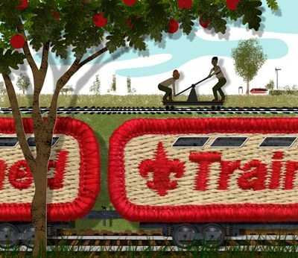
Training (https://www.ncacbsa.org/george-mason/training/)
Cub Scout Den Leader Specific (C42)
  Available on-line (125 min)
  05/04/24 - Alexandria, VA
  05/04/24 - Herndon, VA
  06/01/24 - Alexandria, VA
Basic Adult Leader Outdoor Orientation (BALOO;C32) -
  05/04/24 - 05/05/24 - Gaithersburg, MD
  05/10/24 - 05/11/24 - Fredericksburg, VA
Scoutmaster Position Specific Training(S24)
  Available on-line (192 min)
  05/06/24 - Alexandria, VA
  05/04/24 - Herndon, VA
  06/01/24 - Alexandria, VA
Introduction to Outdoor Leadership Skills (IOLS; S11)
  04/19/24 - Stafford, VA
  05/04/24 - 05/05/24 - Gaithersburg, VA
  05/10/24 - 05/11/24 - Fredericksburg, VA
Climbing Level 1 Instructor
April 20-21 at Great Falls Park, 7:30 AM to 5:00 PM. Logistics memo
April 27-28 at Carderock Rec Area, 8:00 AM to 5:00 PM. Logistics memo
June 15-16 at Great Falls Park, 7:30 AM to 5:00 PM. Logistics memo
Sept 7-8 at Great Falls Park, 7:30 AM to 5:00 PM. Logistics memo
Sept 21-22 at Sugarloaf Mountain, 8:15 AM to 5:00 PM. Logistics memo
Mental Health First Aid
https://www.fairfaxcounty.gov/hscode/ereg/Registration.aspx?groupID=47
NYLT https://www.ncacbsa.org/national-youth-leadership-training/
24.2: 06/16/24-06/21/24
24.3: 06/23/24-06/28/24
24.4: 07/28/24-08/02/24
24.5: 07/28/24-08/02/24
Registration is open. Some seats are still available. There may be a wait list.
Wilderness First Aid (N02) https://scoutingevent.com/082-WFASpring2024
04/27/24 – 04/28/24 – Camp Snyder
Wood Badge (A90) https://www.ncacbsa.org/wood-badge/
04/12/24 – 04/14/24 & 05/04/24 – 05/05/24
10/14/24 – 10/15/24

Slide 23

GM High
Adventure
Members of the High Adventure Committee are available to assist units in planning and training for their upcoming high adventure trips – Contact Brian Heath for more information
Important notes for this month
  NCAC 2025 Outdoor Programs Kick-Off Webinar - April 16 @7pm - REGISTER HERE
  Registration for BSA’s high adventure bases - https://www.scouting.org/outdooradventures/open4adventure/
    2024 treks – Most BSA High Adventure bases still have availability
    2025 treks – Registration for all high adventure bases are now open
2024 NCAC-Organized High Adventure Trips
  Lenhok’sin – James River Canoeing Trek - July 7-13, 2024
    Crew of 6-12 - $475 per participant – 6 slots remaining
    Registration: https://scoutingevent.com/082-75664
    For more information, e-mail highadventure@ncacbsa.org
  11-12 year old Scout High Adventure Experience - Sept 28-29 Prince William Forest
  Joshua Tree with Climbing Committee - Winter Break 2024/25 (Gathering interest)
  Wind River Range, WY: 06/22 to 06/30/24 – Registration is Full
  All NCAC-sponsored trips for Philmont, Northern Tier & Sea Base are already full
2025 NCAC-Organized High Adventure Trips
  Sawtooth Mountain Trip 06/21 to 06/29/2025
    Registration begins June 1, 2024 - $1,165 per person – Ask for details
High Adventure Preparation Training - Open to all NCAC Scouts & adults that are participating in HA trips in the next few years
  Northern Tier: In-person session already passed; Virtual session on Sat, 04/20/24
  All other sessions for this year are over
Apr 2024
Notes:
Sea Base Trip on Jul 29-Aug 3, 2024 - FULL

Slide 24
GM High
Adventure
Other Training
  Back Country Outdoor Leadership Skills
    Maryland session, Spring 2024: Classroom session already passed, Overnight on 04/27-28 https://scoutingevent.com/082-79025-191979
    Virginia session, Fall 2024: 9/21/2024 (classroom), 10/19-20 (overnight)
  Paddle Craft Safety Training: May 18-19, June 1-2, Aug 24-25, Sept 7-8
National High Adventure Base Quick Links
  Philmont: https://www.philmontscoutranch.org/register/
  Northern Tier: https://www.ntier.org/provisional-scout-connections/
  Sea Base: https://www.bsaseabase.org/scouts/scout-connections/
  Summit: https://www.summitbsa.org/registration/scoutconnections/
Other High Adventure Bases
  Adirondack High Adventure Area: https://public.3.basecamp.com/p/hLgsVbk7Suju6cuDzQQJaEn4
  Maine High Adventure Area: https://www.mainehighadventure.org/
  Montana Outdoor High Adventure Base: https://montanabsa.org/camps/high-adventure/
Other useful links for high adventure information and opportunities
  NCAC High Adventure website - https://www.ncacbsa.org/high-adventure/
  List of units with available slots in their upcoming high adventure trips - https://public.3.basecamp.com/p/xWpkdrKHKAA9pCzwmHMNdbWb
Apr 2024 (cont.)

Slide 25
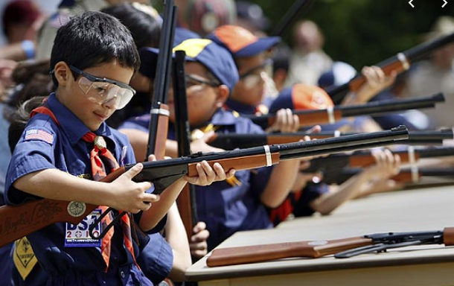
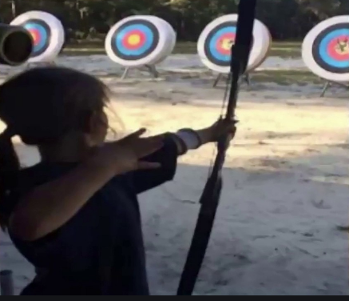
Shooting Sports
Requests for Shooting Events – Lead Time!
  50+ scouts - 6mos
  Less than 50 scouts - 3mos
Shooting on private land:
  Requirements
  Permissions/protocols
Shooting Sports web page
Shooting Sports Instructor Classes:
  Rifle/Shotgun - 04/27/24, 07/20/24, 08/24/24
  Archery – 05/04/24

Slide 26
Order of the Arrow
  Brian Fleck is Chapter Advisor.
  2024 Dues can be paid online: https://wipit470.org/dues.html
  Registrations open online https://wipit470.org/index.html under “Events”

Slide 27
OA – Lodge Master
Instructions for setting up a Troop in Lodge Master for upcoming O/A elections. They should have their election dates confirmed prior to setting this up.
  Log into Lodge Master (https://lodgemaster.oa-bsa.org/)
  Select “Inductions”
  Select “Visit & Election Management” (right side of the screen)
  Filter on “George Mason”
  Find your Troop and select “Edit”
  Scroll to the bottom of the page and enter your eligible Scouts information.
  Please include e-mail addresses for both the Scout and Parent. If no Scout e-mail is available, add the parents.
  Please add phone numbers.
  SAVE
You should be back at the 2024 Inductions page. If you are not, go back and repeat steps 1-4. At the top in the red banner, click on “Reports”
Print 2 copies of the Unit Election Report. The Election Team will sign both and give one to you at the conclusion of the election.
Print 1 copy of the Candidate Information Form. This is for the Election Team to use to verify the election results.
Click on the Unit Election Ballots and print that as many times as you need for all the Scouts in the Troop.

Slide 28
A Game with a Purpose
Practice and Apply Scout Skills
Fulfill Rank Requirements
Learn and Appreciate Ancient History and Culture
Exercise Creativity and Ingenuity

Slide 29
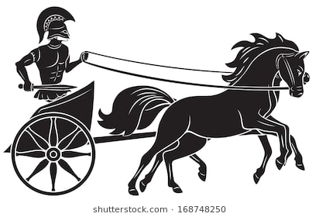
The Chariot Race
Like a Klondike Derby, Patrols will build and race Chariots, pulled by Scouts.

Slide 30
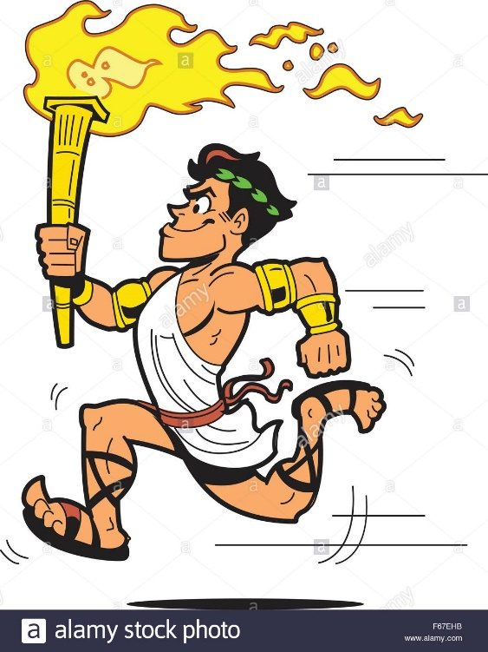
Olympic Running
A one-mile run for either the “before” or “after” section of Tenderfoot requirement 6a.

Slide 31
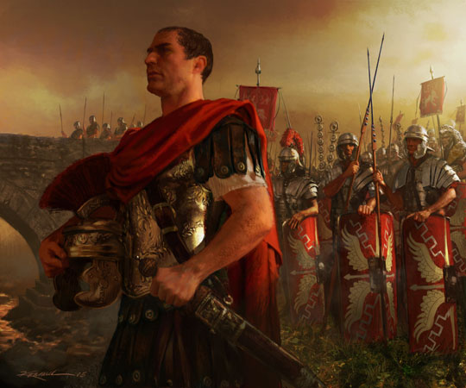
Crossing the Rhine
Use lashings to build a bridge to carry Caesar’s troops to Rome (First Class Requirement 3b, 3c, 3d).

Slide 32
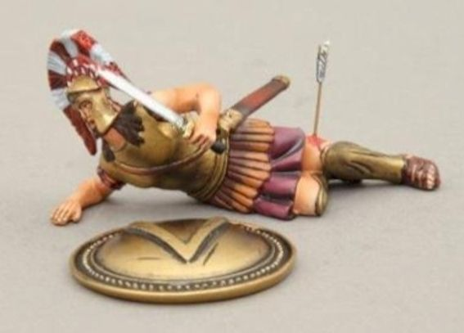
Hoplite Down!
Triage, deliver first aid, and transport a wounded Greek soldier (Second Class, 6a, 6b; First Class, 7a, 7b)

Slide 33
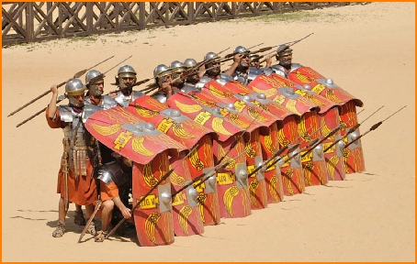

Shield Wall Drills
Learn how Greek and Roman soldiers used teamwork to protect themselves and defeat their enemies.

Slide 34
Culture Competition
Decorate your campsite in Greek or Roman fashion!
Perform themed skits at the Campfire!
Experiment with Greek or Roman camp dishes!

Slide 35
What Do We Need From You?
Make cardboard shields to bring (instructions provided)
Build a chariot

