Slide 1
Advancing Strategic Community Based Partnerships
CTC-RI Annual Conference| October 5, 2023

Slide 2
Agenda
Presenter/Topic | Time
Welcome Moderator: | 5 minutes
Partnerships 101 Garry Bliss, Program Director for Medicaid Accountable Entities (AE) at Prospect Chartercare | 15 minutes
An Overview of Integrated Healthcare Partners Emergency Housing Program Rebecca Plonsky, LICSW, CEO, Integrated Health Partners | 20 minutes
Group Activity & Share-out | 15 minutes
Discussion & Questions | 10 minutes

Slide 3
CTC-RI Conflict of Interest Statement
If CME credits are offered, all relevant financial relationships of those on the session planning committee have been disclosed and, if necessary, mitigated.
The AAFP has reviewed ‘_______,’ and deemed it acceptable for AAFP credit. Term of approval is from _____. Physicians should claim only the credit commensurate with the extent of their participation in the activity. NPs and RNs can also receive credit through AAFP’s partnership with the American Nurses Credentialing Center (ANCC) and the American Academy of Nurse Practitioners Certification Board (AANPCB).

Slide 4
Objectives
Gain insight into the significance of collaboration between clinical and community partners in enhancing healthcare outcomes.
Learn guidelines and best practices for creating robust and sustainable partnerships between healthcare providers and community organizations.
Explore two diverse case studies that vividly illustrate the positive impact of strategic community-based partnerships on patient care within distinct healthcare settings.

Slide 5
Partnerships 101 OR Bliss’s Three Laws of Successful Partnerships

Slide 6
Bliss’s First Law of Successful Partnerships
Everyone does what they are good at…

Slide 7
Bliss’s First Law of Successful Partnerships
Everyone does what they are good at…
…and then STOPS.

Slide 8
Good Partnerships vs. Bad Partnerships
Good
Not So Good

Slide 9
Bliss’s Second Law of Successful Partnerships
A partnership must work for everyone …

Slide 10
Bliss’s Second Law of Successful Partnerships
A partnership must work for everyone …
…or it will not work and it’s NOT a partnership.

Slide 11
Partnerships are a two-way street
The Questions You Should Be Asking Your Partners:
What resources do you need to fully and fairly compensate you and support everyone at your organization contributing to this work?
How can this partnership help you achieve your priorities?
What can WE do for YOU? What are YOUR organizational needs? What do YOUR clients need that we could help with?

Slide 12
What does this look like?
You’re a doctor’s office! Do “doctor stuff.”
You want this organization to open their doors to your patients, you should open your doors to their clients.
Accept New Patient Referrals Patient Education @ CBO
Do a “Clinic” @ the CBO (Blood Pressure Checks, etc.) Staff Education @ CBO
Share outcomes data – anonymous, aggregated, etc.
Help this organization demonstrate the impact they are making with their services.
Your time is valuable. Your expertise is valuable. So is the time and expertise of your community partners.
Pay for it!
Listen and learn from their expertise

Slide 13
Bliss’s Third Law of Successful Partnerships
Good…is Good Enough
And a It’s Very Good Place to Start

Slide 14
Get Started!
Paralysis by analysis doesn’t help anyone.

Slide 15
The Story of One Partnership
The Issue:
Patients at St. Joseph Health Center had a high rate of food insecurity.
Patients at St. Jospeh Health Center had nutrition-related diagnoses, but do not have the resources to quickly adopt a new diet.
The Response:
Create an on-site food pantry.

Slide 16
Can we register with the Food Bank?
Do we need a license to be a Food Pantry?
Who has time to track stock and order resupplies?
Should we get a fridge?
Should we get a freezer?
What kind of shelves to we buy? And where do I get them?
Oh, God, do I need to put them up?

Slide 17
Partnership!
THEM
ME
Know how to run a Food Pantry
Have relationship with Food Bank
Have a system for tracking inventory
Know what people want
Know what equipment to buy
Know what kind of shelves we need
Can install the shelves
Know how to run a Food Pantry
Have relationship with Food Bank
Have a system for tracking inventory
Know what people want
Know what equipment to buy
Know what kind of shelves we need
Can install the shelves

Slide 18
West End “built” the Food Pantry
We paid them for materials, supplies, time & labor
West End stocks and resupplies Food Pantry
West End receives a monthly “infrastructure” payment
Record keeping, meetings, expertise, time, labor, putting up with me
Additional funding if we request special food purchases
We collect client data West End MUST supply
It is anonymous so data is fully HIPPA compliant!

Slide 19
An Overview of Integrated Healthcare Partners Emergency Housing Program
October 5, 2023
Presented by:
Rebecca Plonsky Babigian, LICSW, CEO of IHP
19

Slide 20
Who is Integrated Healthcare Partners (IHP)?
IHP was established in 2018 as a Rhode Island Medicaid Accountable Entity.
IHP is responsible for advancing the health outcomes, lowering unnecessary medical spend, and improving quality for over 32,000 at Risk Rhode Islanders.
Unlike other AE’s IHP is unique in that 8 disparate organizations came together to support our joint mission. IHP’s network is comprised of 5 Community Health Centers and 4 Community Mental Health Centers:
Community Care Alliance (CCA)
Comprehensive Community Action Program (CCAP)
East Bay Community Action Program (EBCAP)
Newport Mental Health (NMH)
Thrive Behavioral Health (TBH - formerly The Kent Center)
Tri-County Community Action Agency (Tri-County)
WellOne Primary Medical and Dental (WellOne)
Wood River Health Services (WRHS)
20

Slide 21
Overview of IHP’s Overarching Goals
Sophisticated Reporting and Analytics System
Strong Partnerships with Insurers and State Leaders
Robust Continuum of Care
Commitment to Quality
Ensure all individuals have a voice in providing their person-centered care, treatment planning, and engagement across a robust continuum of care that provides holistic, safe, timely, cost effective, and
evidence based care in the least restrictive environment.
Advancing integrated behavioral health (BH) and medical care to ensure individuals can access high quality care based in best practices easily.
Utilize data and best practices to decrease total cost of care (TCOC) with a focus on reducing waste and avoidable visits to higher levels of care including Emergency Rooms and Inpatient medical, mental health, and substance use admissions.
Build upon our organizational strengths as it relates to coordination of care, closing gaps in care, and commitment to expanding the healthcare workforce
Provide multi- disciplinary team provides timely outreach to screen and engage individuals in SDOH services, preventative, routine, and sick care
Establish and maintain critical partnerships
including IHP’s hotel
and motel partners
3

Slide 22
IHP’s Emergency Housing Program
To date, IHP has engaged over 100 high risk and rising risk individuals
IHP has received statewide recognition for our comprehensive approach to providing a BH-Medical Respite Model with wrap services that address:
Housing Insecurity through hotel/motel partnerships statewide
Food Insecurity through Medically Tailored Meals
Connectivity to critical BH and Medical care management services and
supports
24/7 Certified Peer Support Services through Marigold
Program has seen significant savings and improved health outcomes
22

Slide 23
Securing Engagement for 1 Year Pilot Program
Establish Community Based Partnerships
Establish KPIs
Begin Key Stakeholder Engagement
What is a Feasible Glidepath?
What is the Problem We are Solving For?
What is the ROI?
What is the total number of individuals to engage?
What are utilization metrics to determine success?
Secured 2 Hotel Partners in support of the mission of the new pilot program
Pitched Proposal to Board of Directors, Managed Care Partners, and Assigned Champions to Project
Develop 1 Year Pilot to test hypothesis: Engage 50 individuals in 42 Day in an Emergency Housing Program will improve health outcomes and lower TCOC
Over 2,000 individuals are homeless or housing insecure.
What can we do to better their health outcomes while lowering TCOC?
23

Slide 24
Lowering Total Cost of Care 7/1/22-6/30/23
#1 PERFORMING AE FOR ED AVOIDABLE VISITS
58 Unique Individuals
Pt enrolled in Job Corps to become Welder
43% Reduction in TCOC
44%
Reduction in Inpatient Admissions
Station fire survivor able to connect to needed services and housing
PY5
Success Stories
IHP provided first/last rent to secure permanent housing for pt who thrived in program
Continue to evaluate impact on Moms Meals
30%
Reduction ED Visits/1000
Analysis based on claims paid thru June 2023
6

Slide 25
Scalability
Invested in development and go live of IHP Portal
HIPAA Compliant
Streamlines Referrals
Sends Authorizations to hotels/care teams
Expanded to include Medically Tailored Meals
Expanded to include Mobile Peer Support Programming

Slide 26
PY6 New Population Health Programming
Launched a focused Food Pharmacy Program 7/1/23 to address impactable
populations
Goal is to engage at least 75 individuals who have a diagnosis of Hypertension, Diabetes, and/or Depression as well as screen positive for Food Insecurity
IHP will build off the strengths of our Emergency Housing Program and leverage our medically tailored meals program to help a new population(s) by providing:
12 weeks Medically Tailored Meals
4 Sessions of Telehealth Counseling by a Registered Dietician
Voluntary Community Based or Virtual Cooking Classes that promote culturally sensitive cooking
Program will look to improve uncontrolled BP, A1C, and decrease and PHQ scores

Slide 27
Lessons Learned
Start slow→ Cannot move faster than the system will allow
Be Patient→ Program Engagement Takes Time
Continuously Engage Key Stakeholders
Stay on top of reporting metrics/KPIs
Image Above from https://navigatemc.com/lessons- learned-process-focus/

Slide 28
It Takes a Village
Elmwood Ave LGBTQ+

Slide 29
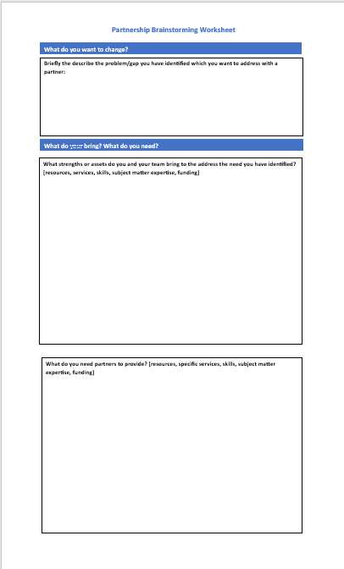
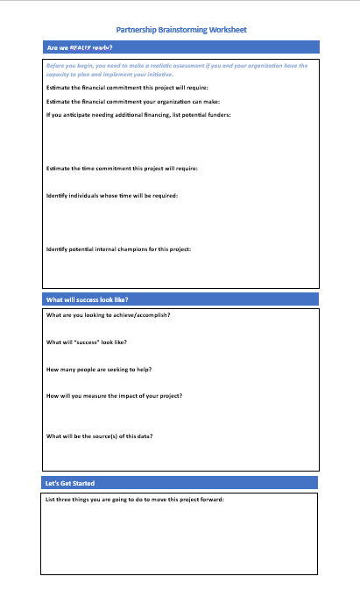
Getting Started

Slide 30
Questions?
Thank you!

