Slide 1


Pediatric Sleep ECHO®
Session 6: sleep and autism spectrum disorder
Date: October 24, 2024
PLEASE NOTE: Project ECHO case consultations do not create or otherwise establish a provider-patient relationship between any clinician and any patient whose case is being presented in a project ECHO setting
Care Transformation Collaborative of RI
Prepared by Care Transformation Collaborative of RI

Slide 2

Welcome
This session will be recorded for educational and quality improvement purposes
Please do not provide any protected health information (PHI) during any ECHO session

Slide 3
Agenda
Time | Topic | Presenter
7:30 – 7:35 AM | Welcome | Liz Cantor, PhD
7:35 – 8:00 AM | Didactic Session: Sleep and Autism Spectrum Disorder | Lindsay Stager, PhD
8:00– 8:25 AM | Case Presentation | Blackstone Valley Pediatrics
8:25-8:30 AM | Wrap Up | All

Slide 4

Announcement
Thursday December 19th Session 8 extended to 90mins 7:30-9:00 AM
Agenda:
Middle School (ages 11-13)
Case presentation: Waterman Pediatrics
PDSA Review from Practices

Slide 5

Sleep and Autism Spectrum Disorder
Lindsay Stager, PhD

Slide 6
Objectives
Provide overview of ASD Symptomology
Discuss Sleep Concerns Commonly Comorbid with ASD
Describe Empirical Evidence for ASD Specific Sleep Interventions
Review ASD Specific, CBT-Based Tools for Sleep

Slide 7
What is Autism Spectrum Disorder (ASD)?

Slide 8
Two Primary Features of ASD
Persistent Deficits in Social Communication and Social Interaction Across Multiple Contexts
Restricted, Repetitive Patterns of Behavior, Interests, or Activities

Slide 9
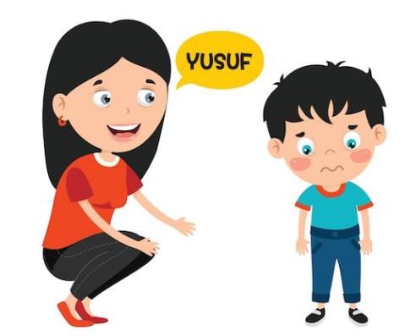
Persistent Deficits in Social Communication and Social Interaction Across Multiple Contexts
Deficits in social-emotional reciprocity
Deficits in nonverbal communication
Difficulty developing and maintaining social relationships

Slide 10
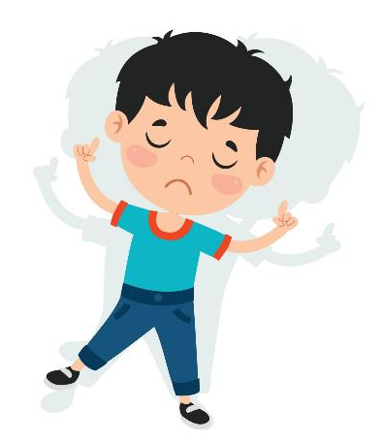
Restricted, Repetitive Patterns of Behavior, Interests, or Activities
Stereotyped or repetitive movements, use of objects, or speech
Insistence on sameness, inflexible adherence to routines, or ritualized patterns of behavior
Restricted interests that are abnormal in intensity or focus
Hyper- or hypo- reactivity to sensory input or unusual sensory interests

Slide 11
Sleep and ASD

Slide 12
Sleep and ASD
44-83% of children with ASD have comorbid sleep difficulties versus 11-37% of children in the general population
Trouble falling or staying asleep, early morning awakenings, prolonged wake after sleep onset, irregular sleep patterns, parasomnias, RLS, rhythmic movement disorder, and short sleep duration
Possible causal factors include:
  Dysregulated melatonin synthesis/altered melatonin secretion patterns
  Abnormalities in circadian clock gene
  Decreased awareness of social and environmental clues which habituate sleep–wake cycles
  Other medical comorbidities (i.e., epilepsy, GI disturbances)
  Picky eating and sensory sensitivities

Slide 13
Empirically Supported Interventions

Slide 14
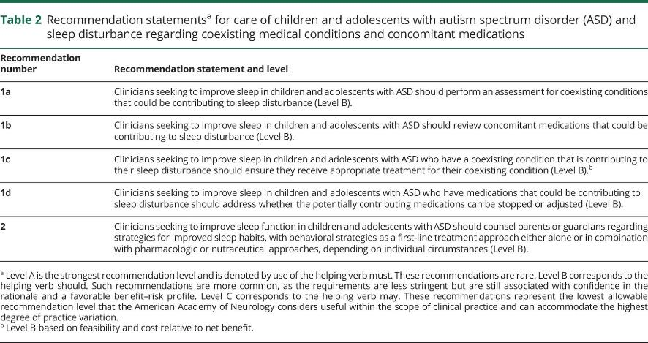
American Academy of Neurology Treatment Recommendations

Slide 15
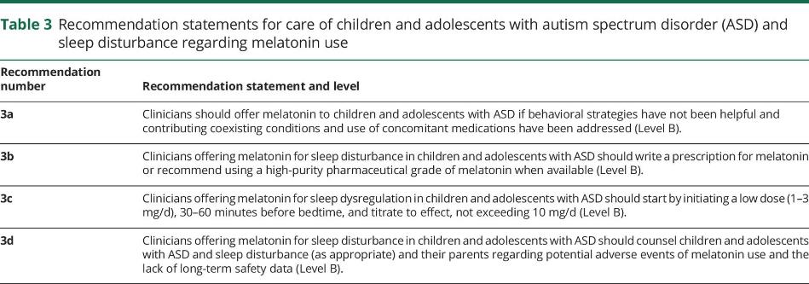
American Academy of Neurology Treatment Recommendations

Slide 16
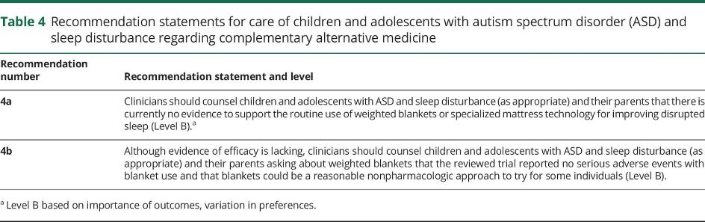
American Academy of Neurology Treatment Recommendations

Slide 17











Bedtime Resistance
Controlled Release Melatonin
CBT
Controlled Release Melatonin
+ CBT
Parent Education
Treatment Indicator:
Consistent (>1-2 nights) resistance to bedtime

Slide 18

Sleep Onset Latency (SOL)
Standard and Prolonged Release Melatonin
CBT
Controlled Release Melatonin
+ CBT
Parent Education
Treatment Indicator:
SOL>30 minutes and associated distress or daytime symptoms

Slide 19

Sleep Efficiency (SE)
Standard and Prolonged Release Melatonin
CBT
Controlled Release Melatonin
+ CBT
Parent Education
Sound-to-Sleep Mattress Technology
Treatment Indicator:
SE<85% and associated distress or daytime symptoms

Slide 20

Nighttime Awakenings
Prolonged Release Melatonin
Family-Based
CBT
Controlled Release Melatonin
+ CBT
Parent Education
Treatment Indicator:
Wake after sleep onset >60 minutes and associated distress or daytime symptoms

Slide 21
Total Sleep Time
Prolonged Release Melatonin
Family-Based CBT
Controlled Release Melatonin
+ CBT
Parent Education
Sound-to-Sleep Mattress Technology
Treatment Indicator:
Total sleep time less than developmentally appropriate + distress
or daytime symptoms

Slide 22
Empirically Supported Interventions
Restless Leg Syndrome
Iron therapy is effective in improving symptoms
Parasomnias
Sleepwalking
Safety devices
Sleep Terrors
Increased sleep duration
Reduce environmental noise
Psychoeducation
Nightmares
Imagery Rehearsal Therapy
Increased sleep duration

Slide 23

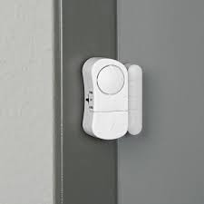
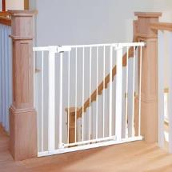
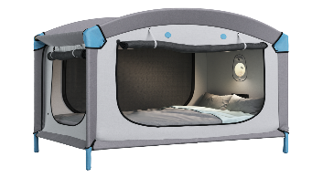
Safety Devices
Smart beds (i.e., Chubby Beds)
  Decrease risk of eloping, falls, and injuries
  Reduce sensory input to promote a calming environment
  Door Alarms
  Alert parents to elopement
  Gates
  Decrease elopement risk

Slide 24
CBT Based Strategies for Improving sleep in asd

Slide 25
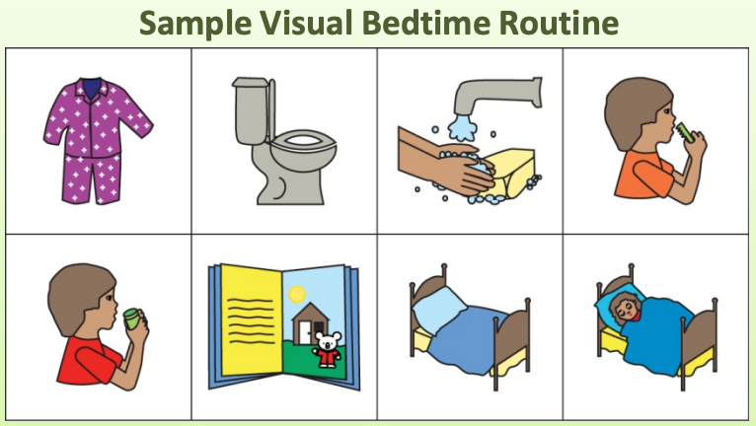
Visual Schedules
Stimulating or difficult activities should occur earlier in the routine
Break down complex multi-step activities
Decrease anxiety about what will happen next
Should be kept in a location visible to child

Slide 26
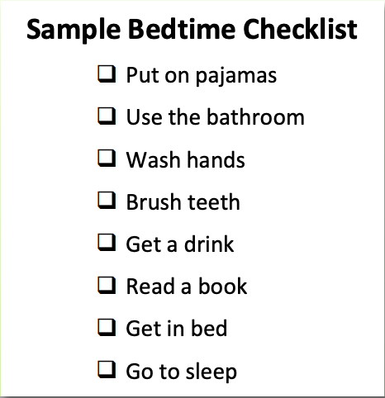
Bedtime Checklist
Stimulating or difficult activities should occur earlier in the routine
Break down complex multi-step activities
Decrease anxiety about what will happen next
Should be kept in a location visible to child
Child should be able to check items off independently

Slide 27
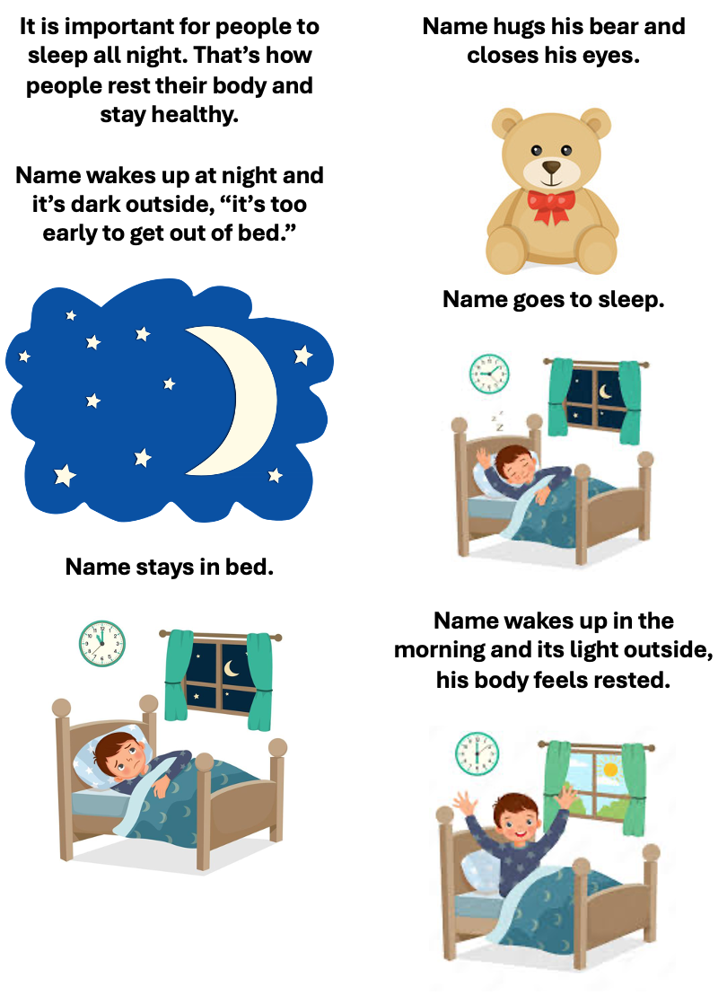
Social Story
Developed with specific challenges and interests in mind
Helps communicate expectations and give the child a plan to manage challenging situations
Should be reviewed frequently

Slide 28
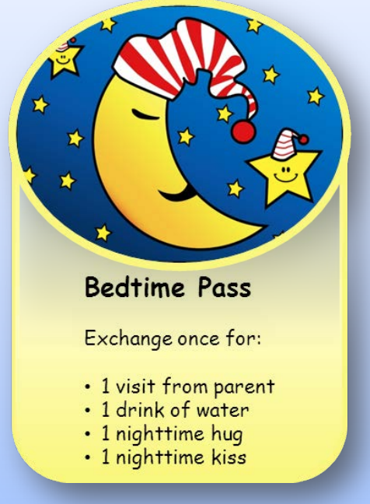
Bedtime Pass
Given to child before bed
Can be exchanged for a nighttime visit to parents’ room
Can be exchanged for a reward in the morning if not used
Child should be reminded of the pass before bed, a story can be used to help explain and remind

Slide 29

Sleep Hygiene Considerations
Ensure pajamas and bedding are comfortable and meet sensory needs
  Consider lycra sheets (sensory compression sheets)
  Consider weighted blankets per the American Academy of Neurology Treatment Recommendations
White noise may help minimize nighttime awakenings
Suggestions for relaxing activities before bed:
  Massage
  Music
  Reading
  Self-Rocking

Slide 30
References
Autism Speaks. (2017, March 6). Sleep. Accessed October 7, 2024. https://www.autismspeaks.org/sleep Veatch, O.J., Maxwell-Horn, A.C. & Malow, B.A. Sleep in Autism Spectrum Disorders. Curr Sleep Medicine Rep. 2015; 1, 131–140. doi:10.1007/s40675-015-0012-1 Williams Buckley A, Hirtz D, Oskoui M, et al. Practice guideline: Treatment for insomnia and disrupted sleep behavior in children and adolescents with autism spectrum disorder: Report of the Guideline Development, Dissemination, and Implementation Subcommittee of the American Academy of Neurology. Neurology. 2020;94(9):392-404. doi:10.1212/WNL.0000000000009033

Slide 31

CME Credits
(Pending credit for MDs, PAs, Rx, RNs, NPs, PsyD, PhD)
CME Credits – Please request session credits when filling out the evaluation at the end of the meeting.
Evaluation/Credit Request Form:
https://www.surveymonkey.com/r/echosleep
The AAFP has reviewed ‘Advancing Community-Oriented Comprehensive Primary Care Through Improved Care Delivery Design and Community Health,’ and AAFP credit is pending. Term of approval is from 04/19/2024 – 04/19/2025. Physicians should claim only the credit commensurate with the extent of their participation in the activity.
NPs and RNs can also receive credit through AAFP’s partnership with the American Nurses Credentialing Center (ANCC) and the American Academy of Nurse Practitioners Certification Board (AANPCB).

Slide 32
Thank you!
Next Meeting: Elementary School ages 6-10
Thursday , November 21st, 2024 - 7:30 – 8:30 AM
Evaluation/Credit Request Form: https://www.surveymonkey.com/r/echosleep

