Slide 1


Pediatric Sleep ECHO®
Session 7:
SLEEP IN ELEMENTARY SCHOOL AGED CHILDREN
(AGES 6-10)
Date: NOVEMBER 21, 2024
PLEASE NOTE: Project ECHO case consultations do not create or otherwise establish a provider-patient relationship between any clinician and any patient whose case is being presented in a project ECHO setting
Care Transformation Collaborative of RI
Prepared by Care Transformation Collaborative of RI

Slide 2

Welcome
This session will be recorded for educational and quality improvement purposes
Please do not provide any protected health information (PHI) during any ECHO session

Slide 3
Agenda
Time | Topic | Presenter
7:30 – 7:35 AM | Welcome | Liz Cantor, PhD
7:35 – 8:00 AM | Didactic Session: Sleep in Elementary School Aged Children (Ages 6-10) | Lindsay Stager, PhD
8:00– 8:25 AM | Case Presentation | Carrie Roy, FNP-BC, PRIMA Pediatrics
8:25-8:30 AM | Wrap Up | All

Slide 4

Announcement
Thursday December 19th Session 8 extended to 90 mins (7:30-9:00 AM)
Agenda:
Middle School (ages 11-13)
Case presentation: Waterman Pediatrics
PDSA Review from Practices

Slide 5

Sleep in Elementary School Aged Children (Ages 6-10)
Lindsay Stager, PhD

Slide 6
Objectives
Brief overview of sleep and sleep disorders in elementary school aged children
Review cognitive and behavioral correlates of poor sleep
Discuss sleep concerns among children with ADHD
Review sleep assessment for children ages 6-10
Discuss empirically supported interventions for healthy sleep among children ages 6-10

Slide 7
Brief Overview of Sleep and Sleep Disorders in Elementary School Aged Children

Slide 8
Goal Duration: 9-12 Hours
Common Sleep Disorders (Ages 6-10)
Diagnosis | Prevalence
Nightmares | 20 – 50%
Confusional Arousals | 17.3%
Sleepwalking | 17%
Behavioral Insomnia of Childhood | 10 – 30%
Sleep Terrors | 1 – 6.5%
Obstructive Sleep Apnea (OSA) | 1 – 5%
Restless Leg Syndrome (RLS) | 2%

Slide 9
Key features
Diagnosis | Key Features
Nightmares | Upsetting dreams remembered upon waking
Confusional Arousals | Slowed responses, slurred speech, confusion and no memory of the event upon waking
Sleepwalking | Ambulating during sleep, difficult to awaken
Behavioral Insomnia of Childhood | Difficulty independently initiating or maintaining sleep
Sleep Terrors | Display of fear in sleep, no memory of event upon waking
OSA | Snoring, nighttime enuresis, morning headaches, daytime sleepiness
RLS | Discomfort in legs alleviated by movement

Slide 10
Cognitive and Behavioral Correlates of Poor Sleep
Notes:
Symptoms of osa and RLS when to refer objectives 11/8 and slides 11/14
School age girls share a room, sleep problems 6 & 9

Slide 11
Cognitive and behavioral Correlates of poor sleep
OSA
  Decreased attention, memory, and executive function
  Increased mood concerns, behavior problems, and academic difficulties
Restless Leg Syndrome
  Decreased cognition and attention
  Increased mood and behavior concerns
Delayed Sleep Phase Disorder
  Decreased attention
  Increased impulsivity and hyperactivity
Behavioral Insomnia of Childhood
  Decreased attentions and concentration
  Increased daytime sleepiness

Slide 12
Sleep concerns among children with adhd

Slide 13
Sleep in Children with ADHD
20 – 55% of children with ADHD have reported sleep concerns
Risk Factors
  Psychotropic medications
  Comorbid mood concerns
  Central nervous system dysfunction
  Alterations in the timing and pattern of melatonin secretion or responsiveness to environmental cues
  Disrupted neurotransmitter pathways (i.e., noradrenergic and dopaminergic pathways)

Slide 14
Sleep in Children with ADHD
High rates of parent reported sleep concerns
  Difficulty initiating and maintaining sleep (~25-50%)
  Poor sleep quality
  Short sleep
  Daytime sleepiness
  Difficulty transitioning to sleep
Objective findings compared to healthy controls:
  Greater between night variability in sleep
  Greater sleep onset latency
  Lower sleep efficiency
  Higher apnea–hypopnea index
  Larger number of sleep stage shifts per hour
  Higher incidence of periodic limb movements in sleep
Notes:
Findings may be confounded by different ADHD subtypes
Subjective and objective reports do not always align in kids – may relate to parental hypervigilance

Slide 15
Sleep Disorders Commonly Associated with ADHD
Obstructive Sleep Apnea
Up to 25% of ADHD diagnoses may relate to symptoms of sleep-disordered breathing
Habitual snoring is three times more common in children with ADHD (33%)
Restless Leg Syndrome
Up to 44% of children with ADHD have RLS symptoms
26% of RLS pediatric patients have symptoms of ADHD
Delayed Sleep Phase Disorder
Children with ADHD have delayed melatonin secretion and increased eveningness preference

Slide 16
Assessment Recommendations

Slide 17
Assessment Recommendations
1
2
3
Screen for sleep problems in children with ADHD
  BEARS Sleep Screening Tool
  The Children’s Sleep Habits Questionnaire
If indicated, conduct more in-depth assessment of sleep
  Sleep Diaries
  Polysomnography
Treat documented sleep disturbances prior to diagnosing ADHD

Slide 18
Empirically Supported Interventions for healthy sleep among children ages 6-10

Slide 19
Sleep Hygiene
Not a stand-alone treatment
May have been abandoned by parents of children with ADHD due to prioritization of other behavioral goals

Slide 20
Mood and Bedtime Resistance
~30% of children with ADHD have comorbid anxiety
Nighttime anxiety can make it hard for kids to sleep and increase risk for bedtime refusal
Psychotherapy
    Sleep restriction, bedtime fading, and/or stimulus control
    Psychoeducation about sleep hygiene
    Relaxation techniques to reduce anxiety
    Cognitive restructuring of maladaptive thoughts regarding sleep
Medications

Slide 21

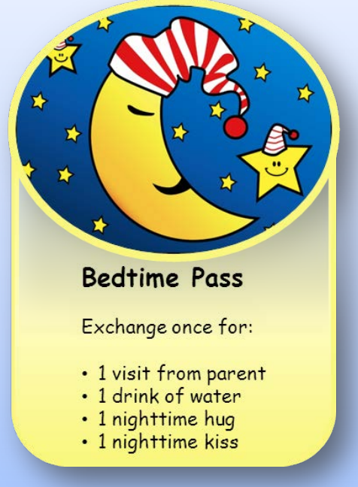
Positive Reinforcement

Slide 22



Comfort Objects

Slide 23
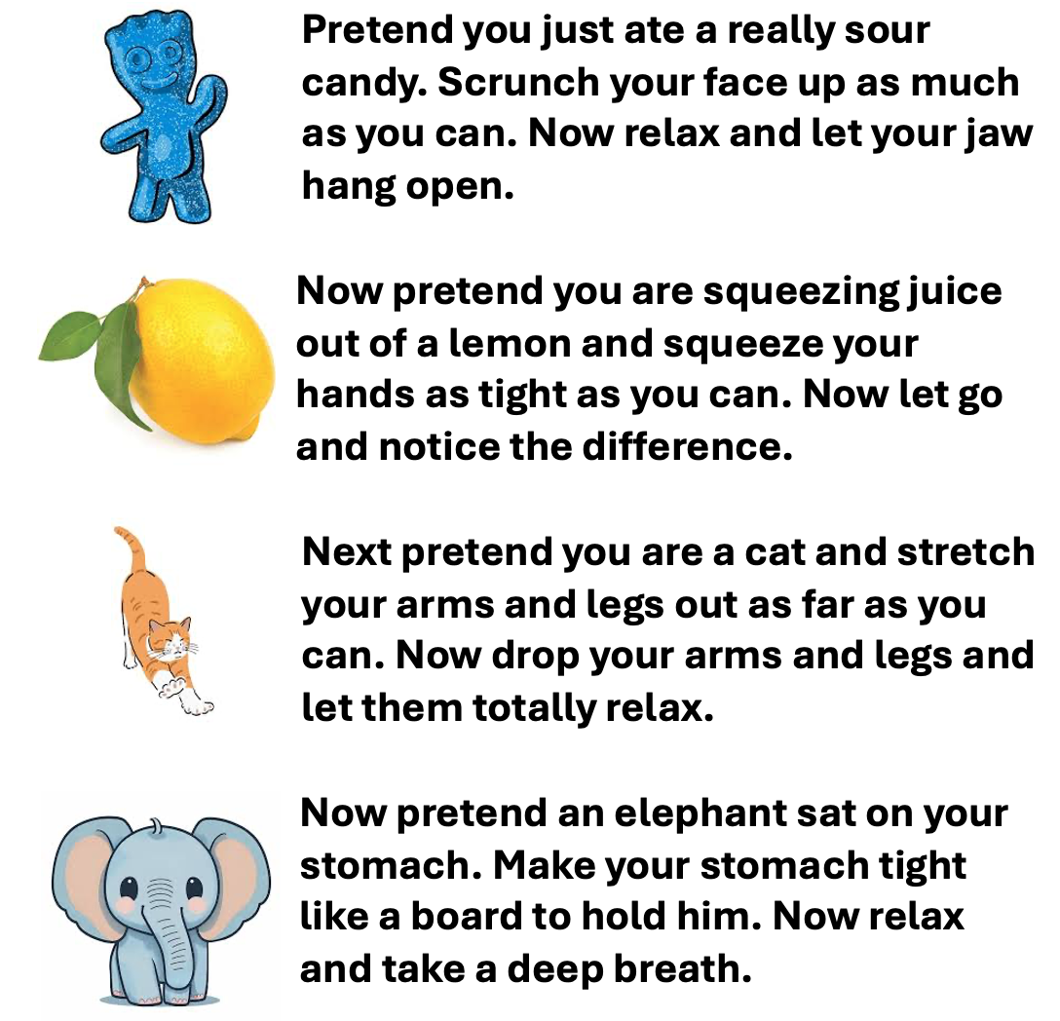
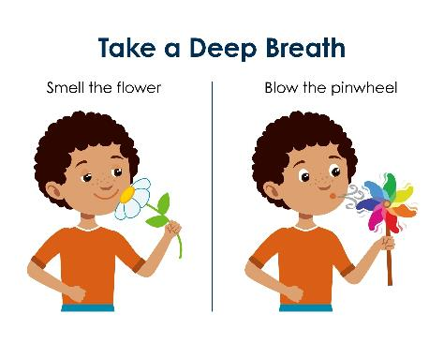
Relaxation Strategies
5 – 4 - 3 – 2 – 1

Slide 24
Nighttime ADHD Symptoms
Use of stimulant medications earlier in the day may lead to return to baseline or rebound ADHD symptoms at night
  Late-day supplementation of medication with a short-acting psychostimulant may be effective
  Use of relaxation strategies may also be helpful

Slide 25

Prolonged sleep onset
Assess for developmentaly appropriate bed and wake time
Consider the potential impact of stimulants
  consider moving administration earlier in the day, changing to shorter-acting doses, or switching to non-stimulant medications like atomoxetine or guanfacine
Children with ADHD may have delayed sleep phase
  3-6mg of immediate release melatonin 20 minutes before bed may improve sleep onset latency
  Bedtime fading may also be effective

Slide 26
References
Carter, K. A., Hathaway, N. E., & Lettieri, C. F. (2014). Common sleep disorders in children. American Family Physician, 89(5), 368–377. Owens, J. A. (2009). A clinical overview of sleep and attention-deficit/hyperactivity disorder in children and adolescents. Journal of the Canadian Academy of Child and Adolescent Psychiatry. 18(2), 92-102. Van der Heijden, K. B., Smits, M. G., Van Someren, E. J., Ridderinkhof, K. R., & Gunning, W. B. (2007). Effect of melatonin on sleep, behavior, and cognition in ADHD and chronic sleep-onset insomnia. Journal of the American Academy of Child and Adolescent Psychiatry, 46(2), 233–241. doi: 10.1097/01.chi.0000246055.76167.0d Weiss, M. D., Wasdell, M. B., Bomben, M. M., Rea, K. J., & Freeman, R. D. (2006). Sleep hygiene and melatonin treatment for children and adolescents with ADHD and initial insomnia. Journal of the American Academy of Child & Adolescent Psychiatry, 45(5), 512-519, doi: 10.1097/01 chi.0000205706.78818.ef.

Slide 27

CME Credits
(Pending credit for MDs, PAs, Rx, RNs, NPs, PsyD, PhD)
CME Credits – Please request session credits when filling out the evaluation at the end of the meeting.
Evaluation/Credit Request Form:
https://www.surveymonkey.com/r/echosleep
The AAFP has reviewed ‘Advancing Community-Oriented Comprehensive Primary Care Through Improved Care Delivery Design and Community Health,’ and AAFP credit is pending. Term of approval is from 04/19/2024 – 04/19/2025. Physicians should claim only the credit commensurate with the extent of their participation in the activity.
NPs and RNs can also receive credit through AAFP’s partnership with the American Nurses Credentialing Center (ANCC) and the American Academy of Nurse Practitioners Certification Board (AANPCB).

Slide 28
Thank you!
Next Meeting: Session 8: Middle school aged children (11-13) and Practice PDSA’s
Thursday , December 19th, 2024 - 7:30 – 9:00 AM (Extended 90 minute session)
Evaluation/Credit Request Form: https://www.surveymonkey.com/r/echosleep

