Slide 1


Pediatric Sleep ECHO®
Session 8:
SLEEP IN middle schoolers
Date: DECEMBER 19, 2024
PLEASE NOTE: Project ECHO case consultations do not create or otherwise establish a provider-patient relationship between any clinician and any patient whose case is being presented in a project ECHO setting
Care Transformation Collaborative of RI
Prepared by Care Transformation Collaborative of RI

Slide 2

Welcome
This session will be recorded for educational and quality improvement purposes
Please do not provide any protected health information (PHI) during any ECHO session

Slide 3
Agenda
Time | Topic | Presenter
7:30 – 7:35 AM | Welcome | Liz Cantor, PhD
7:35 – 8:00 AM | Didactic Session: Sleep in Middle Schoolers | Julie Boergers, PhD
8:00 – 8:25 AM | Case Presentation | Waterman Pediatrics: John Finigan, MD, Vanessa Cubellis, LMHC
8:25 – 8:55 AM | Practice PDSAs Report Out | All Practices
8:55 – 9:00 AM | Wrap Up | Liz Cantor, PhD

Slide 4


ECHO Series: Optimizing a Behavioral Health Approach to Children’s Sleep in Pediatrics
Sleep in Middle Schoolers
Julie Boergers, PhD
December 19, 2024

Slide 5
Objectives
Identify common sleep hygiene issues and sleep disorders among pre-teens
Review biological and societal influences on sleep in this age group
Discuss strategies for helping parents minimize the impact of electronics on sleep

Slide 6
Sleep in Pre-Teens
Middle school students need 9-10 hrs of sleep
Low incidence of parasomnias (sleepwalking, sleep terrors)
    If you see parasomnias, assess for sleep apnea and/or restless sleep, and/or consider referral for sleep eval
  Increased incidence of “psychophysiological” insomnia
      Learned association between bed and wakefulness
      Increased role of maladaptive thoughts about sleep
    Increased incidence of Delayed Sleep/Wake Phase Disorder

Slide 7
Changes & Challenges for Pre-Teens
Biological changes
    Delay in dim light melatonin onset across transition to puberty – able to stay up later, harder to wake up earlier
Increased importance of peer relationships
      > time in bedroom, > time on social media, > sleepovers
Societal changes
    Average US middle school time 8:04am (36% between 7:30 - 7:59 am)
    More homework (often on laptop), more activities (e.g. late practices)
    Pressure to get phones, other electronics

Slide 8
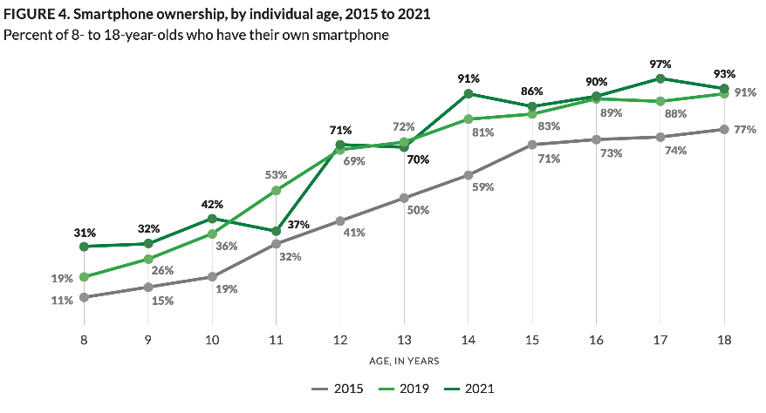
Common Sense Media, 2021

Slide 9
Opportunities
Encourage parents who are ready to get their child a phone to start with a flip phone/limited features
Encourage parents to set rules about no phone in bedroom to set the stage for healthier sleep habits in high school
Encourage parents to continue to set a bedtime, even on weekends
Encourage child to make sleep a priority
    What do they value? Can you emphasize the role of sleep on academics? Sports performance? Are they getting sick a lot and can you emphasize the role of sleep in health and immune function?

Slide 10
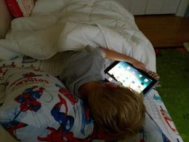
Sleep Hygiene Concerns to Assess in Pre-Teens
Oversleeping on weekends (“social jetlag”) leading to difficulty falling asleep on weekdays
Caffeine
Napping
Electronics
  TVs, smartphones, tablets, laptops, desktops,
  smartwatches, gaming consoles, portable
  gaming systems, VR headsets, smart glasses…

Slide 11
Screens Impair Sleep Health in Kids
Several meta-analyses, dozens of studies around the world
Vast majority of studies found a link between total daily screen time (and evening screen time in particular) and delayed bedtime and/or < sleep duration
Several studies also found screen time is associated with < sleep quality, > sleep onset latency, and > daytime sleepiness
The mere presence of a handheld electronic device in the bedroom has adverse effects on sleep outcomes
Exposure to violent programming within 30 min of bedtime was associated with > sleep latency and < sleep duration.

Slide 12
Why Might Screens Impact Sleep?
Blue light. Bright light (esp. short-wavelength light, or blue light, emitted by screens) suppresses the release of melatonin which could delay the onset of sleep.
Arousal. Screens may be cognitively and emotionally stimulating, marking it harder to fall asleep.
Sleep displacement. Using devices (especially in bed) delays the time when people start trying to fall asleep.
Sleep disruption. Notifications and sounds from devices can interrupt sleep during the night.

Slide 13
What’s the Evidence?
Blue light: Weak. Does suppress melatonin release and significantly delays circadian phase, but only delays sleep onset by ~10 min.
Arousal: Depends. Scary or suspenseful shows or games can delay sleep onset by ~ 10 minutes. Some media could be relaxing, however.
Sleep displacement: Strong. Use of devices at night (e.g., scrolling while laying in bed) has been shown to delay going to sleep by as much as 1 hour and 15 minutes
Sleep disruption: Strong. Compared to adolescents who turn off their phones at night, those that leave the ringer on have more trouble falling and staying asleep

Slide 14

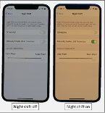
What to do: Blue light
Use lowest brightness that is tolerable in evening.
Use blue light filtering apps and software. Most devices now pre-programmed with option under display settings (e.g. Night Shift on iOS, NightLight/Eye Comfort Shield on Android) that can be set to turn on automatically in evening
Smart lightbulbs similarly can be set to reduce blue spectrum light at night but can be pricey and research is mixed.
Blue light filtering glasses may not be worth the money. A 2021 study found that 46% of those tested filtered out < 50% of blue light. A good pair (e.g. Swannies brand) is ~$90.

Slide 15

What to Do: Screens in Room
Rule changes work best if the are applied to all the kids
Encourage parents to set an example e.g. no phones in bedroom
Put computers and video game consoles in common areas
Parental control options – shutting off wifi at set time, using parental controls in certain programs or apps on phone
If technology is in room at night, ideally
TAKE IT OUT. There is no substitute for
physical control of the device.
The reality: Harm reduction approach.

Slide 16



Problem Solving Common Barriers
Need for morning alarm
Need for light
Need for noise

Slide 17

Harm reduction example: TV
TV out of room
Blanket over screen
Brightness turned down
Volume turned down
TV on timer
Boring vs. preferred show

Slide 18
Harm reduction example: Phone
Phone out of room
Phone in room but out of reach
Transition from video to audio-only (e.g. phone face down for movie, meditations, music etc)
Or transition from phone to TV
Transition from active (e.g. scrolling, games, tik tok) to more passive media (e.g. a boring movie)
Set in airplane mode or DND at bedtime
Begin using physical alarm clock

Slide 19

PEDIATRIC SLEEP ECHO®
CASE PRESENTATION
Presenter(s): John Finigan, MD, Vanessa Cubellis, LMHC
Date: 12/19/2024
Contact Info: Waterman Pediatrics
PLEASE NOTE: Project ECHO case consultations do not create or otherwise establish a provider-patient relationship between any clinician and any patient whose case is being presented in a project ECHO setting
Prepared by Care Transformation Collaborative of RI

Slide 20
Basic Patient Information
Do Not Include PHI
Age/Grade in school (if relevant) | 13 y/o
Gender Identity | Female
Race/Ethnicity | White
How long has this individual been in your care? | IBH- 02/2024 Kelly Cohen, MD- February 2023- Transferred from Dr. Bliss, Patient at Waterman since birth
Who does the patient live with/family constellation? | Mother and older brother (18 y/o)
Insurance type (Commercial, Medicaid, Uninsured, Other) | BCBS

Slide 21
Social/Family History
Do Not Include PHI
Father alcoholic - parent separation several months ago Restraining order b/w patient and father lifted but remains between mother and father. Court ordered visitation b/w patient and father but she declines to go. He has not made any outreach attempts to her. Brother diagnosed with mild ASD No history of direct witnessing DV. Screened negative for PTSD No family hx of sleep disorders

Slide 22
Do Not Include PHI
Sleep behaviors of concern | Insomnia - 1-2 days/wk she will not sleep at all. No pattern based on school/no school days or pre/post parent separation; onset several years ago Goes to bed at 10pm, falls asleep at 12am, wakes for school at 6am. Will sleep in on weekends Frequent daytime fatigue Stares at walls when can not sleep Able to fall back asleep within 10 minutes after awoken at night Able to sleep when she stays over her friend's house on weekends Feels not sleeping some days is normal and her close friends also have nights where they do not sleep Phone on dresser across room/charging at night Patient's bedroom is in a hallway with curtain between room and bathroom. No windows. Often too cold or hot. Able to hear toilet flush, other family members using the bathroom, and at times she can smell an odor following family members using bathroom which bothers her
Relevant BH | Social Anxiety Disorder
Relevant medications | Previously tried melatonin without success

Slide 23
IBH Treatment/Interventions
Do Not Include PHI
Patient centered therapy goal is "to be more confident" and is open to working on promoting better sleep as an objective to reach this go Patient declined for IBH to share sleep troubles with her mother, who she feels she is unaware of this issue Patient declined to use sleep diary Mother told patient that if she took medication for anxiety, she would no longer drive her to therapy Mother declined assistance with SDOH resources

Slide 24
Patient /Family Successes and Strengths
Do Not Include PHI
Mother brings patient to therapy.
Patient has made moderate progress with decreasing symptoms of social anxiety since intake
Patient declines using phone in bed, declines substance use

Slide 25
Reasons for Selecting this Case
Do Not Include PHI
Presenting problem | Insomnia - 1-2 days/wk she will not sleep at all. No pattern based on school/no school days or pre/post parent separation; onset several years ago
What questions do you have for the group? | Addressing poor sleeping conditions contributing to insomnia due to barriers of poverty and low parent engagement

Slide 26

Summary & Clarifying Questions

Slide 27

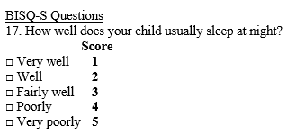
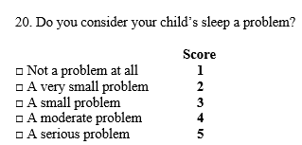
PDSA Focus: Improving sleep in 6–9-month-olds
Blackstone Valley Peds
Plan: Assess sleep at 6 mos using the BISQ-S, provide guidance; then reassess at 9 mos with the BISQ-S
Results: 1. Total number of BISQ-S given at 6 mos from Sept 9-Nov 29 = 96 (82% of WCVs)
2. Only 3/96 scored 4 or 5 on #17; only 4/96 scored 4 or 5 on #20 despite verbal reports of night wakings and other sleep problems
Impressions thus far: BISQ-S #17 and #20 are not identifying infant sleep problems very well; responses to BISQ-S and verbal reports are not consistent
Plan for next cycle: Ask just 2 questions: 1. Does your child sleep through the night (at least 6 hrs)? 2. if not, how often does s/he wake during the night? Provide guidance at 6 mo visit.
Data: look at change over 3 mos; expect the number of night wakings to decrease with provided guidance
Prepared by Care Transformation Collaborative of RI

Slide 28
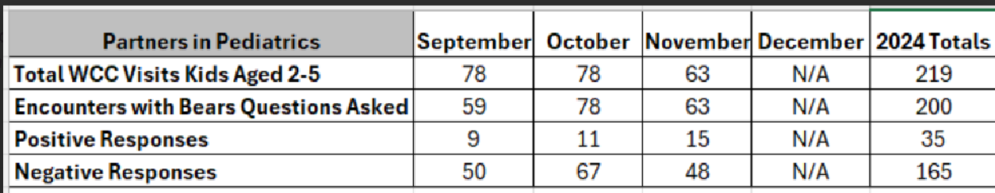
PDSA Focus: Improving sleep in young children 2-5
Partners in Pediatrics
AIM: Consistently identify young children who suffer from snoring/apnea by asking BEARS Qs at WCC
PLAN: One provider to pilot starting Sept. 1
RESULTS: The majority of eligible patients received the BEARS interview - 100% for Oct/Nov (rate of positives: Sep 15%, Oct 14%, Nov 24%)
Clinical utility: Valuable, started with a laminated handout then started asking Qs only; makes the interview much better, more in-depth
Plan for next cycle: Expand BEARS interview to 6–8-year-old WCVs, starting January
Prepared by Care Transformation Collaborative of RI

Slide 29
PDSA Focus: Improving sleep in school age children 6-9
PRIMA Pediatrics
Rolled out the BEARS for all WCVs on Sept 1; Target: 50%
  Note: one provider not participating
Month | WCVs (6-9) | BEARS given | Positive BEARS
September | 52 | 37 (71%) | 6 (16%)
October | 79 | 69 (87%) | 14 (20%)
November | 67 | 53 (79%) | 9 (17%)
Results:
Clinical utility: useful questions, now incorporated into WCVs for all kids
Positive BEARS: mostly related to sleep behaviors (e.g. trouble settling, parental inconsistency with routines/limits; weekday vs weekend sleep schedules; also ADHD/Meds)
Plan for next cycle – continue as is
Prepared by Care Transformation Collaborative of RI

Slide 30
PDSA Focus: Improving response to sleep concerns in children ages 6-12 by creating clinical decision supports
  Atlantic Pediatrics
  Plan: create a more streamlined process for referrals and connecting patients to the care they need
  Tasks: identify list of patient concerns, identify best practice response, create order set in Epic, test it, revise as needed, evaluate usefulness
  Timeline: create the CDS by November, start to test it in December
  (see next slides)
Prepared by Care Transformation Collaborative of RI

Slide 31
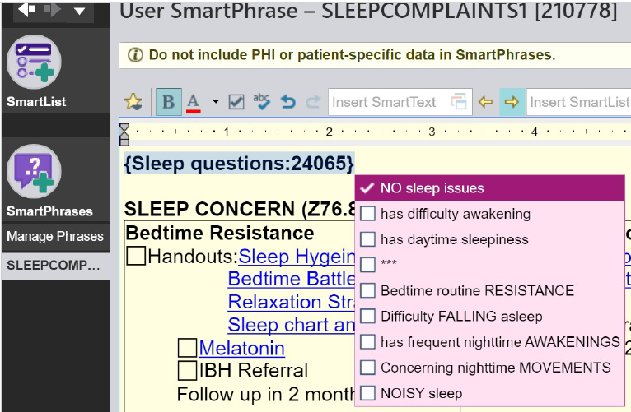
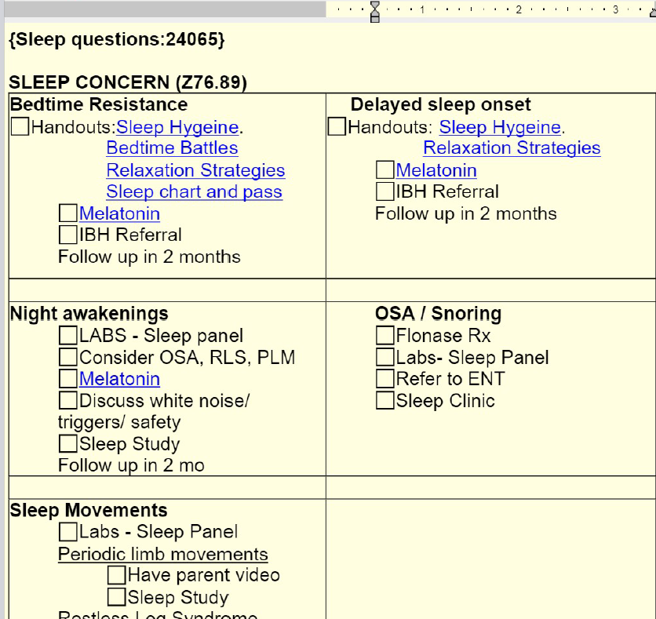
Atlantic Pediatrics
  1. Sleep question list
2. Sleep Smart Phrase
Prepared by Care Transformation Collaborative of RI

Slide 32
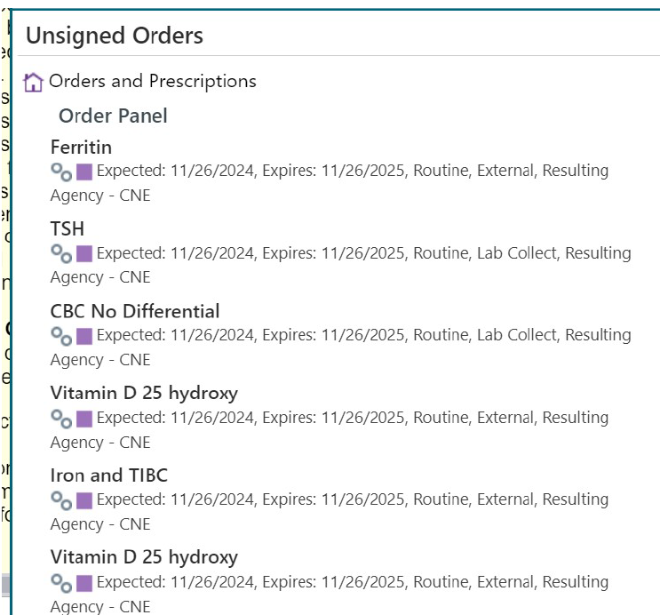
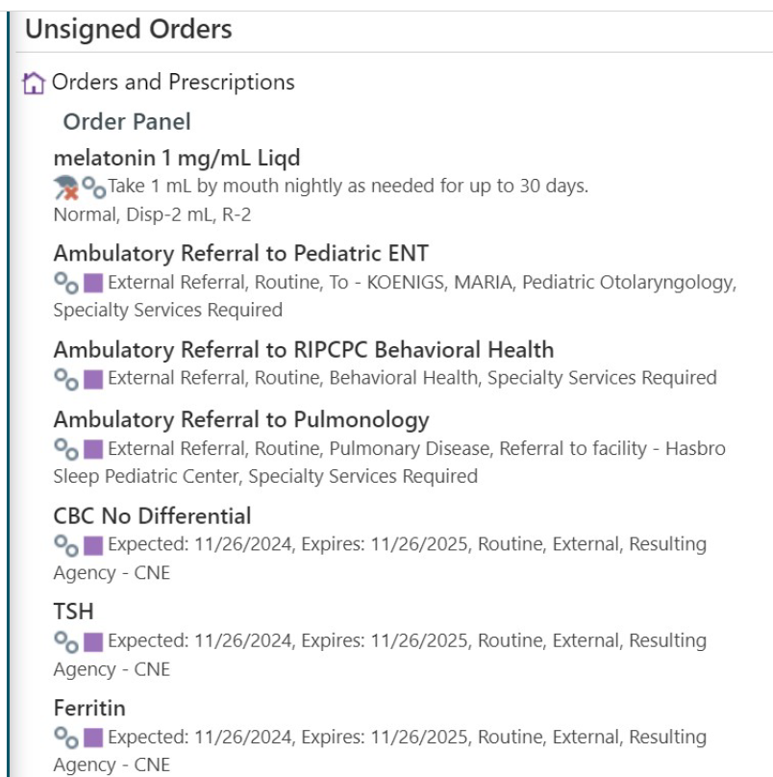
  3. Sleep Labs
Atlantic Pediatrics
4. Sleep Orders
Prepared by Care Transformation Collaborative of RI

Slide 33
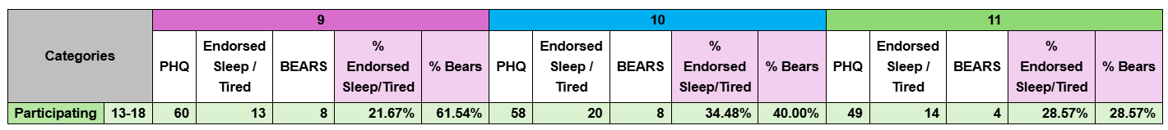
PDSA Focus: Improving sleep in teens
Anchor Pediatrics
Plan: administer a self-report BEARS to 13-18 y.o. pts who identify sleep concerns either on the PHQ9 or during a medical visit; 2 providers piloting
Results: Administration decreased over time because providers were finding it to be redundant
Next cycle: Expand use of order set to all providers starting January 2025
Prepared by Care Transformation Collaborative of RI

Slide 34

CME Credits
(Pending credit for MDs, PAs, Rx, RNs, NPs, PsyD, PhD)
CME Credits – Please request session credits when filling out the evaluation at the end of the meeting.
Evaluation/Credit Request Form:
https://www.surveymonkey.com/r/echosleep
The AAFP has reviewed ‘Advancing Community-Oriented Comprehensive Primary Care Through Improved Care Delivery Design and Community Health,’ and AAFP credit is pending. Term of approval is from 04/19/2024 – 04/19/2025. Physicians should claim only the credit commensurate with the extent of their participation in the activity.
NPs and RNs can also receive credit through AAFP’s partnership with the American Nurses Credentialing Center (ANCC) and the American Academy of Nurse Practitioners Certification Board (AANPCB).

Slide 35
Thank you!
Next Meeting: Session 9: Focus on High School-aged children (ages 14-18) – Session 1 held on January 23rd, 2025
Reasons for Insomnia: it’s not all social media
Subject Matter Expert: Richard P. Millman, MD for questions and answers
Evaluation/Credit Request Form: https://www.surveymonkey.com/r/echosleep

