Slide 1
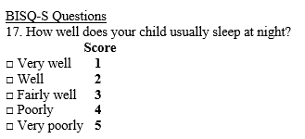
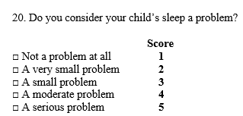
PDSA Focus: Improving sleep in 6-9 month olds
Blackstone Valley Peds
Plan: Assess sleep at 6 mos using the BISQ-S, provide guidance; then reassess at 9 mos with the BISQ-S
Results: 1. Total number of BISQ-S given at 6 mos from Sept 9-Nov 29 = 96 (82% of WCVs)
2. Only 3/96 scored 4 or 5 on #17; only 4/96 scored 4 or 5 on #20 despite verbal reports of night wakings and other sleep problems
Impressions thus far: BISQ-S #17 and #20 are not identifying infant sleep problems very well; responses to BISQ-S and verbal reports are not consistent
Plan for next cycle: Ask just 2 questions: 1. Does your child sleep through the night (at least 6 hrs)? 2. if not, how often does s/he wake during the night? Provide guidance at 6 mo visit.
Data: look at change over 3 mos; expect the number of night wakings to decrease with provided guidance
Prepared by Care Transformation Collaborative of RI

Slide 2
PDSA Focus: Improving sleep in young children 2-5
Partners in Pediatrics
AIM: Consistently identify young children who suffer from snoring/apnea by asking BEARS Qs at WCC
PLAN: One provider to pilot starting Sept. 1
RESULTS: The majority of eligible patients received the BEARS interview - 100% for Oct/Nov (rate of positives: Sep 15%, Oct 14%, Nov 24%)
Clinical utility: Valuable, started with a laminated handout then started asking Qs only; makes the interview much better, more in-depth
Plan for next cycle: Expand BEARS interview to 6–8-year-old WCVs, starting January
Prepared by Care Transformation Collaborative of RI

Slide 3
PDSA Focus: Improving sleep in school age children 6-9
PRIMA Pediatrics
Rolled out the BEARS for all WCVs on Sept 1; Target: 50%
Note: one provider not participating
Month | WCVs (6-9) | BEARS given | Positive BEARS
September | 52 | 37 (71%) | 6 (16%)
October | 79 | 69 (87%) | 14 (20%)
November | 67 | 53 (79%) | 9 (17%)
Results:
Clinical utility: useful questions, now incorporated into WCVs for all kids
Positive BEARS: mostly related to sleep behaviors (e.g. trouble settling, parental inconsistency with routines/limits; weekday vs weekend sleep schedules; also ADHD/Meds)
Plan for next cycle – continue as is
Prepared by Care Transformation Collaborative of RI

Slide 4
PDSA Focus: Improving response to sleep concerns in children ages 6-12 by creating clinical decision supports
Atlantic Pediatrics
Plan: create a more streamlined process for referrals and connecting patients to the care they need
Tasks: identify list of patient concerns, identify best practice response, create order set in Epic, test it, revise as needed, evaluate usefulness
Timeline: create the CDS by November, start to test it in December
(see next slides)
Prepared by Care Transformation Collaborative of RI

Slide 5
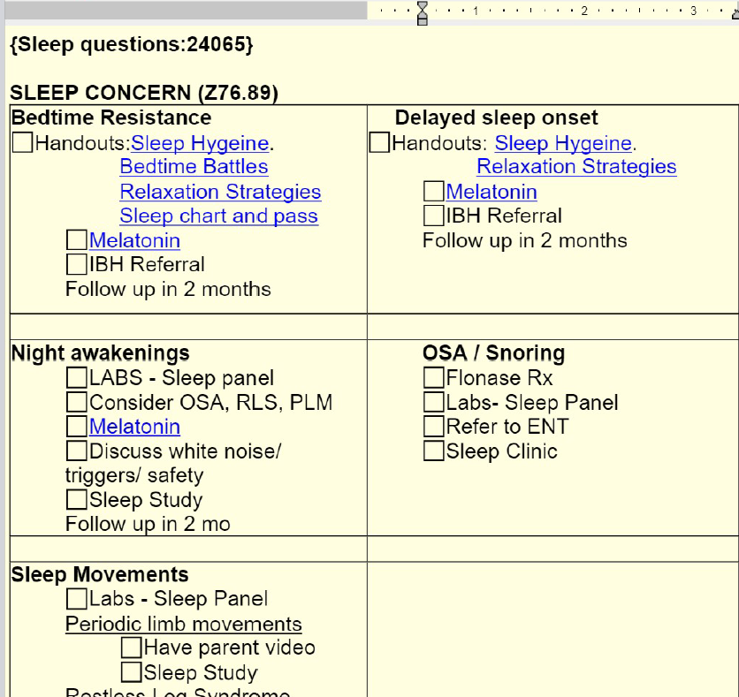
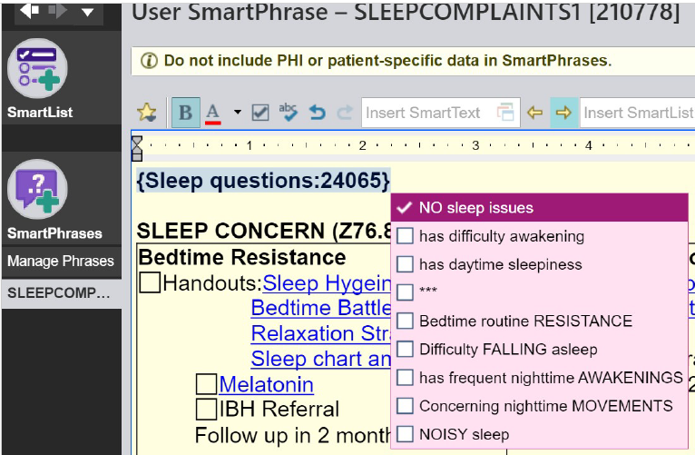
Atlantic Pediatrics
1. Sleep question list
2. Sleep Smart Phrase
Prepared by Care Transformation Collaborative of RI

Slide 6
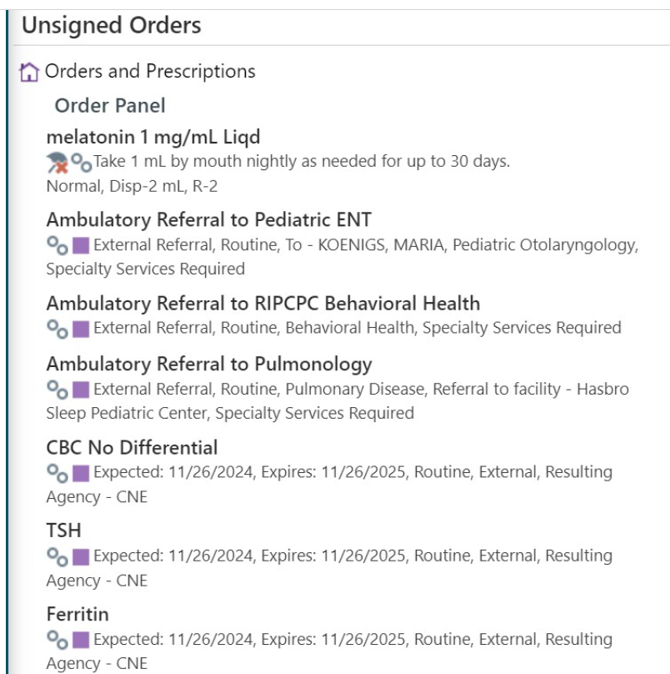
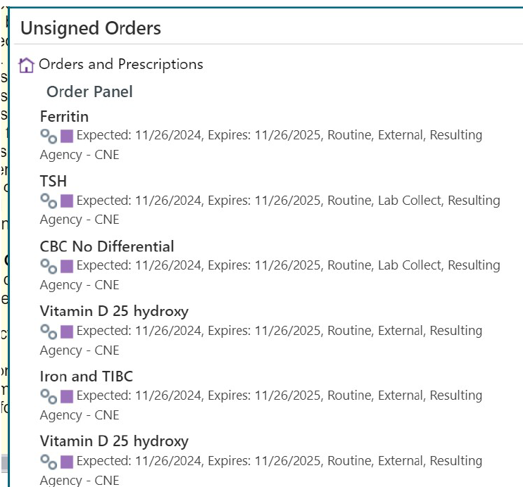
Atlantic Pediatrics
3. Sleep Labs
4. Sleep Orders
Prepared by Care Transformation Collaborative of RI

Slide 7
PDSA Focus: Improving sleep in teens
Anchor Pediatrics
Plan: administer a self-report BEARS to 13-18 y.o. pts who identify sleep concerns either on the PHQ9 or during a medical visit; 2 providers piloting
Results: Administration decreased over time because providers were finding it to be redundant
Next cycle: Expand use of order set to all providers starting January 2025
Prepared by Care Transformation Collaborative of RI

