Slide 1
ECHO Series: Optimizing a Behavioral Health Approach to Children’s Sleep in Pediatrics
Sleep in Middle Schoolers
Julie Boergers, PhD
December 19, 2024

Slide 2
Objectives
Identify common sleep hygiene issues and sleep disorders among pre-teens
Review biological and societal influences on sleep in this age group
Discuss strategies for helping parents minimize the impact of electronics on sleep

Slide 3
Sleep in Pre-Teens
Middle school students need 9-10 hrs of sleep
Low incidence of parasomnias (sleepwalking, sleep terrors)
If you see parasomnias, assess for sleep apnea and/or restless sleep, and/or consider referral for sleep eval
Increased incidence of “psychophysiological” insomnia
Learned association between bed and wakefulness
Increased role of maladaptive thoughts about sleep
Increased incidence of Delayed Sleep/Wake Phase Disorder

Slide 4
Changes & Challenges for Pre-Teens
Biological changes
Delay in dim light melatonin onset across transition to puberty – able to stay up later, harder to wake up earlier
Increased importance of peer relationships
> time in bedroom, > time on social media, > sleepovers
Societal changes
Average US middle school time 8:04am (36% between 7:30 - 7:59 am)
More homework (often on laptop), more activities (e.g. late practices)
Pressure to get phones, other electronics

Slide 5
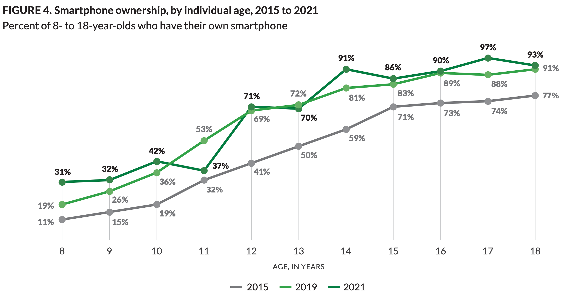
Common Sense Media, 2021

Slide 6
Opportunities
Encourage parents who are ready to get their child a phone to start with a flip phone/limited features
Encourage parents to set rules about no phone in bedroom to set the stage for healthier sleep habits in high school
Encourage parents to continue to set a bedtime, even on weekends
Encourage child to make sleep a priority
What do they value? Can you emphasize the role of sleep on academics? Sports performance? Are they getting sick a lot and can you emphasize the role of sleep in health and immune function?

Slide 7
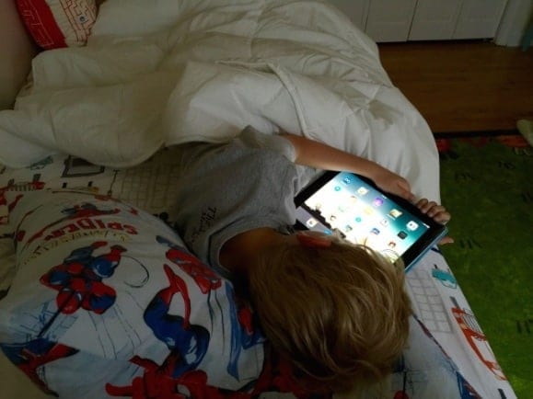
Sleep Hygiene Concerns to Assess in Pre-Teens
Oversleeping on weekends (“social jetlag”) leading to difficulty falling asleep on weekdays
Caffeine
Napping
Electronics
TVs, smartphones, tablets, laptops, desktops, smartwatches, gaming consoles, portable gaming systems, VR headsets, smart glasses…

Slide 8
Screens Impair Sleep Health in Kids
Several meta-analyses, dozens of studies around the world
Vast majority of studies found a link between total daily screen time (and evening screen time in particular) and delayed bedtime and/or < sleep duration
Several studies also found screen time is associated with < sleep quality, > sleep onset latency, and > daytime sleepiness
The mere presence of a handheld electronic device in the bedroom has adverse effects on sleep outcomes
Exposure to violent programming within 30 min of bedtime was associated with > sleep latency and < sleep duration.

Slide 9
Why Might Screens Impact Sleep?
Blue light. Bright light (esp. short-wavelength light, or blue light, emitted by screens) suppresses the release of melatonin which could delay the onset of sleep.
Arousal. Screens may be cognitively and emotionally stimulating, marking it harder to fall asleep.
Sleep displacement. Using devices (especially in bed) delays the time when people start trying to fall asleep.
Sleep disruption. Notifications and sounds from devices can interrupt sleep during the night.

Slide 10
What’s the Evidence?
Blue light: Weak. Does suppress melatonin release and significantly delays circadian phase, but only delays sleep onset by ~10 min.
Arousal: Depends. Scary or suspenseful shows or games can delay sleep onset by ~ 10 minutes. Some media could be relaxing, however.
Sleep displacement: Strong. Use of devices at night (e.g., scrolling while laying in bed) has been shown to delay going to sleep by as much as 1 hour and 15 minutes
Sleep disruption: Strong. Compared to adolescents who turn off their phones at night, those that leave the ringer on have more trouble falling and staying asleep

Slide 11
What to do: Blue light
Use lowest brightness that is tolerable in evening.
Use blue light filtering apps and software. Most devices now pre-programmed with option under display settings (e.g. Night Shift on iOS, NightLight/Eye Comfort Shield on Android) that can be set to turn on automatically in evening
Smart lightbulbs similarly can be set to reduce blue spectrum light at night but can be pricey and research is mixed.
Blue light filtering glasses may not be worth the money. A 2021 study found that 46% of those tested filtered out < 50% of blue light. A good pair (e.g. Swannies brand) is ~$90.

Slide 12
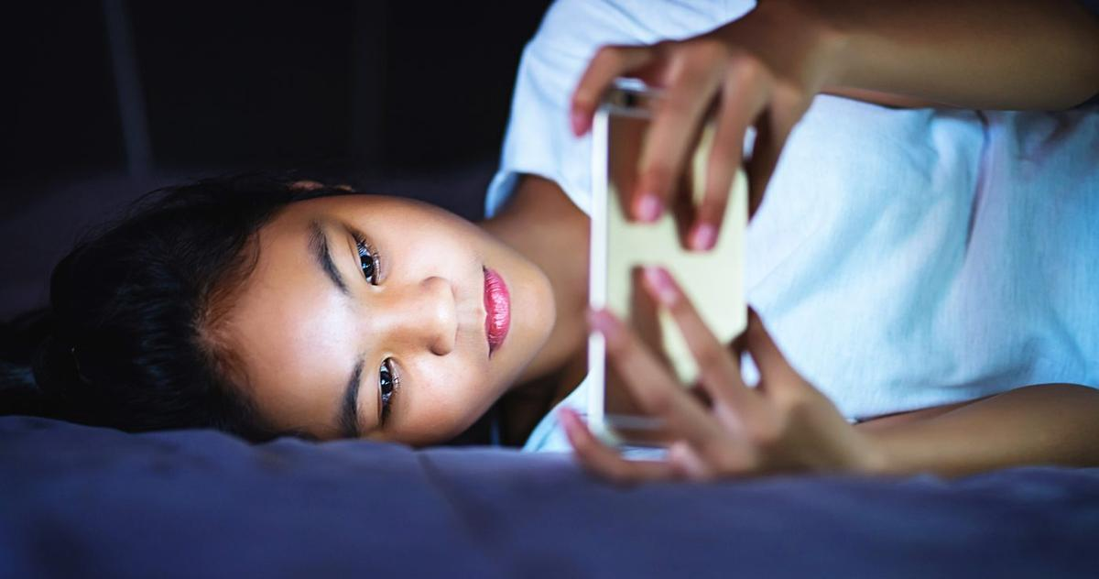
What to Do: Screens in Room
Rule changes work best if the are applied to all the kids
Encourage parents to set an example e.g. no phones in bedroom
Put computers and video game consoles in common areas
Parental control options – shutting off wifi at set time, using parental controls in certain programs or apps on phone
If technology is in room at night, ideally TAKE IT OUT. There is no substitute for physical control of the device.
The reality: Harm reduction approach.

Slide 13
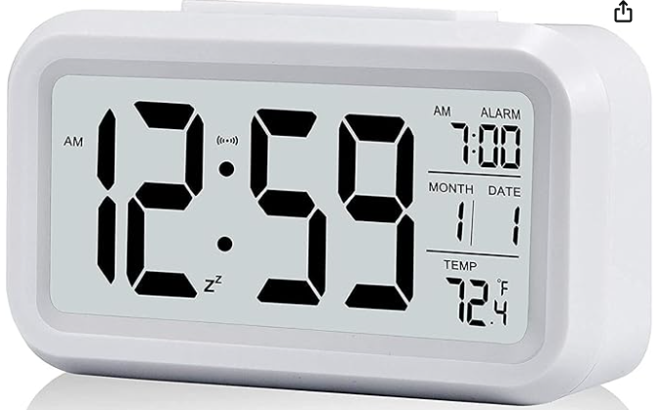
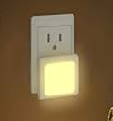
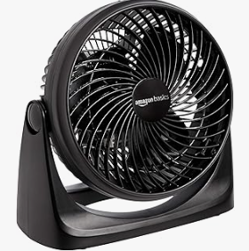
Problem Solving Common Barriers
Need for morning alarm
Need for light
Need for noise

Slide 14
Harm reduction example: TV
TV out of room
Blanket over screen
Brightness turned down
Volume turned down
TV on timer
Boring vs. preferred show

Slide 15
Harm reduction example: Phone
Phone out of room
Phone in room but out of reach
Transition from video to audio-only (e.g. phone face down for movie, meditations, music etc)
Or transition from phone to TV
Transition from active (e.g. scrolling, games, tik tok) to more passive media (e.g. a boring movie)
Set in airplane mode or DND at bedtime
Begin using physical alarm clock

