Slide 1


Pediatric Sleep ECHO®
Session 9:
SLEEP IN HIGH schoolers
Date: JANUARY 23, 2025
PLEASE NOTE: Project ECHO case consultations do not create or otherwise establish a provider-patient relationship between any clinician and any patient whose case is being presented in a project ECHO setting
Care Transformation Collaborative of RI
Prepared by Care Transformation Collaborative of RI

Slide 2

Welcome
This session will be recorded for educational and quality improvement purposes
Please do not provide any protected health information (PHI) during any ECHO session

Slide 3
Agenda
Time | Topic | Presenter
7:30 – 7:35 AM | Welcome | Liz Cantor, PhD
7:35 – 8:00 AM | Didactic Session: Sleep in High Schoolers | Julie Boergers, PhD
8:00 – 8:25 AM | Q&A on Sleep Medicine | Richard P. Millman, MD
8:25 – 8:30 AM | Wrap Up | Liz Cantor, PhD

Slide 4

Announcement
Thursday February 27, 2025, Session 10: Focus on High School-aged Children (2nd session)

Slide 5


ECHO Series: Optimizing a Behavioral Health Approach to Children’s Sleep in Pediatrics
Sleep in High Schoolers
Julie Boergers, PhD
January 23, 2025

Slide 6
Objectives
Identify common sleep hygiene issues among teenagers, beyond electronics use
Discuss strategies for minimizing the use of caffeine
Discuss impact of other substances on sleep, particularly cannabis

Slide 7
Sleep in Teens
Adolescents need 8-10 hrs of sleep
76.4% of teens in RI don’t get sufficient sleep (2021 YRBS data)
American Academy of Pediatrics recommended in August 2014 that middle and high schools start at 8:30 a.m. or later
  Average US high school start time is now 8:00 am (but 42% start before 8:00 am)
  Increased incidence of insomnia and Delayed Sleep/Wake Phase Disorder across adolescence
  Increased napping and use of caffeine and other substances to manage sleep issues

Slide 8
Napping
Compensatory mechanism for many teens
Most likely to impact sleep onset if naps are long or late
  Decreases homeostatic sleep drive
  Displaces homework or other responsibilities until later in the evening
Occasional “power nap” fine for some teens (if not late in the day), but NOT fine for teens with insomnia or delayed sleep phase
Recognize that some parents encourage naps (cultural differences)
Strategies to manage –
  Enlist school’s support in keeping the teen awake
  Resist the temptation to write a blanket “excuse” for school sleep/tardies
  Increased supervision/time out of bedroom/engagement in incompatible activities

Slide 9
Review of Electronics and Sleep
Screen time delays bedtime and reduces sleep duration; can also impact sleep quality, sleep onset latency, daytime alertness
  Use blue light blocker on phone/other devices
  Parental controls on wifi or apps
  Phone out of room if can’t stop using
  Harm reduction tecs - e.g. use TV rather than phone, transition from active to passive media use, etc.

Slide 10
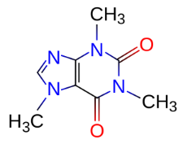
Caffeine Use in Teens
Half-life of 5-6 hours
83% of teens use caffeine habitually
Every 10mg of caffeine that 13 year-olds consume cuts their chances of getting 8.5 hours of sleep by 12% (Lodato et al 2013)
A single energy drink can contain 300mg of caffeine or more
  Some parents confuse energy drinks with sports drinks
  Many teens mistake energy drinks as being healthier than soda too.
  Often marketed to youth (e.g. sponsor sports events that appeal to teens)

Slide 11
Risks of Caffeine in Kids
Physical Health Concerns:
Sleep disruption (quality, duration)
Increased heart rate and blood pressure
Stomach upset or nausea
Excessive consumption can interfere with calcium absorption
Behavioral Effects:
Exacerbation of anxiety and restlessness
Risk of dependency, tolerance, and withdrawal symptoms like headaches, fatigue, and irritability.
Mood swings

Slide 12
AAP Recommendations
Children Under 12:
  Avoid all caffeine due to its potential impact on developing bodies
Adolescents:
  Limit caffeine intake to no more than 100 mg per day
  Avoid energy drinks entirely –addition to high levels of caffeine, often contain other stimulants like guarana and taurine, which can amplify adverse effects
BUT – in the setting of sleep problems, we typically recommend adolescents avoid caffeine entirely (Best), or at least avoid using in the afternoon/evening (Better)

Slide 13
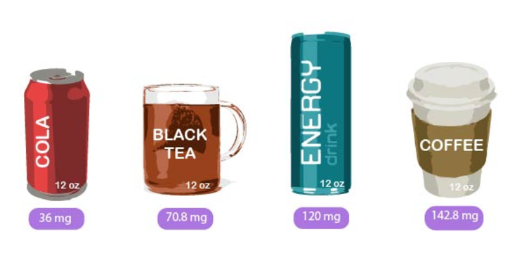

Slide 14
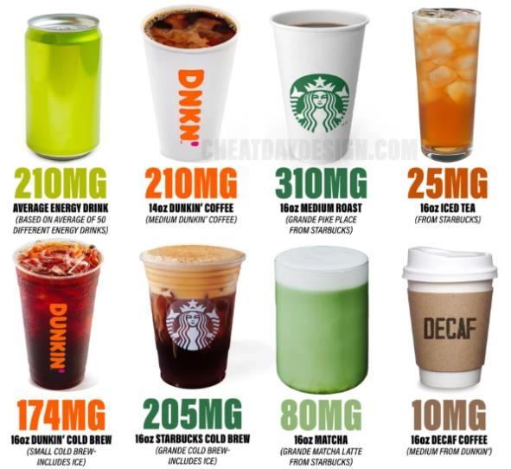

Slide 15
Caffeine – Hidden/Unexpected Sources
Chocolate (especially dark chocolate, some brands of hot chocolate)
Sodas - Barq’s root beer, Sunkist, Mountain Dew; Common misconception that “free” or “diet” means caffeine free
Flavored or vitamin-enriched waters marketed as "energizing"
Pre-workout Supplements
Guarana, Yerba Mate - plants that naturally contain caffeine,not always listed as "caffeine" on labels (energy drinks, snacks, supplements)
Kombucha, Matcha, green tea
Some foods, especially coffee flavored (e.g. ice cream) or those labeled with “energy” (e.g. protein bars, niche products)

Slide 16
Guidance for Clinicians
Ask about it!
Parents are often unaware
  Disposable income, ability to drive to store, increased time out of the house
  Many high schools even sell coffee in the morning and have caffeinated sodas in their vending machines
Low hanging fruit if sleep complaints (or other symptoms like irritability, frequent headaches or stomachaches, increased heart rate, anxiety)

Slide 17
“But caffeine doesn’t affect me”
Yes, some people are genuinely less susceptible to the effects of caffeine
  CYP1A2 gene (fast vs. slow caffeine metabolism)
  ADORA2A gene (high vs. low caffeine sensitivity - affects adenosine receptors
  Tolerance (body adapts, e.g. upregulating adenosine receptors)
AND…
    Caffeine often masks symptoms of sleep deprivation
    “Instant” sleep onset latency is a sign of excessive daytime sleepiness
    Caffeine can affect not only falling asleep, but also increases wakings and arousals, and reduces slow-wave (deep) sleep

Slide 18
Guidance for Parents and Teens
Emphasize moderation
Educate about common sources of caffeine, and energy drinks in particular
Encourage:
  Switching to healthy alternatives – water, decaf options
  Checking labels for terms like "caffeine,“ “energy,” "guarana," "yerba mate," , "green tea extract“
Ask parents to limit access to caffeinated beverages in the home (especially in the afternoon/evening) and to model moderate consumption
Harm reduction approach may be more successful than a prescriptive approach

Slide 19
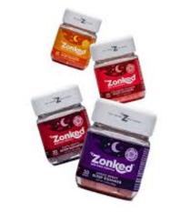
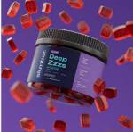
Marijuana/CBD and Sleep
Marijuana: Contains THC (psychoactive, causes
a “high”) and CBD (non-psychoactive).
CBD: Extracted from cannabis or hemp, often used without THC.
Both increasingly popular for purported calming
and sleep-promoting effects.

Slide 20
Evidence for Marijuana Use in Sleep
Limited research: Most studies focus on adults or specific conditions (e.g., chronic pain).
Short-term benefits: May reduce sleep onset latency
Long-term risks/safety concerns:
    Disruption of sleep architecture (e.g., reduced REM sleep)
    Sleep disruption can increase with chronic use or withdrawal
    Effects on developing brain, cognitive & emotional development
    Higher susceptibility to cannabis use disorder in adolescents
    Anxiety, psychosis, or mood disorders in vulnerable individuals

Slide 21
Evidence for CBD Use in Sleep
Preliminary research: may reduce anxiety-related sleep disturbances
Mechanism: Interaction with endocannabinoid system, serotonin receptors
Limited clinical trials specific to sleep issues in children/adolescents
  Promising for children with epilepsy or autism spectrum disorder
  Unclear what dose is safe/recommended
Generally well-tolerated but can cause AM fatigue, gastrointestinal symptoms, potential liver enzyme interactions (caution with medications)
*Long-term effects on children’s development are unknown
Product quality: Risk of contaminants and inconsistent labeling

Slide 22
Current Recommendations
Marijuana:
Not recommended for sleep in children or adolescents
But 26.6% of males, 9.8% of females use cannabis frequently at some point during teen years (2021 study) – so need to bring it up
  Try pros/cons discussion and/or harm reduction approach
CBD:
Considered for sleep in specific conditions (e.g., epilepsy, ASD, severe anxiety) under medical guidance IF safer interventions have failed
  Parents need to be cautioned that this research is in its infancy and we don’t know long term effects
Bottom line:
Marijuana and CBD show potential for sleep but come with significant risks, particularly given that effective behavioral (and safer pharmacological) interventions exist

Slide 23
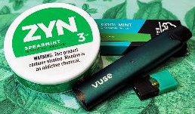
Nicotine and Sleep in Adolescents
Nicotine is a stimulant that increases heart rate, blood pressure, and brain activity, and can delay sleep onset.
Reduces sleep quality: More awakenings, lighter sleep, less REM sleep
    Cravings or withdrawal symptoms during the night
    Can heighten feelings of anxiety, which further impairs sleep quality
Evening use can delay melatonin production by up
to 1.5 hours
Adolescents who use nicotine are 2x more likely
to report sleep disturbances

Slide 24
Alcohol and Sleep in Adolescents
Initial Sedative Effect: Alcohol may help with sleep onset but disrupts later stages
Fragmented Sleep:
  Alcohol reduces REM sleep
  Worsens obstructive sleep apnea severity (increases collapsibility of upper airway)
Some evidence that it can disrupt production of melatonin
Adolescents consuming alcohol regularly report 40% poorer sleep quality

Slide 25
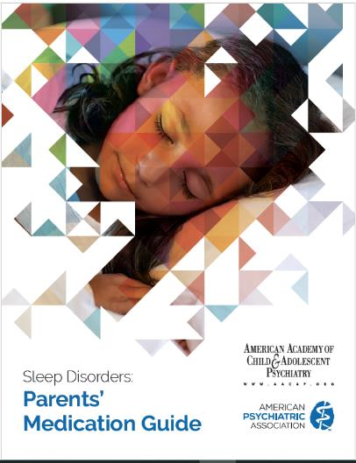

Slide 26

PEDIATRIC SLEEP ECHO®
SLEEP MEDICINE
Presenter: Richard P. Millman, MD
Date: 1/23/25
No PHI
PLEASE NOTE: Project ECHO case consultations do not create or otherwise establish a provider-patient relationship between any clinician and any patient whose case is being presented in a project ECHO setting
Prepared by Care Transformation Collaborative of RI

Slide 27
Questions
Melatonin
Lots of kids are on it long term – what’s the best way to “wean” them off?
How and when to use it; some patients use it every night for a long time – are there side effects or anything else we should be monitoring?
Clonidine/Guanfacine/Trazadone/Mirtazapine
When to consider Clonidine or Guanfacine for children taking stimulant medications
When to consider Trazadone
Trazadone + SSRIs? Is it ok?
How to advise patients who use these medications PRN
Is it appropriate to Rx Mirtazapine w/o a sleep eval if pt isn’t autistic?
Seeing more children on Mirtazapine Rx’d by others – is this being used more and why?

Slide 28
Questions
Hydroxyzine/Benadryl
One patient indicated that Benadryl was negatively affecting their memory – could this be true?
Which is preferred: Hydroxyzine or Benadryl?
How long is it safe to use Hydroxyzine or Benadryl?
General
Is there a decision tree that we could refer to – i.e., when to consider which medications?
  E.g., if a child isn’t responding to melatonin, what’s the next best option?
  When do you increase a dose vs trying another medication?
Recommendations for use of any of the above medications for young children and/or for children with autism
Starting dosages, how to increase, max dosages

Slide 29
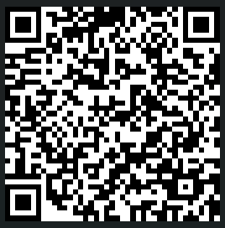
CME Credits
(Pending credit for MDs, PAs, Rx, RNs, NPs, PsyD, PhD)
CME Credits – Please request session credits when filling out the evaluation at the end of the meeting.
Evaluation/Credit Request Form:
https://www.surveymonkey.com/r/echosleep
The AAFP has reviewed ‘Advancing Community-Oriented Comprehensive Primary Care Through Improved Care Delivery Design and Community Health,’ and AAFP credit is pending. Term of approval is from 04/19/2024 – 04/19/2025. Physicians should claim only the credit commensurate with the extent of their participation in the activity.
NPs and RNs can also receive credit through AAFP’s partnership with the American Nurses Credentialing Center (ANCC) and the American Academy of Nurse Practitioners Certification Board (AANPCB).

Slide 30
Thank you!
Next Meeting: Session 10: Focus on High School-aged children (ages 14-18) – Session 1 held on February 27th, 2025
Evaluation/Credit Request Form: https://www.surveymonkey.com/r/echosleep

