Slide 1
Compassion as the Key to Success
Sue Kressly, MD, FAAP
skressly@kresslypediatrics.com
www.linkedin.com/in/susan-kressly

Slide 2
Faculty Disclosure
I have the following financial relationships with the manufacturer(s) of any commercial product(s) and/or provider(s) of commercial services discussed in this CME activity: ownership shares, Connexin Software
I do not intend to discuss an unapproved/investigative use of a commercial product/device in this presentation.

Slide 3
What Is the Key Ingredient for Practice Success?
A robust well-visit recall system
Aggressive coding and appropriate documentation for sick visits
A fully integrated system for virtual care including Telehealth, portal messaging and group visits
An efficient visit workflow where unnecessary steps are eliminated
A collaborative team lead by a clinician and a practice administrator
Successful renegotiation of contracts on a rolling basis
All of the above

Slide 4
Why did you want to go into medicine?

Slide 5
COMPASSION

Slide 6
Learning Objectives
Explore the science and data behind the impacts of compassion in healthcare delivery
Be brave enough to embark on looking at compassion from the receiver’s perspective
Re-imagine your practice with compassion at the center

Slide 7
Compassion vs Empathy
Empathy is our awareness toward’s other people’s emotions ad an attempt to understand how they feel.
Compassion requires taking action. Compassion is the emotional response to another’s pain or suffering involving an authentic desire to help.
When taking action to relieve someone’s suffering, a distinctly different area of the brain lights up on a functional MRI. It stimulates the reward pathway associated with positive emotions and is pleasurable for the giver of compassion.
Notes:
Helper’s high. Compassion for others activates the parasympathetic nervous system by increasing vagus nerve activity resulting in a claiming effect that counterbalances the fight or flight response of the sympathetic nervous system. AND compassion boosts circulating neuromodulators (such as oxytocin) which buffers stress and triggers positive emotions such as calm and closeness.

Slide 8
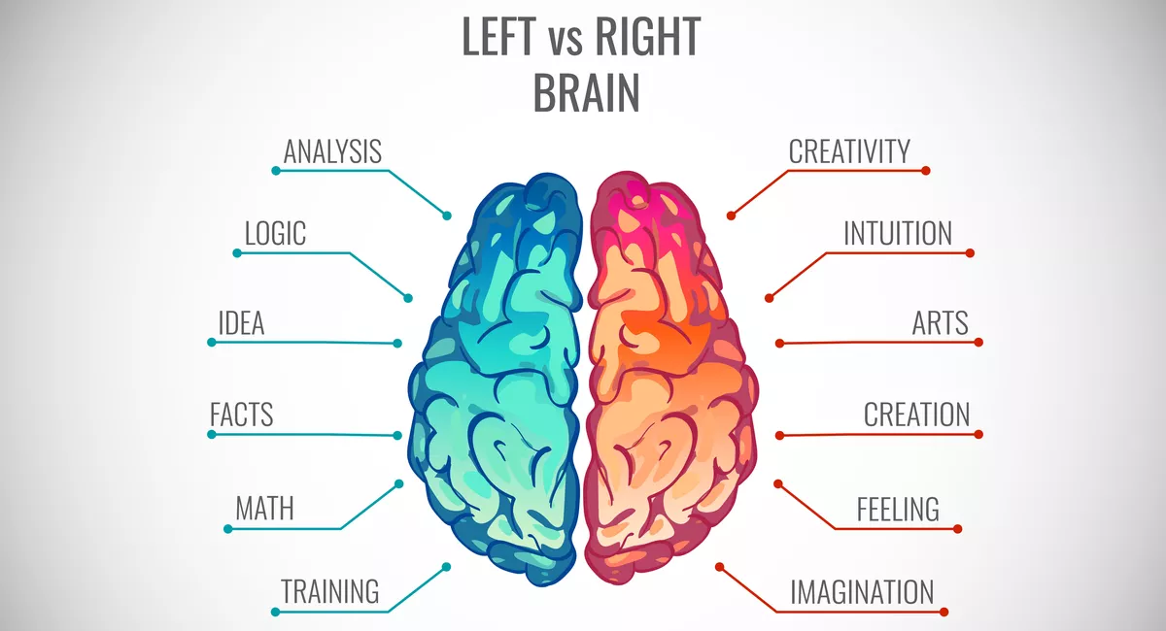
SCIENCE OF MEDICINE
ART OF MEDICINE
Notes:
Being both data driven and open-minded are prerequisites for good science. Is compassion just in the art of medicine or are there compelling evidence based effects belonging in the science of medicine?

Slide 9
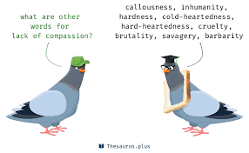
What Does the Data Show?
Lack of compassion causes problems
Presence of compassion confers benefits

Slide 10
Compassion & Clinical Outcomes
Compassionate care means more meticulous care
Compassion improves clinical quality
Compassion lowers the likelihood of making a major medical error
Compassion buffers stress-mediated disease
Compassion can modulate a patient’s experience of pain
Compassion can influence immune response
Compassion impacts patient self-care

Slide 11
Administrative Burden
The business of caring for patients has changed dramatically and is incredibly complex and growing.
As the administrative costs of practices have grown sharply over time. All of the staff we have added is often just to stop the bleeding of lost revenue.
Between 1970-2016, the % of health care costs attributable to administration has more than doubled.
We are all doing more with less….how can we support our Mission?

Slide 12
Compassion Drives Revenue & Cuts Costs
Compassionate physicians refer less and order fewer tests
Median charges per patient were 51% lower with patient-centered care (in a study from UC Davis)
Compassionate care drives lower costs through better adherence
Compassionate care reduces unnecessary ED visits
Compassionate care reduces “doctor shopping” and “2nd/3rd” opinions
Compassion lowers malpractice costs
Notes:
Patients who do not feel a strong personal connection with their physician receive more referrals to specialists and undergo more diagnostic tests

Slide 13
Compassion and Team Wellness
Compassion culture reduces employee absences, lower emotional exhaustion and improved teamwork.
"Emotional culture of the health care facility has a strong association with how employees treated their patients, the patients’ experience and even patient outcomes.”

Slide 14
Compassion and Patient Experience
Happy customers drive business in all industries
Compassion creates “patient-centeredness”
Compassionate culture results in:
Bump in payment (especially in Value Based Payment arrangements that include patient satisfaction metrics) (only 7% of association between patient experience and strong financial performance is tied to VBP incentives) *
Increase in volume (from reviews/word of mouth/marketing)
*Betts, David, et al. “The Value of Patient Experience: Hospitals with Better Patient-Reported Experience Perform Better Financially.” Washington, DC: Deloitte Center for Health Solutions,2016.
Notes:
When an organization encourages its employees to detect and respond to suffering, they put the patient at the very center of everyone’s care and patients can sense it. They feel “seen as a person” and valued.

Slide 15
Compassion & Margin
Can increase margin by reducing costs
Better experience associated with lower spending per episode of care
Recalls and outreach tends to be more successful the FIRST time around
Patient surveys repeatedly say they value their doctor’s interpersonal skills more than anything else on their resume

Slide 16
Most Important Qualities in a Physician
85% “Treating me with dignity and respect”
84% “Listening carefully and being easy to talk to”
81% “Truly caring about me”
27% “Being trained at one of the best medical schools”
THREE TIMES the number of patients value human connection and caring from their physician more than the prestige of the institution where the physician was trained. *
Only 58% agreed that having “a lot of experience treating patients with your medical condition” was extremely important.
14% of patients who reported changing doctors in the past 5 years was because the “doctor didn’t listen carefully.”
*”Doctor’s Interpersonal Skills Are Valued More Than Training.” Wall Street Journal, September 28,2004.

Slide 17
“Healthcare consumers view health care first and foremost as a personal interaction and not just a medical transaction.”
Notes:
And in fact, several studies have demonstrated that compassion communicates COMPETENCE. The malpractice liability also supports this.

Slide 19
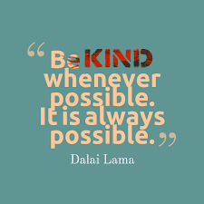

Slide 20
Too Little Time
56% of physicians believe they do not have time to treat patients with compassion
One study looked at how much time it takes to add a compassionate statement to the visit…. 40 seconds
Data support that being compassionate does not add a significant amount of time to the total time spent with the patients
Giving to others makes you actually feel like you have more time
Notes:
40 seconds of compassion is all you need to make a meaningful difference for the patient

Slide 21
Compassion Studies
Study | Time Required to Show Meaningful Compassion to a Patient
Byland et al | 32 seconds
Bensing et al | 38 seconds
Fogarty et al | 40 seconds
Roter et al | 54 seconds
Dempsey | 56 seconds

Slide 22
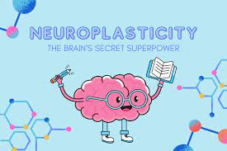
Nature vs Nurture?
Scientific literature clearly shows that compassionate behaviors can be learned.
Compassion makes you a better healer. Period.
Science shows that healthcare providers have to want to get better at compassion. Compassion cannot be mandated.
Before one can learn to be more compassionate, there is a vital first step. First, one must believe that every patient deserves compassion. Every single one.

Slide 23
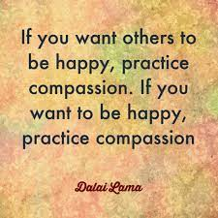

Slide 24
Burnout
Cornerstones of burnout
Depersonalization: the inability to make a personal connection
Lack of personal accomplishment: feeling that one can’t really make a difference
Emotional exhaustion: being emotionally depleted or overextended
Burnout isn’t just about being overworked; it’s also about the absence of meaningful human connection in one’s work.
Escapism interventions do reduce burnout, but the effects are only modest at best.
Maybe the real antidote to burnout is leaning in, rather than pulling back. Maybe to promote wellness, our actions need to occur at the point of care.

Slide 25
Be gentle first with yourself if you wish to be gentle with others.
Notes:
Start with yourself

Slide 26
Cognitive Bias
Many physicians acknowledge that other physicians are not compassionate yet believe themselves to be.
Studies show that doctors self-ratings on emotional intelligence don’t correlate with how our patients view us.
Research shows physicians routinely miss emotional cues from patients and actually miss 60-90% of opportunities to respond to patients with compassion.

Slide 27
Missed Opportunities
“I’m having a tough time…” Most often physicians just “blow by that comment” or terminate the thread or ask a different question instead of..
Using a continuer question or just offering emotional support
“Engage, listen or connect” in a meaningful way
“But doctor, you don’t understand…”
Make a connection, establish rapport, understand the importance of nonverbal language

Slide 28
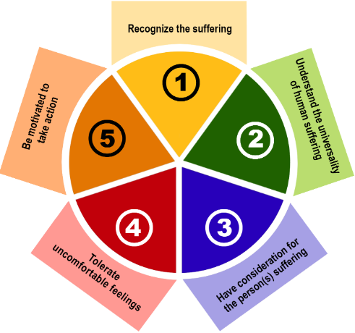
The Five Elements of Compassion
https://www.compassionate.center/pgs/resources/definitions.html

Slide 29
Ideas for Training Compassion
Begin each day with compassion in mind (practice huddle?)
Take 5 seconds to clear your mind before engaging with a patient/family
Actively listen: be fully present, put away distractions, give your full attention to what is being said. Reinforce you were truly listening.
Be mindful, rather than over-identifying with problems (nonassimilative compassion)
Adopt an attitude of kindness, rather than being judgmental
Ask, “how can I best help you?” or “what would be most helpful to you?”

Slide 30
Find Your Why and How
For many who adopt this practice philosophy, it’s personal
Hire differently
Train and support your team
Model and reward compassionate behavior
Provide adequate resources

Slide 31
Compassion in the Eyes of the Receiver
You may think you are acting compassionately, but is it received that way?
You won’t know if you don’t ask
Consider using a standardized tool to measure how you are doing

Slide 32
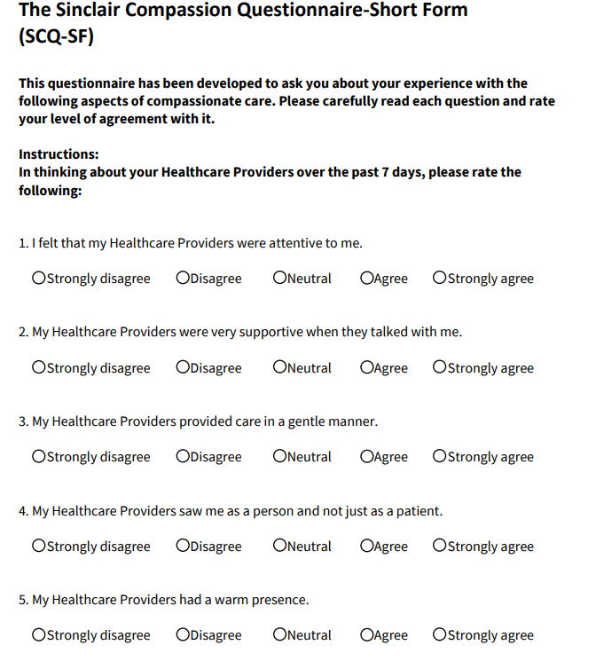
https://www.compassionmeasure.com/

Slide 33
Will compassionate care ever become the new standard of care?

Slide 34
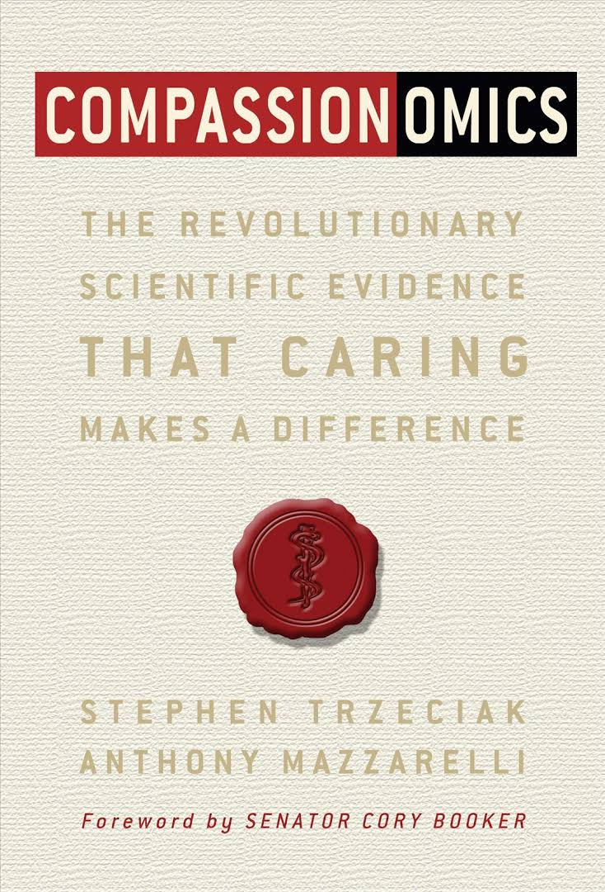
Book References/Resources
Compassionomics: The Revolutionary Scientific Evidence that Caring Makes a Difference by Steven Trzeciak and Anthony Mazzarelli
The Antidote to Suffering: How Compassionate Connected Care Can Improve Safety, Quality and Experience by Christina Dempsey
Self-Compassion: The Proven Power of Being Kind to Yourself by Kristin Neff
Nonviolent Communication: A Language of Life by Marshall B. Rosenberg

Slide 35
Resources
How 40 Seconds of Compassion Could Save a Life, TedxPenn, April 7, 2018, Stephen Trzeciak
https://www.compassioninstitute.com/health/
The Arnold P. Gold Foundation Research, clinician wellbeing resources, podcasts
The Schwartz Center for Compassionate Healthcare Issue briefs and research; media center, video gallery
The Center for Compassion and Altruism Research and Education Stanford University
How The Human Connection Improves Healthcare, TEDxGrandCanyonUniversity, Anthony Orsini
https://theorsiniway.com/
https://www.compassionate.center/pgs/resources/definitions.html

Slide 36
skressly@kresslypediatrics.com

