Slide 1

Wolf Trap District
Roundtable
December 12, 2024

Slide 2

Pledge

Slide 3
Welcome
New to Roundtable?
Please introduce yourself!

Slide 4
Agenda
7:20-7:30 Sign in and Networking
7:30-7:45 Opening
Council /District Updates
Announcements
7:45-7:55 Awards Presentation – Matt Burns
7:55-8:00 Safety Moment
8:00-8:05 Membership Moment
8:05-8:15 Cracker barrel/Networking
8:15-8:45 Cub Scout Breakout – Blue & Gold
Scouts BSA Breakout – Supporting Women in Scouting
8:45-9:00 Closing
Cracker barrel /Networking

Slide 5
Questions/Clarification about Read-ahead?

Slide 6
Council Announcements
District Changes in my.scouting.org – still being worked
Renewals – Send any issues to ruspittman@gmail.com (please include unit type/name, name(s), BSA IDs and emails)
  Parents/Registered Adults - Can register without email notice. https://my.scouting.org, login, Menu, My Application, My Renewals (on the top, middle of page), Click “Start Renewal”
  Don’t See their Youth – Email Rus Unit Type/#, Youth Name & BSA ID, Parent Name & BSA ID (if have one), Parent Email
  Executive Officers – Register by sending EO information to Jay E. No fee. Emailed Key 3 & UCs.
  EO or COR Changes – Paper New Unit Application for EO; Paper Adult App (with CBC and YPT Certificate) for COR.
  MBC/District MAL Only – Renew same way as unit Scouters
$100 Payment – COR (and maybe the CM/SM or CC) can pay online. Units do not need to wait for their Youth and Adults to renew to pay the fee. Can be an issue if don’t have required number of leaders or any expired YPTs. Guide.
Annual Charter Agreement – Paper copy only. Note, different ACA for Catholic organizations. Good through all 2025.
Journey To Excellence - https://www.scouting.org/awards/journey-to-excellence/
Unit Balances – Report in Basecamp. Unit can request check from NCAC for their balance. Need your CC or COR to send an email to Liz with specific wording, “I am the Committee Chair for Pack XXX. Please mail a check for $XXX to (address). Please make the payment line to (insert name the bank knows your unit as – e.g., “Pack 1132”).” Complete the email with their name, position and unit in signature line.

Slide 7
District Updates
Changes in District Leadership Team
  District Commissioner: Rus Pittman -> John Kilduff
  Finance Vice Chair: John Kilduff -> Ryan Beaty
  MarComm Vice Chair: AJ Wolcoski
  Training Chair: Roy DeLauder -> Nate Greiner
  STEM Coordiator: Joel Cline
  RT Commissioner (Cubs): Steve Banowit -> Allen Mohaber
  Asst District Commissioner (Renewals): Ed Hanlon
  Unit Commissioners: Chip Black, John Kilduff, Brandon Nunes

Slide 8
General Announcements

Slide 9
District and other Award(s)

Slide 10

District Court of Honor
To recognize adults who served/are serving at the unit level.
Two awards:
  Unit Commissioner’s Unit Scouter Award – 1 per unit
  Unit Appreciation Award – Maximum 8 per unit.
Please provide a sentence or two describing the individual’s service.
Submit Unit Commissioner’s Unit Scouter Award to Unit Commissioner.
Unit Appreciate Award to gm.adultrecognition@gmail.com
Must have all submissions by no later than March 22, 2025.
Will confer awards at District COH in April 2025.

Slide 11
Safety Moment
https://www.scouting.org/health-and-safety/safety-moments/

Slide 12
Membership Moment
https://www.scouting.org/commissioners/roundtable-support/roundtable-planning-resources/

Slide 13
Cracker Barrel (10 min):
Move to your Breakout Session
Breakout Sessions:
Scouts BSA/Venture Crews - stay here
Cubs - follow John K

Slide 14
Scouts BSA Program

Slide 15

District Life to Eagle Seminar – February 8, 2025
Saturday, 8 February 2025
1:00 to 4:00 p.m.
Virtual
Register at: National Capital Area Council - 2024 Wolf Trap (Virtual) Life to Eagle Seminar
Who should attend:
Life Scouts or advanced Star Scouts who want to pursue the Eagle Rank
Eagle advisors, coaches or unit leaders that haven’t attended a seminar in two years
Parents of Scouts working on Eagle or other adults interested in Scouting
Registration is live now and must be registered by 6 February 2025 to get the Zoom link.
Any questions contact Matt Burns at 703-938-9550 or at gm.advancement @gmail.com.

Slide 16

SCHOLARSHIPS
Deadlines Approaching!!!
BSA Scholarship page - https://www.scouting.org/awards/scholarships/
American Legion Eagle Scout of the Year – Deadline is March 1 2025 – Apply to local Legion Post. Open to Scouts in units sponsored by an American Legion Post or who have a parent or grandparent that is a member of the Legion. Applications at: American Legion Eagle Scout of the Year Scholarship | The American Legion
Sons of American Revolution – Deadline ASAP Arthur M. & Berdena King Eagle Scout Contest – National Society Sons of the American Revolution)
National Eagle Scout Association – Deadline January 31, 2025 Scholarships - The National Eagle Scout Association

Slide 17

Glenn A. and Melinda W. Adams Award
Recognizes a noteworthy Eagle Scout Service Project.
Deadline is January 15, 2025
The Scout or a registered Scouting America volunteer can make a nomination. 2025 Adams Award Application
Scout must sign application to document their “consent.”
Also needs an electronic copy of the project workbook.
Some nominations include video.
Winners can receive:
  $300 at the Territory level.
  $3,500 for National winner.

Slide 18
Supporting Women in Scouting
Video
Discussion

Slide 19
Time for Cracker Barrel
Minutes and slides available on the WTD web site (District Resources, Roundtable). Password is “GMDRT”
Next meeting – January 9, 2025, at Thoreau Middle School

Slide 20
Backup Slides

Slide 21

Current 2024-2025 Wolf Trap Calendar
01/04/25 – OA Lodge Banquet, College Park, MD
02/08/25 – Virtual Life to Eagle Seminar (1pm)
02/22/25 – University of Scouting, Alexandria, VA
03/08/25 – WTD MB Day, Fairfax Presbyterian Church, Fairfax, VA
03/22/25 – DCOH Award Nominations Due
03/28/25 – 03/30/25 – Joint Lodge Ordeal, Camp Snyder, Haymarket, VA
04/10/25 – District Court of Honor, Thoreau MS, Vienna, VA
04/25/25 – 04/27/25 – 2025 OA Spring Fellowship
05/03/25 – 19th NCAC Scout Orienteering Meet, PWD, Triangle, VA
05/XX/25 – 05/XX/25 – WTD Spring Camporee
05/XX/25 – 05/XX/25 – WTD Hike-O-Ree
05/10/25 - Jamboree on the Trail (JOTT)
05/26/25 – Memorial Day Flags In, National Memorial Park, Falls Church
05/08/25 – Program Launch, Thoreau MS, Vienna, VA
05/31/25 – OA Election Season Closes

Slide 22
STEM
Akela Chess Classic
  Cub Scout Tournament – 02/01/2025 at MSSC
  Scouts BSA Tournament – 02/15/2025 at MSSC
Burke Lake District NOVA Nights (Last Friday of Month)
  01/28/2025 at Prince of Peace Lutheran Church
  02/25/2025 at Prince of Peace Lutheran Church
  03/25/2025 at Prince of Peace Lutheran Church
Ancient Earth: Birth of the Sky (on PBS) - link
Anytime – DC STEM Trek- Showcases 24 government agencies, private organizations and monuments related to the tenets upon which STEM is based. Two hikes - 10.57 miles, or 4.75 miles
NCAC STEM contact is Bruce Donlin (bruce.donlin@scouting.org; 240-395-0601)

Slide 23
Scouts Deserve a Trained Leader
Wolf Trap Training site: https://www.ncacbsa.org/george-mason/training/
Cub Leader Position Specific (C40)
  Available on-line (117 min),
  01/11/25 – Alexandria, VA
  02/01/25 – Alexandria, VA
  03/08/25 – Alexandria, VA
  04/05/25 – Alexandria, VA
  05/03/25 – Alexandria, VA
Cub Scout Den Leader Specific (C42)
  Available on-line (125 min)
  01/11/25 – Alexandria, VA
  02/01/25 – Alexandria, VA
  03/08/25 – Alexandria, VA
  04/05/25 – Alexandria, VA
  05/03/25 – Alexandria, VA
Basic Adult Leader Outdoor Orientation (BALOO;C32) – BALOO consists of two sessions, an online portion (https://my.scouting.org, Menu, My Training, Cub Scouts, Catalog, search on BALOO) that takes 35 minutes and a hands-on overnight session. The overnight sessions are listed below.
  03/29/25 – 03/30/25 – TBD, VA (Request permission to attend)
  06/14/25 – 06/15/25 – Lorton, VA (Contact Dominick dscscouting@aol.com for permission to register)
Scoutmaster Position Specific Training(S24)
  Available on-line (192 min)
  01/11/25 – Alexandria, VA
  02/01/25 – Alexandria, VA
  03/08/25 – Alexandria, VA
  04/05/25 – Alexandria, VA
  05/03/25 – Alexandria, VA
Introduction to Outdoor Leadership Skills (IOLS; S11)
  06/14/25 – 06/15/25 – Lorton, VA (Contact Dominick dscscouting@aol.com for permission to register)
Wilderness First Aid (N02)
  12/14/24 – 12/15/24 – Camp Snyder, Haymarket, VA (Registration Closed)
  01/25/25 – 01/26/25 – Camp Snyder, Haymarket, VA
  02/22/25 – 02/23/25 – Camp Snyder, Haymarket, VA (Waitlist only)
  03/22/25 – 03/23/25 – Camp Snyder, Haymarket, VA
  04/26/25 – 04/27/25 – Camp Snyder, Haymarket, VA
  05/17/25 – 05/18/25 – Camp Snyder, Haymarket, VA
Miscellaneous:
Outdoor Ethics/Leave No Trace (D78)
Outdoor Ethics Newsletter
Scouterhorn Operations Training
TBD
University of Scouting
02/22/2025, Alexandria, VA (2024 Course Materials available on Basecamp)
Wilderness First Aid/CPR/AED (N02)
12/14/24 – 12/15/24 – Camp Snyder, Haymarket, VA
Youth Protection Training (YPT)
Online (72 minutes)
2025
BCOLS:
Spring: 03/01/25 & 4/26-27/25
Fall: 09/20/25 & 10/18-19/25
Trainers Edge: 08/09/25 & 12/06/25
University of Scouting: 02/22/25
Wood Badge:
Spring: 4/4-6/25 & 5/3-4/25
Fall: 09/12-14/25 & 10/4-5/25

Slide 24

Outdoor Ethics
Newsletter

Slide 25


Merit Badges
The online Merit Badge Counselor registration.
New Merit Badge Counselors must complete online merit badge counselor training, in addition to YPT. Be sure the counselor uses his/her legal name – no nicknames.
Merit Badge Counselors, or the unit Dean/Leader, also need to scan and send Margee the Merit Badge application form listing the badges the counselor is applying to teach and providing a justification of his/her qualifications.
Youth Protection Training is the essential first step. Don’t hit “send” on the application without it!
Contact Margee if you have questions at GM.MB.Dean@hotmail.com.
Did you know:
The National Council does not limit the number of merit badges a youth may earn from one counselor, though a unit leader is permitted to do so, as long as the same limit applies to all Scouts in the unit. Ideally, Scouts should work with a variety of adults. (GTA 7.0.0.3)
Partial Merit Badges have no expiration except the Scout’s 18th birthday. (GTA 7.0.3.3)
Due to the BSA policies related to Youth Protection and two-deep leadership, a merit badge counselor must have another adult present during all merit badge counseling sessions. However, the parent or legal guardian of the Scout may serve as the second adult. This parent or legal guardian does not have to be a registered leader.
If the requirements for a merit badge differ between the merit badge pamphlet and the current edition of Scouts BSA Requirements, the requirements in the Scouts BSA Requirements book supersede all others.

Slide 26

GM High
Adventure
Members of the High Adventure Committee are available to assist units in planning and training for their upcoming high adventure trips – Contact Brian Heath for more information
Important notes for this month
  Registration for BSA’s high adventure bases – https://www.scouting.org/outdooradventures/open4adventure/
    2025 National High Adventure Base Reservations
      Registration for 2025 for all high adventure bases are now open
      OPIC: 25% off remaining slots for this winter!!
      PHILMONT
        Registration is mostly full – Only a few crew start dates still available
        Philmont is continuing to accept provisional attendance and will attempt to match them with crews willing to take them
      SUMMIT, NORTHERN TIER, & SEA BASE still have availability
    2026 National High Adventure Base Reservations
      NORTHERN TIER: Reservations open Jan 15, 2025
      SEA BASE: Reservations open Jan 16, 2025
      SUMMIT: Reservations open Jan 14, 2025
      PHILMONT: Lottery closed on Oct. 16, 2024
        Very close to being sold out
2025 NCAC-Organized High Adventure Trips
  Philmont – HAC is working with 1 crew – Slots may be available on this crew – Contact me for more information
  Lenhok’sin – Gathering interest for forming a crew – Contact me if you’re interested
High Adventure Preparation Training
  Philmont Crew Training
    Online Sessions - January 5, March 23, 2025
    In-Person Session - April 5, 2025 – Camp Snyder
  Philmont Adult Advisor Practice Hikes – March 8 & 16, 2025
  Northern Tier Training – In-Person - April 5, 2025; Online – April 19, 2025
  BCOLS Spring 2025 – Online Session - March 1; In-Person Session - April 26-27
  Wilderness First Aid – Multiple dates at Camp Snyder
Dec 2024
Notes:
Sea Base Trip on Jul 29-Aug 3, 2024 - FULL

Slide 27
GM High
Adventure
High Adventure Preparation Training
  Philmont Crew Training
    Online Sessions - January 5, March 23, 2025
    In-Person Session - April 5, 2025 – Camp Snyder
  Philmont Adult Advisor Practice Hikes – March 8 & 16, 2025
  Northern Tier Training – In-Person - April 5, 2025; Online – April 19, 2025
  BCOLS Spring 2025 – Online Session - March 1; In-Person Session - April 26-27
  Wilderness First Aid – Multiple dates at Camp Snyder
National High Adventure Base Quick Links
  Philmont: https://www.philmontscoutranch.org/register/
  Northern Tier: https://www.ntier.org/provisional-scout-connections/
  Sea Base: https://www.bsaseabase.org/scouts/scout-connections/
  Summit: https://www.summitbsa.org/registration/scoutconnections/
Council-Run High Adventure Bases
  Lenhok'sin @ Goshen Scout Reservation
  Adirondack High Adventure Area
  Maine High Adventure Area
  Pamlico Sea Base - Blounts Creek, NC
  Montana Outdoor High Adventure Base
Other useful links for high adventure information and opportunities
  NCAC High Adventure website - https://www.ncacbsa.org/high-adventure/
List of units with available slots in their upcoming high adventure trips - https://public.3.basecamp.com/p/xWpkdrKHKAA9pCzwmHMNdbWb
Dec 2024 (cont.)
Notes:
Sea Base Trip on Jul 29-Aug 3, 2024 - FULL

Slide 28
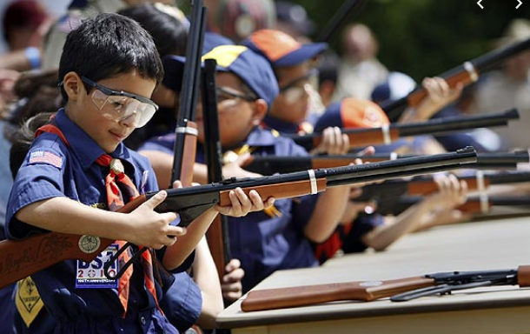
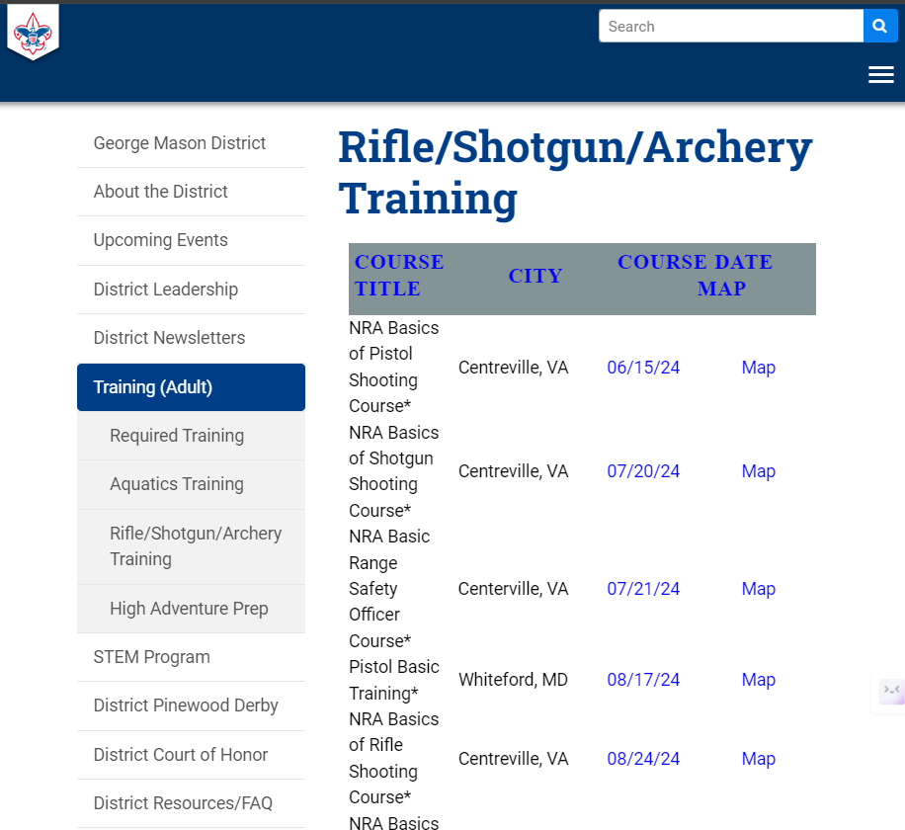
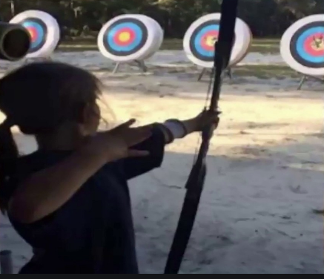
Range and Target Activities
Requests for Shooting Events – Lead Time!
  50+ scouts - 6mos
  Less than 50 scouts - 3mos
Shooting on private land:
  Requirements
  Permissions/protocols
R&TA web page
R&TA Instructor Classes

Slide 29
Order of the Arrow
  Brian Fleck is Chapter Advisor.
  2024 Dues can be paid online: https://wipit470.org/dues.html
  Registrations open online https://wipit470.org/index.html under “Events”

