Slide 1
A World In motion®
Hands-on Cybersecurity Education in a K-16 STEM Experience Continuum

Slide 2
WHO WE ARE

Slide 3
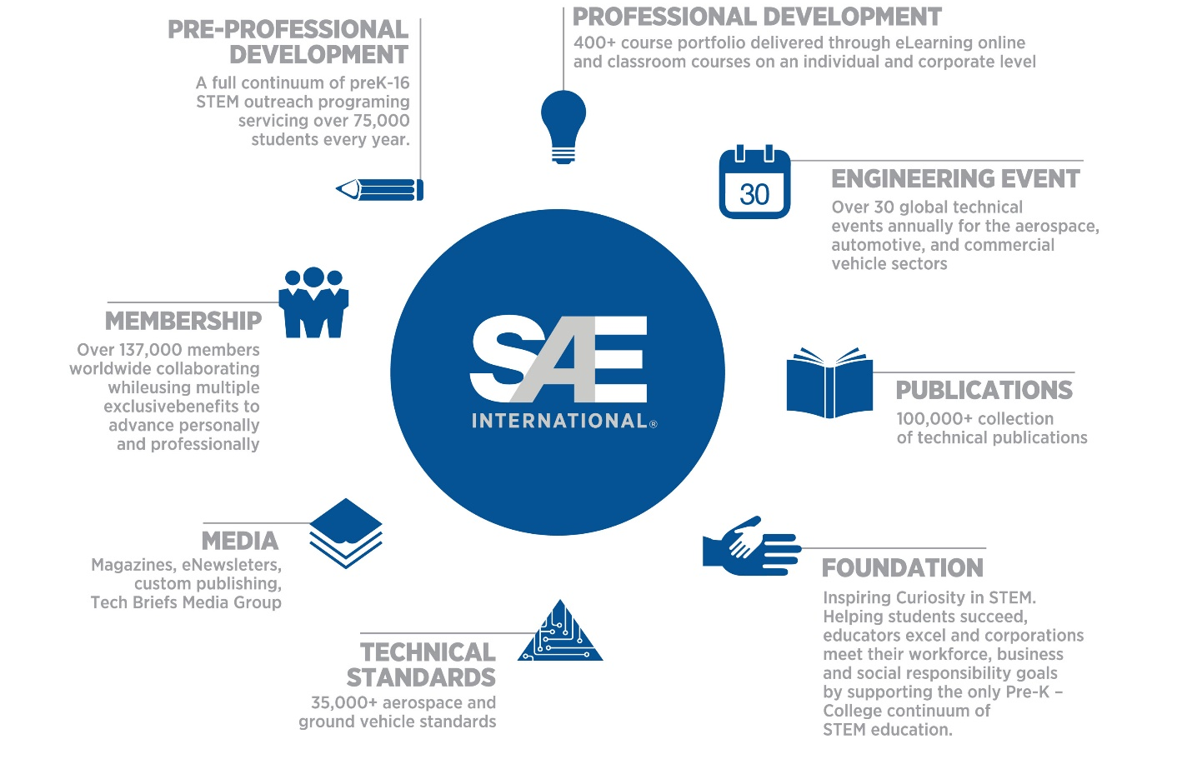
WHAT WE DO

Slide 4
AWIM AT A GLANCE
Primary Series (K-3)
Rolling Things
Elementary Series (4 – 6)
Skimmer
Middle School Series (6 – 8)
Gravity Cruiser
Pinball Designers
Engineering Inspired By Nature
Straw Rockets
JetToy
Gravity Cruiser
Glider
Motorized Toy Car
Fuel Cell
Making Music
Cybersecurity: Keeping Our Networks Secure
Programming Each Other

Slide 5
AWIM IN ACTION

Slide 6
CORE COMPETENCIES
Critical Thinking
Inquiry & Analysis
Teamwork & Collaboration
Communication
Project Management
A World In Motion

Slide 7
WHY IT EDUCATION?
Computing Occupations:
58% of all projected new jobs in STEM fields
#1 source of new wages in the United States
one of the highest-paid bachelor degrees
…yet not many schools teach computer science
Sources
Notes:
https://docs.google.com/document/d/1gySkItxiJn_vwb8HIIKNXqen184mRtzDX12cux0ZgZk/pub

Slide 8
AWIM IT SOLUTION
Fun, hands-on activities designed to build strong IT foundation
“Unplugged” explorations enable students to comprehend and apply computational thinking free of resource limitations
Collaborative lesson structure promotes teamwork, creative problem-solving, and critical thinking

Slide 9
PROGRAMMING EACH OTHER

Slide 10
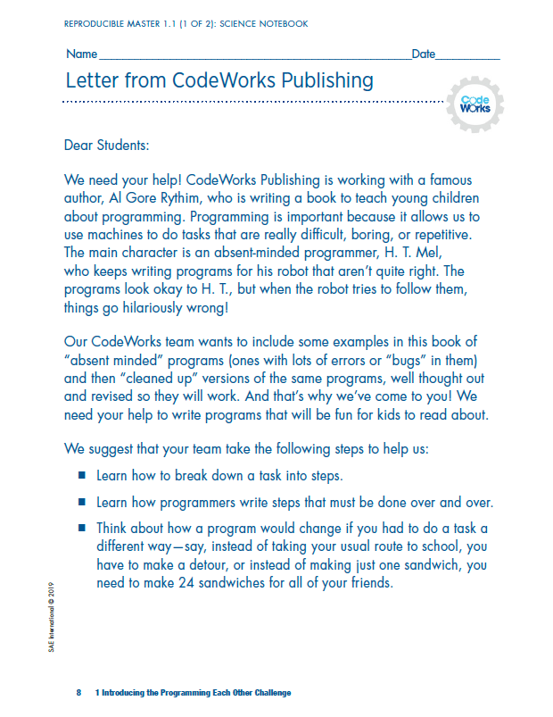
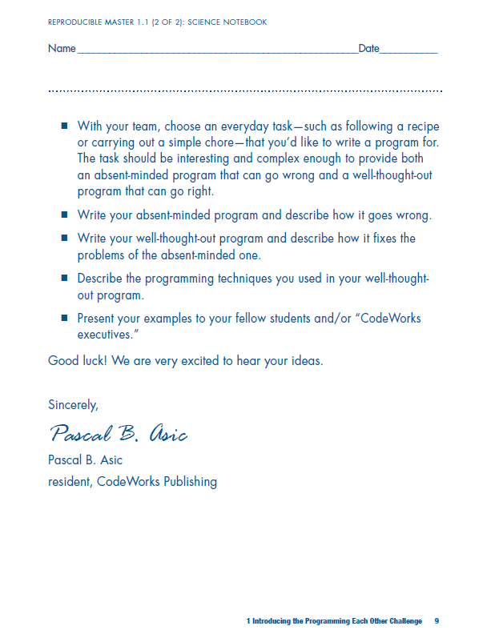
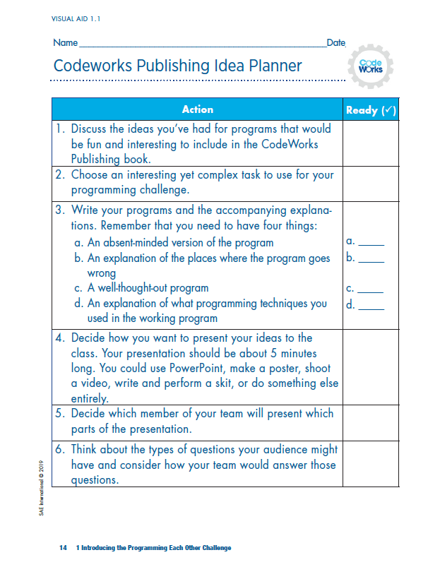
INTRODUCING THE CHALLENGE
Learn how to break down a task into logical steps
Think about how a program would change if you had to do a task a different way
Write an absent-minded program for an everyday task and describe how it goes wrong
Write a well-thought-out program and describe how it fixes the problems of the absent-minded one

Slide 11
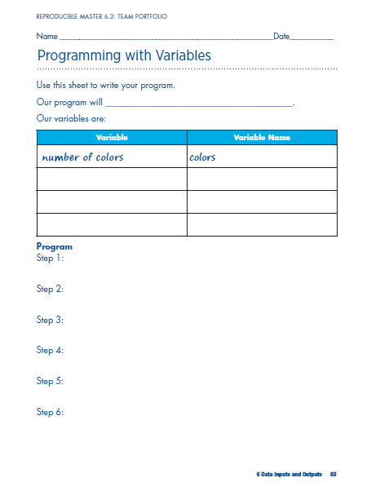
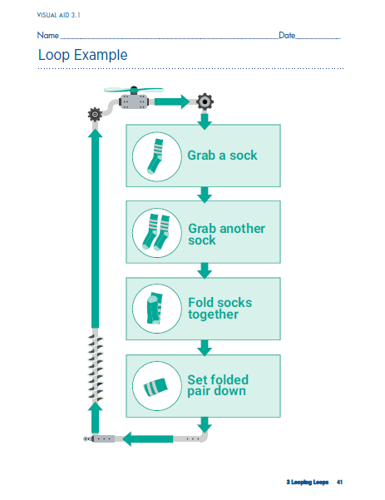
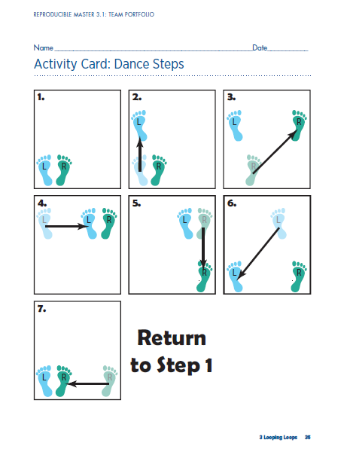
EXPLORING BASIC PROGRAMMING
Students write programs to systematize everyday activities
Tasks increase in complexity with each activity to introduce fundamental concepts, including:
Loops
Conditional Statements
Variables
Parallelization
Error handling

Slide 12
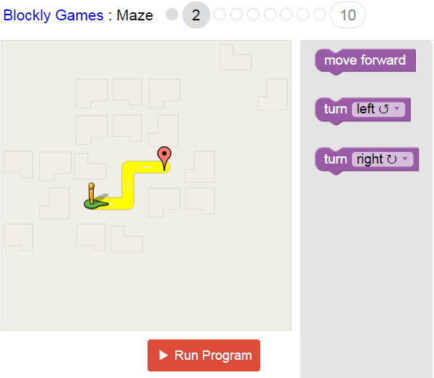
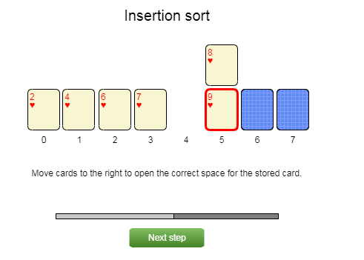
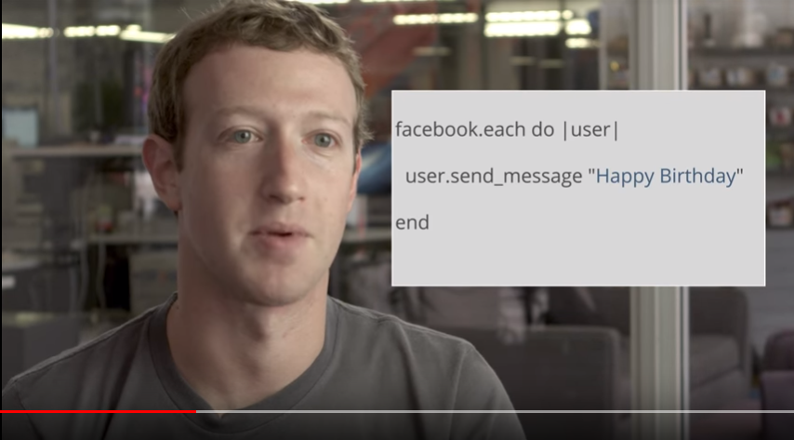
OPTIONAL TECH EXTENSIONS
Activities include optional tech extensions and supporting videos for students to apply their knowledge

Slide 13
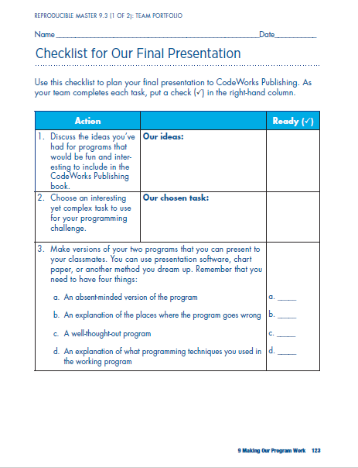
STUDENT PRESENTATIONS
Teams first present absent-minded program
Explain how program can go wrong
Teams then present companion program
Explain how program completes task correctly and efficiently
Include explanation of programming techniques used

Slide 14
CYBERSECURITY: Keeping Our Networks Secure

Slide 15
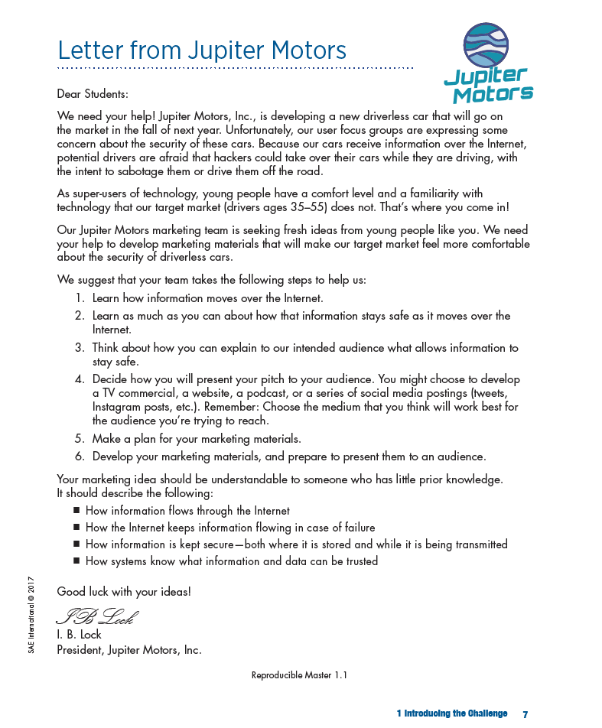
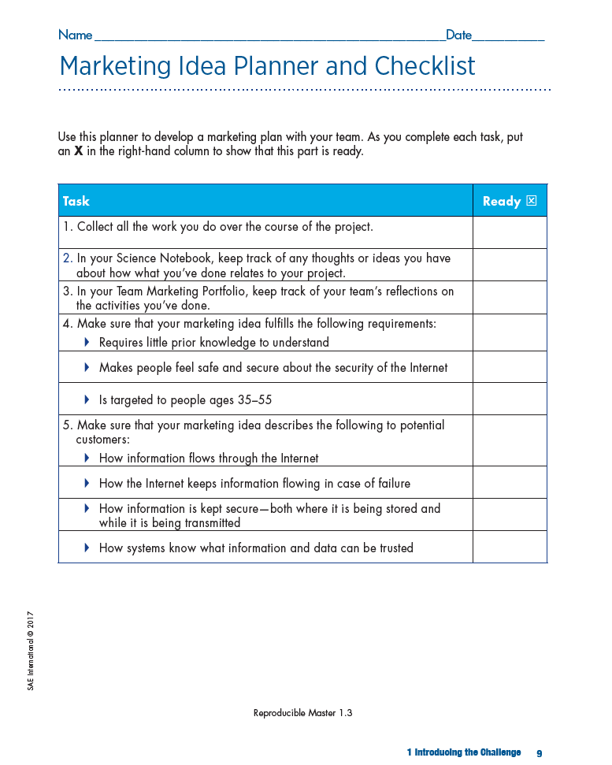
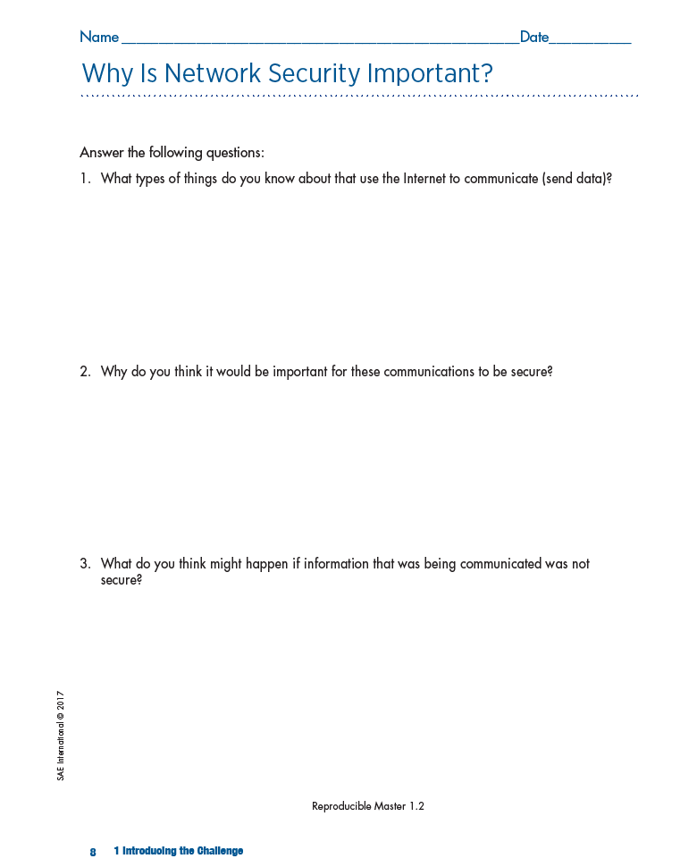
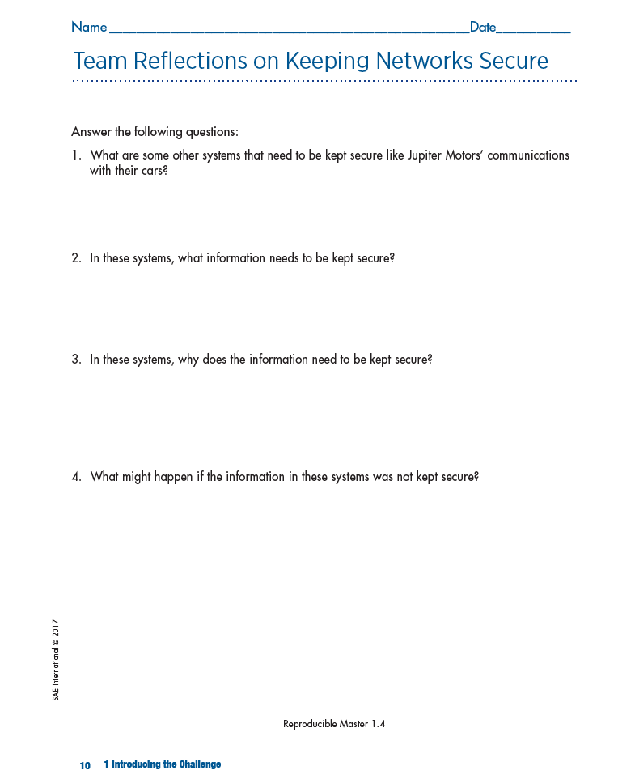
INTRODUCING THE CHALLENGE
How information flows through the internet
How the internet keeps information flowing in case of failure
How information is kept secure—both where it is stored and while it is being transmitted
How systems know what information and data can be trusted
Notes:
Notice that the requirements are broad in nature and can be applied to much more than only an autonomous vehicle marketing presentation.
How information flows through the internet – TCP and IP (protocols that programs use to route messages (IP) and to ensure that entire messages are broken into pieces (packets), sent, received, and reassembled (TCP).
How the internet keeps information flowing in case of failure – Reliability of the internet’s architecture to reroute messages
How information is kept secure—both where it is stored and while it is being transmitted – Cryptography, including encryption, KEYS used to decrypt messages
How systems know what information and data can be trusted – PKE (Public key encryption) to securely exchange keys and provide digital signatures for authenticating messages (public and private keys)

Slide 16
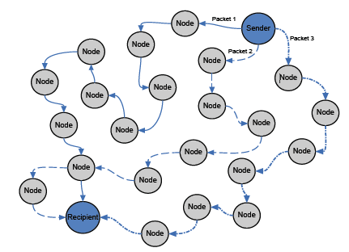
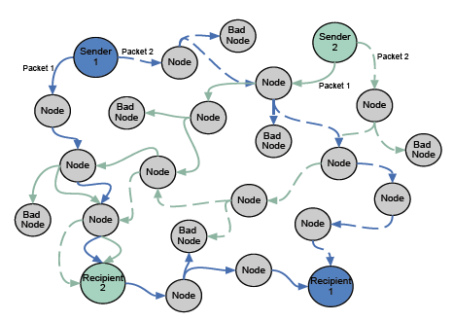
MODELING THE INTERNET
TCP (Transmission Control Protocol) and IP (Internet Protocol)
Hands-on simulations using physical classroom models help students better understand:
How messages are addressed and routed on the internet
How the internet is able to overcome system failures.
1 Sender, 1 Recipient
2 Senders, 2 Recipients, Bad Nodes
Notes:
Based on time and size of audience, we could do a quick 5-minute simulation here.
Or, show simulations on Online Module – Activities 2 & 3.

Slide 17
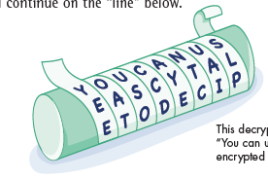
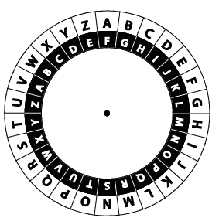
DECIPHERING MESSAGES
Ancient cultures secured messages using cryptography, the art of writing then deciphering codes.
Scytale
(Transposition Cipher)
Cipher Wheel
(Substitution Cipher)
Notes:
Has anyone heard of or used either of these? Likely the cipher wheel…
Click on the scytale for a demonstration video of how to use one.
Have scytales wrapped and ready on each diameter of tube to show that Message 1 only displays correctly on the ¾ diameter tube (KEY).

Slide 18
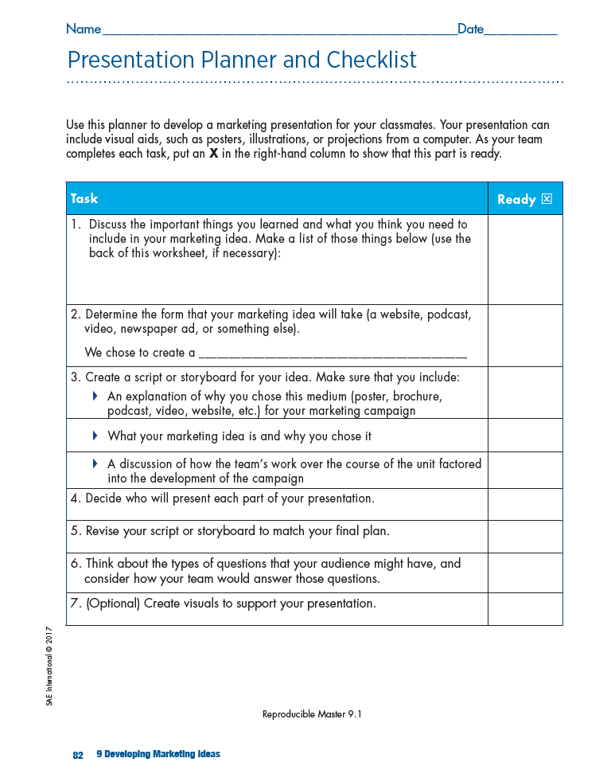
STUDENT MARKETING PRESENTATIONS
Students develop marketing plans for Jupiter Motors to:
Demonstrate learning gained from simulations
Address buyers’ fears about internet security
Plan presentations and understand scoring based on included rubric

Slide 19
Crack the code Competition!

Slide 20
For more information visit sae.org/learn/education
Or contact awim@sae.org

