Slide 1
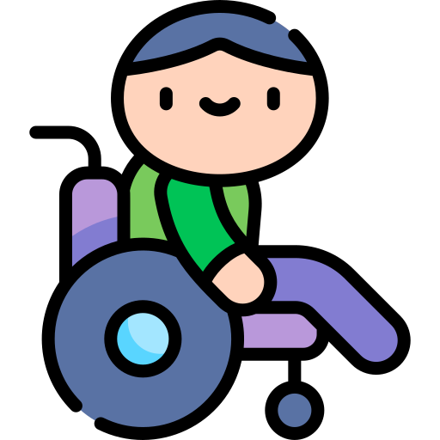
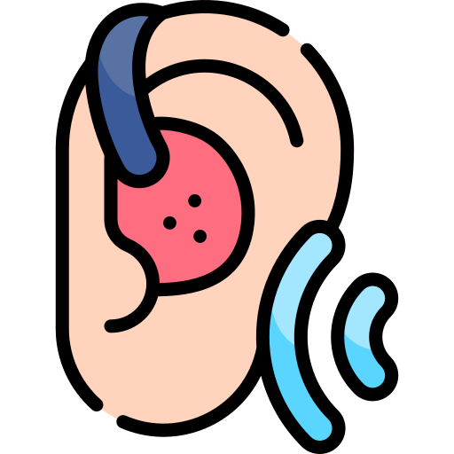
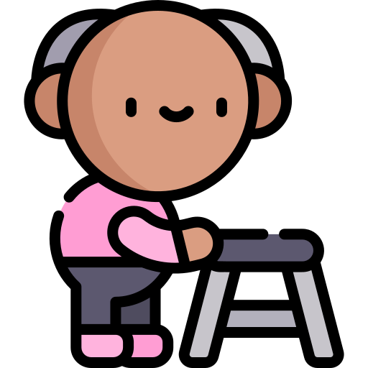
Disability Models & Higher Education
Laura J. Harris
Web Services & Distance Learning Librarian
State University of New York at Oswego
December 6, 2021

Slide 2
Outline & A Few Things To Note
Today, I’ll discuss:
Disability models:
The medical model of disability
The social model of disability
Interactional models of disability
The identity model of disability
Higher education:
Discussion of student experience - process of accommodations
Models of disability in higher education
Discussion
I'll use the acronym PWD throughout this presentation - this is short for person (or people) with disability / disabilities

Slide 3
The religious / moral model of disability
Disability as a punishment (Black, 1996)
If disability exists from birth, parents or other ancestors sinned
If disability happened later in life, the PWD sinned
Disability as a test of faith (Black, 1996)
Disability goes away: the PWD passed
Disability remains: the PWD failed
Disability as a gift
An “opportunity for character development” not given to people without disabilities (Black, 1996, p. 27)
As “disability impairs one sense, it heightens another, often to mythic proportions...This image is legion in fiction, films, and medicine” (Olkin, 2012, Ch. 2)
Notes:
From Daredevil series finale: “I realize that if my life had turned out any differently, that I would never have become Daredevil. And although people have died on my watch, people who shouldn't have, there are countless others that have lived. So, maybe it is all part of God's plan. Maybe my life has been exactly as it had to be.”

Slide 4
The Medical / Biomedical Model of Disability
Began to emerge in the mid-19th century
Disability is construed as “a personal, medical problem, requiring…an individualized medical solution” (Johnson, 2003, p. 27)
Predominant view of disability in the U.S. (Bogart et al., 2019; Dirth & Branscome, 2017; Guevara, 2021)
Weaknesses of this model:
Implies disabled bodies are inferior to able bodies
Implies disabilities can be neatly defined & measured
Implies disabilities are rare
Ignores social and environmental barriers to PWD

Slide 5
The Social Model of Disability
The Union of the Physically Impaired Against Segregation (UPAIS) was formed in the early 1970s by Paul Hunt; Hunt & this organization developed the social model
Physical impairments are distinct from disability; disability is caused by social conditions
Model has since been expanded to include mental & cognitive impairments
Societal institutions have been designed to exclude people with impairments
Focus on independence of PWD
Weaknesses of this model:
Implies any negative effects of impairment are only due to exclusion & discrimination
Not everyone with impairments is excluded

Slide 6
Related Models
Sociopolitical / minority group model (Hahn)
Three major postulates (Hahn, 1986, as cited in Hahn, 1996, p. 53)
“(a) that the primary source of the major problems confronted by persons with disabilities can be traced to unfavorable attitudes;”
“(b) that all aspects of the environment are fundamentally shaped by public policy; and”
“(c) that policies tend to reflect pervasive social attitudes and values.”
Human variations / diversity model (Scotch & Schriner, 1997)
Disability is part of the “natural physical, social, and cultural variability of the human species” (pp. 154-155)
Notes that social institutions (schools, workplaces, etc.) may not currently have the ability to respond to this variability, but they may have the potential (p. 155)
Human rights model (DARU, 2019)
Came about because of the 2006 United Nations Convention on the Rights of Persons with Disabilities
Posits that:
“Disability is a natural part of human diversity that must be respected and supported in all its forms”
“People with disability have the same rights as everyone else in society”
“Impairment must not be used as an excuse to deny or restrict people’s rights”

Slide 7
Interactional Models of Disability
The functional model looks at the “interaction between the individual, the disability, and the functions of the individual” (Smart, 2009, p. 6)
The environmental model looks at the interaction between the individual, the disability, their functions, and the environment
“The more ability someone has to function within their environment, the less their disability is relevant” (Beddes, 2020)
These models are more subjective - recognizes that each person’s required (or desired) functions are different, and each environment is different
Weaknesses of these models:
Disability is still seen as a drawback - something that limits functionality
Notes:
Chilmark, Martha’s Vineyard (basically from 1650 - 1900)

Slide 8
Related Models
The International Classification of Functioning, Disability and Health (ICF) model / biopsychosocial model
Developed by the World Health Organization
“In the ICF, functioning and disability are multi-dimensional concepts, relating to:
the body functions and structures of people, and impairments thereof (functioning at the level of the body);
the activities of people (functioning at the level of the individual) and the activity limitations they experience;
the participation or involvement of people in all areas of life, and the participation restrictions they experience (functioning of a person as a member of society); and
the environmental factors which affect these experiences (and whether these factors are facilitators or barriers)” (WHO - FIC, 2012)

Slide 9
Identity / Cultural Affiliation Models of Disability
“Under an identity model, disability is primarily defined by a certain type of experience in the world – a social and political experience of the effects of a social system not designed with disabled people in mind...[W]hile the identity model owes much to the social model, it is less interested in the ways environments, policies, and institutions disable people, and more interested in forging a positive definition of disability identity based on experiences and circumstances that have created a recognizable minority group called ‘people with disabilities’” (Brewer, 2012, p. 5)
Weaknesses of this model
As stated above, less interested in social influences of disability; less focused on change

Slide 10
Higher Education & Disability
Student experience:
Must self-disclose disability to disability services office to get accommodations
Often must "re-register" each semester they need accommodations
Must provide documentation of disability
Faculty / staff experience:
Often no specific guidelines or resources for faculty & staff
Told to contact Human Resources for accommodations
Information for faculty often focused on how to accommodate students

Slide 11
Higher Education & the Medical Model
It’s a personal problem
“A student once summarized the accommodation process as being like the game Battleship — you can’t perceive what’s on the other side of the board, because there is a barrier there, and so you have to just keep trying to guess where the other player’s ships are — or where the relevant accommodations are, if they exist. You throw your diagnosis over, and hope that it will land on something that will actually help you. But you cannot sense the full range of what may be on the other side, and thus you cannot directly ask for what you need” (Dolmage, 2017, p. 90).
The myth of rarity: “But there are no disabled students in my class!”
In the 2015-2016 school year, 19.4% of undergraduate students reported having a disability (National Center for Education Statistics, 2021)

Slide 12
Higher Education & the Minority Group Model
Hahn’s “unfavorable attitudes”
Many students choose not to disclose their disability (Gierdowski et al., 2020; Newman et al., 2011)
Lyman et al. (2016), identified six themes on why students choose not to disclose their disability status:
desire for self-sufficiency
desire to avoid negative social reactions
insufficient knowledge
quality and usefulness of DSS and accommodations
negative experiences with professors
fear of future ramifications (p. 127).

Slide 13
Higher Education & Interactional Models
Higher education accommodations focus on only one function
Harry Paul, a medical student, commented that "Accommodations do not often take care of accommodating people off campus,” he said. “You can have someone to help you get to class, but if you can’t get your groceries, how can you stay in school?” (as cited in Burke, 2020).

Slide 14
Higher Education & the Diversity Model
Ableist exceptionalism: “the phenomenon whereby values, beliefs, principles, and so on that one holds in other domains of political consciousness are not transferred over to the domain of disability and ableism” (Tremain, 2016, n.p.).
“[V]ery progressive teachers, researchers, and even activists will use words like moron or idiot even when critiquing racist, sexist, or otherwise offensive behavior, all the while refusing to admit or realize that they are channeling one form of bigotry to attack another” (Dolmage, 2017, p. 37).
Disability is often excluded from institutional discussions of diversity, equity & inclusion - Scheef et al. (2020) found that less than a quarter of campus diversity statements explicitly included disability.

Slide 15
Discussion Questions
What other models have you observed at play at colleges & universities?
How do you think colleges & universities treat disabled students differently from disabled faculty & staff?
If disability services offices focus on students' academic function, what other functions can colleges & universities support?
What functions can a library support?
How do libraries limit or facilitate student activities? What about your library in particular?
How can libraries contribute to a positive view of people with disabilities? What about your library in particular?

Slide 16
Image Credits
Wheelchair, hearing aid, and guide dog icons from “International Day Of Persons With Disabilities” pack from Freepik.
Man with walker icon from “Retirement Home” pack from Freepik.
Woman with waving arms icon from “Pilates” pack from Freepik.

Slide 17
References
Beddes, L. (2020, September 10). How do you see disability? Defining someone’s disability changes how you interact with them. https://loganbeddes.medium.com/how-do-you-see-disability-a1165d7e75d
Black, K. (1996). A healing homiletic : preaching and disability. Abingdon Press.
Bogart, K. R., Logan, S. W., Hospodar, C., & Woekel, E. (2019). Disability models and attitudes among college students with and without disabilities. Stigma and Health, 4(3), 260–263.
Brewer, E., Brueggemann, B., Hetrick, N. & Yergeau, M.. (2012). Introduction, background, and history. In B. Brueggemann (ed.), Arts and humanities (pp. 1-62). Sage.
Burke, L. (2020, November 12). Disability as diversity. Inside Higher Ed. https://www.insidehighered.com/news/2020/11/12/could-disability-be-further-included-diversity-efforts
DARU: Disability Advocacy Resource Unit. (2019). Introducing the human rights model of disability. http://www.daru.org.au/how-we-talk-about-disability-matters/introducing-the-human-rights-model-of-disability
Dirth, T. P., & Branscombe, N. R. (2017). Disability models affect disability policy support through awareness of structural discrimination. Journal of Social Issues, 73(2), 413–442.

Slide 18
References
Dolmage, J.T. (2017). Academic ableism. University of Michigan Press.
Gierdowski, D.C., Brooks, D.C., & Galanek, J. (2020). Accessibility and accommodations. EDUCAUSE 2020 Student Technology Report: Supporting the Whole Student. https://www.educause.edu/ecar/research-publications/student-technology-report-supporting-the-whole-student/2020/accessibility-and-accommodations
Guevara, A. (2021). The need to reimagine disability rights law because the medical model of disability fails us all. Wisconsin Law Review, 2021(2), 269-292.
Hahn, H. (1996). Antidiscrimination laws and social research on disability: The minority group perspective. Behavioral Sciences and the Law, 14(1), 41-59.
Johnson, M. (2003). Make them go away: Clint Eastwood, Christopher Reeve, and the case against disability rights. Advocado Press.
Lyman, M., Beecher, M. E., Griner, D., Brooks, M., Call, J., & Jackson, A. (2016). What keeps students with disabilities from using accommodations in postsecondary education? A qualitative review. Journal of Postsecondary Education and Disability, 29(2), 123-140.
Newman, L., Wagner, M., Knokey, A. M., Marder, C., Nagle, K., Shaver, D., & Wei, X. (2011). The post-high school outcomes of young adults with disabilities up to 8 Years after high school: A report from the National Longitudinal Transition Study-2 (NLTS2). https://eric.ed.gov/?id=ED524044

Slide 19
References
Olkin, R. (2012). What psychotherapists should know about disability. Guilford Publications.
Scheef, A., Caniglia, C., & Barrio, B.L. (2020). Disability as diversity: Perspectives of institutes of higher education in the United States. Journal of Postsecondary Education and Disability, 33(1), 49-61.
Scotch, R.K., & Schriner, K. (1997). Disability as human variation: Implications for policy. The Annals of the American Academy of Political and Social Science, 549, 148-159.
Smart, J.F. (2009). The power of models of disability. Journal of Rehabilitation, 75(2), 3-11.
Tremain, S. (2016, November 7). No language is neutral, part II: Ableist language and ableist exceptionism. http://web.archive.org/web/20161117101641/http://philosophycommons.typepad.com/disability_and_disadvanta/2016/11/no-language-is-neutral-ableist-language-and-ableist-exceptionism.html
U.S. Department of Education, National Center for Education Statistics. (2021). Fast facts: Students with disabilities. Retrieved July 8, 2021 from https://nces.ed.gov/fastfacts/display.asp?id=60
World Health Organization. (2012). WHO – FIC information sheet: International Classification of Functioning, Disability and Health (ICF). https://www.cdc.gov/nchs/data/icd/icfinformationsheet.pdf

