Slide 1
Pediatric Weight Management ECHO® Session Topic: Nutrition and Physical Activity Counseling
Presenter(s): Katelyn Fox PhD, RD
Date: April 20, 2023
PLEASE NOTE: Project ECHO case consultations do not create or otherwise establish a provider-patient relationship between any clinician and any patient whose case is being presented in a project ECHO setting

Slide 2
Welcome
This session will be recorded for educational and quality improvement purposes
Please do not provide any protected health information (PHI) during any ECHO session
Please turn on your video
Please enter your name and organization in the chat box
Please mute your microphone when not speaking
Introduction
Lecture
Case
Discussion
Close
Introduce Yourself
Microphones
Agenda
4/20/23 Prepared by Care Transformation Collaborative of RI

Slide 3
CME Credits (currently available for MDs, PAs, Rx, RNs, NPs, PsyD, PhD)
CME Credits – Please request session credits when filling out the evaluation at the end of the meeting.
Evaluation/Credit Request Form: https://www.surveymonkey.com/r/PediWtMgmtCMEEvaluation
The AAFP has reviewed ‘Advancing Community-Oriented Comprehensive Primary Care Through Improved Care Delivery Design and Community Health,’ and deemed it acceptable for AAFP credit. Term of approval is from 09/15/2022 to 09/15/2023. Physicians should claim only the credit commensurate with the extent of their participation in the activity.
NPs and RNs can also receive credit through AAFP’s partnership with the American Nurses Credentialing Center (ANCC) and the American Academy of Nurse Practitioners Certification Board (AANPCB).
4/20/23 Prepared by Care Transformation Collaborative of RI
Notes:
Linda

Slide 4
Agenda
Time | Topic | Presenter
7:30 – 7:35 AM | Welcome & Introductions | Linda & Pat
7:35 – 8:00 AM | Didactic: Nutrition and Physical Activity Guidelines | Katelyn Fox
8:00 - 8:10 AM | Case Presentation | Casey Sardo, TriCounty
8:10 - 8:25 AM | Discussion | All
8:25 – 8:30 AM | Wrap up; Evaluation; Announcements | Linda
4/20/23 Prepared by Care Transformation Collaborative of RI
Notes:
Liz Introduce Vania

Slide 5
Today’s Faculty
Katelyn Fox Ph.D., R.D. is a registered dietitian and postdoctoral fellow at the Weight Control and Diabetes Research Center of The Miriam Hospital and Alpert Medical School of Brown University.
Dr. Fox worked as a pediatric dietitian at Hasbro Children’s Hospital from 2013-2020. She completed her Ph.D. in Health Science at the University of Rhode Island in 2021.
Her research focuses on:
Identifying targets for childhood obesity prevention and treatment.
Addressing barriers to the adoption and integration of innovations that improve nutrition in healthcare, community, and public health programs.
4/20/23 Prepared by Care Transformation Collaborative of RI

Slide 6
Disclosures
Session presenters have no financial relationships with a commercial entity producing healthcare-related products used on or by patients. If CME credits are offered, all relevant financial relationships of those on the session planning committee have been disclosed and, if necessary, mitigated.
4/20/23 Prepared by Care Transformation Collaborative of RI

Slide 7
Learning Objectives
Describe nutrition and physical activity guidelines from infancy-adolescence.
Recognize common barriers to meeting guidelines.
Identify strategies to support families in meeting guidelines.
4/20/23 Prepared by Care Transformation Collaborative of RI

Slide 8
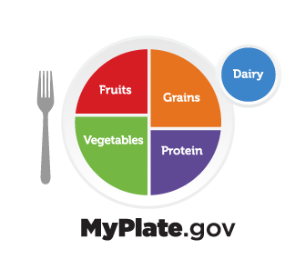
The 2020-2025 Dietary Guidelines for Americans
A healthy eating routine is important at every stage of life and can have positive effects that add up over time.
It’s important to eat a variety of fruits, vegetables, grains, protein foods, and dairy and fortified soy alternatives.
When deciding what to eat or drink, choose options that are full of nutrients. Make every bite count.
4/20/23 Prepared by Care Transformation Collaborative of RI
Notes:
Every 5 years the USDA convenes an advisory committee of experts in food, nutrition, and health to analyze surveillance nutrition, model changes in dietary intake, and review the current body of scientific evidence on diet and health outcomes and aims to promote health and prevent chronic diseases. They also translate the results of this report to into actionable consumer messages and resources to help individuals, families, and communities achieve healthy dietary patterns. How many of you are familiar with My Plate? From 2017–March 2020, less than one-third of U.S. adults had heard of MyPlate
Focus on balance – all food groups are present ; within each food groups focus on maximizing nutrition (whole fruits vs juice; and variety of fresh, frozen or canned vegetables, whole grains, variety of lean and plant based protien; low fat dairy and dairy alternatives

Slide 9
Healthy Eating Can Promote Health and Reduce the Risk of Chronic Disease Throughout the Life Course
Infants and Toddlers
Reduced risk of overweight & obesity
Reduced risk of type 1 diabetes
Reduced risk of iron deficiency
Reduced risk of peanut allergy
Reduced risk of asthma
*These outcomes demonstrated strong or moderate evidence (Dietary Guidelines Advisory Committee, 2020)
4/20/23 Prepared by Care Transformation Collaborative of RI
Notes:
Prior to the 2020-2025 guidelines, there were no national guidelines on nutrition for infants and toddlers, partially because there was limited data. Study in this area has increased over the past 10 years with the understanding that the first 1000 days were a critical developmental window. There is now a significant body of evidence on the influence of what and how we feed infants and children influences their immediate and lifelong health.

Slide 10
Infants and Toddlers Key Recommendations
For about the first 6 months of life, exclusively feed infants human milk. Continue to feed infants human milk through at least the first year of life, and longer if desired.
Feed infants iron-fortified infant formula during the first year of life when human milk is unavailable.
Provide infants with supplemental vitamin D beginning soon after birth.
4/20/23 Prepared by Care Transformation Collaborative of RI
Notes:
All infants who are fed human milk exclusively or who receive both human milk and infant formula (mixed fed) will need a vitamin D supplement of 400 IU per day beginning soon after birth.

Slide 11
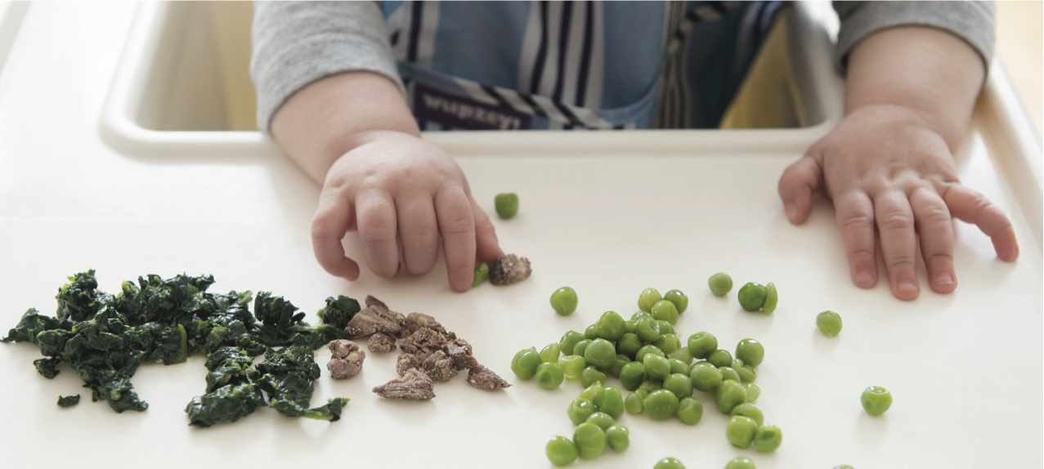
At about 6 months, introduce infants to nutrient-dense complementary foods.
The goal is exposure and learning -- 70-80% of calorie needs are met by human milk/formula.
Encourage a variety of whole foods from all food groups. Include foods rich in iron and zinc, particularly for infants fed human milk.
Introduce infants to potentially allergenic foods along with other complementary foods.
Avoid foods and beverages with added sugars as well as honey and any unpasteurized beverages.
Limit foods and beverages higher in sodium.
4/20/23 Prepared by Care Transformation Collaborative of RI
Notes:
At about 6 months is recommended to introduce complementary foods. Complementary because infants up to 1-year-old meet 70-80% of the calorie needs from milk or formula. The goal here should really be exposure to healthy foods and learning to like them, self-regulate their appetite, feed themselves, and enjoy family meals.
We want to introduce foods from all food groups so that by the time a child is 2 they are able to eat in line with my plate recommendations.
Allergenic foods should be introduced; and there is strong evidence that early and consistent introduction can decrease the risk of allergy development.
Because of the incredible growth and development at this time, there is limited room for any added sugars to meet vitamin and mineral needs and stay within calorie goals. Additionally, food preferences develop early and track into adulthood so exposure to highly sweet or salty foods can increase preferences for these foods later in life when it may have a more direct impact on health.

Slide 12
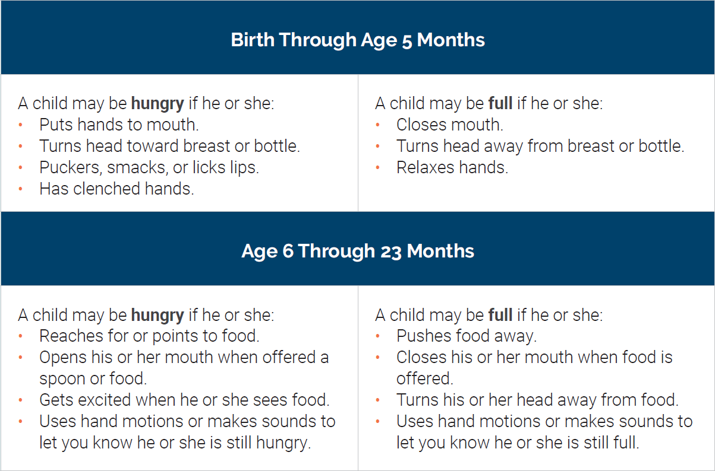
Supporting Healthy Eating Behaviors
Signs a Child is Hungry or Full*
Responsive Feeding
The child signals hunger and fullness.
The caregiver recognizes the cues and responds promptly in a way that is emotionally supportive, and developmentally appropriate
The child learns that caregivers will respond in a specific way, based on the different cues the child gives.
*More information on infant development skills, hunger and satiety cues, and typical daily portion sizes is available at
wicworks.fns.usda.gov/sites/default/files/media/document/Infant_Nutrition_and_Feeding_Guide.pdf.
4/20/23 Prepared by Care Transformation Collaborative of RI
Notes:
In order to allow children to learn self-regulation it is important to follow responsive feeding practices
Responsive feeding is a term used to describe a feeding style that emphasizes recognizing and responding to the hunger or fullness cues of an infant or young child. Most children are born knowing how to self-regulate their energy intake, however consistently overriding a child’s natural cues can lead to a weakened response leading to overeating.
It is important to listen to the child’s hunger and fullness cues to build healthy eating habits during this critical age. If parents, guardians, or caregivers have questions or concerns, a conversation with a healthcare provider will be helpful.

Slide 13
Make Healthy Shifts to Empower Toddlers to Eat Nutrient-Dense Foods in Dietary Patterns
4/20/23 Prepared by Care Transformation Collaborative of RI
Notes:
Science shows that early food preferences influence later food choices. Make the first choice the healthiest choices that set toddlers on a path of making nutrient-dense food choices in the years to come. Examples of shifts in common choices to healthier, more nutrient-dense choices are shown here.
Because very young children are being exposed to new textures and flavors for the first time, it may take up to 8 to 10 exposures for an infant to accept a new type of food. Repeated offering of foods such as fruits and vegetables increases the likelihood of an infant accepting them.
These guidelines highlight what we should feed children during this stage but we also know that how we feed children has a significant influence on the development of their food preferences and eating behaviors.

Slide 14
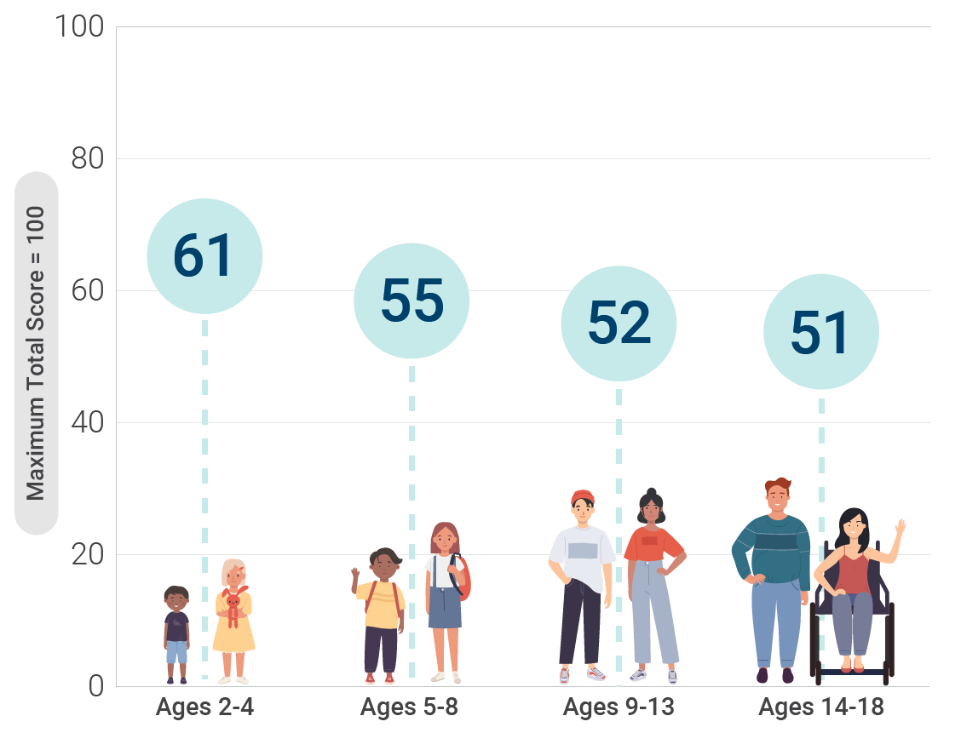
Healthy Eating Index Scores Across Childhood and Adolescence
Data Source: Analysis of What We Eat in America, NHANES 2015-2016, ages 1 through 18, day 1 dietary intake, weighted.
4/20/23 Prepared by Care Transformation Collaborative of RI
Notes:
The quality of infants and toddlers’ diets is not only important for the health benefits described earlier; but also because diet quality tends to peak during this stage and decline as children get older. Here we can see average healthy eating index scores across childhood and adolescents. HEI is a reflection of adherence to the USDA guidelines with a maximum score of 100 reflecting perfect adherence. We can see that children are not starting out well (basically a D) and getting worse

Slide 15
Healthy Eating Can Promote Health and Reduce the Risk of Chronic Disease Throughout the Life Course
Children and Adolescents
Lower adiposity
Lower total cholesterol
Lower low-density lipoprotein (LDL) cholesterol
*These outcomes demonstrated strong or moderate evidence (Dietary Guidelines Advisory Committee, 2020)
4/20/23 Prepared by Care Transformation Collaborative of RI
Notes:
This is concerning because dietary patterns at this age influence adiposity, and lifelong heart disease risk

Slide 16
Children and Adolescent Key Recommendations
Expose to a variety of nutrient-dense foods within each food group.
Offer healthy food repeatedly, prepared in different ways to increase acceptance.
Create environments that support healthy eating at home, school, and in communities.
4/20/23 Prepared by Care Transformation Collaborative of RI
Notes:
As growth and development slow nutrient need more closely resemble adult needs. This means that there is more room in the diet to include foods with added sugars or saturated fats, although in order to meet all of one nutrient needs without consuming excessive calories it is recommended to consume most of your foods from nutrient-dense sources.. This works out to about 85% of our diet meeting my plate recommendations and 15% for fun, flavor, etc.
This is a nice way to talk about balance and how all foods can fit in a healthy dietary pattern but only some foods provide us with the nutrition we need.
Repeated exposure continues to be important as tastes and preferences continue to develop as we age. Exposure doesn’t have to be eating – seeing food, smelling food, watching others eat food, and tasting food all help to develop our food preferences.
We also know that the majority of decisions we make about what and when we eat are influenced subconsciously by our environment. This applies to adults too. We eat what’s around. Children and adolescents are developing the ability to control the impulse to eat based on their environment.

Slide 17
Supporting Healthy Eating: Children and Adolescents
Provide structure
Consistent meal and snack routines
Offer meals and snacks that meet My Plate guidelines
Stimulus control
Availability & Accessibility
Support developing autonomy
Respect decisions on whether, what*, and how much to eat
Encourage involvement in selecting and preparing healthy meals
Discuss the role of nutrition in health in a developmentally appropriate manner
(Savage et al., 2007, Wood et al., 2020)
4/20/23 Prepared by Care Transformation Collaborative of RI

Slide 18
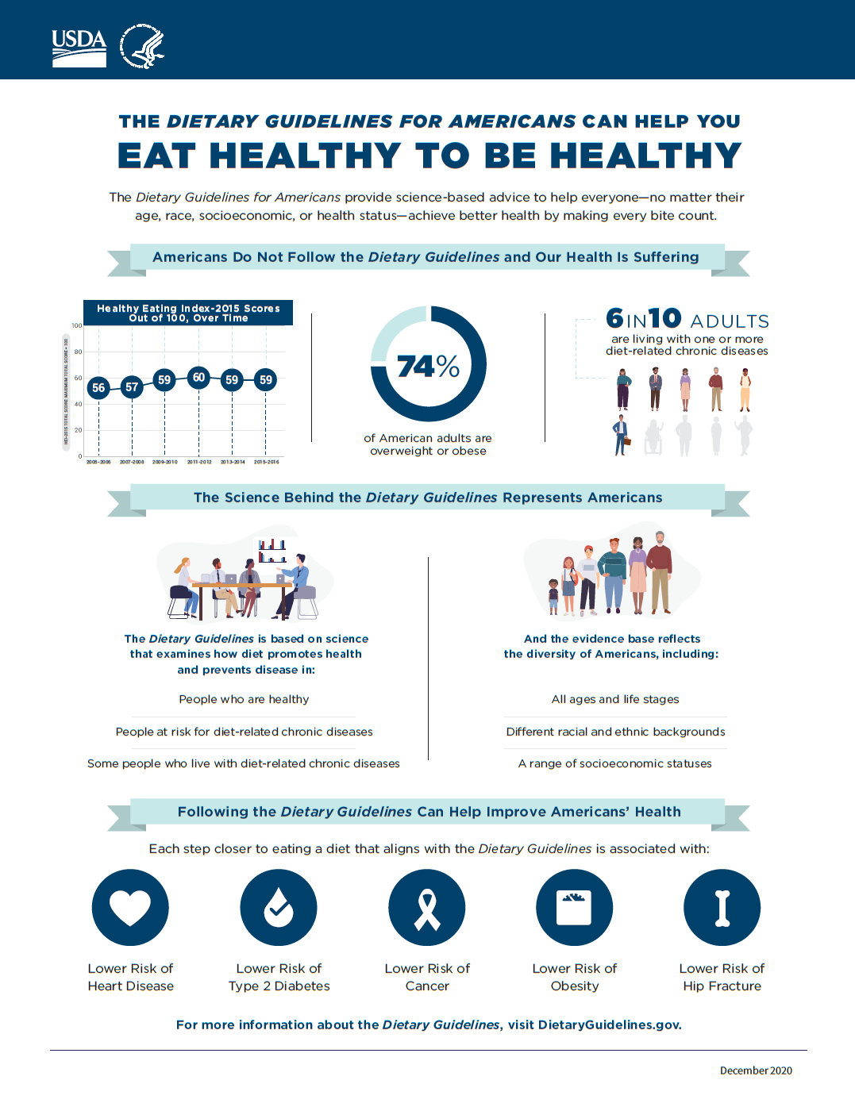
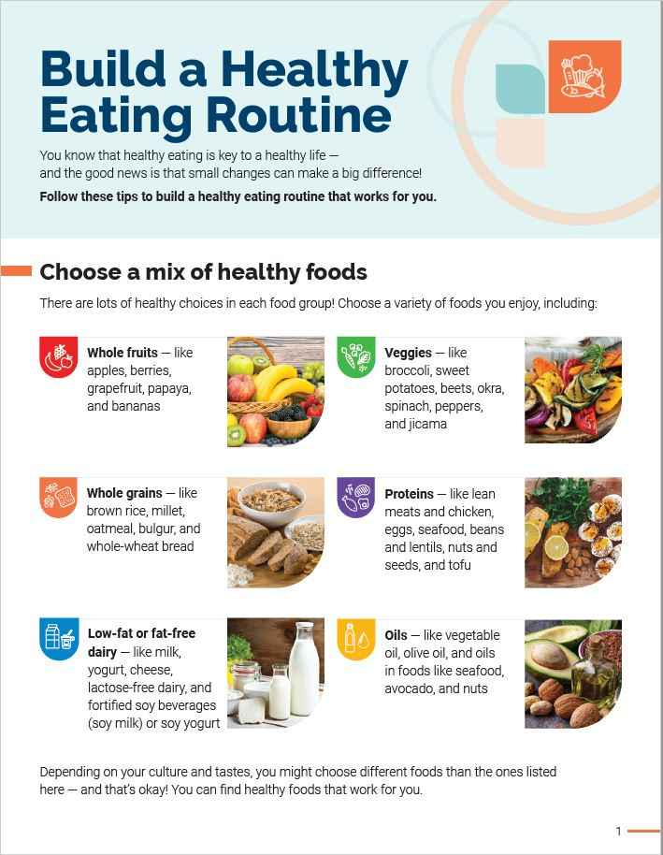
Visit DietaryGuidelines.gov to access online resources
Professional
Presentations
Infographics
Healthcare
Provider Toolkit
Most
Popular Questions
4/20/23 Prepared by Care Transformation Collaborative of RI
Notes:
Professional Presentations: 1 extensive, adaptable slide deck covers the entire Dietary Guidelines + a handful of adaptable life stage focused presentations. Available to download as either PPT or PDF.
Infographics: A series of infographics are also provided for your use covering both content within and the process to develop the Dietary Guidelines for Americans, 2020-2025, such as the difference between the Advisory Committee’s Scientific Report and the Dietary Guidelines or how public engagement strengthened the process (Note: The Departments received >106,000 public comments!)
Healthcare Provider Toolkit: This toolkit is provided to help healthcare providers communicate Dietary Guidelines messages. Content covers nutrition tips and conversations starters for dietitians, nurses and other providers working with the public.
Most Popular Questions: Have a specific question about the Dietary Guidelines? Visit dietaryguidelines.gov/most-popular-questions to find answers to questions such as, “What’s new and different in this edition of the Dietary Guidelines?” (partial answer: 1st set of guidelines to provide guidance by life stage!).

Slide 19
Physical Activity Can Promote Health and Reduce the Risk of Chronic Disease Throughout the Life Course
Improved bone health (ages 3 through 17 years)
Improved weight status (ages 3 through 17 years)
Improved cardiorespiratory and muscular fitness (ages 6 through 17 years)
Improved cardiometabolic health (ages 6 through 17 years)
Improved cognition (ages 6 to 13 years)
Reduced risk of depression (ages 6 to 13 years)
Physical Activity Guidelines Advisory Committee, 2018
4/20/23 Prepared by Care Transformation Collaborative of RI
Notes:
New research also strengthens the evidence for previously reported benefits. (new benefits in bold)
For children and adolescents, physical activity can help improve cognition, bone health, fitness, and heart health, and reduce the risk of depression.

Slide 20
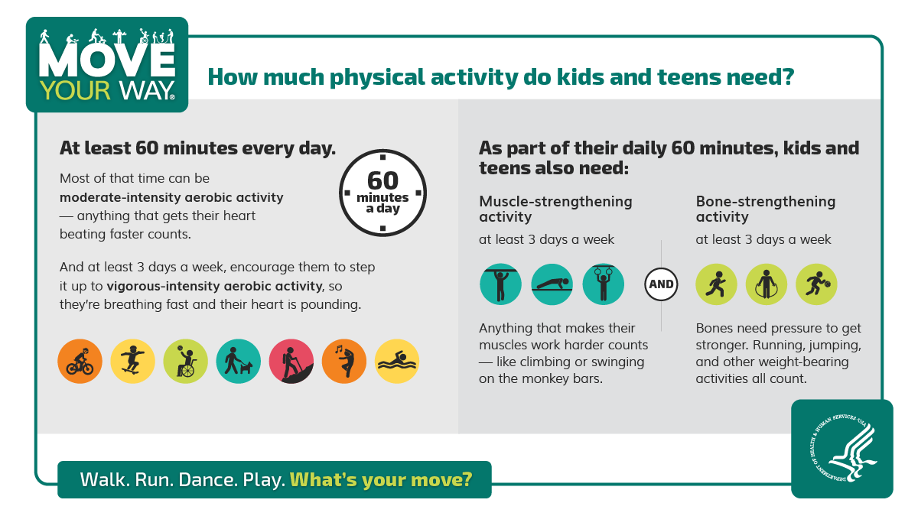
The Physical Activity Guidelines for Americans 2nd Edition
4/20/23 Prepared by Care Transformation Collaborative of RI
Notes:
The USDA also convenes a scientific advisory committee that conducts a systematic review of the literature on physical activity and health outcomes which translates into pupublic-facingblic facing messaging. The US PA guidelines published in 2018 recommend 60 minutes of physical activity every day .
Key Guidelines for Preschool-Aged Children  Preschool-aged children (ages 3 through 5 years) should be physically active throughout the day to enhance growth and development.  Adult caregivers of preschool-aged children should encourage active play that includes a variety of activity typ
Key Guidelines for Children and Adolescents  It is important to provide young people opportunities and encouragement to participate in physical activities that are appropriate for their age, that are enjoyable, and that offer variety. 
Children and adolescents ages 6 through 17 years should do 60 minutes (1 hour) or more of moderate-to-vigorous physical activity daily: • Aerobic: Most of the 60 minutes or more per day should be either moderateor vigorous-intensity aerobic physical activity and should include vigorousintensity physical activity on at least 3 days a week. • Muscle-strengthening: As part of their 60 minutes or more of daily physical activity, children and adolescents should include muscle-strengthening physical activity on at least 3 days a week. • Bone-strengthening: As part of their 60 minutes or more of daily physical activity, children and adolescents should include bone-strengthening physical activity on at least 3 days a week.

Slide 21
Supporting Physical Activity: Children and Adolescents
Provide Structure
Build consistent physical activity routines
Incorporate lifestyle activity
Establish limits for sedentary leisure time (e.g. screen time)
Support Developing Autonomy
Respect preferences- physical activity should be enjoyable!
Encourage involvement in selecting or planning family activities
Discuss the benefits of activity for physical and mental health
(Mossman et al., 2022)
4/20/23 Prepared by Care Transformation Collaborative of RI

Slide 22
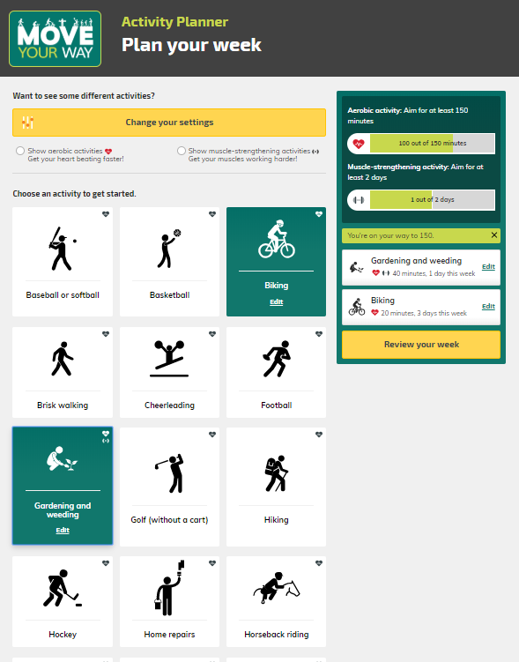
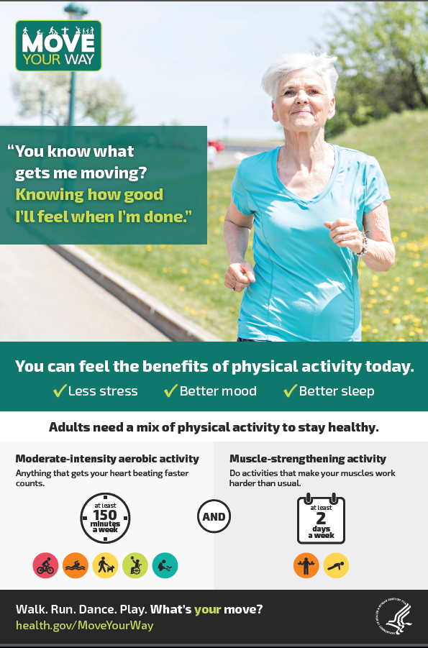
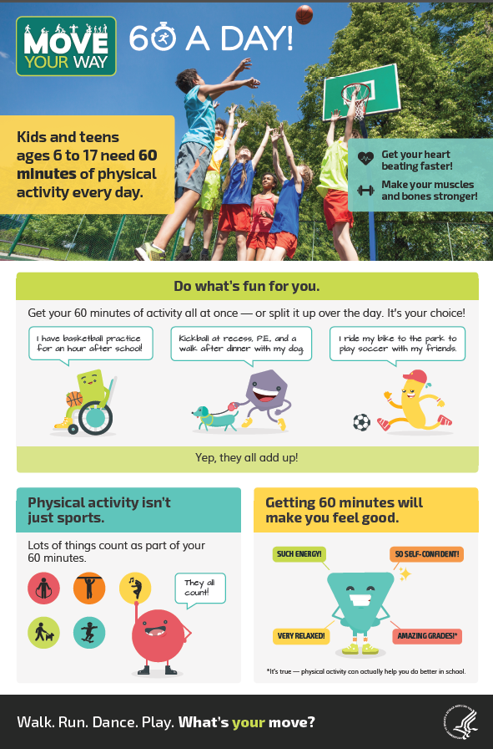
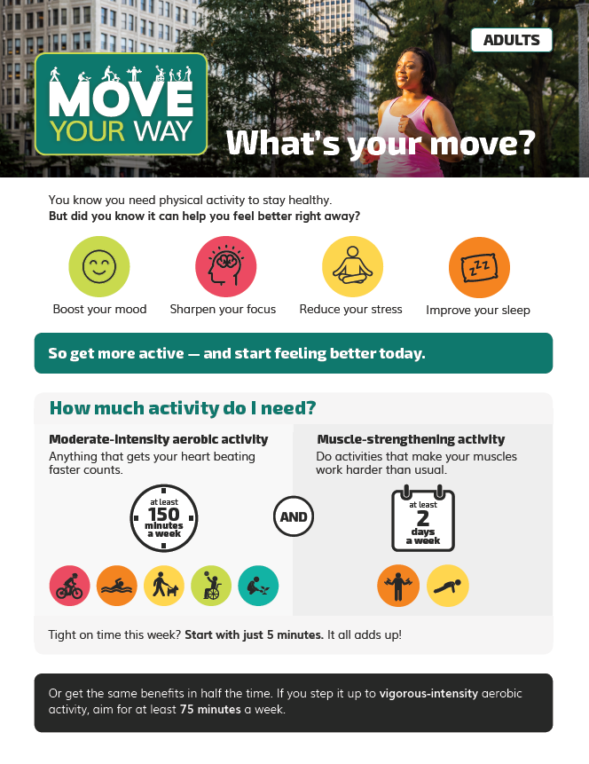
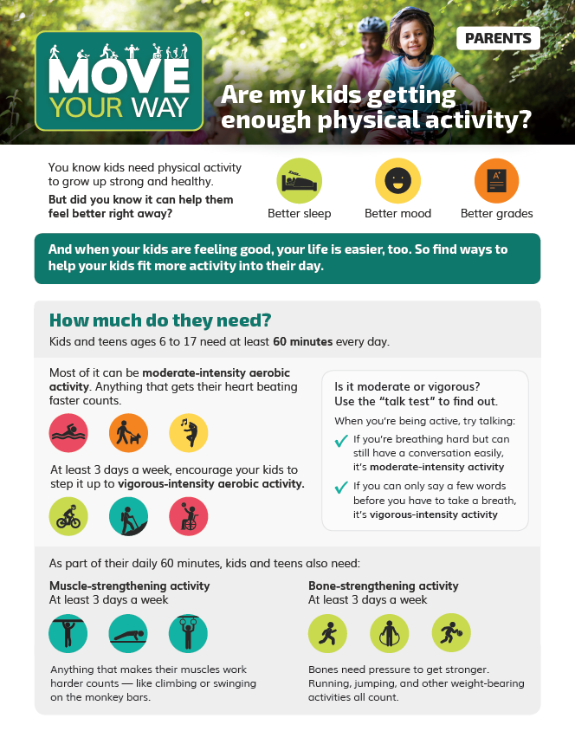
Move Your Way Campaign Resources https://health.gov/PAGuidelines
Interactive tools
Posters and factsheets
Series of videos
4/20/23 Prepared by Care Transformation Collaborative of RI
Notes:
HHS used audience research to inform a suite of over 40 resources that are available in English and Spanish at health.gov. Just a few of these resources are pictured on the slide.
These resources include:
A weekly activity planner for adults that allows users to develop a personalized plan for meeting the recommendations based on their preferences,
An interactive infographic for parents to assess opportunities for their school-aged children to get active throughout the day,
A series of five posters and five factsheets for adults, older adults, parents, children, and health professionals, and
A series of four videos with tips for adults and parents to fit more physical activity into the day.
A toolkit for promoting the Move Your Way campaign through social media

Slide 23
Opportunities for Care
Screen
Healthy lifestyle behaviors (i.e. 5210)
Provide guidance on how to meet guidelines.
Provide anticipatory guidance + child-specific suggestions based on screening.
Automate as much of the process as possible
Engage family in conversation to understand barriers that are impacting them.
Refer to programs/ providers to address barriers
Collaborate with multidisciplinary teams
Establish connections to community organizations
Utilize MI to encourage families to connect with referral
Follow up
4/20/23 Prepared by Care Transformation Collaborative of RI

Slide 24
Visit AAP Institute for Healthy Childhood Weight to access online resources including validated screeners, clinical support tools, and patient education materials
Professional
Education
Clinical Support Tools
Family Resources
4/20/23 Prepared by Care Transformation Collaborative of RI

Slide 25
Common Barriers to Healthy Eating and Physical Activity
Social Determinants of Health (SDoH)
Limited awareness or understanding of nutrition and physical activity guidelines and their impact on health
Characteristics of the child or family
Characteristics of the environments where children spend their time
4/20/23 Prepared by Care Transformation Collaborative of RI

Slide 26
Addressing Barriers to Healthy Eating and Activity
Screen and Intervene
Every patient; every routine visit
Hunger Vital Sign
Work with a clinical social worker or social service organization to address the need
https://www.unitedwayri.org/get-help/2-1-1/
https://uniteus.com/networks/rhode-island/
(Council On Community Pediatrics et al., 2015; Hager et al, 2010)
4/20/23 Prepared by Care Transformation Collaborative of RI

Slide 27
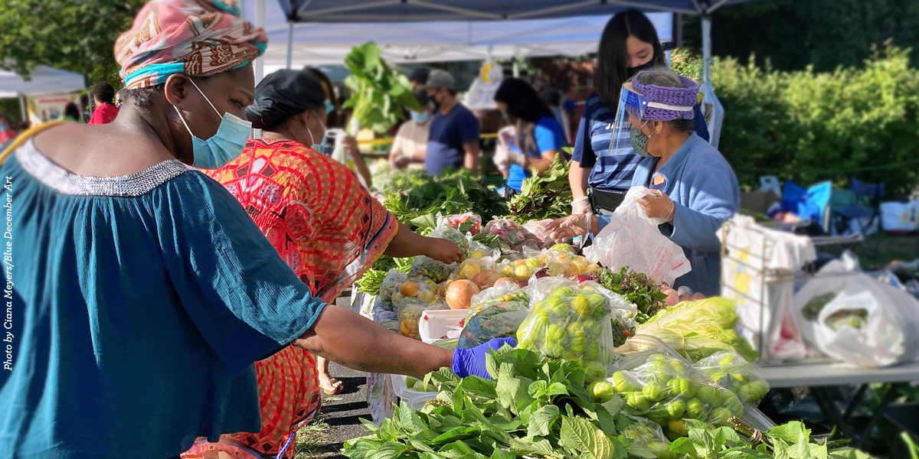
Resources to Support Food Security
Federal Programs
SNAP | Supplemental Nutrition Assistance Program
WIC | Special Supplemental Nutrition Program for Women, Infants, and Children
CACFP | Child and Adult Care Food Program
NSLP/ SBP | National School Lunch Program and School Breakfast Program
SFSP | Summer Food Service Program
 | Headstart
Rhode Island Programs
URI SNAP Outreach | toll free hotline:1-866-306-0270 https://web.uri.edu/endhunger/snap-outreach/
RI Community Food Bank | https://rifoodbank.org/find-food/
Food On the Move | https://riphi.org/food-on-the-move/
Farm Fresh RI | https://www.farmfreshri.org/programs/farmers-markets/
4/20/23 Prepared by Care Transformation Collaborative of RI
Notes:
Many resources exist to support healthy growth and development during childhood and adolescence. The following Government programs play an essential role in providing access to healthy meals and educational resources to support healthy dietary patterns for all children and adolescents.
The Supplemental Nutrition Assistance Program (SNAP) provides temporary benefits to families with qualifying incomes for the purchase of foods and beverages. About one-half of all SNAP participants are children.
Households with young children may be eligible for the Special Supplemental Nutrition Program for Women, Infants, and Children (WIC). WIC can help families with limited resources meet their child’s nutritional needs by providing nutritious foods to supplement diets. WIC serves children up to the age of 5 who are at nutritional risk.
In childcare and afterschool settings, the Child and Adult Care Feeding Program (CACFP) can support the development of healthy dietary patterns. CACFP is a nutrition program that provides reimbursements for meals and snacks that align with the Dietary Guidelines to eligible children enrolled at childcare centers, daycare homes, and in afterschool programs.
School-age children can benefit from the National School Lunch Program and School Breakfast Program. The school meal programs can provide nearly two-thirds of daily calories, and therefore play an influential role in the development of a healthy dietary pattern.
Outside of the school year, the Summer Food Service Program (SFSP) fills the gap by ensuring that children continue to receive nutritious meals when school is not in session. The SFSP operates at sites in a community where children can receive nutritious meals in a safe and supervised environment.
Source: Characteristics of Supplemental Nutrition Assistance Program Households: Fiscal Year 2018. Available at: https://www.fns.usda.gov/snap/characteristics-supplemental-nutrition-assistance-program-households-fiscal-year-2018.

Slide 28
Addressing Barriers to Healthy Eating and Activity
Provide anticipatory guidance and educational materials on what and how to feed at each developmental stage.
Refer to specialists depending on the family’s need for additional education or support
Certified Lactation Counsellor
Registered Dietitian
Behavioral health specialist
Community programs for non-competitive, cooperative, fun aerobic, and nonaerobic activity.
Advocate for policies that support healthier environments!
4/20/23 Prepared by Care Transformation Collaborative of RI

Slide 29
Links
Find breastfeeding support
https://lllusa.org/locator/
https://www.womenandinfants.org/services/pregnancy/feeding-your-baby
Find a dietitian
https://www.eatrightri.org/rdn.html
Find a mental health provider
https://zencare.co/us/rhode-island/therapists/specialty/child-mental-health
Find physical activity opportunities
https://health.ri.gov/healthyweight/about/physicalactivity/
https://ymcagreaterprovidence.org/
http://www.bgcri.org/
4/20/23 Prepared by Care Transformation Collaborative of RI

Slide 30
Contact information
Katelyn Fox Ph.D., R.D.
Katelyn_fox@brown.edu
4/20/23 Prepared by Care Transformation Collaborative of RI

Slide 31
References
U.S. Department of Agriculture and U.S. Department of Health and Human Services. Dietary Guidelines for Americans, 2020-2025. 9th Edition. December 2020. Available at ¹.
Dietary Guidelines Advisory Committee. 2020. Scientific Report of the 2020 Dietary Guidelines Advisory Committee: Advisory Report to the Secretary of Agriculture and the Secretary of Health and Human Services. U.S. Department of Agriculture, Agricultural Research Service, Washington, DC. https://www.dietaryguidelines.gov/sites/default/files/2020-07/ScientificReport_of_the_2020DietaryGuidelinesAdvisoryCommittee_first-print.pdf
Savage, J. S., Fisher, J. O., & Birch, L. L. (2007). Parental influence on eating behavior: Conception to adolescence. Journal of Law, Medicine and Ethics, 35(1), 22–34. https://doi.org/10.1111/j.1748-720X.2007.00111.x
Wood, A. C., Blissett, J. M., Brunstrom, J. M., Carnell, S., Faith, M. S., Fisher, J. O., Hayman, L. L., Khalsa, A. S., Hughes, S. O., Miller, A. L., Momin, S. R., Welsh, J. A., Woo, J. G., & Haycraft, E. (2020). Caregiver Influences on Eating Behaviors in Young Children. Journal of the American Heart Association, 9(10). https://doi.org/10.1161/JAHA.119.014520
2018 Physical Activity Guidelines Advisory Committee. 2018 Physical Activity Guidelines Advisory Committee Scientific Report. Washington, DC: U.S. Department of Health and Human Services, 2018.
Lara H. Mossman, Gavin R. Slemp, Kelsey J. Lewis, Rachel H. Colla & Paul O’Halloran (2022) Autonomy support in sport and exercise settings: a systematic review and meta-analysis, International Review of Sport and Exercise Psychology, DOI: 10.1080/1750984X.2022.2031252
Council On Community Pediatrics, Committee On Nutrition, Gitterman, B. A., Chilton, L. A., Cotton, W. H., Duffee, J. H., Flanagan, P., Keane, V. A., Krugman, S. D., Kuo, A. A., Linton, J. M., McKelvey, C. D., Paz-Soldan, G. J., Daniels, S. R., Abrams, S. A., Corkins, M. R., de Ferranti, S. D., Golden, N. H., Magge, S. N., & Schwarzenberg, S. J. (2015). Promoting Food Security for All Children. Pediatrics, 136(5), e1431–e1438. https://doi.org/10.1542/peds.2015-3301
Hager, E. R., Quigg, A. M., Black, M. M., Coleman, S. M., Heeren, T., Rose-Jacobs, R., Cook, J. T., Ettinger de Cuba, S. E., Casey, P. H., Chilton, M., Cutts, D. B., Meyers A. F., Frank, D. A. (2010). Development and Validity of a 2-Item Screen to Identify Families at Risk for Food Insecurity. Pediatrics, 126(1), 26-32. doi:10.1542/peds.2009-3146.
4/20/23 Prepared by Care Transformation Collaborative of RI

Slide 32
Pediatric Weight Management ECHO® Case Presentation
Presenter: Casey Sardo, RD, LDN, CDOE
Date: 4/20/23
Contact Info: csardo@tricountyri.org
PLEASE NOTE: Project ECHO case consultations do not create or otherwise establish a provider-patient relationship between any clinician and any patient whose case is being presented in a project ECHO setting
Prepared by Care Transformation Collaborative of RI

Slide 33
Reasons for Selecting this Case
Do Not Include PHI
Why did you choose this case? | We chose to highlight this case due to the patient’s past complex weight, social, and mental health history.
What questions do you have for the group? | -How to promote diet and lifestyle changes while being mindful of past trauma. -How to promote long-term diet and lifestyle changes in a pediatric patient with profound obesity since infancy/early childhood.
4/20/23 Prepared by Care Transformation Collaborative of RI

Slide 34
Basic Patient Information
Do Not Include PHI
Age | 15
Gender Identity | Patient identifies as a heterosexual female.
Race/Ethnicity | Black/African American; Non-Hispanic or Latino
Current Weight and Height | Weight: 377.00lbs (171.00kg) Height: 5’7 (~170cm)
 | Pt is 208% of the 95th%ile indicating class 3 obesity.
How long has the patient had concerning growth trends? | Pt’s Wt/Len was >99th%ile since 7-8months of age. At 2 years of age, pt’s BMI/Age was in the 100th%ile and continued to rise through the present.
How long has this individual been in your care? | She has been a patient of Tri-County since 4 days old. She engaged with BH in January 2023. She engaged in medical nutrition therapy in February 2023.
Insurance type (Commercial, Medicaid, Uninsured, Other) | Medicaid/NHP RI
Current BMI and BMI%/Obesity class
4/20/23 Prepared by Care Transformation Collaborative of RI

Slide 35
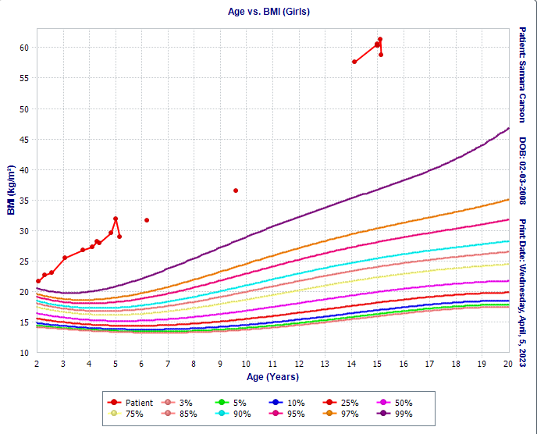
Growth Curve
Do Not Include PHI
4/20/23 Prepared by Care Transformation Collaborative of RI

Slide 36
Relevant Background
Do Not Include PHI
Relevant medical and/or behavioral comorbidities | Medical: Lifetime history of obesity, elevated blood pressure, acanthosis nigricans, and irregular menstrual bleeding. BH: Dx of Adjustment disorder with mixed anxiety and depressed mood-describes negative thought pattern, lack of motivation, restlessness, difficulty concentrating, difficulty managing mood, excessive worry at times.
Relevant medications | Loestrin (birth control)
Relevant lab results | January 2023: Normal TSH, Low Hgb (<10), HCT WNL
Relevant BH Screening results | 3/20/23 PHQ-A=1, GAD-7=6 (mild) 2/2023 PHQ-A=6 (mild)
Family constellation/SDOH Screening results | Pt and brother are in foster care with aunt (and uncle and cousin) since 12/22, DCYF became involved due to concerns of neglect Has weekly supervised visits with parents
4/20/23 Prepared by Care Transformation Collaborative of RI

Slide 37
Relevant Social History
Do Not Include PHI
Relevant obesity related family history? | Pt’s brother Unsure of other family hx
Family/patient history of trauma? | Bio- mother left family when patient was 7; Bio-fa hx of assault/strangulation of fiancé, legal involvement Patient witnessed violence and verbal abuse between parents Patient was a primary care taker for her younger brother; prepped meals/ordered out; no structure/no support re healthy eating
School related concerns? | Patient struggled in school, overall lack of motivation in school prior to beginning BH treatment.
Other social history concerns? | Pt has few friends/difficulty relating to peers.
4/20/23 Prepared by Care Transformation Collaborative of RI

Slide 38
Does the Patient/Family have a weight management goal? Please describe.
Do Not Include PHI
The pt’s aunt is very interested in healthy interventions for the entire family; admits that the entire family could benefit from improved diet and lifestyle practices.
Family Goals Include:
increased intake of fruits and veggies,
having the kids participate in grocery shopping,
at least 30-60 min exercise daily,
less fried foods, less “take-out” and more home-cooked meals.
4/20/23 Prepared by Care Transformation Collaborative of RI

Slide 39
Nutrition
Do Not Include PHI
What interventions have been tried? How responsive has the family been to nutrition interventions? | 1:1 w/ an RD for medical nutrition therapy since January 2023. “Health At Every Size” model of counseling and treatment. Personal meal plan outlining goals for fruit intake, veg, whole grains, lean proteins, healthy snack alternatives, etc. Pt Success slide has more info on this
What barriers have the family identified for improving nutrition? | Aunt: lack of time to prepare meals and the increasing cost of food.
Does the patient have any of the following: Excessive hunger Night-time eating or binging Sneaking food | Night-time eating and hx of binging. Pt states she “emotional eats” at times. Hx of sneaking food, but has since d/c’d.
Other concerns with nutrition/eating (such as cultural considerations)? | Patient formerly had a poor relationship with food. Was sneaking food and binging. Eating/preparing meals was a significant stressor for her. Through Medical Nutrition Therapy (MNT) and BH services, she is no longer sneaking food and has less stress surrounding eating/meals.

Slide 40
Physical Activity
Do Not Include PHI
What interventions have been tried? How responsive has the family been to physical activity recommendations? Does the patient engage in regular physical activity? (yes/no) Please describe. | -Pt takes 15 min walks 3-4 days weekly w/ friends or family. -Pt is going to the gym at least 2x/week w/ her aunt and family. -Pt participates in gym class. -Pt and family have voiced being unmotivated to remain physically active in the past, but are striving to foster healthier habits.
Is screen time a significant part of the patient’s social time? (yes/no) Please describe | -Pt reports 4-6 hrs screen time daily through phone, laptop, etc. -Pt uses social media often (viewing) s/a Tik Tok and Instagram.
Other concerns with physical activity/exercise (such as physical restrictions, access, environmental safety)? | -Pt’s body size makes it difficult for her to maintain moderate-intensity exercise. -Pt reports “chafing” and being uncomfortable with her body at times when exercising.
4/20/23 Prepared by Care Transformation Collaborative of RI

Slide 41
Were other approaches used for managing this patient?
Do Not Include PHI
Tri-County utilizes interdisciplinary collaboration (BH team and Registered Dietitian) to help the patient meet her nutritional and mental health goals. The RD and BH clinician collaborate to better understand the struggles and barriers the pt is facing and formulate improved action steps to address them.
4/20/23 Prepared by Care Transformation Collaborative of RI

Slide 42
Patient /Family Successes and Strengths?
Do Not Include PHI
Patient is engaged in OP BH tx (6 sessions since Dec. 2022):
Improved mood
Reduced stress overall while with aunt
Patient able to express emotions and process trauma, including journaling, relaxed breathing, and recently writing a letter to both of her parents
Pt has been improving at school and doing well academically
Meal times are calm and meals are now prepared by her aunt
4/20/23 Prepared by Care Transformation Collaborative of RI

Slide 43
Patient /Family Successes and Strengths?
Do Not Include PHI
Patient is engaged in MNT (3 sessions since January 2023)
Pt engages in goal setting.
No weight gain since January 2023. (Previously the patient was steadily gaining (>10-20lbs per year).
Salt intake, saturated fat intake, and refined carb intake has decreased while her intake of fruits, vegetables, and lean meats has increased.
Blood pressure has remained WNL since end of January 2023.
The family continues to support each other in diet and lifestyle change
Pt is now routinely followed up by GYN and primary care since being placed w/ her foster family
4/20/23 Prepared by Care Transformation Collaborative of RI

Slide 44
Summary & Clarifying Questions
4/20/23 Prepared by Care Transformation Collaborative of RI

Slide 45
Recommendations from the group
Has medication/surgery been discussed?
Yes, on the radar for the patient for when she gets older
Patient is informed of different options
Concern: Lack of exercise because it’s uncomfortable for her. Suggest anti-chafing products
Is sleep a concern? (no)
Trauma informed CBT may be useful
Suggest increase therapy to weekly, if possible
4/20/23 Prepared by Care Transformation Collaborative of RI
Notes:
IBH Clincian involved?

Slide 46
CME Credits (currently available for MDs, PAs, Rx, RNs and NPs)
Please provide us your feedback!
Evaluation/Credit Request Form: https://www.surveymonkey.com/r/PediWtMgmtCMEEvaluation
Please request CME credits when filling out the evaluation at the end of the meeting
The AAFP has reviewed ‘Advancing Community-Oriented Comprehensive Primary Care Through Improved Care Delivery Design and Community Health,’ and deemed it acceptable for AAFP credit. Term of approval is from 09/15/2022 to 09/15/2023. Physicians should claim only the credit commensurate with the extent of their participation in the activity.
NPs and RNs can also receive credit through AAFP’s partnership with the American Nurses Credentialing Center (ANCC) and the American Academy of Nurse Practitioners Certification Board (AANPCB).
4/20/23 Prepared by Care Transformation Collaborative of RI
Notes:
Linda

Slide 47
Announcements
Next Session: May 18th
Topic: Role of IBH clinician / PEDIPRN / Triage Care
Presenter: Sarah Hagin/All sites
4/20/23 Prepared by Care Transformation Collaborative of RI

Slide 48
Practice Name
Describe the PDSA your practice has been working on:
What is something you have found valuable in the project so far?
(Ex. implementation change)
4/20/23 Prepared by Care Transformation Collaborative of RI

Slide 49
4/20/23 Prepared by Care Transformation Collaborative of RI

