Slide 1
Fostering Job Foundation Supports between Employment Providers & School Partners
Dr. Cinda Johnson
Center for Change in Transition Services
Principal Investigator
cinda@seattleu.edu
Dr. Tania May
Office of Superintendent of Public Instruction
Director of Special Education
tania.may@k12.wa.us
January 18, 2022
Notes:
Thank you for the opportunity to meet with you. I am Cinda Johnson, Principal Investigator for the Center for Change in Transition Services, at Seattle University. I’m joined by my colleague Dr. Tania May, Director of Special Education, Office of Superintendent of Public Education.

Slide 2
Special Guest Speaker
Beth Sykes
Special Education Teacher, Transition Specialist
Wenatchee School District
sykes.bethanne@wenatcheeschools.org
Notes:
We have quite a bit to cover today in our short time together. We will share with you how transition services and Job Foundation aligns, Ideas and strategies to partner with district leaders and IEP case managers and then hear from our teacher partner, Beth Sykes.

Slide 3
Today’s Topics
How Transition Services and Job Foundation Align
How to Partner with District Leadership
How to Partner with IEP Case Managers
Strategies that Work
School Partner Voice
Notes:
We have quite a bit to cover today in our short time together. We will share with you how transition services and Job Foundation aligns, Ideas and strategies to partner with district leaders and IEP case managers and then hear from our teacher partner, Beth Sykes.

Slide 4
How Transition Services and Job Foundation Align

Slide 5
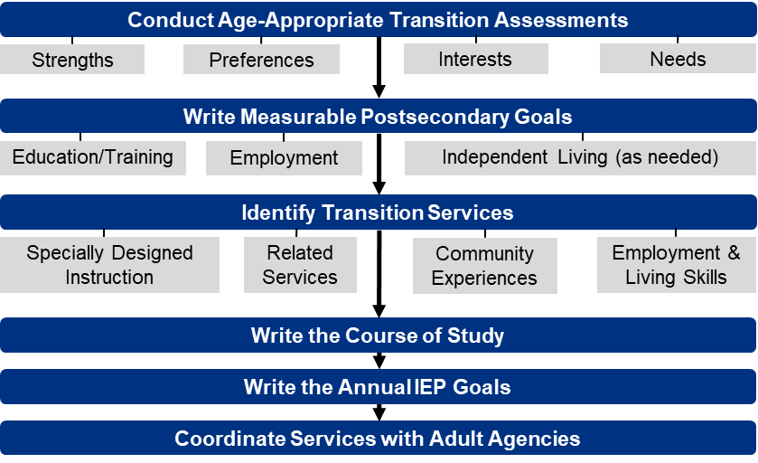
Transition Services Flowchart
(Johnson, 2004)
Notes:
In this slide, we see those transition components assembled into a flowchart.
Dr. Cinda Johnson, Principal Investigator at CCTS, developed this flowchart, which forms the underpinnings of all trainings at CCTS.
The flowchart also includes several subcomponents that have been added to the first three sections of the sequence.
In conducting the age-appropriate transition assessments, the purpose is to help the student identify their strengths, preferences, interests, and needs.
Under writing measurable postsecondary goals, there need to be goals written in the areas of education and training, employment, and if considered necessary by the IEP team, independent living.
And in the area of identifying transition services, specially designed instruction, any necessary related services, community experiences, and employment and living skills need to be addressed to support the progress toward reaching the student’s postsecondary goal.
The next step is developing a course of study for the student that includes not only courses that need to be completed for graduation, but also courses that lead to their post-school goals.
The course of study also includes coordinated experiences in school and the community that enhance the student’s learning and preparation for their postsecondary goals.
Next, annual goals are written that connect to the postsecondary goals and lead the student to achieving those goals.
Lastly is the identification, coordination, and planning for agency connections to support the student as they leave the school system.
You can find more information on the CCTS website: www.seattleu.edu/ccts

Slide 6
Job Foundation Report Components Directly Maps to IEP Transition Services!
Communication Skills
Interactive Social Skills
Self-Advocacy Skills
Task Management Skills
Work Interest Exploration
Critical Documents & Enrollments
Notes:
When a youth is served through Job Foundations, a series of assessments and information is gathered in order to develop a report that reviews the following skills:
Communication Skills
Interactive Social Skills
Self-Advocacy Skills
Task Management Skills
Work Interest Exploration
Critical Documents & Enrollments
All of these components directly relate to transition services outlined on the Flow Chart. Information gathered from the reports generated from Job Foundation can provide valuable information as part of the transition assessments, identifying post-secondary goals and providing transition services.

Slide 7
How to Partner with District Leadership

Slide 8
The Role of District Leadership in the Job Foundation Project
District partners can support information sharing about Job Foundation with students, families, and school staff.
School districts can facilitate provider access to educational and, as appropriate, health records, in line with local safety policies and procedures, including signed release of authorization from families.
Note that participation in Job Foundation is driven by individual student and family choice.
Notes:
Start with the district leadership. Introduce yourself and Job Foundation. This may be a special education director, a principal, or, in smaller districts, a superintendent.

Slide 9
How Employment Providers Can Partner with District Leadership for Job Foundation (1 of 1)
Start with the district leadership! This may be a special education director, a principal or, in smaller districts, a superintendent.
  Special Education Directory
Introduce yourself and the Job Foundation project.
  County Best Practices
  Job Foundation Information Brief for School Partners
  Job Foundation Project Overview for School Partners
  Job Foundations for School Partners
Notes:
This includes resources to help connect with district leadership.

Slide 10
How Employment Providers Can Partner with District Leadership for Job Foundation (2 of 2)
Inform district leadership that you will be requesting documentation and information from IEP case managers.
  Strategy for having a communication or welcome packet ready, with consent forms, for example.
  Ask district leadership to facilitate your meeting or connection with teacher(s).
Notes:
Tania

Slide 11
How to Partner with IEP Case Managers

Slide 12
The Role of IEP Case Managers in the Job Foundation Project
Communicate with DDA-eligible students and families about the job foundations opportunity and process.
Facilitate access to educational and health records (with written authorization) and observation of participating student.
Examples could include in-person instruction, online classes, work sites, community access, etc.
Notes:
So where do the Case managers fit into this?
Communicate with DDA-eligible students and families about the job foundation opportunity and process.
Facilitate access to educational and health records (with written authorization) and observation of participating student.
Examples could include in-person instruction, online classes, work sites, community access, etc.

Slide 13
How Employment Providers Can Partner with IEP Case Managers for Job Foundation
Identify and meet the teachers who work directly with perspective students.
  Strategy for having a communication or welcome packet ready, with consent forms, for example.
  Highlight how the Job Foundation report can inform IEP transition planning.
Introduce yourself and the Job Foundation project.
  County Best Practices
Inform IEP case managers of the Job Foundation timeline, activities, and report development.
  Job Foundation Information Brief for School Partners
  Job Foundation Project Overview for School Partners
  Job Foundations for School Partners
Notes:
Tania

Slide 14
Strategies that Work

Slide 15
What Strategies Can Help Employment Providers Partner with the School System?
Relationships – building rapport and trust.
Focus on how Job Foundation supports and informs the IEP transition process (and isn’t just more work to do!).
Leverage students and families! Consider developing an information packet with talking points to support IEP team discussions.
Notes:
Cinda – building relationships involves creating rapport and trust. School partners will appreciate your expertise and any way that you can help them support students in the transition process.
I’d like to introduce Beth Sykes from Wenatchee School District who will share a bit of her experiences and insight in this work.

Slide 16
School Partner Voice
Beth Sykes, Wenatchee School District

Slide 17
Tips from the Field (1 of 2)
Learn about the available programs in your county!
Provide information about student interests.
Help students identify strengths and needs.
Maintain flexibility in scheduling.

Slide 18
Tips from the Field (2 of 2)
Working with Families
  Have a meeting to introduce the community partners who will be providing services.
  Encourage self-advocacy.
  Prepare items for students to be successful in advocacy with service providers and employers.

Slide 19
What Successes or Barriers are Employment Providers Experiencing within the School System?
Notes:
With the time we have left we’d love for you to add anything in the chat box to share your successes or barriers with us. If you have questions, we haven’t had time to answer please reach out to us!

Slide 20
Thank you!
Let us know if you have questions!
Dr. Tania May, tania.may@k12.wa.us
Dr. Cinda Johnson, cinda@seattleu.edu
Center for Change in Transition Services

