Slide 1
6/14 SUNY Library Services Platform Project Update
Shannon Pritting,
SUNY Shared Library Services

Slide 2
Banner-Alma Integration Update
Banner patch/SICAS application now available to all SICAS member campuses.
SUNY will support Alma integration when you have an XML file to test.
We’re happy to set up a meeting with you if desired; we’ve done this with several campuses.
Or, we can work with you via e-mail.
SICAS will support the Banner application.
Please use their Service Now portal to submit requests/issues.
Your IT contact has been getting updates on issues encountered, so the cycle to get to test loading should be shorter than just a few weeks ago.
11 Banner campuses have tested SIS integration; 16 total.
About 5-6 more are very close to having this set up.
Please reach out to us before testing SIS synchronization in your live Alma environment.
Recommend testing with small file of test patrons if you haven’t completed SIS in your test load environment.

Slide 3
Primo Speed and Responsiveness
Meeting with VP of discovery at ExLibris, to identify how to continue to engage on speed.
ExLibris released speed enhancement to all environments last week.
Exlibris discovery team indicates some speed improvements will come as result of going live.
SUNY and SLC Discovery WG is still working to monitor and escalate speed issues to continue to improve performance.

Slide 4
Resource Sharing Roll Out Plan
Developed by ASRS and approved by LSP TF.
Campuses will go-live in borrowing at their Alma/Primo live date (unless they choose to change this themselves).
How to turn off borrowing: https://slcny.libanswers.com/faq/266453
Small percentage of campuses live in lending at their go-live.
Only Buff State and Brockport currently live in lending.
Remainder of campuses go live in lending throughout July and into early August.
Link to Overall Plan:
https://slcny.libguides.com/ld.php?content_id=48366964
Link to Schedule of campuses going live on lending:
https://docs.google.com/spreadsheets/d/1jTBxs4gTb5QmKjCUdV6k2CLxBiqUaxTt_Mxc6Y9vHTo/edit#gid=0
Conducted several RS sessions before cutover began, and will work with campuses to help them go-live with RS lending.

Slide 5
Resource Sharing Rollout Rota Management
Rota Management from June 13 – July 7:
Only 10 campuses will go live with RS lending on their Alma go live date
Single rota for all of SUNY distributed from NZ
Resource sharing partners for campuses not live on lending will be set to inactive in NZ
Single rota assignment rule distributed from NZ
Rota Management from July 8 – August 5:
Remaining campuses will go live with RS lending in phases starting July 8
Three rotas based on ELD hubs (East, West, NYC) distributed from NZ
Resource sharing partners will be switched from inactive to active in NZ as campuses go live with lending
Three rota assignment rules configured in IZ
SSLS will configure rota assignment rules for each campus and then and order them based on the campus’ location

Slide 6
How to handle requests for items held by non-lenders
Items held by all libraries in group 1 and some libraries in group 2 are currently visible in Primo, and users can submit requests for those items
Alma will attempt to locate requested items only at libraries that have started lending (Buffalo State and Brockport)
If Alma does not find a requested item at a library that has started lending, it changes the status of the request to “Locate Failed”
Three options for handling requests with a “Locate Failed” status:
Auto-cancel requests when the locate process fails
Manually cancel requests after the locate process fails
Hold requests and rerun the locate process after more libraries have started lending (Binghamton, Cobleskill, Cortland, and Geneseo will start lending next week)
For more details on each option, please see https://slcny.libanswers.com/faq/266728

Slide 7
ILLiad Email Import Feature Update
Requests that cannot be filled within the Network Zone can be transferred from Alma to ILLiad for fulfillment via ILLiad’s email import feature
The email import feature adds =09 to the end of every value it imports if the publication date field contains a copyright symbol
Testing has revealed that this is an issue for approximately 25-30% of requests
If you are experiencing this issue, please contact OCLC Support
https://www.oclc.org/en/contacts/support.html
A second option for transferring requests from Alma to ILLiad is to send the user a cancellation email containing an OpenURL link to ILLiad that will auto-populate an ILLiad request form
An FAQ on how to add this OpenURL link to the Alma cancellation notice will be posted soon

Slide 8
Support Review and SUNY Shared Library Services
www.suny.edu

Slide 9
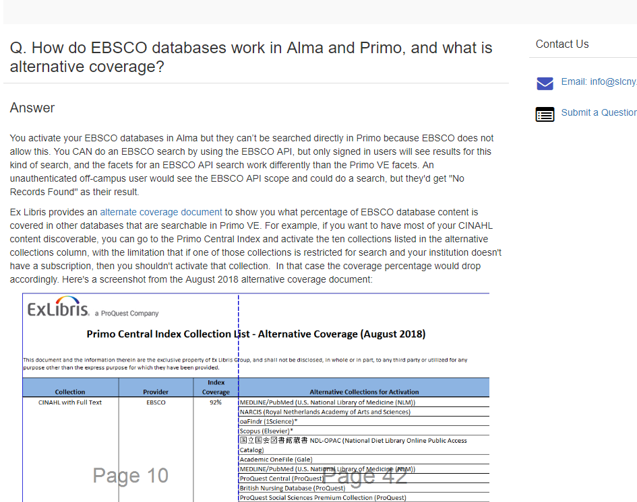
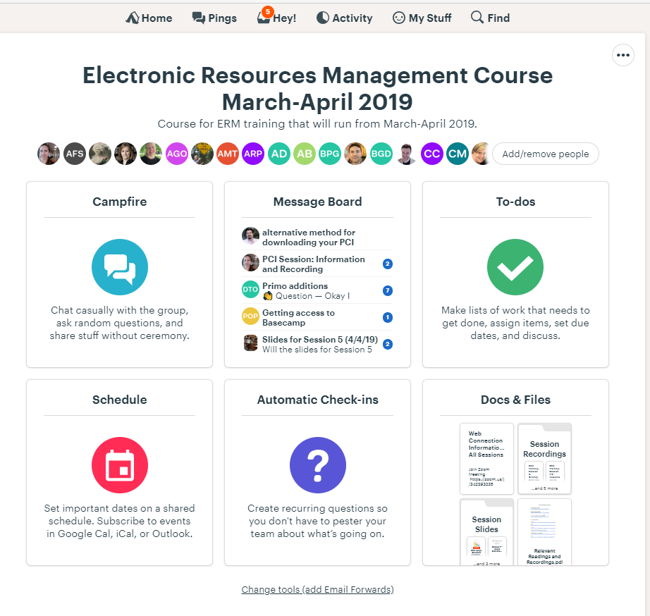
Surge of Training and Support
16 Full Days of In-Person training
400 Documented Workflows
Over 225 Hours of Large Group Webinars Provided
175 Hours of One-on-One sessions focused on E-Resources
125 Hours of Small-Group sessions for campuses needing extra assistance
175 Certifications (100 Total System 75 Discovery)
6 Courses in areas of librarianship developed
Roughly 50-75 questions per day monitored and answered by 4 vendor consultants and 4 SUNY staff.
www.suny.edu

Slide 10
Why Develop a Shared Service for SUNY Libraries?
Sustainable
Combining System and Campus Funding.
Organizational and Financial Infrastructure and Oversight.
Responsive
Able to respond to needs of campuses and system.
Review of initiatives for usefulness and satisfaction.
Scalable
SLSS focus on System-Campus partnership to develop financially stable yet efficient services.
Ability to accept requests for new services.
System-Empire partnership will allow growth if there are funds committed for programs.
Allows for more flexibility of services that are beyond or outside of “core” all-SUNY initiatives.
Services are mix of System and Campus funds and oversight, which may insulate from drastic and abrupt changes from either side.
www.suny.edu

Slide 11
SLSS Base Services
Offers high level support for new library technology
SLSS will provide general support and point libraries to FAQs or documentation with documentation on how to resolve their question/issue.
Issues related to NZ level configuration or functionality will be reviewed and resolved if possible.
Occasional all-SUNY webinars on Alma topics.
High-level vendor management with ExLibris
Configuration and maintenance of Network Zone functionality (does not extend to hosting e-resources in NZ on behalf of campuses or groups).
Limited support for SLC working groups to facilitate best practices and collaborative initiatives.
Creation of SUNY specific documentation and best practices
Communication about new Alma features, functionality, and resolution of known issues
www.suny.edu

Slide 12
FT Staffing for SLSS Base Support
SUNY Shared Library Services Director (Shannon)
Discovery and E-Resource Manager (Michelle)
Sr. Alma Support Specialist (Gail)
Logistics and Communications Support (Karen)
NZ Coordinator (Maggie)
Resource Sharing Program Manager (Tim)
Coordinator of Training Development (1-Yr Temp Contract Position)
Procurement, Contract, & Vendor Management (Position Description Being finalized)

Slide 13
Future Goals + Structure Library Shared Services
STRATEGIC PLANNING & MANAGEMENT
OPERATIONAL SOLUTIONS AND SUPPORT
OLIS
Library Services Platform
SUNY OER Services
Policy development
SUNY Provost Liaison
Fiscal Agent
Procurement
Contract & Vendor Management
Innovation Funding
Partnership Development
CORE PRINCIPLES AND SERVICES
Change Management
Investment in Innovation
Managed Technology Solutions
Training and Professional Development
Campus Engagement
E-Resource Management
Metadata Services
System Analytics
Managed Hosting Solutions
Discovery
Resource Sharing
Training
Curated OER Catalog
Faculty and Professional
Development
Consultation Services:
Sustainability
Change Management
ADVISORY BODIES
SLC Board
OER Advisory Council
www.suny.edu

Slide 14
2 years of seed Funding Starts July 1.
After 2 years, library community needs to increase contribution to shared service
We will build the system as a shared SUNY Libraries system, with the understanding that not all campuses will want to nor be able to participate at all levels
Within the next year we will determine the full suite of extended shared library services we will offer. Costs will be included for these additional services
The SLC Board and the LSP Task Force will advise us on the services
www.suny.edu

Slide 15
Current Campus Investment: $235,000.
Current System Investment:
$275,000
SUNY Libraries need to decide by 10/2020 if new recharge or system will use Subsidy to cover additional costs.
Extended Services Offered at Additional Cost
www.suny.edu
Notes:
Mark’s Comments from similar slide:
lets change icons and use this to show the funding.
1st icon, Current campus investment $235k
2nd icon System investment $275k per year to make base package whole
3rd icon, Extended services will be offered to campuses at an additional cost
4th icon, library community will need to decide by October 2020 if they want new recharge or us to use the current SUNY Connect subsidy. If decision can't be made we will use subsidy.

Slide 16
SUNY Library Shared Services Optional Extended Services
Campuses must agree to MOU with funding agreement.
No 2-year subsidy as with base support.
Costs developed and will be shared soon.
If you’re interested in learning more, let us know.
General Services Offered in near future:
Comprehensive Management of Alma/Primo for campuses.
Workflow, training, and metadata consultation services.
Analytics consultation services.
Other services will be shared very soon.
www.suny.edu

Slide 17
Cutover Update
We’re almost there……

Slide 18
Where to send issues when you’re in the cutover cycle
ExLibris Cutover listserve:
SUNY-Cutover@exlibrisgroup.com
SUNY listserve:
slc_lsp@suny.edu
Both listserves continuously monitored.

Slide 19
Group 1 Lessons Learned
Data Review Period: Look, but don’t touch.
From period of Alma release to acceptance of data:
Review data and file salesforce cases
Don’t update Alma, which includes:
No updating bib, user, or other records via jobs or record by record editing.
Most testing of functionality includes updating records, so the data review is intended to just review data, not test Alma functionality.
If you need to change staff users to allow them to test data, that’s fine.

Slide 20
Go-Live Process
Data Review Period Alma
1. Alma Environment Released to Inst. Lead.
2. Campus Reviews Data (At least 2 days provided).
3. Issues report via SF/Email and either resolved, or solution identified.
4. Campus accepts data via e-mail.
Data Review Period Primo VE
1. Primo VE Environment Released to Inst. Lead.
2. Campus Reviews Primo VE data (at least 4 hours).
3. Issues report via SF/Email and either resolved, or solution identified.
4. Campus accepts Primo via e-mail, and is set to go-live.
Go-Live Process
1. Alma and Primo Environments Accepted.
2. ExLibris goes through Go-Live Process and turns on jobs, unscrubs emails.
3. Campus is live in morning.
4. Campus emails ExL/SUNY that they are live and circulating in Alma.

Slide 21
What Responses We Need from Campuses
Response/Reply to our email that you have received our notice that your Alma environment has been delivered.
Read receipt is okay.
Notification if there are issues: submit via case.
Notification when you accept Alma data.
This is email to let ExLibris know not to turn on certain jobs.
Response/Reply to our email that you have received our notice that your Primo VE environment has been delivered.
Read receipt is okay.
Notification when you accept Primo VE environment.
Notification when you have begun circulating in your live Alma environment

Slide 22
What’s the Go-Live Process?
After you accept your data, and the night before you go-live, ExLibris will turn on scheduled jobs to run overnight, and run prep. jobs so that your site will be live in the morning.
If you don’t want any jobs to be enabled, please indicate in your acceptance email.
ExLibris will review your jobs, but it’s best if you make explicit what you don’t want turned on.
SUNY has requested that these jobs are turned off for all SUNYs until we determine how we’ll approach as a system:
Authorities - Link BIB Headings
Authorities - Preferred Term Correction

Slide 23
Data Review Reminders
Reserves will migrate unless you have deleted records.
Special Parameters for Proquest, Gale, etc. should be added by campus.
Need to wait until your data is accepted. Can do this between data acceptances and your go-live or at go-live.
User email address will still be “scrubbed” until go-live process/job unscrubs them.
Collection Proxy is at the service level—we made this mistake.
Most of your users will come over as external—which means you can’t reset pw.

Slide 24
Some Common Things to Look For that Came Up in Group 1
These may be resolved before you’re in the go-live cycle.
Gale linking issues
Course Reserves indexing lag in Primo VE
Reviewing whether there are other publishing lags or whether part of group 1 overall publishing cycle.
Depending on when your environment is loaded, your analytics may not be ready yet.
We want to release environments quickly, so will send as soon as they’re ready and won’t check analytics.

Slide 25
Offline Circulation
Results of Group 1 campuses are generally:
It’s likely there will be errors, but these don’t seem to be difficult to resolve.
If you’re using more than one workstation, make sure that you combine the file and sort transactions by timestamp.
Must wait until data is reviewed and accepted before loading offline circulation file.

Slide 26
Go-Live Process Report: Buffalo State
Joe Riggie

Slide 27
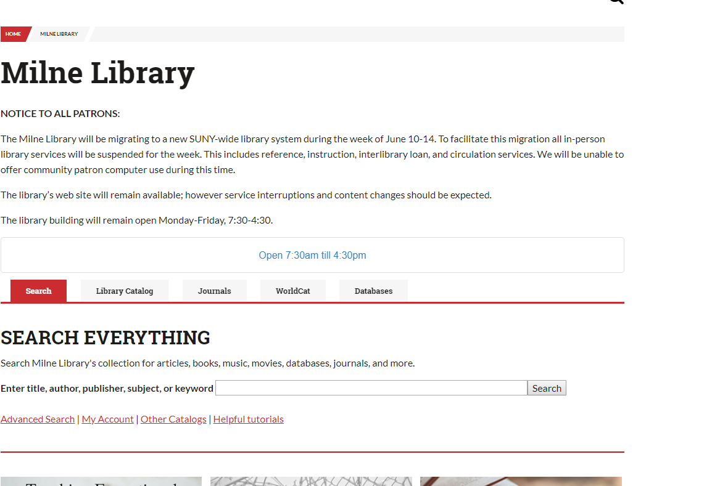
Go-Live Process Report: Oneonta
Maggie McGee

Slide 28
Questions

