Slide 1
Learning Session 6:
Celebrating Success & Sustaining Healthy Changes
Enter Coach Name(s)
Notes:
Welcome to Learning Session 6: Celebrating Success.
Coaches, depending on the number of ECE programs that are participating in your learning collaborative, you may need to extend the time of this Learning Session or schedule another Learning Session so everyone will have ample time to share their Storyboards.

Slide 2
Agenda
Welcome & Introductions
Review Group Norms
Storyboards
Sustaining Your Food and Farming Education Activities
Next Steps – Final Action Period
Notes:
Here is a quick snapshot of how we will spend our time together today.
Read aloud the agenda items.
Please remind participants that they can follow along with the slides during the Session.

Slide 3
Group Norms
Notes:
Share the Group Norms in the chat box and add them to this slide. These are the Group Norms you created in the Orientation Session with this group. Ask anyone if they have any questions or additions.
In our Orientation Meeting we created Group Norms to help guide our discussions. I will review them briefly now. If you have any additions or questions, please share those with the group.
A few suggestions are listed below. Having around 5 group norms is a good goal.
Be on time.
Respect other members of the learning collaborative at all times.
Speak 1 at a time without interrupting.
If something is unclear, ask.
Imagine the other person’s point of view.
Assume good intentions. Listen with respect.
Everyone has something to share. Be sure to share while also making space for others to share.
Share stories and tips with one another. Stories and experiences shared here are confidential.
Accept that each individual participating in the Session will be managing different circumstances in their environment.
Assume technological glitches will happen.
Adhere to agreements on using cameras and muting when possible.
We are going to start with an Icebreaker.

Slide 4
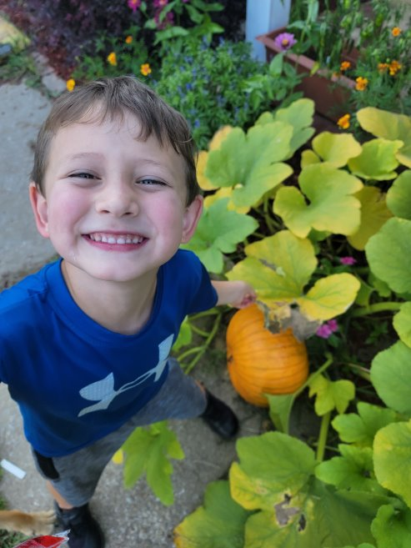
Learning Objectives
Participants share Storyboards, including successes and lessons learned.
Explore ways to sustain ECE program food and farming education activities.
Discuss next steps to finish up the Food and Farming Education Learning Collaborative.
Notes:
Review learning objectives with participants.

Slide 5
Food and Farming Learning Collaborative Structure
Session 1: Food and Farming Education Introduction
Session 2: Food and Farming Education Benefits
Session 5: Family Engagement
Session 6 : Celebrating Success & Sustaining Healthy Changes
OR
Action Period
LS 3&4
Action Period
LS 5&6
Action Period
Session 3: Nutrition Education
Session 4: Farming and Agriculture Education
Notes:
We are now at Learning Sessions 6! Today we will spend our time hearing from you all! Each of you will have an opportunity to share about your Storyboards and the great work you did throughout this learning collaborative. We can’t wait!
Coaches, depending on the number of participating ECE programs, you may want to consider extending the time of this Learning Session or hosting an additional Learning Session so all programs will have enough time to present.

Slide 6
Storyboards
Notes:
Most of our time today will be spent hearing from you all about the progress you have made to create or expand your program’s garden! We are excited to hear about all you have learned, including your successes and lessons learned!

Slide 7
Learning Session 6 Storyboards
Notes:
It is helpful to share the order of ECE program’s that will be sharing during today’s Learning Session. We suggest having the participating programs to share their Storyboard slides with the Coach in advance. Adding all of the Storyboard slides to this PowerPoint will create a more seamless session with fewer technology issues.

Slide 8
Sustaining Your Food and Farming Education Activities
Notes:
Before we end out session today, we’re going to walk through an activity to help you reflect on your experience of incorporating Food and Farming Education activities into your program and to plan for how to sustain and build on these activities.

Slide 9
What are your key takeaways?
Notes:
This is the key takeaways document was shared during Learning Session 4 and can be found in the Resource Guide.
Ask participants: How have you used this handout to share with staff and families what you've been doing during this learning collaborative?
Remind participants if they haven't already, to share this key learning with staff and families.

Slide 10
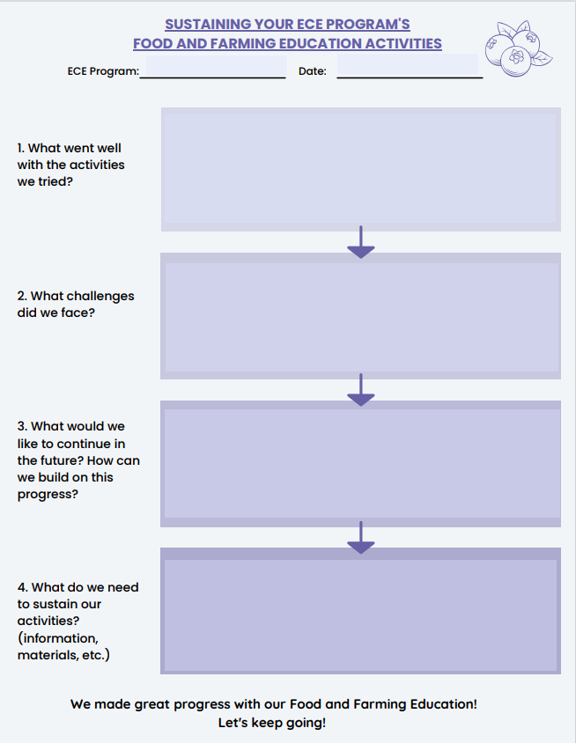
How can you sustain your program’s food and farming education activities?
Notes:
It will be helpful for you to work together with your Leadership Team to talk through the questions on this handout. Let’s go through the questions together.

Slide 11
What went well with the activities you tried?
Notes:
Discussion Prompt: What went well with the activities you tried at your program during the learning collaborative? We just heard from everyone about all of the successes that you had so far. It will be great to write some of those down. Document them and build on your success.

Slide 12
What challenges did your program face?
Notes:
Discussion Prompt: What challenges did your program face? Which challenges have you been able to overcome? Are there some challenges that you gave up on trying to find a solution?

Slide 13
What would you like to continue in the future? How can you build on this progress?
Notes:
Discussion Prompt: What would you like to continue in the future? How can we build on this progress?

Slide 14
What does your program need to sustain your food and farming education activities? How can your program further engage families in this work?
Notes:
Discussion Prompt: What does your program need to sustain your food and farming education activities? How can your program further engage families in this work? Consider:
Information you may need
Materials that you need
Support from community partners

Slide 15
Reflection
Notes:
Discussion Prompt: How will you use this handout to share your key learnings and to develop a plan to sustain and expand your ECE program’s food and farming education activities?
What stood out to you from the Storyboard presentations today? What’s something you heard that you’d like to try?

Slide 16
Resources

Slide 17
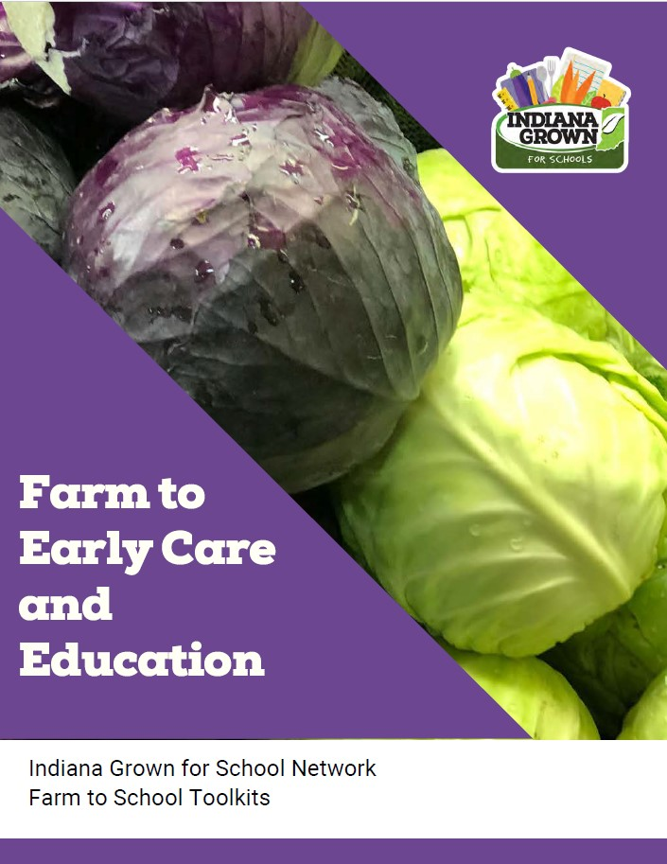
Indiana Specific Resources
Indiana Farm to Early Care and Education Toolkit
Indiana Grown: School Gardens
Purdue University Cooperative Extension
Notes:
https://www.ingrown4schools.com/farm-to-ece

Slide 18
Next Steps

Slide 19
Final Action Period
Session 1: Food and Farming Education Introduction
Session 2: Food and Farming Education Benefits
Session 5: Family Engagement
Session 6 : Celebrating Success & Sustaining Healthy Changes
OR
Action Period
LS 3&4
Action Period
LS 5&6
Action Period
Session 3: Nutrition Education
Session 4: Farming and Agriculture Education
Notes:
We hope that you learned a lot during Learning Sessions 5 and 6. Hearing you all share about the progress you have made during this Learning Collaborative is really inspirational! Let’s chat about the final steps we need to take before we finish the Learning Collaborative.

Slide 20
Action Period Tasks
Meet with Coach for final TA visit.​
Finish working through your program’s action plan steps.
Create two additional action plans to keep making progress.
Check the resources shared during the Learning Collaborative.
Complete the Farm to ECE self-assessment again by *insert date*
Notes:
Coaches should review and update the “Action Period Tasks” slides at the end of each Session to ensure accuracy, align tasks with your Learning Collaborative timeline, and reduce repetitive tasks.

Slide 21
Key Dates
Final Technical Assistance “visit”: ____
Final Action Period dates:
Action Period 3:
Notes:
Coaches should add in dates for all upcoming sessions.
Review the timeline. Share dates for all Learning Sessions so providers will know what to expect and to reduce barriers to participation. Be sure to provide a list of actions for each program to complete before and after each Learning Session. The goal is to ensure participants know when they need to complete each action item.
Today was our final Learning Session! Now we will begin our final Action Period, and you will complete a few final tasks, which includes creating 2 additional action plans to keep making progress.

Slide 22
Questions?

Slide 23
Coach Information
Insert Coach Contact Information Here

Slide 24
Coach Reminders
After Session 6, coaches should:
Meet with ECE programs and provide TA to help “complete” their action plans.
Help programs create two additional action plans to keep making progress.
Ensure participating programs complete the Farm to ECE self-assessment again by *insert date*
Share any final resources.
Notes:
This “Coach Reminder” slide gives you, the coach, reminders for the Action Periods and next steps for facilitating the Learning Collaborative. They are hidden in the PowerPoint. They are not intended to be shared with ECE providers. Do not include them in any printed versions of the slides you provide to ECE providers.
After Session 6, coaches should:
Meet with ECE programs and provide TA to help “complete” their action plans.
Help programs create two additional action plans to keep making progress.
Ensure participating programs complete the Farm to ECE self-assessment again by [insert date].
Share any final resources.

