Slide 1

SUNY Library Services Update
January 15th, 2021
www.suny.edu

Slide 2

Transition from Basecamp and Listserves to Workplace
In the next few weeks, OLIS will be transitioning its communication channels from listserves and Basecamp to Workplace.
Goal is to transition by January 31, 2021
Will be developing communication to different groups in Basecamp
Will continue to use Basecamp for internal collaboration with extended support and working groups.
To see Workplace, go to: sunyedu.workplace.com
OLIS will facilitate transition of groups, but please notify staff of this transition.

Slide 3

What SLS Related will stay in Basecamp, and What’s Moving to Workplace?
SLC Working Groups
Short-Term Projects Already Underway, Ex:
  Expanding System-Wide Library Agreements
  Ebook DDA Pilots
Specific Campus Extended Service Coordination
SUNY/SLC HQ
Institutional Leads
Will Decide on Dormant Groups in Basecamp, Ex:
  SUNY Instruction Resources for Primo
  COVID 19 Library Response and Planning

Slide 4
But there is good information on Basecamp in the HQ, will I lose access?
We’ll archive the Basecamp groups that we’re migrating to Workplace, which means that you can access information, but won’t be able to post new information.
Taking the same approach as Ex Libris did with our Implementation basecamp.

Slide 5
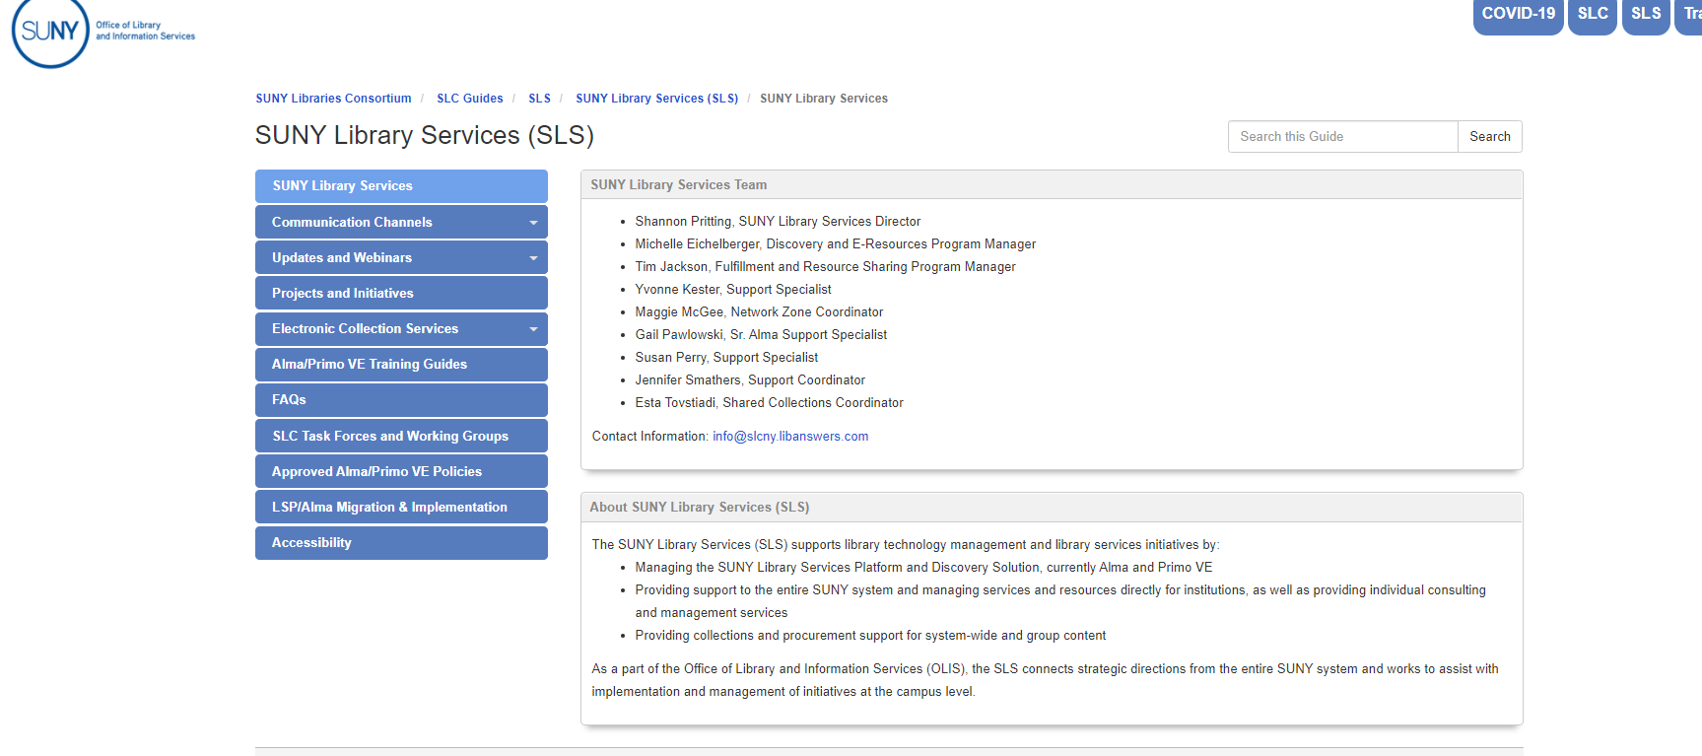
Will this transition affect Libanswers or Libguides?
SLS will continue to maintain the SLS libguides, including training guides, and also to create and maintain FAQs and answer appropriate questions via Libanswers.
We may coordinate further clean up of SLC content, but no major changes are planned at this point.
https://slcny.libguides.com/sls

Slide 6
Where can I learn more and how will we know where/when groups will be moved?
2 webinars by Kelly Williamson, SUNY Workplace Coordinator scheduled.
  Dates/Registration Info. shared soon
Specific details about where groups will be moving and how to access Workplace groups will be shared within the existing channels/platforms/listserves.
https://slcny.libguides.com/sls

Slide 7
SUNY Library Accessibility Cohort
Completed VPAT Reviews and Top-Level Testing of about 20 of the ~80 most commonly e-resources in SUNY.
  https://slcny.libguides.com/vendor_accessibility
Repository updating would be a project that would address every 1-2 years as needed.
Working with Cohort to finish reviews for the remaining commonly held resources.
Will be developing update presentations as soon as possible (anticipated in February).
SLS will need to address/respond to needs expressed by campuses that would best be addressed as a shared service, rather than cohort.
Future of Cohort or Working Group being discussed, with remaining work in second half of the group’s time being defined now. Future cohorts/working groups being reviewed—and reviewed as desired professional development need or interest in collaborative work.

Slide 8


Procurement Update
OCLC
IT Umbrella
Direct Linking Service

Slide 9

Discovery & E-Resources
Michelle Eichelberger
www.suny.edu

Slide 10
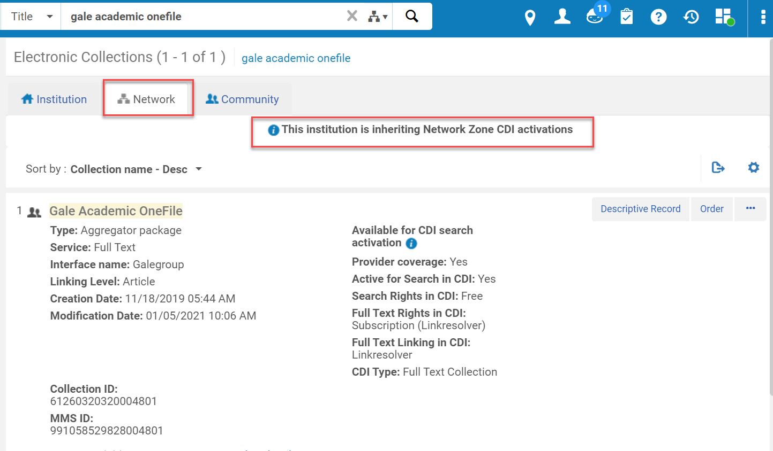
January Release Note Highlights: CDI
Collections that are defined as ‘Search Rights in CDI: Subscription’ can only be activated for search in CDI if your institution subscribes to the collection." This will save you from accidentally activating something that you can't access
Consortia CDI Inheritance - "The CDI inheritance indication has been added to the Network tab making it visible and easy to understand whether the institution inherits the collection CDI setup from the Network Zone (NZ) or not. CDI inherited collections will be presented in the combined search results and the Network Zone tab with the specific CDI related setup present in a new dedicated CDI drawer."

Slide 11
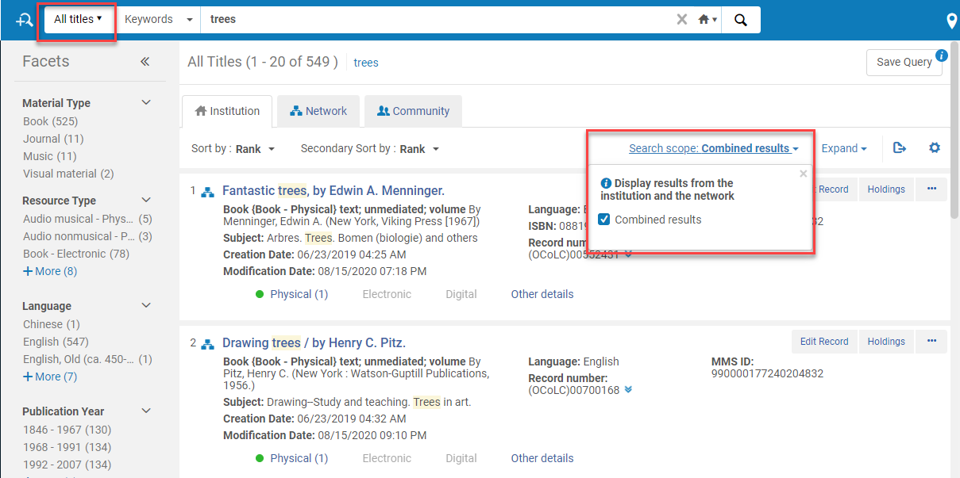
Odds and Ends
Problems with missing holdings with FRBR/Dedup seem to be resolved
New combined search results for IZ and content managed by NZ
Browzine and IDS sets have been updated to bring in NZ managed content

Slide 12
SUNY Shared Collections
Esta Tovstiadi
www.suny.edu

Slide 13
ESWLCA: Invitation for Bids (IFB)
IFB released 12/18/20, closes 2/1/21
Product list included over 800 resources, 40 vendors
Currently about 20 vendors developing bids
Bid review in February
  Group of 12 librarian reviewers from SUNY Libraries
March –April development of Master Agreements, recharge proposals, Participating Institution Agreements

Slide 14
eBook Central DDA Pilot
Title pools mostly finalized
Working on setting up access in Alma
Goal is to have set up complete by Feb. 1

Slide 15
Other updates
Artstor contract extension still in negotiation
  Should be approved by end of January
  Campuses should see no interruption in service
Rialto implementation moving forward at MVCC and Buffalo State
Whole ebook ILL pilot
  Please return signed participation letters ASAP

Slide 16
Resource Management
Maggie McGee
www.suny.edu

Slide 17
Upcoming Training
New MD Editor Series resumes on Thursday, January 28, 2021 at 10:00 am:
  Sessions will be held every Tuesday from February 2, 2021 through June 1, 2021 from 10:00 am – 11:00 am
  Sessions will cover:
    Templates
    Prediction Patterns (Serials)
    Rules (Indication and Normalization Rules)
  Sessions will be recorded and posted to the SLS Libguide after each session:
  https://slcny.libguides.com/sls/webinars
  Visit LibCal to register for the New MD Editor sessions: https://slcny.libcal.com/

Slide 18
January 2021 Release Notes – Resource Management
New Holdings Management Privilege: IMPORTANT!!!!
  Ex Libris added the PHYSICAL_INVENTORY_MANAGE privilege to prevent unauthorized users with cataloging roles from creating and editing holdings records
    The following roles contain PHYSICAL_INVENTORY_MANAGE:
      PHYSICAL_INVENTORY_OPERATOR
      PHYSICAL_INVENTORY_OPERATOR_LIMITED
      PURCHASE_MANAGER
      PURCHASE_OPERATOR
      REPOSITORY_MANAGER
  Ex Libris added the PHYSICAL_INVENTORY_Delete privilege to prevent unauthorized users with cataloging roles from deleting holdings records
    The following role contain PHYSICAL_INVENTORY_DELETE:
      PHYSICAL_INVENTORY_OPERATOR_EXTENDED

Slide 19
January 2021 Release Notes – Acquisitions
PO Line Confirmation Message – now includes the owning library
  To disable confirmation messages, go to Configuration Menu>Acquisitions> Manage acquisitions alerts
Control Availability Status of Electronic Resources created via Real Time Ordering - ebooks can be activated automatically upon creation in Alma when using real time ordering via New Order APIs
  To implement activation of a portfolio when added via New Order APIs go to Configuration>Acquisitions>Other settings>acq_activate_portfolio_from_API and set this to “true”

Slide 20
January 2021 Release Notes – Acquisitions
Additional collections for activating OASIS 'Real Time' Ordered Portfolios from the Community Zone:
  Brill
  De Gruyter
  IGI Global Online
  JSTOR
  Oxford Scholarly Editions Online
  Project MUSE
Improved Inventory Import:
  New Look
  All mapping options available on one screen, instead of selecting Basic or Advanced mapping
  Field and subfield mapping clearly defined
  New fields have been added for item-level mapping

Slide 21
January 2021 Release Notes – Other
New Alma Hot Keys – Ctrl_Alt+C allows users to quickly toggle to and from the configuration menu in Alma
New Layout - Ex Libris recommends that all users opt-in and begin using the new layout
  The old Layout will no longer be available to use in Alma after the March 2021 release
Configuration Change Tracking in Code and Mapping Tables – New ability to view the history of changes made by your staff to code and mapping tables
  Does not include full details of any changes made to the code and mapping tables
  Default is 0 (zero days), which does not store any change history
  To change the number of days history will be stored go edit the
  code_and_mapping_table_log_retention_period under Configuration>General>Other Settings

Slide 22
Resource Sharing
Timothy Jackson
www.suny.edu

Slide 23
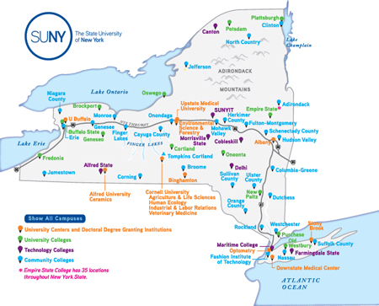
Automated Fulfillment Network Project
Kickoff meeting held on January 13
Meeting Covered:
  Project Overview and Timeline
  AFN Functionality Overview & Demo
  AFN Implementation Options
  AFN Policies
  Next Steps
Recording: https://public.3.basecamp.com/p/e15Pg9uNGqrBGRDVoMtSa86e
AFN FAQ: https://slcny.libanswers.com/faq/335353
Next AFN Meeting will be February 10 at 2:00pm
  Register: https://slcny.libcal.com/event/7427393
  Will share survey on whether we move forward with the project

Slide 24
Resource Sharing
Please make sure your lending is turned off if you can’t fill requests
  FAQ: https://slcny.libanswers.com/faq/266453
Digital delivery now possible for physical resource sharing requests:
  Can be used for instances where users have requested specific book chapters or other items that can be easily digitized
  Users receive email with download link from their own library
  Training Session on January 22 at 2:00pm
  Register: https://slcny.libcal.com/event/7434033
Ithaca College will begin participating in SUNY Alma RS later this month
  Nazareth College expected to begin participating in February or March
Workaround found for issue with SUNY/CSCU article resource sharing

Slide 25


Questions or Discussion?
www.suny.edu

