Slide 1
Automated Fulfillment Network (AFN) Meeting #2
Timothy Jackson
Resource Sharing & Fulfillment Program Manager
SUNY Library Services

Slide 2
Agenda
AFN Project Overview
Purpose of Project
Project Timeline & Key Decision Points
AFN Project Scope
AFN Functionality Overview
Pickup Anywhere
Return Anywhere
Walk-In Borrowing
Potential AFN Policies
Pickup & Return Anywhere For Hold Requests Demo
Your users requesting pick-up at other SUNYs
Other SUNY users picking up items at your library
Next Steps
AFN Interest Survey
AFN Meeting #3

Slide 3
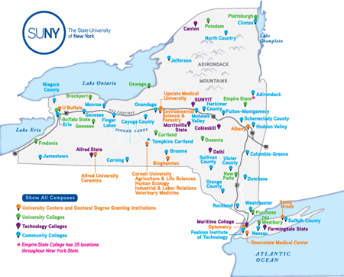
AFN Project Overview
The COVID-19 pandemic, the SUNY Online initiative, the SUNY For All program, and general trends in higher education will contribute to a long-term increase in online and hybrid learning in the SUNY system
More users who are not living near the campus where they are enrolled
More users will be asking to pick up items at and return item to the closest SUNY library
Current Alma configuration does not meet the needs of these users

Slide 4
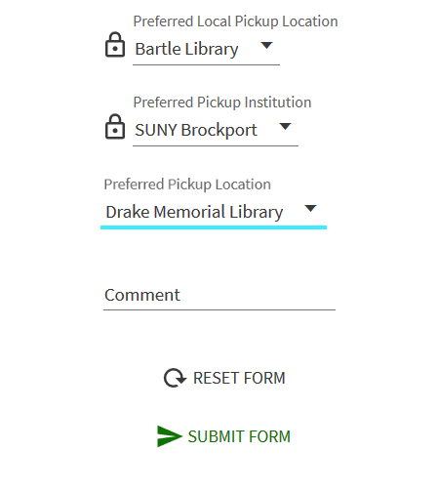
AFN Project Overview
Alma’s Automated Fulfillment Network functionality could help us better serve these users
AFN functionality allows users to:
Pick up requested items at any AFN library
Return checked out items to any AFN library
Borrow directly from any AFN library as a walk-in borrower
Similar functionality to many public library systems
Used by several other Alma-Primo VE consortia
Walk-in borrowing already implemented for all of SUNY libraries at Alma go live

Slide 5
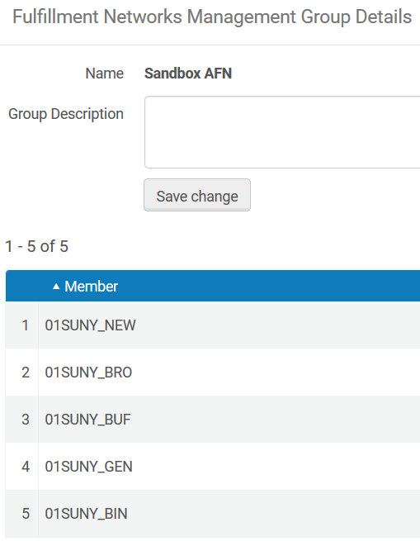
AFN Project Overview
No final decision on AFN implementation has been made yet
Final decision will be based on input from campuses
AFN participation will be opt-in
Libraries that do not join the AFN will still be able to use Alma NZ resource sharing
AFN will be permanent change if implemented
SLS will do all necessary configuration work
ASRS will assist SLS with documentation and training

Slide 6
AFN Project Timeline
Project Timeline
February - April: AFN testing & policy development
May: AFN beta tester training & implementation
June - July: AFN beta testing evaluation & system-wide training
August: AFN implementation for all interested libraries
Decision Points
Late February: Is there sufficient interest in AFN functionality to move forward with the project?
Early May: Are any campuses willing to serve as AFN beta testers?
Late July: Are enough campuses interested in joining an AFN to fully implement an AFN?
Project timeline and timing of decision points could change due to COVID-19

Slide 7
AFN Project Modifications: How Might the Scope and/or Timeline Change Based on Input?
We could push back the implementation timeline if there aren’t enough campuses willing or able to implement AFN functionality this spring/summer.
If there isn’t enough interested in all AFN functionality, we could implement only portions of AFN, such as return anywhere.
If there’s enough interested in being a pickup location, we could implement an AFN where some users can pick up/drop off (most) anywhere but all can drop off (most) anywhere.
Decide not to implement any further AFN functionality if there is little interest or if key stakeholders have reservations about strategic value.

Slide 8
Issues Out of Scope for AFN Project
Personal/home delivery to users from other SUNY campuses
Adding non-SUNY Alma libraries to a SUNY AFN
Allowing SUNY users to pick up items at and return items to non-SUNY libraries (CUNY, Ithaca College, etc.)
Providing pick-up anywhere options for requests filled via ILLiad/OCLC
Customization of pickup institution & library dropdowns and other Primo customizations that cannot be achieved through standard Alma/Primo configuration

Slide 9
AFN Functionality Overview
Pick-up Anywhere
Possible for both hold requests and resource sharing requests
Can implement separately for hold requests and resource sharing requests via Request TOU configuration
Can limit pickup location options for hold requests but not resource sharing requests
Resource sharing requests must be filled by AFN library for pick-up institution to be honored
Return Anywhere
Possible for all Alma loans
Can limit return options via Institutions Relations Table
Non-AFN libraries can still accepts returns from other SUNYs, but those returns won’t be tracked
Walk-in Borrowing
Libraries who do not participate in an AFN will not be able to use walk-in borrowing via linked account functionality
Walk-in borrowing has seen very little use since go live (less than 300 linked accounts created)
Non-AFN libraries can still manually create non-linked accounts for walk-in borrowers

Slide 10
Potential AFN Policies
Successful implementation of an AFN functionality will likely require policies to ensure a consistent user experience
Possible AFN policies:
Loan and renewal periods
Overdue and lost loan notification schedules
Fines and fees for late returns and lost items
Lost item billing procedure
Hold shelf period
Institution naming convention
Hold request pickup anywhere policy for courtesy borrowers
AFN policies will be developed by ASRS working group and approved by LSP Advisory Board
Policy proposals will be based on input from campuses

Slide 11
AFN Functionality Demo
pickup and return anywhere for hold requests

Slide 12
AFN Next Steps – Project Interest Survey
Survey link will be distributed to institutional leads via Workplace & email time
Please respond by close of business on Friday, February 26
Please limit responses to one per campus
Email info@slcny.libanswers.com to request AFN meeting with Shannon & Tim
We are not asking for final decisions about AFN participation at this time
Libraries will not need to make a final decision on AFN participation until this summer
Responses will determine whether we:
Move forward with current project scope and timeline
Move forward with modified project scope and/or timeline
Abandon the project
Collection size and geographic location of interested libraries will be taken into account when evaluating responses
Survey results will be announced in early March

Slide 13
AFN Next Steps – Sandbox Refresh & Meeting #3
Sandbox Refresh
All SUNY sandboxes being refreshed on February 14
SLS will rebuild sandbox AFN
AFN Meeting #3
Wednesday, February 17, from 2:00pm-3:00pm
Registration link: https://slcny.libcal.com/event/7524012
Will demo pick-up an return anywhere functionality for resource sharing requests
Will leave time for questions about AFN interest survey
AFN Project FAQ: https://slcny.libanswers.com/faq/335353
Project overview & timeline
Project updates
Meeting recordings
Links to detailed workflows

Slide 14
AFN Survey Demo

