Slide 1

Advanced ERM:
Troubleshooting
Linking
January 29, 2020
Michelle Eichelberger
www.suny.edu

Slide 2

Today’s session expands on basic troubleshooting explained by Alana Nuth:
First, identify which system(s) is the source of the issue:
Alma:
● Can you locate the portfolio in Primo and see available electronic services in View Online?
● Upon clicking an electronic service in View Online, are you directed to the appropriate vendor
platform or login page for off-campus access?
Vendor:
● On the vendor platform, can you access full-text?
● Do you see an error message about the item not being found or not being available?
EZ Proxy:
● Does an error message appear when off-campus which says the host is not configured
correctly?
● Can users authenticate properly and get to the vendor platform?
www.suny.edu

Slide 3
Errors: Links Not Working in Alma
If you're having trouble getting your link working, check the https://knowledge.exlibrisgroup.com/Cross_Product/Integrations/Alma_and_SFX document for parser parameters for the collection that you're trying to activate. Once you get the correct parser parameter, it can give you new fields where you can enter your customer id
Also check
https://knowledge.exlibrisgroup.com/Alma/Product_Documentation/010Alma_Online_Help_(English)/040Resource_Management/050Inventory/020Managing_Electronic_Resources
If nothing from a collection is working, there might be a problem with the CZ settings. Submit a Salesforce case to report the problem. E.g. UB case 00793357, links from MLA International Biography with full-text. Error was: “Error in HttpHandler.“ Had to be fixed in knowledgebase.
www.suny.edu

Slide 4
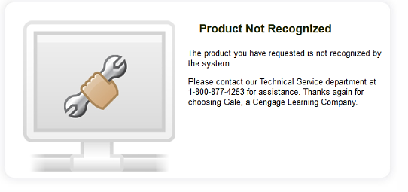
Errors: Not Authorized for Access
Assume Alma set-up is correct, and that the link is showing correctly on a Primo VE result.
“Not Authorized” Error:
See this when the link lands in a place that doesn’t recognize you as having access
Can happen within your campus network, or only outside of the network if it’s an IP access issue
Possible Causes:
Missing id on Edit Service linking tab
Activation of wrong version of package
No proxy
www.suny.edu

Slide 5
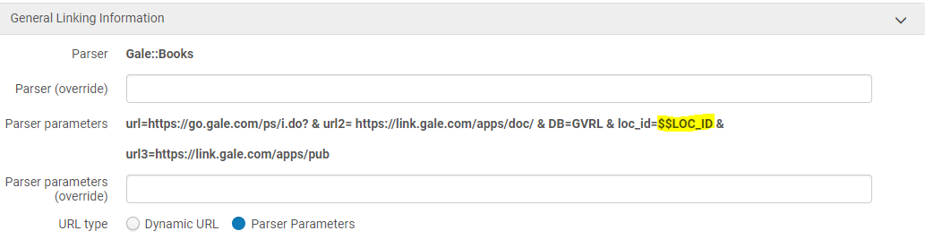
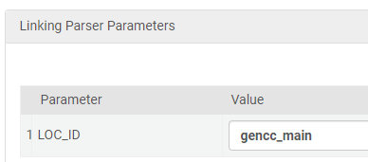
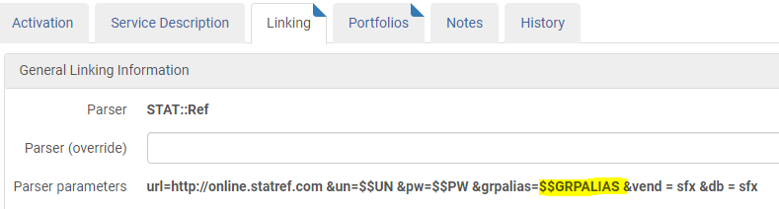
Not Authorized for Access: Missing ID
How to fix:
Look up your electronic collection in the IZ:
Edit Service and check the linking tab
If parser parameters have all caps field, you may need to add local code.
Scroll to bottom to check for loc_id or customer_id box
OR
What Collections Require Special Parameters
www.suny.edu

Slide 6
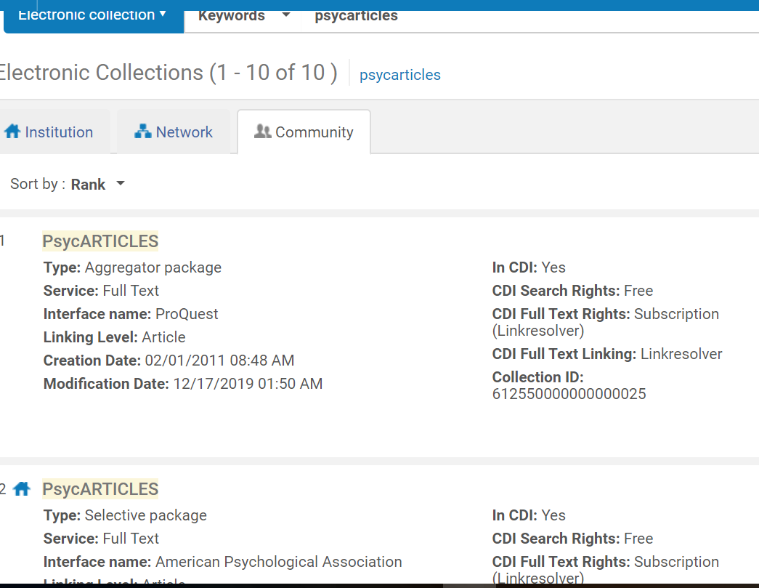
Not Authorized for Access: Wrong Collection
Example: Psycarticles
10 matches by title in CZ
How do you know which one to pick?
Check for an Interface name: APA, Proquest, etc.
If you’re unsure, activate one portfolio and see if you’re authorized to get in – test in Alma from portfolio
If it’s a SUNYwide purchase, check to see if other SUNY libraries have activated this collection: What's the best way to find electronic collections activated by SUNY campuses in the NZ?
Can take trial and error
www.suny.edu

Slide 7
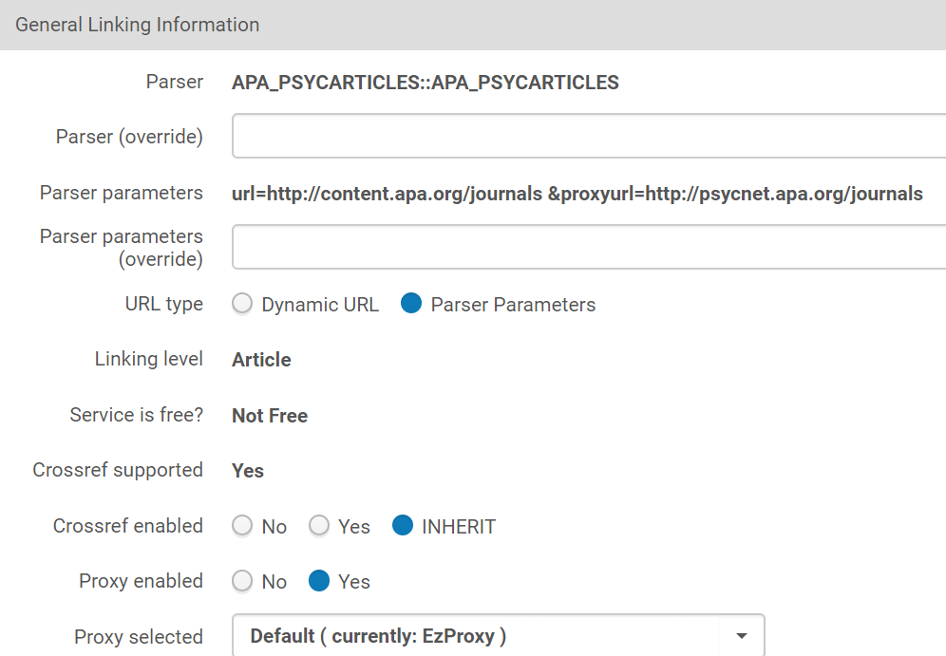
Not Authorized for Access: Proxy Missing on Service
If you can get to your resource from campus but it’s not working offsite, you may need to activate your proxy settings on the Edit Service area for your collection.
How to fix:
  Look up collection in IZ
  Edit Service
  Make sure default proxy is selected
  If it’s a new collection, make sure to add the stanza to your Ezproxy config file
www.suny.edu

Slide 8
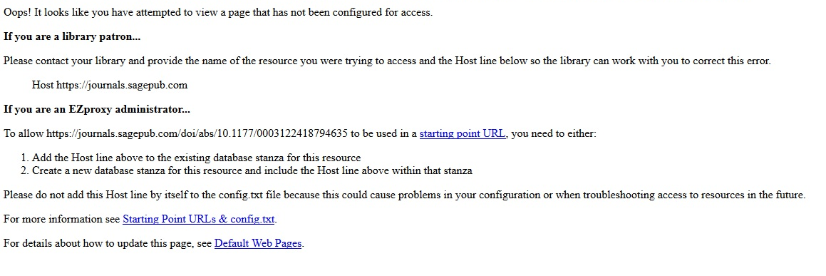
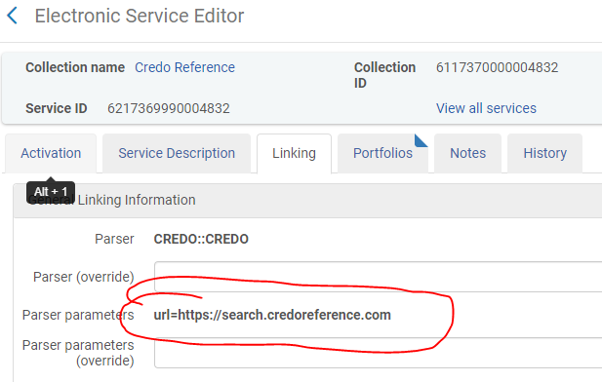
Not Authorized for Access: Proxy Config File
You'll get an error like this when the link that you're using to get out of Primo doesn't match a known link stored in your Ezproxy config file.
How to fix:
  Look up collection in IZ
  Edit Service
  Check link tab and note the URL
  And/or check OCLC for most current stanza
www.suny.edu

Slide 9
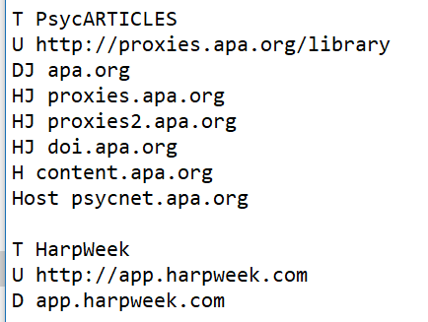
Not Authorized for Access: Proxy Config File
If you’re self-hosted:
Check your config file to make sure that there’s a stanza for the collection that you’re trying to activate
If there is a stanza, make sure that the URL from your Alma Edit Service is included in the U/URL, H/Host, or domain. May have to try different ways to get it in there.
If there isn’t a stanza, if it’s ezproxy, check OCLC for the most current stanza for that collection, copy it and paste it into your config file
If it’s not in OCLC, you can create your own using pre-existing stanza as template – T is title, U is URL, H is host, and D is domain
Save your changes and restart the proxy server
If you’re hosted, contact your vendor and ask them to add the collection, or use your account to add it yourself.
www.suny.edu

Slide 10

Metadata linking problems (AKA Welcome to the Weeds)
Content we’ve looked at so far is fairly straight-forward to fix.
Let’s get into the weeds.
www.suny.edu

Slide 11
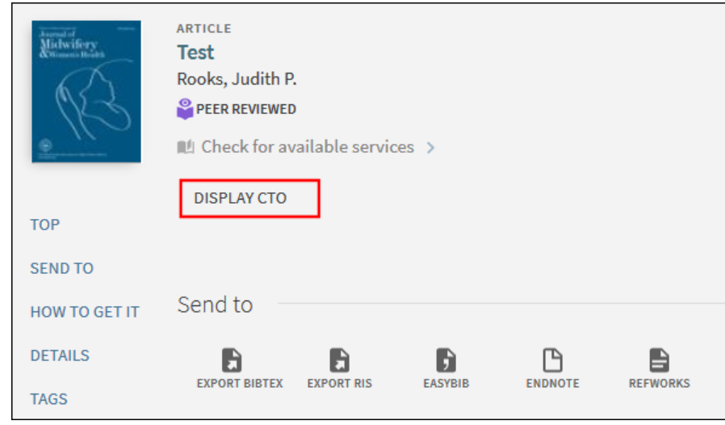
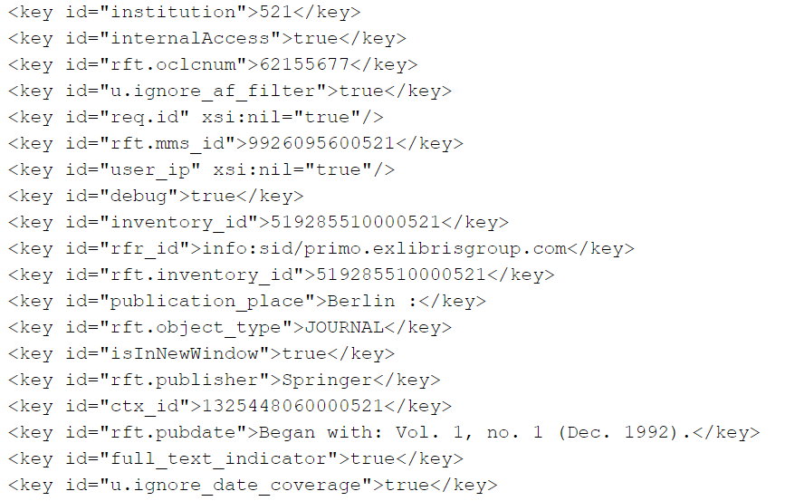
Weed-whacking Tools
&DisplayCTO=true
Add at the end of any search or record URL
Shows you the fields in the record
Helps identify missing or incorrect fields
Especially good for PCI data – articles, book chapters, etc.
Can see Alma source data with “view source” at bottom of full record
FAQ: How can I troubleshoot View Online links?
www.suny.edu

Slide 12
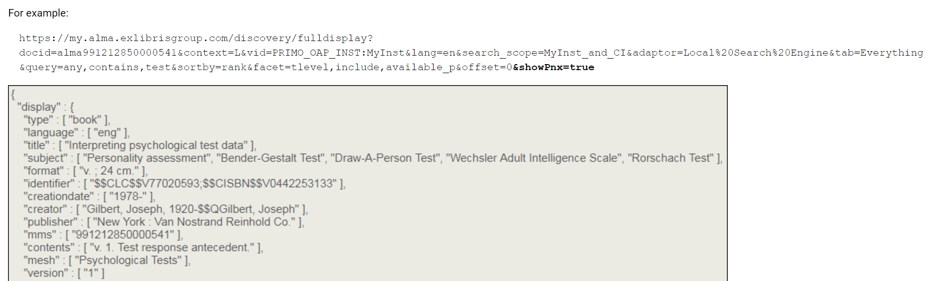
Weed-whacking Tools, cont.
&ShowPNX=true
Add at the end of any search or record URL
Shows record in JSON format
“useful to understand what metadata is being used in Primo VE and why information appears in the results.”
www.suny.edu

Slide 13
EBSCO
Linking out to ILLiad: "Need separate rule for EBSCO and ProQuest is that they don’t send the journal title in the jtitle parameter. They use the title parameter"
Title and volume not included in OpenURL
EBSCO messing up volume numbers, drops the 1 from 185 and volume becomes 85
Linking in from link resolver: doesn’t handle multi-part titles well, missing volume/issue info, etc.
www.suny.edu

Slide 14
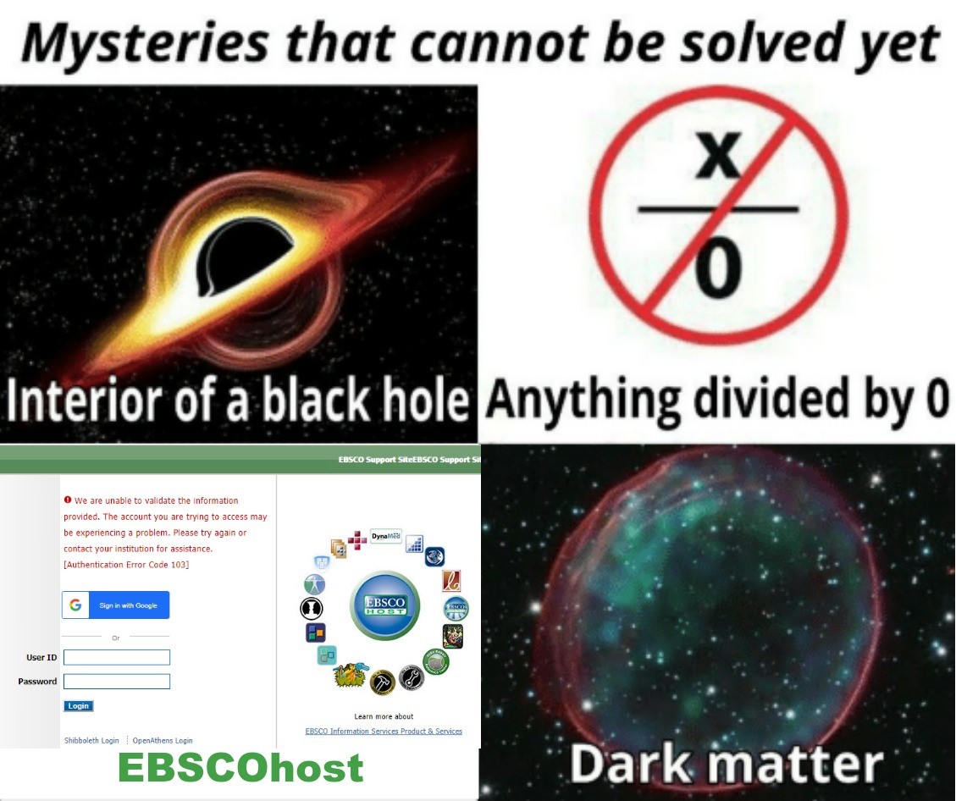
Petrina Collingwood, ““Primo is broken, can you fix it?”: Converting anecdotal evidence into e-resource access solutions” 2019 ANZREG Conference
https://www.kapwing.com/
Notes:
Basically…

Slide 15
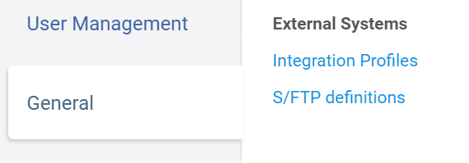
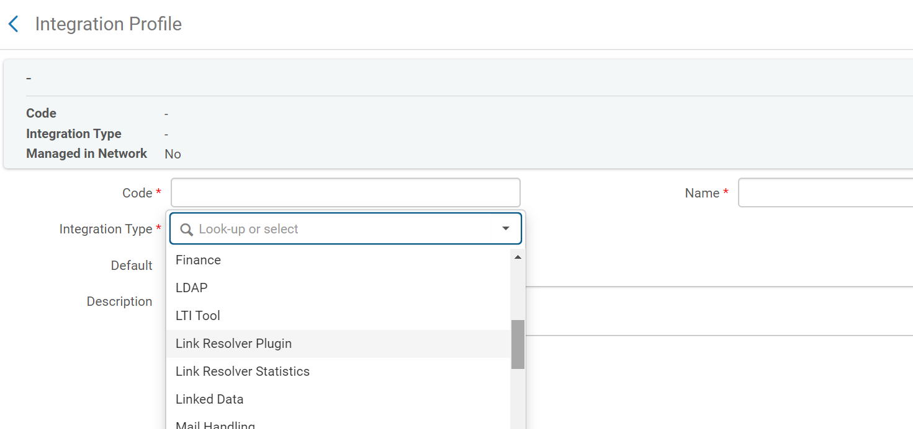
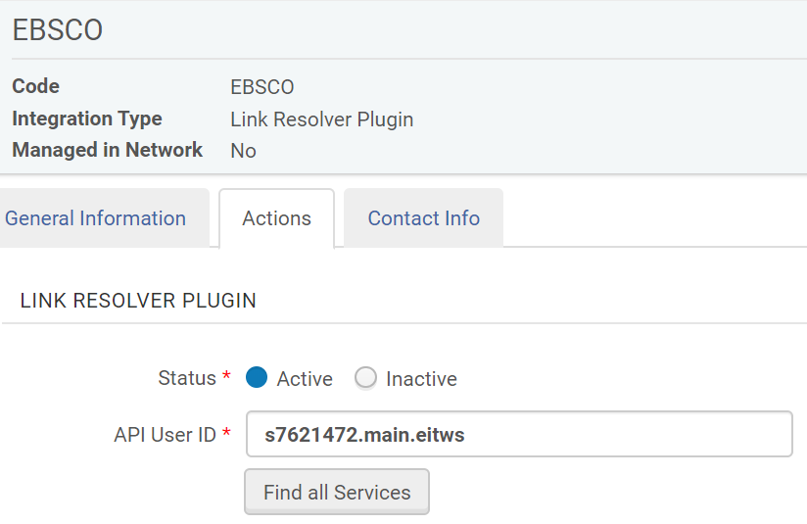
EBSCO: What can you do? Add EBSCO Link Resolver API
EBSCO Link Resolver API is different from EBSCO API scope. It solves some, but not all, linking problems
Add Integration
Code & Name can be EBSCO
Pick Link Resolver Plugin as type
API user ID is your [EBSCO account number].main.eitws
Make it active
www.suny.edu

Slide 16
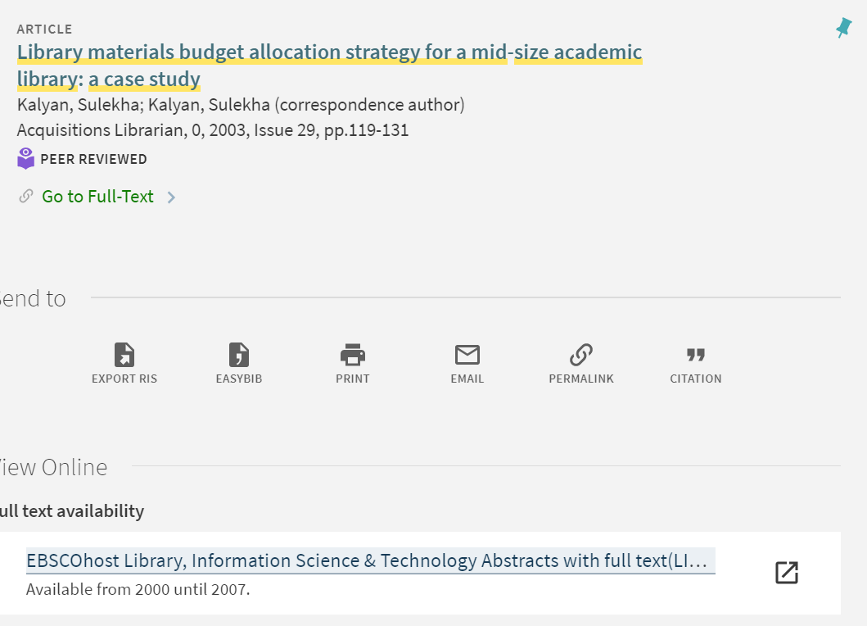
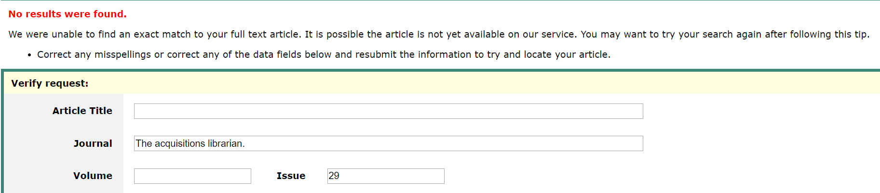
EBSCO: What can you do? Report to Salesforce
Example: LISTA article
FIN reported to Salesforce. Ex Libris: “It looks like this is occurring because the OpenURLs do not include a volume parameter, but EBSCO's OpenURL resolver requires that element in order to succeed (even when all other citation information is available).
I have added the linking exception "atitle" which creates a "search" link using the article title, journal title, and publication year which should resolve the issue.
Linking exceptions such as this one are added at the individual portfolio level as part of the parser parameter.”
Have to fix one journal at a time
Varying levels of support success
www.suny.edu

Slide 17
EBSCO: What can you do? Report to Salesforce, cont.
00792182 Corning CC: When we search in Primo, a limited number of articles show up. For example, in Primo, a search in Scientific American for the keyword "plastic" yields 37 results; however, when searching directly in the EBSCOhost platform, we find 135 articles.
Also not linking correctly in Academic Search Alumni. “Clicking on the first result for the article "Rivers of Plastic" brings users to an article called "Misled Penguins" when they try to access the full text.”
EL: implement EBSCO API scope, opened another ticket for linking issue (forwarded to data service):
“Regarding the content from EBSCOhost, It seems that "Academic Search Alumni Edition" collection is not on the list of the collections, for which alternative coverage is available. The list can be found here: https://knowledge.exlibrisgroup.com/Primo/Content_Corner/Primo_Central_Index/Product_Documentation/Primo_Central_Indexing
If you would like this to be added, please submit this as an enhancement via the idea exchange portal: https://ideas.exlibrisgroup.com/forums/574345-content
I believe that you can also enable the EBSCO scope, as a search option in your Primo. This should allow all the content from the collections that are available to you in EBACO and that are shared via the EBSCO API to be searchable by your users.”
www.suny.edu

Slide 18
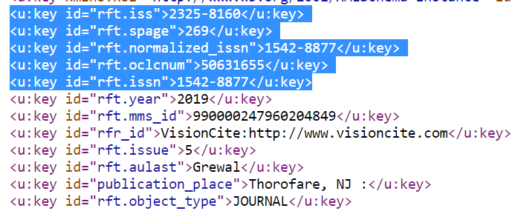
Link Resolver Service Page
Many problems, sometimes from vendor, sometimes from Alma/Primo
Cases:
00720044 UB: Google Scholar articles with DOIs not showing with DOI on the Link Resolver Service Page, meaning that Browzine PDF link doesn’t appear for patrons, would appear for same article in Primo search because of record grouping
00719580 OPT: multiple ISSNs coming from VisionCite causing service page to pull up previous title content because of old ISSN. Also seeing VisionCite content coming in as rft.genre book instead of journal.
www.suny.edu

Slide 19
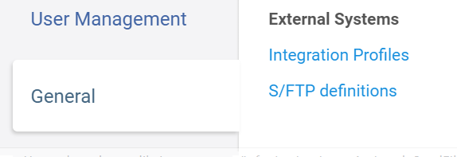
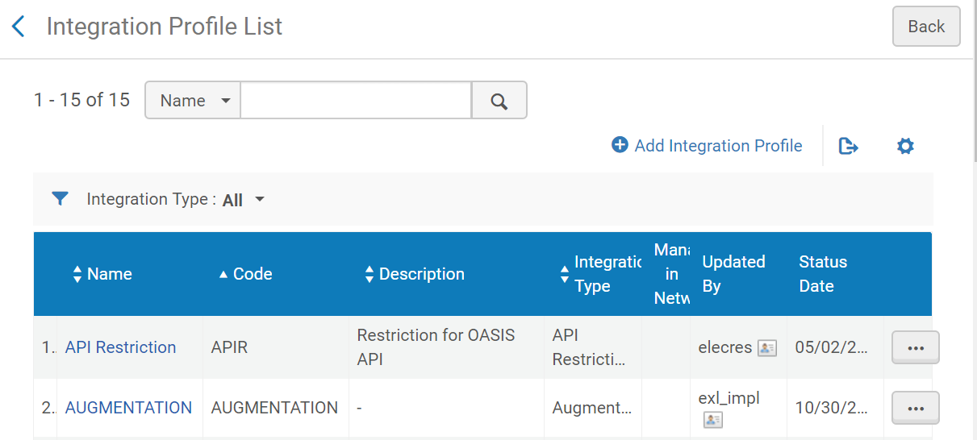
Link Resolver Service Page: Enhance Content
Thanks to Nancy Babb for investigating this issue.
Problem: Content coming in from Google Scholar doesn’t have all of the fields necessary to retrieve holdings from Alma or populate an ILL request.
Odd twist: same article sent out from Google Scholar through other SUNY link resolvers (UPS, OPT), does have the necessary content (full list of authors)
Why the difference: Augmentation Implementation Profile. Nancy fixed issue by getting new CrossRef Account and updating username/password credentials in Augmentation Profile.
This FAQ about DOI searching explains how to set up a CrossRef Account. Free and straight-forward to do.
Augmentation profile may have been set up for you during migration or you may need to add it.
www.suny.edu

Slide 20
Questions? Thoughts?
Thanks to all who continue to troubleshoot linking in Alma/Primo, especially Nancy Babb, Jill Locascio, Jen Parker, Heidi Webb, and members of the Discovery Working Group.
www.suny.edu

