Slide 1

SUNY Library Services Update
October 28, 2020
www.suny.edu

Slide 2
Support Update: Highlights from October Meeting
Content rep at meeting.
  CDI group is hiring/has hired many new people.
    May be some temporary unevenness support as staff are being trained.
Primo deduping issue still in development
Still working on Gale linking issues, but some progress.
Wrong content type—understand issue now, will review.
Personal delivery issue fix est. release in December—reviewing whether can be released sooner.
Reviewing Ebook indexing issue at UB
www.suny.edu

Slide 3


Expanding System Wide Library Agreements Project
Kickoff Meeting on 11/4 from 11-12:
  https://slcny.libcal.com/event/7231689
Goal is to greatly increase system wide agreements for library content to reduce duplication of licensing and procurement effort and realize system-level savings.
www.suny.edu

Slide 4
SUNY Library Accessibility Cohort
Will begin reviewing resources in coming month.
Generating reports of reviews of Accessibility Conformance Reports (VPATs) and high level review of tools.
Reports will be made available online (to internal SUNY people at this point).
If you’re being asked to “review VPATs” or consider accessibility as part of procurement process, we want to hear from you.
We're in process of updating our Third-Party Vendor Repository:
  https://slcny.libguides.com/vendor_accessibility
www.suny.edu

Slide 5
Print to Electronic Assistance Ends
SLS will no longer be providing the analysis and vendor management to assist campuses with finding high circ. titles and working with vendors to see if there are titles that can be purchased in e at a discount.
Provided 16 reports.
Need to reallocate staff time to other initiatives.
www.suny.edu

Slide 6
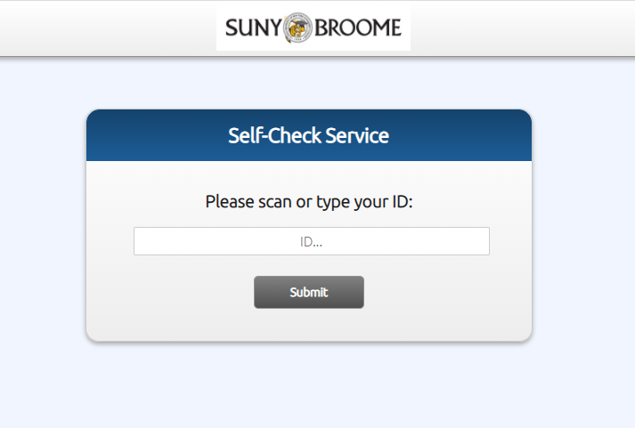
Self-Check Alma Application
Libraries can now request to begin using this in a live environment.
Send us a request via libanswers: info@slcny.libanswers.com
Will begin review of improvements soon.
  Authentication integration is top priority.
Campuses may want to consider whether this has use other than full self-check.
  Ex: self-serve hold shelves, reserves, etc.
www.suny.edu

Slide 7

Rialto Pilot
Buffalo State and MVCC piloting Rialto, and beginning implementation now.
SLS is monitoring to review Rialto's maturity and to explore the implementation process to share with other SUNY libraries.
www.suny.edu

Slide 8

Discovery & E-Resources
Updates
Michelle Eichelberger
www.suny.edu

Slide 9
CDI Updates
Yvonne and Michelle have done a total of 36 CDI Audits, both requested and house calls
Criteria for house call:
  Over ~225 collections active
  Numerous unnecessary PCI OA collections
3rd CDI Lunch & Learn this week, one more after this
Continuing to add new FAQs, keep an eye on the Primo-L for CDI discussion
www.suny.edu

Slide 10
Primo VE Release Notes
Working with DWG to design testing script for new releases to try to catch regressions or other problems
November Updates:
  Improved the contrast of font, button, and background colors – could impact customization
  Can set single item physical material not available to show more info, such as Not available - Loan, Not available - Requested, and Not available – Lost
  Boost your institution – could make it easier to include the SUNY Catalog in your everything search
  New fields for Hold Request form to make chapter and periodical requests easier
  Improved "bound-width" options
  Fixed missing electronic content when print and electronic are deduped
www.suny.edu

Slide 11
SUNY Shared Collections Updates
Esta Tovstiadi
www.suny.edu

Slide 12
Expanding System-wide Library Agreements Project (ESLAP)
  Targeting contracts for resources that impact many campuses:
    Nature
    IEEE Explore journals
    American Chemical Society journals
  Central license
    Frontfile, perpetual access
    Discounted article publication charges (APCs)
    Limits on annual price increases
www.suny.edu

Slide 13
SUNY eBook Central DDA Pilot
  Two Cohorts:
    A: University Centers, Comprehensives and Technology Schools
    B: Campuses with nursing programs
  Limited to specific publishers and subject areas
  Multiplier on single user list price* to purchase an unlimited access license; access granted to all participating campuses (4x and 3x respectively)
  Through end of June, 2021
www.suny.edu

Slide 14


SUNY eBook Central DDA Pilot Goals
  Prevent duplication (of content and effort)
  Develop workflow for DDA in the Network Zone
  Develop funding model that distributes costs fairly and provides a good ROI for campuses
  Lay groundwork for future collaboration across SUNY
www.suny.edu

Slide 15
New England Journal of Medicine Update
  2020 access was for all campuses; 37 contributed to the subscription (approx. $67,400)
  NEJM reported challenges maintaining access, invoicing
  Some campuses utilizing subscription but not contributing; others contributing but not utilizing
  2021 deal is $60,000 for 25 campuses, all contribute to subscription
  Access will be managed in the Network Zone
  If your campus did not opt-in to this offer, your campus will lose access starting 1/1/2021
www.suny.edu

Slide 16

SUNY Press eBook Offer
  Offer for all of SUNY purchase perpetual unlimited user access to the 2021 SUNY Press titles on the eBook Central platform
  3x price of a single user title($95), or $285 per title
  Pricing and details in the Collections Portal
  Please let me know if your campus is interested in this offer by Friday, November 13th using this form: https://slcny.libwizard.com/f/sunypricing
www.suny.edu

Slide 17

SUNY Elsevier Package Title Swap Analysis
Current Elsevier package contains 248 titles selected in Spring 2020
Contract allows for swaps
Can add any Elsevier title for a 3.4x list price multiplier
Want to get the best ROI for our package
www.suny.edu

Slide 18



Process
SLS compiled and collated data
SSCC provided stakeholder input, made decisions
Process in place for future reviews
www.suny.edu

Slide 19
Data that Informed Our Analysis
Overall number of full-text uses
Number of full-text uses of content published from 2018 – current (“current use”)
Cost per current use (CPCU) (list price with a 3.4 multiplier, the price for a journal as stipulated by our contract, divided by current use)
Use of Open Access content
Inter-library loan requests
On-demand article purchases
Campus supplemental subscriptions
Turnaways
www.suny.edu

Slide 20
Next Steps
SUNY Shared Collections Committee met 10/28 to select swaps
Communicate changes to Elsevier and Libraries
Update Network Zone
Per our contract, we will retain perpetual access to any titles that we swap out, for the years that we subscribed
www.suny.edu

Slide 21
Resource Sharing Update
Timothy Jackson
www.suny.edu

Slide 22
Physical Resource Sharing Restart
50 libraries have resumed Alma physical resource sharing
  Nearly all are both borrowing and lending
ELD Service has resumed for NYC hub libraries who requested service
  Reverted to using regional rotas
  Switched expiry days setting to 7 days for all libraries
Statistics for October 2020 (to date)
  Request volume: 1,393 requests (3,157 requests in October 2019)
  Fill rate: 56% (50% for September 2020)
  Turnaround time: 9.6 days (10.9 days for September 2020)
Delivery Days and Quarantine Period Survey
  https://slcny.libwizard.com/f/quarantineanddeliverydays
www.suny.edu

Slide 23
Article Resource Sharing
16 libraries now borrowing articles via Alma
Statistics:
  Request volume: 112 requests (55 requests in September 2020)
  Fill rate: 90% (76% in September 2020)
  Turnaround time: 0.7 days (2.4 days in September 2020)
Alma article RS is a viable alternative to ILLiad for lower volume libraries
  Copyright compliance functionality does not work properly, so Alma article RS is not a viable option for libraries concerned about CONTU Rule of 5
Email info@slcny.libanswers.com if you would like to test Alma article RS
www.suny.edu

Slide 24


Alma Resource Sharing with Non-SUNY Libraries
Article RS Pilot Project with Connecticut State Colleges and Universities (CSCU) System planned for Fall 2020 & Spring 2021
  Adirondack, Cayuga, Corning, Dutchess, Ulster participating as borrowers & lenders
  Empire State and Buffalo participating as lenders
  4 CSCU libraries participating
Began configuration work on October 27, live testing at Cayuga to start the week of November 2
Will expand to all current participants granted we don’t run into problems
Hope to expand participation in both SUNY and CSCU
www.suny.edu

Slide 25
RS Changes in November 2020 Release
Locate Process
  Requests submitted from NZ records will locate on Record ID, not request metadata
  Should reduce number lending locate failures, especially when requested item is held in print and electronic
  No configuration work required
Remove and Recalculate Rota Assignment
  Possible to edit request and create new rota before sending to other libraries
  Check for alternate editions or missed holdings before exporting requests to ILLiad
  Make blank resource sharing request form available to users
  Plan to conduct training sessions in November
www.suny.edu

Slide 26
Automated Fulfillment Network Update
Automated Fulfillment Networks allow users to pick up and return items at any library in the network
Already using parts of AFN functionality for walk-in borrowing, but wider implementation of AFN functionality may help better serve students no longer living on campus
Initially configured multiple small AFNs in our sandboxes, but concerns over how AFN requests filled by non-AFN libraries behave have us rethinking our approach
Investigating possibility of single AFN where each library can customize pickup institution options
www.suny.edu

Slide 27
Network Zone
Maggie McGee
www.suny.edu

Slide 28


OCLC Bib Data Sync/New Processing Update
All bib publishing profiles were published to OCLC as "Full" on 9/22/2020 (daily publishing) or 9/26/2020 (weekly publishing)
Bib Publishing profiles have been accepted and are processing holdings files automatically at OCLC and matching only on the OCN (OCLC number) again
OCLC will begin the "Scan/Delete" process to remove holdings that are not in Alma
  Institutions who do not publish e-resource holdings manually or using OCLC's Knowledge Base are being processed first
  "Scan/Delete" is begging the week of 10/26/2020
Contacting Institutions who publish e-resources manually or via OCLC's Knowledge Base to review their e-resource holdings prior to "Scan/Delete"
www.suny.edu
Notes:
Good attendance and engagement for all sessions. A successful switch to registration-based training, which makes it easier to communicate with and count participants.

Slide 29
Resource Management Enhancements
10,919 bib records were deleted from the NZ that were added due to OCLC's new process issues
Field information URLs for SUNY local fields will be added over the next month
  Configured for all SUNY Institutions
  Field information will display in the MD Editor
  The corresponding Library of Congress (LOC) field information will be used for the SUNY Local Fields (18 SUNY local fields)
An XML extension pack will be added for MARC 019 to MARC21 Bibliographic Configuration
  Configured for all SUNY institutions
  The extension pack will remove the error warning in the MD Editor that is triggered every time a bib records in opened in the MD Editor that contains MARC 019
  MARC 019 field information URL will point to OCLC field documentation
www.suny.edu
Notes:
Good attendance and engagement for all sessions. A successful switch to registration-based training, which makes it easier to communicate with and count participants.

Slide 30

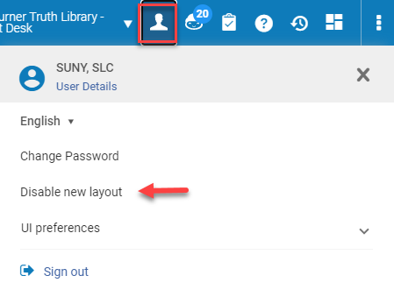
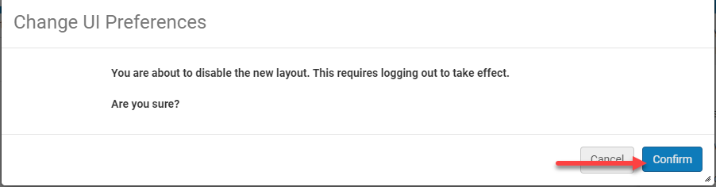
Alma November 2020 Release Notes
New Layout:
  New Alma Layout Turned On for All Users
    Enabled users can toggle between the old and new layout easily
    Alma Administrators can turn the new functionality off for specific user (Opt-out)
    January 2021 - New Layout exclusive use
    SLSS New Alma Layout Libguide
Ex Libris New layout improvements documentation
www.suny.edu
Notes:
Good attendance and engagement for all sessions. A successful switch to registration-based training, which makes it easier to communicate with and count participants.

Slide 31
Alma November 2020 Release Notes
Resource Management:
  Resource Management semi-annual reindexing
    Ex Libris reindexes all inventory data in order to enhance Alma's search mechanism
    Features or resolved issues that require re-indexing to be fully functional will be addressed by the November semi-annual re-indexing
  DARA Recommendation to Remove Multiple Bibliographic Records with the Same OCLC Number
    Identifies multiple bib records with the same OCLC in MARC 035 $$a
www.suny.edu
Notes:
Good attendance and engagement for all sessions. A successful switch to registration-based training, which makes it easier to communicate with and count participants.

Slide 32
Alma November 2020 Release Notes
Acquisitions:
Disable PO Line and Invoice Alerts - some invoice and POL alerts can now be disabled
  It is important to note that if an alert is disabled and purchasing review rules or invoice review rules are set for the alert that is disabled, the rule will not work for any PO lines/invoices that are recalculated or created
  If an alert is disabled, alerts on existing PO lines/invoices are maintained until the PO line or invoice is recalculated
  https://knowledge.exlibrisgroup.com/Alma/Product_Documentation/010Alma_Online_Help_(English)/020Acquisitions/110Configuring_Acquisitions/Managing_Acquisitions_Alerts
Manually Mark PO Line for Review When Creating from EOD/API
  Require Manual Review- Set to True to stop PO line for review when the PO line is created via EOD. Valid values are Yes, Y, y, TRUE, True, affirmative
www.suny.edu
Notes:
Good attendance and engagement for all sessions. A successful switch to registration-based training, which makes it easier to communicate with and count participants.

Slide 33
Analytics
Gail Pawlowski
www.suny.edu

Slide 34
SUNY instance of Alma Analytics is scheduled to be upgraded on November 8th, 2020
On November 1st the freeze period will begin until the upgrade on the 8th. During this time you will be able to run reports but any changes you make will NOT be saved.
Any reports you currently have saved in your “My Folders ” folder will NOT migrate to the new version. If you wish to save those reports you must copy them to your institution folder in the Shared Folders area. You need to move them BEFORE the freeze period begins on November 1st.
With the new version (OAS - Oracle Analytics Server) some new functionality will be added, such as Data Visualization. And, the new version will look a little bit different.
The Primo Analytics upgrade for SUNY will occur on November 22nd, with the freeze period beginning on November 15th.
www.suny.edu

Slide 35
Copy “My Folder” to “Institution” Folder
Copying your individual My Folders to Shared Folders/[Institution Folder]
https://knowledge.exlibrisgroup.com/Alma/Knowledge_Articles/What_do_I_need_to_do_to_prepare_for_Alma_Analytics_OBI_upgrade_from_OBI11%2F%2FOBI12_to_OAS
To identify staff users that have the analytics roles in your institution
Run the ‘Users with Analytics Access’ report.
Report path: In Alma Analytics go to Catalog > Shared Folders > Community > Reports > Consortia > SUNY > Users > Users with Analytics Access
www.suny.edu

Slide 36
Additional Information from the Analytics Working Group
  •Additional information and on-screen demo from the Analytics Working Group
  AWG August 12 webinar recorded session
  •Reminder on HQ Basecamp
  https://public.3.basecamp.com/p/8JW1LqQG2aFe5y5pD3hFMDpc
www.suny.edu

Slide 37
More Info on Oracle Analytics Server (OAS) and Data Visualization from Ex Libris
  OAS (Oracle Analytics Server) and DV (Data Visualization) Upgrade Info
  https://knowledge.exlibrisgroup.com/Alma/Product_Documentation/010Alma_Online_Help_(English)/080Analytics/010Introduction/The_Basics_of_Working_with_Analytics/OAS_(Oracle_Analytics_Server)_and_Data_Visualization_(DV)
  Ex Libris blog
  https://developers.exlibrisgroup.com/blog/an-introduction-to-alma-analytics-data-visualization-dv/
  What’s new in Analytics with OAS (Oracle Analytics Server)
  https://developers.exlibrisgroup.com/blog/whats-new-in-analytics-with-oas-oracle-analytics-server/
  YouTube videos on OAS, DV & Primo Analytics demo
  https://www.youtube.com/user/ExLibrisLtd/search?query=OAS+and+DV
www.suny.edu

Slide 38
E-Resource Management and Organizational Adjustments Sessions
3 Sessions on analyzing and contextualizing shifts in collection building and e-resource management.
Sessions will be Thursdays from 2-3 from 11/5-11/19
3 Sessions will be:
  Introduction to Framework for organizational shifts related to ERM
  Panel of SUNY libraries taking different org. Approaches to ERM
  Overview of organizational shifts in adjusting to ERM
Register at:
  https://slcny.libcal.com/event/7245698
Providing advanced ERM sessions in early December as well.
www.suny.edu

Slide 39

Save the Date
SLC Fall Virtual Meeting
afternoons of December 7-9, 2020
www.suny.edu

Slide 40


Questions or Discussion?
www.suny.edu

