Slide 1
Publishing Profiles: Publishing Bibliographic & Holdings Records from Alma to OCLC
Shared Library Services Platform Project
Maggie McGee

Slide 2
Publishing Profiles: What are they?
Publishing Profiles syncs data between Alma and WorldShare
Data Sync was known as Batch Load
Automated process that compares institutional holdings to WorldShare and manages the holdings of these records at the Bib record level or the Holdings record level
Facilitates adding new records to WorldShare
How does Data Sync between Alma and WorldShare work?
The Publishing Profile in Alma exports records to the defined WorldShare FTP server where OCLC retrieves them and synchronizes them with the institution’s WorldCat records
During migration all records with OCLC numbers will be flagged publish bib
Local Holdings Records (LHRs) will not be published during this process
This is a separate process that needs to be done by creating a set for records with LHRs and batch updating the flag to “publish holdings”

Slide 3
Publishing Profiles: What are they?
Two types of Publishing Profiles need to be configured in WorldShare and Alma:
Bibliographic
Syncs Bib holdings between Alma and WorldShare
Holdings
Syncs Local Holdings Records for serials between Alma and WorldShare

Slide 4
Setting Up Publishing Profiles: Start With OCLC
Call OCLC @ 1-614-793-8682 if you DID NOT receive an OCLC password from LSP and/or have a WorldShare account already set up
This means the institution does not have an account set up in WorldShare
Ask about setting up a Synchronization Project from ALMA to OCLC using the Product Collection Manager
Cataloging Subscription is required – you can request one if your institution does not have one
Username & password will be created for your institution by OCLC
WorldShare URL and password will be given verbally and/or by email
Log-in and reset the password
Required for setting up a publishing profile in Alma
Collection ID (project ID)
Synchronization project
OCLC password for setting up the S/FTP Connection
Notes:
LSP has a list of every institutions’ password to set up Step 2 in Alma. Username is the OCLC symbol for the institution

Slide 5
Publishing Profiles Steps After Go-Live
Verify the Data Sync Collections for publishing profiles have been submitted to OCLC
Verify the publishing profile server is set to OCLC’s server
Testing is done on the SUNY’s S/FTP server
Activate the publishing profiles in Alma
Run a baseline for both bibliographic and local holdings records
This publishes all the OCLC records flagged to publish to the Alma Publishing index
Only NZ linked records are flagged to publish
It does not go to the OCLC FTP or make any changes to holdings in OCLC
After the baseline runs the system will automatically switch to incremental and the job will run regularly syncing the campus’s holdings in Alma and OCLC

Slide 6
Creating a Data Sync Collection for Bibliographic Holdings in WorldShare

Slide 7
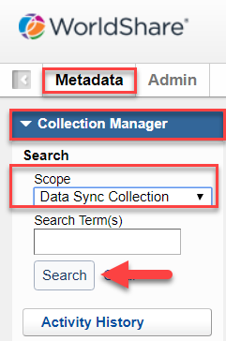
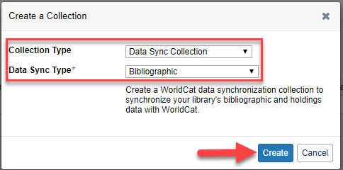
Setting Up Publishing Profiles in WorldShare
Create a Data Sync Collection for Bibliographic Holdings in WorldShare
Login to WorldShare
Click on the Metadata Link
Click on Collection Manager and expand it
Change Scope to: Data Sync Collection
Check for existing Data Sync Collections
by leaving the search term box empty and
click search
If there are no existing collections that will be used:
Click Create a Collection
Collection Type: Data Sync Collection
Data Sync Type: Bibliographic
Click Create

Slide 8
Create a Data Sync Collection in WorldShare for Bibliographic Holdings
Expand Properties Tab:
Type in a Collection Name
Collection ID will populate once you save the Data Sync Collection*
Group: No
Original Data Format: MARC
Use Record Status for Processing: YES
Header with D can then be used to deleted holdings in Alma and publish it to OCLC and remove the institution’s holdings
Description: optional

Slide 9
Create a Data Sync Collection in WorldShare for Bibliographic Holdings
Properties Tab Example:

Slide 10
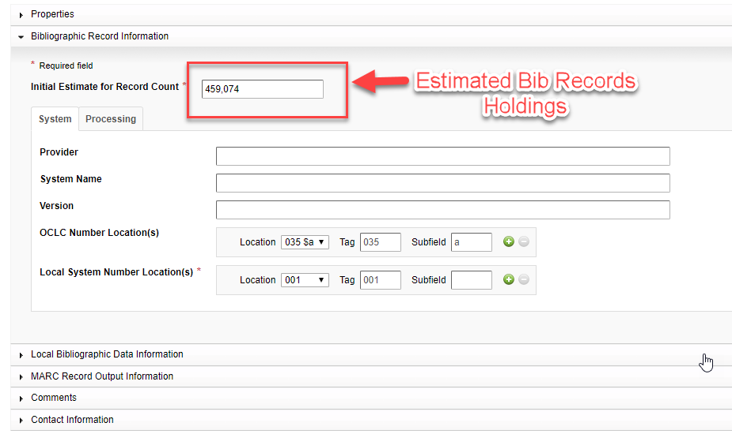
Create a Data Sync Collection in WorldShare for Bibliographic Holdings
Expand Bibliographic Record Information Tab:
Initial Estimate for Record Count:
Put in a estimate of the number of bibliographic records for the institution.

Slide 11
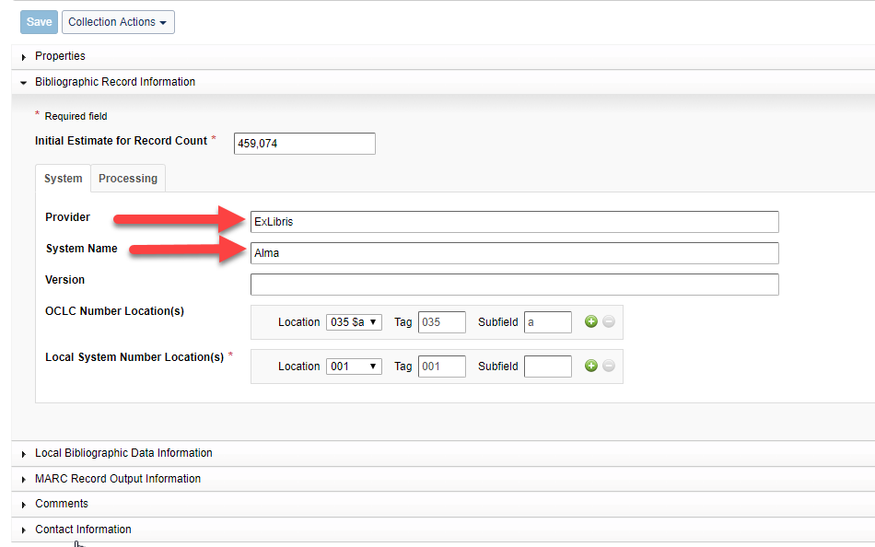
Create a Data Sync Collection in WorldShare for Bibliographic Holdings
Bibliographic Record Information Tab Continued:
Provider: ExLibris
System Name: Alma
Version: [leave blank]
OCLC Number Location(s): [default value]
Local System Number Location(s): [default value]

Slide 12
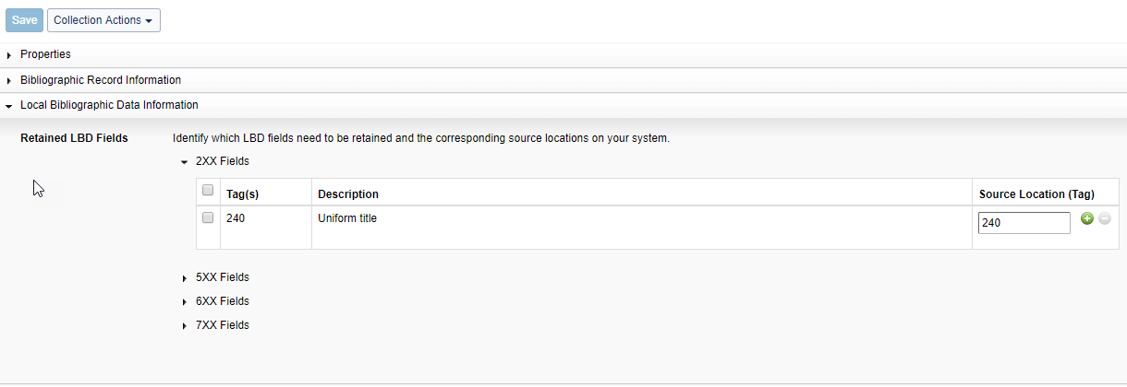
Create a Data Sync Collection in WorldShare for Bibliographic Holdings
Expand Local Bibliographic Information Tab:
Retained Local Bibliographic Data Fields
Do not change, unless you are not mapping bibliographic records to OCLC MARC recognized fields

Slide 13
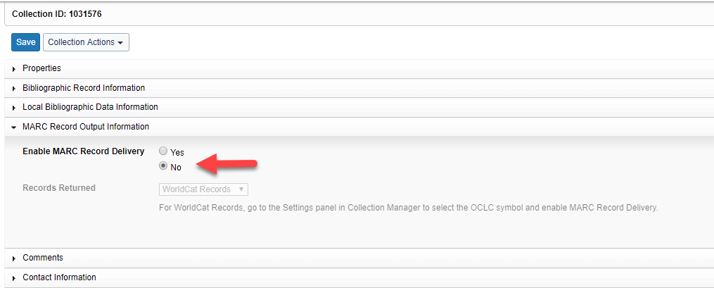
Create a Data Sync Collection in WorldShare for Bibliographic Holdings
Expand Marc Record Output Information Tab:
Enable MARC Record Delivery: NO

Slide 14
Create a Data Sync Collection in WorldShare for Bibliographic Holdings
Expand Contact Information Tab:
Input contact person’s information
This assigns a data sync specialist to this data sync collection for troubleshooting
Click Save
Data Sync Collection has been created for Bibliographic Holdings

Slide 15
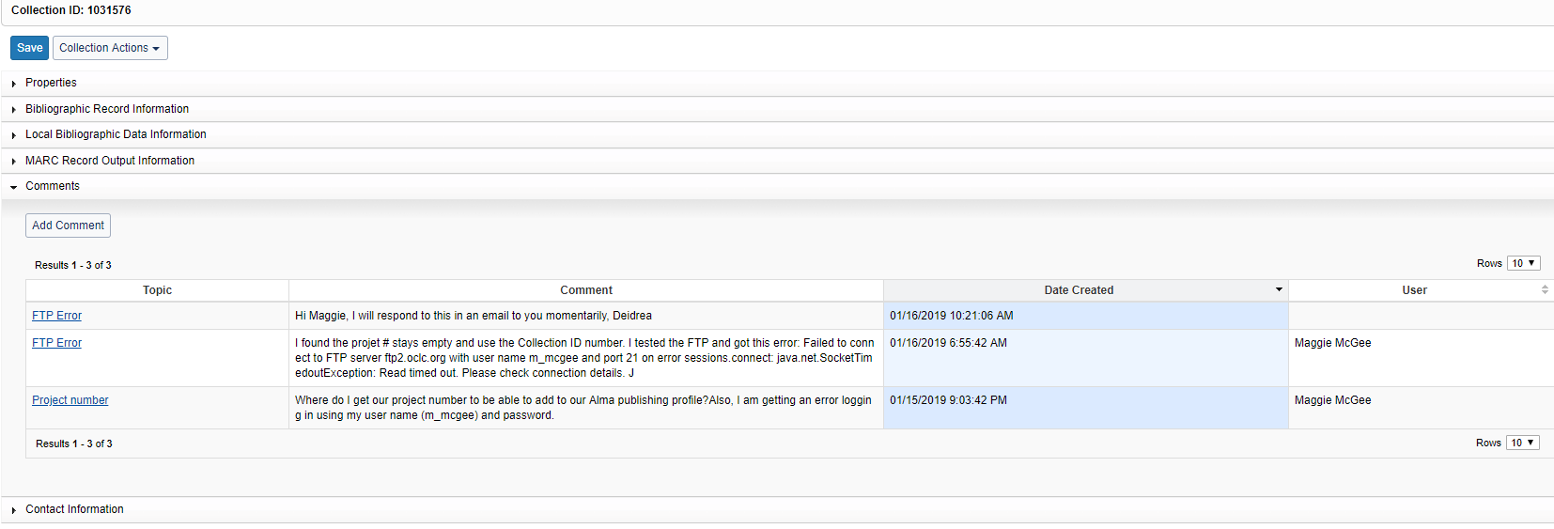
Create a Data Sync Collection in WorldShare for Bibliographic Holdings
Expand Comments Tab:
Only appears after filling out the Contact Tab and Saving the Data Sync Collection
This is where each institution can communicate with an OCLC Data Sync Specialist if there are any issues with creating a Data Sync Collection

Slide 16
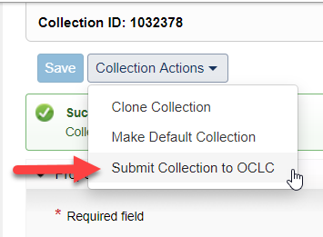
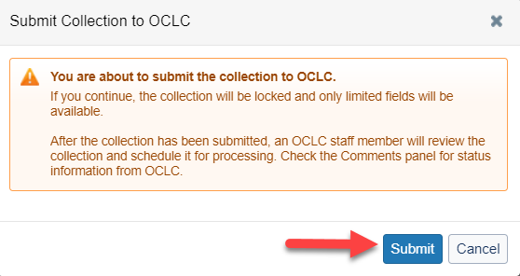
Create a Data Sync Collection in WorldShare for Bibliographic Holdings
Submitting the Collection to OCLC:
Click on the Bibliographic Data Sync Collection Name
Select Submit Collection to OCLC from the drop-down menu
Click Submit

Slide 17
Creating a Data Sync Collection for Local Holdings RECORDS in WorldShare

Slide 18
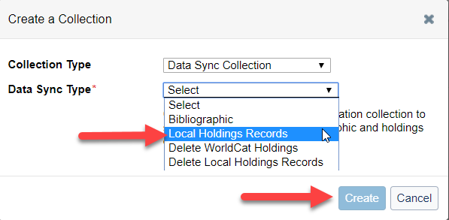
Create a Data Sync Collection in WorldShare for Local Holdings Records
Create a Local Holdings Record Data Sync Collection in WorldShare
Login to WorldShare
Click on the Metadata Link
Click on Collection Manager and expand it
Change Scope to: Data Sync Collection
Check for existing Data Sync Collections
by leaving the search term box empty and
click search
If there are no existing collections that will be used:
Click Create a Collection
Collection Type: Data Sync Collection
Data Sync Type: Local Holdings Record
Click Create

Slide 19
Create a Data Sync Collection in WorldShare for Local Holdings Records
Properties Tab:
Type in a Collection Name
Collection ID will populate once you save the Data Sync Collection*
Group: No
Original Data Format: MARC
*Use Record Status for Processing: No
This allows all data submitted to be processed as LHRs
Description: optional

Slide 20
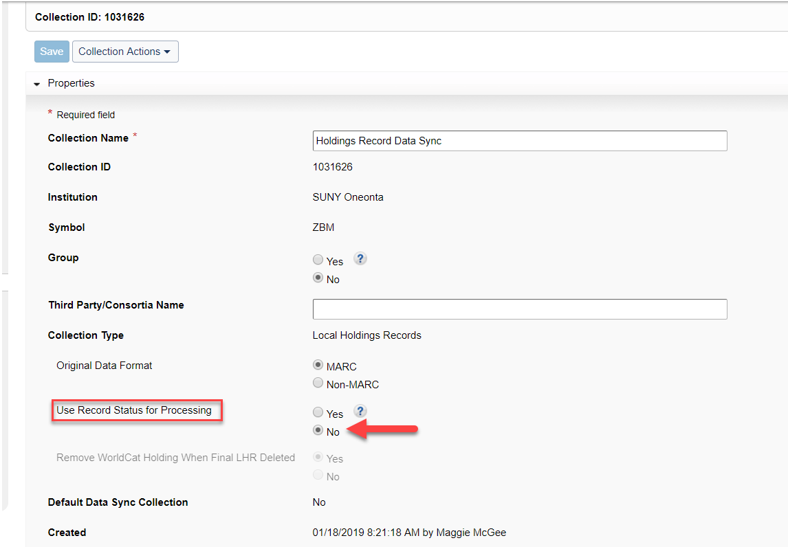
Create a Data Sync Collection in WorldShare for Local Holdings Records
Properties Tab Example:

Slide 21
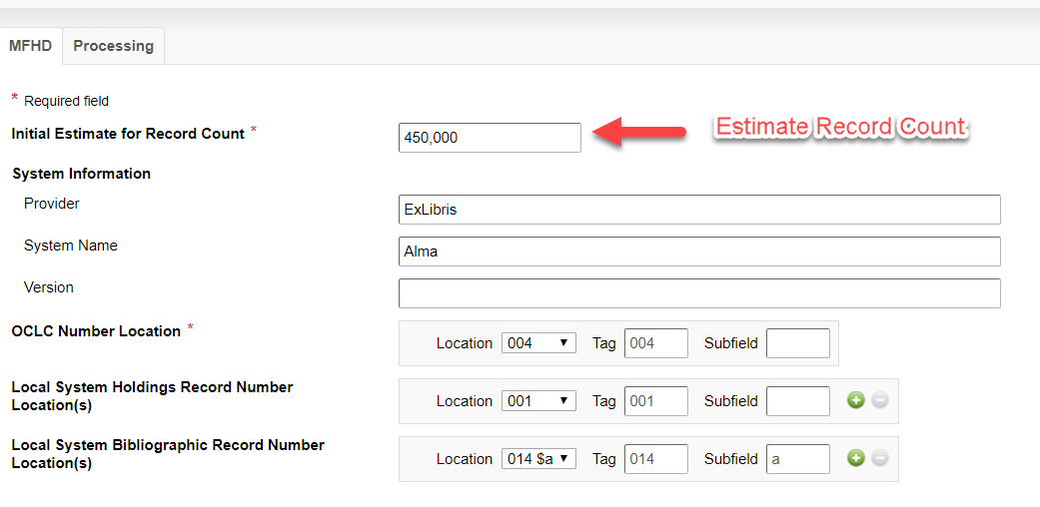
Create a Data Sync Collection in WorldShare for Local Holdings Records
Local Holdings Records Information Tab:
Initial Estimate for Record Count:
Put in a estimate of the number of bibliographic records for the institution.

Slide 22
Create a Data Sync Collection in WorldShare for Local Holdings Records
Local Holdings Records Tab Continued:
Provider: ExLibris
System Name: Alma
Version: [leave blank]
OCLC Number Location(s): [default values]
Local System Number Location(s): [default values]
Local System Bibliographic Record Number Locations: [default values]

Slide 23
Create a Data Sync Collection in WorldShare for Local Holdings Records
Marc Record Output Information Tab:
Enable MARC Record Delivery: NO

Slide 24
Create a Data Sync Collection in WorldShare for Local Holdings Records
Contact Information Tab:
Input contact person’s information
This assigns a data sync specialist to this data sync collection for troubleshooting
Click Save
Data Sync Collection has been created for Local Holdings Records

Slide 25
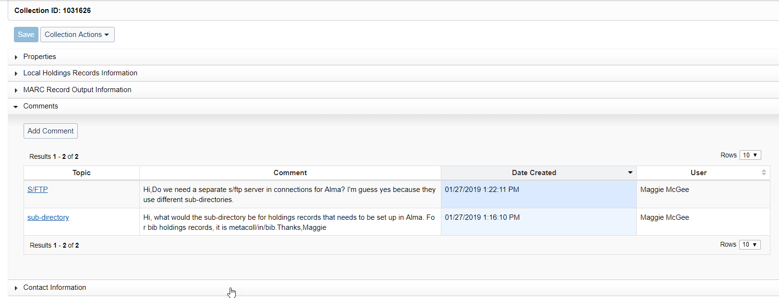
Create a Data Sync Collection in WorldShare for Local Holdings Records
Comments Tab:
Only appears after filling out the Contact Tab and Saving the Data Sync Collection
This is where each institution can communicate with an OCLC Data Sync Specialist if there are any issues with creating a Data Sync Collection

Slide 26
Create a Data Sync Collection in WorldShare for Bibliographic Holdings
Submitting the Collection to OCLC:
Click on the Name
Select Submit Collection to OCLC from the drop-down menu
Click Submit

Slide 27
Setting up Publishing Profiles For Bibliographic Holdings Records in Alma

Slide 28
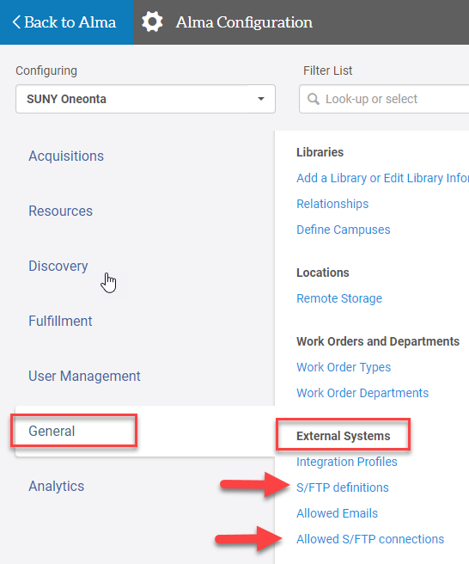
Setting up Publishing Profiles for Bibliographic Holdings Records in Alma
Three steps in setting up Publishing Profiles in Alma:
Add S/FTP definitions*
Add Allowed S/FTP connections
Configuring Publishing Profiles

Slide 29
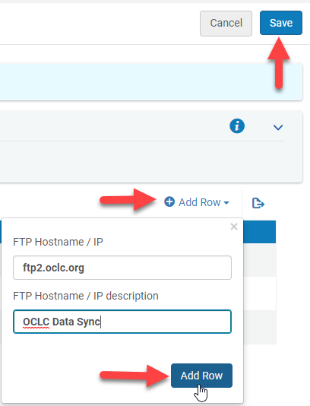
Setting Up Publishing Profiles for Bib Holdings Records in Alma
STEP 1: Add Allowed S/FTP Connections
Configuration>General>External Systems>Allowed S/FTP connections
Click Customize
Click Add Row
Type FTP Hostname/IP: ftp2.oclc.org
Type FTP Hostname/IP description: OCLC Data Sync
Click Add Row
Click Save
*Only need to set this up one time and can be used for Bibliographic and Holdings Data Syncing.

Slide 30
Setting Up Publishing Profiles for Bibliographic Holdings Records in Alma
STEP 2: S/FTP Definitions for Bibliographic Holdings Records
Configuration>General>External Systems>S/FTP definitions
Click Add S/FTP connection
Name: OCLC Bib Data Sync
Server: ftp2.oclc.org
Port: 22
Sub-directory: metacoll/in/bib
Max. Number of Files: [leave blank]
Min. Number of Files: 1
Max. file size: 100000
Size type: MB
Allow Navigation: True
Ftp Server Type: Default
Ftp Passive Mode: [keep unchecked]
Ftp Server Secured: [check the box]
Authentication method: username/password authentication
Username: [OCLC Symbol]
Password: [supplied by OCLC]

Slide 31
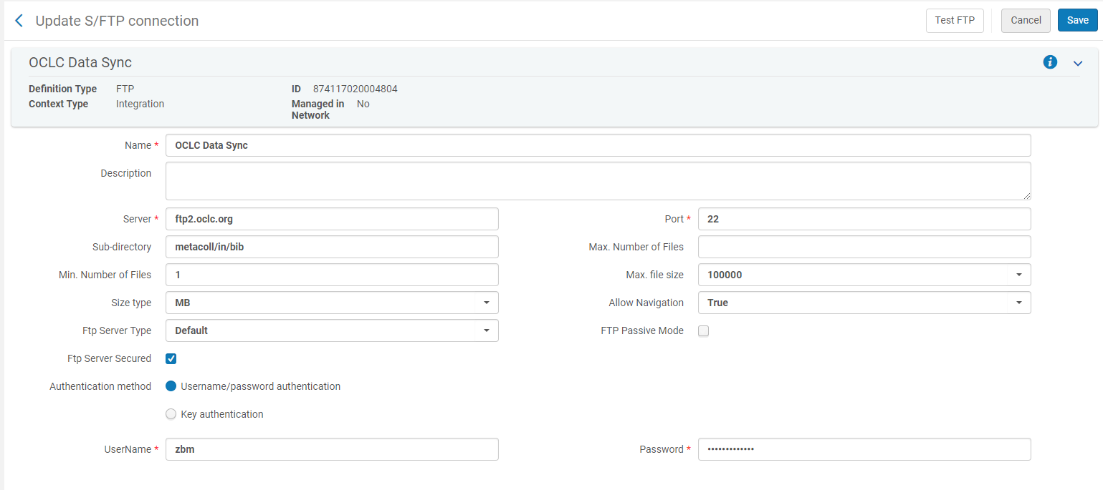
Setting Up Publishing Profiles for Bibliographic Holdings Records in Alma
STEP 2: S/FTP Definitions for Bibliographic Holdings Records Example

Slide 32
Setting Up Publishing Profiles for Bibliographic Holdings Records in Alma
STEP 2 S/FTP Definitions for Bibliographic Holdings Records Continued
Click Test FTP
A message will appear saying the Ftp upload, download, and delete were successful
If an error message appears, try changing the Port to 21
Click Save

Slide 33
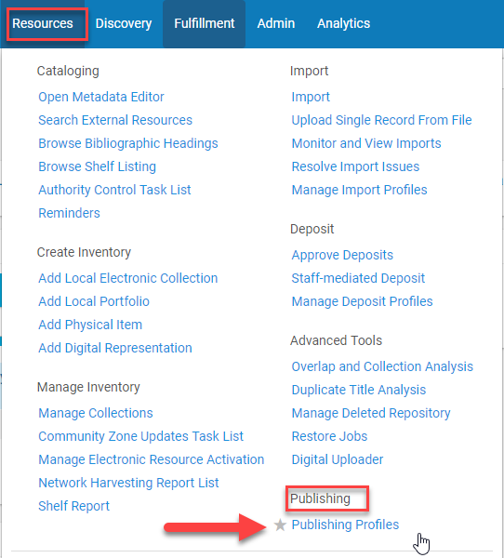
Setting Up Publishing Profiles for Bibliographic Holdings Records in Alma
STEP 3: Configuring Publishing Profiles for Bibliographic Holding Records
Resources>Publishing>Publishing Profiles
Click the ellipses for Publish Bibliographic record (DataSync) to OCLC
Choose Edit

Slide 34
Setting Up Publishing Profiles for Bibliographic Holdings Records in Alma
STEP 3: Configuring Publishing Profiles for Bibliographic Holdings Records Continued
Profile Details
Name: [keep]
Profile description: [keep]
OCLC institution symbol: OCLC Symbol
Project number: [keep blank]
Collection ID: From OCLC Data Sync Collection

Slide 35
Setting Up Publishing Profiles for Bibliographic Holdings Records in Alma
STEP 3: Configuring Publishing Profiles for Bibliographic Holdings Records Continued
Publishing Parameters & Submission Format for Bibliographic Holdings Records:
Publishing Mode:
Incremental
Publish only changed records since the last time the profile was run. This will be run regularly after the initial Baseline has been run after go-live.
*Baseline
This option is intended for use ONE TIME immediately after the database is migrated to Alma and before any OCLC records are changed in Alma
Full
Publishes all records
Notes:
Baseline will be run one time after go-live. Incremental will be run after baseline to update holdings.
Jobs cannot be run during implementation. ExLibris tested running Oneonta’s baseline and incremental to SUNY’s S/FTP server instead

Slide 36
Setting Up Publishing Profiles for Bibliographic Holdings Records in Alma
STEP 3: Configuring Publishing Profiles for Bibliographic Holdings Records Continued
Publishing Parameters & Submission Format for Bibliographic Holdings Records Continued:
Status:
Active or Inactive
Choose Inactive until go-live
Scheduling:
Select Not scheduled, Every day at 06:00 or Every Saturday at 6:00
Email Notifications:
To get email notifications from the Data Sync
Choose send on Success and/or Send on Error
Submission Format:
FTP Configuration: the server where the Data Sync file is being sent
Click Save
Notes:
Keep inactive until the institution is ready to either test with ExLibris or after go-live
For testing the Data Sync file was being sent to the SUNY S/FTP server

Slide 37
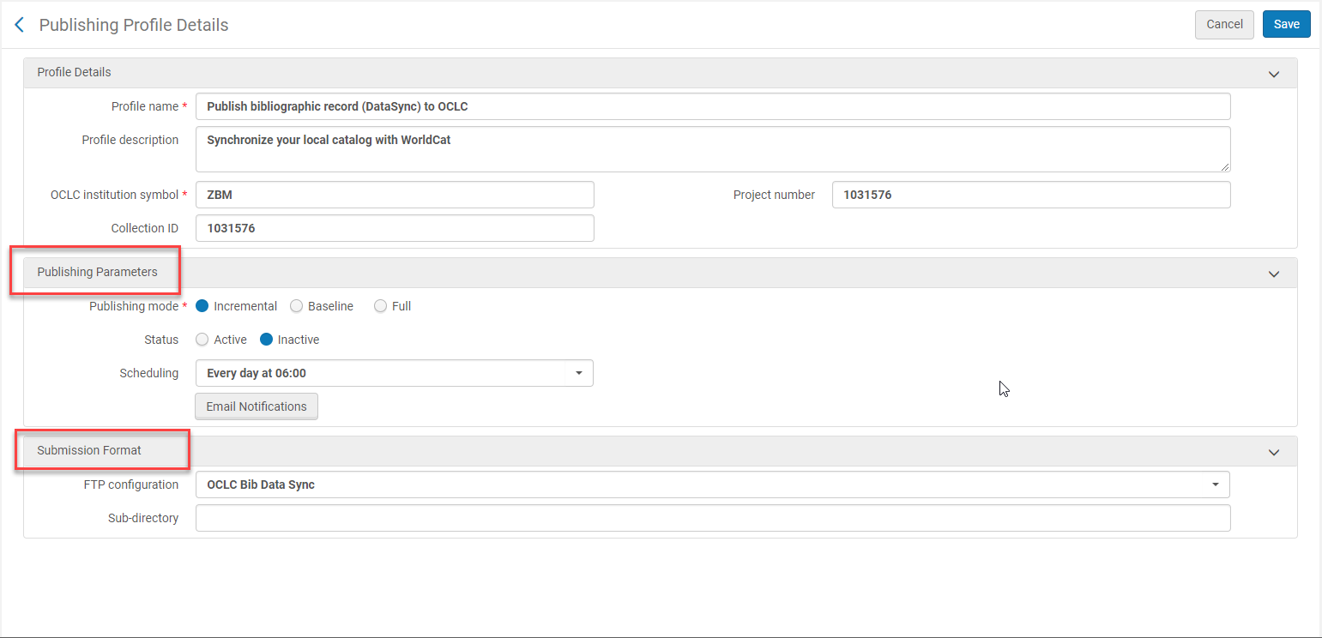
Setting Up Publishing Profiles for Bibliographic Holdings Records in Alma
STEP 3: Configure Publishing Profiles Profile Details Bib Holdings Records Continued
Publishing Parameters & Submission Format for Bibliographic Holdings Record Example:
Notes:
Bib and Local Holdings Publishing Profiles can run at the same time because they are different jobs.

Slide 38
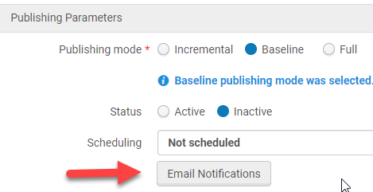
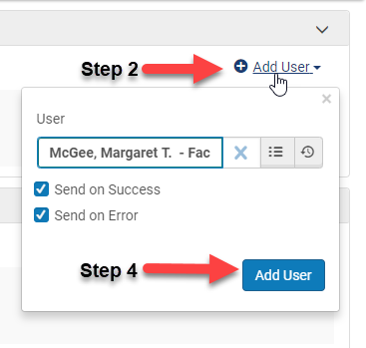
Setting Up Publishing Profiles for Bibliographic Holdings Records in Alma
STEP 3: Configure Publishing Profiles for Bibliographic Holdings Records Continued
Setting up email notifications:
Click on Email Notifications
Click Add User
Enter user name or search for user
Keep Send on Success and Send on Success checked unless you do not want to receive a notification the job is complete
Click Add User
Click Done

Slide 39
Setting up Publishing Profiles For Local Holdings Records in Alma

Slide 40
Setting Up Publishing Profiles for Local Holding Records In Alma
STEP 2: Add S/FTP Definitions for Local Holdings Records
Configuration>General>External Systems>S/FTP definitions
Click Add S/FTP connection
Name: OCLC Bib Data Sync
Server: ftp2.oclc.org
Port: 21
Sub-directory: metacoll/in/lhr
Max. Number of Files: [leave blank]
Min. Number of Files: 1
Max. file size: 100000
Size type: MB
Allow Navigation: True
Ftp Server Type: Default
Ftp Passive Mode: [keep unchecked]
Ftp Server Secured: [check the box]
Authentication method: username/password authentication
Username: [OCLC Symbol]
Password: [supplied by OCLC]

Slide 41
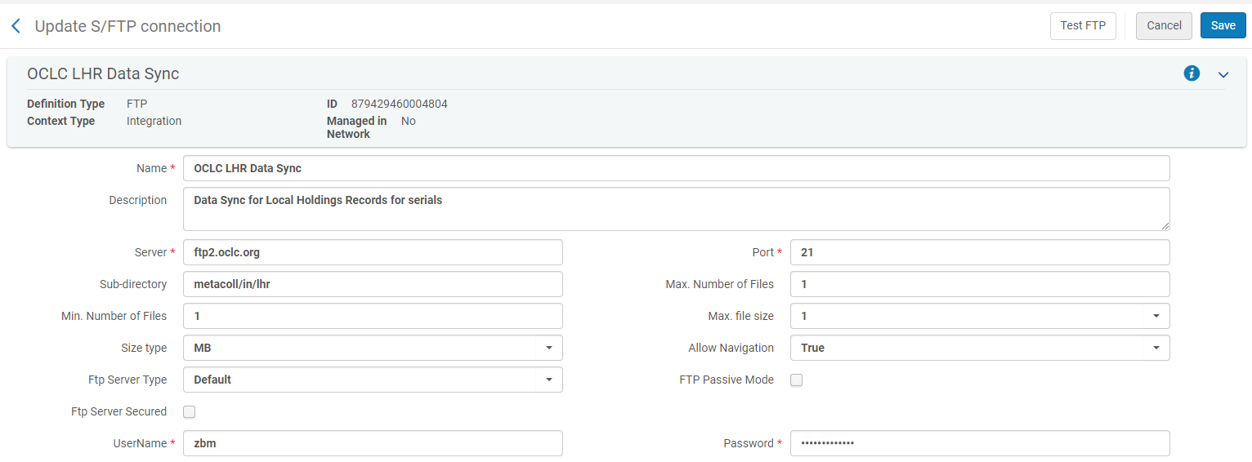
Setting Up Publishing Profiles for Local Holdings Records in Alma
STEP 2: S/FTP Definitions for Local Holdings Records Example

Slide 42
Setting Up Publishing Profiles for Local Holdings Records in Alma
STEP 2 S/FTP Definitions for Local Holdings Records Continued
Click Test FTP
A message will appear saying the Ftp upload, download, and delete were successful
If an error message appears, try changing the Port to 22
Click Save

Slide 43
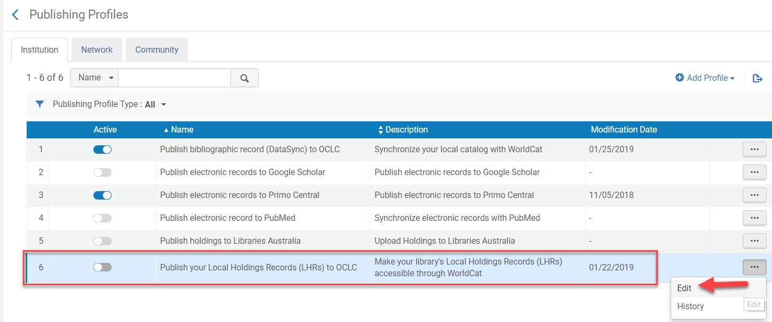
Setting up Publishing Profiles for Local Holdings Records in Alma
STEP 3: Configure Publishing Profiles for Local Holding Records
Resources>Publishing>Publishing Profiles
Click the ellipses for Publish your Local Holdings Records (LHRs) to OCLC
Choose Edit

Slide 44
Setting Up Publishing Profiles for Local Holdings Records in Alma
STEP 3: Configure Publishing Profiles for Local Holdings Records Continued
Profile Details
Name: [keep]
Profile description: [keep]
OCLC institution symbol: OCLC Symbol
Project number: [keep blank]
Collection ID: From OCLC Data Sync Collection

Slide 45
Setting Up Publishing Profiles for Local Holdings Records in Alma
STEP 3: Configure Publishing Profiles for Local Holding Records Continued
Parameters & Submission Format for Local Holdings Records Continued
Publishing Mode:
Incremental
Publish only changed records since the last time the profile was run. This will be run regularly after the initial Baseline has been run after go-live.
*Baseline
This option is intended for use ONE TIME immediately after the database is migrated to Alma and before any OCLC records are changed in Alma
Full
Publishes all records
Notes:
Baseline will be run one time after go-live. Incremental will be run after baseline to update holdings.
Jobs cannot be run during implementation. ExLibris tested running Oneonta’s baseline and incremental to SUNY’s S/FTP server instead

Slide 46
Setting Up Publishing Profiles for Local Holdings Records in Alma
STEP 3: Configure Publishing Profiles for Local Holdings Records Continued:
Publishing Parameters & Submission Format for Bibliographic Holdings Records Continued:
Status:
Active or Inactive
Choose Inactive until go-live
Scheduling:
Select Not scheduled, Every day at 06:00, or Every Saturday at 6:00
Email Notifications:
To get email notifications from the Data Sync
Choose send on Success and/or Send on Error
Submission Format:
FTP Configuration: the server where the Data Sync file is being sent
Click Save
Notes:
Keep inactive until the institution is ready to either test with ExLibris or after go-live
For testing the Data Sync file was being sent to the SUNY S/FTP server

Slide 47
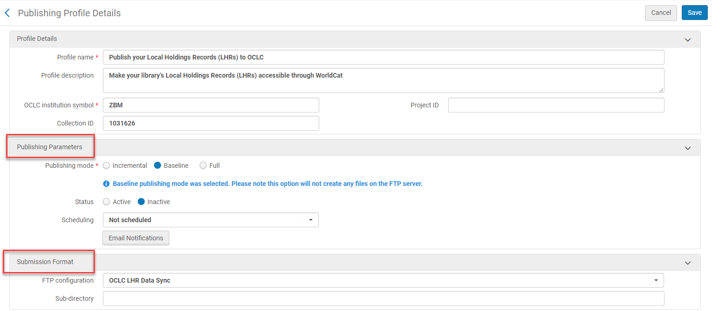
Setting Up Publishing Profiles for Local Holdings Records in Alma
STEP 3: Configure Publishing Profiles for Local Holdings Records Continued
Publishing Parameters & Submission Format for Bibliographic Holdings Record Example:
Notes:
Bib and Local Holdings Publishing Profiles can run at the same time because they are different jobs.

Slide 48
Setting Up Publishing Profiles for Local Holdings Records in Alma
STEP 3: Configure Publishing Profiles Profile Details Local Holdings Records Continued
Setting up email notifications:
Click on Email Notifications
Click Add User
Enter user name or search for user
Keep Send on Success and Send on Success checked unless you do not want to receive a notification the job is complete
Click Add User
Click Done

Slide 49
Testing the Publishing Profiles Job in Alma

Slide 50
Testing the Publishing Profile Job in Alma
DO NOT test the Publishing Profile Job using the OCLC FTP server
Publishing Profile jobs should only be done using the OCLC FTP server after go-live
Change the FTP Configuration to the SUNY S/FTP server in Publishing Profile Step 3
After go-live you will:
Run Baseline one time using the OCLC server
Run Incremental for the daily or weekly job using the OCLC server
Testing the Publishing Profile Job needs to be done through ExLibris
Jobs cannot be run during the implementation phase
ExLibris can test running jobs for an institution through a request
First, run Baseline with ExLibris for both Bibliographic and Local Holdings Records.
Does not require any changes to either record type to be run
Next, run Incremental for both Bibliographic and Local Holdings Records
Requires making changes to Bibliographic or Local Holdings Records

Slide 51
Testing the Publishing Profile Job in Alma
Change the FTP Configuration to the SUNY S/FTP server in Publishing Profile Step 3 for Bibliographic and Local Holding Records
Refer to the slides at the end to configure the SUNY S/FTP server if it has not already configured in Alma
Go to Resources>Publishing Profiles from the Alma menu
Choose edit from the ellipses from the Publishing Profile being chosen
Choose either Baseline or Incremental for the Publishing Mode
Baseline for the first test
Incremental for the second test
Change Status to Active
Choose a scheduling time
Change the FPT Configuration from the OCLC to the SUNY S/FTP server
Sub-directory: OCLC
Click Save

Slide 52
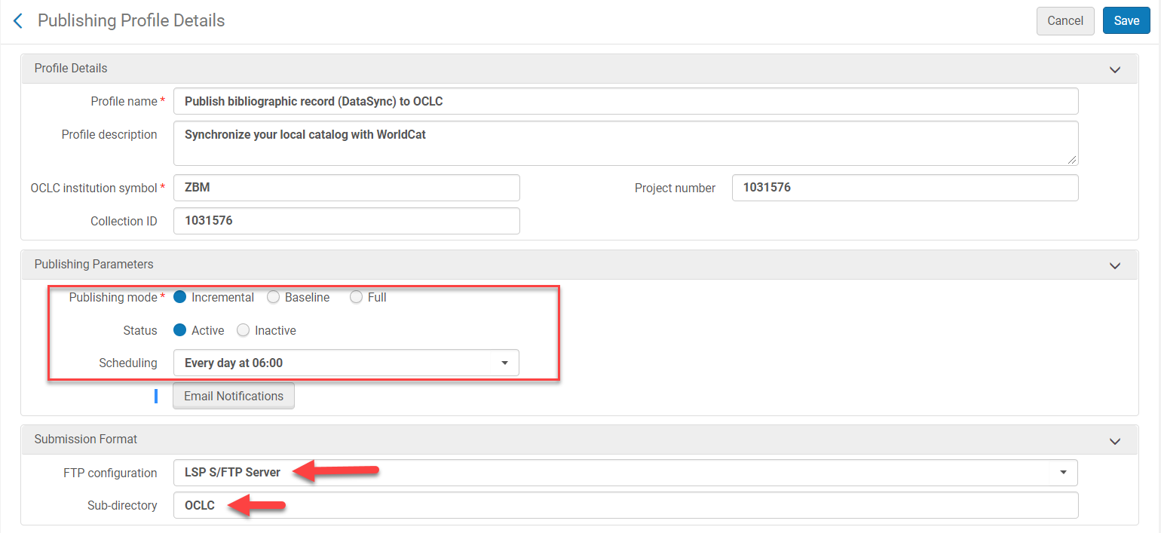
Testing the Publishing Profile Job in Alma
Change to the Publishing Profile in Step 3 for Publish Bibliographic Record (DataSync) to OCLC Example:

Slide 53
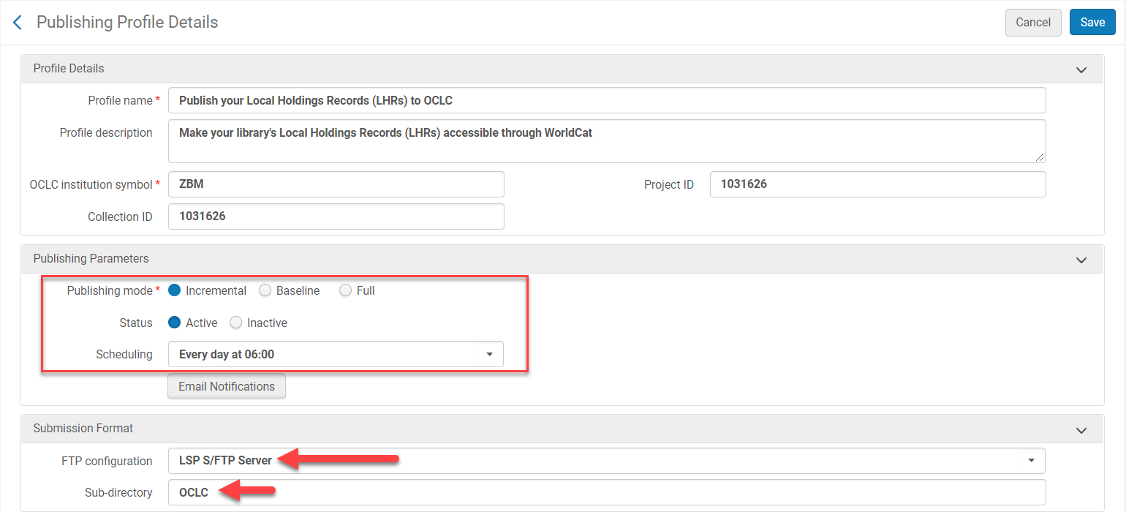
Testing the Publishing Profile Job in Alma
Change to the Publishing Profile in Step 3 for Publish your Local Holdings Records (LHRs) to OCLC Example:

Slide 54
Editing Bibliographic Holdings Records to Test Publishing Profiles
Before running the Bibliographic Holding incremental test
Change the leader (LDR) 05 position to d on a group of records in the Metadata editor
Create a set from a repository search and change the LDR 05 position to d for some of the records
From the Set choose a record and open it in the Metadata Editor:
Ctrl+f opens the form to edit position 05 easier
Choose d Deleted from the drop-down menu
File>Save and Release the record or Ctrl+Alt+R

Slide 55
Editing Local Holdings Records to Test Publishing Profiles
Before running the Local Holdings Records incremental test change the holdings information in MARC field 866
Creating a set for physical serials titles with Local Holdings Records and change some of the records in the set
This set will need to be recreated after go-live to batch change the flag to publish holdings to sync local holdings records with OCLC
Open the holdings record of a title from the set in the Metadata Editor
Edit MARC field 866 in the Local Holdings Record
Save the record: Tools>Save, Save icon, or Ctrl+S
Click on the Spilt Editor (F6) icon to open the Bibliographic Record
Click Tools>Set Management Tags>Export to WorldCat>
Choose publishing holdings
Save and Release both the Holdings and Bibliographic records: File>Tools>Save and Release Record or Ctrl+Alt+R

Slide 56
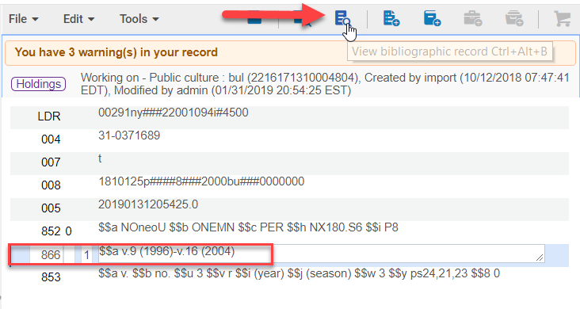
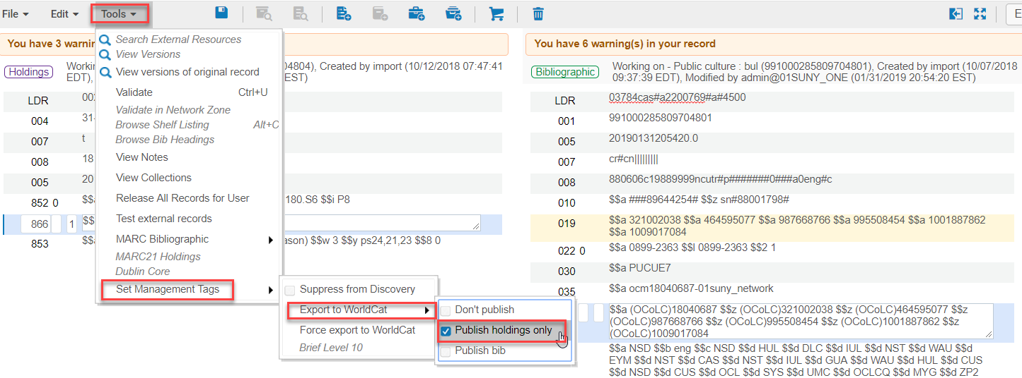
Editing Local Holdings Records to Test Publishing Profiles

Slide 57
Ready to Test Running the Publishing Profile
Ask ExLibris to run the job
After the Publishing Profile Job Runs in Alma
An email notification will be sent to the email(s) in Email Notifications in Publishing Profiles Step 3 in Alma
Results of the Job can also be seen by going to Admin>Monitor Jobs
Click the History Tab
Adjust the Submit Date Range is the Job does not appear in the list
Click the ellipses
Choose Report to view results of the Job

Slide 58
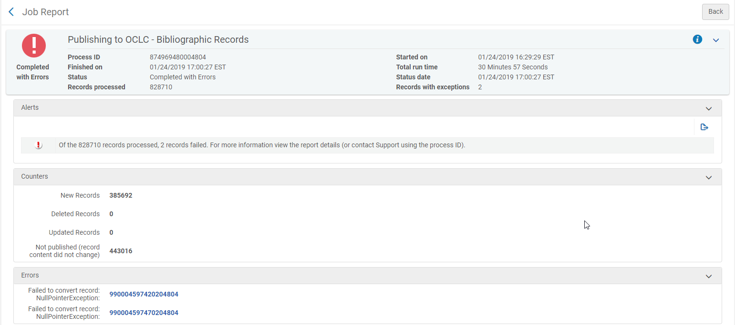
After the Publishing Profile Job Runs in Alma
Example of a Completed Publishing Profile for a Baseline Job Report in Alma:

Slide 59
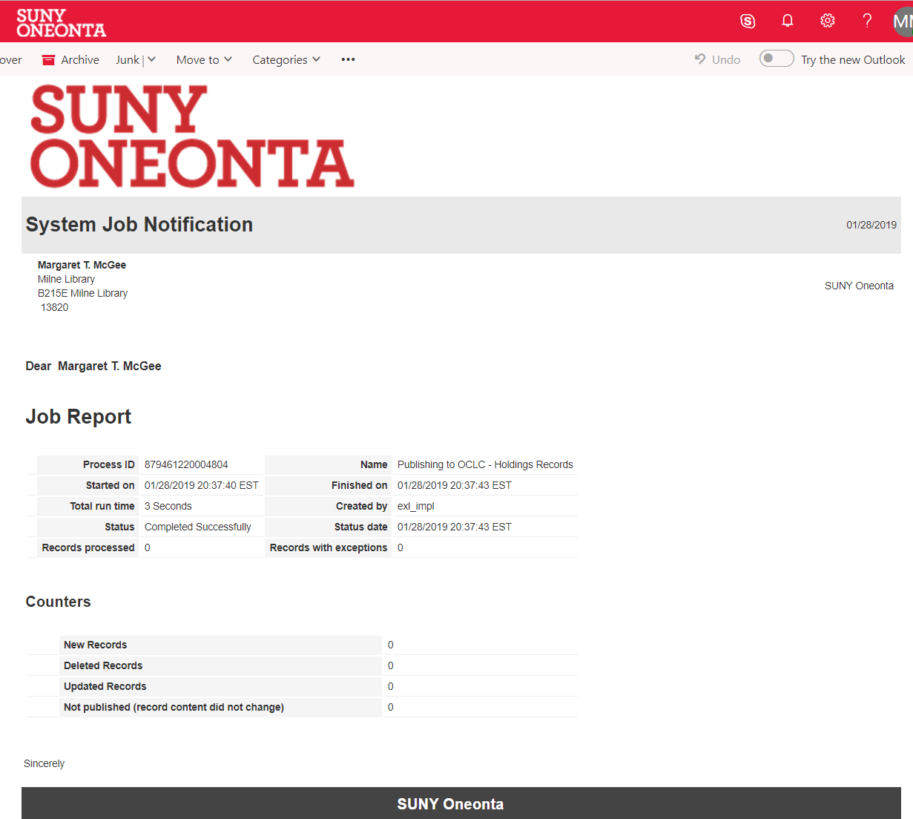
After the Publishing Profile Job Runs in Alma
Example of a Completed Publishing Profile for a Baseline Job Email:

Slide 60
After the Publishing Profile Job Runs in Alma
Example of a Completed Publishing Profile for an Incremental Job Report in Alma:

Slide 61
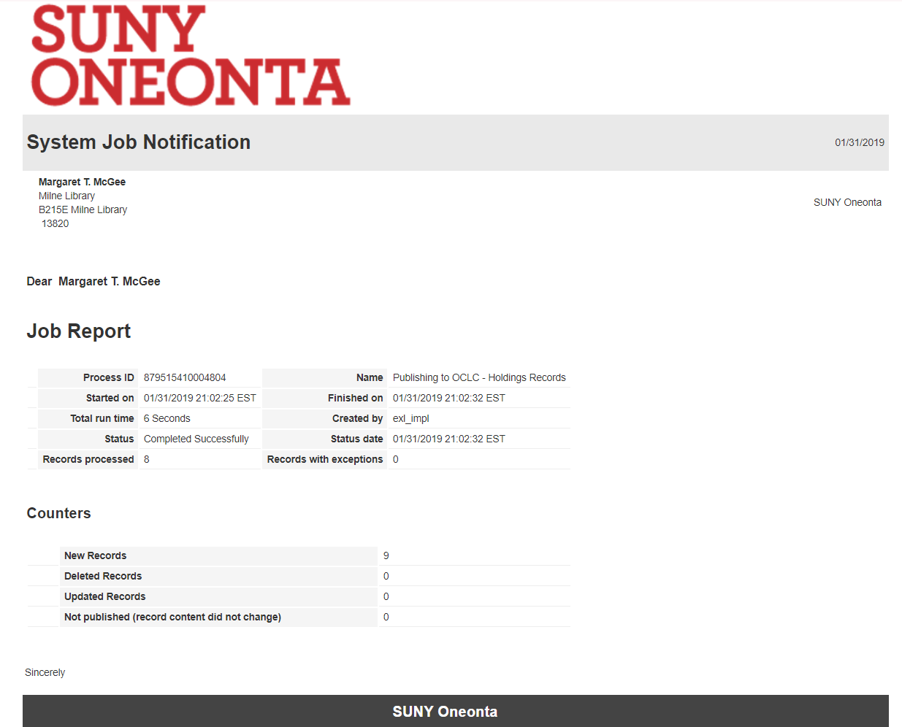
After the Publishing Profile Job Runs in Alma
Example of a Completed Publishing Profile for an Incremental Job Email:

Slide 62
Configuring the SUNY S/FTP Server

Slide 63
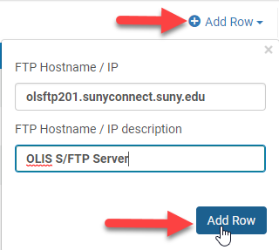
SUNY S/FTP Server Configuration in Alma
Only do this is if the SUNY S/FTP server has not been configured in Alma
STEP 1:
Configuration>General>Allowed S/FTP connections
Click Add Row
FTP Hostname/IP: olsftp201.sunyconnect.suny.edu
FTP Hostname/IP Description: OLIS S/FTP Server
Click Add Row

Slide 64
SUNY S/FTP Server Configuration in Alma
Only do this is if the SUNY S/FTP server has not been configured in Alma
STEP 2:
Configuration>General>S/FPT definitions
Click Add S/FPT connection
Name: OLIS or LSP S/FTP Server
I chose LSP S/FTP Server to not confuse it with OCLC by mistake
Server: olsftp201.sunyconnect.suny.edu
Port: 2222
Leave the Default settings
Check the FTP Server Secured box
Authentication method: Username/password authentication
Username/Password: same credentials used to access the Aleph sandbox
Click Test FTP
Click Save if Test worked

Slide 65
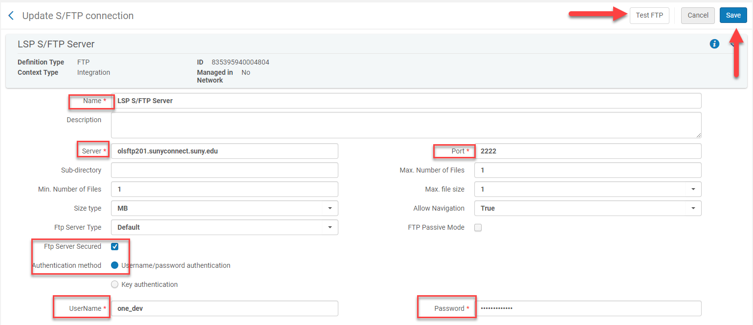
SUNY S/FTP Server Configuration in Alma
Only do this is if the SUNY S/FTP server has not been configured in Alma
S/FTP Example:

Slide 66
Updating a batch of serials holdings in Alma After Go-Live

Slide 67
Updating a Batch of Serials Holdings in OCLC Using Publishing Profiles
Create a set
Perform a repository set and save the set or
Upload a file
Run a job
Go to Admin>Monitor Jobs and Sets>Run a Job
Publishing Profile Runs
This will run automatically every day at 6:00 am

Slide 68
Create a Set for Serials Using Save Query
Perform an advanced repository search for print serials that need to have their holdings records synced with OCLC (if they haven’t been updated or are in OCLC and you would like to add them)
Physical titles
Zone: IZ
Holdings: Permanent physical location: Equals: [periodicals permanent location]

Slide 69
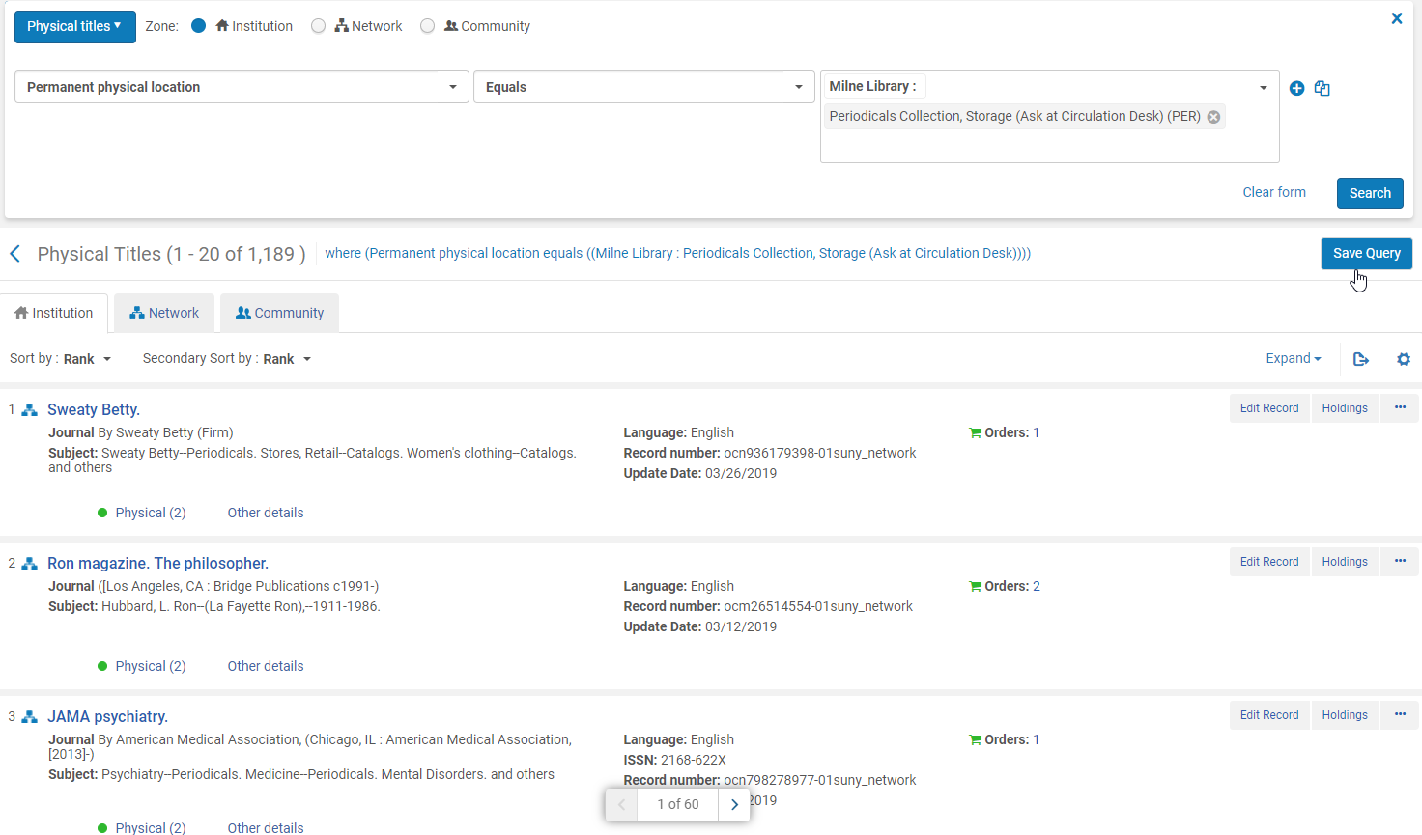
Create a Set for Serials Using Save Query
Click Search
Click Save Query

Slide 70
Create a Set for Serials Using Save Query
The Set Details screen open
Set Name: [name it something meaningful]
Description: [add to help identify the purpose of the set]
Private: [Click on the No radio button]
Status: [Keep the Active radio button clicked]
Click Save
The set is now added to Manage Sets

Slide 71
Create a Set from a File
Perform an advanced repository search for print serials that need to have their holdings records synced with OCLC (if they haven’t been updated or are in OCLC and you would like to add them)
Physical titles
Zone: IZ
Holdings: Permanent physical location: Equals: [periodicals permanent location]

Slide 72
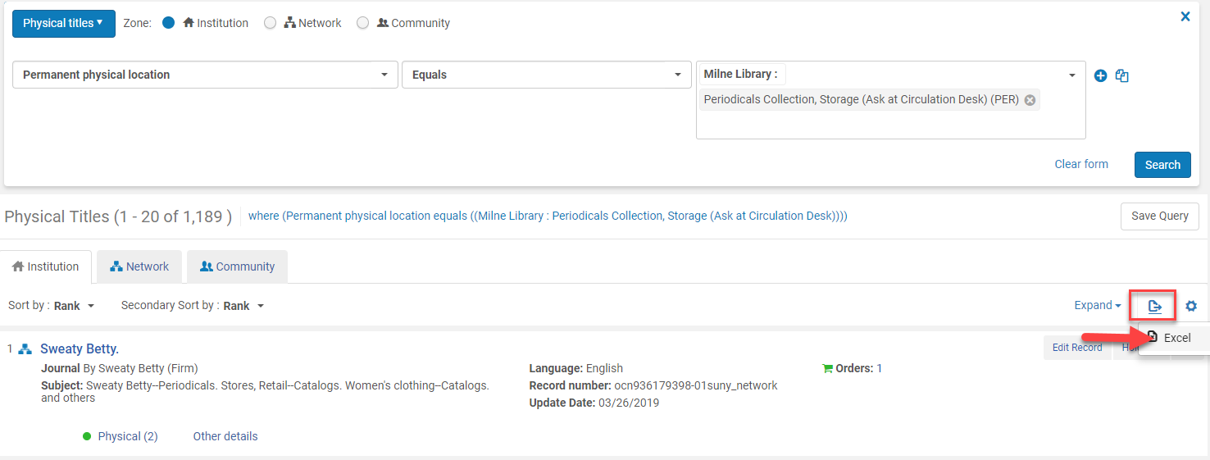
Create a Set from a File
Click Search
Click Export list icon to export the query to Excel
The set will open in Excel
Review and edit the Excel file
Save and name the Excel file

Slide 73
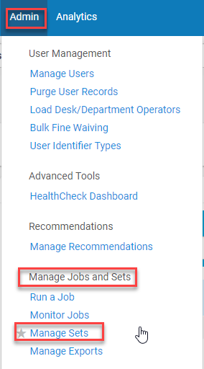
Creating a Set from a File
Got to Admin>Manage Jobs and Sets>Manage Sets
The Manage Sets screen appears
Click Add Set
Click Itemized

Slide 74
Creating a Set from a File
The Set Details screen open
Set Name: [name it something meaningful]
Description: [add to help identify the purpose of the set]
Set content type: [keep All Titles]
Private: [Click on the No radio button]
Status: [Keep the Active radio button clicked]
Add Contents from File to Set: [click the from file radio button]
Upload the file
Click Save
The set is now added to Manage Sets

Slide 75
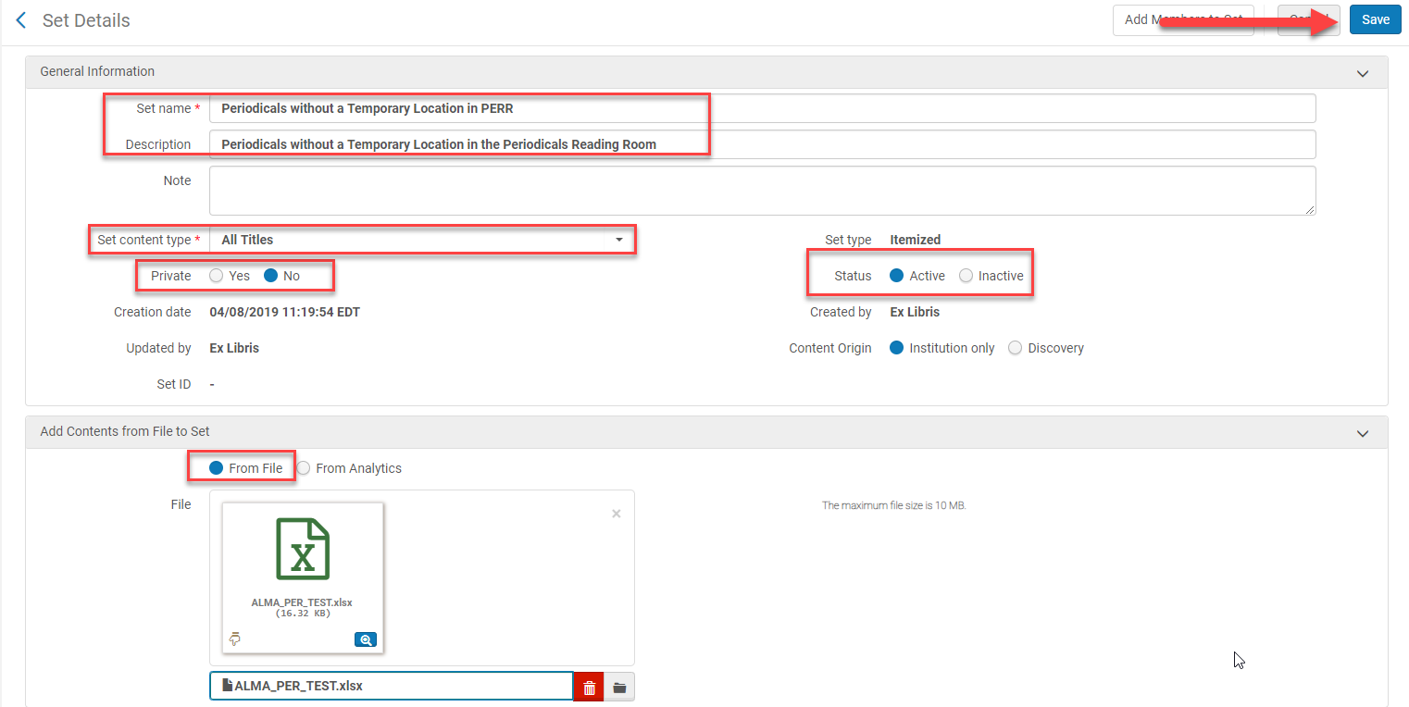
Creating a Set from a File
The Set Details screen continued

Slide 76
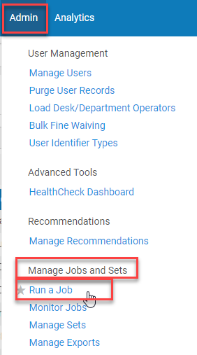
Running a Job to Change the Holdings Flag
Got to Admin>Manage Jobs and Sets>Run a Job
Type sync in the search field
Click the Search icon or hit enter
Click on the radio button next to Synchronize bib records
with external catalog
Click Next

Slide 77
Running a Job to Change the Holdings Flag
Click the radio button next to the saved set
Click Next

Slide 78
Running a Job to Change the Holdings Flag
Run a Job – Enter Task Parameters screen opens
Synchronize with external catalog: [click the radio button next to Publish holdings only]
Click Next
Run a Job – Review and Confirm screen opens
Click Submit

Slide 79
Running a Job to Change the Holdings Flag
A confirmation message appears asking if you really want to continue
Once Confirm is clicked, the changes cannot be undone
Click Confirm
Monitor Jobs screen opens
Once the job has finished running it will be under the History tab
Click Report from the ellipses to view the results of the job
Click Events to see errors if the job failed or completed with errors
Spot check the flag was changed

Slide 80
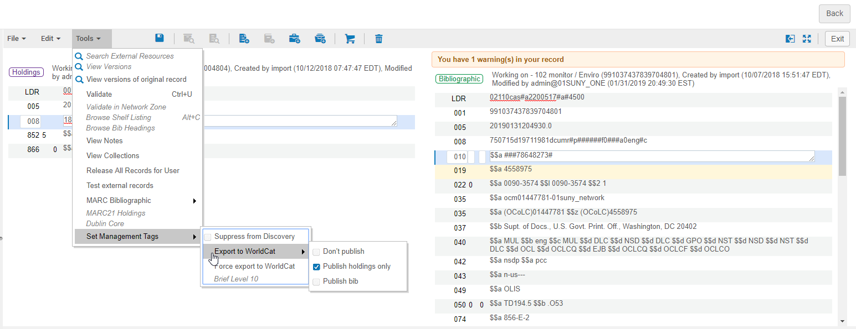
Spot Check the Holding Flag Changes Took Place

