Slide 1

George Mason District
Roundtable
October 12, 2023

Slide 2
Agenda
Welcome and Pledge
Questions about Read-ahead
General Announcements
Scouting for Food
Camporee Update
Scout Expo Update
Breakout Session (Cubs): Cub leader issues (CM, ACM, DL)
Breakout Session (Scouts BSA): Recruitment
Cracker Barrel/Networking (Optional; NLT 9pm)
Next Meeting: November 9, 2023 (7:00pm Scout Expo/RT)

Slide 3

Pledge

Slide 4
Welcome
New to Roundtable?
Please introduce yourself!

Slide 5
Questions/Clarification about Read-ahead?

Slide 6
General Announcements
Charter Renewal
    Merit Badge Counselors – Cont. and only
    Multiples – Clear Cache/Incognito Mode
    Transfers from out of Council - Paper
    Training for Outdoor Ethics Guides – 10/22/23 at the Vale UMC (4:30pm – 6:30pm)
    Troop 987 Recruiting Events – 10/28, 11/4, 11/18

Slide 7

Hunger is still out there, and so are we!
GEORGE MASON DISTRICT
SCOUTING FOR FOOD
2023

Slide 8
The Basics:
  Saturday, October 28: Put the Scouting for Food stickers on doors in your unit’s assigned zone
  Saturday, November 4: Pick up the food and deliver to the unit’s assigned food pantry
  Coverage areas for each unit are here: GMD Scouting for Food map

Slide 9

Good news: We have stickers! AND THEY HAVE DATES*!
  We have more than last year. I have extras, some of which have dates and some that don’t
  Through Basecamp, let me know if you have extras, and if you need more
Rules to keep in mind:
  YPT: drive as families or two adults per car
  Respect no soliciting signs
  Don’t go inside people’s homes
  Be careful crossing streets
  Don’t ring doorbells

Slide 10
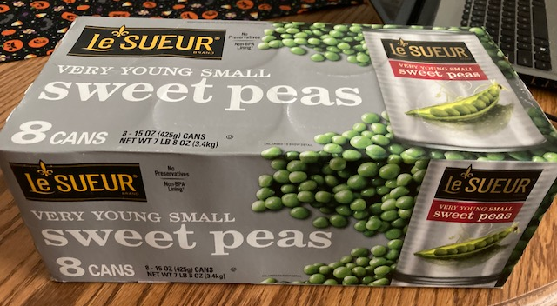
OPTIONAL: Awareness-building during the week
  Weekly bulletins
  Neighborhood Facebook pages
  Signs
If possible, try to get the food pantry to weigh each unit’s donation and record the weight. If not, you can estimate: A full bag is about ten pounds (welcome better methodologies from the crowd)
  8 cans=7.5 pounds

Slide 11
Data Capture
Unit’s fill out at:
https://www.ncacbsa.org/scouting-for-food-unit-data/
District: George Mason District
Number of Scouts and Other Youth Participants (siblings, friends, etc)
Number of Adult Participants
Pounds of Food Collected
Food pantry delivered to
For your Scouts: Express the weight in fun terms, for example
  Vehicles, animals, dinosaurs

Slide 12
Camporee

Slide 13
Scout Expo – November 09, 2023

Slide 14

Current 2023 George Mason Calendar
October 20-22, 2023 – Fall Camporee
October 28, 2023 – Scouting for Food (Tags)
November 4, 2023 – Scouting for Food (Collection)
November 11, 2023 – Flags In (Veterans Day)

Slide 15
Time for Cracker Barrell
Minutes and slides available on the GMD web site (District Resources, Roundtable). Password is “GMDRT”
Next meeting – November 9, 2023, at Thoreau MS
  7:00pm – Scout Expo
  8:00pm - Roundtable

Slide 16
Backup Slides

Slide 17
Fall Camporee
  Camp Rock Enon (off 81 in western VA) on October 20-23, 2023 – registration opens Monday. Webelos welcome. Units provide their own food. About 1.5 hours from Vienna, VA.
  Activities will include Shooting Sports, Merit Badge completions, Friendship & Fellowship, and a Campfire.
  Will need lots of volunteers to successfully do this. Even if you could only do a few hours, that would be helpful.
  Partial and full merit badge classes
  Scouts sign up for Merit Badges when they register and pay
  Cost is $30 for scouts, adults, and staff - more if doing shooting.
  (2) 90-minute AM sessions, (2) 90-minute PM sessions, (1) 60-minute slow prior to dinner

Slide 18
Council Update
2024 National Dues – Effective 08/01/23 - https://public.3.basecamp.com/p/XoisQJcMr1NncMfshG7xCj9f
2024 Council Dues – Effective 1/1/24 - https://www.ncacbsa.org/participation-fee/https://www.ncacbsa.org/participation-fee/
Unit Charter Renewal - Charter Renewal opened on 10/02/23 at https://advancements.scouting.org/. Only the unit Key 3 and Key 3 delegates can access the software. Use the same Username and Password that you use for https://my.scouting.org and Scoutbook.
  Thanks to all that attended one of the two Charter Renewal training sessions. The first session was recorded. Link (Passcode: n%7N4C^u) to view the session (70 minutes long).
Here is a link to the GMD Basecamp site that contains the
2024 Annual Membership Handbook (PDF)
Internet Rechartering User Guide (PDF)
Membership Renewal for Units (PPTX)
NCAC Charter Renewal web site: https://www.ncacbsa.org/recharter/
In addition to the online Charter Renewal, we need units to get their unit’s Annual Charter Agreement signed by the Chartering Organization (Executive Officer), the COR, and your Unit Committee Chair. The fillable Annual Charter Agreement is here. If your Chartering Organization is a Catholic Dioceses/Parish, they may require this version. Please check with your Executive Officer to determine which version they would prefer to submit. NCAC will accept either version.

Slide 19
STEM
Cubs Can Code, 11-18-23 (6pm), Zoom
Ancient Earth: Birth of the Sky (on PBS) - link
Anytime – DC STEM Trek- Showcases 24 government agencies, private organizations and monuments related to the tenets upon which STEM is based. Two hikes - 10.57 miles, or 4.75 miles

Slide 20


Merit Badges
The online Merit Badge Counselor registration works for all Scouters who do not already hold another District position.
New Merit Badge Counselors must complete online merit badge counselor training, in addition to YPT. Be sure the counselor uses his/her legal name – no nicknames.
Merit Badge Counselors, or the unit Dean/Leader, also need to scan and send Margee the Merit Badge application form listing the badges the counselor is applying to teach and providing a justification of his/her qualifications.
Youth Protection Training is the essential first step. Don’t hit “send” on the application without it!
Contact Margee if you have questions at GM.MB.Dean@hotmail.com.
Did you know:
The National Council does not limit the number of merit badges a youth may earn from one counselor, though a unit leader is permitted to do so, as long as the same limit applies to all Scouts in the unit. Ideally, Scouts should work with a variety of adults. (GTA 7.0.0.3)
Partial Merit Badges have no expiration except the Scout’s 18th birthday. (GTA 7.0.3.3)
Due to the BSA policies related to Youth Protection and two-deep leadership, a merit badge counselor must have another adult present during all merit badge counseling sessions. However, the parent or legal guardian of the Scout may serve as the second adult. This parent or legal guardian does not have to be a registered leader.
If the requirements for a merit badge differ between the merit badge pamphlet and the current edition of Scouts BSA Requirements, the requirements in the Scouts BSA Requirements book supersede all others.

Slide 21

Training (https://www.ncacbsa.org/george-mason/training/)
Basic Adult Leader Outdoor Orientation (BALOO;C32) –
10/13/23 – 10/14/23, Huntingtown, MD
10/14/23 – 10/15/23, Middleburg, VA
11/18/23 – 11/19/23, Lorton, VA
Introduction to Outdoor Leadership Skills (IOLS; S11)
    10/13/23 – 10/14/23, Huntingtown, MD
    10/14/23 – 10/15/23, Middleburg, VA
    11/18/23 – 11/19/23, Lorton, VA
Back Country Outdoor Leader Skills (BCOLS) - 10/21/23 – 10/22/23, Camp Big Mac, Markham, VA
NYLT 24-1: 01/12/24 -01/15/24 & 01/27/24-01/28/24
  24.2: 06/16/24-06/21/24
  24.3: 06/23/24-06/28/24
  24.4: 07/28/24-08/02/24
  24.5: 07/28/24-08/02/24
  Registration will open in the Fall and will be announced via email and on Facebook
  Wilderness First Aid (N02) –
  10/21/23 – 10/22/23, Camp Snyder, Haymarket, VA
  11/18/23 – 11/19/23, Camp Snyder, Haymarket, VA
  12/16/23 – 12/17/23, Camp Snyder, Haymarket, VA
Wood Badge (A90) https://www.ncacbsa.org/wood-badge/
04/12/24 – 04/14/24 & 05/04/24 – 05/05/24
10/14/24 – 10/15/24 & 10/05/24 – 10/06/24
Leave No Trace/Outdoor Ethics - 10/16/23 (Zoom) & 10/21/23 (Camp Snyder)
BSA Leave No Trace Trainer Course - Outdoor Ethics - 10/16/23 (Zoom) & 10/21/23 – Haymarket, VA
Outdoor Ethics Orientation Courses (Scouts and Cubs) - Outdoor Ethics Newsletter - Sign up here.
  12/03/23 – Brandywine, MD

Slide 22

GM High
Adventure
Important notes for this month
  HELP NEEDED FROM ALL George Mason Scouts BSA Troops, Venture Crews & Sea Scout Ships!!
    Thanks to Troops 152, 1978, 918, 1887, & 1888 that have completed the survey!!
    If you haven’t already, please complete the Google Form survey on your unit’s high adventure activities (even if your unit hasn’t done any) at the URL below
    https://docs.google.com/forms/d/e/1FAIpQLSf9JOXShmdJVlDg4GeVD4a0bbrQUS6JDW4tOsruUsml9lJ9cw/viewform?usp=sharing
  Philmont 2025 registration occurs Oct 1-16, 2023 – For more information, go to https://www.registerphilmont.org/entry/2025
  Most BSA High Adventure bases still have availability for summer 2024 trips – See the URL below for more information
    https://www.scouting.org/outdooradventures/open4adventure/
NCAC-Organized High Adventure Trips - 2024
  Lenhok’sin – James River Canoeing Trek - July 7-13, 2024 - Crew of 6-12
    Registration Opens November 1, 2023 - $470
    FOR INFO: highadventure@ncacbsa.org
  Wind River Range, WY: Proposed DIY HAC Provo Trip – June 22-30, 2024, ~$1,500
  Northern Tier – Jul 23-Aug 3, 2024 – Already full
  Philmont – Jul 13-27, 2024 – Already full
  Sea Base – Jul 29-Aug 3, 2024 – Already full
  Sea Base – Aug 6-11, 2024 - Already full
Training - Open to all NCAC Scouts & adults that are participating in HA trips in the next few years
  Philmont 2024 Sessions: I – 11/19/23; II – 01/07/24; IIIa – 03/24/24; IIIb – 04/06/24
  Philmont Advisor Hikes: 8:00am, Sat 3/09 & Sun 3/17/24, 8:00am Catoctin Mt Park, Thurmont, MD
  Northern Tier 2024 Sessions: Sat, 04/06/24 (in-person); Sat, 04/20/24 (virtual)
  Sea Base Session: TBD
  Members of the High Adventure Committee are available to assist units in planning and training for their upcoming high adventure trips
National High Adventure Base Quick Links
  Philmont: https://www.philmontscoutranch.org/register/
  Northern Tier: https://www.ntier.org/provisional-scout-connections/
  Sea Base: https://www.bsaseabase.org/scouts/scout-connections/
  Summit: https://www.summitbsa.org/registration/scoutconnections/
Other High Adventure Bases
  Adirondack High Adventure Area: https://public.3.basecamp.com/p/hLgsVbk7Suju6cuDzQQJaEn4
  Maine High Adventure Area: https://www.mainehighadventure.org/
  Montana Outdoor High Adventure Base: https://montanabsa.org/camps/high-adventure/
Other useful links for high adventure information and opportunities
  NCAC High Adventure website - https://www.ncacbsa.org/high-adventure/
  List of units with available slots in their upcoming high adventure trips - https://public.3.basecamp.com/p/xWpkdrKHKAA9pCzwmHMNdbWb
Oct 2023
Notes:
Sea Base Trip on Jul 29-Aug 3, 2024 - FULL

Slide 23
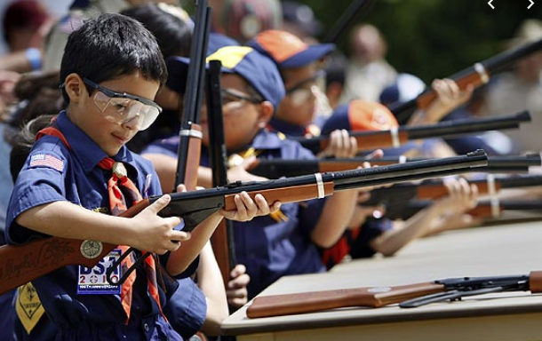
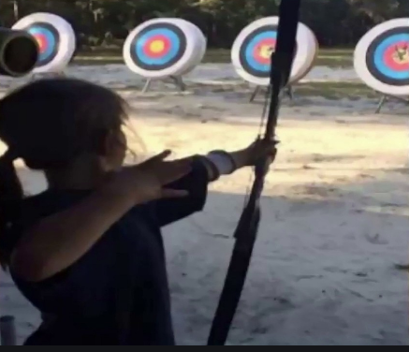
Shooting Sports
Requests for Shooting Events – Lead Time!
  50+ scouts - 6mos
  Less than 50 scouts - 3mos
Shooting on private land:
  Requirements
  Permissions/protocols
Shooting Sports web page
Shooting Sports Instructor Classes:
  Rifle/Shotgun
  Archery

Slide 24
Order of the Arrow
  Mary Neuse has accepted the Scoutmaster position at T1978G. Brian Fleck will be the new Chapter Advisor.
  2023 Dues can be paid online: https://wipit470.org/dues.html
  11/01/23 – Election Season Opens
The Amangamek-Wipit Lodge will be sending a contingent to the one-and-only National Order of the Arrow Conference (NOAC) next summer and we want you to join us! Registration is now open! Follow the directions below to register for the one and only 2024 National Order of the Arrow Conference (NOAC) at the University of Colorado at Boulder. Here are the steps to register for this once-in-a-lifetime opportunity!
Step 1: Click the registration link here!
Step 2: Fill out all information for the registration form.
Step 3: Congrats! You have reserved your spot for the 2024 NOAC! Look out for other emails in regard to both national registration AND further payments you may need to make! Can’t wait to see you there!!
If you have any questions regarding the National Order of the Arrow Conference email noac2024@wipit470.org
  * Registrations open online https://wipit470.org/index.html under “Events”

