Slide 1
E-Resource Troubleshooting & Ticket Best Practices
December 1, 2020
Michelle Eichelberger
www.suny.edu

Slide 2
Plan for Today
Review Troubleshooting for:
Activating content in Alma
Deactivating content in Alma
Primo search results
Searching and posting on Basecamp
Alma-L and Primo-L
Best Practices for submitting a Salesforce Ticket to Ex Libris
www.suny.edu

Slide 3
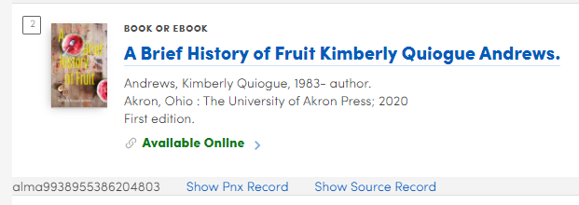
Activating Content in Alma
Electronic collections, e-books, e-journals, etc. should take around 15 minutes for Alma records (portfolio bib records) to start showing in Primo
CDI data (chapters, articles) will take 72 hours to a week to show up in Primo unless already active for another package, can sometimes find content in expanded search if search records are already active
Best practice is to search directly in Primo – sometimes display in discovery will give you a false positive
www.suny.edu

Slide 4
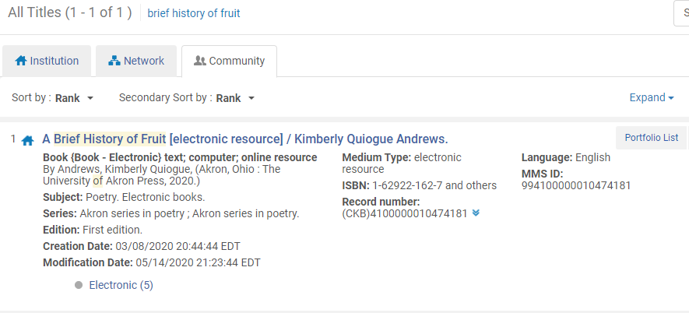
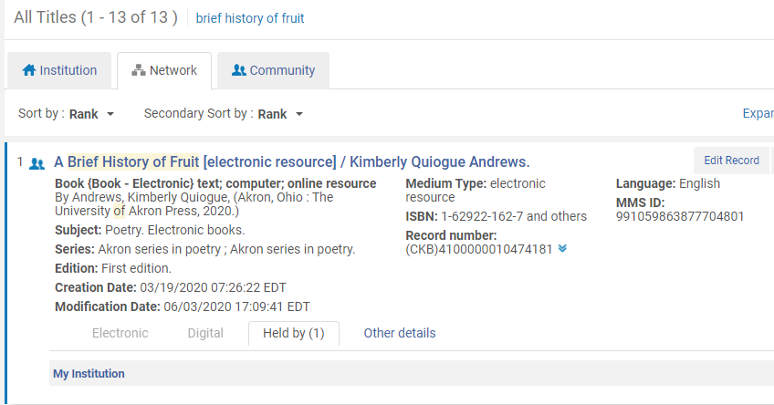
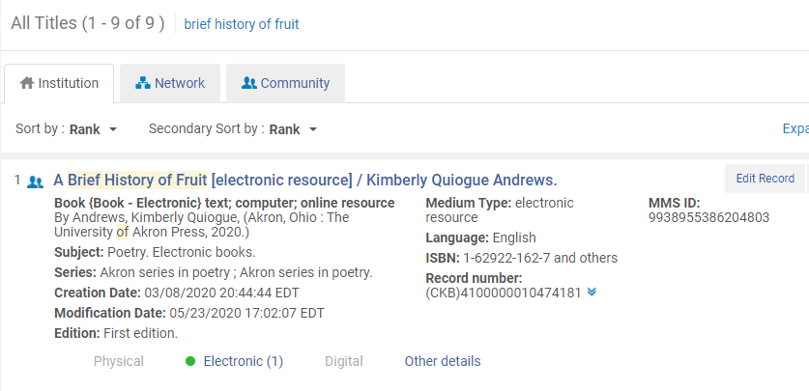
Activating Content in Alma: The NZ and You
Activating content from the CZ creates an IZ record in your system and also either creates an NZ record or links your holdings to an NZ record that already exists
Do All Titles search to see all three
4801 at end of MMSid indicates NZ record
www.suny.edu

Slide 5
Troubleshooting Missing Alma Content in Primo
How can I troubleshoot Primo VE search results and links using Record Id, Display CTO and Show PNX?
Do all titles search to see if another version is suppressed in your system
Problem with indexing – happening at other libraries – try save & release and if it’s an NZ record submit info@slcny.libanswers.com ticket to ask us to try save & release
Problem with activating content removed from NZ, pursuing for UB with EL
www.suny.edu

Slide 6
Deactivating/Deleting Content in Alma
Electronic collections, e-books, e-journals, etc. should take around 15 minutes for Alma records (portfolio bib records) to stop showing in Primo
CDI content can take 72 hours to a week to go away – needs to wait for publishing cycle to catch up
www.suny.edu

Slide 7
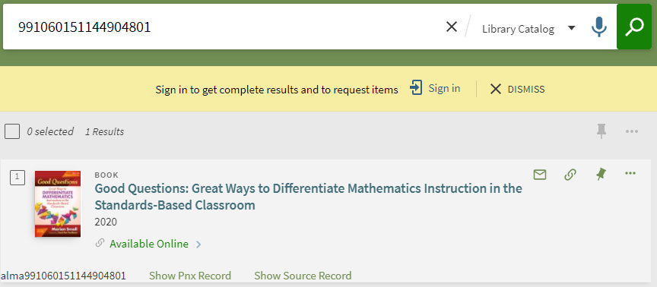
Troubleshooting Unwanted Alma Content in Primo
Do all titles search to see if another version is active in your system – duplicate unsuppressed bib could leave it available
Could be problem with indexing – also happening outside of SUNY – try save & release to force reindex. If it’s an NZ record, submit info@slcny.libanswers.com ticket to ask us to save & release
www.suny.edu

Slide 8
CDI Content: False Availability
Problem: you’re getting full-text results for content that you don’t really own.
Troubleshooting:
Try to figure out what’s publishing it as available – this will get easier by the end of the year because PNX will show activation source
Look at CTO, PNX
Still have a problem identifying link in record collections and collections that are publishing content as available
OPT’s problem where they’re getting search records that they don’t want – chapters – we’re fully flexible and should be able to control those records
www.suny.edu

Slide 9
Missing Primo Content: Missing Search Records
UB Barron’s case – missing search records after April 2019 = if records in expanded search don’t match number in CDI tab, could be problem with CDI that needs to be reported to Salesforce
Articles only appearing in expanded search = system is not seeing correct availability publishing for content
Submit to Salesforce
www.suny.edu

Slide 10
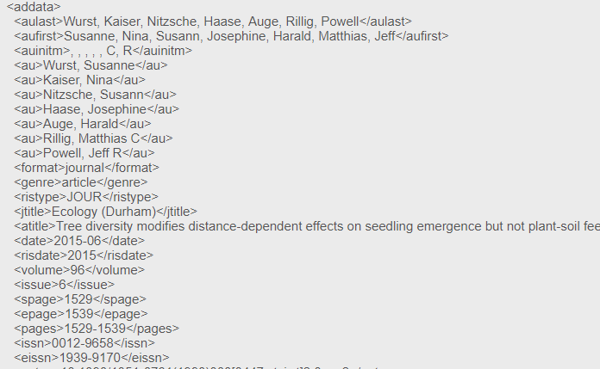
CDI Records and Link Resolver linking
Link Resolver collections link from Alma portfolios rather than Link in Record – easier to see and control
How does it work? From recent Ex Libris Troubleshooting webinar:
If you look at the PNX (&showPnx=true), there’s an Addata section that’s used to populate the OpenURL search that goes out to Alma to do the live match on your content
OpenURL is sent
Alma matches the metadata with ISSN/ISBN or title data and tries to find active portfolios that match date/volume/issue
Those matches are shown in View It and link is created by Alma parser when clicked
www.suny.edu

Slide 11
CDI Records and Link Resolver linking: Problems
Many points of failure:
PNX Addata section has wrong info from CDI search record – could be wrong date, wrong embargo, slightly different title, no ISSN, etc. = may have to report to Salesforce to fix
Alma portfolio could be missing ISSN, could have variant on title, coverage dates could be wrong = you may be able to fix
The search records might include content that you don’t get for that title: e.g. NYT obituaries, newspaper blog posts, etc. = hard for Ex Libris to fix because they’re getting that content from a vendor
These problems can impact both the initial look-up (content can’t be found), or linking (content is found but link fails)
www.suny.edu

Slide 12
Troubleshooting Bad Links
Finds correct content from Alma but link fails
Kinds of failure:
Ezproxy error message: problem with your Ezproxy config file where you’re either missing a stanza, or the stanza is outdated – URL doesn’t match what Ezproxy expects – check OCLC for updates or contact them for support
Link to one database is going someplace else: Sciencedirect links going to LWW – happens when article is marked as OA – system tries to use DOI for link – but OA may be misapplied, had to add “no DOI” override for Sciencedirect parser
Link gets to database but it doesn’t recognize you – check your linking in Edit Service linking tab – do you need a loc_id? Also check Central Index linking table to see if you need customer code for link in record collection like Naxos or FOD
Link get to database, it recognizes you, but can’t find the article. Go to database from your A-Z and see if the article is really there. Try to find difference in the metadata, coverage dates, article id, etc. and then report to Salesforce
www.suny.edu

Slide 13
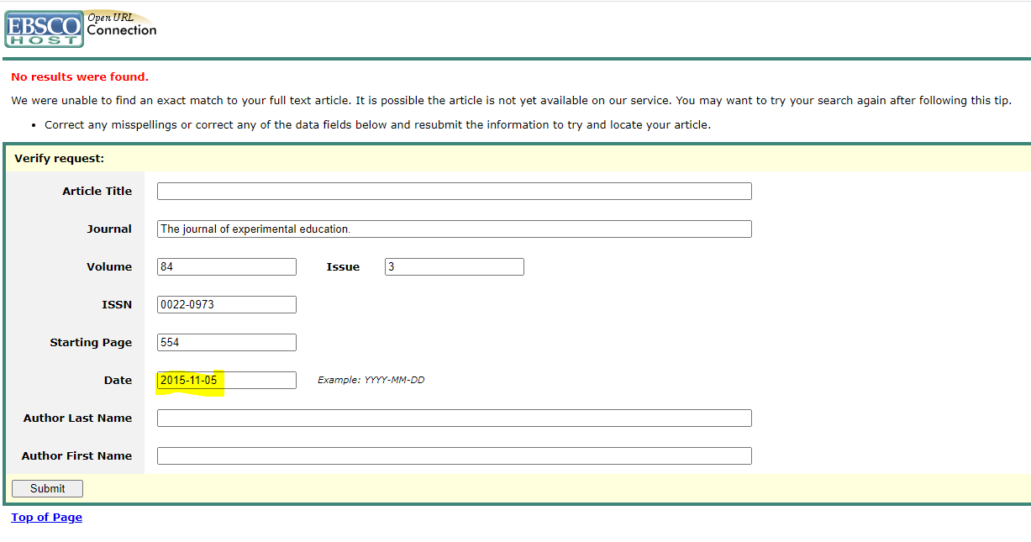
Links don’t work: Metadata Problems
E.g. Wrong publication date
If you can find the article in the database, see if you can figure out what’s different between the citation in Primo and the one in the database. Could be the date, the id for the article, title, name of publication, etc.
In this case, right date is 2016, can test by removing date in failed search and retry
Will need to report to Salesforce to fix
www.suny.edu

Slide 14
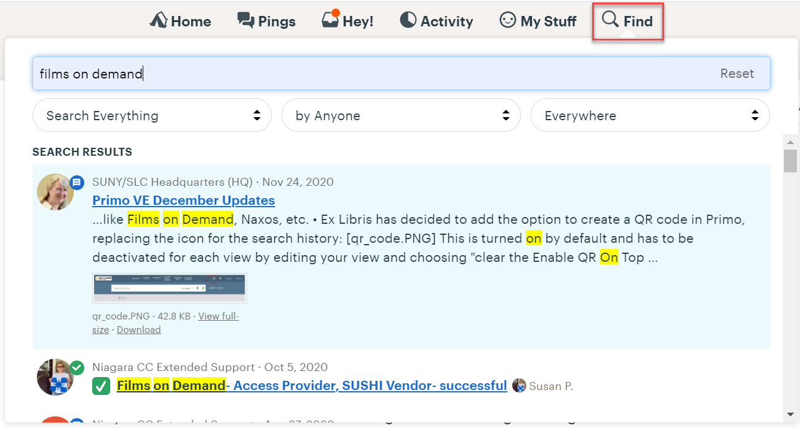
Places to Check Before Submitting Ticket
Basecamp
www.suny.edu

Slide 15
Places to Check Before Submitting Ticket
Alma-L and Primo-L:
https://el-una.org/about/mailing-lists/alma-mailing-lists/
https://el-una.org/about/mailing-lists/primo-email-list/
Can search archive, can send to folder in your email so that messages don’t flood your inbox
www.suny.edu

Slide 16
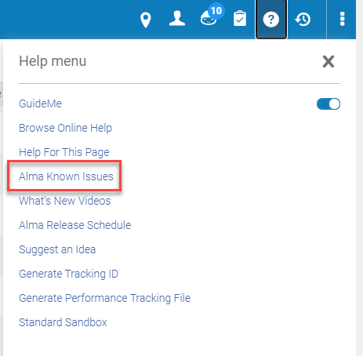
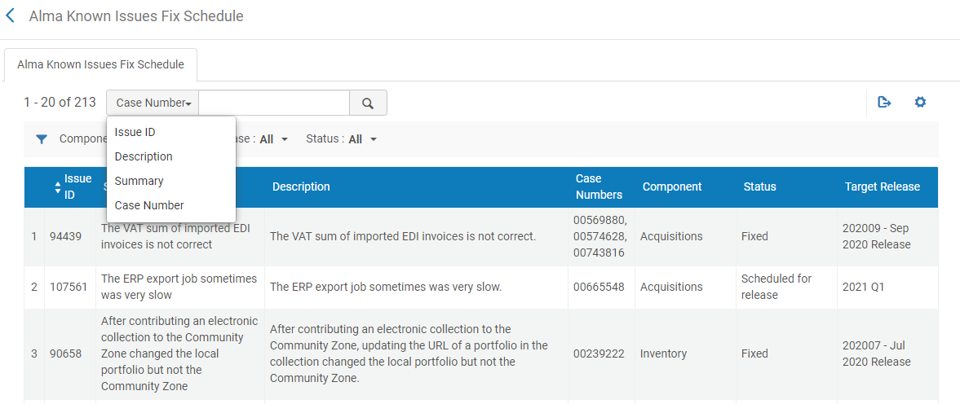
Places to Check Before Submitting Ticket
Alma Known Issues
Need Known Issues Operator role
www.suny.edu

Slide 17
Ticket Best Practices
Put yourself in the support person’s shoes:
What would you need to know?
You are not a campus user and can’t authenticate for database links unless you have test account. They can get into our Alma but aren’t part of our authentication.
Be as clear as possible – Ex Libris supports institutions all over the world – they don’t work in our environment and may not know our workflows
Don’t add attachments if it can be avoided – takes time to open and pursue
Do one case for each problem – from recent ticket: “it's helpful to us to have separate tickets for each issue, it helps with our workflows and to accurately record the number of problems people are running into.”
Make high priority cases high priority – whole collection not working, indexing problems, authentication not working, etc. Even high priority cases can take months to address
www.suny.edu

Slide 18
Ticket best practices
Explain the problem. E.g.: we own this journal but the link isn’t showing in View Online, or, it's finding a match but the link fails, the embargo is causing it not to work, etc.
Provide the link to the article in Primo (be sure you don’t have to be logged in to see it) or Alma information (MMSid, etc.) so that they can see the problem
List troubleshooting steps you’ve taken so they won’t tell you to do something you’ve already done
Explain what you’ve found, and if you think you know what the problem is, let them know
If it’s a metadata issue, give them the correct info, let them know how you found it, and give them a public link, maybe to the journal website, so they can see for themselves
www.suny.edu

Slide 19
Ticket Expectations
Time to resolve a ticket can vary wildly. The more specific and clear you are, the better chance you have of getting your case resolved quickly. Your time spent troubleshooting before submitting the ticket will help get it fixed in a timely fashion.
It depends on what needs to be done to make the fix: metadata fixes in the CDI are easy for Ex Libris to do. Getting a vendor to change their content, or redo resources types, or bigger projects like that will take longer. Indexing issues are difficult to figure out and can take many months.
A simple metadata error can be fixed in a couple of weeks: “the corrected data will appear in your discovery system after the next Index update, which usually takes about a week. I will notify you when it is released so you can check the new data!”
www.suny.edu

Slide 20
References
CDI Update - Strategies, Tips, and Tricks for Troubleshooting Ex Libris Webinar, 11/18/20
Central Discovery Index (CDI) - Troubleshooting Tips and Tricks Ex Libris (Stacey van Groll)
CDI Tips and Tricks Ex Libris, includes how to find the OpenURL sent by the full record
How can I troubleshoot Primo VE search results and links using Record Id, Display CTO and Show PNX? SLC
CDI SLC FAQs
www.suny.edu

