Slide 1
Publishing Profiles: Next Steps
Shared Library Services Platform Project
Maggie McGee

Slide 2
Things I Discovered Upon Testing Publishing Profiles After Go-live
Holdings records will not be updated automatically after you run your fist publishing profiles job
It will take several weeks for your files to be reviewed by someone at OCLC and accepted
Once the file is accepted it will be automatically updated each time the publishing profile job runs
Publishing profiles were going into the wrong sub-directory
Check with OCLC through your bib datasync collection to see it your files are going into the correct sub-directory
Ask in the Comments section of the datasync collection in Worldshare
Bib records without OCLC numbers (ocns) will be published to OCLC
Unless you change from “Limit Added Records to Wordlcat Staging = No” to “Limit Added Records to Wordlcat Staging = Yes”

Slide 3
Check the Publishing Profiles and S/FTP Definitions are Correct
There are several reason your files may end up in the wrong sub-directory:
There is a sub-directory path in the bib publishing profile in Alma
The sub-directory should be empty
There are spaces before or after the sub-directory in the S/FTP definitions for OCLC Bib DataSync
Go to Configuration>General>External Systems>S/FTP Definitions
Click Edit from the ellipses of the datasync collection
Sub-directory path is: metacoll/in/bib
Remove unwanted spaces
Copy and pasting the path is not recommended for the sub-directory path

Slide 4
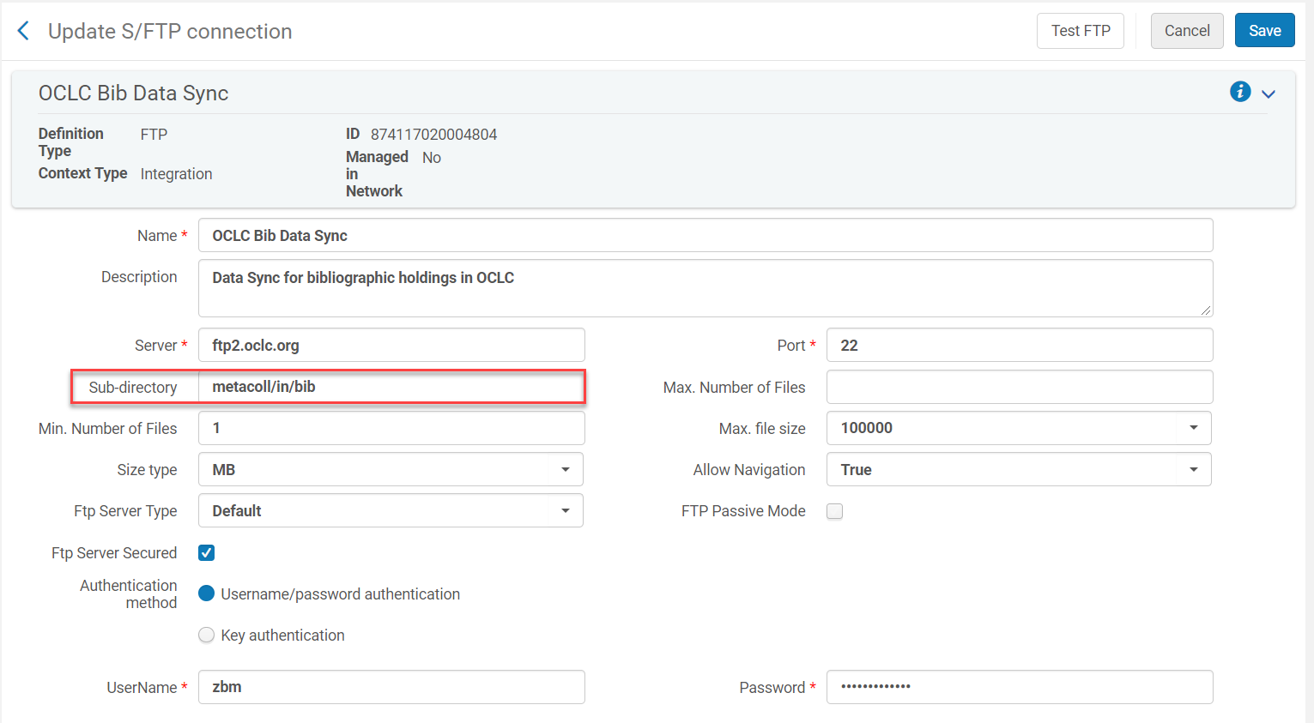
S/FTP Definitions for OCLC Bib Datasync

Slide 5
Updating the Bib Worldshare Datasync Collection
Change the status of the bibliographic datasync collection in Worldshare back to “Saved In Progress”
Change “Limit Added Records to Wordlcat Staging = No” to “Limit Added Records to Wordlcat Staging = Yes”
Add electronic resources to the “Excluded Information for Variable Fields”

Slide 6
Updating the Bib Worldshare Datasync Collection
Login to your Worldshare account
Open the bibliographic datasync collection
Click on the Comments bar
Click Add Comment
Ask to have your datasync collection set back to “Saved In Progress”

Slide 7
Updating the Bib Worldshare Datasync Collection
Once your datasync collection is set to “Saved in Progress”:
Open the bibliographic Worldshare datasync collection
Click on the “Bibliographic Record Information” bar
Click on the Processing tab
Change “Limit Added Records to Wordlcat Staging = No” to “Limit Added Records to Wordlcat Staging = Yes”

Slide 8
“Limit Added Records to Wordlcat Staging = Yes”
By changing this setting from “No” to “Yes” bib records without ocns will be placed in a file for review
This setting prevents bib records without ocns being published to OCLC and having OCLC assign ocn to these bib records
This is important because brief bib records in the IZ that are flagged “Publish Bib”, whether they are linked to the NZ or not, will get published to OCLC if you do not change this setting from “No” to “Yes”

Slide 9
Updating the Worldshare Bib Datasync Collection
Add electronic resources to the “Excluded Information for Variable Fields” section of the “Bibliographic Information” in the bib datasync collection
Tag: 300 Ind 1: Any Ind2: Any Subfield: a
Condition: Contains This Value
Value: 1 online resource
Action: Exclude Any Record(s) Containing Data

Slide 10
Excluding Online Resources from Publishing
This is important if you do not want you e-resources of any kind to be published to OCLC:
ebooks
e-journals
databases
You can add other resources you want to exclude from publishing by clicking the green plus sign

Slide 11
Updating the Worldshare Bib Datasync Collection
Click Save once you have made all the necessary changes to the collection
Click on the Collection Actions drop-down menu
Click on Submit Collection to OCLC

Slide 12
Unflagging Bib Records in Alma
All bib records are flagged “Publish Bib” during migration
All new bib records added to your holdings are flagged “Publish Bib”
If you do not want new records published to OCLC they will need to have their flag changed to “Don’t Publish”
Unflag bib records from publishing to OCLC by changing “Publish Bib” to “Don’t Publish”
Individually in the MD Editor
From a set and by running a job on the set
LDR 05 is set to “d” when bib records set to “Don’t’ Publish”
This means the record is considered “deleted” by OCLC and the holdings will not be published, or they will be removed from OCLC if they were previously published

Slide 13
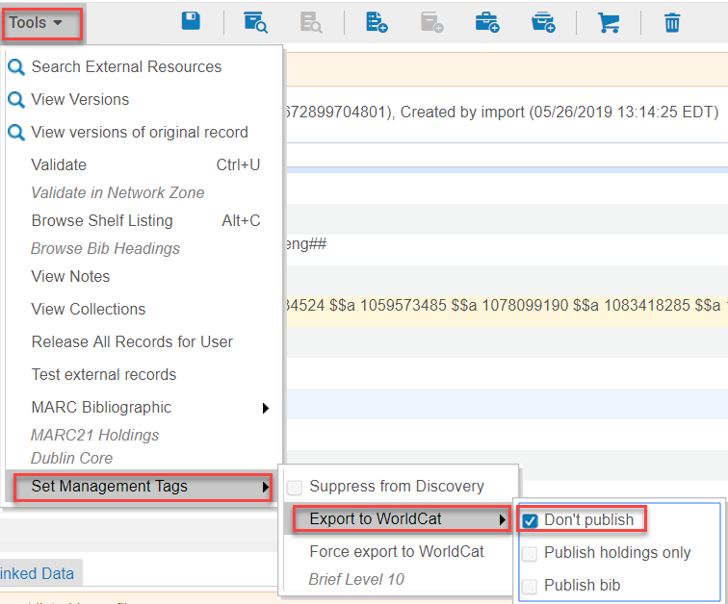
Unflagging an Individual Bib Record Manually
Open a bib record in the MD Editor
Go to Tools>Set Management Tags>Export to Worldcat
Click on the check box next to “Don’t Publish”
Save and Release Record (Ctrl+Alt+R)

Slide 14
Unflagging a Set Using a Job
Create and save a set of records that you do not want to be published to OCLC
Go to Admin>Manage Jobs and Sets>Run a Job
Search job name: Synchronize Bib records with external catalog
Click on the radio button for the “Synchronize Bib records with external catalog” job
Click Next

Slide 15
Unflagging a Set Using a Job
Click on the radio button next to the set you want
Click Next

Slide 16
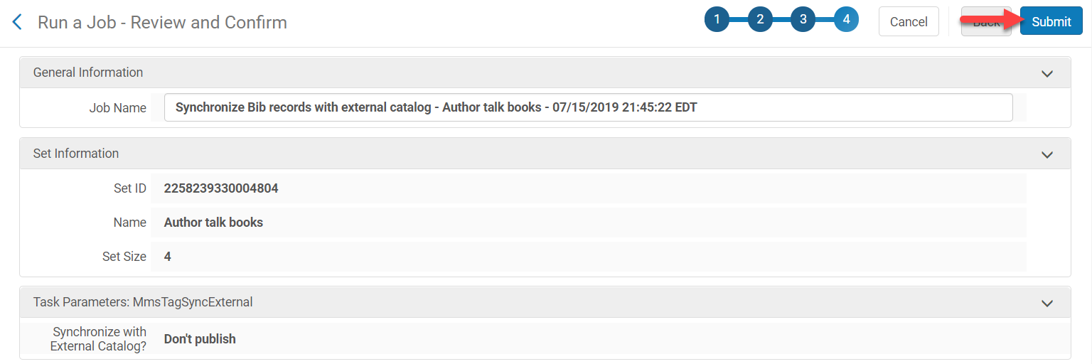
Unflagging a Set Using a Job
Click on the “Don’t Publish” radio button
Click Next
Review the job and click Submit

Slide 17
Unflagging a Set Using a Job
Click Confirm
The job will run, and the flag will change from “Publish Bib” to “Don’t Publish”

