Slide 1
“The Thief is One Hundred Years Ahead of the Locksmith.”
NICE K12 Cybersecurity Education Conference
Strategic Plan for the National Initiative of Accelerating Cybersecurity Learning and Skills Development in a Diverse User Community
By Ronald Malden
Email: ronaldmalden@gmail.com
LinkedIn: https://www.linkedin.com/in/ronaldmalden/

Slide 2
Strategic Plan for the National Initiative of Accelerating Cybersecurity Learning and Skills Development in a Diverse User Community
NICE K12 Cybersecurity Education Conference
By Ronald Malden
Email: ronaldmalden@gmail.com
LinkedIn: https://www.linkedin.com/in/ronaldmalden/

Slide 3
Executive Summary
Cyber Education.
Direction, content & techniques of cyber education
Educational levels for technical and non-technical
Institutional curriculum:
General education programs
Cyber-related electives
Cyber threads
Cyber minors
Cyber-related majors
Cyber enriched opportunities
Cyber skills

Slide 4
Introduction
Objective of cyber education is create multi-level, multi-discipline approach to educate all individuals at a level appropriate to their role:
In work place
In Society

Slide 5
Approach to Cyber Education
What is Cyber
What is Cyber Science
Diverse interpretation based on:
People
Place
Things
Branding a collection of computing disciplines with technology, people and processes to ensure operations in view of risks and adversaries.

Slide 6
Current Strategy to Cyber Education
3 levels
What people should know?
What should executives know?
What should the technical team know?
.
Current Curriculum:
Characteristics of the Cyberspace Domain
Cyberspace Risk Management
Cyberspace Operations, Planning, and Management
Cyber Attack
Cyber Defense
Authorities, Policies and Law
Human Factors
Personal Responsibilities and Ethics
Technology

Slide 7
Cyber Domain Defined
“A global ever evolving domain within the information environment consisting of the interdependent networks of information technology infrastructures and resident data, including the internet, telecommunications network, computer systems and embedded processors and controllers – as well as people, organizations and processes – which create a dimension of risks, adversaries and opportunities.”
Definition influenced by:
NICE
US Department of Labor
US Department of Energy
Cyber Domain

Slide 8
Multi-Level, Multi-Discipline Approach
Include technical and non-technical content
Cross functional education:
Cyber-related Majors
Cyber Minors
Cyber Threads
Cyber Electives
Cyber in General Education

Slide 9
Cyber in General Education Approach
“Computing communications is occurring when you wake up and does not stop when you fall asleep.”
Therefore it is important:
Educate cyber knowledge across the life spectrum
Including non-computing (remote or implanted devices)
Teach in small doses in diverse general education classes:
Physics, Law, Philosophy, etc.

Slide 10
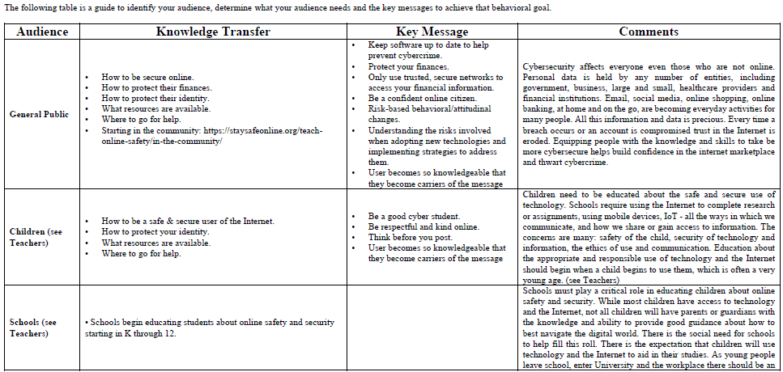
Target Audience Messenger

Slide 11
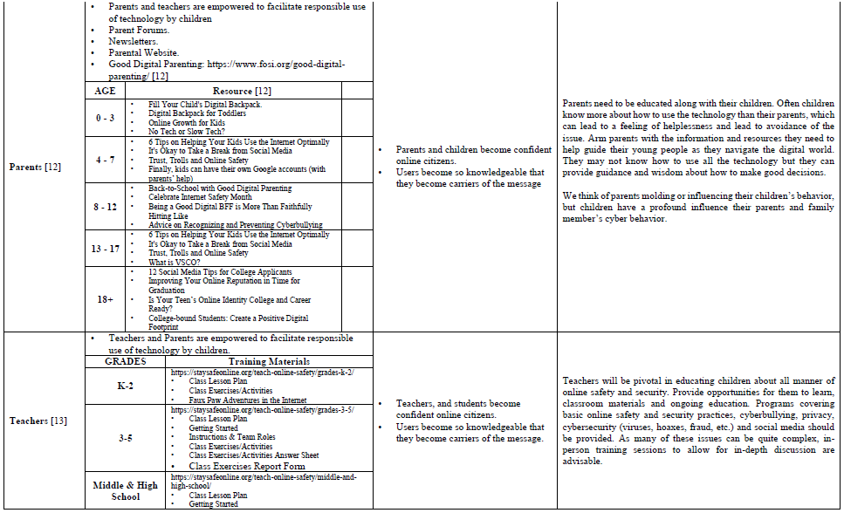
Target Audience Messenger (cont.)

Slide 12
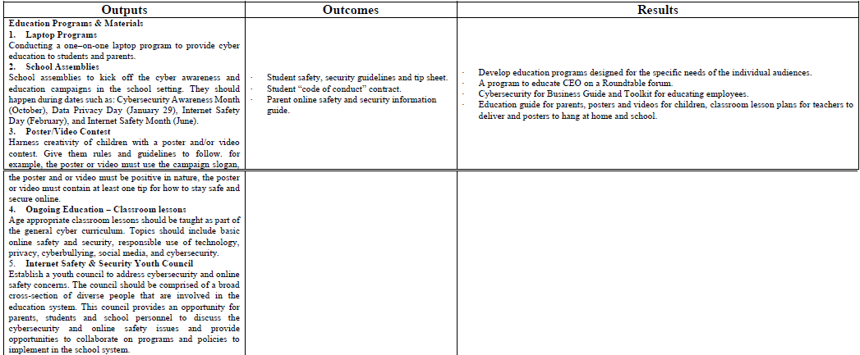
Success is defined as outputs, outcomes and results.

Slide 13
Conclusion
Address all education of all individual.
Increase involvement in cyber education.
Integrate cyber domain concepts as organizations ethos or curriculum.
A paradigm shift from defensive to offensive education.

Slide 14
Questions?

